Slide 1


CRAFT CREATOR
HIRING MANAGEMENT SYSTEM
SOLVING PROBLEMS WITH DESIGN THINKING & INNOVATION
A PROJECT BY RIYA GUPTA(e22bcau0055)
VINAY BHANDARI(e22bcau0028)
VANSH KOHLI(e22bcau0022)
VAIBHAV KANSAL(e22bcau0012)
HARNOOR SINGH(e22bcau0017)

Slide 2
INDEX
•Introduction
•Skills and dataset
•Methodology
•Result and analysis
•Conclusion

Slide 3
Introduction
Are you in search of a beautifully crafted custom product, or perhaps you're a talented artisan looking to showcase your skills?
Our platform serves as a vibrant marketplace where creativity meets craftsmanship. Whether you're in need of personalized gifts, bespoke home decor, or one-of-a-kind accessories, our community of artisans offers a diverse range of talents to fulfill your desires

Slide 4
Target Audience:
• Clients: Individuals and businesses seeking unique, handmade products.
• Craft Creators: Any common/Skilled artisans offering their services and creations(educational background is not important if the person is creative and diligent).
Why Choose Craft Creator?
Quality
Customization
Community
Wellbeing

Slide 5
Skills & Dataset
Skills:
Programming Languages: You need proficiency in one or more programming languages for backend and frontend development. Common choices include HTML , JavaScript, and CSS.
Web Development: Understanding of web development frameworks for building the system.
Database Management: Knowledge of database systems (such as MySQL) to store and manage data efficiently.

Slide 6
Dataset:
For a crafting creator hiring management system, you might need datasets related to:
Job Listings: Information about available job positions, including job title, description, requirements, and location.
Crafting Creators Profiles: Profiles of crafting creators, including their skills, experience, portfolio, and contact information.
Application Data: Data on applications submitted by crafting creators, including application status, submission date, and any attached documents.
User Data: Information about users registered in the system, including their usernames, passwords, and roles.
Feedback and Reviews: Feedback and reviews provided by employers or other users about crafting creators.

Slide 7
Methodology
1.Objectives and Scope:
The project is a platform for freelance craft creators and selling handmade craft to customers through our website
2.Market Research:
We have conducted market surveys to understand the demand for such a platform as it is difficult to find hand crafted materials online
3.User Personas and Use Cases:
Create user personas representing different types of users (craft creators, buyers, administrators).
4.Development:
Implement necessary features such as user registration, profile management, search and filtering, messaging system, payment integration, etc.
5.Testing:
Perform usability testing to ensure a seamless user experience.

Slide 8
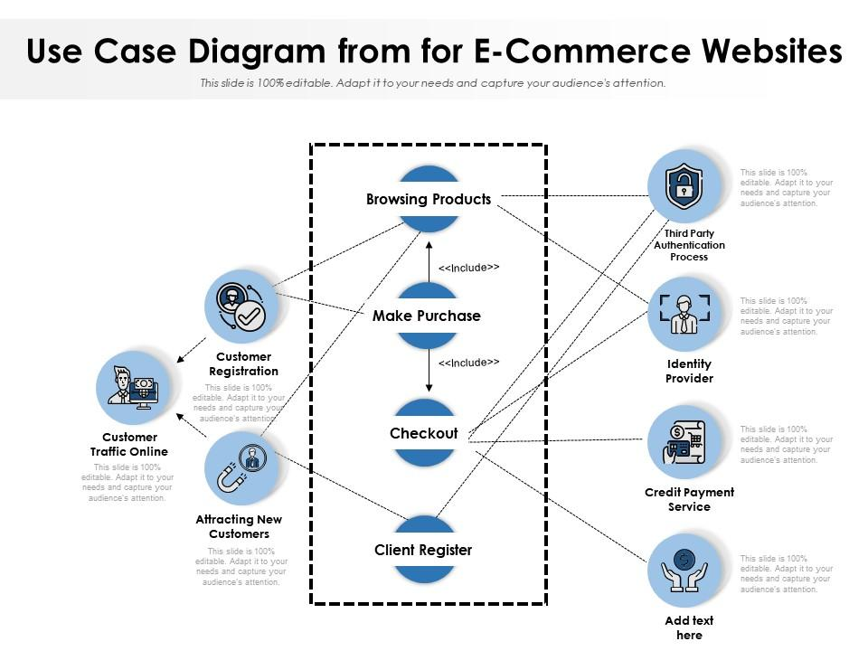

Slide 9
Result & Analysis
Craft Creator Hiring Management System and Website has demonstrated notable success in facilitating connections between craft creators and employers and customers

Slide 10
Challenges
Challenges were encountered in database handling , user profile section along with search bar integration.

Slide 11
Conclusion
We have designed a creative and responsive website which includes hand crafted goods ultimately helping the poor craft makers and freelancers

Slide 12
Linked in / Blog
/Youtube Link
LINKED IN POST:
https://www.linkedin.com/posts/riya-gupta-ab5a68243_craftmanship-scsetbennett-website-activity-7187159917449875456-4xcK?utm_source=share&utm_medium=member_desktop
BLOG ON MEDIUM.COM:
https://medium.com/@riyagupta8076/crafting-connections-the-emergence-of-craft-creator-websites-3acdb516b484
YOUTUBE VIDEO LINK:
https://youtu.be/yVAwAqKAPj0

