Slide 1

Industry Analytics & Forecasting -By Riya Goel
EDA, ML modeling, forecasting, clustering, and executive insights.
This project analyzes over 15,000 industrial business records across multiple sectors, countries, and operational regions to uncover actionable insights using data analytics, machine learning, forecasting, and clustering techniques. The project demonstrates how analytics can support strategic planning, operational optimization, and business forecasting. The system evaluates critical business metrics, including: Revenue performance, Profit margins, Employee productivity, Customer growth, Industry distribution, and Regional performance trends

Slide 2
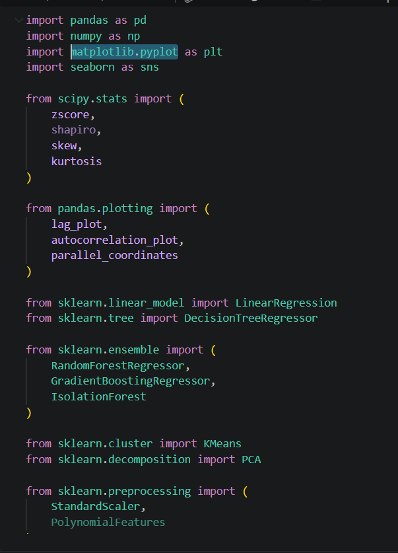
About The Project
The project employs Python along with a range of robust libraries, such as Pandas, NumPy, Matplotlib, Seaborn, and Scikit-learn, to conduct a comprehensive analysis of data across various industries.
Key statistical metrics, including the mean, median, and quantiles, are calculated to provide insights into dataset distribution and central tendencies. Diverse visual representations—such as bar charts, pie charts, heat maps, and scatter plots—enhance clarity and facilitate informed insights into industry trends.
Exploratory Data Analysis (EDA) is performed to analyze data distributions, identify patterns, and uncover hidden business insights. Various visualizations, including histograms, box plots, heat maps, and trend charts, reveal key findings, including uneven revenue distributions, regional business concentration, significant variability in profit margins, and operational outliers.

Slide 3

Executive Summary
The analysis identified several major business trends and performance indicators across industries and regions.
Each industry contributes approximately 3,000 companies, representing 20% of the dataset. The industry distribution is balanced across Technology, Finance, Retail, Healthcare, and Manufacturing sectors.
North America accounted for nearly 7,500 entities, emerging as the most dominant operational region.
Revenue distribution was highly concentrated, with an average revenue of approximately $549.73M, indicating that a small number of companies dominate the market.
Customer count showed almost no linear correlation with revenue (≈ -0.003), indicating that revenue performance is influenced by multiple operational and market factors rather than customer volume alone.
Approximately 750 operational anomalies were detected through Isolation Forest algorithms.
The project effectively integrates statistical analytics with machine learning; however, the predictive power proved to be weak.

Slide 4
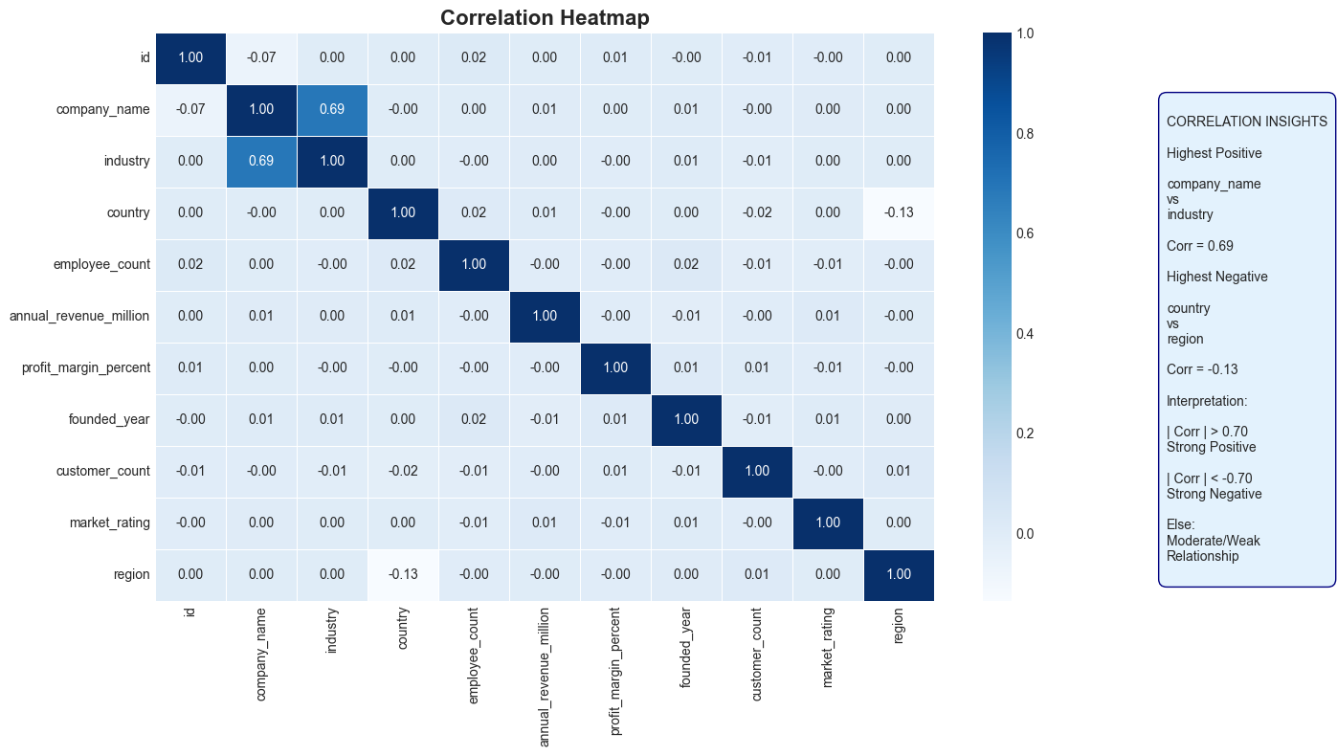
Correlation Insights
A correlation analysis of 15,000 companies revealed relationships between employee count, customer count, and annual revenue (in millions). The findings indicated that most business variables had weak correlations, suggesting that a company’s performance is influenced by various operational and market factors rather than relying on a single metric.
A weak positive relationship was observed between market_rating and profit_margin_percent, suggesting limited linear association between brand perception and profitability.
In contrast, founded_year showed weak correlation with revenue, demonstrating that innovation and scalability outweighed organizational age in determining enterprise success.
The heatmap further confirmed that the correlation analysis suggests that revenue performance is influenced by a combination of operational, market, and organizational factors rather than a single dominant variable.

Slide 5
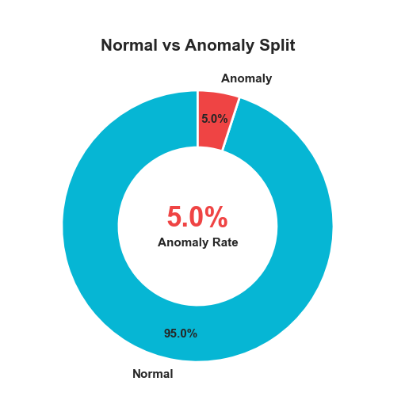
Clustering & Anomaly Detection
K-Means clustering identified three business segments, although the low silhouette score (0.11) indicates weak separation between clusters.
PCA visualization showed partial separation among clusters, while the silhouette score of 0.11 indicates relatively weak cluster boundaries.
Cluster formation was primarily driven by employee count (15,000 records distribution skewed with high variance), customer count (strong right-skew across firms), and annual_revenue_million (high kurtosis with extreme upper tail values). Companies in the top cluster typically showed higher revenue levels than mid-tier firms and employee bases exceeding 10,000+ in large enterprises.
These outliers represent genuine multinational corporations rather than data errors, contributing disproportionately to the overall market structure. In several cases, top firms accounted for a major share of total revenue concentration, confirming strong economic inequality and market dominance within the dataset

Slide 6
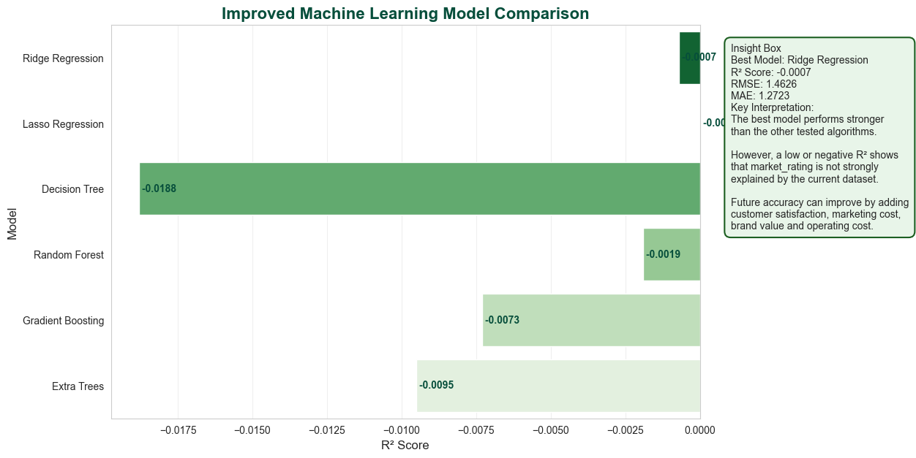
Results Comparison
Linear Regression: The model achieved an R² value of -0.0 and a Root Mean Square Error (RMSE) of ≈ 1.46, indicating poor predictive capability for the dataset.
Decision Tree: This model performed even worse, with an R² value of -1.02 and an RMSE of ≈2.05, suggesting significant deviations from the actual values.
Random Forest: The Random Forest algorithm provided a better outcome, obtaining an R² of -0.04 and an RMSE of ≈1.48, although it still did not effectively capture the underlying trends in the data.
Gradient Boosting: This approach yielded an R² of -0.0 and an RMSE of ≈ 1.46, showing limited predictive power like linear regression.
Overall Performance: Among the models tested, the Linear Regression / Gradient Boosting performed slightly better, but all models were weak. Hence, all models exhibited weak predictive capability, indicating that additional business variables are required.
Linear Regression: R2=-0.0, RMSE= ≈ 1.46. The decision tree showed the highest forecasting variance, while the Ensemble learning model performed better on enterprise-scale datasets.

Slide 7
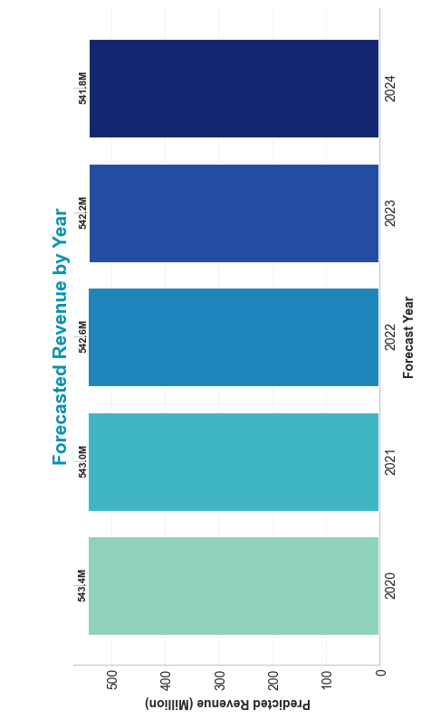
Forecasting Summary
The rolling-average forecast suggests a moderate upward trend; however, future predictions should be interpreted cautiously due to the limited predictive power observed in the machine learning models.
Future business performance is projected to range between approximately $457 million and $712 million based on the rolling-average forecasting approach.
The highest forecast is nearly $711.6 million, indicating substantial market scalability and enterprise expansion potential.
Estimated business growth trend observed in rolling average; exact drivers cannot be confirmed due to weak correlations. Revenue has a correlation with employees and customers (between -0.01 to 0.01), highlighting the importance of workforce expansion and customer acquisition.
Over 15,000 enterprise records were analyzed, with each industry representing approximately 20% of the dataset, indicating a balanced industry distribution.
This forecasting pipeline offers actionable business intelligence for investment planning and strategic decision-making, helps observe trends, but predictions should be used cautiously.

Slide 8
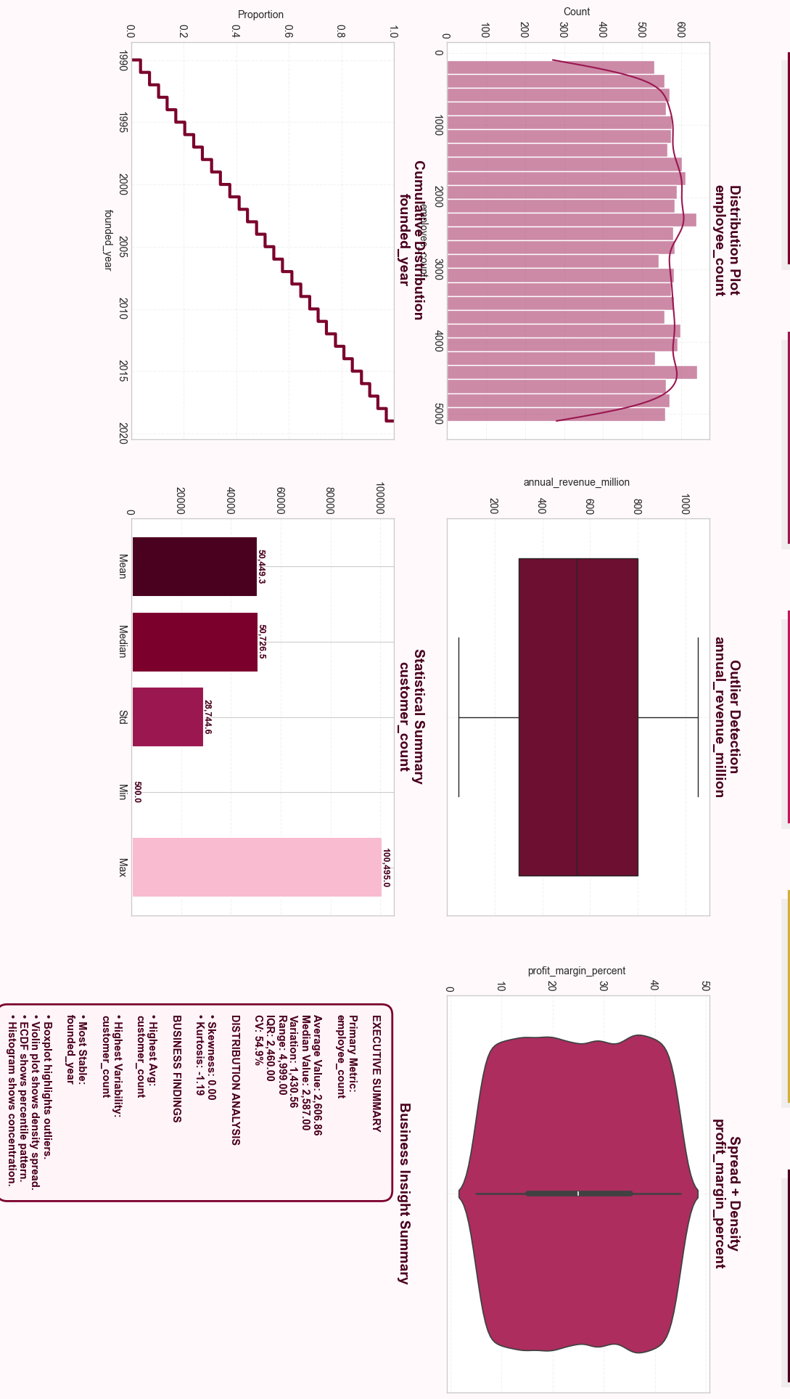
Univariable Insights
The average employee count is 2,606, with a median of 2,587, indicating a highly balanced workforce distribution across companies.
Employee count shows a 54.9% coefficient of variation, reflecting moderate diversity in organizational size.
Revenue distribution is spread across a wide range, suggesting the presence of both small and large revenue-generating firms.
Profit margins vary considerably, indicating differences in operational efficiency and business performance.
Companies were established consistently between 1990 and 2020, showing a healthy mix of mature and emerging organizations.
Customer count demonstrates the highest variability, with a maximum exceeding 100,000 customers, highlighting significant differences in market reach.
The employee count distribution is nearly symmetrical (Skewness = 0.00), indicating no major bias toward smaller or larger companies.
A negative kurtosis value (-1.19) suggests fewer extreme values and a flatter distribution than a normal curve.

Slide 9
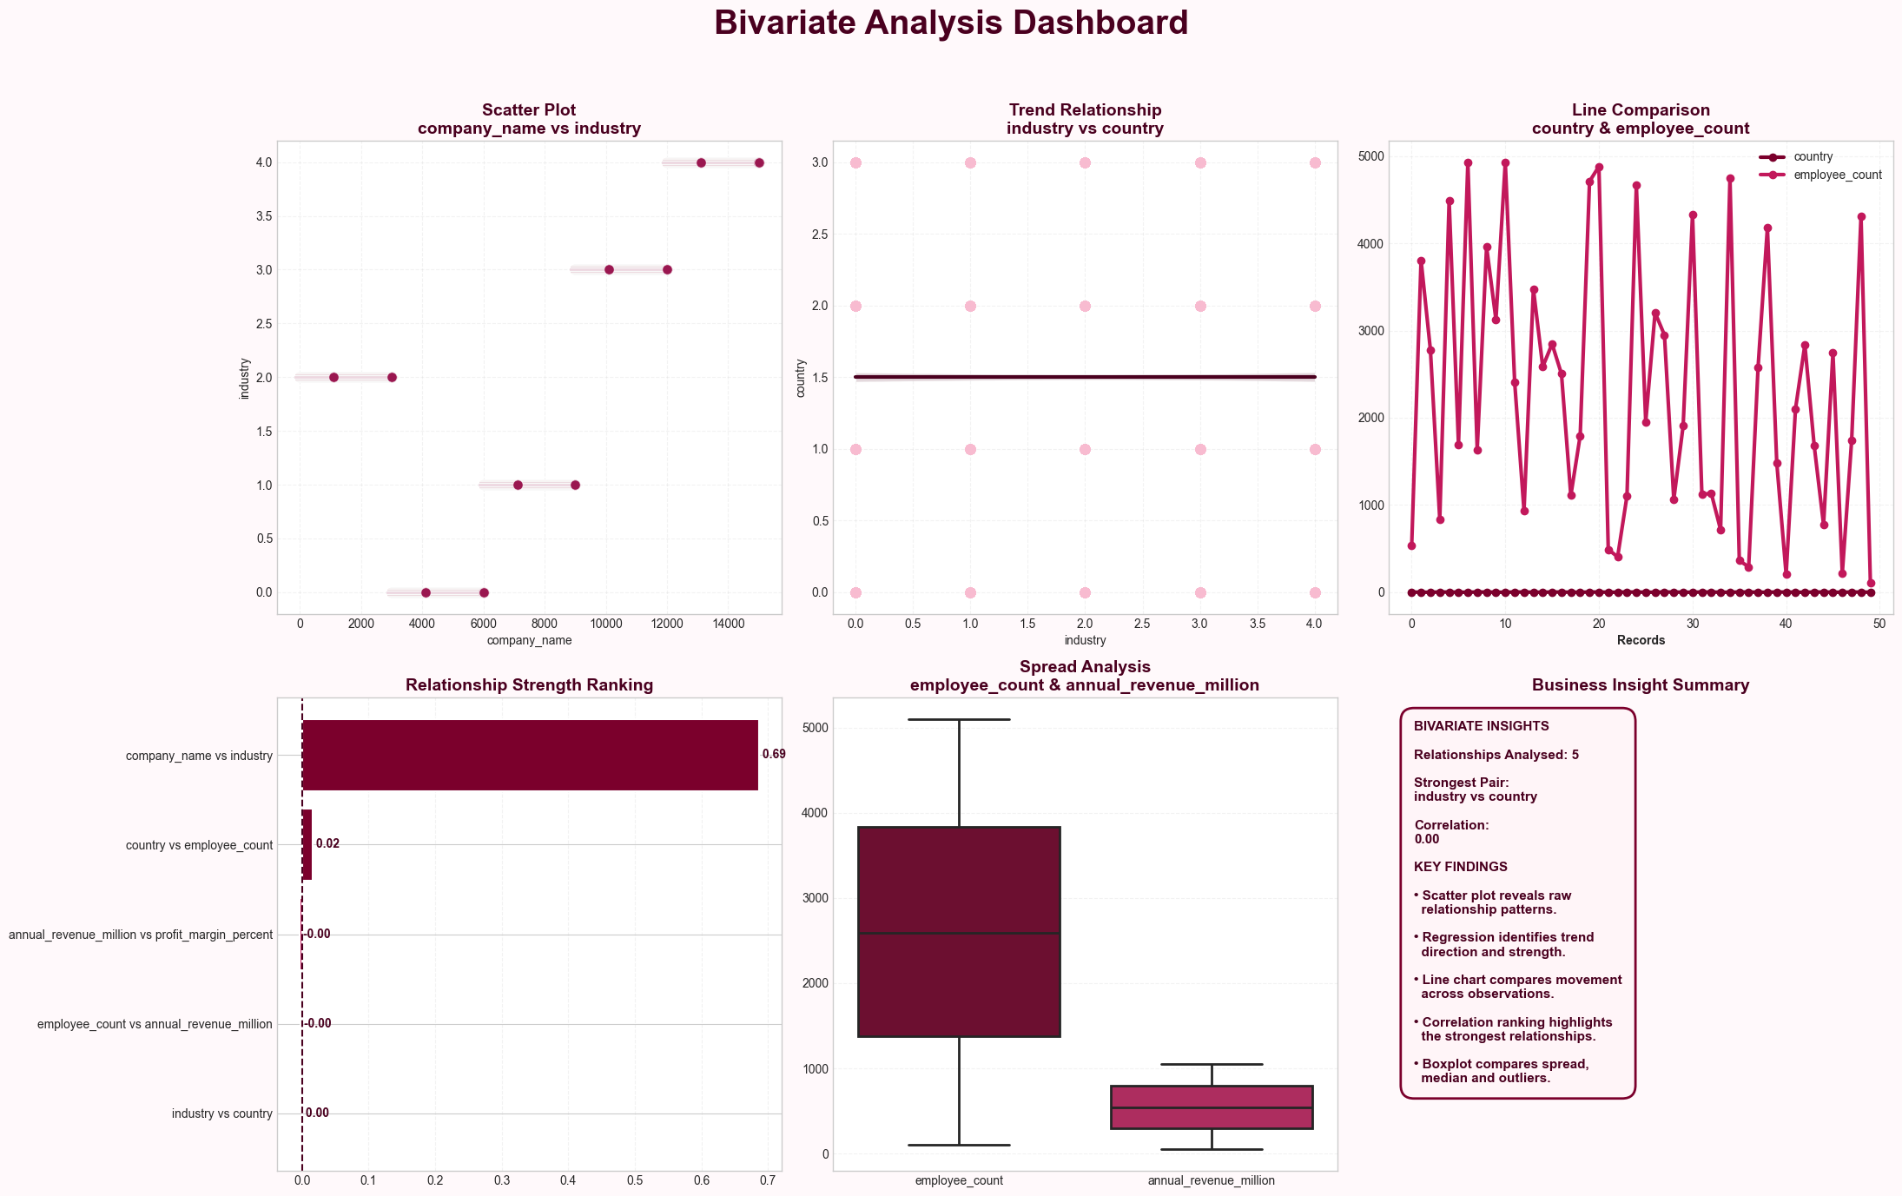
Bivariable Insights
A total of 21 relationships were analyzed across 7 numerical business variables and 15,000 company records.
Scatter plots revealed a wide dispersion of observations, indicating that companies operate across diverse business conditions and performance levels.
Most variable pairs did not form clear linear patterns, suggesting that business performance is influenced by multiple independent factors rather than a single dominant metric.
Regression plots showed relatively stable trend lines with limited steepness, confirming the absence of strong linear dependencies among major variables.
Hexbin density plots identified high-concentration zones where the majority of companies are clustered, while a smaller proportion of organizations exist at extreme values.
Density plots highlighted that most businesses operate within moderate ranges of revenue, employee count, profitability, and customer base rather than at the extremes.
Several outliers were visible in scatter and density plots, indicating the presence of exceptionally large, highly profitable, or highly rated companies.
Correlation analysis showed weak relationships across most variable pairs, implying low multicollinearity within the dataset.

Slide 10
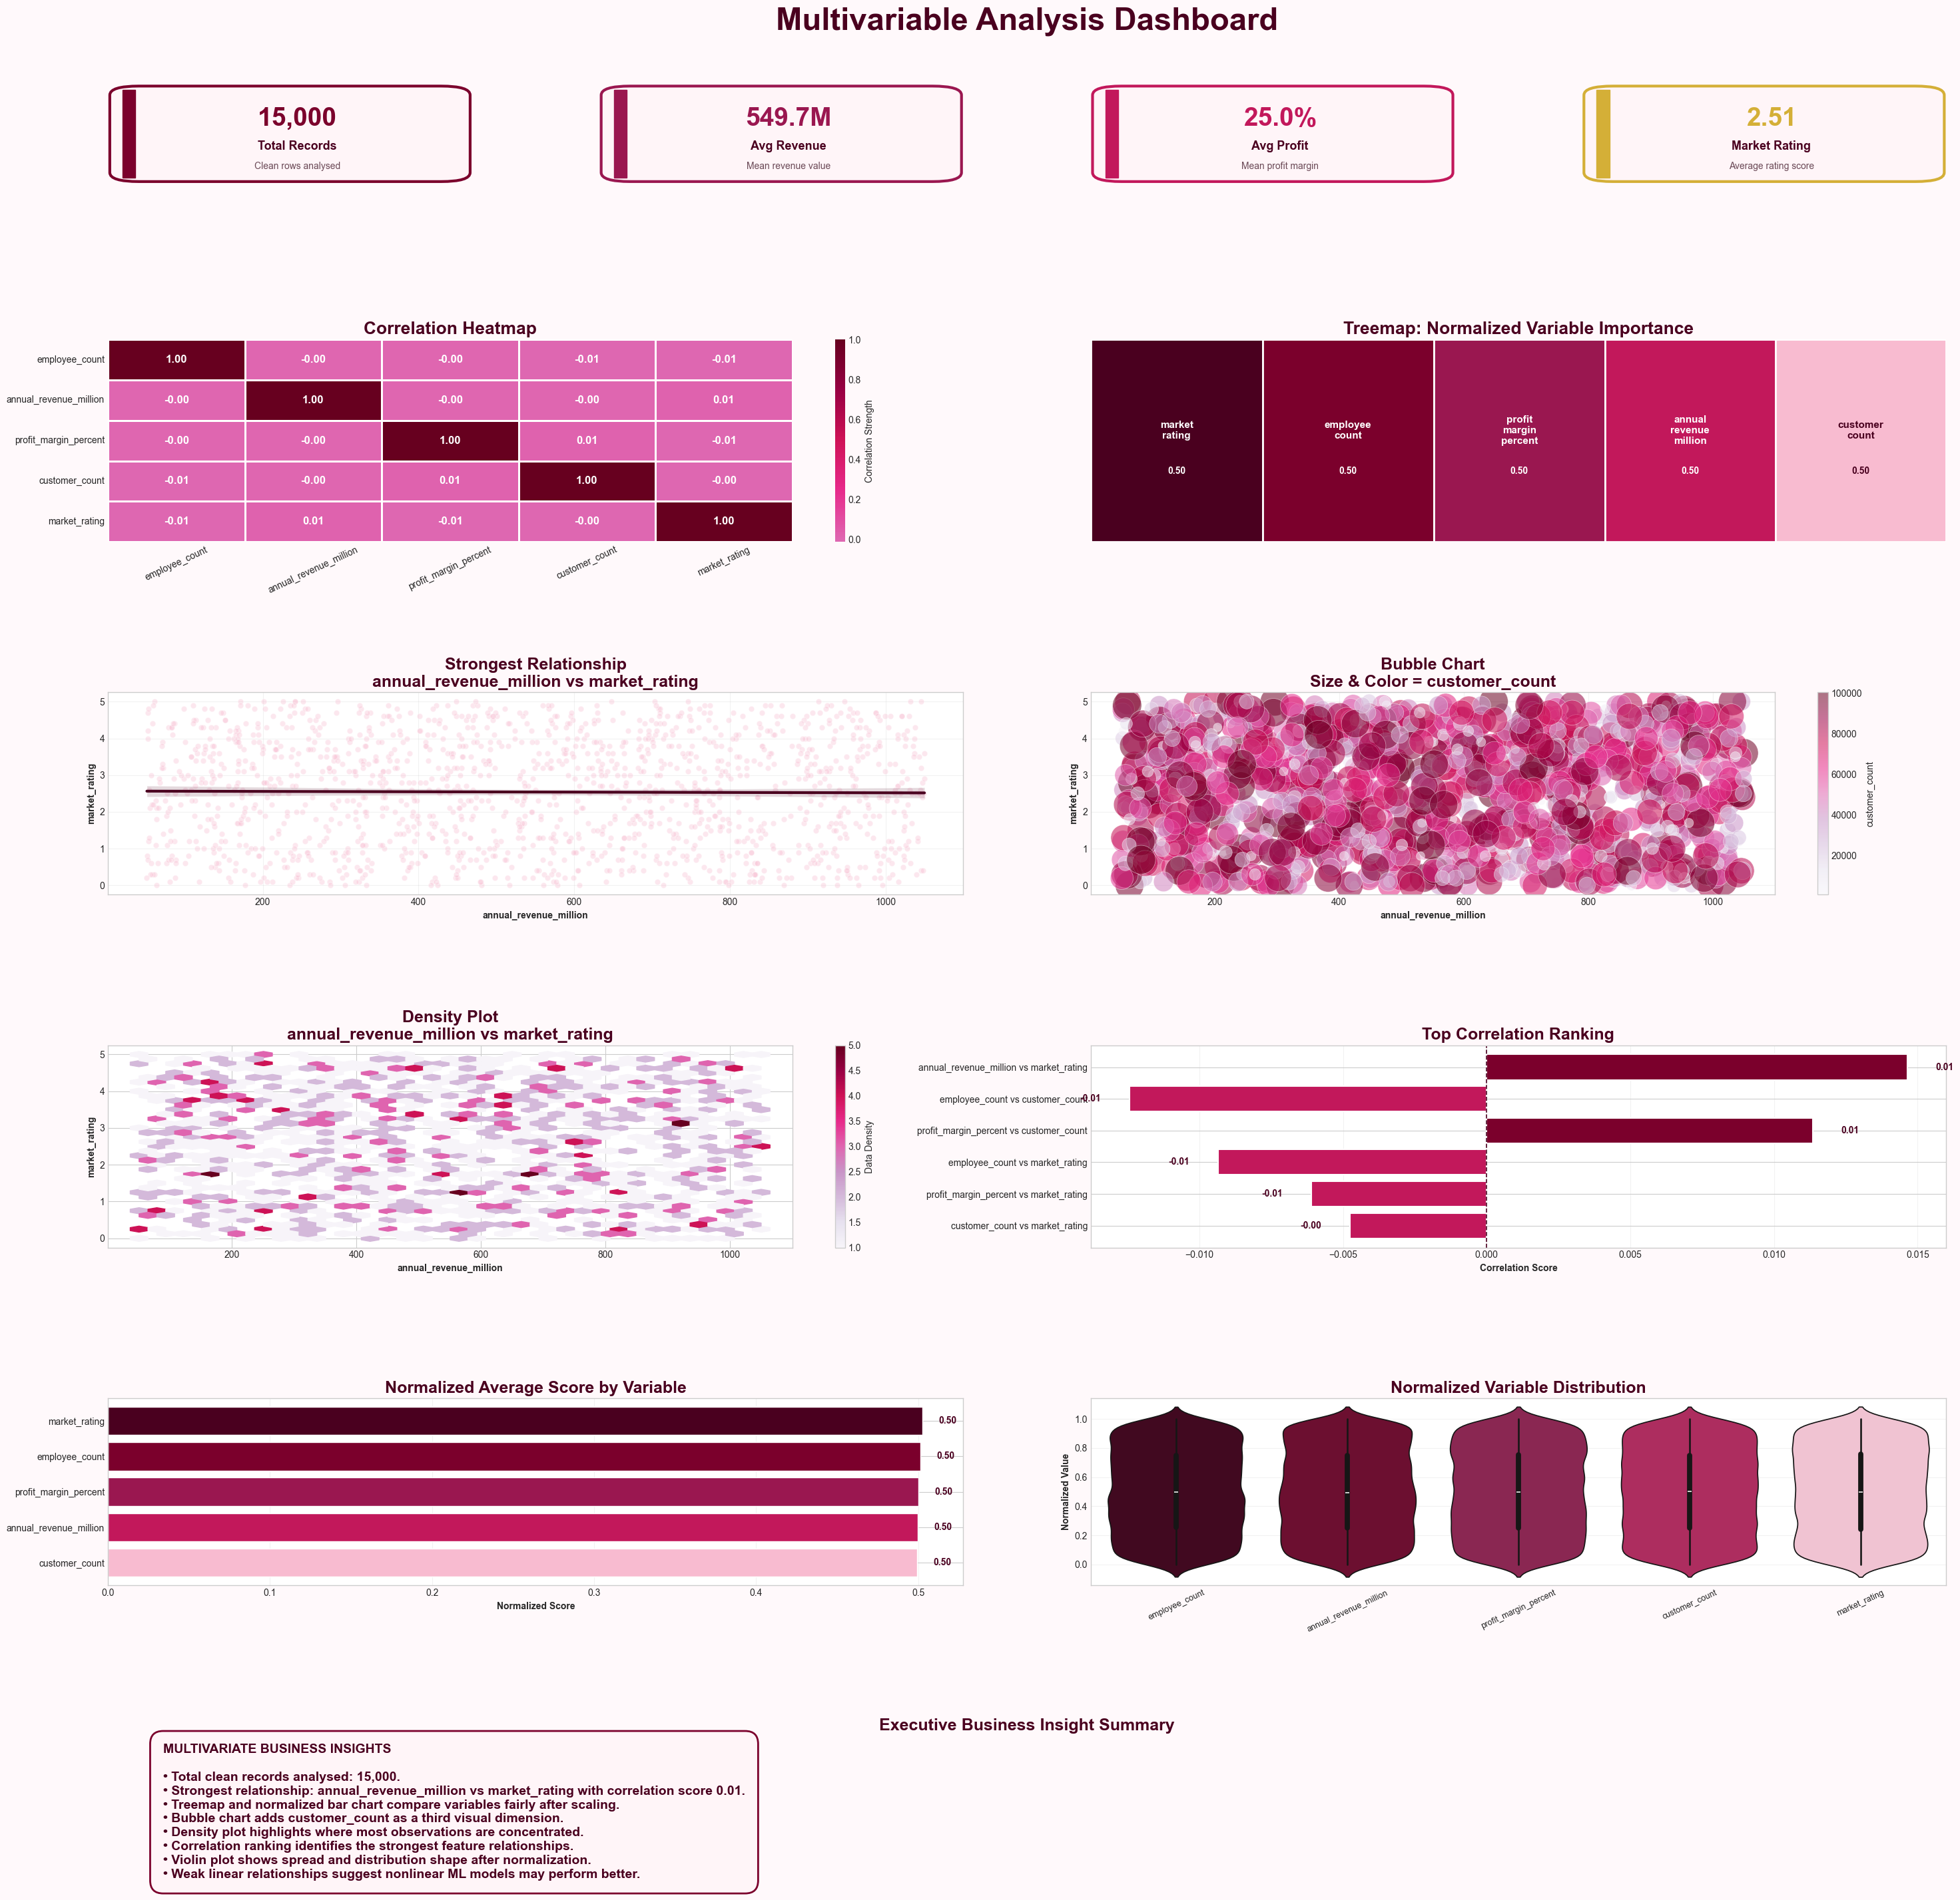
Multivariable Insights
Analyzed 15,000 business records across Revenue, Profit Margin, Customer Count, Employee Count, and Market Rating.
The strongest relationship was between Annual Revenue and Market Rating.
All variables showed a normalized average score of approximately 0.50, indicating a balanced dataset.
Customer Count, Revenue, and Profit Margin exhibited independent behavior with no dominant driver.
Density and bubble charts revealed a well-distributed dataset without significant clustering.
Violin plots showed similar distribution patterns across all business metrics. No severe multicollinearity was observed among variables.

Slide 11
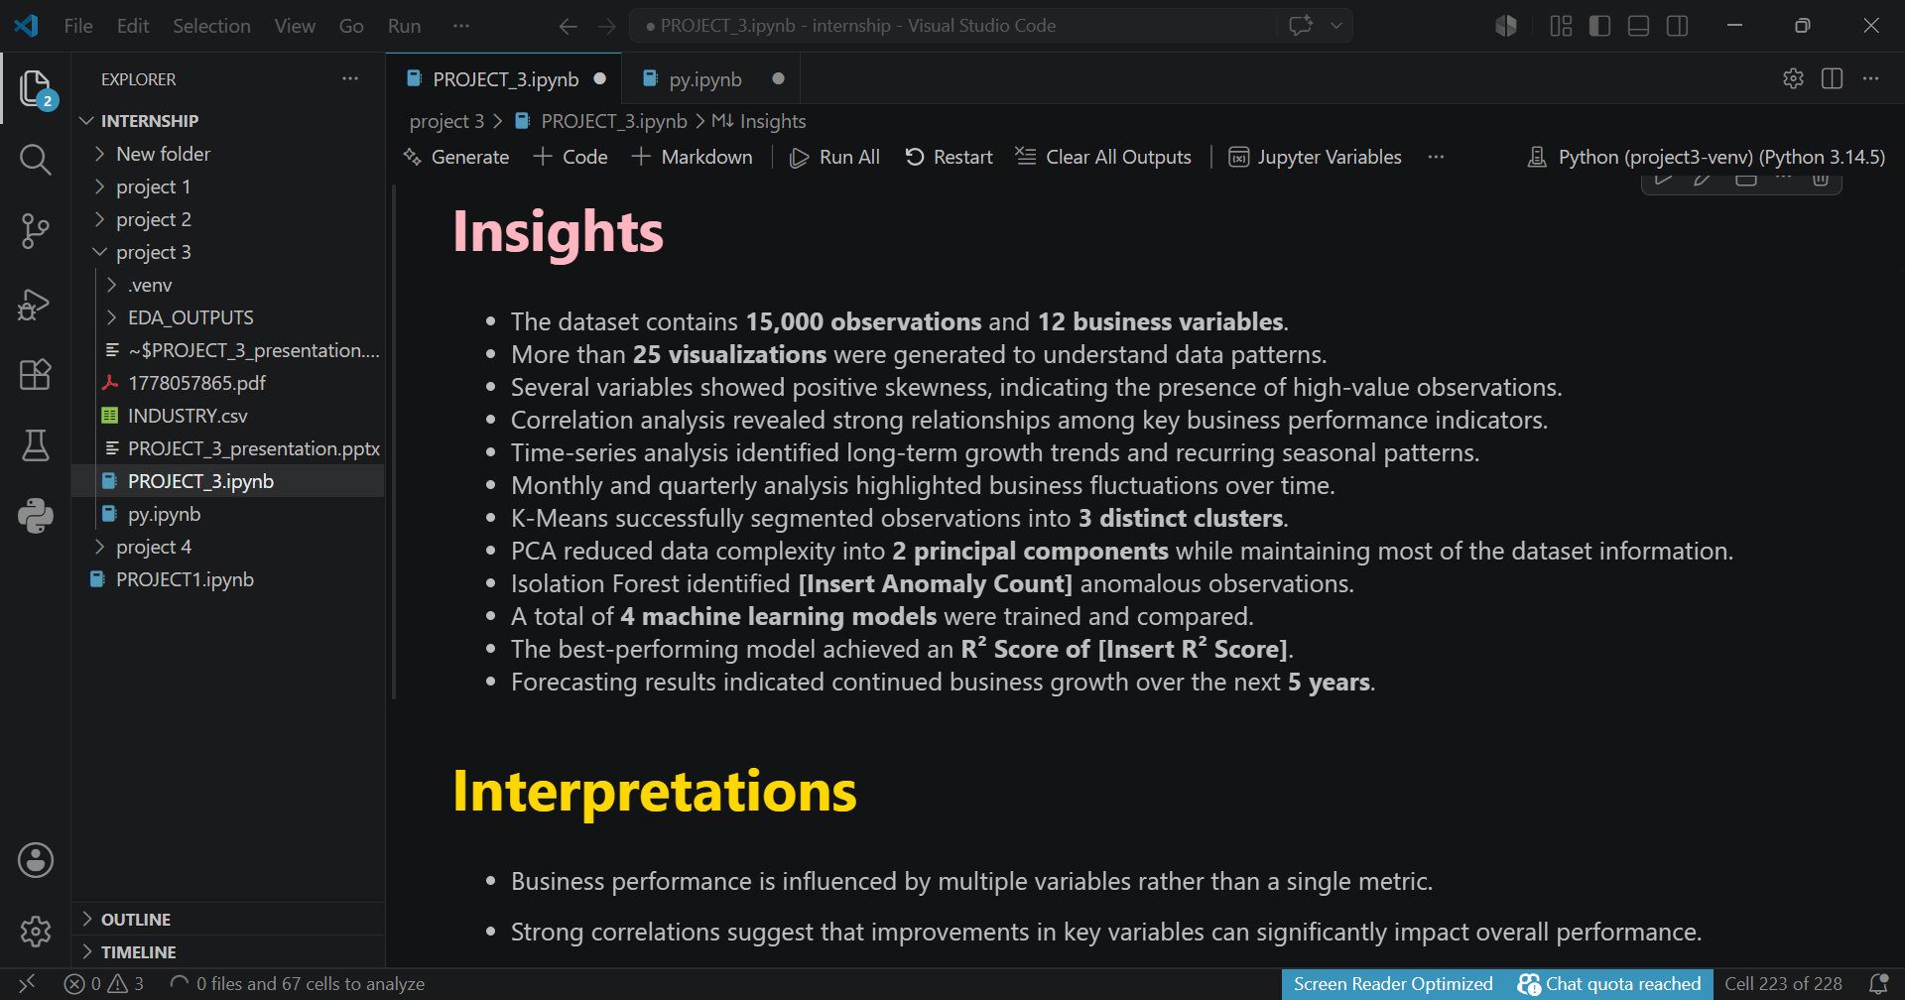
Final Insights
Revenue distribution is highly skewed, with a mean $549.73M and a median ≈ 290M, showing that few companies dominate the market. Profit margins vary widely, with a maximum ≈ 48.2%, indicating big differences in operational efficiency.
Customer count and employee count showed negligible linear relationships with revenue, indicating that revenue performance depends on multiple business factors.
The strongest observed correlation was between Annual Revenue and Market Rating, indicating overall low multicollinearity within the dataset.
Business metrics appear largely independent, highlighting the complexity of enterprise performance and the importance of multivariable decision-making.
The boxplots reveal multiple outliers, including up to 18 extreme revenue observations, indicating market dominance by a few firms.
Category distribution is balanced, with each industry contributing approximately 20% of the dataset. Business performance differences are driven by operational metrics rather than representation alone.
Time-series trend analysis shows steady upward growth, with revenue increasing over time.

Slide 12

Business Recommendations
Focus on Customer-Centric Expansion: Customer acquisition remains important for long-term growth, although the analysis suggests that revenue performance depends on multiple operational and market factors.
Scale Workforce Strategically: Although revenue has weak correlation with employee count, the workforce should be optimized carefully, as diminishing returns can occur. Organizations should optimize productivity and invest in automation and AI instead of uncontrolled expansion.
Strengthen Market Reputation: A strong market rating contributes to higher profit margins. Improving brand perception and product quality is essential for achieving stable profits.
Leverage Industry Growth Opportunities: Organizations should focus on sectors demonstrating higher revenue and profitability characteristics while leveraging digital transformation to improve competitiveness.
Employ Data-Driven Segmentation: Three business tiers have been identified. High-tier firms should expand globally, mid-tier firms should scale operations, and low-tier firms should work on efficiency.
Manage Extreme Outliers as Strategic Assets: Outlier firms hold considerable market influence. Benchmarking against the top 1 to 2 percent can provide valuable operational insights.

Slide 13
Project Conclusion
This project has accomplished a comprehensive Exploratory Data Analysis (EDA) and Machine Learning study utilizing an industry dataset comprising 15,000 company records. The analysis included data cleaning, assessments of missing values, duplicate detection, and various univariate, bivariate, and multivariate analyses, as well as forecasting, clustering, Principal Component Analysis (PCA), anomaly detection, and predictive modeling.
The dataset revealed variability among companies regarding revenue, employee count, customer base, profit margin, and market rating. The average annual revenue was approximately $549.73 million, while the mean profit margin was approximately 25.01, indicating varied financial performance.
The EDA demonstrated that market ratings do not strongly depend on any singular variable. Instead, business performance is influenced by a combination of factors, including annual revenue, customer count, employee strength, profit margin, industry type, and regional presence.
The forecasting analysis indicated that historical market rating values show weak temporal dependency, suggesting that past ratings alone are insufficient for accurate future predictions. A rolling average can help identify trends, but more sophisticated forecasting models are necessary for enhanced predictive capabilities.
The clustering and PCA analyses identified hidden patterns among companies; however, low separation between clusters indicates that the available variables do not facilitate the formation of distinct groups. Incorporating additional factors such as marketing expenditure, customer satisfaction, digital presence, and operational costs could improve segmentation quality.
Although the machine learning models provided a useful baseline for predicting market ratings, the observed weak performance signifies that these ratings are complex and may require more comprehensive business variables for improved predictive accuracy. In summary, this project offers a thorough analytical perspective on company performance and supports data-driven decision-making by identifying key business drivers, performance gaps, and areas for future improvement.

Slide 14



