Slide 1

Smartphone Pricing
Analytics
A Comprehensive Study of Market Dynamics, Feature Influence,
Statistical Validation, Interactive Dashboards,
and Machine Learning-Based Price Prediction
Prepared by: Riya Goel
Python | Statistical Analysis | Data Visualization | Machine Learning | Predictive Analytics
This project combines exploratory data analysis, statistical hypothesis testing, interactive business intelligence, and advanced machine learning algorithms to decode how hardware specifications, design attributes, and processor technologies collectively determine smartphone market pricing.

Slide 2
Problem Statement
The global smartphone market is characterized by rapid technological advancements, evolving consumer preferences, and intense competition. Despite abundant specification data, determining how each feature contributes to a device’s market price remains a complex and unresolved challenge for manufacturers, retailers, and consumers alike.
The Challenge
Analytical Approach
Smartphones with seemingly similar configurations often exhibit significant pricing differences due to variations in hardware quality, processor generation, brand positioning, feature combinations, and consumer demand patterns.
Without a structured analytical approach, it becomes challenging to objectively identify the most influential pricing determinants, assess feature significance, uncover hidden market patterns, and support data-driven pricing decisions across product tiers.
As the smartphone market continues to evolve with new processor architectures, camera technologies, and storage standards, there is a growing need for predictive systems capable of estimating prices accurately and adapting to newly introduced devices in real time.
Manufacturers need pricing intelligence to optimize product portfolios, retailers need it for competitive positioning, and consumers need it to evaluate value-for-money propositions objectively.
Statistical analysis using Pearson correlation, Chi-Square tests, ANOVA, and t-tests to validate feature significance and quantify the strength of relationships.
EDA including univariate, bivariate, and multivariate techniques to uncover distribution patterns, market segmentation, and feature interaction effects across 531 smartphone records.
Interactive dashboards developed to transform complex analytical outputs into intuitive visualizations, enabling stakeholders to explore market trends and pricing behavior interactively.
Machine learning models (XGBoost, Gradient Boosting, Random Forest, Decision Tree, Linear Regression, LightGBM) trained and evaluated to establish a reliable, accurate price prediction system.
A scalable, future-ready analytical framework designed to incorporate new smartphone data and generate continuous predictive insights as the market evolves.

Slide 3
Project Objectives
The primary objective is to develop a comprehensive analytical framework for understanding smartphone pricing behavior and building a reliable machine learning system capable of predicting prices based on device specifications.
1
Data Exploration & Assessment
Understand the structure, characteristics, and quality of the smartphone dataset through detailed exploration of 531 records across all features, identifying data types, distributions, and potential preprocessing requirements.
2
Feature Influence Investigation
Investigate how technical specifications—RAM, storage capacity, battery performance, processor technology, and camera capabilities—contribute to price differentiation within the smartphone market.
3
Design & Market Impact Analysis
Evaluate the impact of design-oriented attributes including color variants (275 unique values), AI Lens presence, and mobile form factor on consumer value perception and pricing trends.
4
Statistical Validation
Validate feature significance through Pearson/Spearman correlation, Shapiro-Wilk normality testing, Chi-Square independence tests, one-way ANOVA, and independent samples t-tests at 95% confidence level.
5
Univariate, Bivariate & Multivariate Analysis
Conduct comprehensive analysis at single-variable, pairwise, and multi-feature levels to uncover distribution patterns, correlation structures, interaction effects, and hidden market segments.
6
Interactive Dashboard Development
Develop interactive business intelligence dashboards that transform raw analytical data into intuitive visualizations, enabling data-driven decision-making for market analysis and product positioning.
7
Machine Learning Model Development
Build, compare, and evaluate 6 ML models (XGBoost, Gradient Boosting, Random Forest, Decision Tree, Linear Regression, LightGBM) using R², RMSE, MAE, and MAPE metrics for price prediction.
8
Scalable Framework Design
Design a future-ready analytical framework capable of incorporating newly available smartphone data, supporting continuous model retraining, and generating scalable predictive insights for evolving markets.

Slide 4


Data Quality Assessment
Data quality assessment ensures the dataset is complete, consistent, accurate, and suitable for reliable statistical analysis and machine learning. Poor data quality can lead to misleading insights, unreliable models, and inaccurate business decisions.
Data Type Distribution
Quality Checks (All Passed)
Data Type | Count | Features
String (Object) | 6 | Model, Colour, Camera, Processor, Price
Integer (int64) | 5 | Memory, RAM, Battery, AI Lens, Index
Float (float64) | 1 | Mobile Height
Missing Values
0 (0.00% across all 12 features)
Duplicate Records
0 unique records confirmed
Data Types Validated
All types correct for analysis
Price Standardized
Comma-separated strings → int64
Column Names Cleaned
Stripped whitespace, renamed Prize→Price
Interpretation & Preprocessing Actions
The dataset demonstrates exceptional data integrity with zero missing values and zero duplicates, indicating high-quality data collection. The target variable (originally “Prize”) contained comma-formatted price strings (e.g., “15,999”) which were cleaned, converted to numeric integers, and renamed to “Price.” The unnecessary index column (“Unnamed: 0”) was removed, reducing dimensionality from 12 to 11 analytical features. The presence of mixed data types (6 numerical, 6 categorical) confirms that encoding (LabelEncoder, OneHotEncoder) and scaling (StandardScaler) will be required for machine learning. Overall, the dataset requires minimal imputation but benefits from feature engineering to maximize model performance.

Slide 5
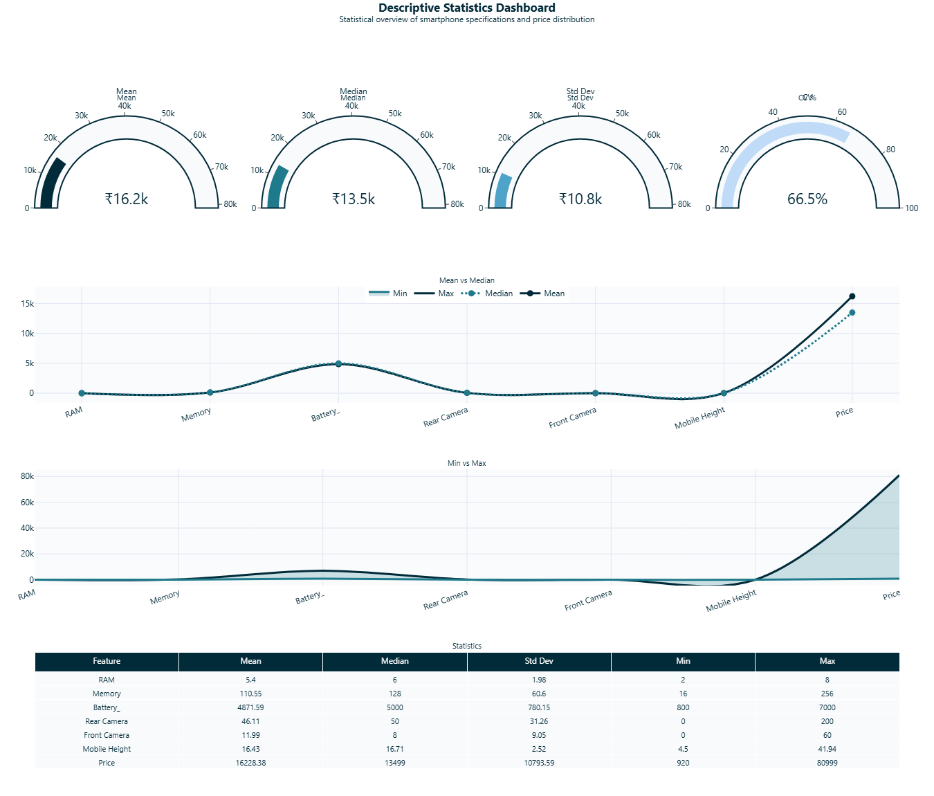
Descriptive Statistics
Descriptive statistics reveal the central tendency, dispersion, and distributional shape of each numerical feature, establishing the quantitative foundation for hypothesis testing, outlier detection, and model selection.
₹16,228
₹13,499
₹10,794
₹920 – ₹80,999
Mean Price
Median Price
Std Deviation
Price Range
Arithmetic average of all 541 records
50th percentile – robust to outliers
High variability around the mean
88x multiplier across market segments
Distribution Shape & Skewness
Key Hardware Statistics
Right-skewed (positive skewness = 2.43)
Mean (₹16,228) > Median (₹13,499) confirms premium devices pulling the average upward. The majority of smartphones cluster in the budget-to-mid-range segment (₹9K–₹19K), forming the highest frequency region. A relatively small number of premium flagship devices (Samsung, Apple) extend the upper tail significantly, increasing the overall average. Kurtosis of 9.61 indicates heavy tails with extreme outlier values—devices priced well above ₹34,000 are statistically rare but present. This pricing pattern is typical of competitive markets where affordability and premium innovation coexist.
Feature | Mean | Median | Std Dev
Memory | 110.6 GB | 128 GB | 60.6
RAM | 5.4 GB | 6 GB | 1.98
Battery | 4,872 mAh | 5,000 mAh | 780.1
AI Lens | 0.063 | 0 | 0.24
Height | 16.4 cm | 16.7 cm | 2.52
Median > Mean for Memory and Battery indicates left-skew in hardware specs, contrasting with the right-skewed price distribution. Battery clusters heavily at 5,000 mAh (standard), while Memory shows a slight preference for 128 GB.

Slide 6
Distribution Analysis: Normality, Skewness & Kurtosis
Understanding the distributional behavior of each feature is critical for selecting appropriate statistical tests and machine learning algorithms. The Shapiro-Wilk test evaluates normality, skewness measures distribution asymmetry, and kurtosis assesses tail heaviness. These diagnostics guide transformation decisions and validate the use of non-parametric methods.
Shapiro-Wilk Normality Test (H₀: Feature is Normal)
Skewness & Kurtosis Profile
All features reject H₀ at p < 0.05, meaning none follow a normal distribution. This is expected for real-world market data with natural segmentation.
Skewness indicates asymmetry direction; Kurtosis indicates tail heaviness. Values far from 0 (skew) or 3 (kurtosis) suggest non-normality.
Feature | W Statistic | p-value | Normal?
Memory | 0.799 | 0.000 | No – right-skewed
RAM | 0.860 | 0.000 | No – slight left-skew
Battery | 0.517 | 0.000 | No – heavy left-skew
AI Lens | 0.259 | 0.000 | No – binary, extreme
Mobile Height | 0.282 | 0.000 | No – outlier-influenced
Price | 0.804 | 0.000 | No – right-skewed, heavy tail
Feature | Skewness | Kurtosis | Interpretation
Memory | 1.03 | 0.86 | Right-skewed, light tails
RAM | 0.07 | -1.31 | ~Symmetric, flat distribution
Battery | -3.30 | 14.75 | Heavy left-skew, extreme tails
AI Lens | 3.61 | 11.09 | Extreme right-skew (93.7% = 0)
Height | 1.17 | 48.22 | Outlier-driven extreme kurtosis
Price | 2.43 | 9.61 | Strong right-skew, heavy premium tail
Modeling Implications
The universal non-normality across all features has important implications for analytical methodology. Traditional parametric methods (e.g., OLS regression) assume normally distributed residuals, which may not hold here. This finding strongly justifies the use of tree-based machine learning models (XGBoost, Random Forest, Decision Tree) which make no distributional assumptions and naturally handle skewed, heavy-tailed data. Price’s skewness (2.43) and kurtosis (9.61) confirm that the market is bifurcated: the majority of devices occupy the budget-to-mid-range segment, while a long tail of premium flagships creates extreme values. Log-transformation of Price could reduce skewness for parametric approaches, but tree-based models handle this directly. Battery’s extreme negative skew (-3.30) reflects market standardization on 5,000 mAh, making it a poor standalone predictor despite its intuitive importance.

Slide 7
Outlier Analysis (IQR Method)
The Interquartile Range (IQR) method identifies observations that lie significantly outside the normal range by calculating the spread of the middle 50% of data. Detecting outliers is essential because they may influence statistical tests, ML model training, and business conclusions. In this context, outliers often represent genuine premium devices rather than data errors.
Feature | Lower Bound | Upper Bound | Outliers | % | Interpretation
RAM | -2.00 | 14.00 | 0 | 0.00% | Standardized specs, no extremes
Memory | -32.00 | 224.00 | 55 | 10.17% | Premium 256GB devices
Battery | 5,000 | 5,000 | 152 | 28.10% | 5000mAh is the market norm
Rear Camera | -42.5 | 105.5 | 39 | 7.21% | High-MP camera outliers
Front Camera | -11.5 | 32.5 | 13 | 2.40% | Premium selfie cameras
Mobile Height | 15.87 | 17.58 | 33 | 6.10% | Non-standard form factors
Price | -5,695 | 34,265 | 25 | 4.62% | Flagship premium devices
Business Interpretation
Battery shows the highest outlier rate (28.1%) because the IQR is nearly zero (Q1=Q3=5000mAh)—the market has overwhelmingly standardized on 5,000 mAh batteries, making any deviation (e.g., 7000 mAh power banks or 800 mAh feature phones) statistically “outlier.” RAM has zero outliers, confirming that 2–8 GB is a well-bounded specification range. Memory outliers (10.2%) represent 256 GB premium configurations. Price outliers (4.6%) are genuine flagship devices priced above ₹34,265—not data errors—and are valuable for understanding the premium segment. These outliers should be retained for model training as they capture the full price spectrum and enable accurate prediction across budget, mid-range, and premium tiers.

Slide 8
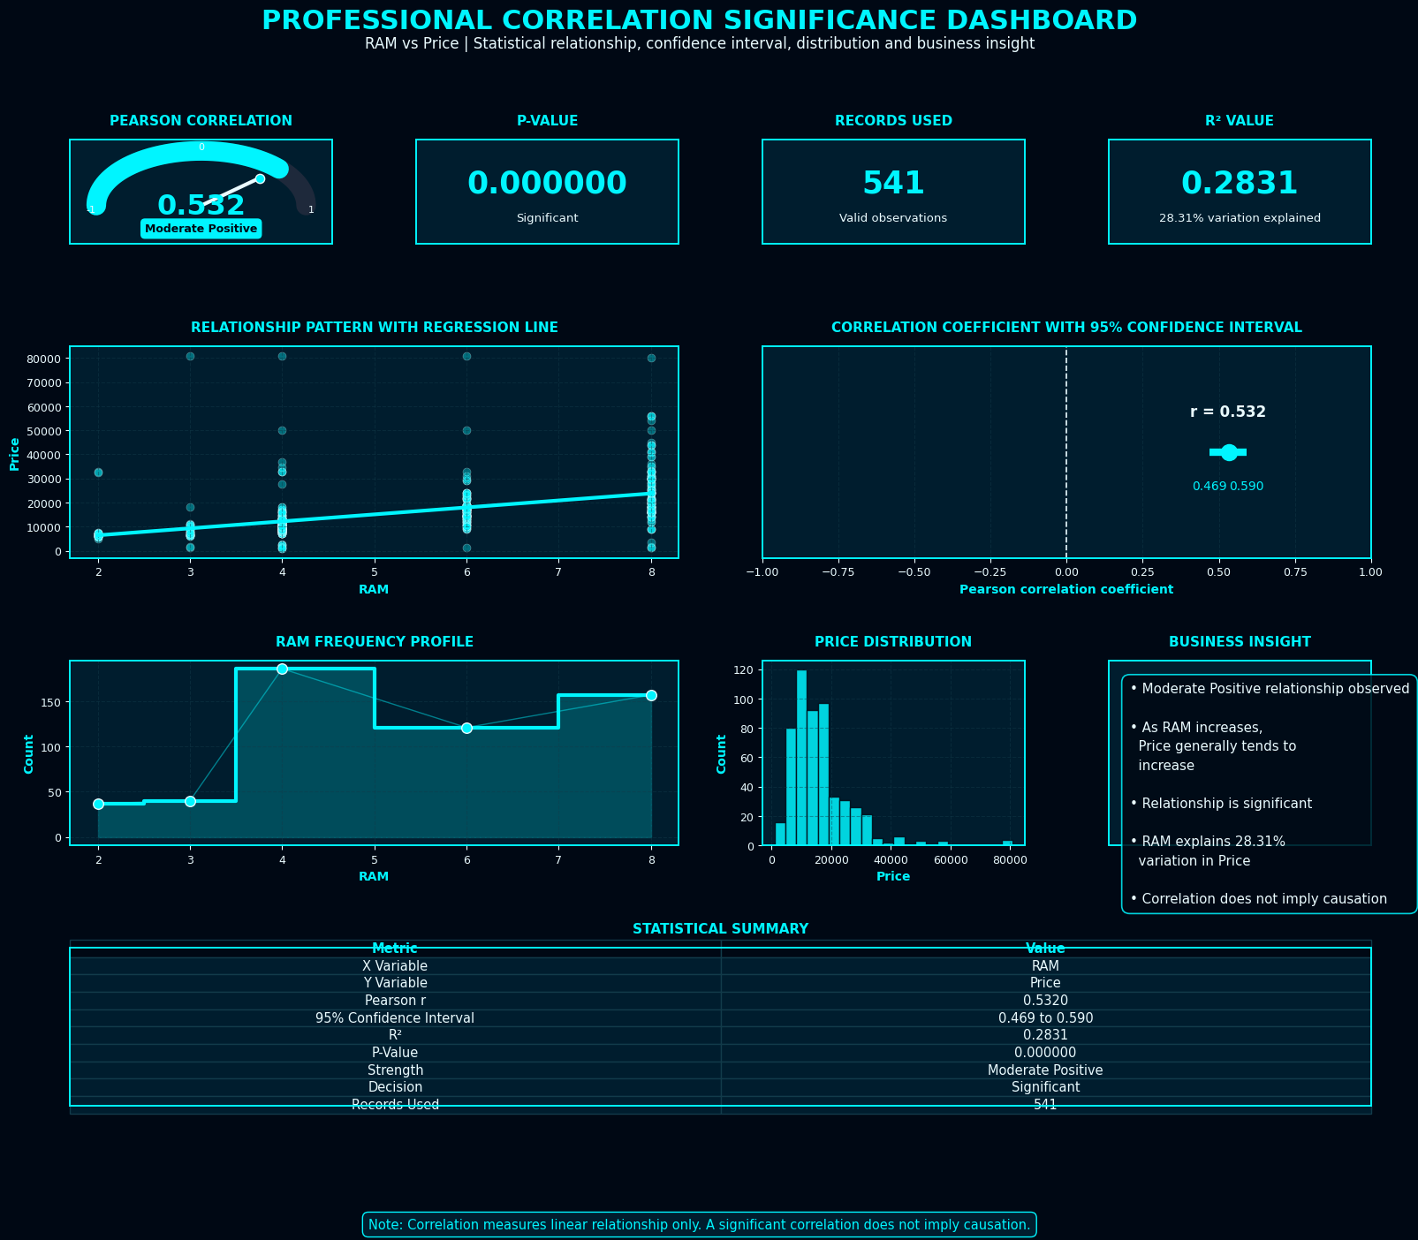
Correlation Analysis: What Drives Smartphone Price?
Pearson correlation coefficients quantify the linear relationship strength between each hardware specification and smartphone price. Values range from -1 (perfect negative) to +1 (perfect positive), with |r| > 0.5 indicating a strong association. Understanding these relationships is critical for identifying the most influential pricing determinants and guiding feature selection for predictive models.
Detailed Findings
Storage (r=0.567) – Strongest
Storage capacity shows the strongest positive linear relationship with price. Higher storage tiers (128GB, 256GB) command significantly higher prices, reflecting both manufacturing cost and consumer willingness to pay for capacity.
RAM & Camera (r=0.532) – Strong
RAM and Front Camera are tied for second. More RAM enables better multitasking and commands premium pricing. Higher front camera resolution correlates with selfie-focused, higher-priced devices.
Battery (r=0.288) – Weak
Battery capacity has a surprisingly weak correlation with price. Since 5,000 mAh is standardized, battery size alone does not differentiate pricing. The relationship is diluted by the market’s convergence on a single battery standard.
Height (r=0.176) – Negligible
Mobile height has minimal price impact, confirming that physical form factor is not a primary pricing driver in this market segment.

Slide 9
Statistical Hypothesis Testing
Hypothesis testing validates whether observed relationships between specifications and price are statistically significant or merely due to random chance. All tests were conducted at the 95% confidence level (α = 0.05). The results confirm that every major feature category is statistically significantly associated with smartphone pricing.
Chi-Square Test of Independence (Categorical Features vs. Price Category)
The Chi-Square test determines whether categorical variables (processor family, storage tier, camera category, etc.) are independent of price segment or whether significant associations exist. A significant result (p < 0.05) indicates that the feature’s categories are not randomly distributed across price tiers—specific feature values are strongly linked to particular price ranges.
Feature | χ² Statistic | Degrees of Freedom | p-value | Conclusion
Processor Family | 397.46 | 21 | < 0.00001 | Strongly Significant
Storage Category | 344.50 | 6 | < 0.00001 | Strongly Significant
Front Camera Category | 320.88 | 9 | < 0.00001 | Strongly Significant
Rear Camera Category | 293.49 | 9 | < 0.00001 | Strongly Significant
RAM Category | 293.13 | 3 | < 0.00001 | Strongly Significant
One-Way ANOVA (Price by Processor Family)
Independent Samples T-Test (RAM ≤6GB vs ≥8GB)
F-Statistic: 52.83 | p-value: < 0.0001
The ANOVA test confirms that processor family has a statistically significant impact on smartphone price (reject H₀). Different processor tiers—from budget Unisoc chips to premium Snapdragon 8 Gen 2—correspond to distinct and significantly different price segments. The high F-statistic indicates substantial between-group variance relative to within-group variance, meaning processor choice is a powerful price differentiator.
t-Statistic: -11.35 | p-value: < 0.000001
The t-test confirms that average prices differ significantly between the Standard RAM group (≤6 GB) and the High RAM group (≥8 GB). The large absolute t-value indicates a substantial price gap between these segments. This validates that RAM tier is a primary price differentiator and supports premium pricing for 8 GB configurations.
.

Slide 10
Machine Learning: Methodology & Pipeline
Six regression algorithms were trained and evaluated to build a smartphone price prediction system. The notebook workflow moves from feature engineering and preprocessing to model comparison, diagnostics, feature importance, and a future-phone prediction demo.
1
Feature Engineering
Categorical variables such as model, colour, processor and camera attributes are label/one-hot encoded, while engineered numeric features such as RAM_GB, Memory_GB, Battery_mAh and camera megapixels are prepared for modeling.
2
Train/Test Split & Preprocessing
The data is split into training and test sets. Scaling is applied for Linear Regression, while tree-based models use the engineered feature set directly. Encoded features preserve both hardware and brand/model information.
3
Model Training (6 Algorithms)
Linear Regression, Decision Tree, Random Forest, Gradient Boosting, XGBoost, and LightGBM were trained to compare baseline, single-tree, bagging, and boosting approaches for price prediction.
4
Evaluation Metrics
R² Score (proportion of variance explained, higher=better), RMSE (average prediction error in ₹, lower=better), MAE (mean absolute error robust to outliers), and MAPE (percentage error for business interpretability). Multiple metrics ensure comprehensive performance assessment beyond any single measure.
5
Feature Importance Analysis
The best-performing model’s feature importance values are extracted to identify which attributes most influence predicted price, converting model output into business-readable pricing intelligence.
Notebook focus: compare model accuracy, inspect prediction error, rank feature importance, and use the selected model to estimate a future smartphone price from specification inputs.

Slide 11

Model Performance Comparison
Six machine learning models were evaluated using R², RMSE, MAE, and MAPE. In the notebook output, LightGBM ranks highest by R² and RMSE, while XGBoost records the lowest MAPE. This suggests a close ensemble-model race where the best choice depends on whether variance explained or percentage-error consistency is prioritized.
Model | R² | RMSE (₹) | MAE (₹) | MAPE
LightGBM | 0.5641 | ₹6,779 | ₹2,646 | 16.2%
Random Forest | 0.5581 | ₹6,826 | ₹2,523 | 13.0%
Gradient Boost | 0.5541 | ₹6,856 | ₹2,566 | 15.7%
XGBoost | 0.4526 | ₹7,597 | ₹2,303 | 10.3%
Linear Reg. | 0.4098 | ₹7,888 | ₹4,964 | 37.5%
Decision Tree | 0.0619 | ₹9,945 | ₹2,910 | 12.4%
Best Overall: LightGBM
Highest R² (0.5641) and lowest RMSE (₹6,779). LightGBM explains 56.4% of price variance while maintaining competitive MAE and MAPE across the test set.
Model Selection Insights: LightGBM, Random Forest, and Gradient Boosting perform very closely by R², indicating that ensemble approaches capture non-linear smartphone pricing patterns better than simpler baselines. XGBoost has the lowest MAPE (10.3%), making it useful when percentage-error control matters. Linear Regression underperforms due to non-linear feature interactions, and the single Decision Tree shows weak generalization.

Slide 12

Best Model Deep Dive: LightGBM
LightGBM is a gradient boosting framework designed for efficient tree-based learning. In this notebook, it achieves the strongest R² and RMSE results, making it the selected model for future smartphone price prediction.
0.5641
₹6,779
₹2,646
16.16%
R² Score
RMSE
MAE
MAPE
56.4% of test-set price variance explained
Average prediction error across the price spectrum
Mean absolute prediction error in rupees
Average absolute percentage deviation from actual price
Why LightGBM Leads
Prediction Demo
The model achieved the highest R² value among all six tested models, with a score of 0.5641, compared to 0.5581 for Random Forest.
It also had the lowest RMSE at ₹6,779, indicating the best overall fit in terms of squared-error penalty.
Gradient boosting effectively captures non-linear interactions among various features such as model type, processor, storage, RAM, battery, and camera.
Its efficient learning process manages engineered and encoded variables without a heavy burden of manual feature selection.
The feature importance output enhances interpretability by ranking the most significant drivers of price.
Future Smartphone Scenario
Storage: 256 GB | RAM: 12 GB
Battery: 6000 mAh | Rear: 108 MP | Front: 32 MP
Processor: Snapdragon 8 Gen 2
Model Input: 18 features, 15 active
Predicted Price: ₹31,210
This demo shows how the trained model can estimate market price for an unseen configuration using specification-level inputs, supporting automated pricing analysis for new product launches.

Slide 13
Feature Importance Analysis
LightGBM feature importance scores quantify how strongly each engineered input contributes to price prediction. The notebook ranks model identity, processor, battery, colour, mobile height, RAM, memory and camera megapixels as the strongest contributors.
Business Interpretation
#1: Model Identity
The Model feature receives the highest importance score (730), showing that product-line positioning and model-specific attributes strongly influence pricing beyond raw specifications alone.
#2: Processor Technology
Processor ranks second (530), confirming that chipset family and performance tier are central to market value and premium positioning.
#3: Battery, Colour & Form Factor
Battery (265), Colour (259), and Mobile Height (244) provide meaningful segmentation signals linked to product design, configuration, and market category.
#4: RAM, Memory & Camera Specs
RAM, Memory, Front Camera MP and Rear Camera MP remain important hardware drivers, supporting the insight that pricing reflects a combined specification profile.
Combined insight: pricing is not driven by one isolated feature. The best model weighs brand/model positioning, processor class, and hardware configuration together to estimate market value.

Slide 14
Key Findings & Strategic Recommendations
This section consolidates the most significant findings from the statistical analysis, exploratory data analysis, and machine learning modeling, paired with actionable strategic recommendations for manufacturers, retailers, and product teams.
Key Findings
Strategic Recommendations
Dataset structure is strong: 541 records, 12 original columns, 187 smartphone models, 275 colour variants, zero missing values, and zero duplicate records after validation.
Price-related analysis shows that storage, RAM, front camera, rear camera and processor features have meaningful relationships with price, while market segmentation produces a right-skewed price distribution.
Statistical validation supports feature relevance through correlation analysis, categorical association testing, ANOVA-style comparisons, and group-level price testing across major specification categories.
LightGBM is selected by the notebook’s model ranking with R²=0.5641, RMSE=₹6,779, MAE=₹2,646, and MAPE=16.16%. XGBoost records the lowest MAPE at 10.25%.
Feature importance ranks Model and Processor highest, followed by Battery, Colour, Mobile Height, RAM, Memory, and camera megapixel features.
The future prediction module estimates a high-spec smartphone at ₹31,210.31 using 18 input features and 15 active engineered features.
Pricing Strategy: Use model family, processor class, storage and RAM combinations as primary pricing levers when positioning devices across budget, mid-range and premium tiers.
Automated Pricing: Deploy the LightGBM model as a decision-support tool for early price estimation, then monitor percentage errors and benchmark against XGBoost for MAPE-sensitive use cases.
Product Development: Prioritize processor tier, memory/storage configuration, battery, camera package and form-factor decisions because these features carry high predictive importance.
Market Positioning: Maintain strong mid-range offerings while using premium configurations—higher RAM, larger storage and stronger processors—to justify higher price bands.
Business Intelligence: Use dashboards and correlation views for ongoing monitoring of specification-price relationships, segment mix, and product portfolio competitiveness.
Scalability: Retrain the pipeline with newer launches, competitor prices, promotion signals and customer feedback to improve model reliability as the smartphone market evolves.

Slide 15
Thank You
Smartphone Pricing Analytics | Prepared by Riya Goel
541 Records | 187 Models | 6 ML Models | LightGBM R² = 0.5641 | Model & Processor = Top Drivers
Python | Statistical Analysis | Data Visualization | Machine Learning | Predictive Analytics

