Slide 1
NEXTHIKES IT SOLUTIONS · RETAIL ANALYTICS
ANALYTICAL SCOPE
Sales Forecasting Across
Multiple Retail Stores
1,115
Stores analysed
5.87 B
Total sales in period
644 M
Total customer visits
Task 1 · Exploration of Customer Purchasing Behaviour
6,956
Average daily sales
An exploratory analysis was conducted on 1,017,209 historical store-day records from the Rossmann Pharmaceuticals network, which were synthesized into a comprehensive 35-feature analytical framework. This analysis serves as the evidence base for the development of a daily sales forecasting model covering a six-week period.
9.12
Sales per customer
2013–2015
Historical horizon
Submission by :
Riya Goel
Prepared data completeness: 100.0% across core analytical fields
Rossmann Retail Demand Analysis · Task 1 Exploratory Data Analysis
01

Slide 2
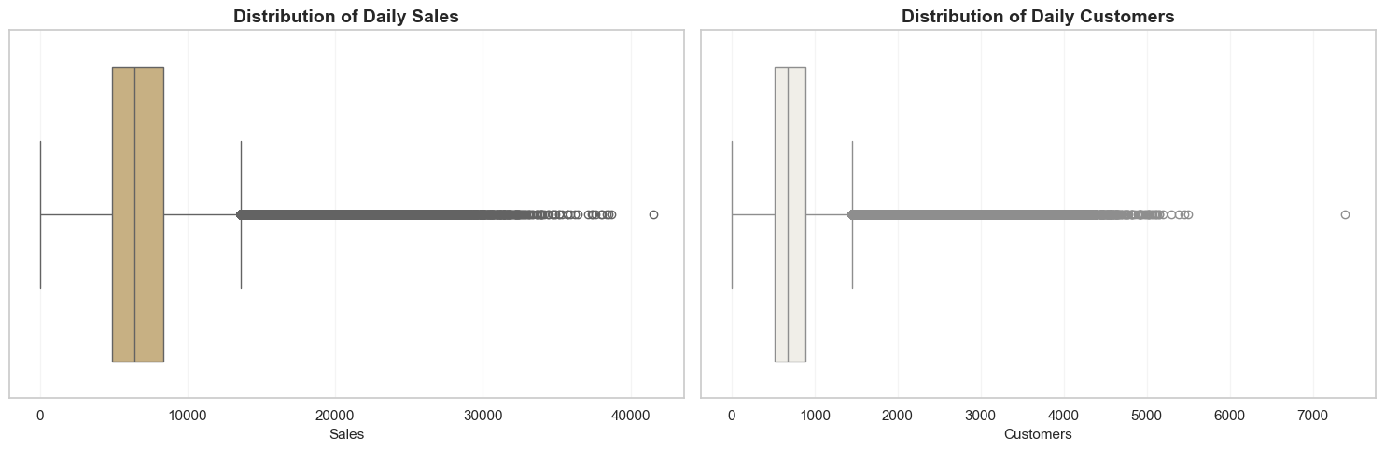
01 · DATA FOUNDATION
Data Integrity Established Before Any Inference
Before any behavioural inference, the three source tables were profiled, reconciled and merged into a single 35-feature analytical view. Every missing field was classified as structural or genuine, and each remediation preserves the original signal through an accompanying indicator variable.
1,017,209
41,088
35 / 8 / 8
TRAINING RECORDS
FORECAST RECORDS
FEATURES · RULES · CHECKS
1,115 stores · 942 trading dates · Jan 2013 – Jul 2015
856 stores · 48 dates · six-week horizon to Sep 2015
35-column analytical view · 8 validation rules passed · 2.30% residual missing
MISSINGNESS CLASSIFIED AND TREATED
EXTREME VALUES CONTEXTUALISED, NOT DISCARDED
FIELD | GAP | CLASSIFICATION AND TREATMENT
Promo2 attributes | 48.79% | Structural — 544 stores never enrolled
Competition open date | 31.75% | Genuine — kept with availability flag
Competition distance | 0.27% | Genuine — store-type median + flag
Test-set Open status | 0.03% | Operational — store-day history
StateHoliday encoding | — | Normalised to 0 / a / b / c
IQR fencing flags 2.62% of sales and 3.75% of customer observations as statistically extreme.
71.9% of those extreme days coincide with promotions and 22.7% with school holidays — commercial peaks, not measurement error.
Only 0.53% fall on state holidays, confirming the upper tail is promotion-driven rather than calendar-driven.
All extremes were flagged rather than removed, keeping genuine demand peaks available to the forecasting model.
No observations were deleted. Promo2 gaps mean a store never enrolled — commercial meaning, not error.
QUALITY GATE
Zero negative sales, zero customers at closed stores, zero duplicate store-date keys, zero unmatched StoreType or Assortment after merge.
1,017,209 store-day records validated · 100% completeness on core analytical fields
02

Slide 3
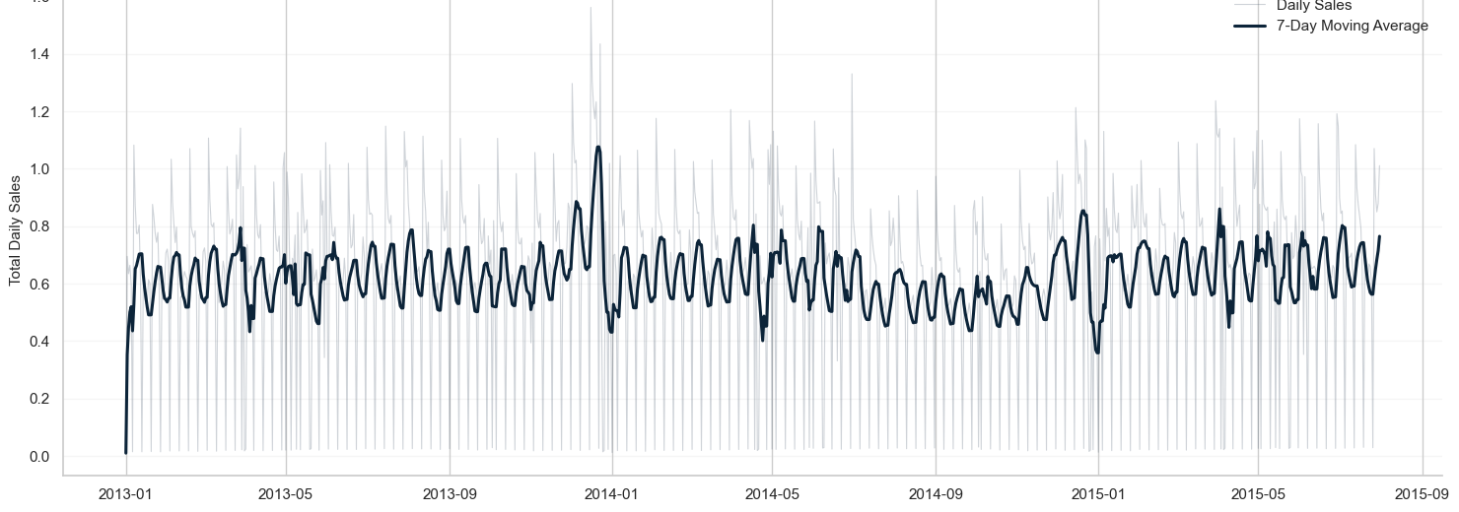
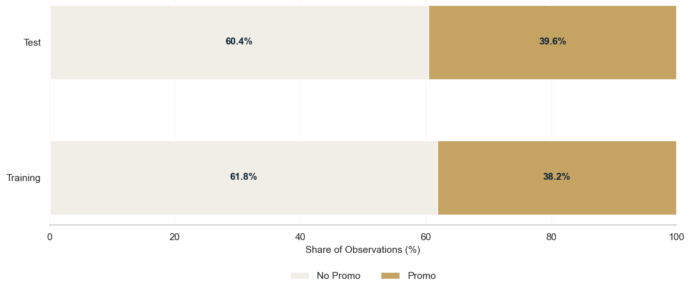
02 · CUSTOMER DEMAND & PROMOTION
Traffic Explains Demand; Promotions Amplify It Unevenly
Across 2013–2015 the network realised 5.87 billion in sales from 644 million customer visits — averaging 6,955 per store-day. Traffic and promotions are the strongest observable influences on realised demand.
NETWORK SALES TREND · SEVEN-DAY MOVING AVERAGE
0.824
SALES–CUSTOMER CORRELATION
Traffic is the dominant demand component
+38.8%
PROMOTIONAL SALES UPLIFT
Strongest comparable descriptive signal
Stable across 2013–2015 with recurring weekly cycles and a December spike each year — no structural trend break that would undermine training on the full history.
9.12
PROMOTIONAL EXPOSURE · TRAINING VERSUS FORECAST PERIOD
AVERAGE SALES PER CUSTOMER
Purchasing intensity across 644 M visits
INTERPRETATION
Exposure differs by only 1.43 points between periods (38.15% vs 39.58%); across trading days the network promotes on 44.64% of open store-days. Uplift is not uniform across stores — targeting beats blanket deployment.
Promotional response varies by store · Selective deployment is preferred to uniform network-wide promotion
03

Slide 4
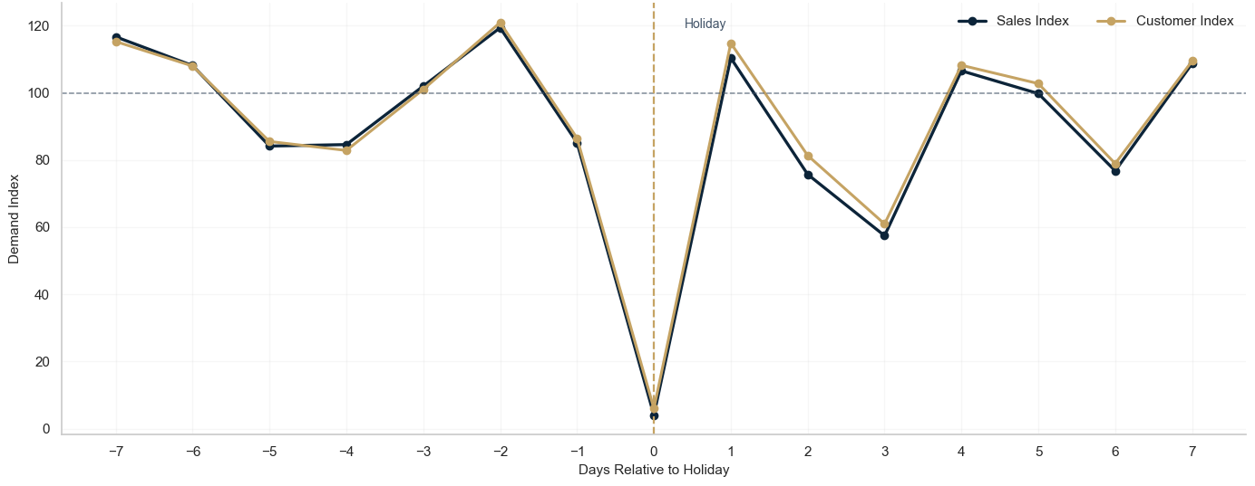
03 · CALENDAR, STORE STRATEGY & COMPETITION
Structural Factors Differentiate Demand Across the Network
Beyond traffic and promotions, demand is shaped by the trading calendar, store configuration and local market structure. The network is dominated by StoreType a (54.2%) and d (30.8%), with assortment a running in 52.8% of stores — a mix that must condition every store-level comparison below.
SALES AND CUSTOMER BEHAVIOUR AROUND STATE HOLIDAYS
STRUCTURAL DEMAND DRIVERS
+23.8%
December
Peak trading month against the annual average
+30.5%
Extra assortment
Best-to-lowest spread across the three configurations
85.0%
Store portfolio
StoreType a and d together dominate the network mix
Indexed to a pre-holiday baseline of 100 across a −7 to +7 window — 31,050 holiday events across 455,714 window observations (public, Easter, Christmas).
2.33 km
Competitor proximity
Median distance; 99.7% of stores originally observed
THE HOLIDAY EFFECT IS AN AVAILABILITY EFFECT
Headline holiday sales fall 95.95% and customers 94.03% — but only 2.93% of stores trade that day.
Among stores that do open, sales rise +12.18% to 8,809 per day on 1,367 customers.
Demand recovers within a day, then runs 9.19% below baseline for the following week.
−4.3%
Competitor entry
Median store-level post-entry sales difference
Associations, not causal estimates — promotions and assortments were never randomly assigned.
Seasonality, assortment and competitive context should enter store-level planning jointly
04

Slide 5
04 · RECOMMENDATIONS & FORECASTING READINESS
From Exploratory Evidence to a Leakage-Safe Forecasting Pipeline
MANAGEMENT ACTIONS
FORECASTING HANDOFF
DOCUMENTED LIMITATIONS
Direct promotional investment toward stores with demonstrated incremental response rather than uniform network deployment.
Align inventory and workforce planning with the December peak and observed weekend demand profiles.
Benchmark assortment decisions within comparable store formats, not across the whole network.
Treat competitive proximity as one input to multi-factor store planning, not an isolated decision rule.
RETAIN AS PREDICTORS
No customer identifiers, so new versus existing promotional response cannot be separated.
No intraday timestamps; opening and closing behaviour is measurable only at daily resolution.
No city-centre or geographic classification, so location-specific competition cannot be tested.
Competitor openings are recorded only to month and year, making event anchors approximate.
Store identity · Open · Promo · engineered calendar features · state and school holidays · StoreType · Assortment · CompetitionDistance with missingness indicator · competitor-entry timing
EXCLUDE TO PREVENT LEAKAGE
Customers and SalesPerCustomer, which are unavailable at prediction time despite strong explanatory value in analysis.
EXECUTIVE CONCLUSION
100.0%
100.0%
99.7%
Rossmann demand should be interpreted as a multi-factor retail system rather than through any single variable. Task 1 delivers a validated, documented foundation for a leakage-safe, store-aware and calendar-aware forecasting pipeline.
Requirement
coverage
Core data
completeness
Competition
coverage
Task 1 status: complete and validated · Next stage: predictive sales-forecasting pipeline
05

