Slide 1
NATURAL LANGUAGE PROCESSING · MACHINE LEARNING
Incoming tweet
Disaster Tweet
raw social-media text
"Forest fire near La Ronge Sask. Canada"
Classification
NLP + Machine Learning Classifier
Real-time disaster identification from social media using NLP and machine learning
DISASTER (1)
NON-DISASTER (0)
PROJECT SCOPE
PREPARED BY
Data exploration to deployment
Riya Goel

Slide 2
INTRODUCTION
Project Overview & Roadmap
Objective & Approach
Pipeline Stages
▪ Goal: classify each tweet as a real disaster (1) or non-disaster (0)
▪ Business need: help emergency teams spot genuine incidents among millions of noisy social-media posts
▪ Data: 7,613 hand-labelled tweets with keyword, location, text and target
▪ Challenge: disaster words are often used figuratively, e.g. "this song is fire"
▪ Approach: classical NLP with TF-IDF features and linear and tree-based models
▪ Design principle: leakage-safe pipeline with a protected, untouched test set
▪ Priority metrics: recall and F1, since a missed disaster costs more than a false alarm
▪ Validation: 5-fold stratified cross-validation, robustness and subgroup testing
▪ Deliverables: trained model, Flask REST API and Streamlit web application
▪ Reproducibility: fixed random seed (42), versioned model and logged runs
1
Data Exploration
2
Data Preparation
3
Feature Engineering
4
Model Selection & Tuning
5
Test Evaluation
6
Validation & Robustness
7
Flask API Deployment
8
Streamlit Interface
7,613
32,136
0.747
Tweets
Features
Test F1
Each stage is built so that test data never influences training, giving an honest estimate of real-world performance.
KEY TAKEAWAY
Disaster Tweet Classification · NLP & Machine Learning
2

Slide 3
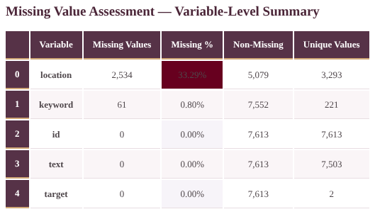
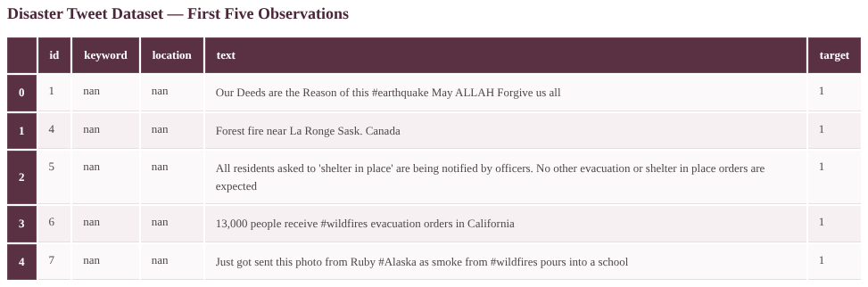

TASK 1 · DATA EXPLORATION
Dataset Overview & Data Quality
Output: first five observations
Output: missing-value summary
Output: class distribution
▪ Size: 7,613 records, 5 variables, 38,065 data points
▪ Variables: id, keyword (221 unique), location (3,293 unique), text (7,503 unique), target
▪ Target: 3,271 disaster and 4,342 non-disaster tweets
▪ Typical tweet: about 17 words and 101 characters
▪ Safeguard: deep copy of raw data preserved before any change
▪ Duplicates: 0 duplicate rows, but 110 repeated tweet texts
▪ Keyword values: 221 distinct keywords; 61 tweets have none
▪ Completeness: 93.18% filled; 2,595 missing values (6.82%)
▪ Location / keyword: 33.29% and 0.80% missing; text and target complete
▪ Label validity: target contains only binary values 0 and 1
▪ Class balance: 57.03% vs 42.97% (ratio 1.33:1), a moderate imbalance
▪ Plan: stratified sampling; F1, precision, recall and ROC-AUC as metrics
▪ Treatment: explicit placeholders for missing keyword and location
▪ Text and target: no missing or blank values in any of the 7,613 records
KEY TAKEAWAY
The tweet text carries the signal; missing metadata, repeated texts and mild imbalance shape the design choices that follow.
Disaster Tweet Classification · NLP & Machine Learning
3

Slide 4
TASK 1 · DATA EXPLORATION
Keyword & Phrase Analysis
Top Disaster Keywords
Top Non-Disaster Keywords
▪ Vocabulary size: 7,458 unique disaster keywords vs 9,737 non-disaster
▪ Disaster terms: events and consequences (fire, suicide, police, killed, storm)
▪ Non-disaster terms: casual conversation (like, love, get, now, day)
▪ Top bigram: encoded URL fragment leads both classes (109 vs 108)
▪ Top trigram, disaster: "suicide bomber detonated" (30)
▪ Top trigram, other: "liked youtube video" (35)
▪ Overlap: "people", "via", "more" appear in both classes
▪ Implication: context and phrases are needed, not single words
1
fire
182
1
like
254
2
after
181
2
amp
209
3
news
137
3
new
170
4
disaster
121
4
get
163
5
california
115
5
now
147
6
suicide
112
6
one
131
7
police
109
7
body
116
8
killed
95
8
video
96
9
hiroshima
92
9
love
90
10
storm
89
10
day
86
▪ Why it matters: overlapping vocabulary means a keyword list alone would raise many false alarms
▪ Design response: word and phrase TF-IDF (1–2 grams), character n-grams and domain lexicon features
▪ Noise note: "amp" and URL fragments are artefacts, removed during cleaning
KEY TAKEAWAY
Single keywords are not enough: shared vocabulary means the model must use context, phrases and sub-word patterns.
Disaster Tweet Classification · NLP & Machine Learning
4

Slide 5
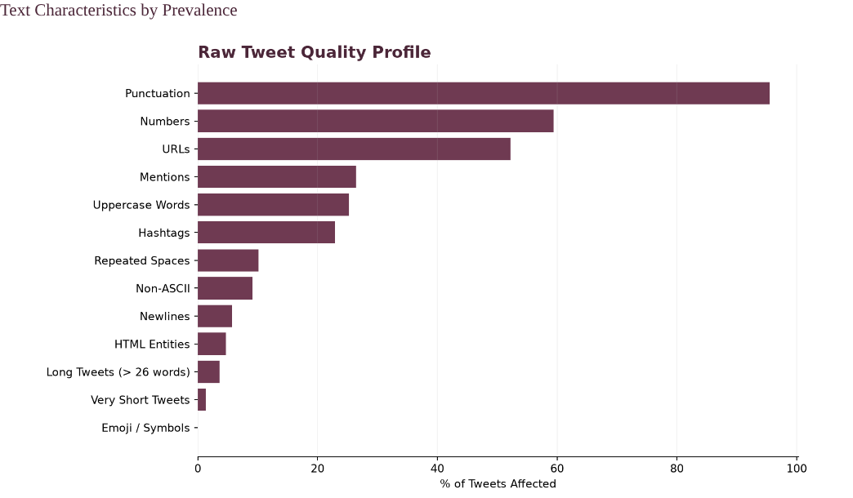
TASK 2 · DATA PREPARATION
Text Preprocessing Pipeline
▪ Noise audit: URLs 52.2%, mentions 26.4%, hashtags 22.9%, HTML entities 4.7%
▪ Cleaning: 98.8% of tweets normalised (HTML decoded, lower-cased)
▪ Removed: URLs and @mentions; hashtag symbol dropped but word kept
▪ Counts kept: URL, mention and uppercase counts retained as features
▪ Tokenisation: 105,703 tokens, 14,969 unique, 13.9 per tweet
▪ Stopwords: 36.9% of tokens removed (38,958 tokens)
▪ Negations kept: 681 negations (no, not, never) preserved to protect meaning
▪ Lemmatisation: vocabulary cut 13.2% (14,698 to 12,761), e.g. killed to kill
▪ Missing values: filled with "no keyword" / "no location"; no rows dropped
▪ Character audit: all 7,613 tweets ASCII-only; no encoding problems
▪ Hashtags: 3,330 occurrences in 22.9% of tweets; words kept for context
▪ Numbers: present in 59.4% of tweets; preserved initially
▪ Final text: 7,609 usable texts (99.95%), 8.8 tokens on average
Output: raw tweet quality profile (% of tweets affected)
KEY TAKEAWAY
Cleaning removes noise but keeps meaning: negations and hashtag words stay, and original text is preserved for later features.
Disaster Tweet Classification · NLP & Machine Learning
5

Slide 6
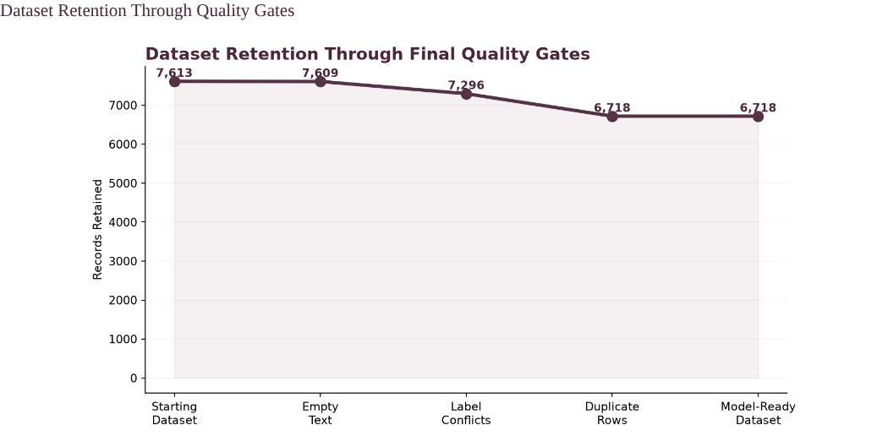
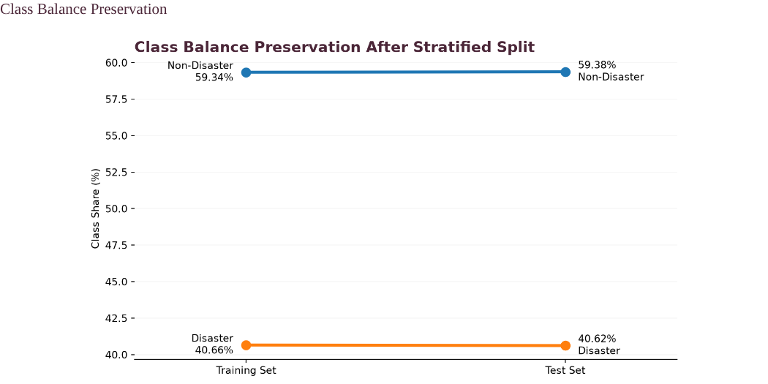
TASK 2–3 · PREPARATION AND SPLITTING
Final Dataset & Leakage-Safe Split
Output: dataset retention through quality gates
Output: class balance after stratified split
▪ Exact duplicates: 1,161 records in 355 duplicate groups
▪ Near-duplicates: 253 highly similar record pairs identified
▪ Label conflicts: 126 records with the same text but different labels removed
▪ Retention: 7,613 to 6,718 records (88.24%)
▪ Readiness: 7/7 final quality checks passed
▪ Audit trail: original text kept beside processed text
▪ Quality gates: empty text, label conflicts, duplicate rows, final dataset
▪ Split: 5,374 training and 1,344 test tweets (80/20)
▪ Stratified: train 59.34% / 40.66%, test 59.38% / 40.62% (gap 0.034%)
▪ Text overlap: zero identical tweets between train and test
▪ Order of work: split first, then fit TF-IDF, scalers and models
▪ Test set role: locked until the final model is chosen
▪ Target encoding: binary labels validated; none missing
▪ Reproducibility: fixed random state (42) for the split
KEY TAKEAWAY
Removing conflicting duplicates and splitting before any fitting keeps the final test score unbiased.
Disaster Tweet Classification · NLP & Machine Learning
6

Slide 7
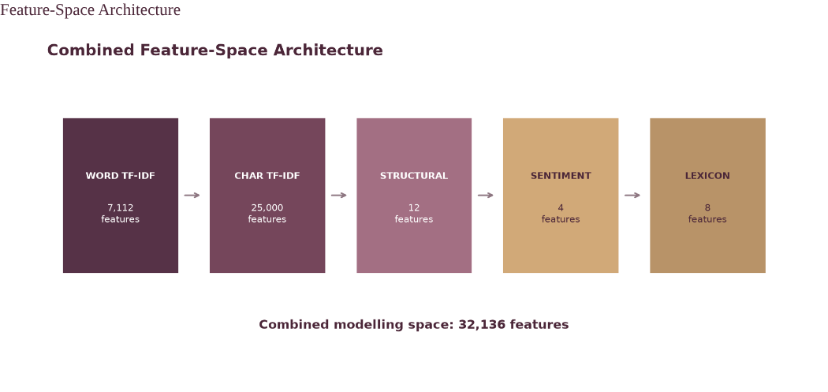
TASK 3 · FEATURE ENGINEERING
Feature Engineering
▪ Word TF-IDF: 7,112 features (1–2 grams); top disaster cues kill, flood, storm, fire, bomb
▪ Non-disaster cues: like, love, just, scream, bag
▪ Character TF-IDF: 25,000 features (3–5 grams); handles typos, slang and word stems
▪ Structural (12): URL presence 1.6x and digit counts 1.7x higher in disaster tweets
▪ Social signals: hashtags 1.4x more common; question marks 0.4x as common
▪ Sentiment (4): VADER scores; disaster tweets more negative (compound -0.25 vs -0.05)
▪ Domain lexicon (8): disaster terms 3.8x and casualty terms 2.7x more frequent
▪ GloVe embeddings: glove-twitter-25 mean vectors; 8,996 of 11,138 training words matched (80.77%), 89.04% frequency-weighted coverage
▪ OOV handling: 2,142 unseen words ignored; all-OOV tweets get a 25-d zero vector; 12/12 requirements closed
▪ Leakage control: all vectorisers fitted on training data only
▪ Combined: 5 feature blocks, 32,136 columns, 7/7 validation checks passed
Output: combined feature space of 32,136 features (99.57% sparse)
KEY TAKEAWAY
Combining statistical, structural, emotional and domain signals gives the classifier richer evidence than words alone.
Disaster Tweet Classification · NLP & Machine Learning
7

Slide 8
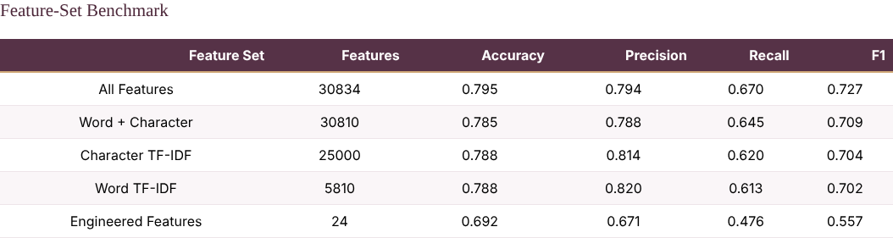
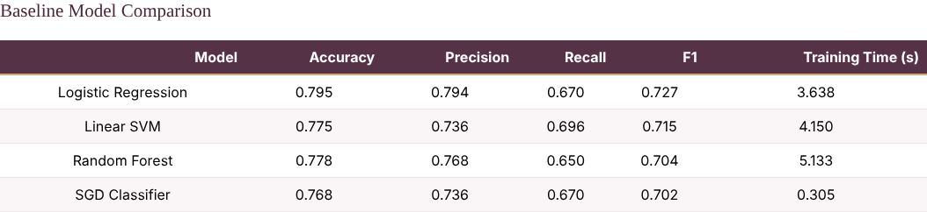
TASK 3–4 · MODEL SELECTION
Feature Ablation & Baseline Models
Output: feature-set ablation (development data only)
Output: baseline model comparison
▪ Method: each feature block tested alone and combined on a development split
▪ Best set: All Features, F1 0.727, recall 0.670, precision 0.794
▪ Word + Character: F1 0.709; Character alone 0.704; Word alone 0.702
▪ Engineered alone: F1 0.557, weak alone but useful in combination
▪ Feature count: 30,834 for All Features vs 5,810 for word TF-IDF
▪ Fair test: protected test set not used
▪ Metrics reported: accuracy, precision, recall and F1
▪ Winner: Logistic Regression: F1 0.727, accuracy 0.795, precision 0.794
▪ Linear SVM: F1 0.715 with the highest recall (0.696)
▪ Random Forest: F1 0.704, accuracy 0.778, slowest baseline (5.1 s)
▪ SGD Classifier: F1 0.702, fastest to train (0.3 s)
▪ Margin: 1.18 points of F1 over the runner-up
▪ Next step: cross-validation and tuning before the final choice
▪ Selection logic: highest F1 with balanced precision and recall
KEY TAKEAWAY
Every feature block adds value, and a simple linear model beats more complex ones on this sparse text data.
Disaster Tweet Classification · NLP & Machine Learning
8

Slide 9
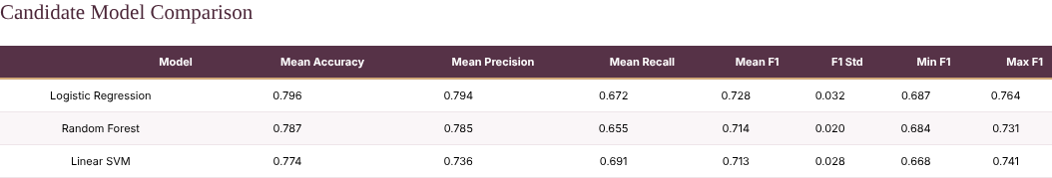
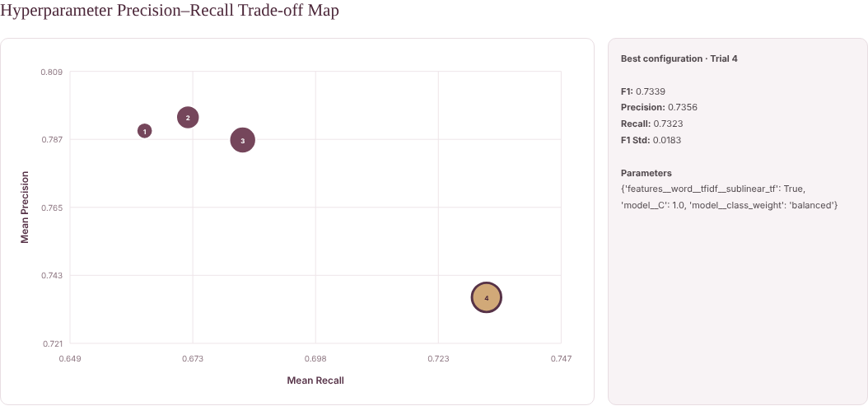
TASK 4 · MODEL SELECTION
Cross-Validation & Hyperparameter Tuning
Output: 5-fold stratified cross-validation
Output: precision–recall trade-off across tuning trials
▪ Cross-validation: 5 stratified folds on training data only
▪ Logistic Regression: mean F1 0.728, std 0.032, fold range 0.687–0.764
▪ Random Forest: mean F1 0.714, std 0.020 (most consistent)
▪ Linear SVM: mean F1 0.713, highest mean recall (0.691)
▪ Shortlist: top two models by CV F1 were tuned
▪ Metrics per fold: accuracy, precision, recall and F1
▪ Best Logistic setting: C = 1.0, balanced class weights, sublinear TF
▪ Tuned Logistic: F1 0.734, recall 0.732, precision 0.736
▪ Tuned Random Forest: F1 0.723; 300 trees, 581 s vs 131 s runtime
▪ Locked model: Logistic Regression, validation F1 0.743, recall 0.746
▪ Why balanced weights: trade a little precision for higher recall
▪ Discipline: all tuning performed on training data only
▪ Runtime: 5-fold comparison of three models took 1.92 minutes
KEY TAKEAWAY
The final model is chosen on cross-validation evidence only, then locked before the test set is opened.
Disaster Tweet Classification · NLP & Machine Learning
9

Slide 10
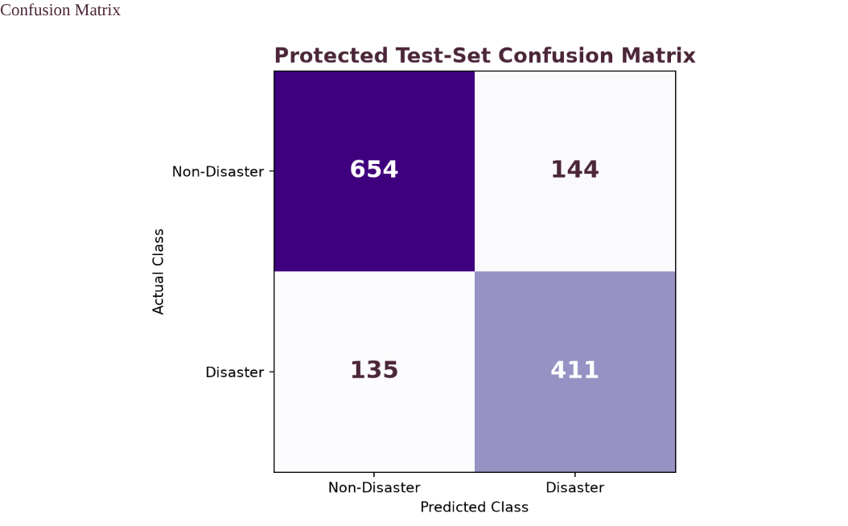
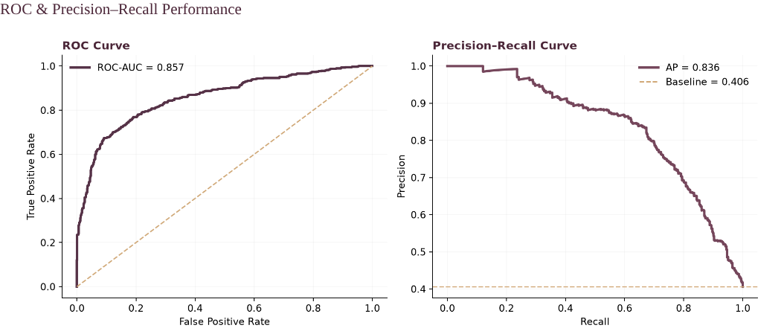
TASK 5 · MODEL EVALUATION
Test Performance, Ranking & Threshold
Output: confusion matrix, protected test set
Output: ROC and precision–recall curves
▪ Test set: 1,344 unseen tweets, stratified like training
▪ Accuracy / F1: 0.792 and 0.747; specificity 0.820
▪ Precision: 0.741, so 74% of alerts are real disasters
▪ Recall: 0.753, so about 75 of 100 disasters are caught
▪ Counts: 411 TP, 654 TN, 144 FP, 135 FN
▪ Error mix: 51.6% false positives, 48.4% false negatives
▪ F1 across stages: CV 0.728, validation 0.743, test 0.747 (training 0.878, gap monitored)
▪ ROC-AUC 0.857: strong separation of the two classes
▪ Average precision 0.836: about 2x the 0.406 chance baseline
▪ Default threshold 0.50: F1 0.747, 135 FN, 144 FP
▪ Diagnostic F1-max 0.476: F1 0.751, 126 FN, 153 FP; reference only
▪ Trade-off: lower thresholds find more disasters but raise false alerts
▪ Decision: threshold kept at 0.50; not tuned on test data
KEY TAKEAWAY
Held-out scores agree across CV, validation and test, and the threshold choice stays an operational decision, not a test-set tweak.
Disaster Tweet Classification · NLP & Machine Learning
10

Slide 11
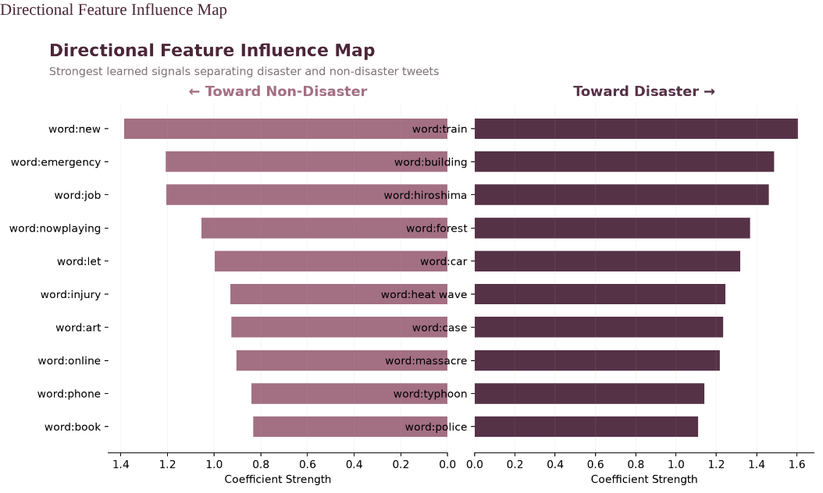
TASK 5 · MODEL EVALUATION
Explainability & Error Analysis
▪ Method: coefficients of the linear model across 32,136 features
▪ Toward disaster: train, building, hiroshima, forest, car, heat wave, massacre, typhoon, police
▪ Toward non-disaster: new, emergency, job, nowplaying, injury, book, online
▪ Dominant family: character n-grams (25,000 features) vs 7,112 word features
▪ Errors: 279 in total (20.76%): 144 false positives and 135 false negatives
▪ False positives: figurative or news-style use, e.g. "time bomb", "apocalyptic earthquake"
▪ False negatives: slang or indirect wording, e.g. "blaze", "destroy"
▪ Score pattern: false positives cluster just above 0.5; false negatives below
▪ Confidence of errors: mostly borderline, not strongly committed
▪ Error mix: 51.6% false positives (144) and 48.4% false negatives (135)
▪ Transparency: linear coefficients give auditable reasons for each prediction
Output: strongest learned features by direction
KEY TAKEAWAY
The model learns sensible disaster vocabulary; its mistakes are mostly genuinely ambiguous tweets that even humans could dispute.
Disaster Tweet Classification · NLP & Machine Learning
11

Slide 12
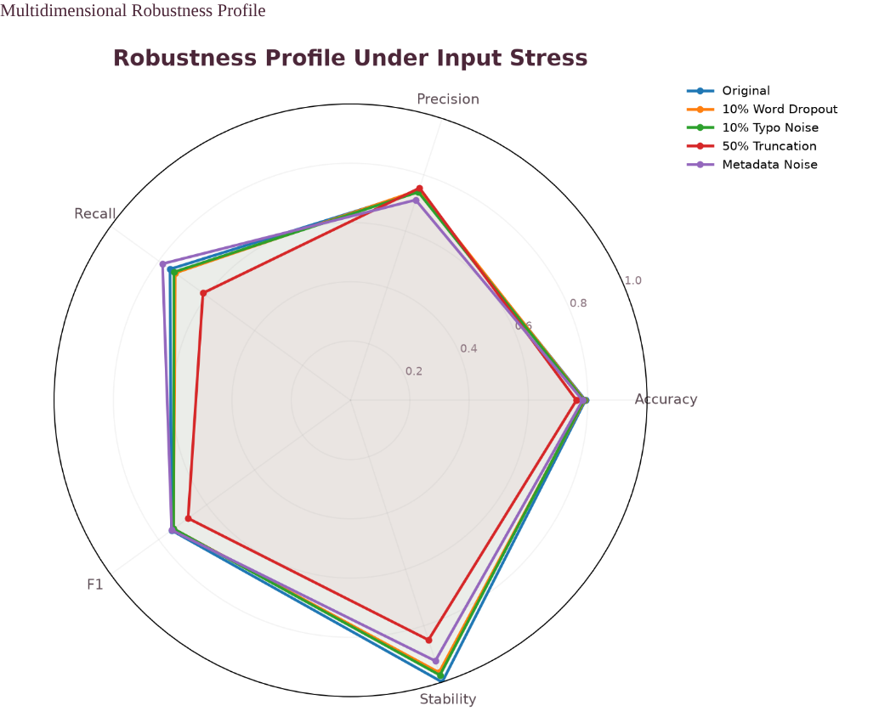
TASK 6 · MODEL VALIDATION
Robustness, Subgroups & Human Review
▪ Stress tests: word dropout, typo noise, truncation and metadata noise
▪ Robustness: 97.07% of baseline F1 retained on average
▪ Typical results: F1 0.738 with word dropout and typo noise; 0.746 with metadata noise
▪ Prediction stability: 92.5–97.5% of predictions unchanged under these tests
▪ Subgroups: 9 slices tested (length, hashtag, mention, URL)
▪ Slice F1: ranges 0.591–0.823; URL tweets 0.823, hashtag tweets 0.812, short tweets 0.743
▪ Confidence: median certainty 0.632 for correct vs 0.311 for wrong predictions
▪ Accuracy by confidence: 0.944 at very high certainty, 0.557 at very low
▪ High-confidence errors: only 16 of 279 errors
▪ Human review: certainty ≤ 0.60 sent to analysts (52.4% of tweets) captures 77.1% of errors
▪ Decision: "Candidate with Monitoring" (validation index 0.840)
Output: robustness profile under input stress
KEY TAKEAWAY
The model is stable under noise, and uncertainty scores give a practical way to route risky tweets to human reviewers.
Disaster Tweet Classification · NLP & Machine Learning
12

Slide 13
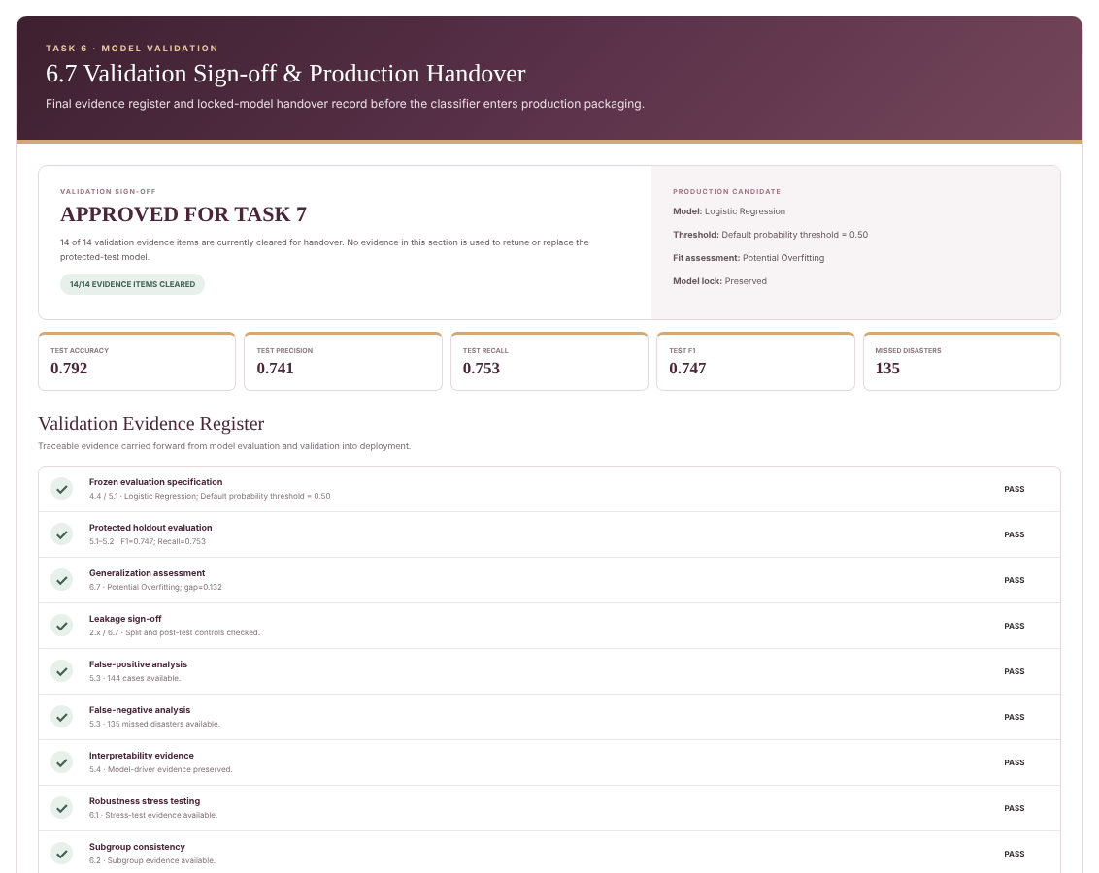
TASK 6 · MODEL VALIDATION
Validation Sign-off & Monitoring Plan
▪ Evidence register: 14 of 14 validation evidence items cleared for handover
▪ Generalisation ledger: F1 training 0.878, CV 0.728, validation 0.743, protected test 0.747
▪ Leakage sign-off: record-ID overlap 0; exact text overlap 0; 5,374 + 1,344 = 6,718 rows reconciled
▪ Model lock: no post-test retraining, tuning or threshold change; any change needs a new cycle
▪ Scorecard: diagnostic validation index 0.840; verdict "Candidate with Monitoring"
▪ Embedding closure: 12/12 pre-trained embedding requirements evidenced
▪ Monitor 1: recall and missed-event patterns (135 false negatives in test)
▪ Monitor 2: alert burden and precision (144 false positives)
▪ Monitor 3: performance under noisy text and across tweet formats
▪ Monitor 4: high-confidence errors (16 in test)
▪ Review capacity: thresholds 0.2 to 0.8 route 15.6% to 78.9% of tweets to review and capture 25% to 92% of missed disasters
Output: validation sign-off and production handover
KEY TAKEAWAY
Validation closes with a traceable evidence trail, a locked model and a clear monitoring plan for production.
Disaster Tweet Classification · NLP & Machine Learning
13

Slide 14
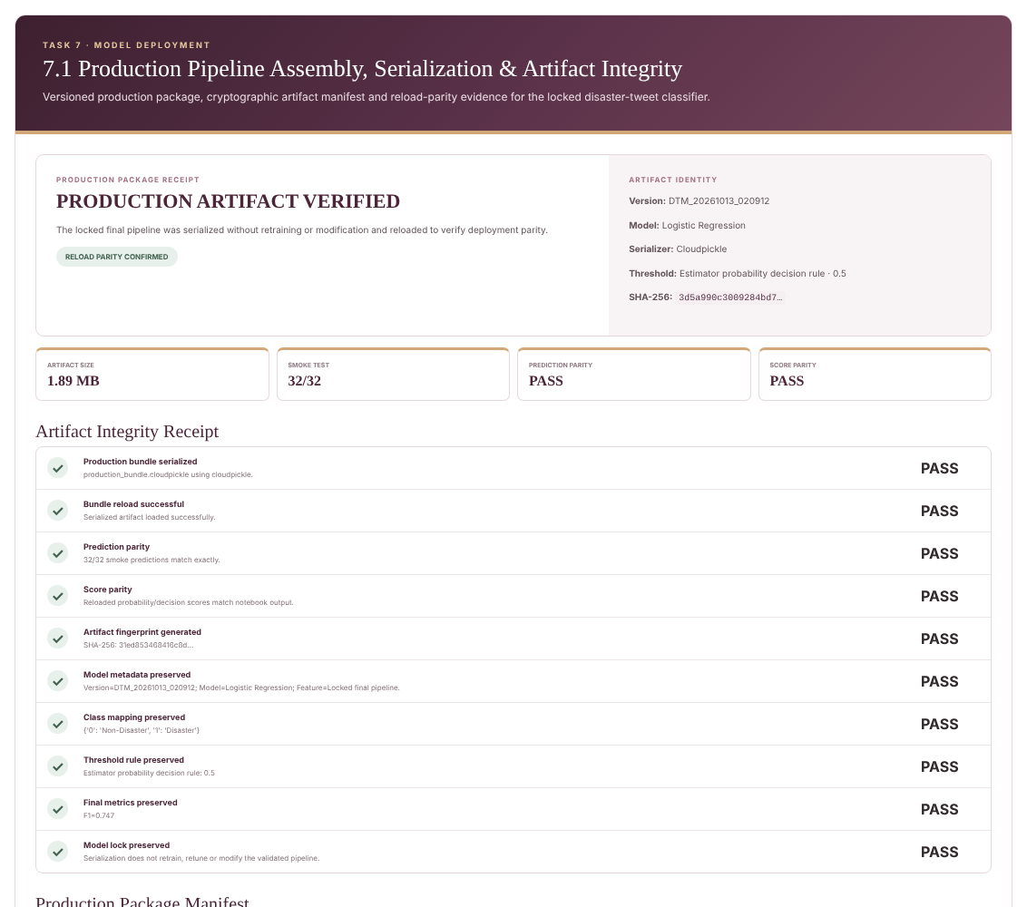
TASK 7 · MODEL DEPLOYMENT
Production Packaging & Flask API
▪ Artifact: locked pipeline serialised with cloudpickle; 1.89 MB; SHA-256 fingerprint
▪ Reload parity: 32/32 smoke predictions and scores identical after reload
▪ Metadata kept: version DTM_20261013_020912, class mapping, threshold 0.5, F1 0.747
▪ Inference contract: predict_tweet(text) reproduces training-time preprocessing; 0 mismatches vs notebook
▪ Preprocessing: frozen mappings; no NLTK needed at deployment time
▪ Endpoints: GET /, GET /health, POST /predict
▪ Response: label, prediction, probability score, status and model version
▪ HTTP tests: 14/14 passed: 200, 400, 404, 413 and 415 cases covered
▪ Latency: health check 0.46 ms; predictions about 40–185 ms
▪ Fresh-process test: API verified outside the notebook process
▪ Safeguards: input and body size limits; raw tweet text not logged
Output: production package receipt and artifact integrity
KEY TAKEAWAY
The model is packaged without retraining and served through a tested, versioned API with a stable response contract.
Disaster Tweet Classification · NLP & Machine Learning
14

Slide 15
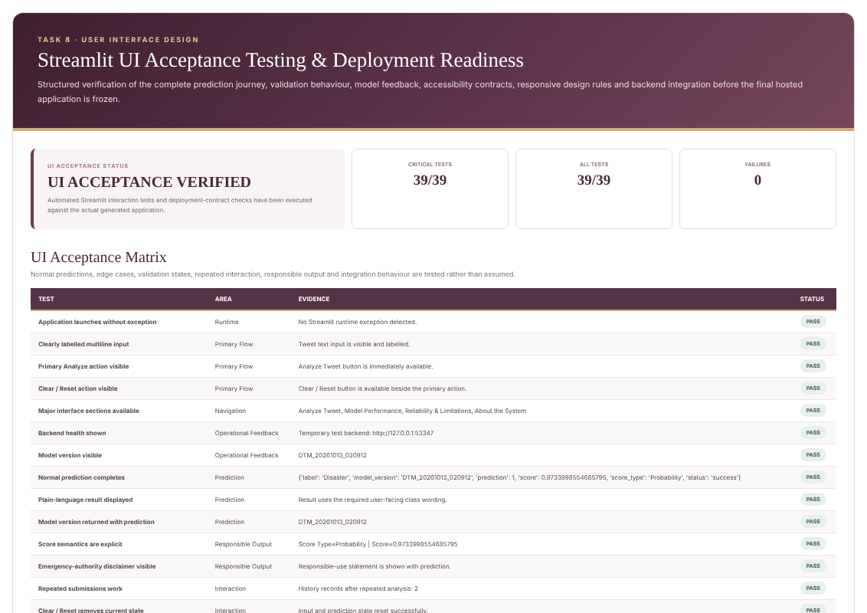
TASK 8 · USER INTERFACE
Streamlit Application & UI Acceptance
▪ Design: simple analyse-and-review workflow with 16 UI features
▪ Sections: Analyze Tweet, Model Performance, Reliability & Limitations, About the System
▪ Prediction view: plain-language label, probability score and model version
▪ Input experience: multi-line box, live character counter, Clear / Reset, 1,000-character limit
▪ Validation: empty, whitespace-only and over-length input rejected with clear messages
▪ Resilience: backend health check; text preserved if the service is unavailable
▪ Responsible use: emergency-authority disclaimer; scores not presented as certainty
▪ Accessibility: labelled keyboard-accessible controls, visible focus, responsive layout
▪ History: repeated submissions tracked in session
▪ Running it: start the Flask backend, then run streamlit_app.py; the app checks /health and calls /predict
▪ Testing: 39/39 automated acceptance tests passed
Output: Streamlit UI acceptance testing (39/39 passed)
KEY TAKEAWAY
The interface turns the API into an accessible, responsibly worded tool that analysts can use without technical knowledge.
Disaster Tweet Classification · NLP & Machine Learning
15

Slide 16
SUMMARY
Final Integration & Conclusion
Key Results
Delivery & Governance
▪ Logistic Regression on 32,136 combined features
▪ Test F1 0.747, recall 0.753, precision 0.741
▪ ROC-AUC 0.857; average precision 0.836
▪ 97% of F1 kept under noisy text
▪ Leakage-safe split with a locked test set
▪ Flask API and Streamlit UI delivered and tested
▪ All five feature blocks combined (development F1 0.727)
▪ Final setting: C = 1.0 with balanced class weights
▪ Reproducibility: 6/6 checks, fixed seed 42
▪ Model card and production metadata documented
▪ README and dependency file finalised
▪ Critical evidence 14/14 artifacts located
▪ Submission package of 103 files, SHA-256 verified (102/102)
▪ Compressed archive of 18.66 MB
▪ Validation evidence: 14/14 items cleared
▪ Notebook and API predictions match 100%
▪ HTTP tests 14/14; UI tests 39/39
The model is a reliable decision-support tool for disaster monitoring: strong on unseen data, robust to noisy text, and well suited to support analysts with human review.
Disaster Tweet Classification · NLP & Machine Learning
16

Slide 17
Thank You
Questions and discussion are welcome
PROJECT AT A GLANCE
Logistic Regression
F1 0.747
ROC-AUC 0.857
API + Web App
Final locked model
Unseen test data
Ranking quality
Flask and Streamlit
Disaster Tweet Classification
Prepared by Riya · NLP & Machine Learning

