Slide 1
Predictions of Loan Defaulter - A Data Science Perspective
Riya Gori
B1
1911079

Slide 2
Paper by:
P. Maheswari
CH. V. Narayana

Slide 3

Problem
With the progress of technology and implementation of Data Science in banking, changes the face of banking industry.
Most of the banking, financial sectors and social lending platforms are actively investing on lending.
But financial institutions might face huge capital loss if they approved the loan without having any prior assessment of default risk.
Financial institutions always need a more accurate predictive system for various purposes.

Slide 4

Purpose of this paper
This paper classifies that, the customer will be defaulter or not, by performing data science process
Predicting loan defaulters is a crucial task for the banking industry especially in such times when people are most vulnerable to not paying back their loans. Institutions can’t bear such huge losses and hence there is a requirement for a prediction system of loan defaulter.

Slide 5
Literature review:
(EDA)
Decision Tree Induction Algorithm
clustering mechanism
Naive Bayesian classifier

Slide 6
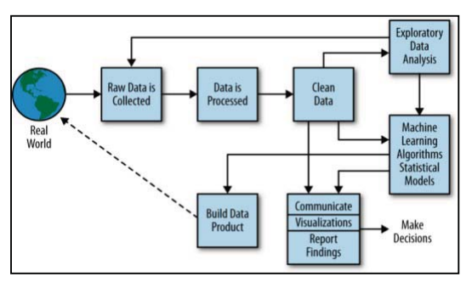
PROPOSED METHODOLOGY
-> Business Understanding
-> Data Understanding
-> Data Preparation
-> Exploratory Data Analysis (EDA)
-> Data Modeling
-> Model Evaluation
-> Model Deployment

Slide 7
Implementation details
Dataset Collection
Data Pre-processing
Feature Engineering and Data Splitting
Model Building and Performance Metrics

Slide 8
Let’s go over the steps one by one.

Slide 9
Dataset Collection
This paper uses lending club loan dataset available in Kaggle. The dataset was composed of 1.6 million records and 150 features. The entire dataset is in un-processed form consists of categorical data and descriptions.

Slide 10
Data Pre-processing
-> Exploratory data analysis (EDA) on each variable will be performed.
-> Home-Owner ship plot identifies that more home owners and renters are tend to be loan defaulter.
-> Selection of relevant features using sampling techniques like Principal Component Analysis (PCA) or Linear Discriminant Analysis (LDA).

Slide 11
Data Pre-processing
Both LDA and PCA are linear transformation techniques: LDA is a supervised whereas PCA is unsupervised – PCA ignores class labels.
Principal Component Analysis (PCA)
PCA is an unsupervised machine learning method that is used for dimensionality reduction. The main idea of principal component analysis (PCA) is to reduce the dimensionality of a data set consisting of many variables correlated with each other, either heavily or lightly, while retaining the variation present in the dataset, up to the maximum extent.

Slide 12
Data Pre-processing
Linear Discriminant Analysis (LDA)
LDA is a supervised machine learning method that is used to separate two groups/classes. The main idea of linear discriminant analysis(LDA) is to maximize the separability between the two groups so that we can make the best decision to classify them. LDA is like PCA which helps in dimensionality reduction, but it focuses on maximizing the separability among known categories by creating a new linear axis and projecting the data points on that axis.
LDA doesn’t work on finding the principal component, it basically looks at what type of point/features/subspace gives more discrimination to separate the data.

Slide 13
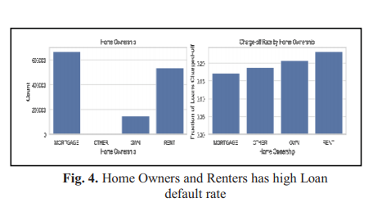

Slide 14
Feature Engineering and Data Splitting
Feature Engineering involves feature scaling and feature selection. Through Machine learning pipelines feature engineering had performed using normalization and standardization techniques
14

Slide 15
Model Building and Performance Metrics
Dataset splitting is performed based on issue date of loans, considering earliest date issued loans. This paper worked on large amount of records, through GridSearchCV technique built the model instead of default algorithm process.
Logistic Regression with Stochastic Gradient Descent (SGD):
Random Forest:
K-Nearest Neighbor (KNN):
15
15

Slide 16
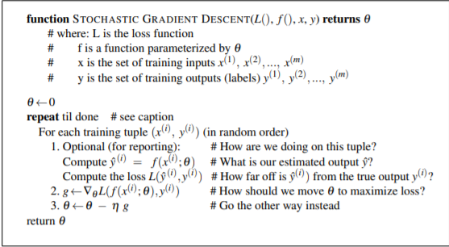
Stochastic Gradient Descent (SGD) is a simple yet very efficient approach to fitting linear classifiers and regressors under convex loss functions such as (linear) Support Vector Machines and Logistic Regression.
16
16

Slide 17
Random Forest: Random Forest is an ensemble classification technique. From the previous studies random forest works better than logistic regression and efficient for processing large datasets. In this work model built on training dataset without standardization which results little low accuracy but classification metrics results similar to logistic regression
17
17

Slide 18
The KNN algorithm is used to solve both classification and regression problems. This algorithm requires feature-scaling. The algorithm results same as logistic regression but the main drawback is, it takes more processing time for lagers datasets.
18
18

Slide 19
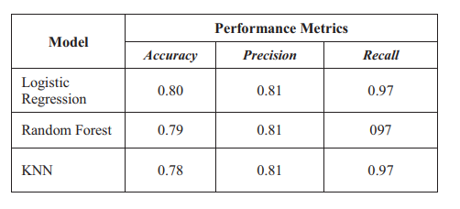
Experimental results
The overall performance of the models that are tabulated:
19
19

Slide 20
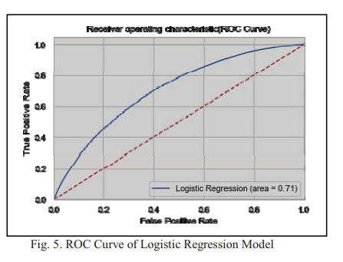

Slide 21
Strategy for implementation:
Data set collection: Data set fetched from Kaggle.
Pre-processing will be done using EDA.
Data modeling will be done by Using the 3 methods: logistic, KNN and random forest and compare the results accordingly.
Fetch the accuracy, precision and recall for the three methods.

Slide 22
Conclusion:
This paper discussed how data science can impact the banking sector to improve their analysis of identifying risk by preprocessing the historical data of customers and building the model using machine learning techniques.
Few observations made while performing EDA,
• Even income source verified sanctioned loans have higher probability of loan default.
• From the home ownership feature, it is identified that we cannot consider the own home ownership as highest priority to approve a loan.

Slide 23
Bibiliography:
[1] M. S. Sivasree, “Loan Credibility Prediction System Based on Decision Tree Algorithm,” Int. J. Eng. Res. Technol., 2015.
[2] Aida Krichene,” Using a naive Bayesian classifier methodology for loan risk assessment,” Journal of Economics, Finance and Administrative Science, 2017
[3] Bagherpour, “Predicting mortgage loan default with machine learning methods,” Univ. California / Riverside, 2017.
[4] Namvar, M. Siami, F. Rabhi, and M. Naderpour, “Credit risk prediction in an imbalanced social lending environment,” arXiv Prepr. arXiv1805.00801, 2018
[5] Goyal and R. Kaur, “Loan Prediction Using Ensemble Technique.,” Int. J. Adv. Res. Comput. Commun. Eng., vol. 5, no. 3, pp. 523–526, 2016. [6] X.Francis Jency, V.P.Sumathi, Janani Shiva Sri , “An Exploratory Data Analysis for Loan Prediction Based on Nature of the Clients”

Slide 24
thanks!

