Slide 1


SQL Portfolio Project:
Shark Tank Data Analysis
RIYA JADHAV

Slide 2
DESCRIPTION
To analyze business investment data from various episodes to gain insights into entrepreneurial trends, investment patterns, and the success rates of different business sectors.

Slide 3
Database Description
The dataset consists of business investment data collected from various episodes of an entrepreneurial show. Each row in the dataset represents a business pitch, including details about the business, the deal offered, and the investment received.

Slide 4

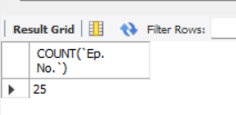
To determine the total number of episodes.

Slide 5
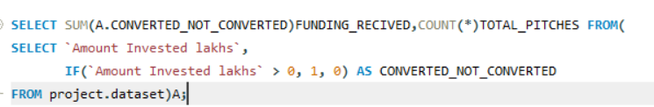
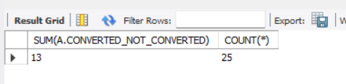
To determine the total number of pitches

Slide 6




Determine the total number of Male, Female participants

Slide 7
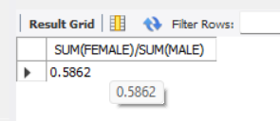
Analyze the gender ratio

Slide 8

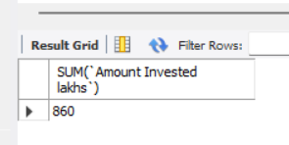
Calculate the total amount invested in all pitches

Slide 9
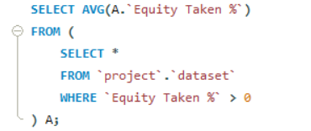
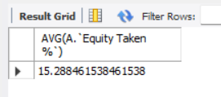
Determine the average equity percentage taken by the sharks in successful investments

Slide 10
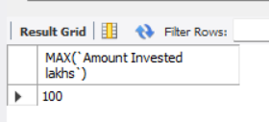
Identify the highest deal amount invested in any single pitch

Slide 11

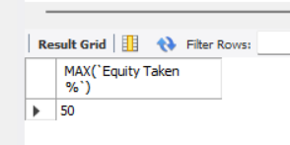
Identify the highest equity percentage taken by the sharks in any single pitch

Slide 12
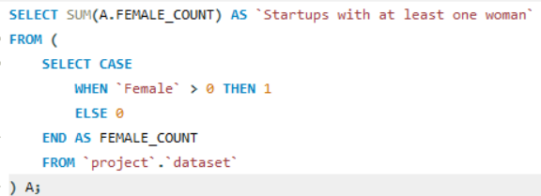
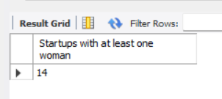
Determine the number of startups that have at least one female participant

Slide 13
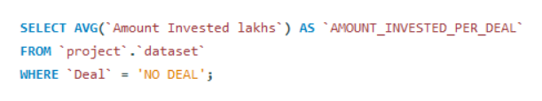
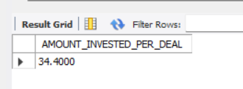
Calculate the average amount invested per deal

Slide 14
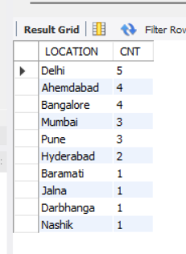
Identify the location from which the most number of teams have come in the Shark Tank dataset.

Slide 15
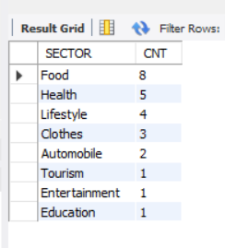
Analyze which sectors are most popular among participants.

Slide 16
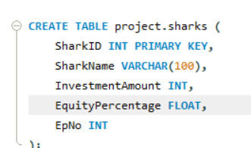
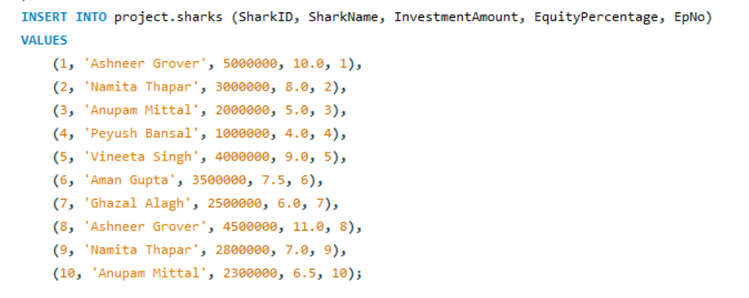
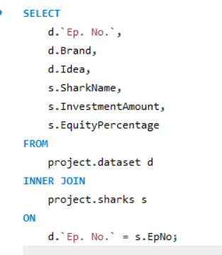
To extract detailed information about each episode, including the brands presented, ideas pitched, and the investment details from the sharks.

Slide 17
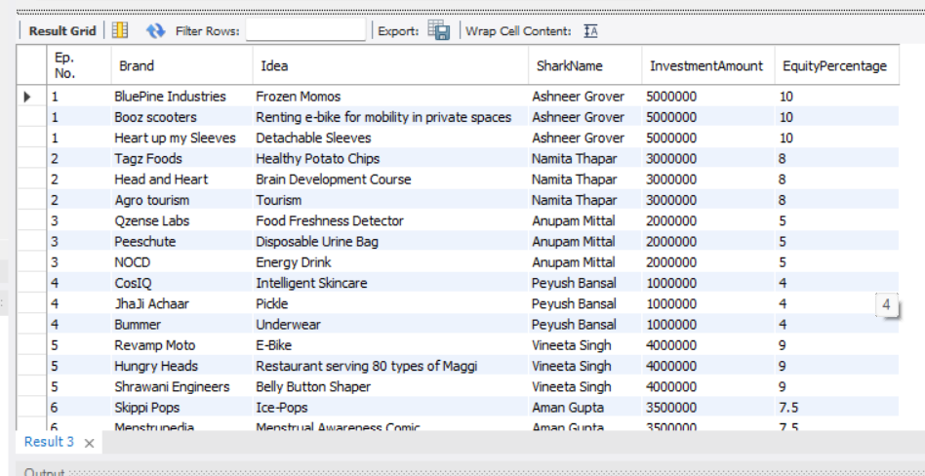
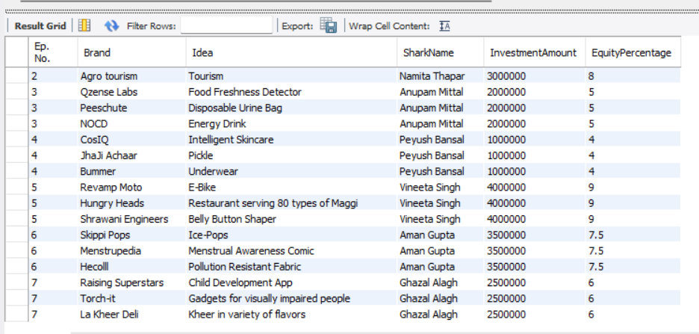

Slide 18
Provide a detailed overview of all pitches presented to the sharks, including those that did not receive any investment.
SELECT
d.`Ep. No.`,
d.Brand,
d.Idea,
s.SharkName,
s.InvestmentAmount,
s.EquityPercentage
FROM
project.dataset d
LEFT JOIN
project.sharks s
ON
d.`Ep. No.` = s.EpNo;

Slide 19
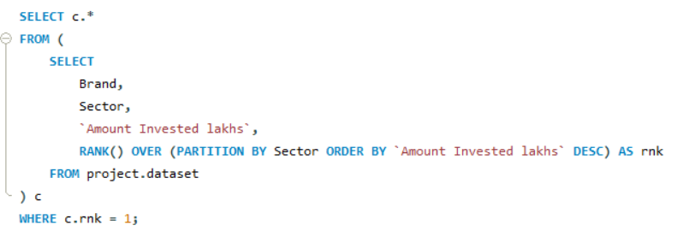
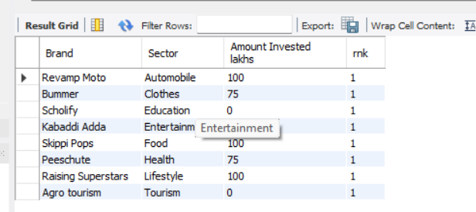
which is the startup in which the highest amount has been invested in each domain/sector

Slide 20
Thank You!

