Slide 1
IT QUARTERLY BUSINESS REVIEW — Q1 2025
IT Leadership | Board Distribution | Confidential
02 April 2025 | James Wu, CTO | David Kim, CISO | Angela Brooks, IT Director

Slide 2
Q1 2025 Executive Summary
Service performance — three SLA categories in BREACH
  • P1 SLA: 84.2% vs 99.0% — INC0001234 APAC BGP outage drove January/February breaches
  • P2 SLA: 91.7% vs 95.0% — INC0001789 DataVault API caused February breach
  • Availability: 99.71% vs 99.9% — 2h 35min APAC outage = 0.29% monthly downtime
Key achievements this quarter
  • ServiceNow Vancouver release — zero post-go-live incidents — 8,412 flows migrated
  • CMDB coverage: 68% → 78% — Phase 1 discovery patterns deployed
Investment decisions required urgently
  • GPU cluster: 98.1% peak — $220K decision required by January 24
  • SAN Primary: 9.3 months to full — $310K order needed by March 15

Slide 3
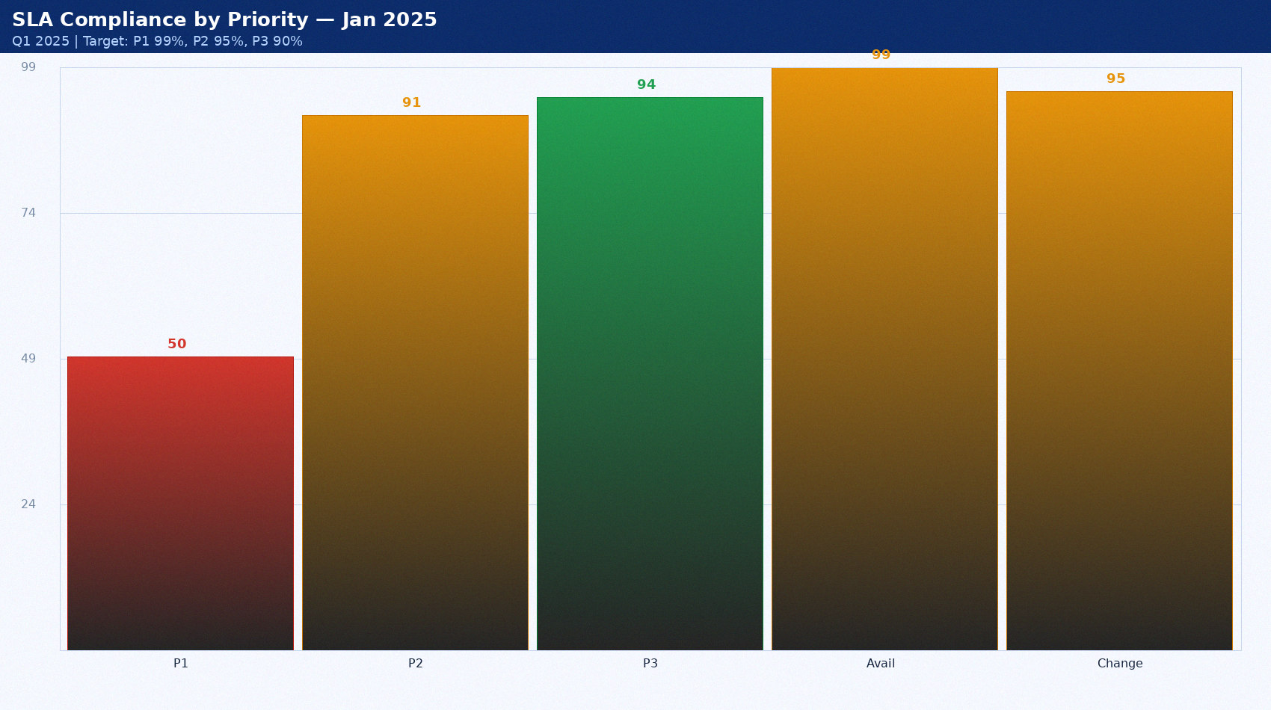
SLA Compliance by Priority — Jan 2025
Q1 2025 | Target: P1 99%, P2 95%, P3 90%

Slide 4
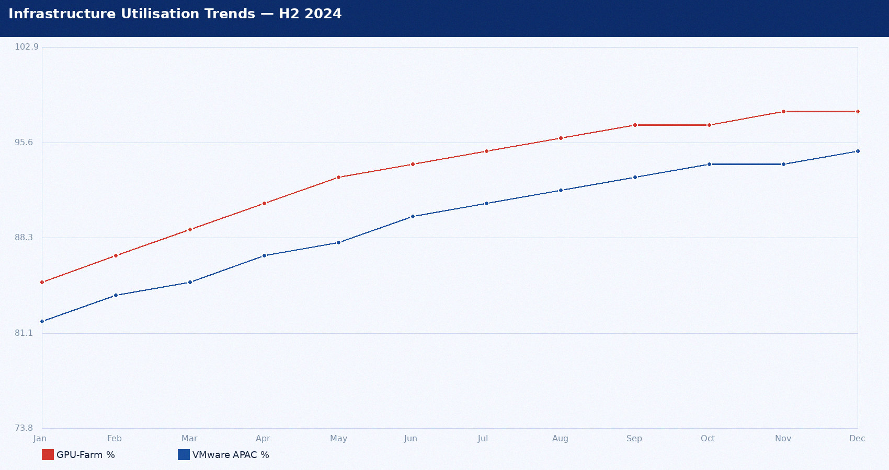
Infrastructure Utilisation Trends — H2 2024

Slide 5
Major Incidents Q1 2025
Incident | Priority | Duration | Users | Root Cause | Cost
INC0001234 | P1 Critical | 2h 35min | 847 | Ansible gate defect | $142,000
INC0001456 | P2 High | 47 min | 12 batch | Oracle RAC failover latency | $18,000
INC0001789 | P2 High | 3h 12min | 28 API | DataVault API rate limit | $22,000
INC0002011 | P3 Moderate | 8 hours | All staff | Teams storage exhausted | $5,000

Slide 6
Capacity Risk Summary
CRITICAL: GPU-Farm-01 at 98.1% peak — decision required Jan 24
  • ML training job ML-TRAIN-0047 scheduled Feb — will evict inference pods
  • Add 4x p3.8xl reserved instances — $220K/yr — board approval needed
CRITICAL: VMware-02 APAC at 94.7% CPU
  • Q2 APAC workloads will cause contention — order by Jan 31
HIGH: SAN Primary 9.3 months to full — order by Mar 15
  • 12-week lead time — $310K capex — board approval needed

Slide 7
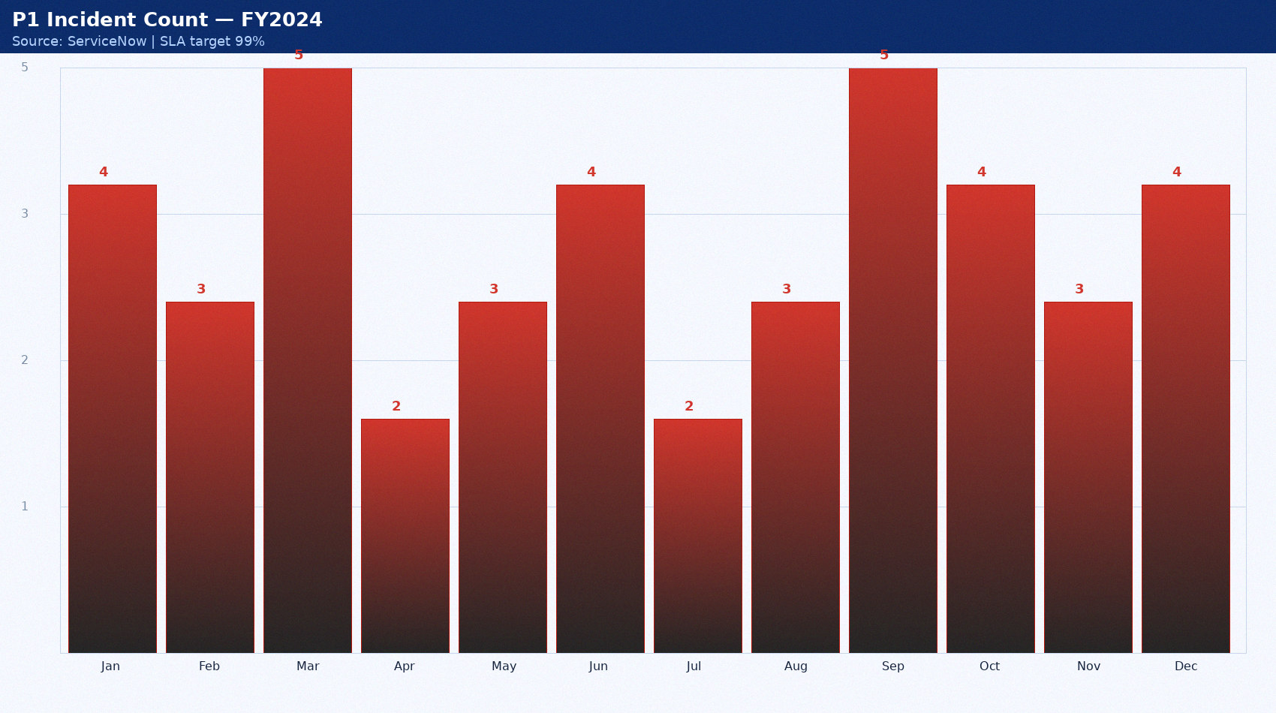
P1 Incident Count — FY2024
Source: ServiceNow | SLA target 99%

Slide 8
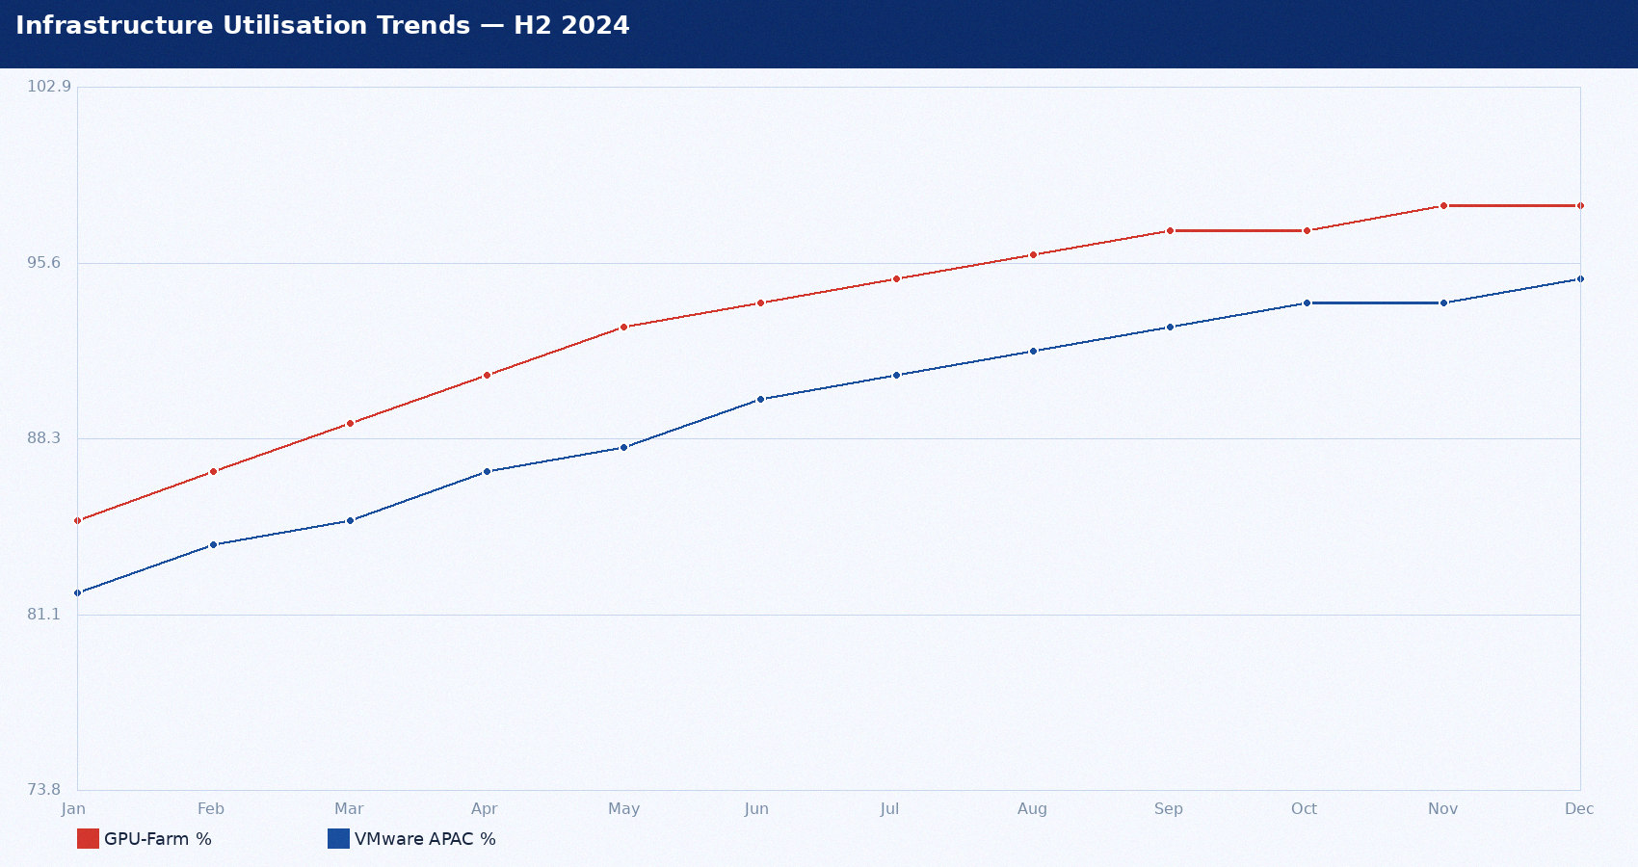
Infrastructure Utilisation Trends — H2 2024

Slide 9
Major Incidents Q1 2025
Incident | Priority | Duration | Users | Root Cause | Cost
INC0001234 | P1 Critical | 2h 35min | 847 | Ansible gate defect | $142,000
INC0001456 | P2 High | 47 min | 12 batch | Oracle RAC failover latency | $18,000
INC0001789 | P2 High | 3h 12min | 28 API | DataVault API rate limit | $22,000
INC0002011 | P3 Moderate | 8 hours | All staff | Teams storage exhausted | $5,000

Slide 10
CMDB Health Improvement Plan
Current: CI Accuracy 61.4% vs 90% target
  • Phase 1 complete: server/DB CI classes improved +9.8pp
  • Phase 2 Q2 2025: business service mapping (currently 0%)
Discovery Coverage: 78.2% vs 95% target
  • AWS Config integration live: 2,891 cloud CIs at 100% accuracy
  • Gap: NFS and SAN have 0% discovery — custom patterns needed

Slide 11
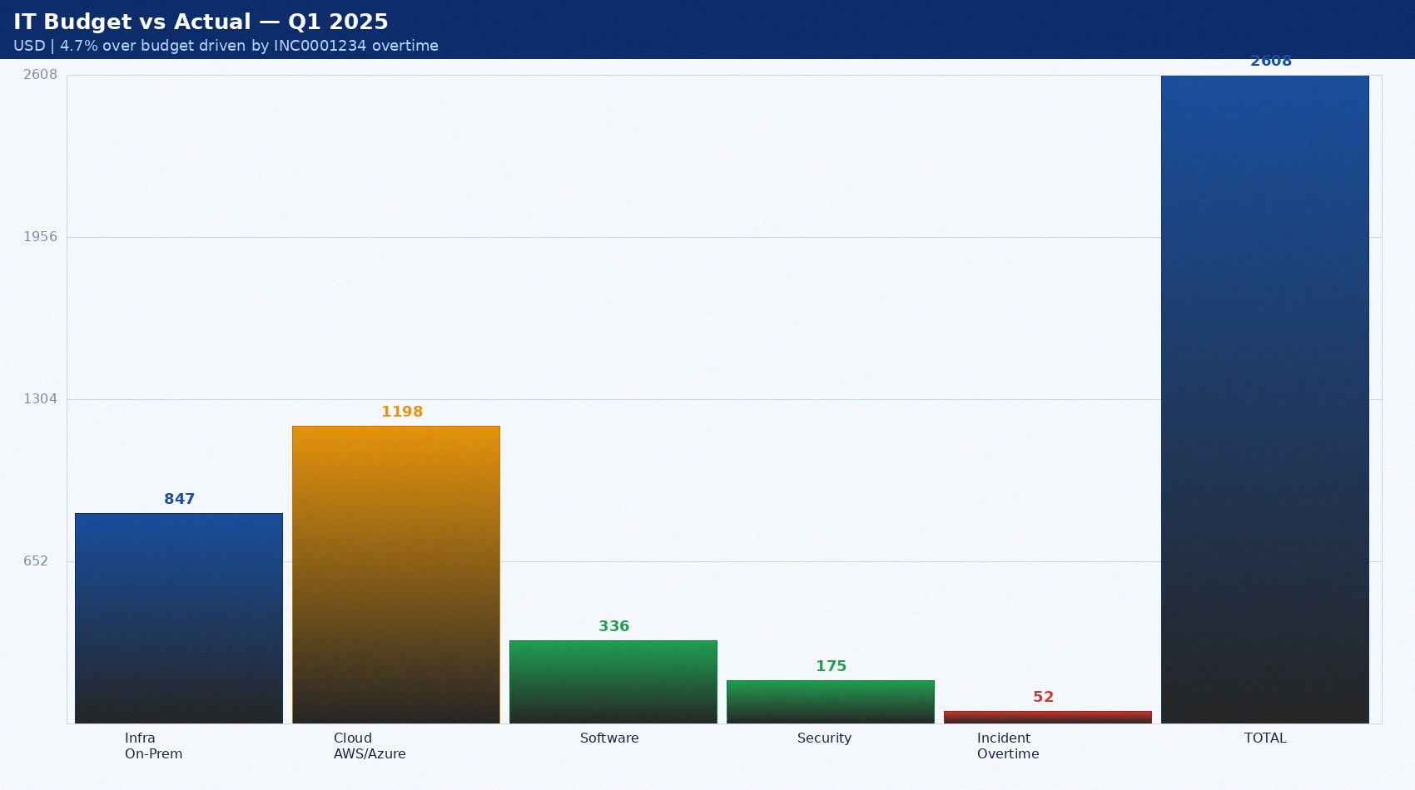
IT Budget vs Actual — Q1 2025
USD | 4.7% over budget driven by INC0001234 overtime

Slide 12
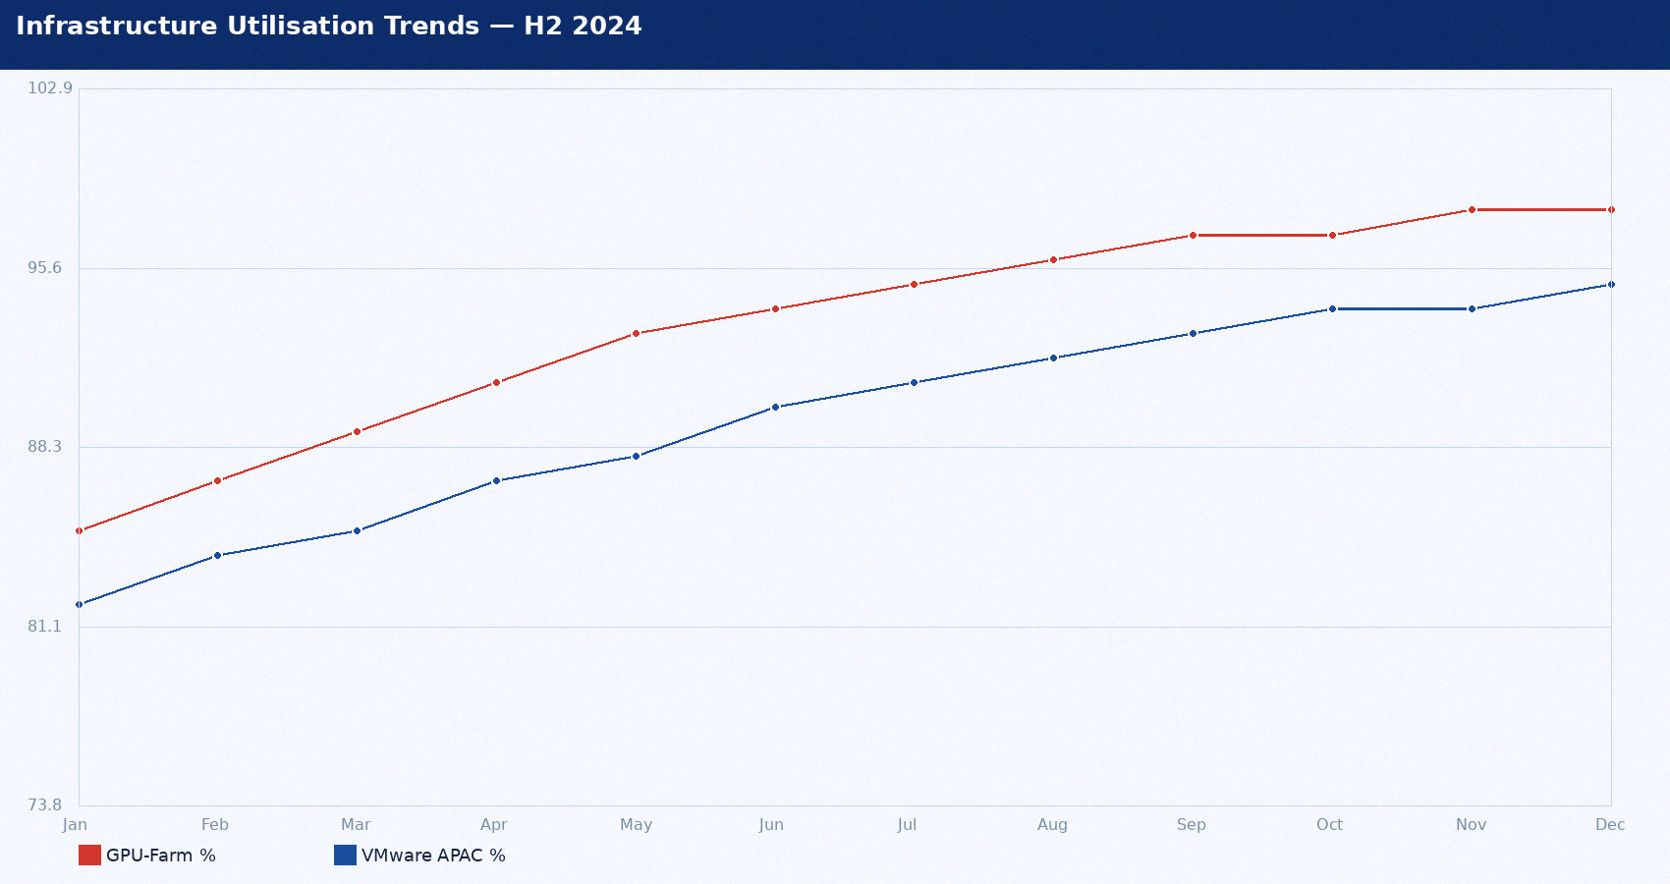
Infrastructure Utilisation Trends — H2 2024

Slide 13
Major Incidents Q1 2025
Incident | Priority | Duration | Users | Root Cause | Cost
INC0001234 | P1 Critical | 2h 35min | 847 | Ansible gate defect | $142,000
INC0001456 | P2 High | 47 min | 12 batch | Oracle RAC failover latency | $18,000
INC0001789 | P2 High | 3h 12min | 28 API | DataVault API rate limit | $22,000
INC0002011 | P3 Moderate | 8 hours | All staff | Teams storage exhausted | $5,000

Slide 14
Security and Compliance Headlines
ISO 27001: 84.0% compliance — 8 open findings
  • Lowest domain: A.15 Supplier Relationships 71.4% — DataVault review overdue
  • CF-2024-001 HIGH: 14 admin accounts without MFA — deadline April 30
SOC 2 Type II: Clean opinion — all trust service criteria effective
Patch compliance: 97.1% — above 95% policy for first time in 3 quarters
  • BREACH: ESXi 8.0 at 50% — GPU passthrough conflict — isolated
  • BREACH: WS2019 at 71.8% — 11 outstanding hosts — in progress

Slide 15
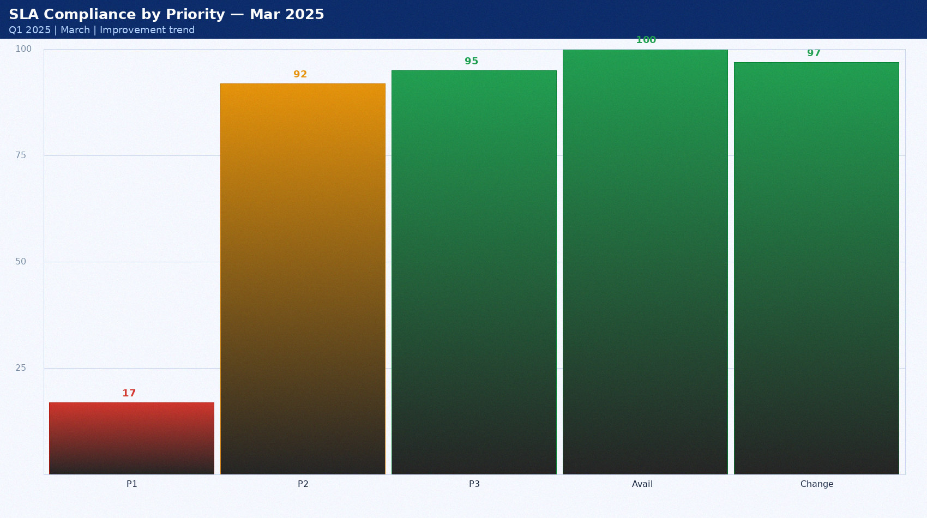
SLA Compliance by Priority — Mar 2025
Q1 2025 | March | Improvement trend

Slide 16

Infrastructure Utilisation Trends — H2 2024

Slide 17
Major Incidents Q1 2025
Incident | Priority | Duration | Users | Root Cause | Cost
INC0001234 | P1 Critical | 2h 35min | 847 | Ansible gate defect | $142,000
INC0001456 | P2 High | 47 min | 12 batch | Oracle RAC failover latency | $18,000
INC0001789 | P2 High | 3h 12min | 28 API | DataVault API rate limit | $22,000
INC0002011 | P3 Moderate | 8 hours | All staff | Teams storage exhausted | $5,000

Slide 18
Capacity Risk Summary
CRITICAL: GPU-Farm-01 at 98.1% peak — decision required Jan 24
  • ML training job ML-TRAIN-0047 scheduled Feb — will evict inference pods
  • Add 4x p3.8xl reserved instances — $220K/yr — board approval needed
CRITICAL: VMware-02 APAC at 94.7% CPU
  • Q2 APAC workloads will cause contention — order by Jan 31
HIGH: SAN Primary 9.3 months to full — order by Mar 15
  • 12-week lead time — $310K capex — board approval needed

Slide 19
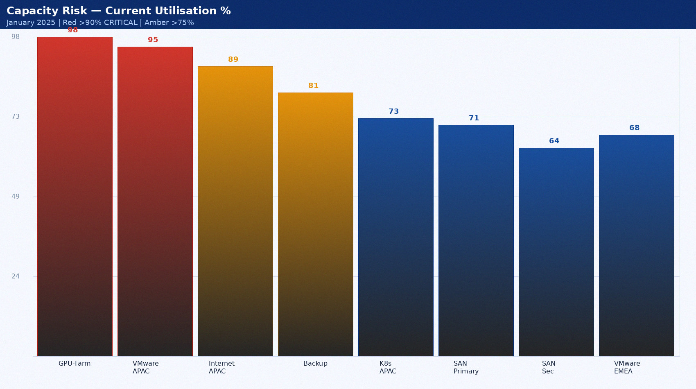
Capacity Risk — Current Utilisation %
January 2025 | Red >90% CRITICAL | Amber >75%

Slide 20
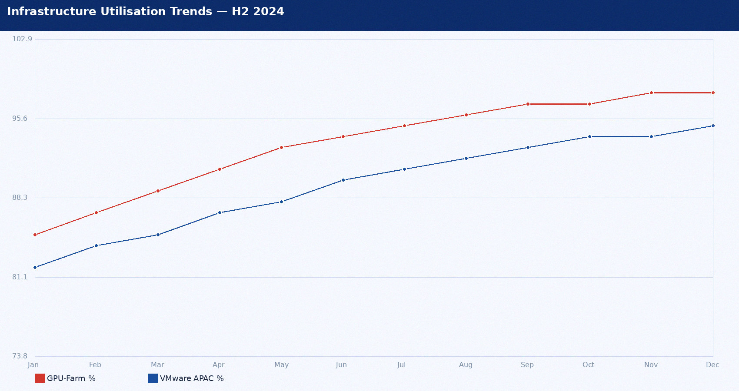
Infrastructure Utilisation Trends — H2 2024

Slide 21
Major Incidents Q1 2025
Incident | Priority | Duration | Users | Root Cause | Cost
INC0001234 | P1 Critical | 2h 35min | 847 | Ansible gate defect | $142,000
INC0001456 | P2 High | 47 min | 12 batch | Oracle RAC failover latency | $18,000
INC0001789 | P2 High | 3h 12min | 28 API | DataVault API rate limit | $22,000
INC0002011 | P3 Moderate | 8 hours | All staff | Teams storage exhausted | $5,000

Slide 22
CMDB Health Improvement Plan
Current: CI Accuracy 61.4% vs 90% target
  • Phase 1 complete: server/DB CI classes improved +9.8pp
  • Phase 2 Q2 2025: business service mapping (currently 0%)
Discovery Coverage: 78.2% vs 95% target
  • AWS Config integration live: 2,891 cloud CIs at 100% accuracy
  • Gap: NFS and SAN have 0% discovery — custom patterns needed

Slide 23

SLA Compliance by Priority — Jan 2025
Q1 2025 | Target: P1 99%, P2 95%, P3 90%

Slide 24
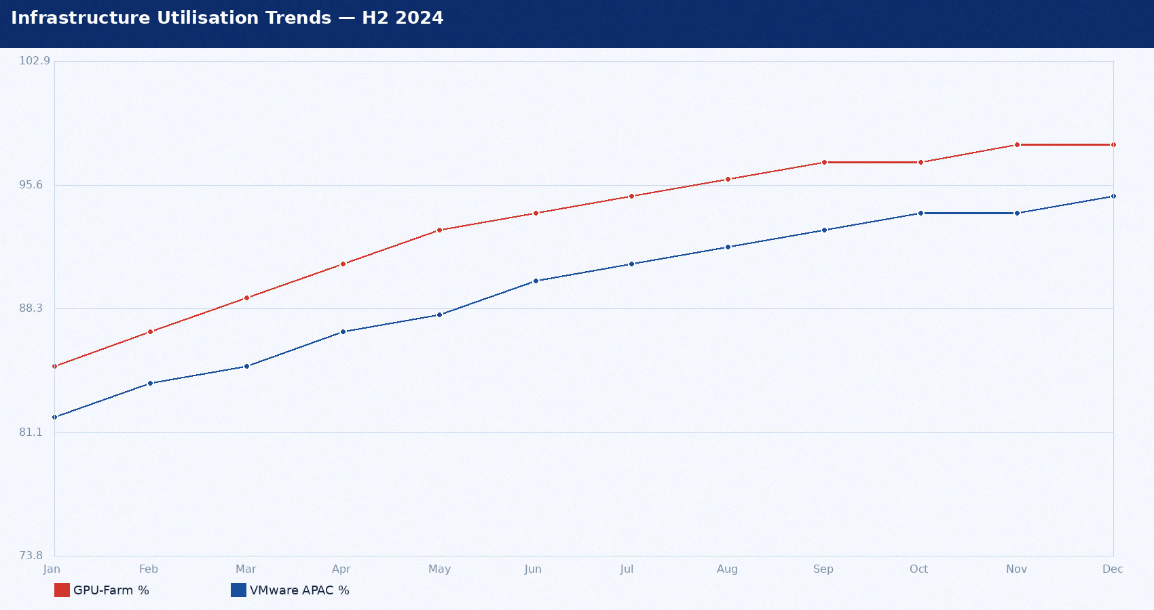
Infrastructure Utilisation Trends — H2 2024

Slide 25
Major Incidents Q1 2025
Incident | Priority | Duration | Users | Root Cause | Cost
INC0001234 | P1 Critical | 2h 35min | 847 | Ansible gate defect | $142,000
INC0001456 | P2 High | 47 min | 12 batch | Oracle RAC failover latency | $18,000
INC0001789 | P2 High | 3h 12min | 28 API | DataVault API rate limit | $22,000
INC0002011 | P3 Moderate | 8 hours | All staff | Teams storage exhausted | $5,000

Slide 26
Security and Compliance Headlines
ISO 27001: 84.0% compliance — 8 open findings
  • Lowest domain: A.15 Supplier Relationships 71.4% — DataVault review overdue
  • CF-2024-001 HIGH: 14 admin accounts without MFA — deadline April 30
SOC 2 Type II: Clean opinion — all trust service criteria effective
Patch compliance: 97.1% — above 95% policy for first time in 3 quarters
  • BREACH: ESXi 8.0 at 50% — GPU passthrough conflict — isolated
  • BREACH: WS2019 at 71.8% — 11 outstanding hosts — in progress

Slide 27

P1 Incident Count — FY2024
Source: ServiceNow | SLA target 99%

Slide 28
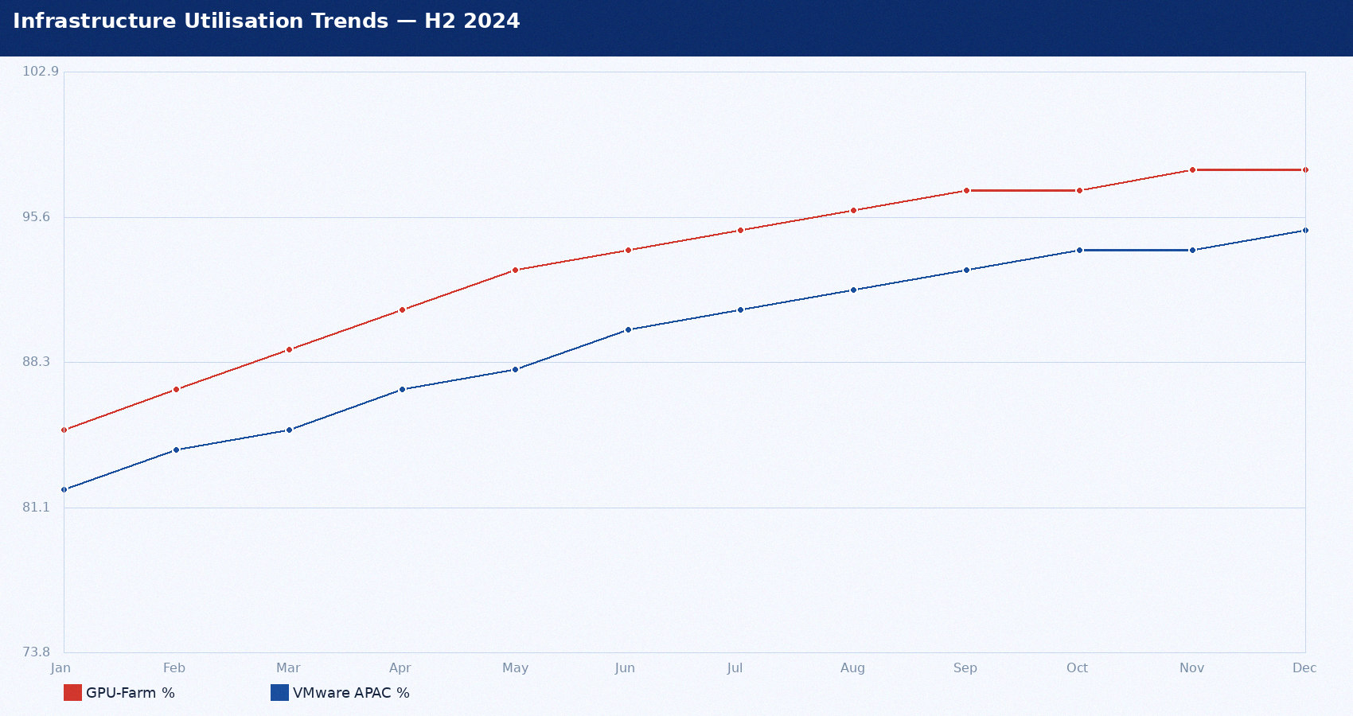
Infrastructure Utilisation Trends — H2 2024

Slide 29
Major Incidents Q1 2025
Incident | Priority | Duration | Users | Root Cause | Cost
INC0001234 | P1 Critical | 2h 35min | 847 | Ansible gate defect | $142,000
INC0001456 | P2 High | 47 min | 12 batch | Oracle RAC failover latency | $18,000
INC0001789 | P2 High | 3h 12min | 28 API | DataVault API rate limit | $22,000
INC0002011 | P3 Moderate | 8 hours | All staff | Teams storage exhausted | $5,000

Slide 30
Capacity Risk Summary
CRITICAL: GPU-Farm-01 at 98.1% peak — decision required Jan 24
  • ML training job ML-TRAIN-0047 scheduled Feb — will evict inference pods
  • Add 4x p3.8xl reserved instances — $220K/yr — board approval needed
CRITICAL: VMware-02 APAC at 94.7% CPU
  • Q2 APAC workloads will cause contention — order by Jan 31
HIGH: SAN Primary 9.3 months to full — order by Mar 15
  • 12-week lead time — $310K capex — board approval needed

Slide 31
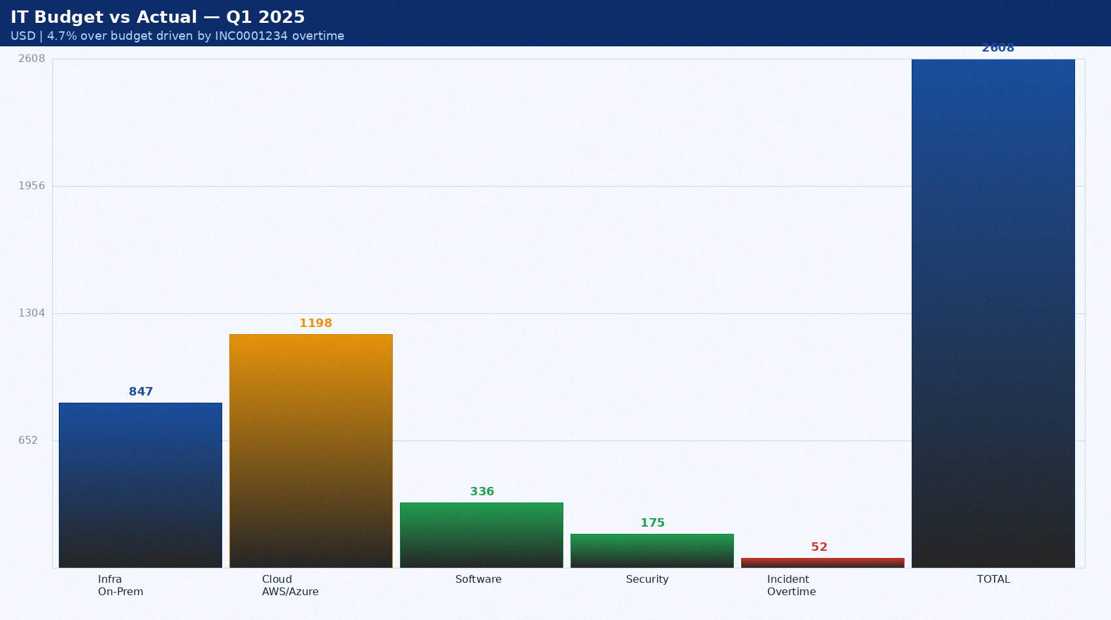
IT Budget vs Actual — Q1 2025
USD | 4.7% over budget driven by INC0001234 overtime

Slide 32

Infrastructure Utilisation Trends — H2 2024

Slide 33
Major Incidents Q1 2025
Incident | Priority | Duration | Users | Root Cause | Cost
INC0001234 | P1 Critical | 2h 35min | 847 | Ansible gate defect | $142,000
INC0001456 | P2 High | 47 min | 12 batch | Oracle RAC failover latency | $18,000
INC0001789 | P2 High | 3h 12min | 28 API | DataVault API rate limit | $22,000
INC0002011 | P3 Moderate | 8 hours | All staff | Teams storage exhausted | $5,000

Slide 34
CMDB Health Improvement Plan
Current: CI Accuracy 61.4% vs 90% target
  • Phase 1 complete: server/DB CI classes improved +9.8pp
  • Phase 2 Q2 2025: business service mapping (currently 0%)
Discovery Coverage: 78.2% vs 95% target
  • AWS Config integration live: 2,891 cloud CIs at 100% accuracy
  • Gap: NFS and SAN have 0% discovery — custom patterns needed

Slide 35

SLA Compliance by Priority — Mar 2025
Q1 2025 | March | Improvement trend

Slide 36
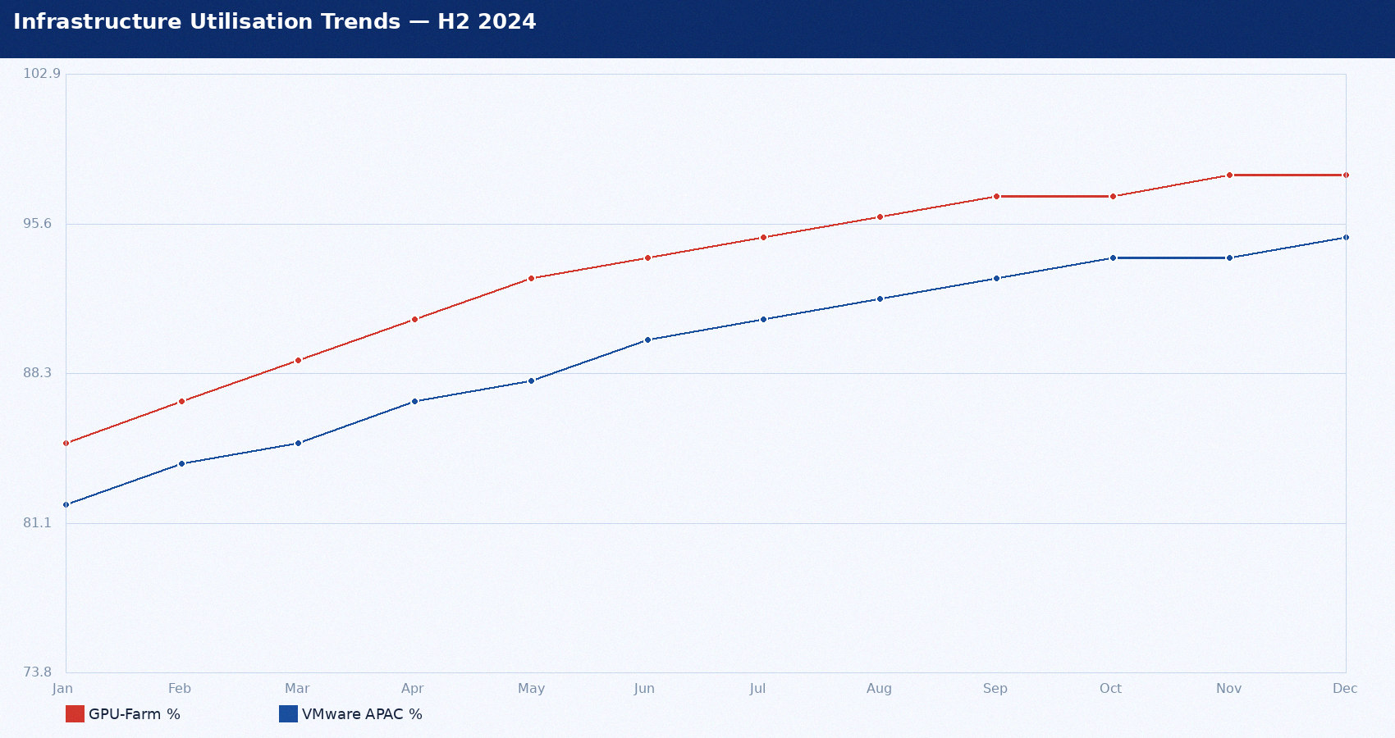
Infrastructure Utilisation Trends — H2 2024

Slide 37
Major Incidents Q1 2025
Incident | Priority | Duration | Users | Root Cause | Cost
INC0001234 | P1 Critical | 2h 35min | 847 | Ansible gate defect | $142,000
INC0001456 | P2 High | 47 min | 12 batch | Oracle RAC failover latency | $18,000
INC0001789 | P2 High | 3h 12min | 28 API | DataVault API rate limit | $22,000
INC0002011 | P3 Moderate | 8 hours | All staff | Teams storage exhausted | $5,000

Slide 38
Security and Compliance Headlines
ISO 27001: 84.0% compliance — 8 open findings
  • Lowest domain: A.15 Supplier Relationships 71.4% — DataVault review overdue
  • CF-2024-001 HIGH: 14 admin accounts without MFA — deadline April 30
SOC 2 Type II: Clean opinion — all trust service criteria effective
Patch compliance: 97.1% — above 95% policy for first time in 3 quarters
  • BREACH: ESXi 8.0 at 50% — GPU passthrough conflict — isolated
  • BREACH: WS2019 at 71.8% — 11 outstanding hosts — in progress

Slide 39

Capacity Risk — Current Utilisation %
January 2025 | Red >90% CRITICAL | Amber >75%

Slide 40
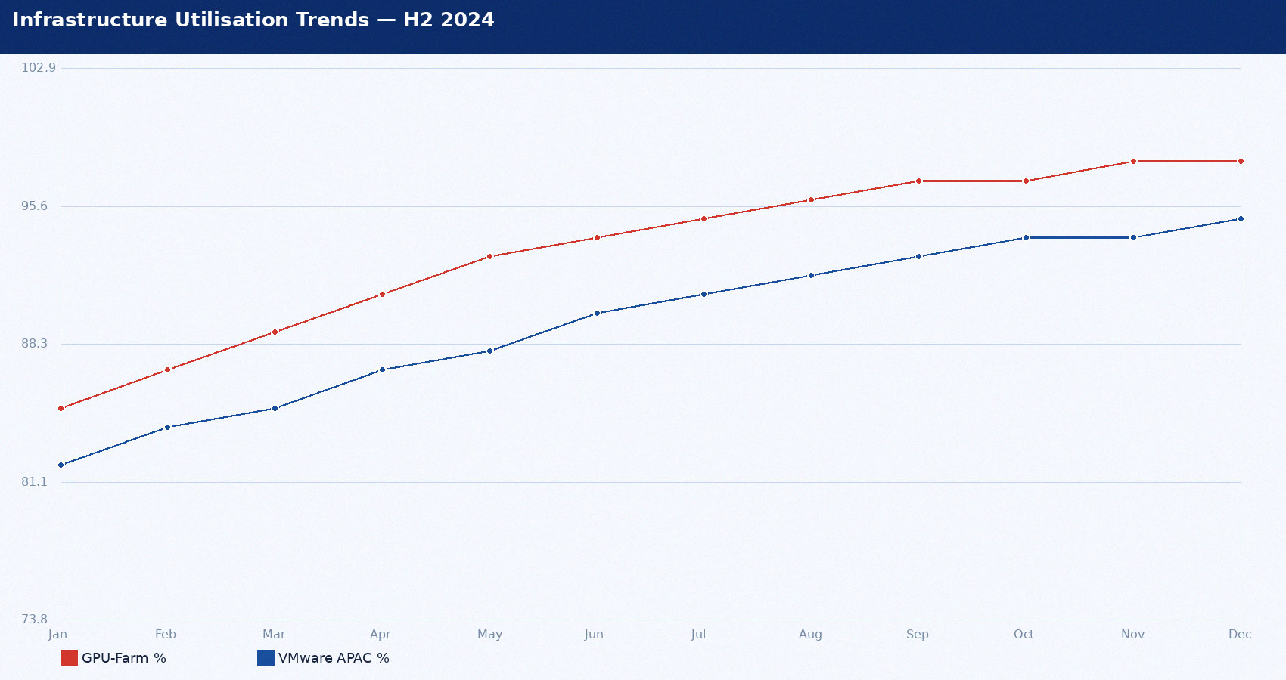
Infrastructure Utilisation Trends — H2 2024

Slide 41
Major Incidents Q1 2025
Incident | Priority | Duration | Users | Root Cause | Cost
INC0001234 | P1 Critical | 2h 35min | 847 | Ansible gate defect | $142,000
INC0001456 | P2 High | 47 min | 12 batch | Oracle RAC failover latency | $18,000
INC0001789 | P2 High | 3h 12min | 28 API | DataVault API rate limit | $22,000
INC0002011 | P3 Moderate | 8 hours | All staff | Teams storage exhausted | $5,000

Slide 42
Capacity Risk Summary
CRITICAL: GPU-Farm-01 at 98.1% peak — decision required Jan 24
  • ML training job ML-TRAIN-0047 scheduled Feb — will evict inference pods
  • Add 4x p3.8xl reserved instances — $220K/yr — board approval needed
CRITICAL: VMware-02 APAC at 94.7% CPU
  • Q2 APAC workloads will cause contention — order by Jan 31
HIGH: SAN Primary 9.3 months to full — order by Mar 15
  • 12-week lead time — $310K capex — board approval needed

Slide 43

SLA Compliance by Priority — Jan 2025
Q1 2025 | Target: P1 99%, P2 95%, P3 90%

Slide 44

Infrastructure Utilisation Trends — H2 2024

Slide 45
Major Incidents Q1 2025
Incident | Priority | Duration | Users | Root Cause | Cost
INC0001234 | P1 Critical | 2h 35min | 847 | Ansible gate defect | $142,000
INC0001456 | P2 High | 47 min | 12 batch | Oracle RAC failover latency | $18,000
INC0001789 | P2 High | 3h 12min | 28 API | DataVault API rate limit | $22,000
INC0002011 | P3 Moderate | 8 hours | All staff | Teams storage exhausted | $5,000

Slide 46
CMDB Health Improvement Plan
Current: CI Accuracy 61.4% vs 90% target
  • Phase 1 complete: server/DB CI classes improved +9.8pp
  • Phase 2 Q2 2025: business service mapping (currently 0%)
Discovery Coverage: 78.2% vs 95% target
  • AWS Config integration live: 2,891 cloud CIs at 100% accuracy
  • Gap: NFS and SAN have 0% discovery — custom patterns needed

Slide 47

P1 Incident Count — FY2024
Source: ServiceNow | SLA target 99%

Slide 48
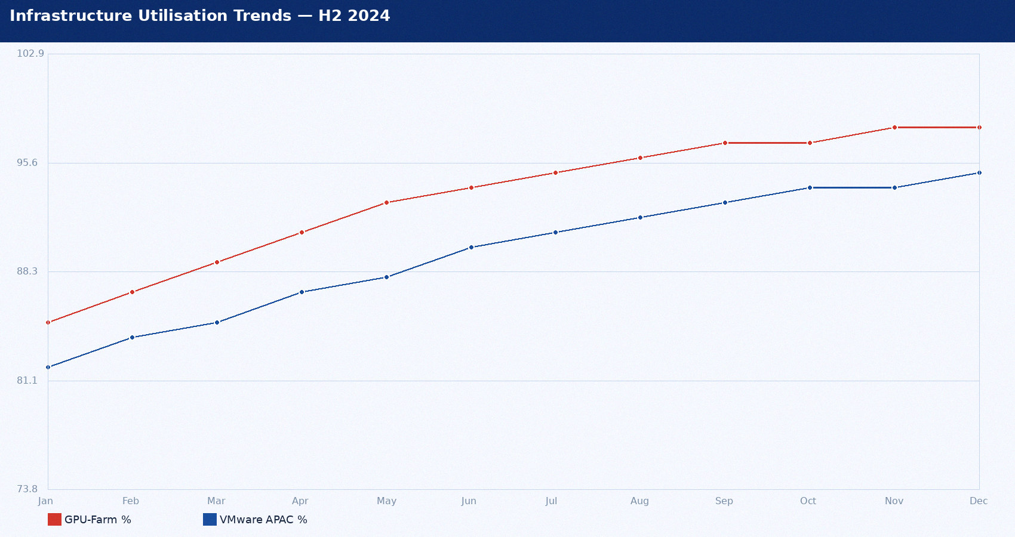
Infrastructure Utilisation Trends — H2 2024

Slide 49
Major Incidents Q1 2025
Incident | Priority | Duration | Users | Root Cause | Cost
INC0001234 | P1 Critical | 2h 35min | 847 | Ansible gate defect | $142,000
INC0001456 | P2 High | 47 min | 12 batch | Oracle RAC failover latency | $18,000
INC0001789 | P2 High | 3h 12min | 28 API | DataVault API rate limit | $22,000
INC0002011 | P3 Moderate | 8 hours | All staff | Teams storage exhausted | $5,000

Slide 50
Security and Compliance Headlines
ISO 27001: 84.0% compliance — 8 open findings
  • Lowest domain: A.15 Supplier Relationships 71.4% — DataVault review overdue
  • CF-2024-001 HIGH: 14 admin accounts without MFA — deadline April 30
SOC 2 Type II: Clean opinion — all trust service criteria effective
Patch compliance: 97.1% — above 95% policy for first time in 3 quarters
  • BREACH: ESXi 8.0 at 50% — GPU passthrough conflict — isolated
  • BREACH: WS2019 at 71.8% — 11 outstanding hosts — in progress

Slide 51

IT Budget vs Actual — Q1 2025
USD | 4.7% over budget driven by INC0001234 overtime

Slide 52

Infrastructure Utilisation Trends — H2 2024

Slide 53
Major Incidents Q1 2025
Incident | Priority | Duration | Users | Root Cause | Cost
INC0001234 | P1 Critical | 2h 35min | 847 | Ansible gate defect | $142,000
INC0001456 | P2 High | 47 min | 12 batch | Oracle RAC failover latency | $18,000
INC0001789 | P2 High | 3h 12min | 28 API | DataVault API rate limit | $22,000
INC0002011 | P3 Moderate | 8 hours | All staff | Teams storage exhausted | $5,000

Slide 54
Capacity Risk Summary
CRITICAL: GPU-Farm-01 at 98.1% peak — decision required Jan 24
  • ML training job ML-TRAIN-0047 scheduled Feb — will evict inference pods
  • Add 4x p3.8xl reserved instances — $220K/yr — board approval needed
CRITICAL: VMware-02 APAC at 94.7% CPU
  • Q2 APAC workloads will cause contention — order by Jan 31
HIGH: SAN Primary 9.3 months to full — order by Mar 15
  • 12-week lead time — $310K capex — board approval needed

Slide 55
Q2 2025 Priorities — Decision Register
Priority | Item | Owner | Deadline | Investment
CRITICAL | GPU Farm p3.8xl reservation | James Wu | 2025-01-24 | $220K/yr
CRITICAL | VMware APAC blade order | Angela Brooks | 2025-01-31 | $84K capex
HIGH | SAN Primary expansion | Mike Torres | 2025-03-15 | $310K capex
HIGH | Azure Blob backup overflow | Ravi Patel | 2025-02-28 | $43K/yr
HIGH | MFA: 14 admin accounts | David Kim | 2025-04-30 | Staff time only

Slide 56
SLA Performance Q1 2025 vs Target
Metric | Jan | Feb | Mar | Q1 2025 | Target | Status
P1 SLA % | 50.0% | 91.7% | 94.0% | 84.2% | 99.0% | BREACH
P2 SLA % | 89.0% | 91.0% | 95.0% | 91.7% | 95.0% | BREACH
P3 SLA % | 93.0% | 94.0% | 95.0% | 94.0% | 90.0% | MET
Availability | 99.68% | 99.70% | 99.75% | 99.71% | 99.90% | BREACH
Change Success | 95.0% | 96.5% | 97.0% | 96.2% | 98.0% | BREACH

Slide 57
Capacity Investment Decisions
System | Risk | Action | Investment | Decision By
GPU-Farm-01 A100 | CRITICAL | Add 4x p3.8xl reserved | $220K/yr | 2025-01-24
VMware-02 APAC | CRITICAL | Order 2x HPE BL460c | $84K capex | 2025-01-31
SAN Primary | HIGH | 300TB expansion | $310K capex | 2025-03-15
Backup Target ME5 | HIGH | Azure Blob Cool tier | $43K/yr | 2025-02-28

Slide 58
Corrective Actions Register
ID | Action | Owner | Priority | Due | Status
CA-01 | Fix Jenkinsfile CAB approval gate | Ravi Patel | CRITICAL | 2025-02-15 | In Progress
CA-02 | Add BGP community pre-check to Ansible | Mike Torres | HIGH | 2025-02-28 | In Progress
CF-2024-001 | MFA for 14 admin accounts | David Kim | HIGH | 2025-04-30 | Open
CF-2024-002 | WS2019 patch remediation | Sarah Chen | HIGH | 2025-03-31 | In Progress
CF-2024-004 | DataVault supplier review | Angela Brooks | MEDIUM | 2025-03-15 | Open

Slide 59
Vendor Performance Scores — FY2024
Annual scorecard | red = POOR/EXIT, green = EXCELLENT

Slide 60
Patch Compliance by Platform — Q1 2025
Policy 95% within 72h | red = BREACH, green = OK

Slide 61
Q1 2025 Closing Summary
• Three SLA categories in BREACH — P1 84.2%, P2 91.7%, Availability 99.71%
• INC0001234 APAC BGP outage drove the majority of Q1 breaches ($142K impact)
• Key wins: ServiceNow Vancouver (zero post-go-live incidents), CMDB 68% → 78%
• Patch compliance above 95% policy for the first time in three quarters
• Urgent decisions: GPU cluster $220K by Jan 24, SAN Primary $310K by Mar 15
• Q2 focus: close corrective actions CA-01/CA-02, MFA rollout, DataVault review

