Slide 1
IT VENDOR REVIEW PACK — Q1 2025

Slide 2
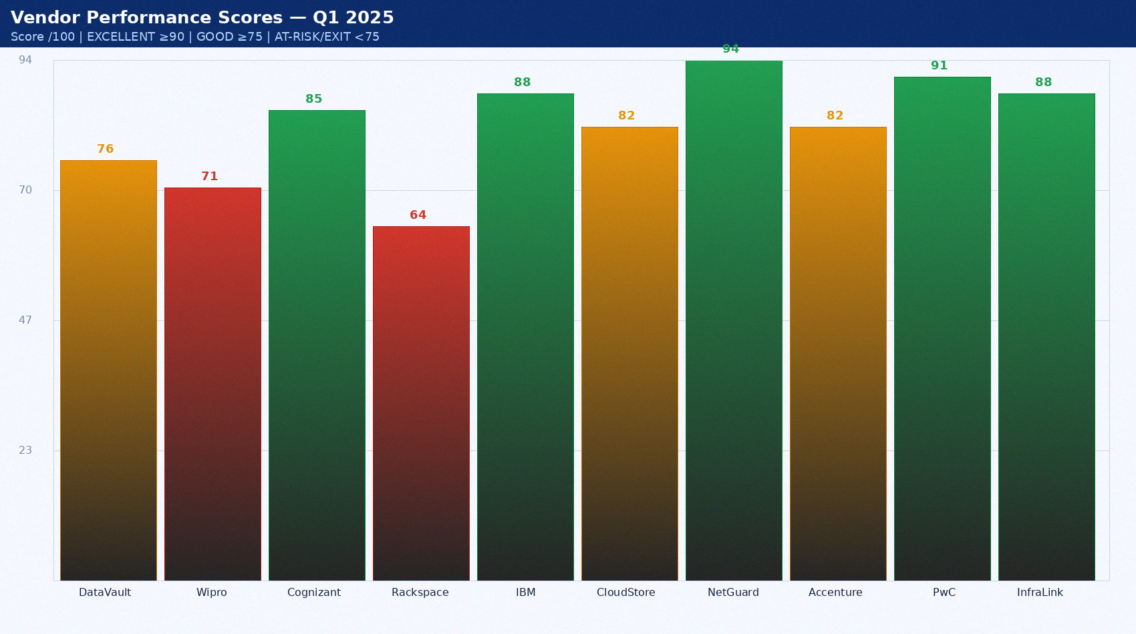
Portfolio Performance Overview

Slide 3
Vendor Scorecard — Full Q1 2025
Vendor | Spend/yr | Q1 Score | Breaches | Trend | Decision
DataVault Inc. | $284,000 | 76/100 | 2 | ↓ -4pp | MEDIUM
Wipro MSP | $1,200,000 | 71/100 | 3 | ↓ -8pp | ISSUE PIN
Cognizant | $780,000 | 85/100 | 0 | ↑ +2pp | EXTEND
Rackspace | $240,000 | 64/100 | 3 | ↓ -12pp | EXIT
IBM Mainframe | $420,000 | 88/100 | 0 | → steady | RETAIN
CloudStore | $180,000 | 82/100 | 0 | ↑ +1pp | RETAIN
NetGuard | $95,000 | 94/100 | 0 | ↑ +3pp | EXCELLENT
Accenture | $340,000 | 82/100 | 0 | ↑ stable | CONTINUE
PwC IT Audit | $95,000 | 91/100 | 0 | ↑ +2pp | EXCELLENT
InfraLink | $160,000 | 88/100 | 0 | → steady | RETAIN

Slide 4
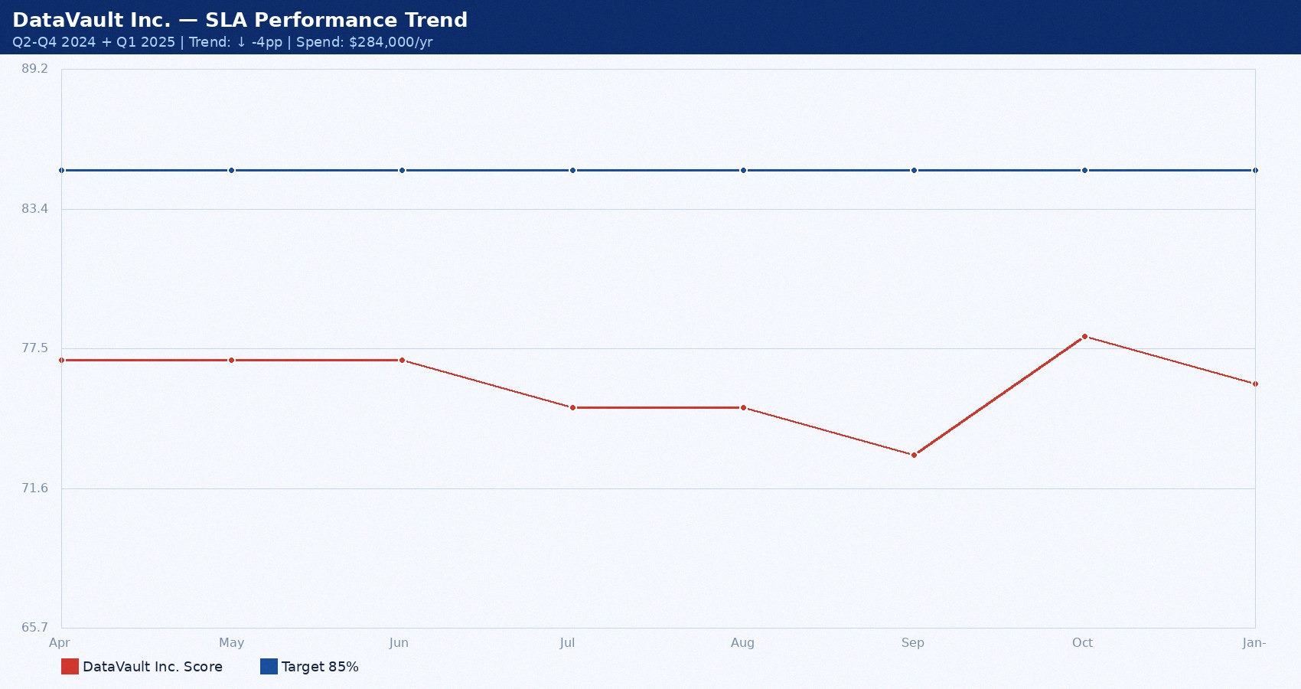
DataVault Inc. — Performance Trend

Slide 5
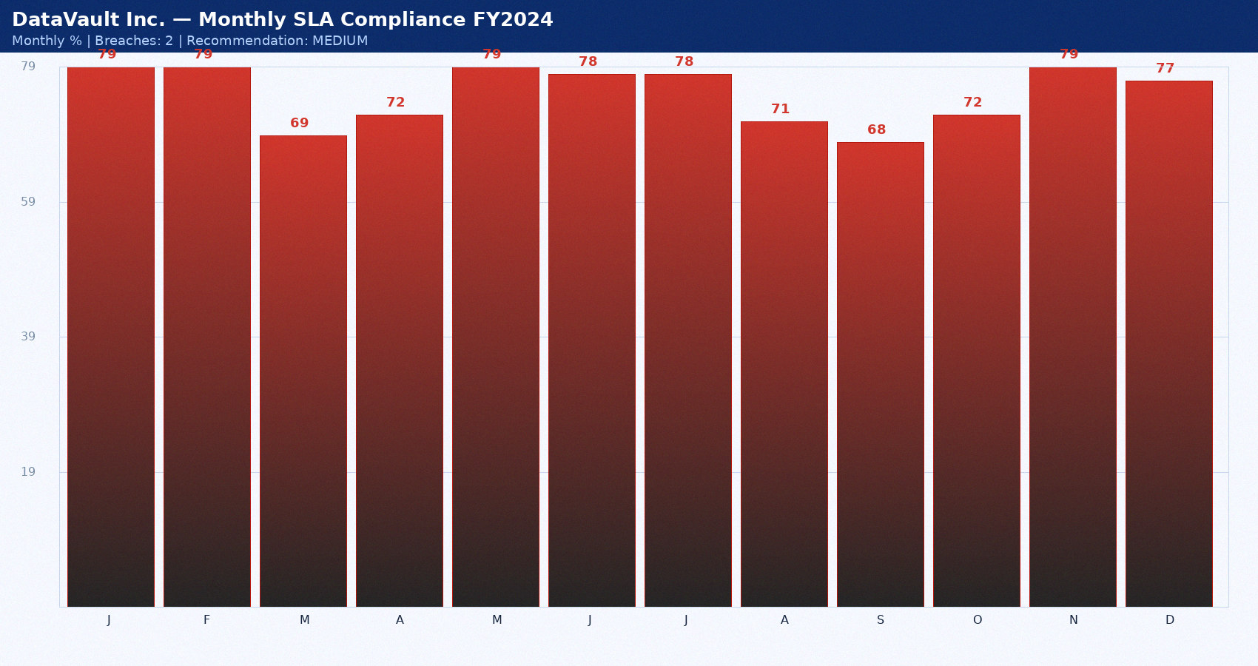
DataVault Inc. — Monthly SLA FY2024

Slide 6
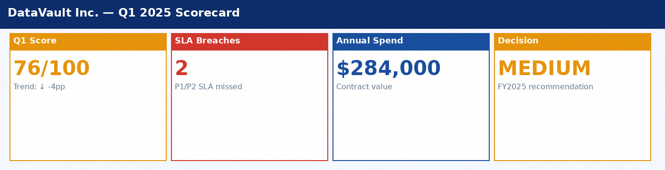
DataVault Inc. — Scorecard

Slide 7
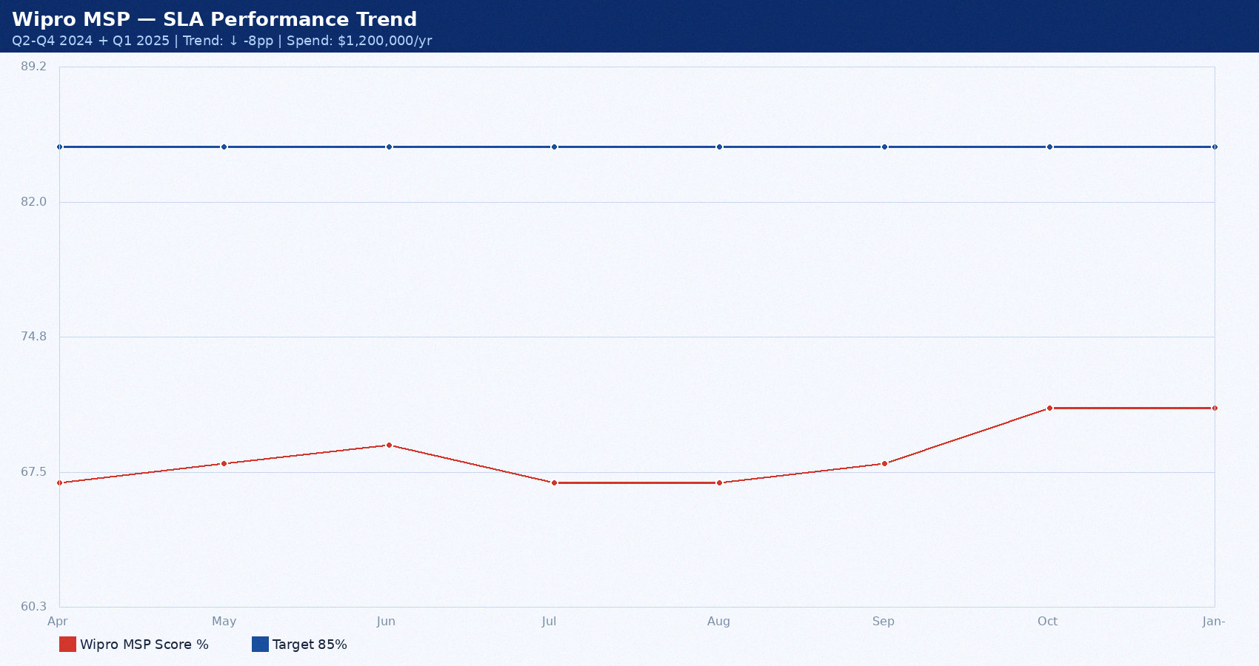
Wipro MSP — Performance Trend

Slide 8
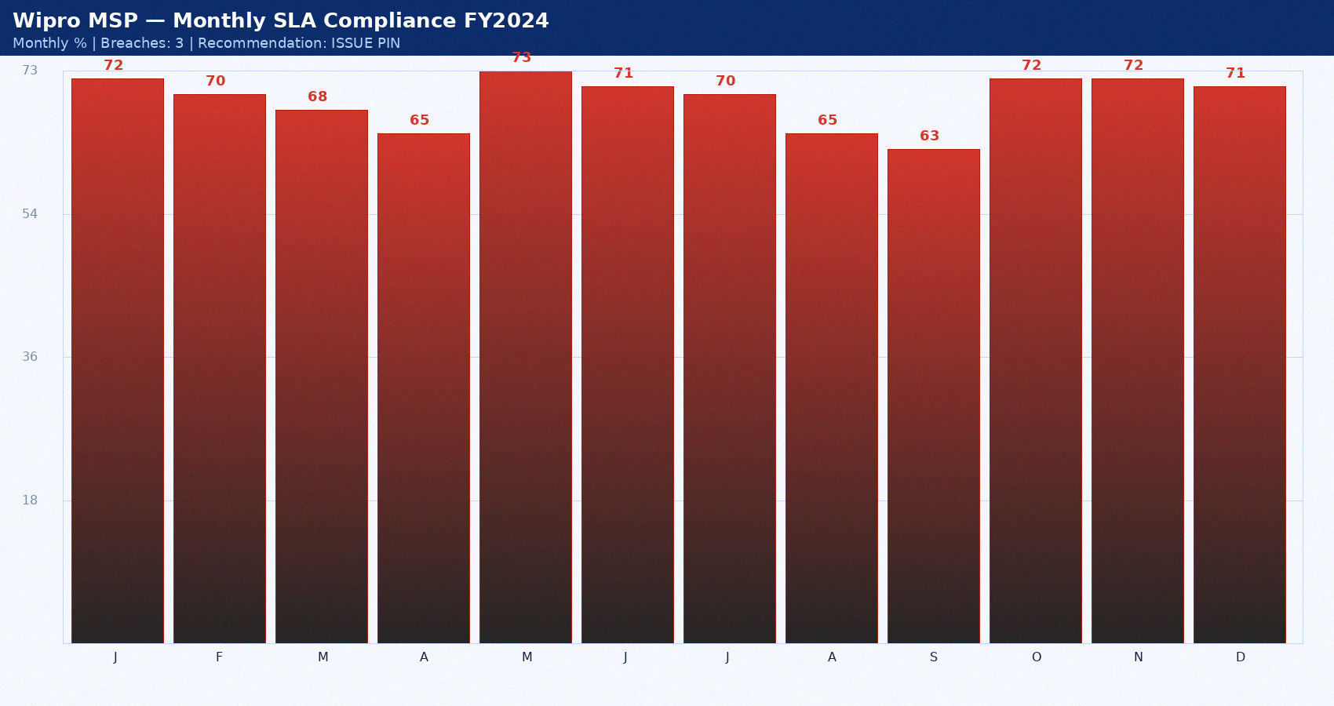
Wipro MSP — Monthly SLA FY2024

Slide 9
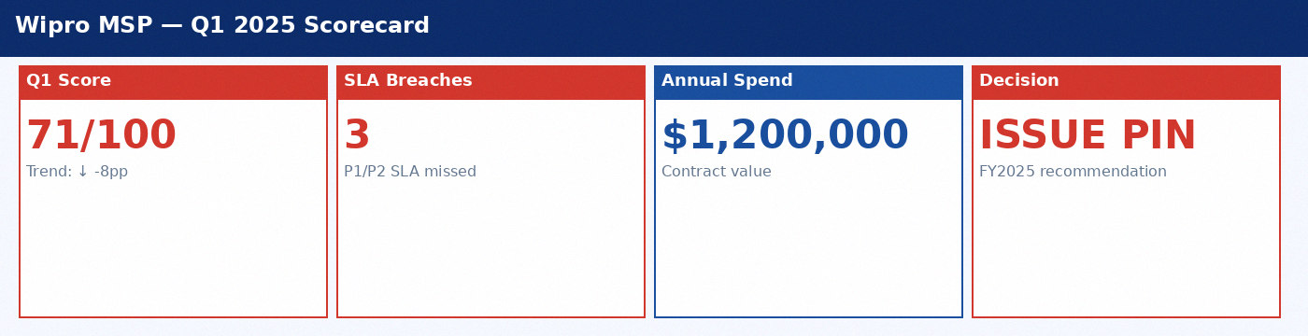
Wipro MSP — Scorecard

Slide 10
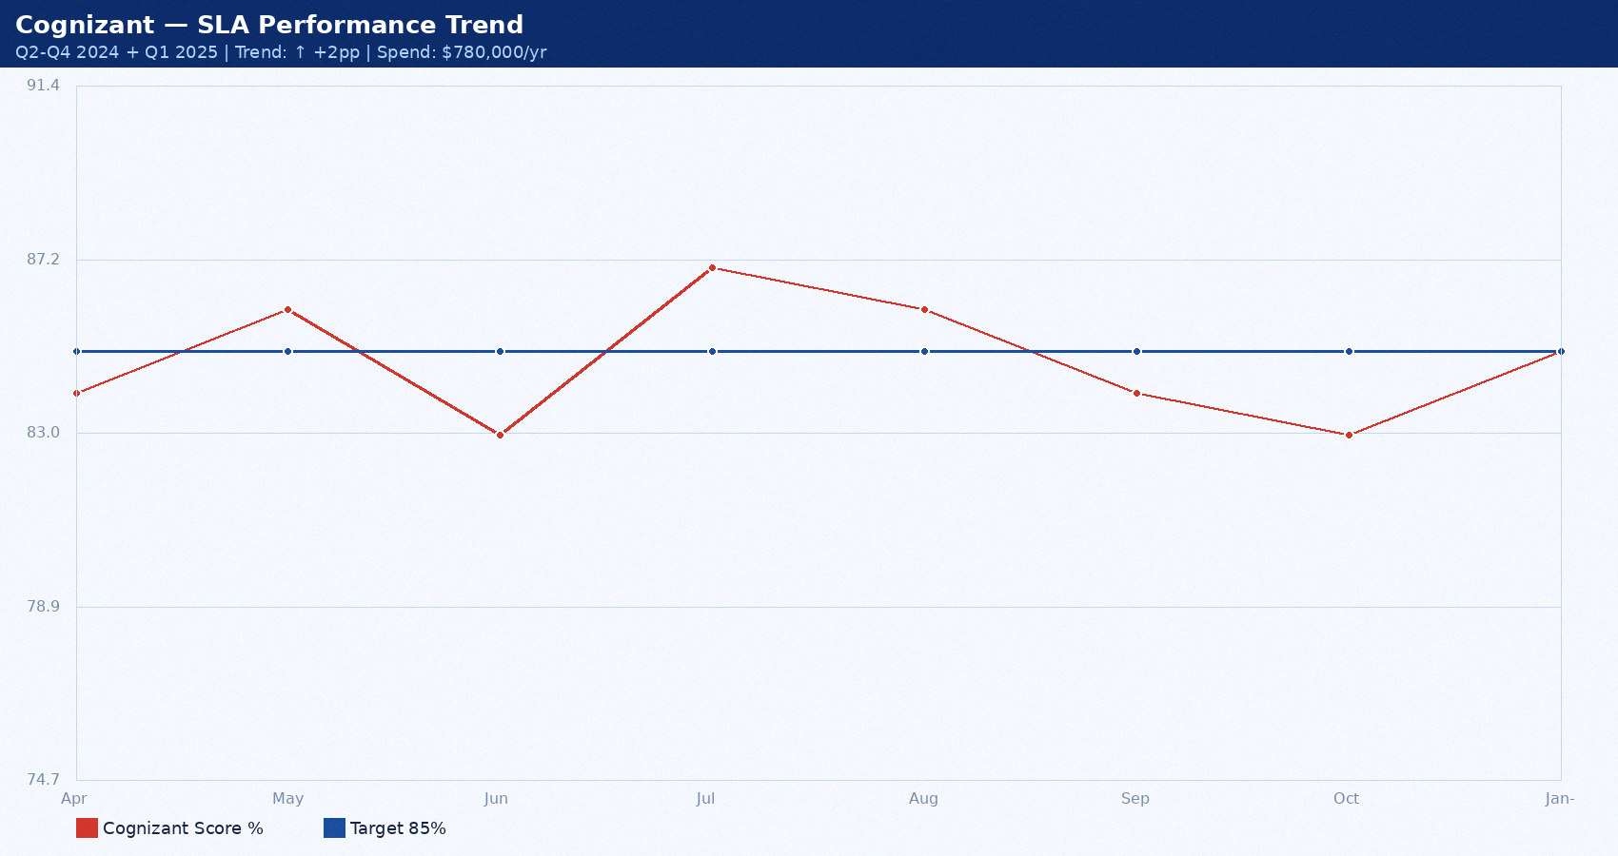
Cognizant — Performance Trend

Slide 11
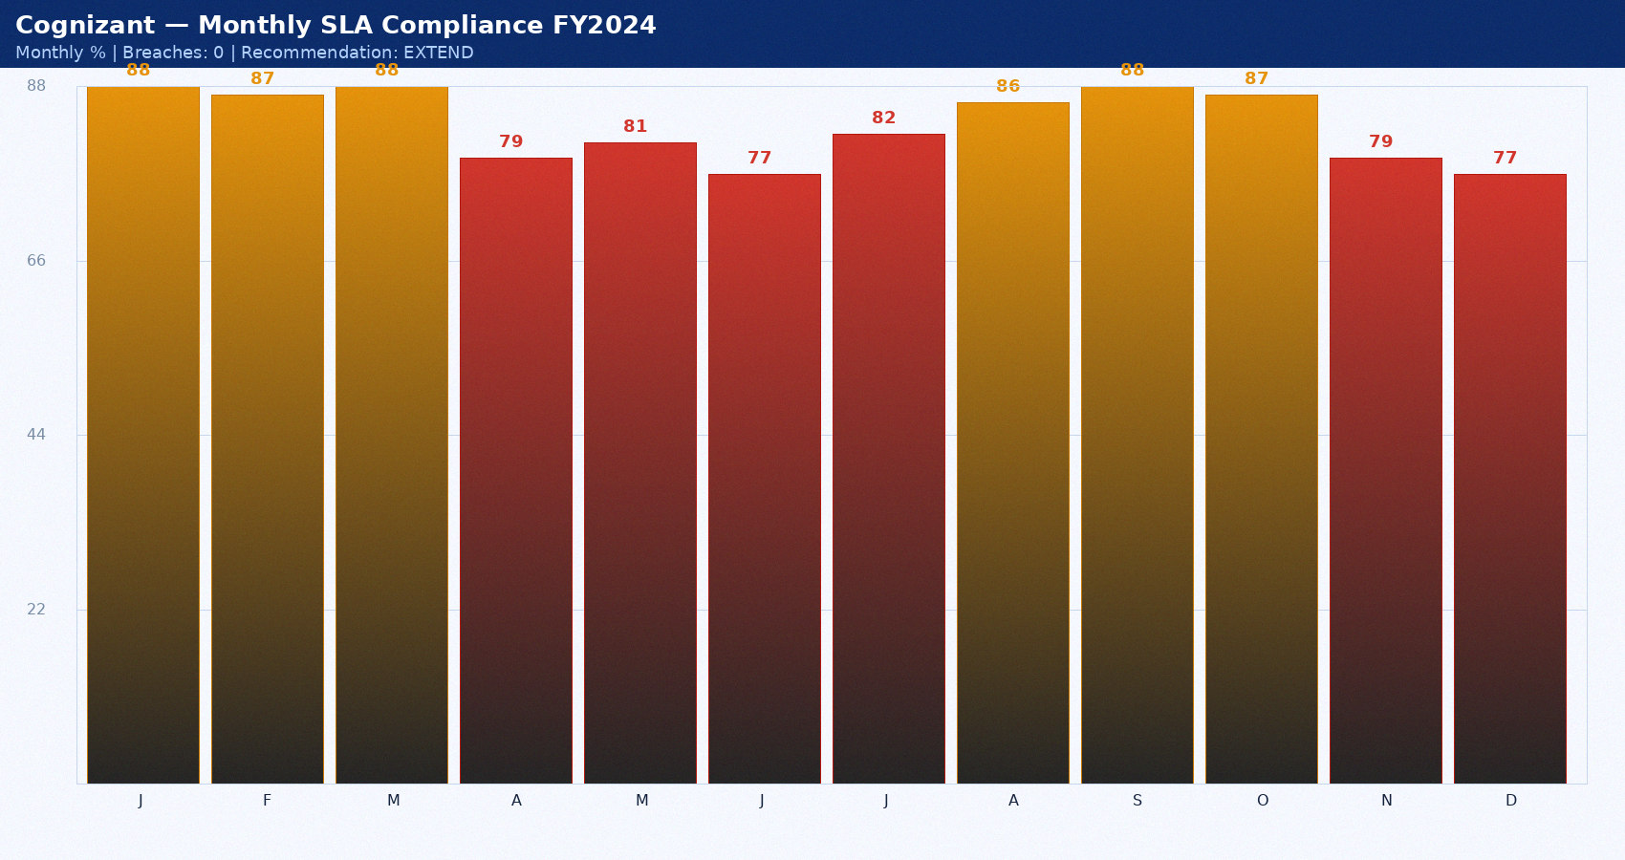
Cognizant — Monthly SLA FY2024

Slide 12
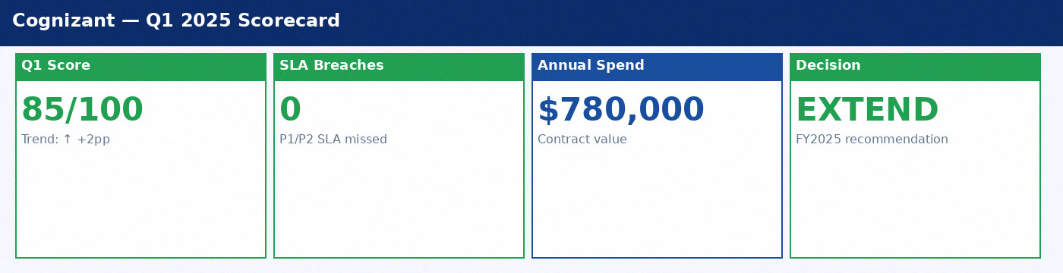
Cognizant — Scorecard

Slide 13
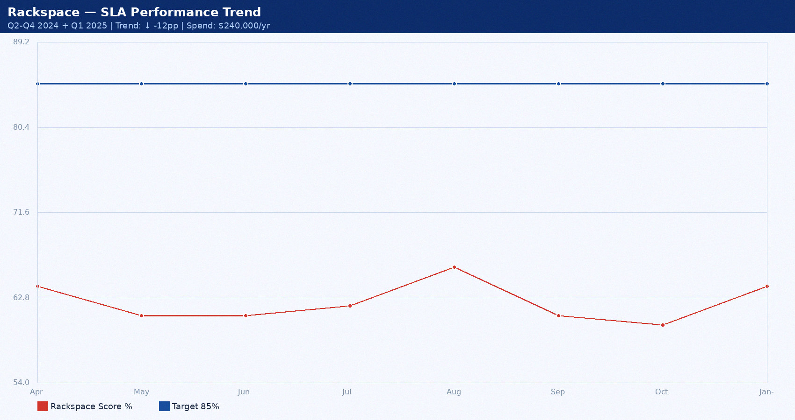
Rackspace — Performance Trend

Slide 14
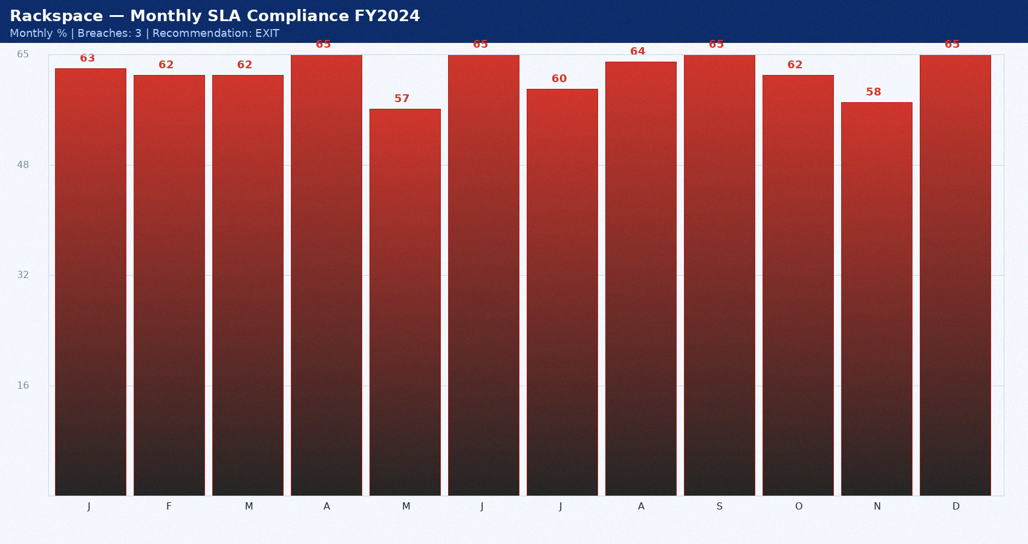
Rackspace — Monthly SLA FY2024

Slide 15
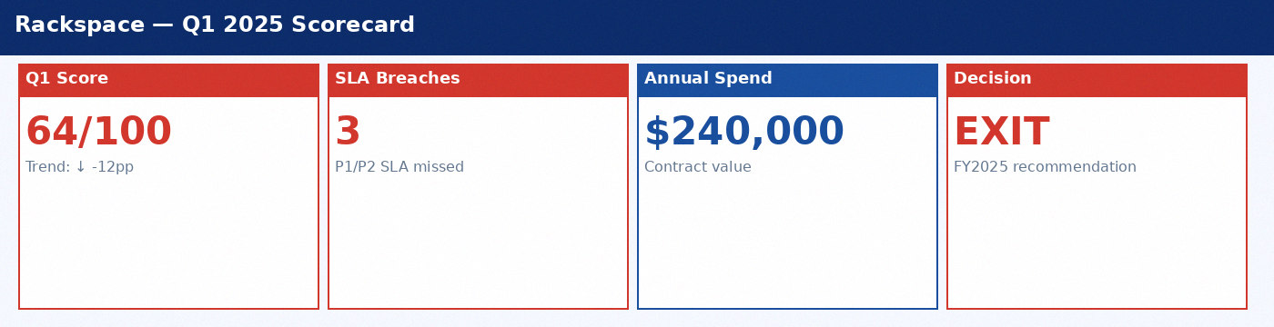
Rackspace — Scorecard

Slide 16
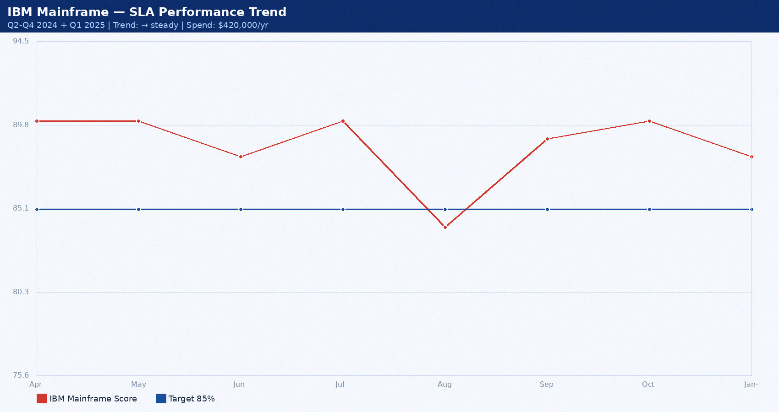
IBM Mainframe — Performance Trend

Slide 17
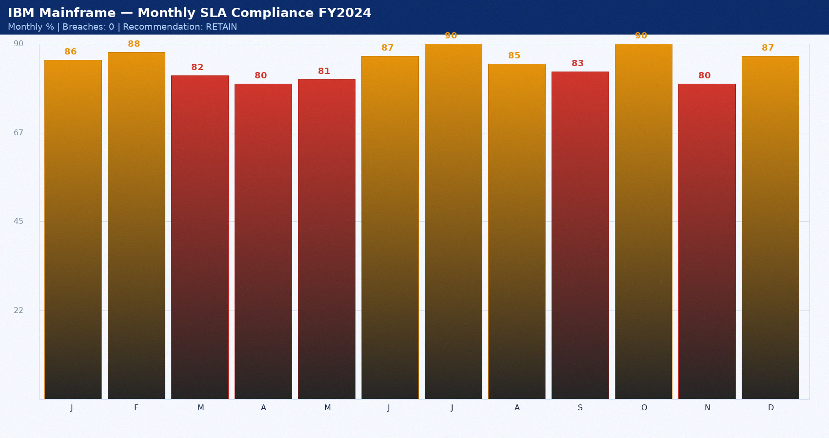
IBM Mainframe — Monthly SLA FY2024

Slide 18
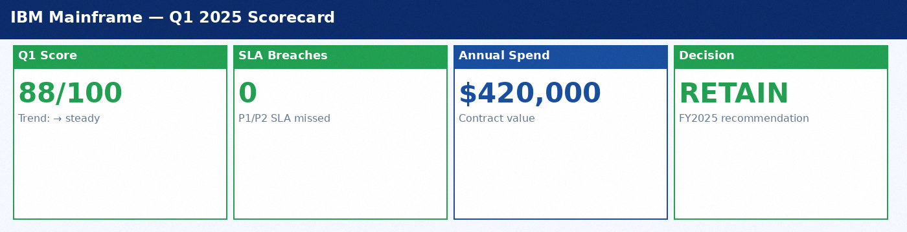
IBM Mainframe — Scorecard

Slide 19
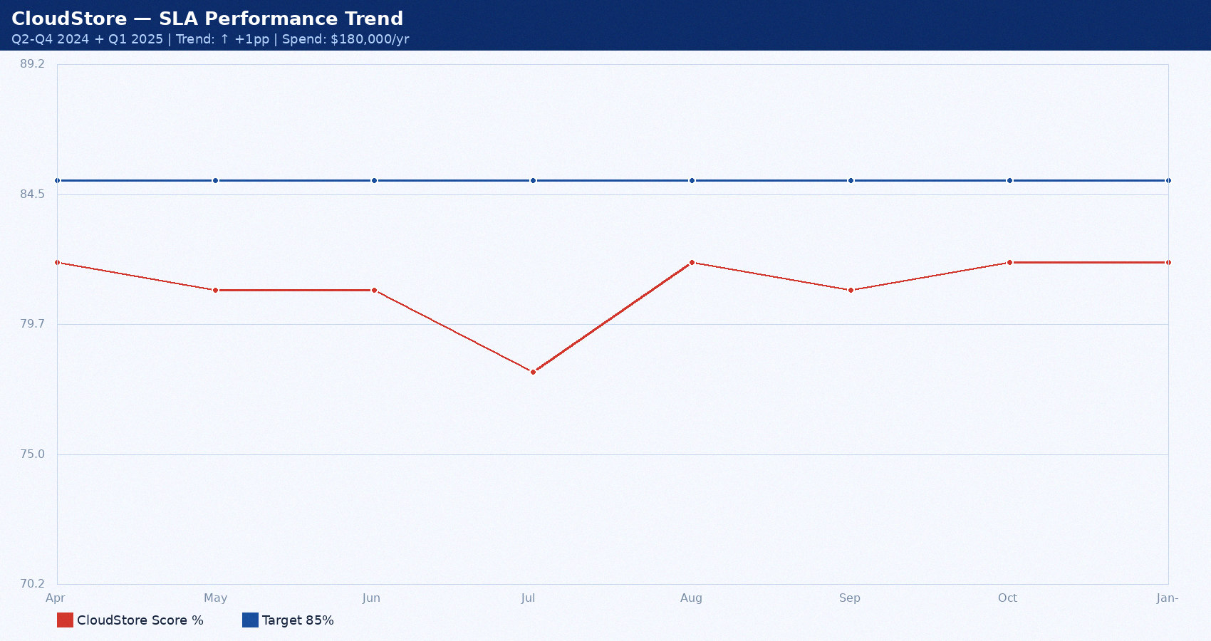
CloudStore — Performance Trend

Slide 20
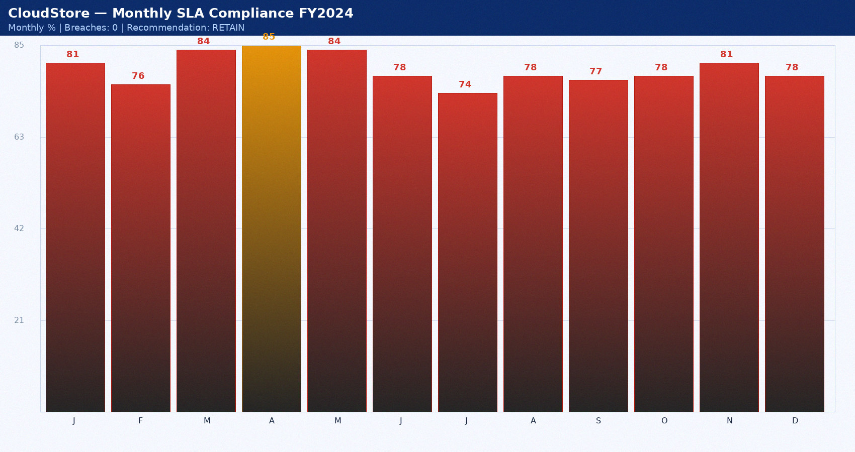
CloudStore — Monthly SLA FY2024

Slide 21
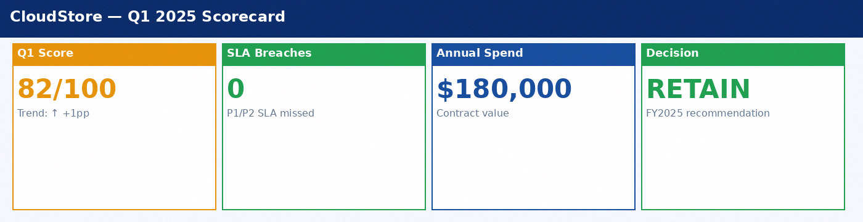
CloudStore — Scorecard

Slide 22
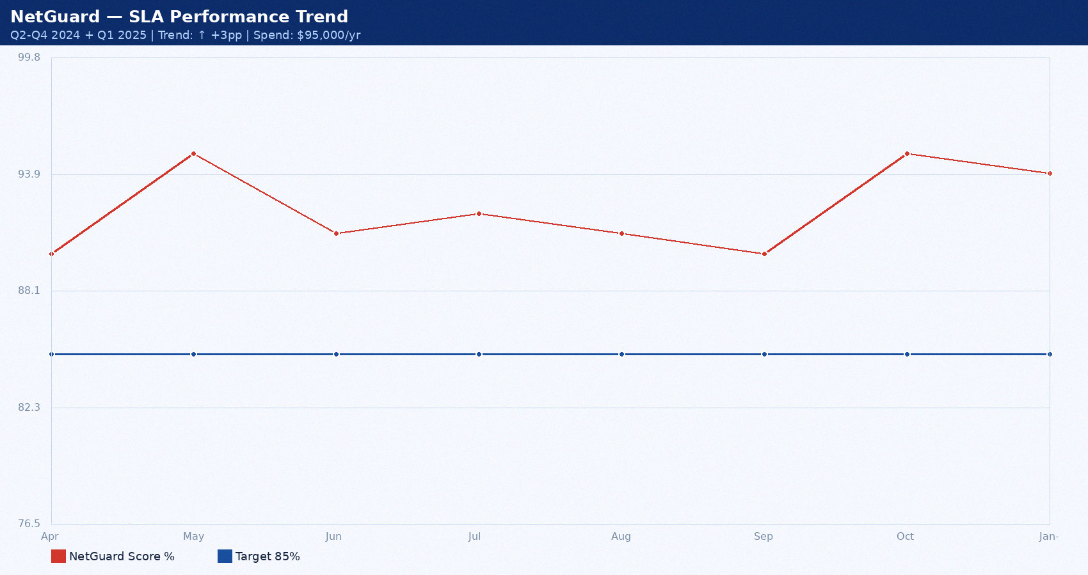
NetGuard — Performance Trend

Slide 23
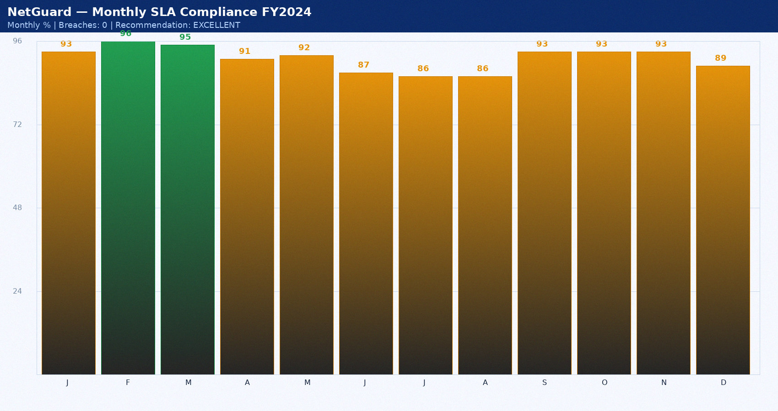
NetGuard — Monthly SLA FY2024

Slide 24
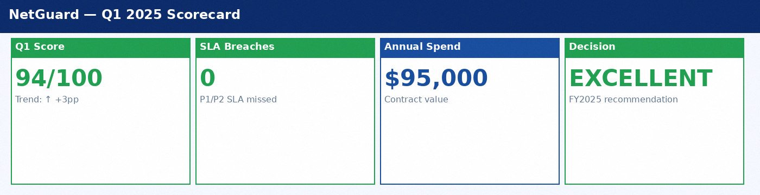
NetGuard — Scorecard

Slide 25
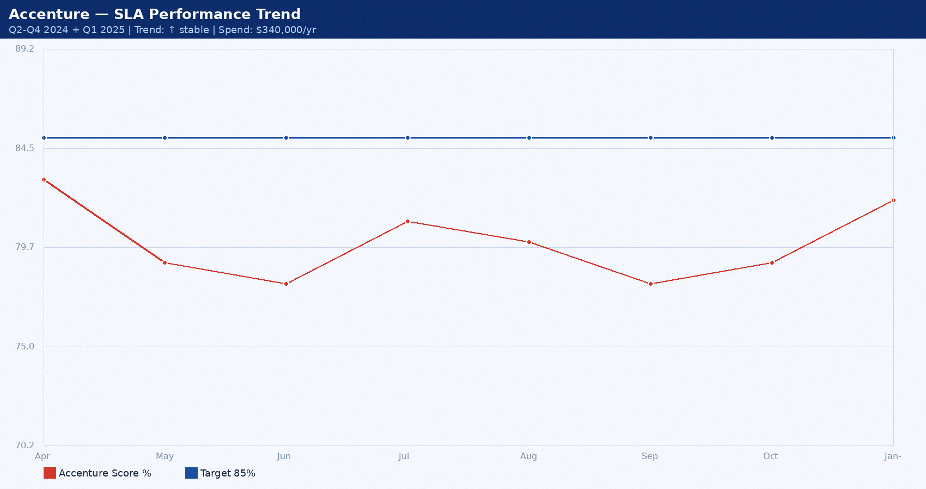
Accenture — Performance Trend

Slide 26
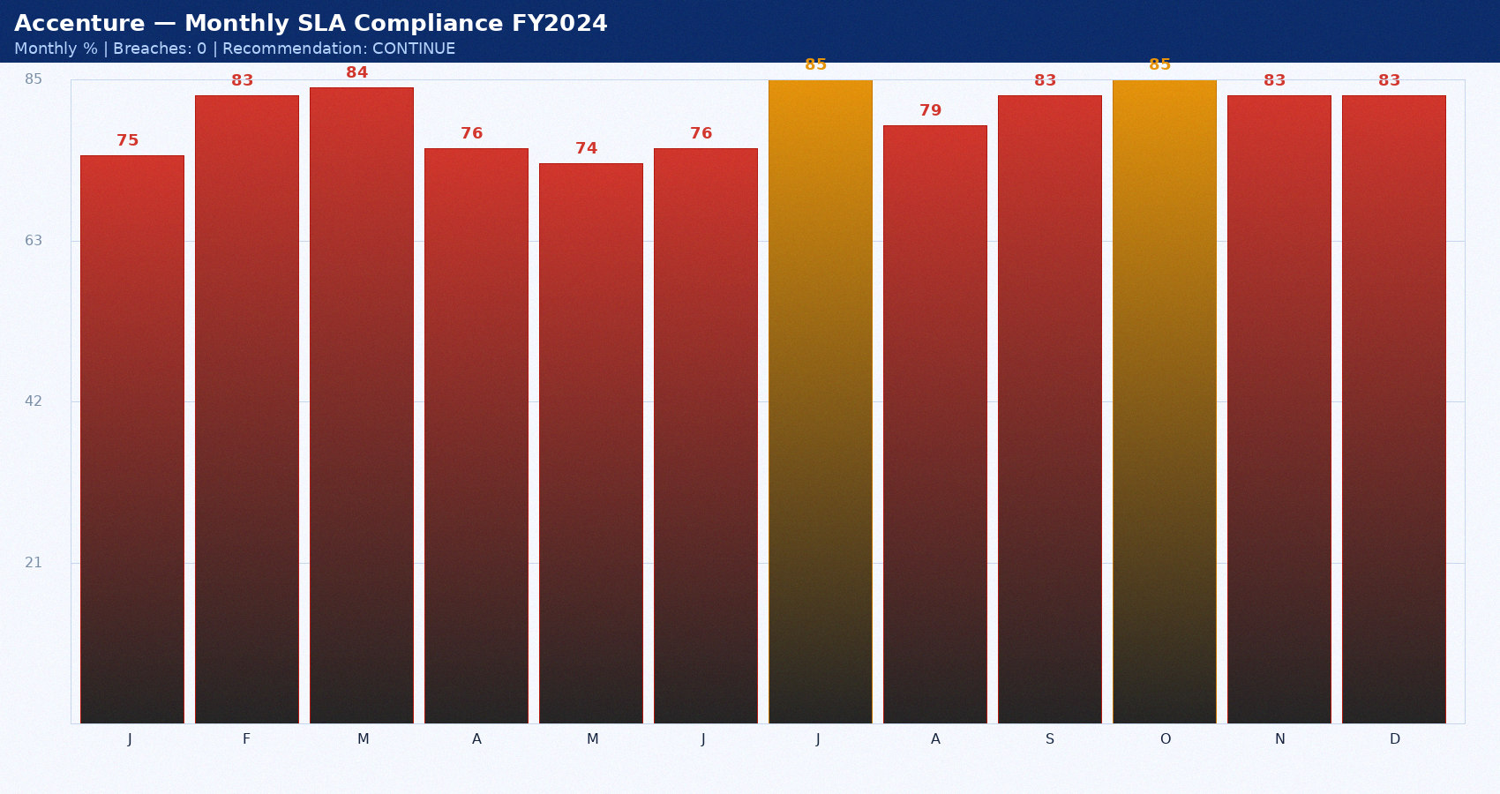
Accenture — Monthly SLA FY2024

Slide 27
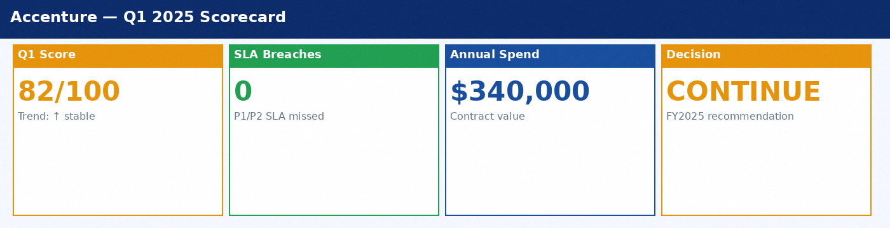
Accenture — Scorecard

Slide 28
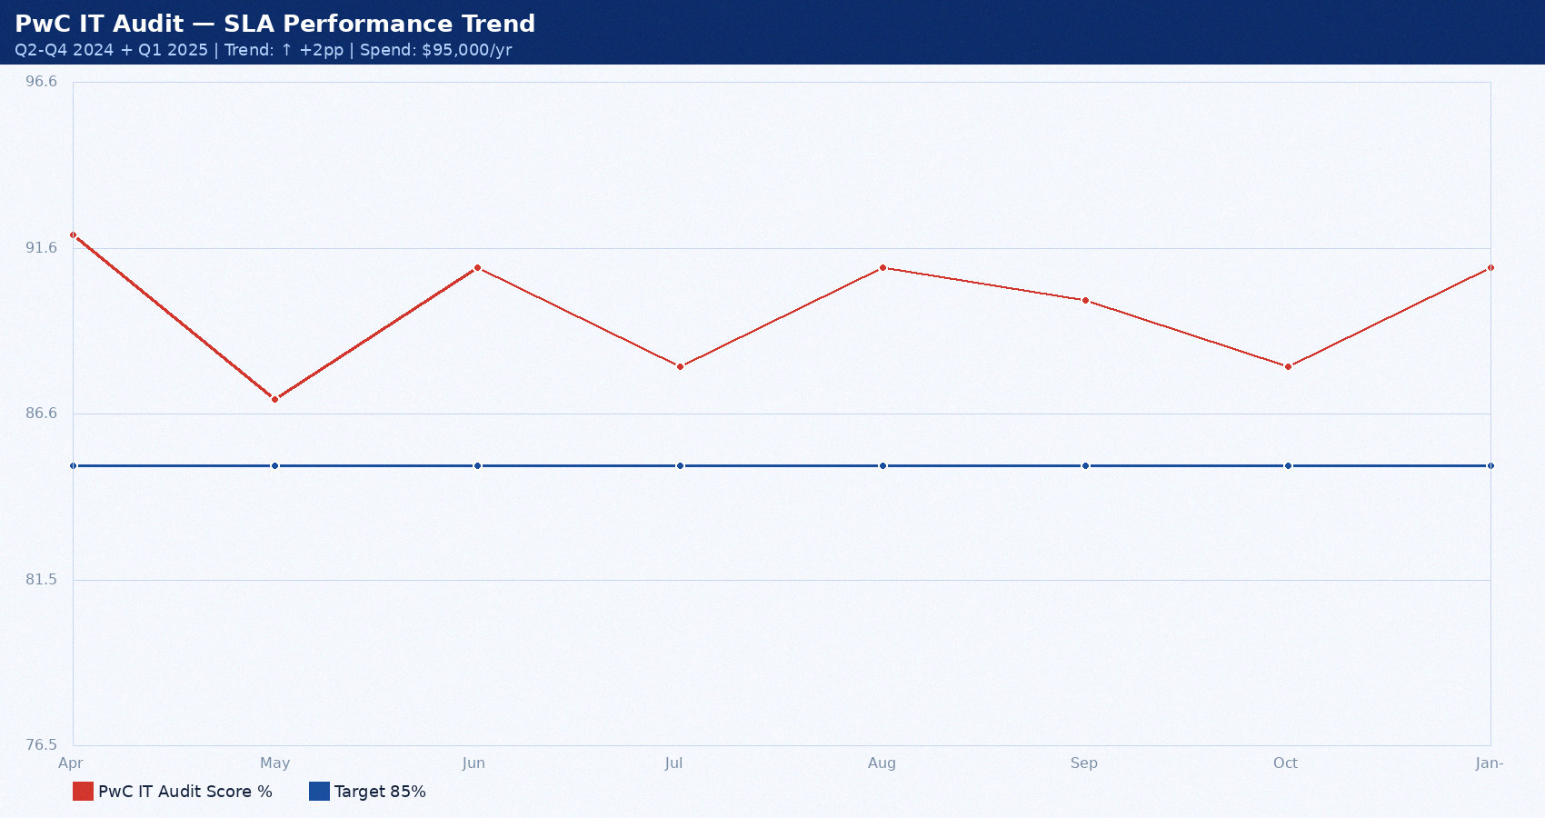
PwC IT Audit — Performance Trend

Slide 29
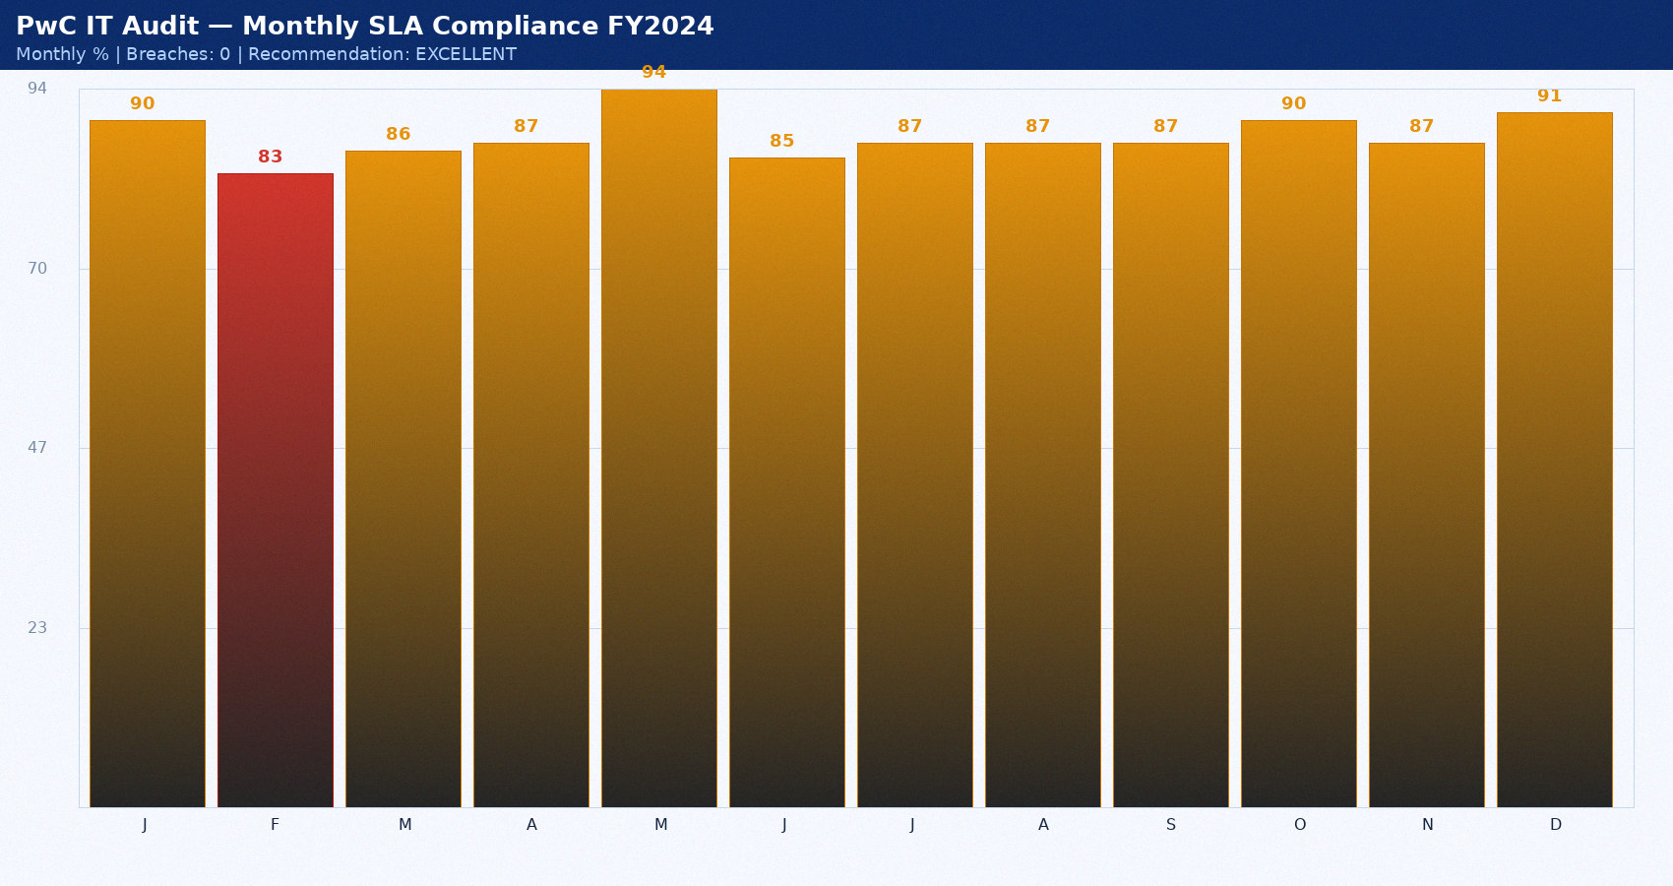
PwC IT Audit — Monthly SLA FY2024

Slide 30
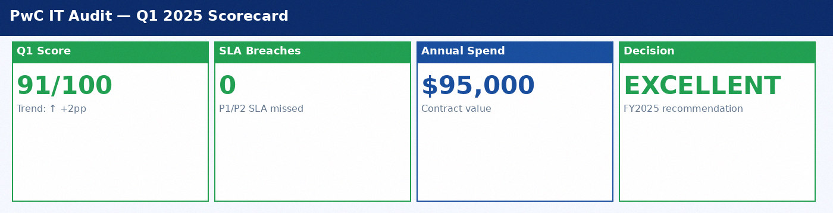
PwC IT Audit — Scorecard

Slide 31
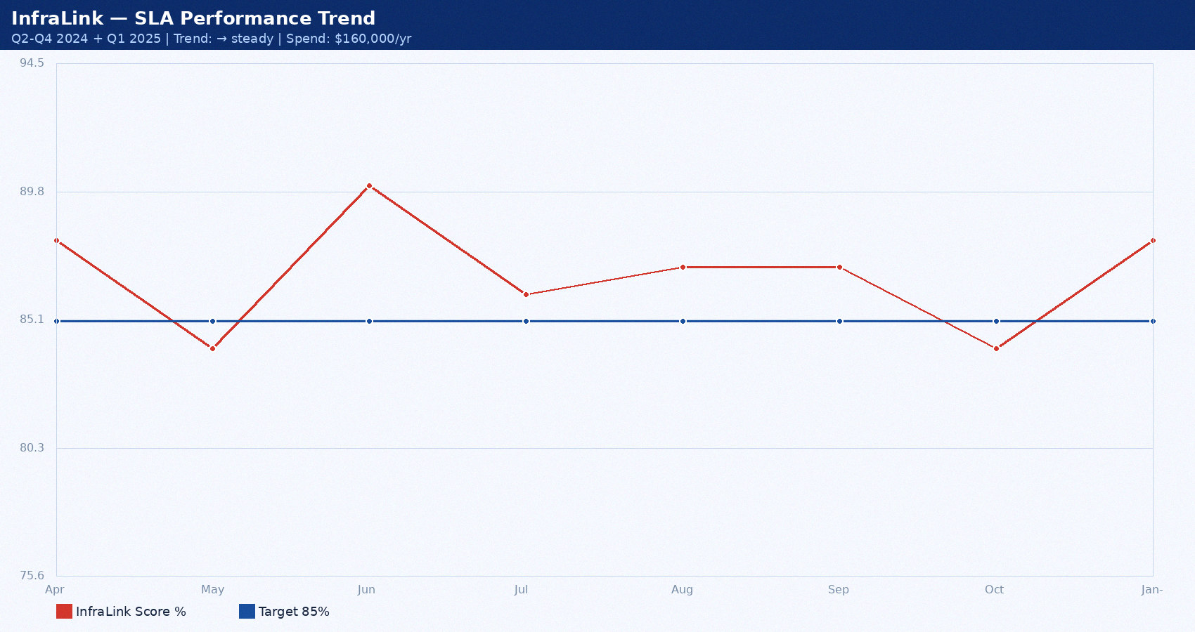
InfraLink — Performance Trend

Slide 32
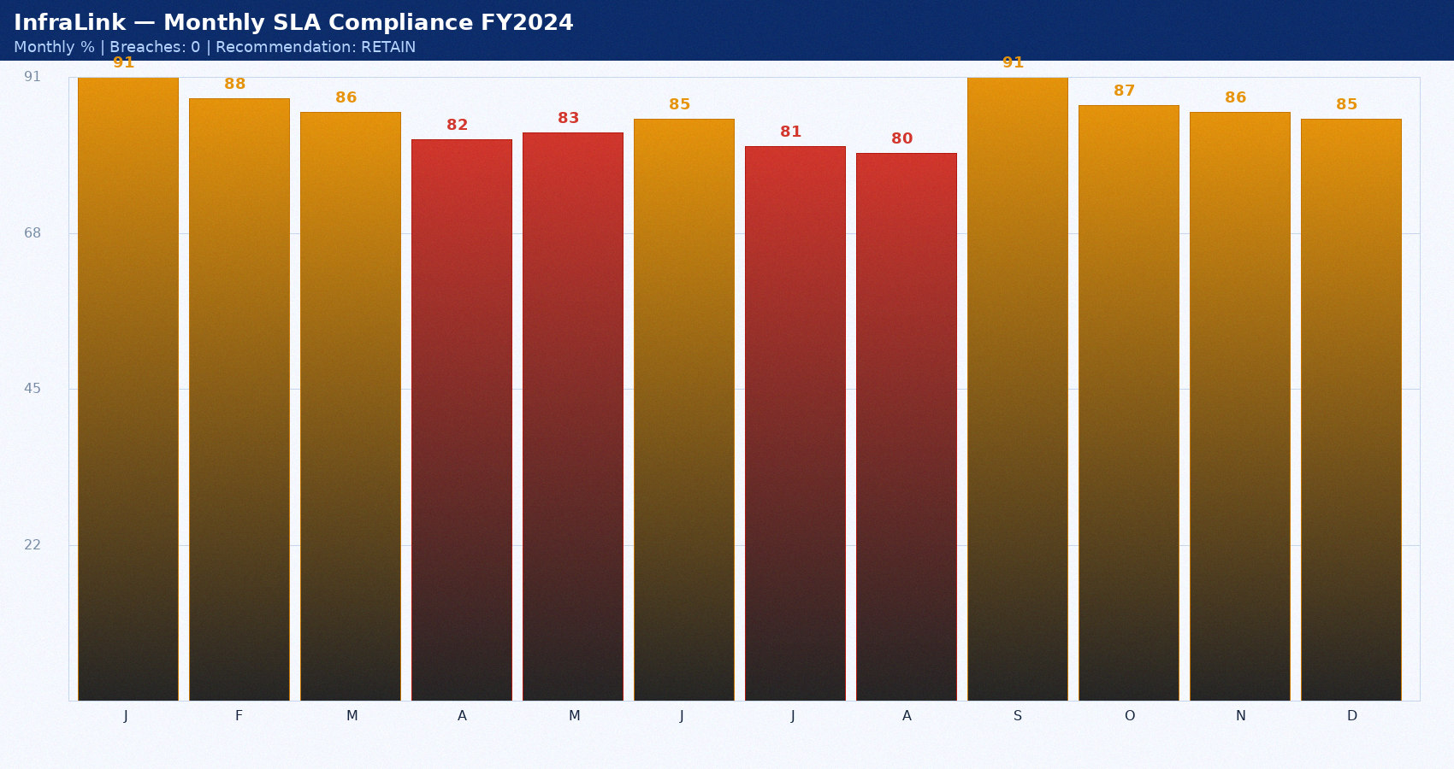
InfraLink — Monthly SLA FY2024

Slide 33
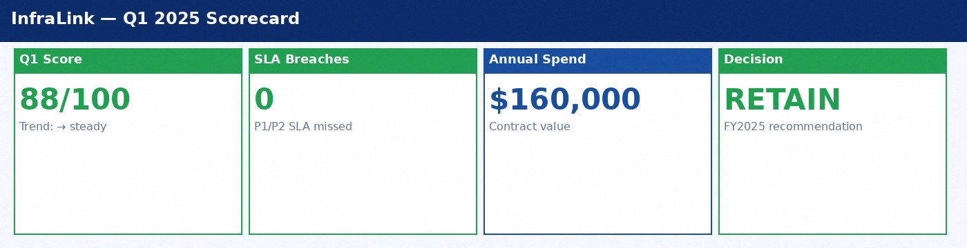
InfraLink — Scorecard

