Slide 1
IT QUARTERLY BUSINESS REVIEW — Q1 2025
IT Leadership | Board Distribution | Confidential
02 April 2025 | James Wu, CTO | David Kim, CISO | Angela Brooks, IT Director

Slide 2
Q1 2025 Executive Summary
Service performance — three SLA categories in BREACH
  P1 SLA: 84.2% vs 99.0% — INC0001234 APAC BGP outage drove 2 of 4 P1 breaches
  P2 SLA: 91.7% vs 95.0% — INC0001789 DataVault API February breach
  Availability: 99.71% vs 99.9% — APAC 2h 35min = 0.29% monthly downtime
Key achievements
  ServiceNow Vancouver — zero post-go-live incidents — 8,412 flows migrated
  CMDB coverage: 68%→78% — Phase 1 discovery patterns deployed
Investments required — decisions urgent
  GPU cluster 98.1% peak — $220K decision required by January 24
  SAN Primary: 9.3 months to full — $310K order needed by March 15

Slide 3
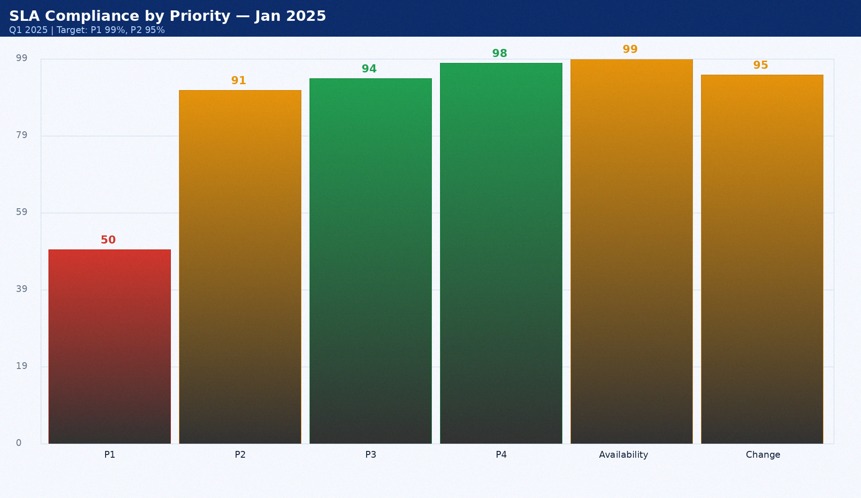
SLA Compliance by Priority — Jan 2025
Q1 2025 | Target: P1 99%, P2 95%

Slide 4
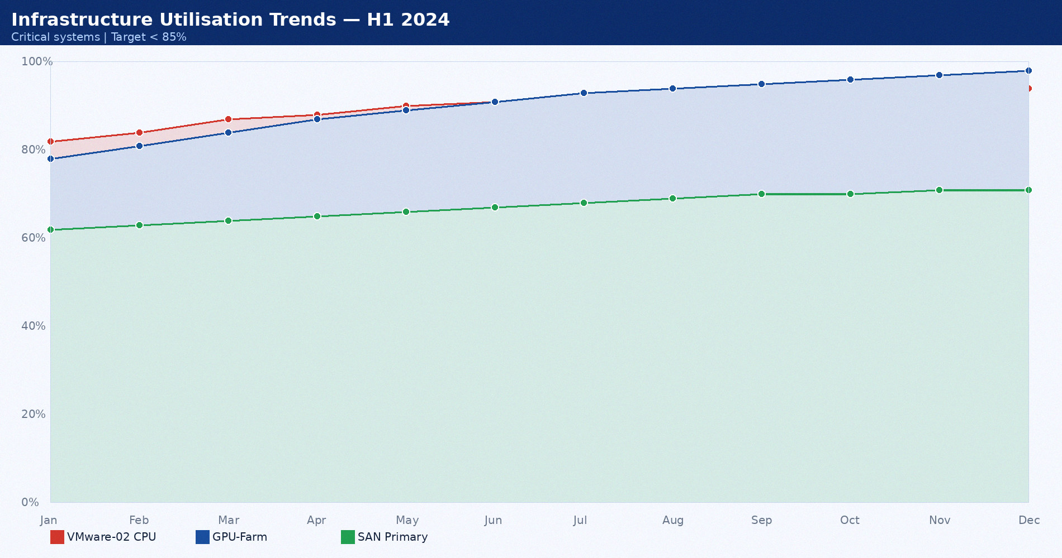
Infrastructure Utilisation Trends — H1 2024
Critical systems | Target < 85%

Slide 5
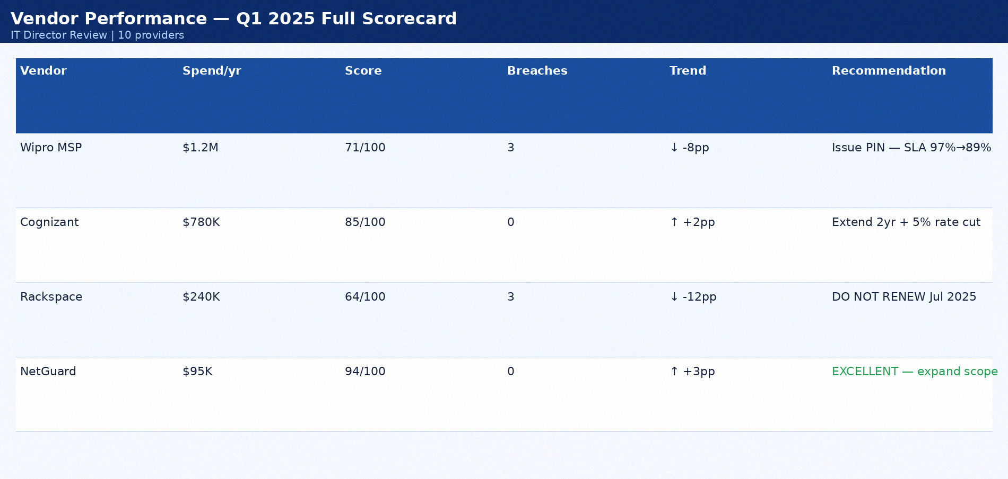
Vendor Performance — Q1 2025 Full Scorecard
IT Director Review | 10 providers

Slide 6
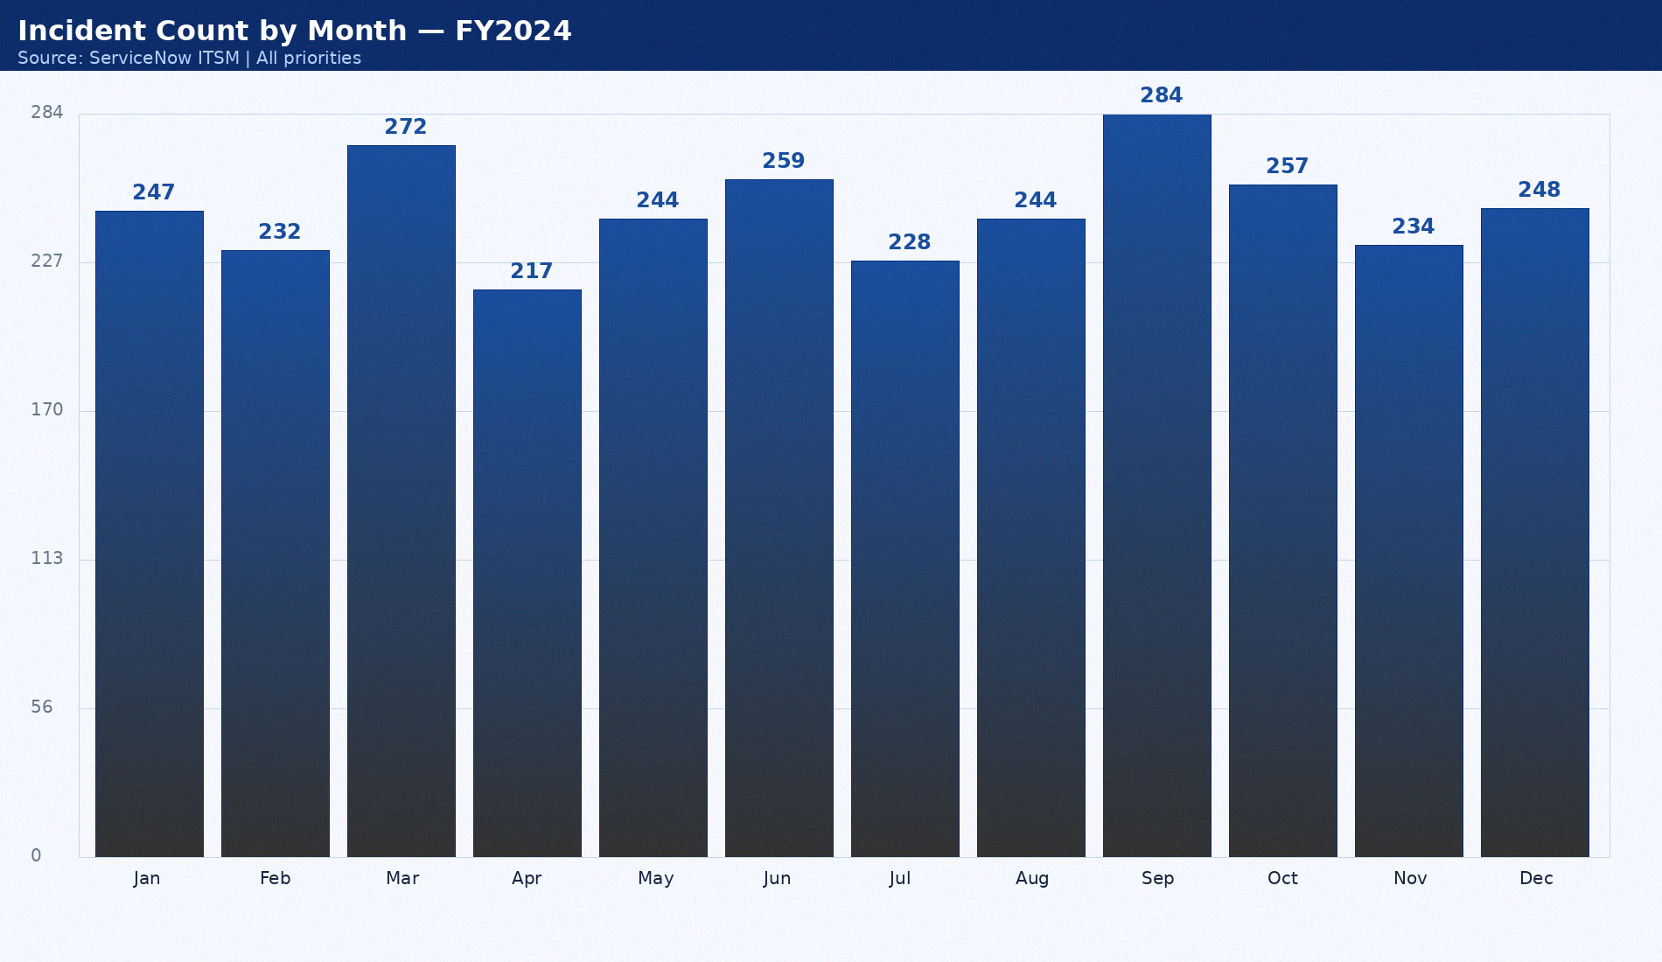
Incident Count by Month — FY2024
Source: ServiceNow ITSM | All priorities

Slide 7
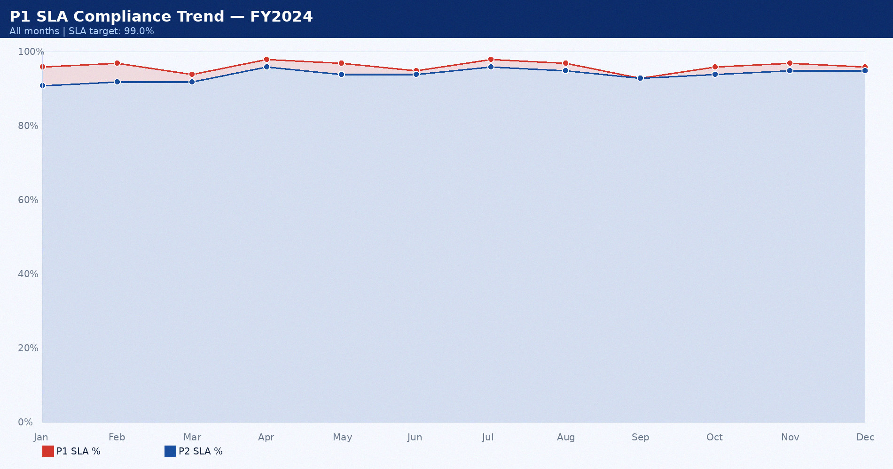
P1 SLA Compliance Trend — FY2024
All months | SLA target: 99.0%

Slide 8
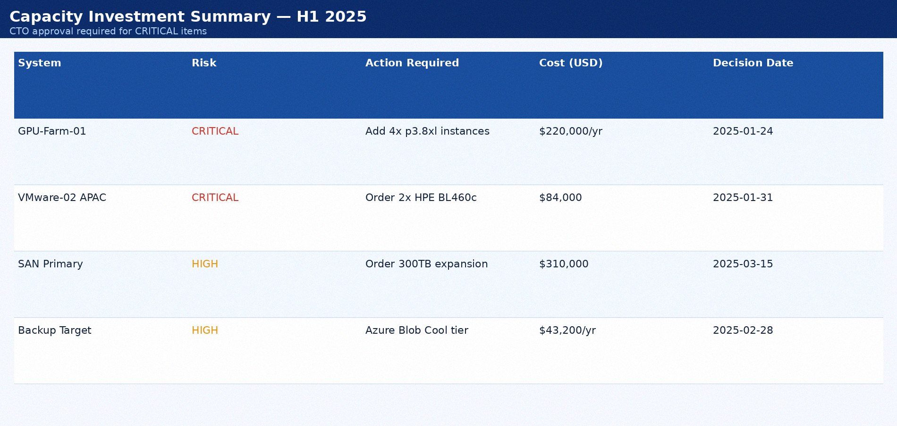
Capacity Investment Summary — H1 2025
CTO approval required for CRITICAL items

Slide 9
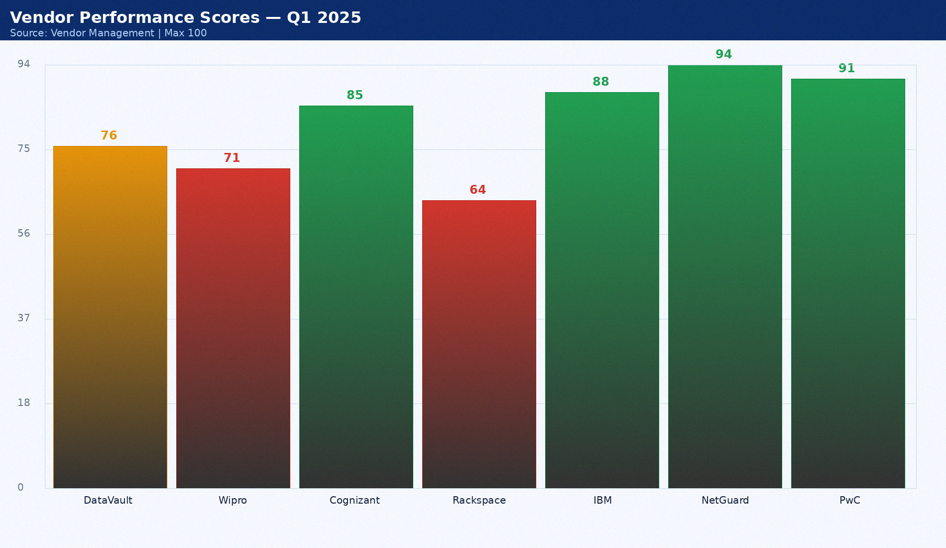
Vendor Performance Scores — Q1 2025
Source: Vendor Management | Max 100

Slide 10
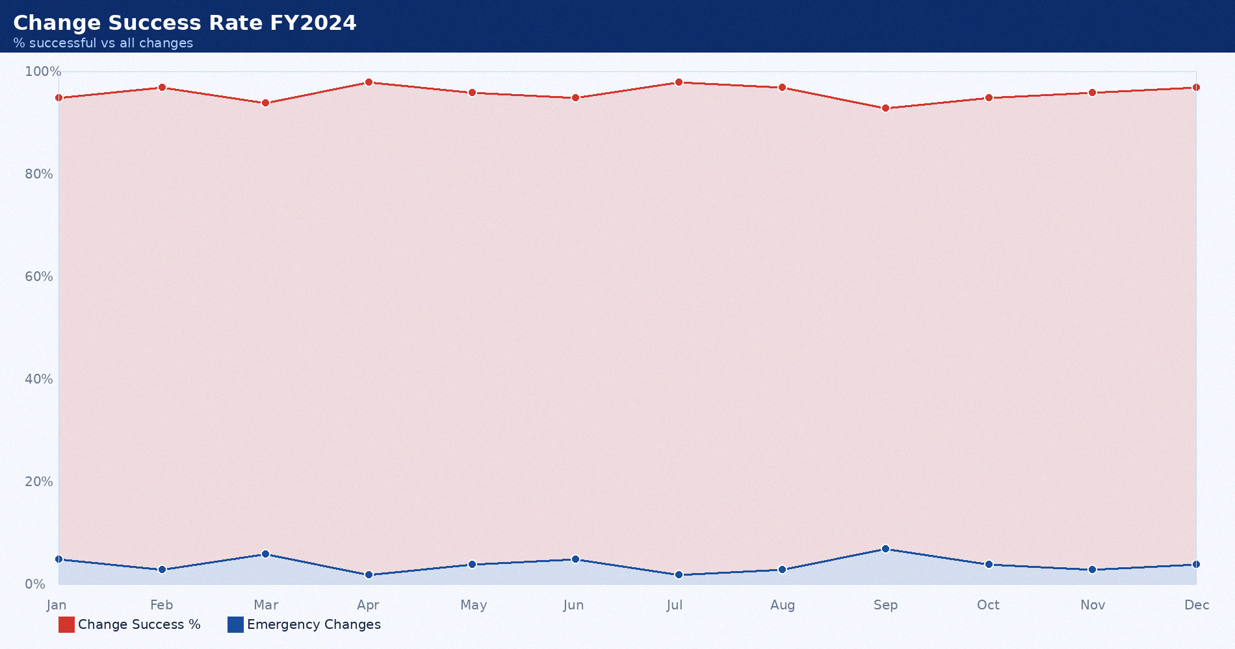
Change Success Rate FY2024
% successful vs all changes

Slide 11
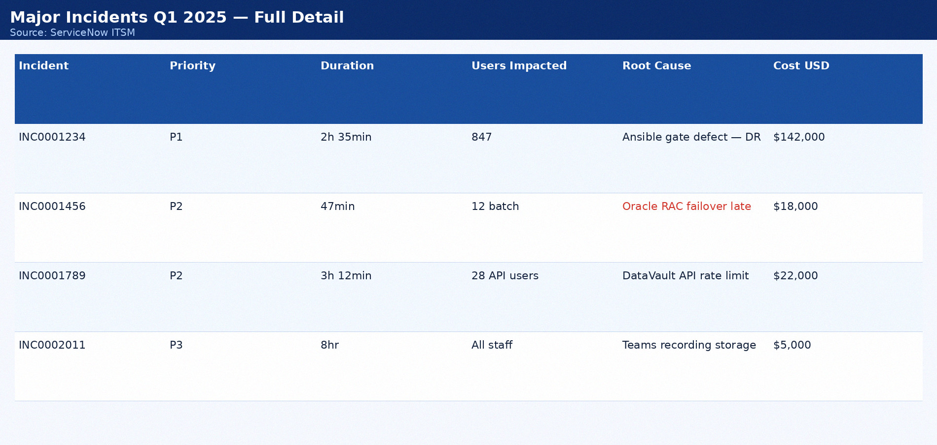
Major Incidents Q1 2025 — Full Detail
Source: ServiceNow ITSM

Slide 12
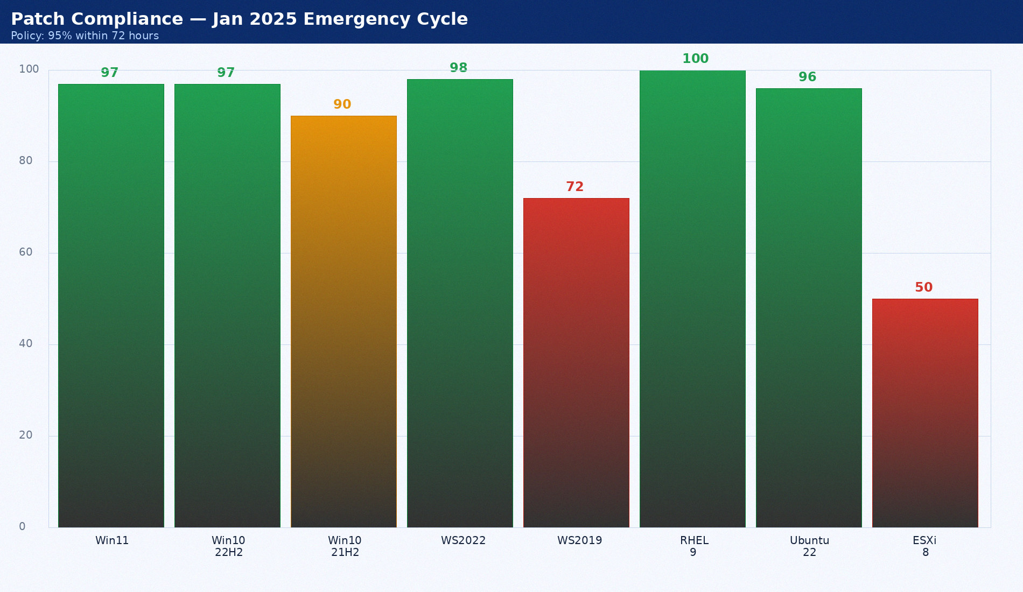
Patch Compliance — Jan 2025 Emergency Cycle
Policy: 95% within 72 hours

Slide 13
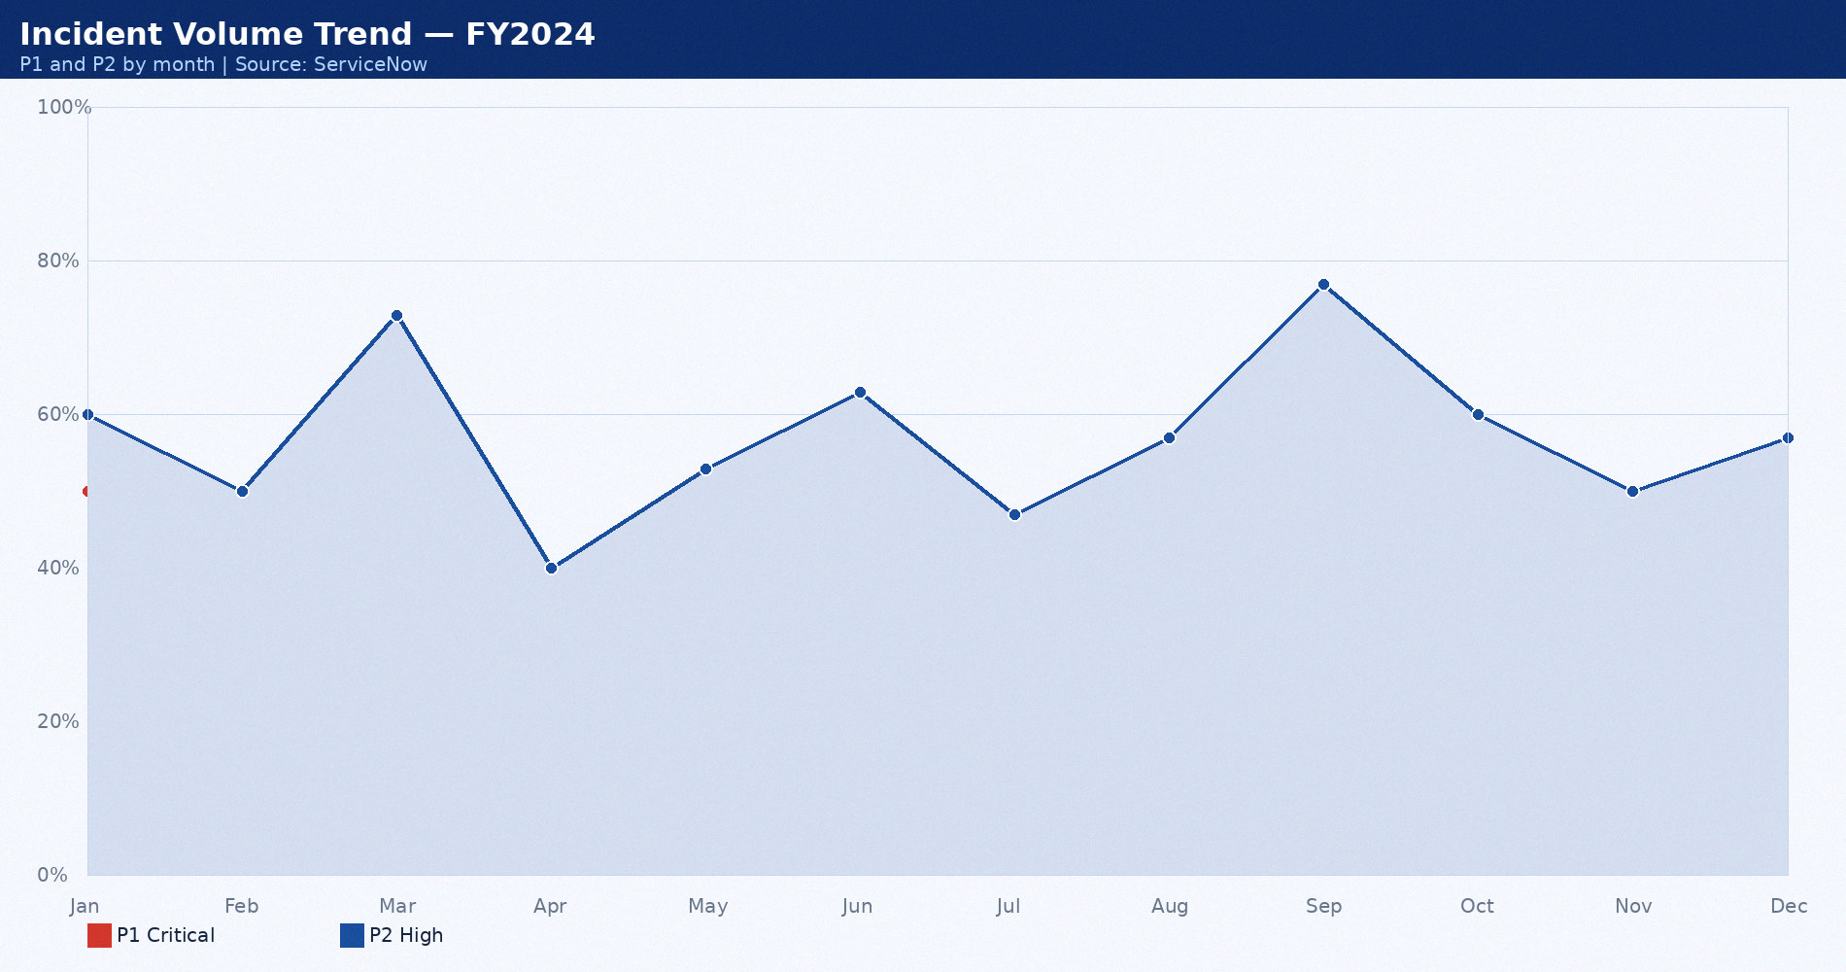
Incident Volume Trend — FY2024
P1 and P2 by month | Source: ServiceNow

Slide 14
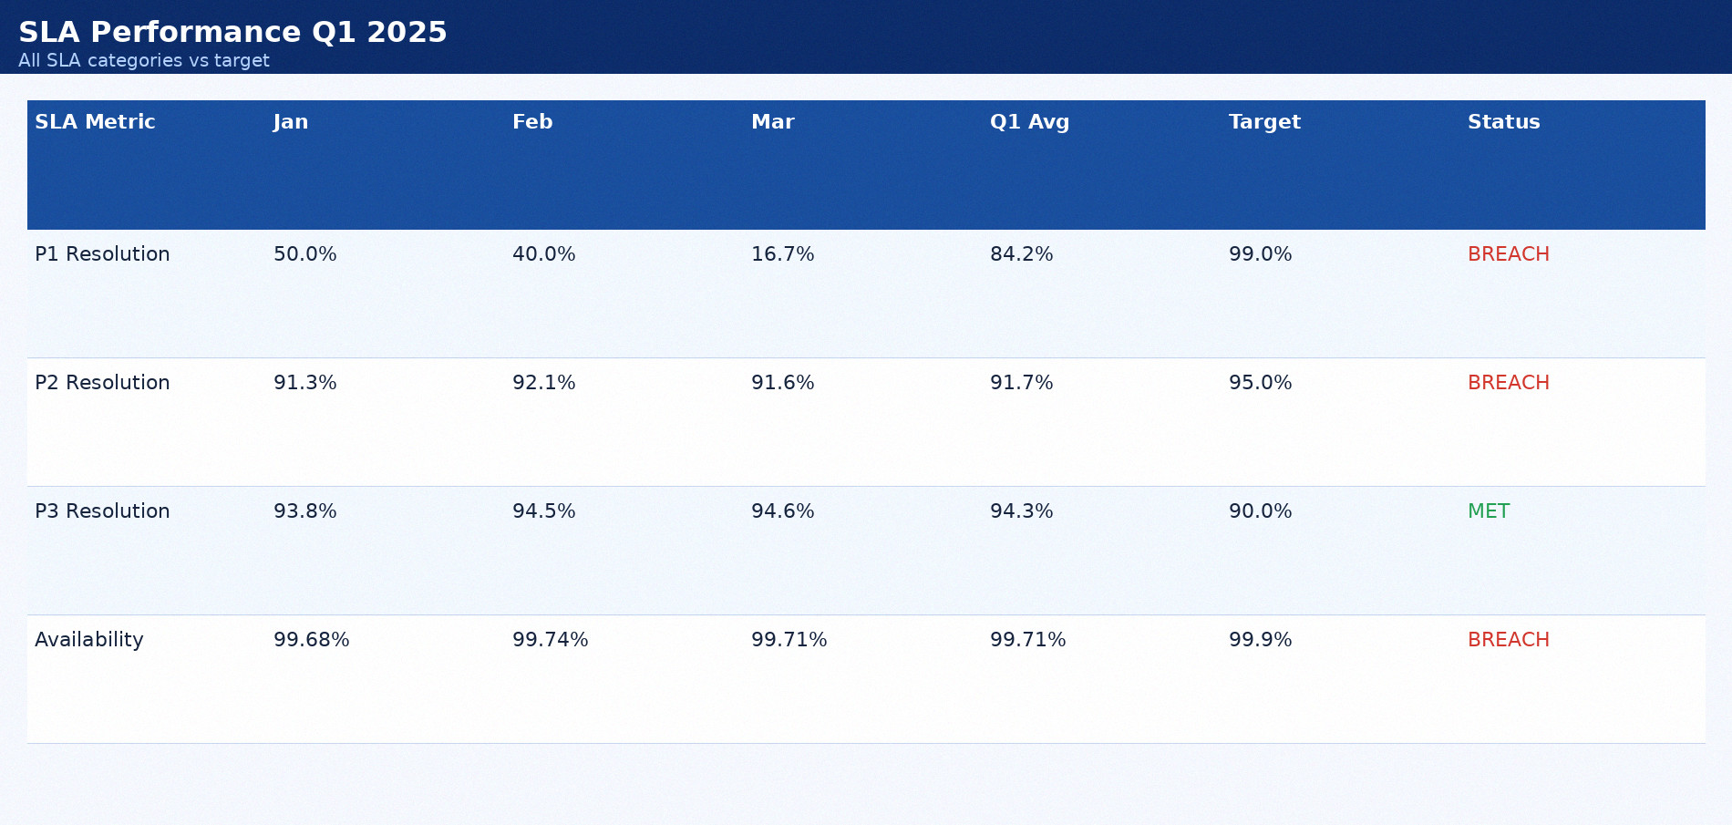
SLA Performance Q1 2025
All SLA categories vs target

Slide 15
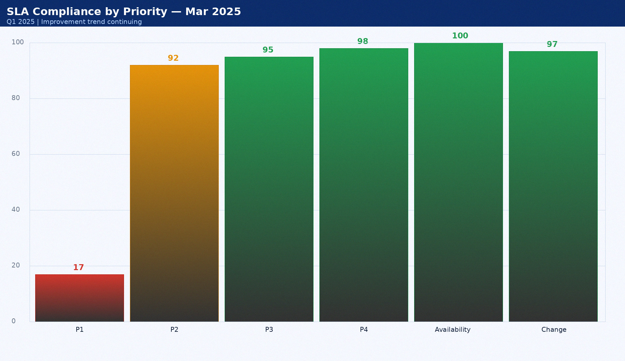
SLA Compliance by Priority — Mar 2025
Q1 2025 | Improvement trend continuing

Slide 16
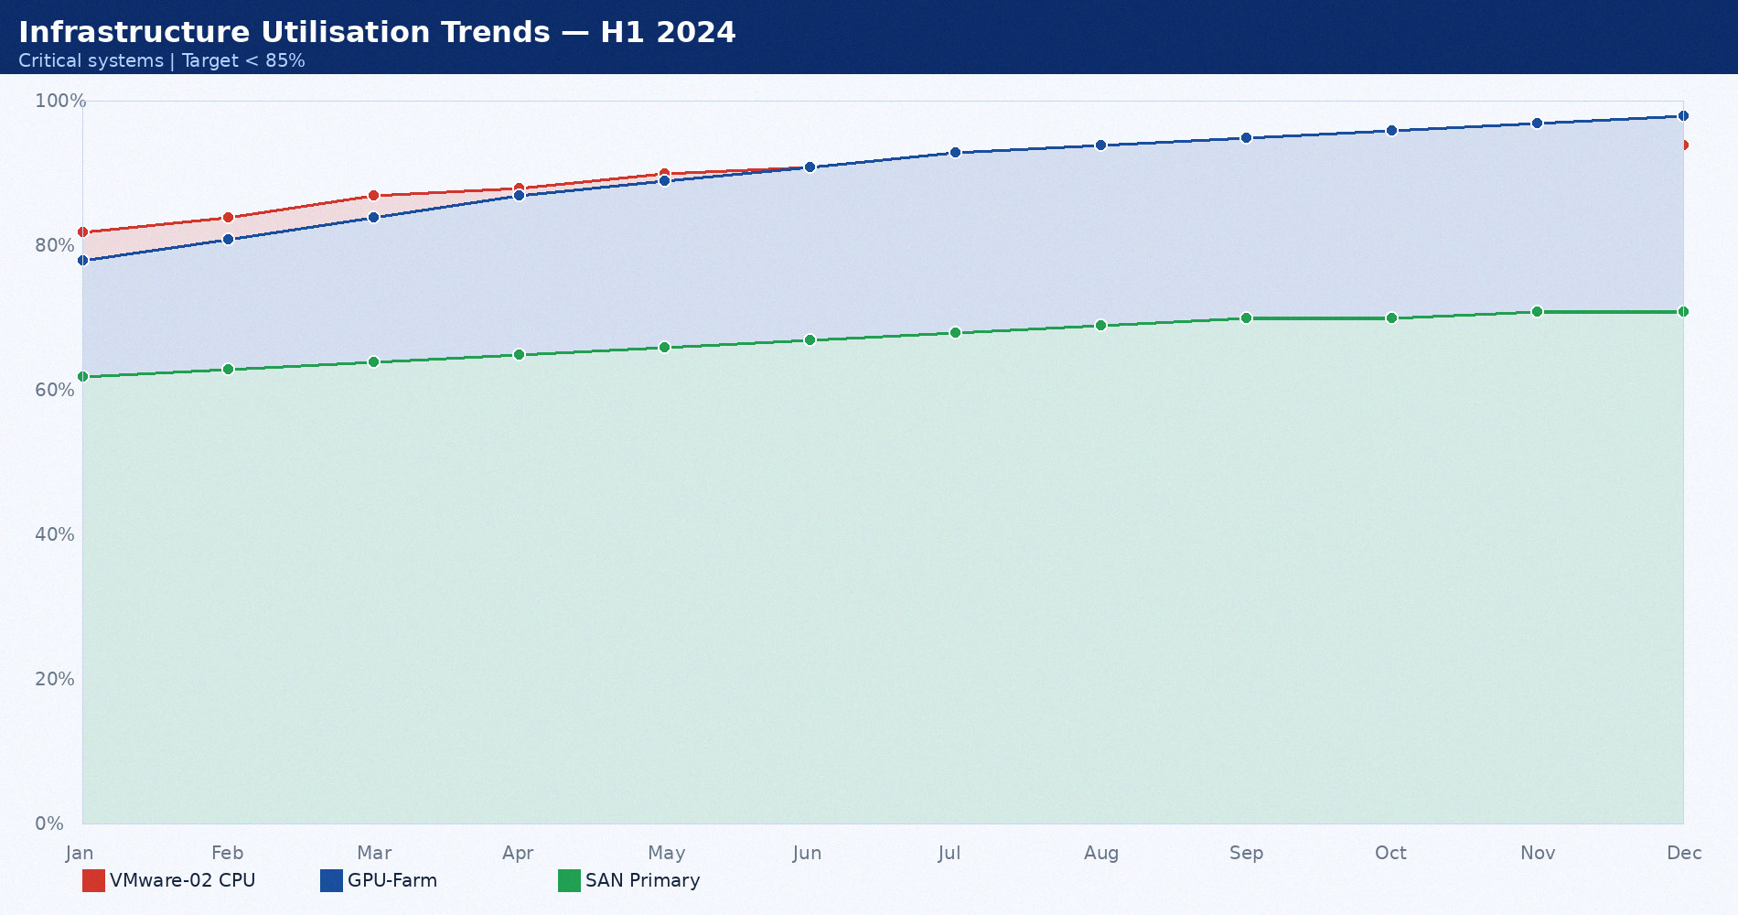
Infrastructure Utilisation Trends — H1 2024
Critical systems | Target < 85%

Slide 17
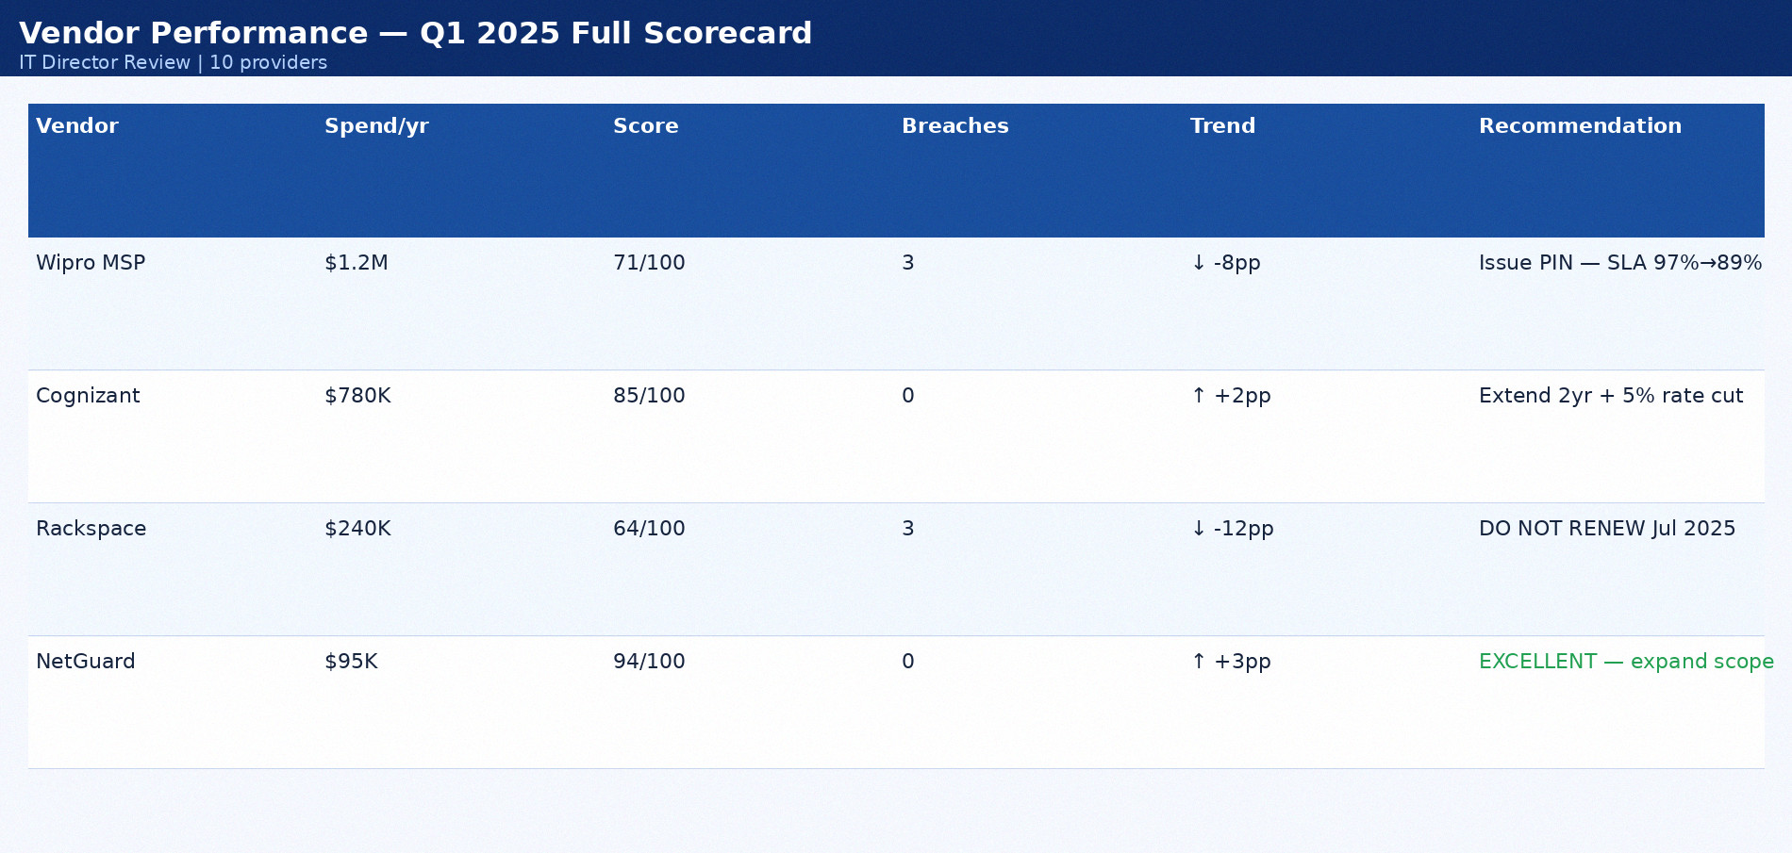
Vendor Performance — Q1 2025 Full Scorecard
IT Director Review | 10 providers

Slide 18
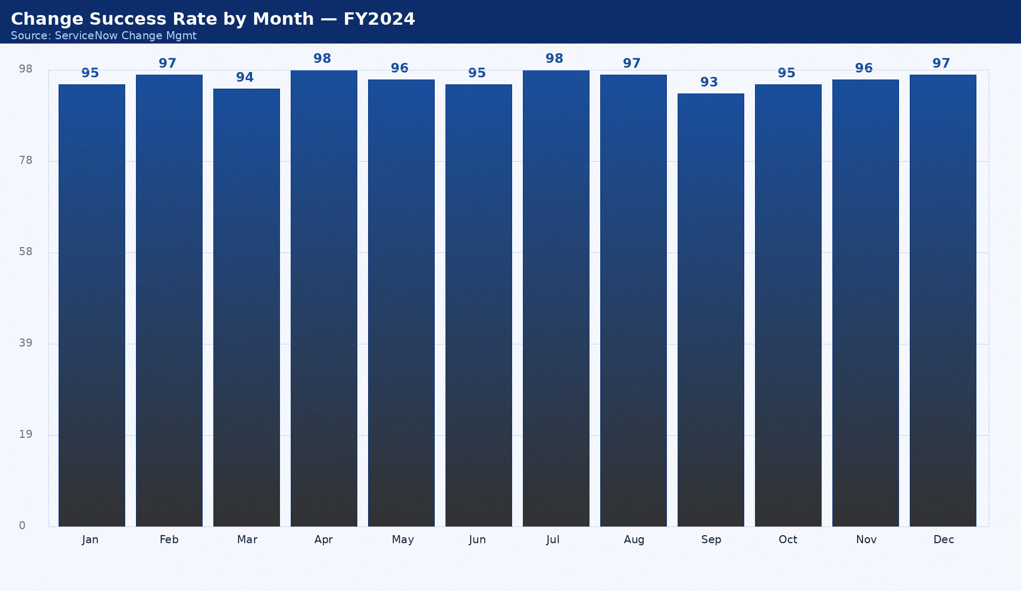
Change Success Rate by Month — FY2024
Source: ServiceNow Change Mgmt

Slide 19

P1 SLA Compliance Trend — FY2024
All months | SLA target: 99.0%

Slide 20
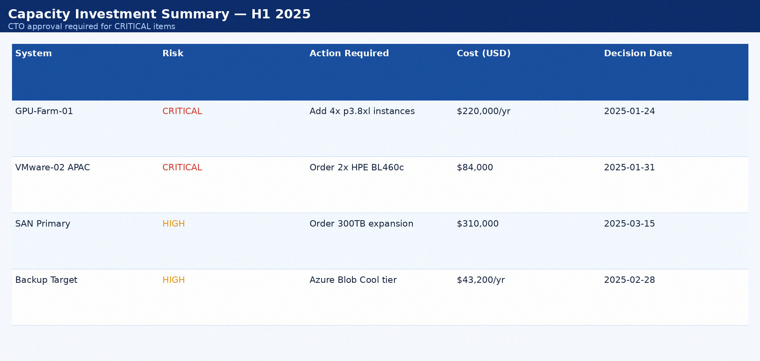
Capacity Investment Summary — H1 2025
CTO approval required for CRITICAL items

Slide 21
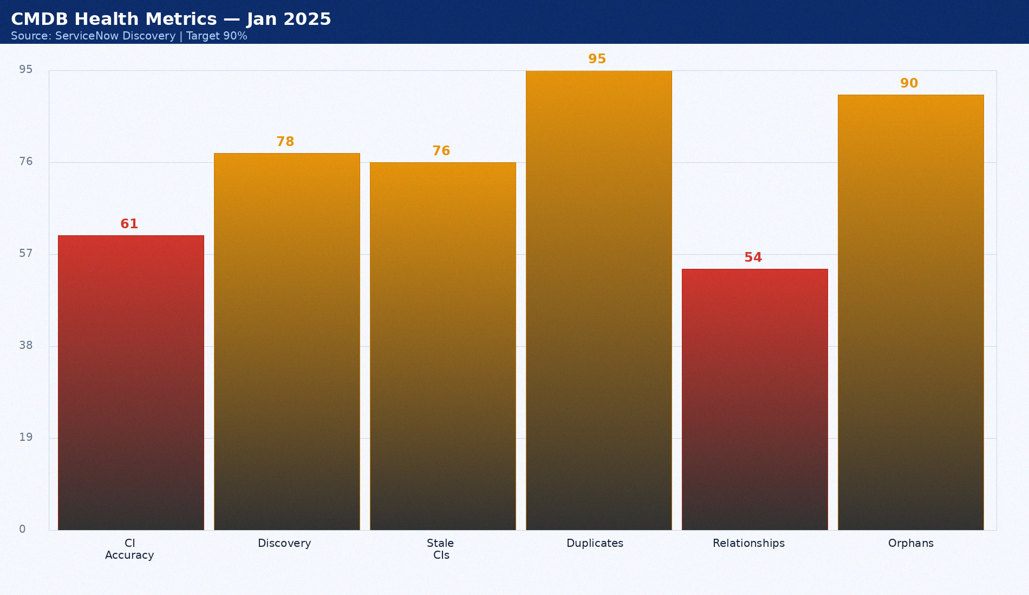
CMDB Health Metrics — Jan 2025
Source: ServiceNow Discovery | Target 90%

Slide 22

Change Success Rate FY2024
% successful vs all changes

Slide 23
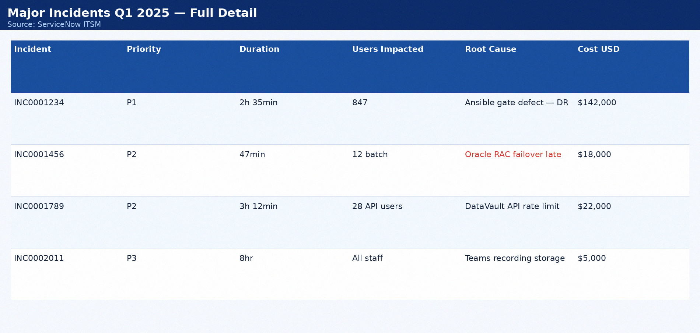
Major Incidents Q1 2025 — Full Detail
Source: ServiceNow ITSM

Slide 24
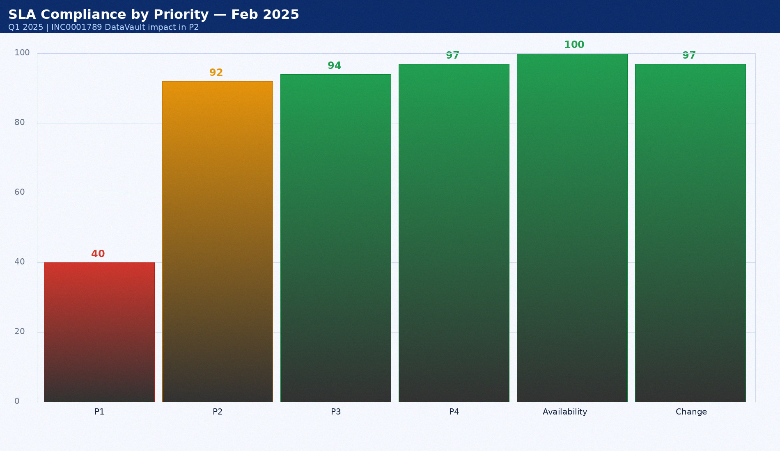
SLA Compliance by Priority — Feb 2025
Q1 2025 | INC0001789 DataVault impact in P2

Slide 25

Incident Volume Trend — FY2024
P1 and P2 by month | Source: ServiceNow

Slide 26
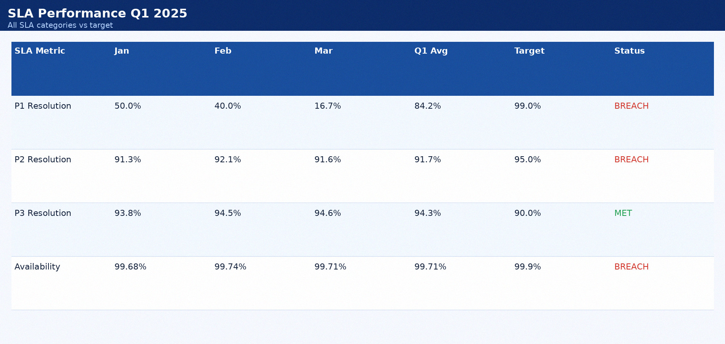
SLA Performance Q1 2025
All SLA categories vs target

Slide 27
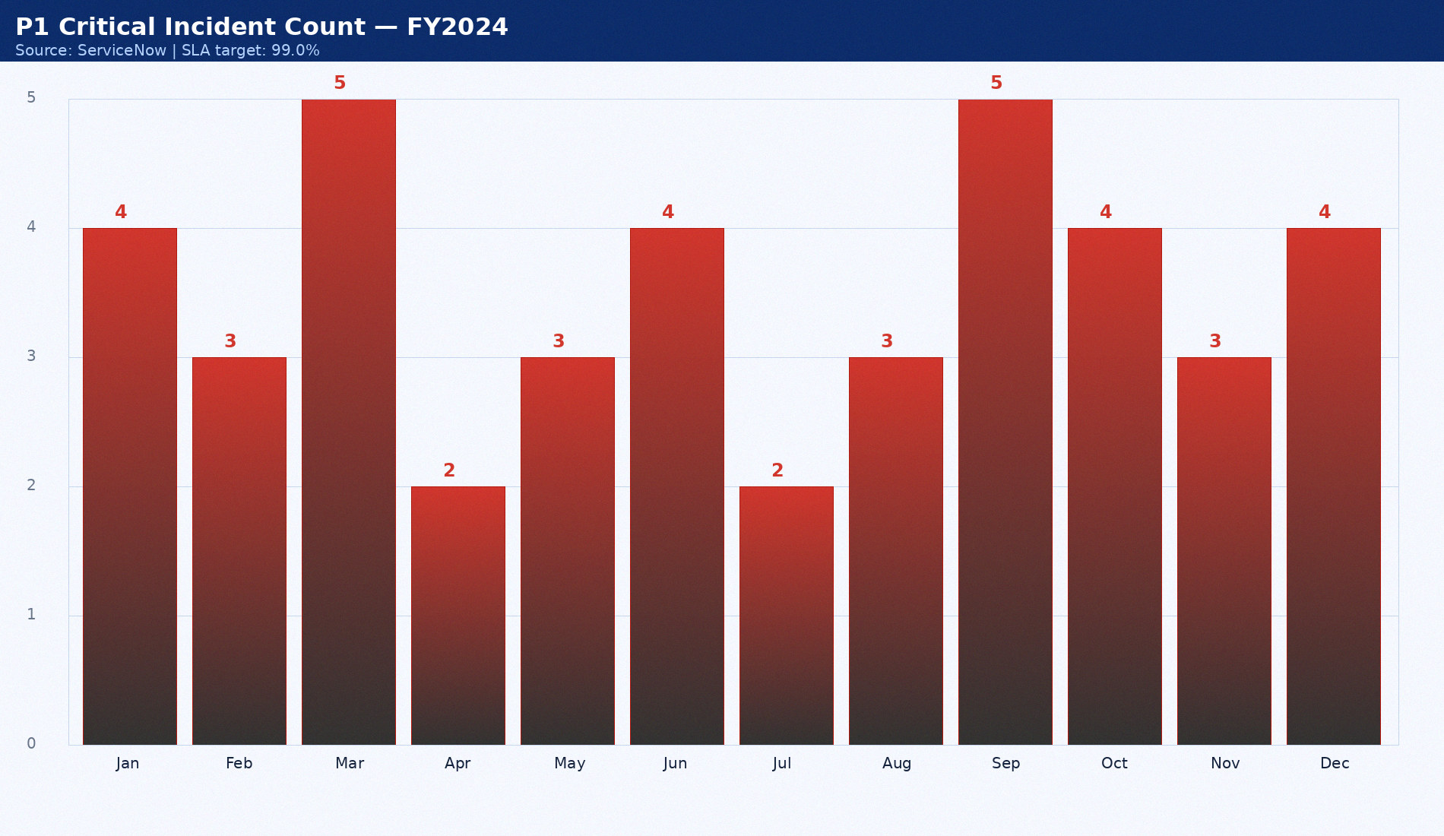
P1 Critical Incident Count — FY2024
Source: ServiceNow | SLA target: 99.0%

Slide 28

Infrastructure Utilisation Trends — H1 2024
Critical systems | Target < 85%

Slide 29

Vendor Performance — Q1 2025 Full Scorecard
IT Director Review | 10 providers

Slide 30
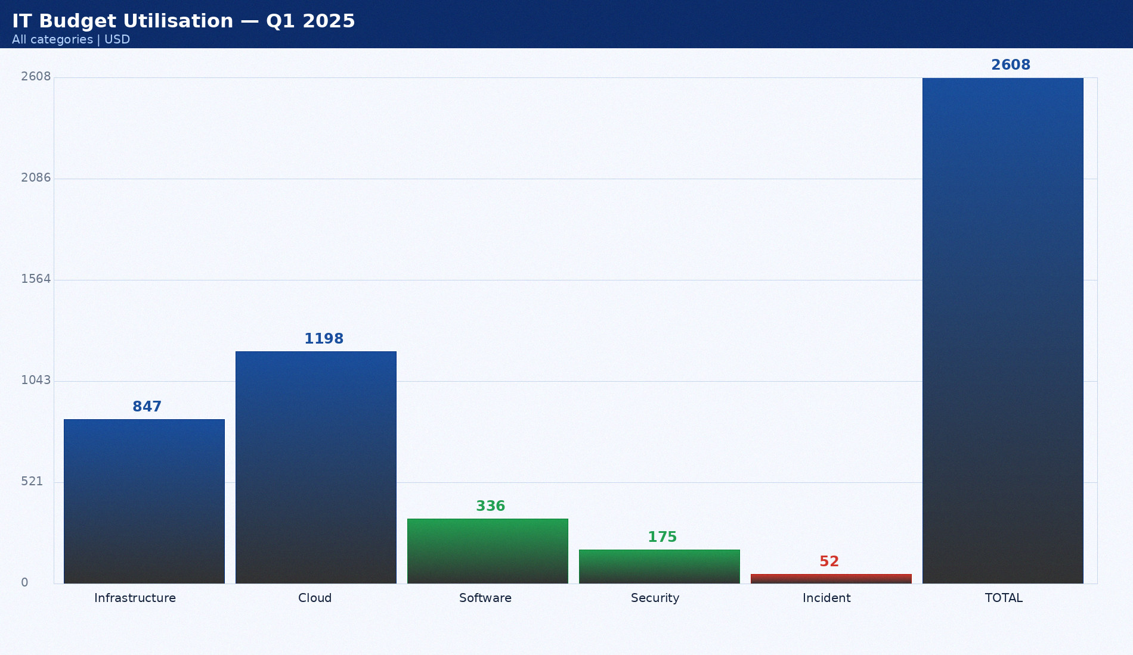
IT Budget Utilisation — Q1 2025
All categories | USD

Slide 31

P1 SLA Compliance Trend — FY2024
All months | SLA target: 99.0%

Slide 32

Capacity Investment Summary — H1 2025
CTO approval required for CRITICAL items

Slide 33

SLA Compliance by Priority — Jan 2025
Q1 2025 | Target: P1 99%, P2 95%

Slide 34

Change Success Rate FY2024
% successful vs all changes

Slide 35

Major Incidents Q1 2025 — Full Detail
Source: ServiceNow ITSM

Slide 36

Incident Count by Month — FY2024
Source: ServiceNow ITSM | All priorities

Slide 37

Incident Volume Trend — FY2024
P1 and P2 by month | Source: ServiceNow

Slide 38

SLA Performance Q1 2025
All SLA categories vs target

Slide 39

Vendor Performance Scores — Q1 2025
Source: Vendor Management | Max 100

Slide 40

Infrastructure Utilisation Trends — H1 2024
Critical systems | Target < 85%

Slide 41

Vendor Performance — Q1 2025 Full Scorecard
IT Director Review | 10 providers

Slide 42

Patch Compliance — Jan 2025 Emergency Cycle
Policy: 95% within 72 hours

Slide 43

P1 SLA Compliance Trend — FY2024
All months | SLA target: 99.0%

Slide 44

Capacity Investment Summary — H1 2025
CTO approval required for CRITICAL items

Slide 45

SLA Compliance by Priority — Mar 2025
Q1 2025 | Improvement trend continuing

Slide 46

Change Success Rate FY2024
% successful vs all changes

Slide 47

Major Incidents Q1 2025 — Full Detail
Source: ServiceNow ITSM

Slide 48

Change Success Rate by Month — FY2024
Source: ServiceNow Change Mgmt

Slide 49

Incident Volume Trend — FY2024
P1 and P2 by month | Source: ServiceNow

Slide 50
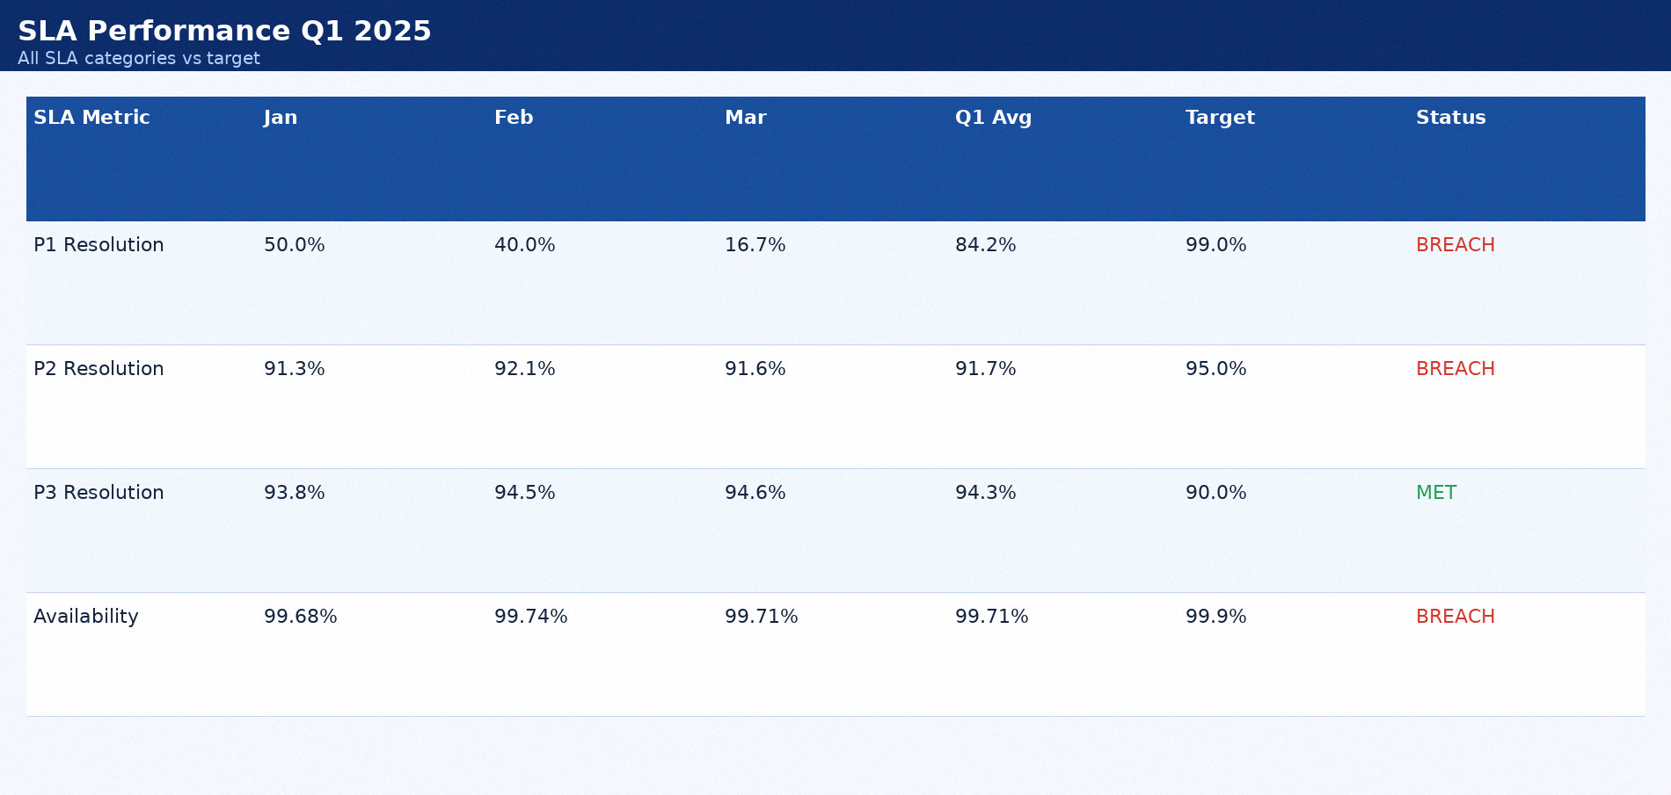
SLA Performance Q1 2025
All SLA categories vs target

Slide 51

CMDB Health Metrics — Jan 2025
Source: ServiceNow Discovery | Target 90%

Slide 52

Infrastructure Utilisation Trends — H1 2024
Critical systems | Target < 85%

Slide 53
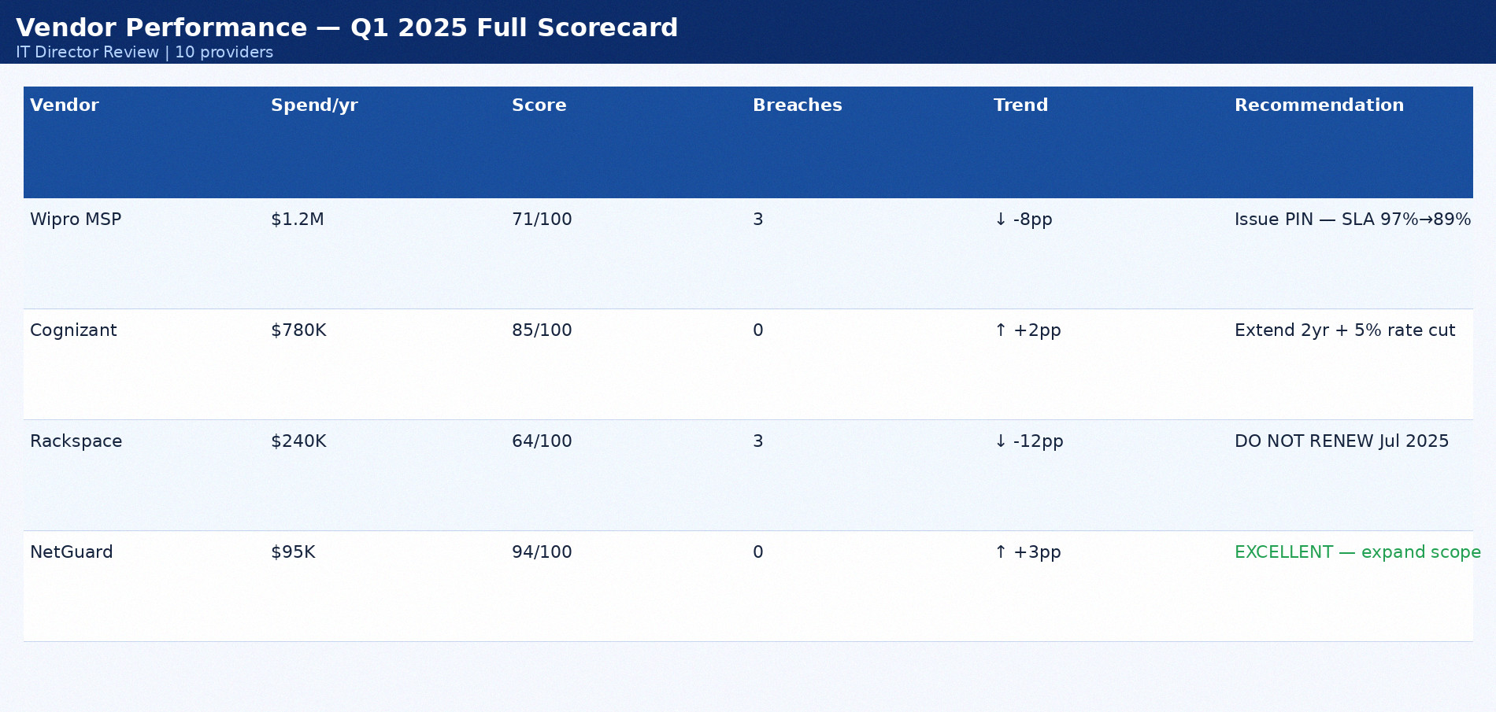
Vendor Performance — Q1 2025 Full Scorecard
IT Director Review | 10 providers

Slide 54

SLA Compliance by Priority — Feb 2025
Q1 2025 | INC0001789 DataVault impact in P2

Slide 55
Q2 2025 Priorities and Investment Decisions
Priority | Item | Owner | Deadline | Investment
CRITICAL | GPU Farm p3.8xl reservation | James Wu | 2025-01-24 | $220K/yr
CRITICAL | VMware APAC blade order | Angela Brooks | 2025-01-31 | $84K capex
HIGH | SAN Primary expansion | Mike Torres | 2025-03-15 | $310K capex
HIGH | Azure Blob backup overflow | Ravi Patel | 2025-02-28 | $43K/yr
HIGH | MFA: 14 admin accounts | David Kim | 2025-04-30 | Staff time only

