Slide 1
ANNUAL SECURITY REVIEW — 2024
Board of Directors and IT Leadership | Classification: Restricted
20 January 2025 | David Kim, CISO

Slide 2
2024 Security Posture Overview
Overall maturity: Level 2 → Level 2.5 (CMMI)
  ISO 27001:2022: 84.0% (100/119 controls passed)
  SOC 2 Type II: clean opinion — effective controls throughout 2024
Key achievements
  ZTNA: 1,200 of 1,400 remote workers — VPN replacement in progress
  CrowdStrike Falcon EDR: 100% of endpoints covered
  Patch compliance: 88.4% → 97.1% (72-hour policy window)
Gaps requiring 2025 action
  14 admin accounts without MFA — CF-2024-001 High finding
  CMDB at 61.4% — cannot correlate assets to vulnerabilities effectively

Slide 3
ISO 27001 Compliance by Domain
Ernst and Young LLP — Q4 2024 audit
  2 domains at 100%: A.5 Policies, A.10 Cryptography, SOC 2 A1
  Lowest domain: A.15 Supplier Relationships — 71.4% — DataVault gap
  A.9 Access Control: 83.3% — 14 admin accounts without MFA (HIGH)
Remediation actions
  MFA enforcement: April 30, 2025 — CISO mandate
  DataVault annual review: March 31, 2025
  Access Control: stale accounts — April 30, 2025 (CF-2024-001, CF-2024-006)

Slide 4
Vulnerability Management 2024
Critical vulnerabilities (CVSS ≥ 9.0) — 2024 summary
  Identified: 28 critical CVEs affecting production systems
  Remediated within 72hr: 26 of 28 (92.9%)
  Outstanding: Log4Shell (CVE-2021-44228) — 3 legacy Java apps isolated
January 2025 emergency cycle
  CVE-2024-21413 (9.8): all 14 Exchange servers patched within 24hr
  CVE-2024-43461 (9.1): 3,218 endpoints — 96.6% complete, 110 outstanding
  CVE-2024-38112 (8.9): WS2019 — 71.8% compliant — BREACH status

Slide 5
Zero Trust and Identity Progress
ZTNA deployment progress
  Deployed: 85.7% of remote workers (1,200 of 1,400)
  Remaining 200: legacy app dependency — ZTNA migration March 31, 2025
MFA coverage
  End users: 99.6% enrolled (3 on medical exemption)
  Admin accounts: 93.8% — 14 outstanding — hard deadline April 30, 2025
Privileged Access Management
  CyberArk PAM: all Domain Admin, DBA, and Network Admin roles
  Session recording: 100% of privileged sessions — reviewed monthly

Slide 6
Incident Response Summary 2024
Confirmed incidents by severity
  Critical: 0 confirmed (3 investigated — all false positive)
  High: 4 confirmed (ransomware attempt, phishing ×2, privilege escalation)
  Medium: 14 confirmed (misconfiguration and policy violations)
Detection and response metrics
  MTTD (High/Critical): 4.2 hours
  MTTR (High/Critical): 1.8 hours
GDPR notifications
  3 incidents requiring notification — 2 within 72-hour ICO window, 1 late (CF-2024-003)

Slide 7
2025 Security Roadmap
Q1 2025 — Foundation building
  MFA enforcement: 14 admin accounts — April 30 hard deadline (CISO mandate)
  ZTNA completion: 200 remaining VPN users — March 31
  Log4Shell remediation: legacy Java apps — February 28 deadline
Q2 2025 — Capability improvement
  CMDB accuracy to 80%: enables vulnerability-to-asset correlation
  All vendor security reviews completed — June 30
Q3-Q4 2025 — Transformation
  CNAPP deployment: cloud-native application protection platform
  ISO 27001 recertification audit — October 2025

Slide 8
ISO 27001 Compliance Summary — Q4 2024
Domain | Controls | Passed | Failed | Exceptions | Compliance
A.5 Policies | 4 | 4 | 0 | 0 | 100%
A.6 Organisation | 7 | 6 | 1 | 0 | 85.7%
A.9 Access Control | 18 | 15 | 2 | 1 | 83.3%
A.10 Cryptography | 6 | 6 | 0 | 0 | 100%
A.15 Suppliers | 7 | 5 | 1 | 1 | 71.4%
A.16 Incidents | 10 | 8 | 1 | 1 | 80.0%
A.17 Bus. Continuity | 9 | 7 | 2 | 0 | 77.8%
TOTAL | 119 | 100 | 12 | 7 | 84.0%

Slide 9
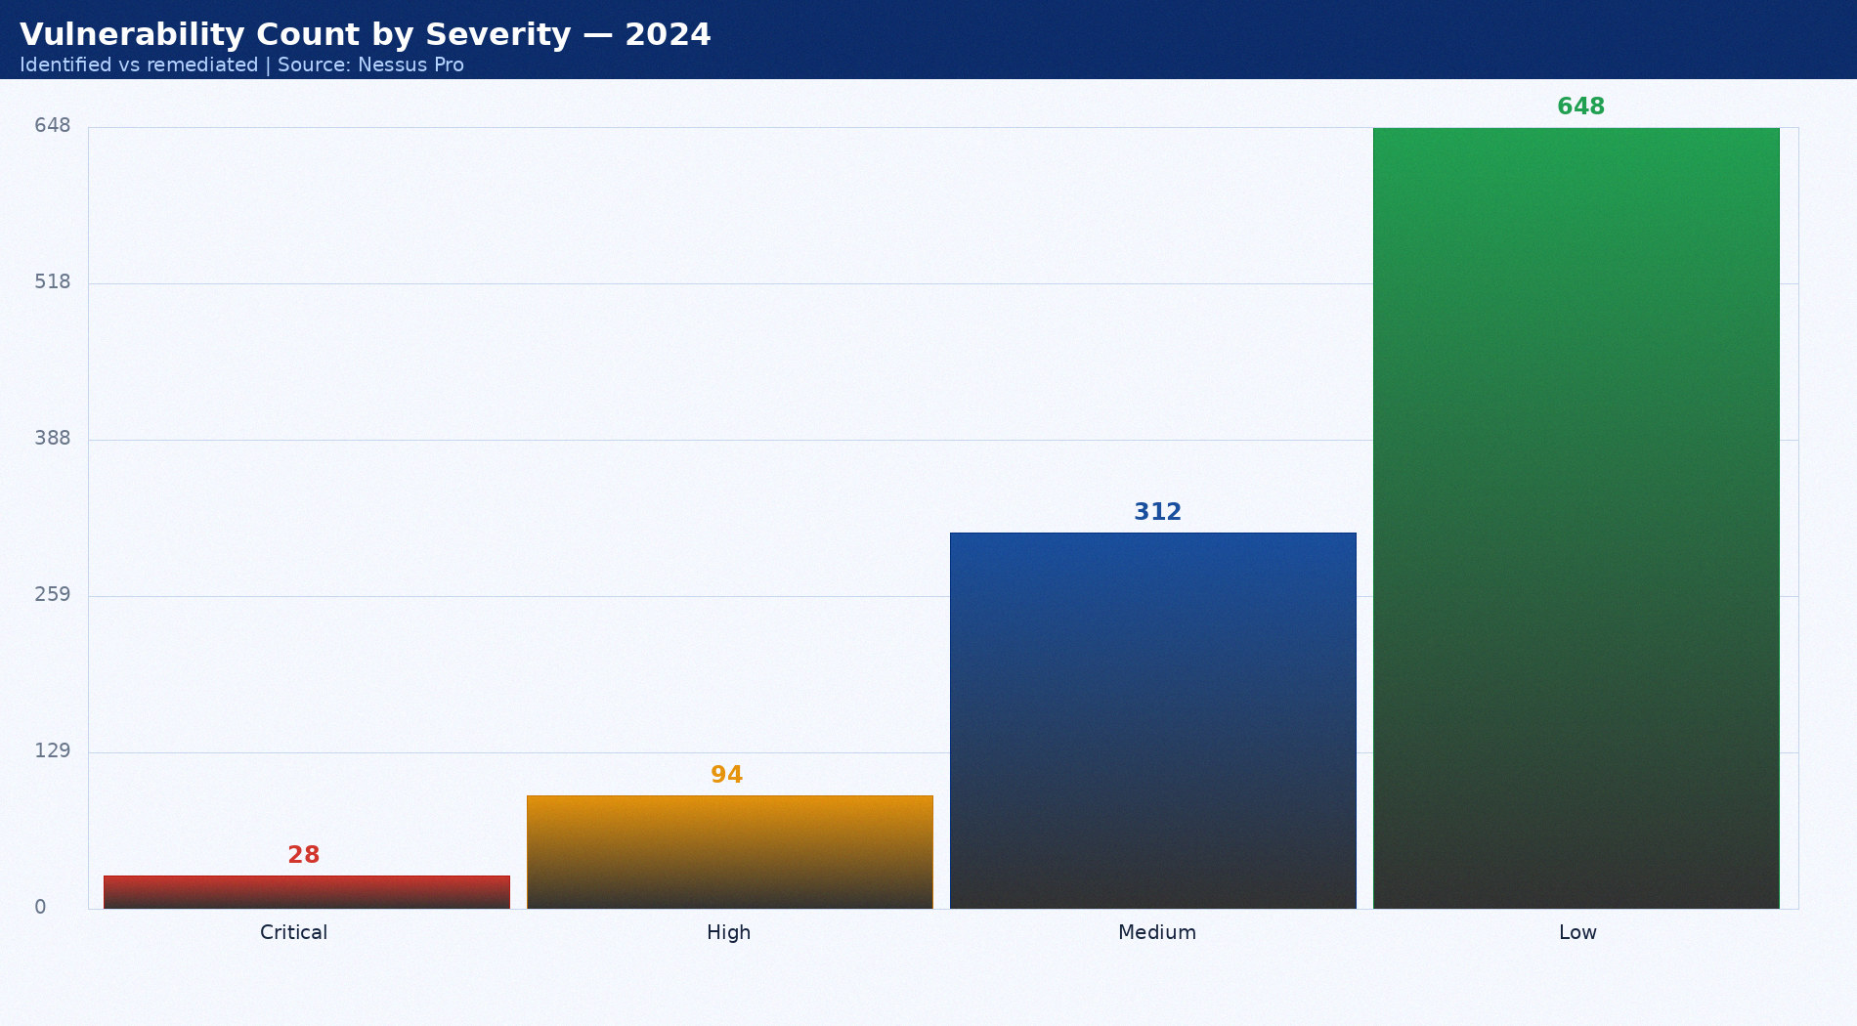
Vulnerability Count by Severity — 2024
Identified vs remediated | Source: Nessus Pro

Slide 10
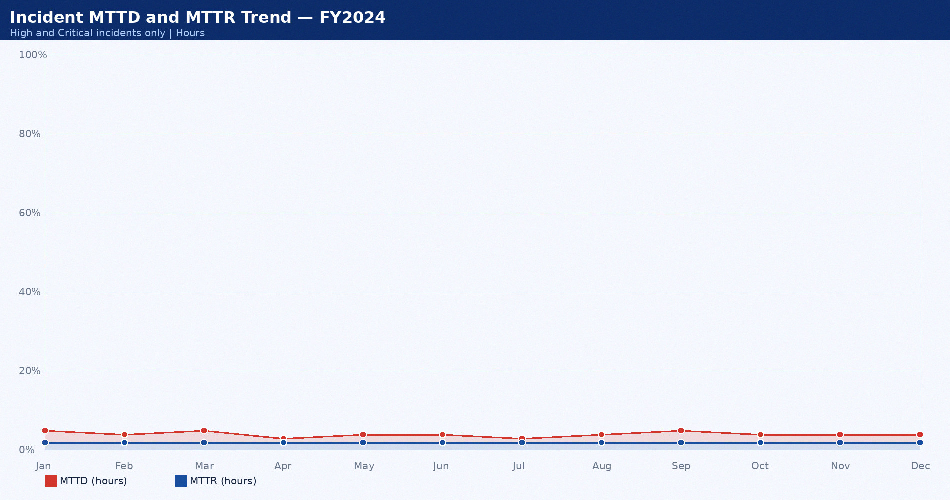
Incident MTTD and MTTR Trend — FY2024
High and Critical incidents only | Hours

Slide 11
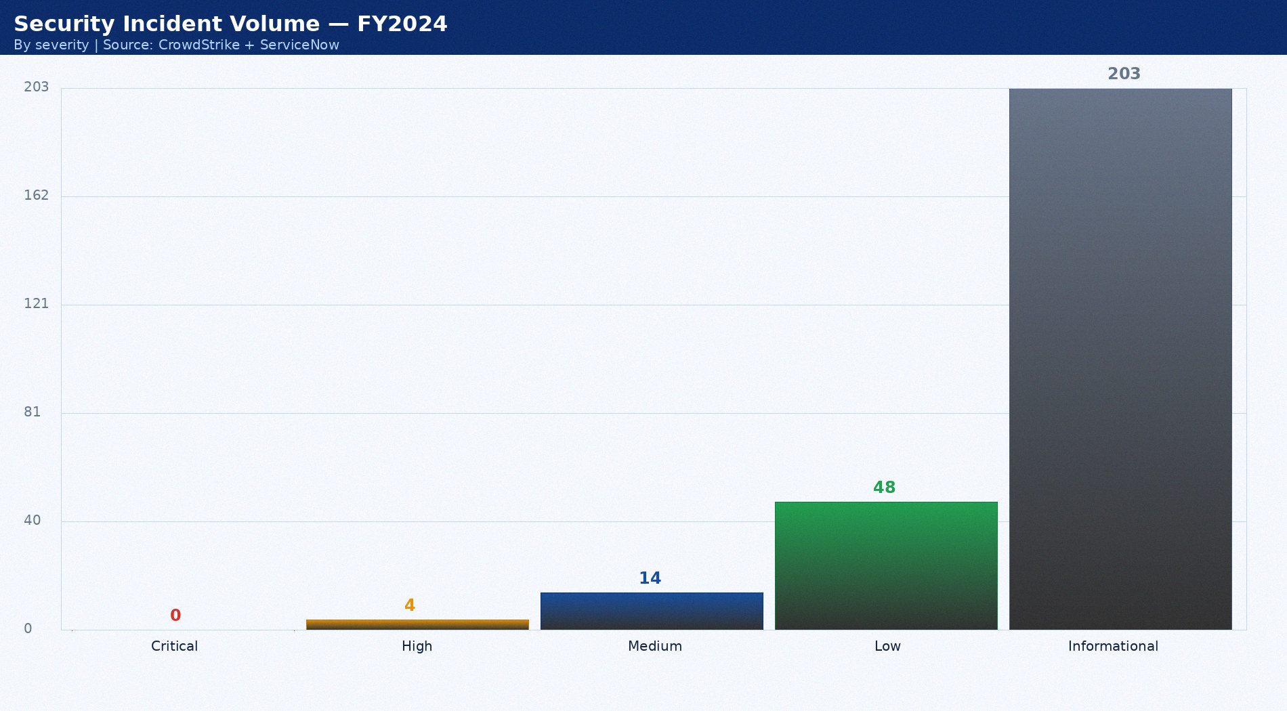
Security Incident Volume — FY2024
By severity | Source: CrowdStrike + ServiceNow

Slide 12
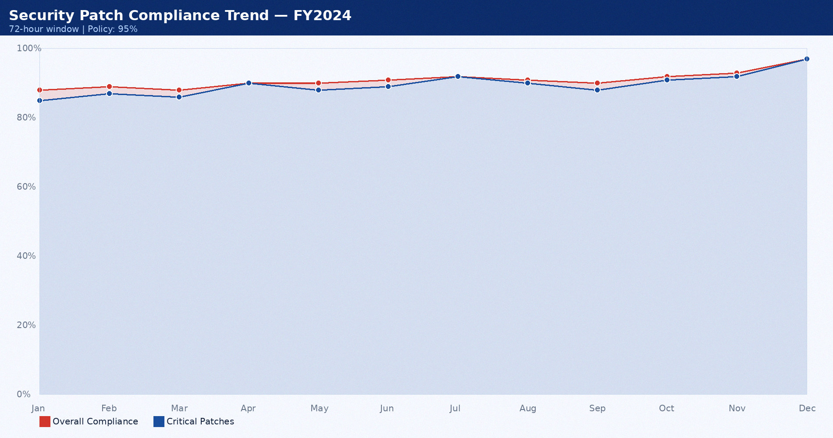
Security Patch Compliance Trend — FY2024
72-hour window | Policy: 95%

Slide 13
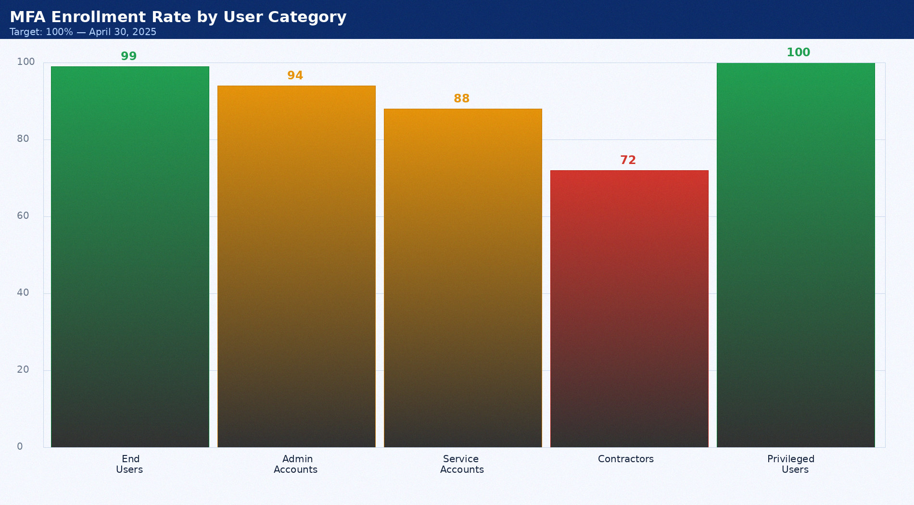
MFA Enrollment Rate by User Category
Target: 100% — April 30, 2025

Slide 14
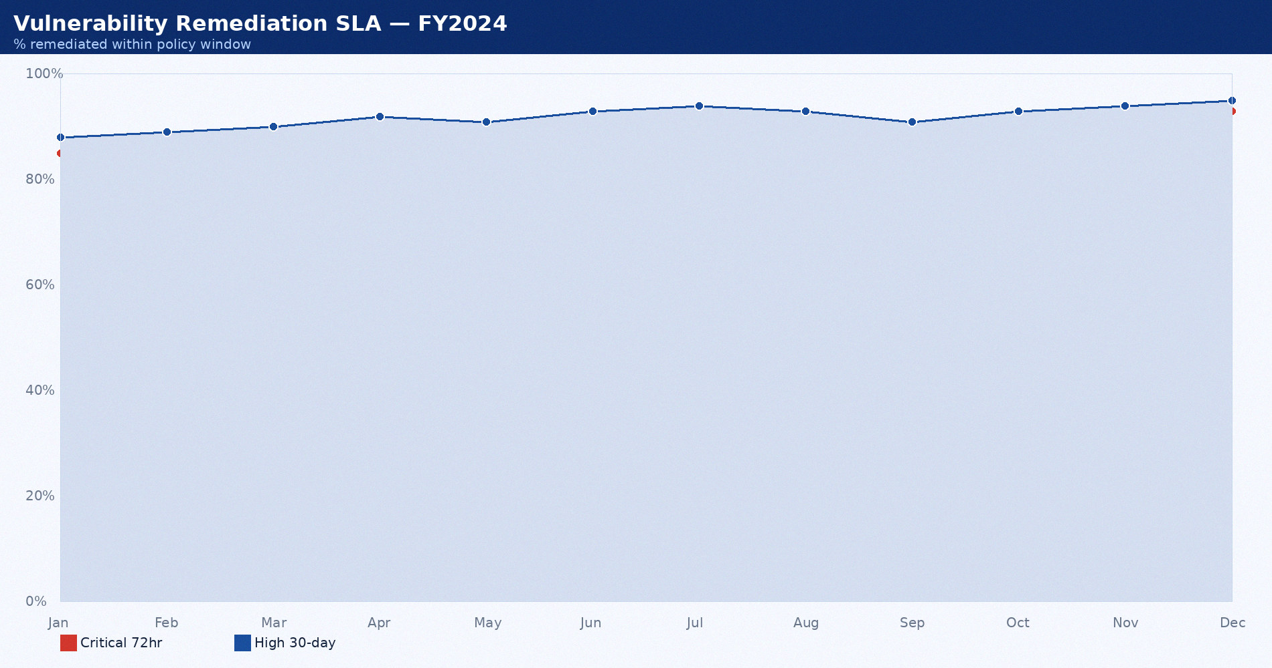
Vulnerability Remediation SLA — FY2024
% remediated within policy window

Slide 15

Vulnerability Count by Severity — 2024
Identified vs remediated | Source: Nessus Pro

Slide 16

Incident MTTD and MTTR Trend — FY2024
High and Critical incidents only | Hours

Slide 17

Security Incident Volume — FY2024
By severity | Source: CrowdStrike + ServiceNow

Slide 18
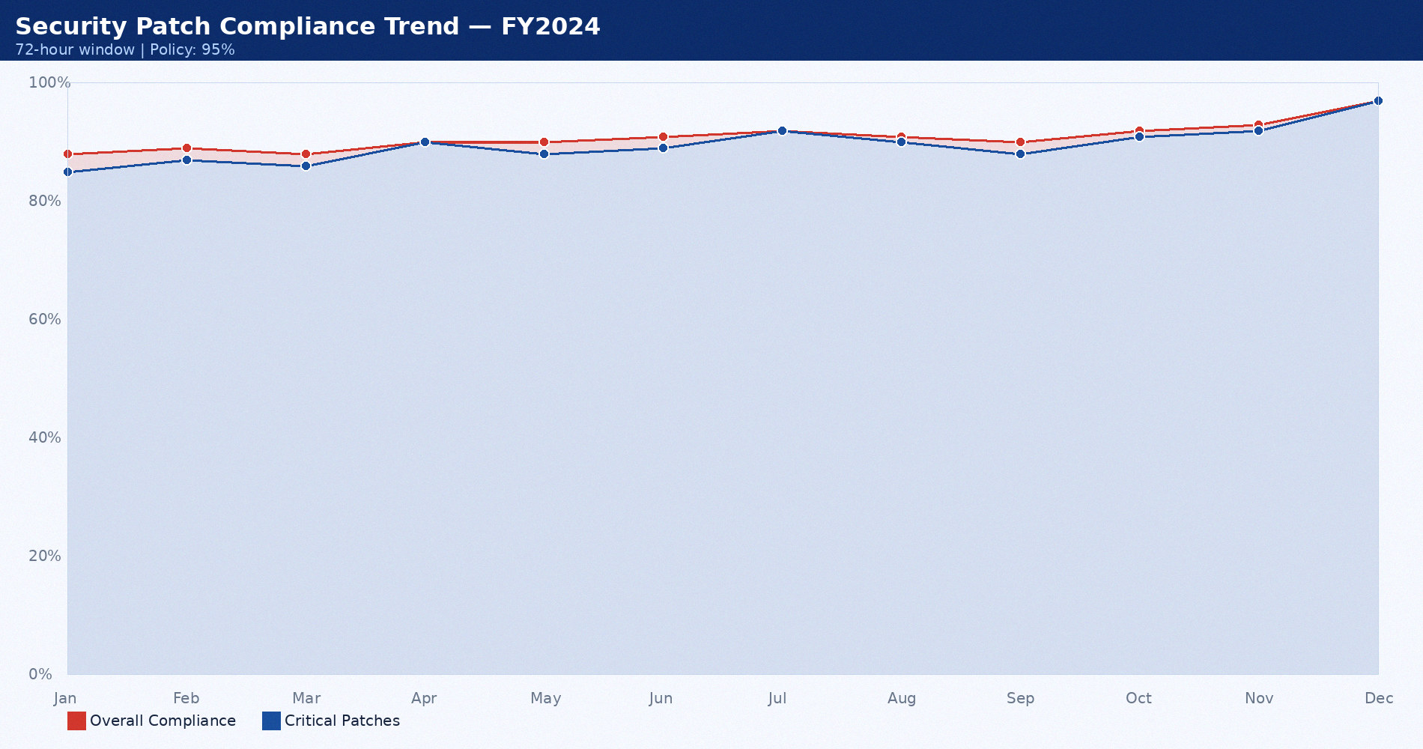
Security Patch Compliance Trend — FY2024
72-hour window | Policy: 95%

Slide 19

MFA Enrollment Rate by User Category
Target: 100% — April 30, 2025

Slide 20

Vulnerability Remediation SLA — FY2024
% remediated within policy window

Slide 21

Vulnerability Count by Severity — 2024
Identified vs remediated | Source: Nessus Pro

Slide 22

Incident MTTD and MTTR Trend — FY2024
High and Critical incidents only | Hours

Slide 23

Security Incident Volume — FY2024
By severity | Source: CrowdStrike + ServiceNow

Slide 24

Security Patch Compliance Trend — FY2024
72-hour window | Policy: 95%

Slide 25

MFA Enrollment Rate by User Category
Target: 100% — April 30, 2025

Slide 26

Vulnerability Remediation SLA — FY2024
% remediated within policy window

Slide 27

Vulnerability Count by Severity — 2024
Identified vs remediated | Source: Nessus Pro

Slide 28

Incident MTTD and MTTR Trend — FY2024
High and Critical incidents only | Hours

Slide 29

Security Incident Volume — FY2024
By severity | Source: CrowdStrike + ServiceNow

Slide 30

Security Patch Compliance Trend — FY2024
72-hour window | Policy: 95%

Slide 31

MFA Enrollment Rate by User Category
Target: 100% — April 30, 2025

Slide 32

Vulnerability Remediation SLA — FY2024
% remediated within policy window

Slide 33

Vulnerability Count by Severity — 2024
Identified vs remediated | Source: Nessus Pro

Slide 34
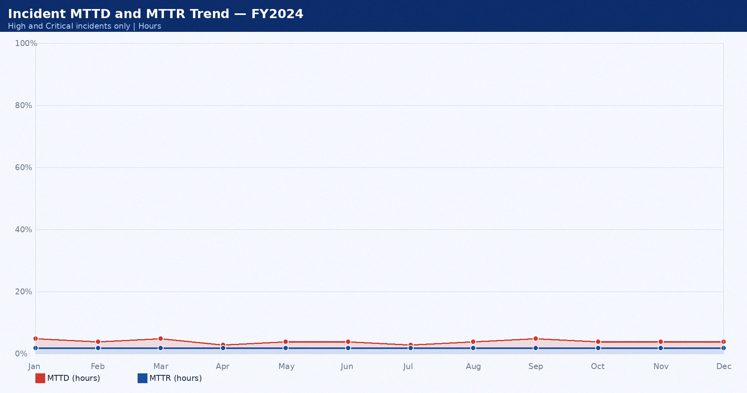
Incident MTTD and MTTR Trend — FY2024
High and Critical incidents only | Hours

Slide 35

Security Incident Volume — FY2024
By severity | Source: CrowdStrike + ServiceNow

Slide 36

Security Patch Compliance Trend — FY2024
72-hour window | Policy: 95%

Slide 37

MFA Enrollment Rate by User Category
Target: 100% — April 30, 2025

Slide 38

Vulnerability Remediation SLA — FY2024
% remediated within policy window

Slide 39

Vulnerability Count by Severity — 2024
Identified vs remediated | Source: Nessus Pro

Slide 40
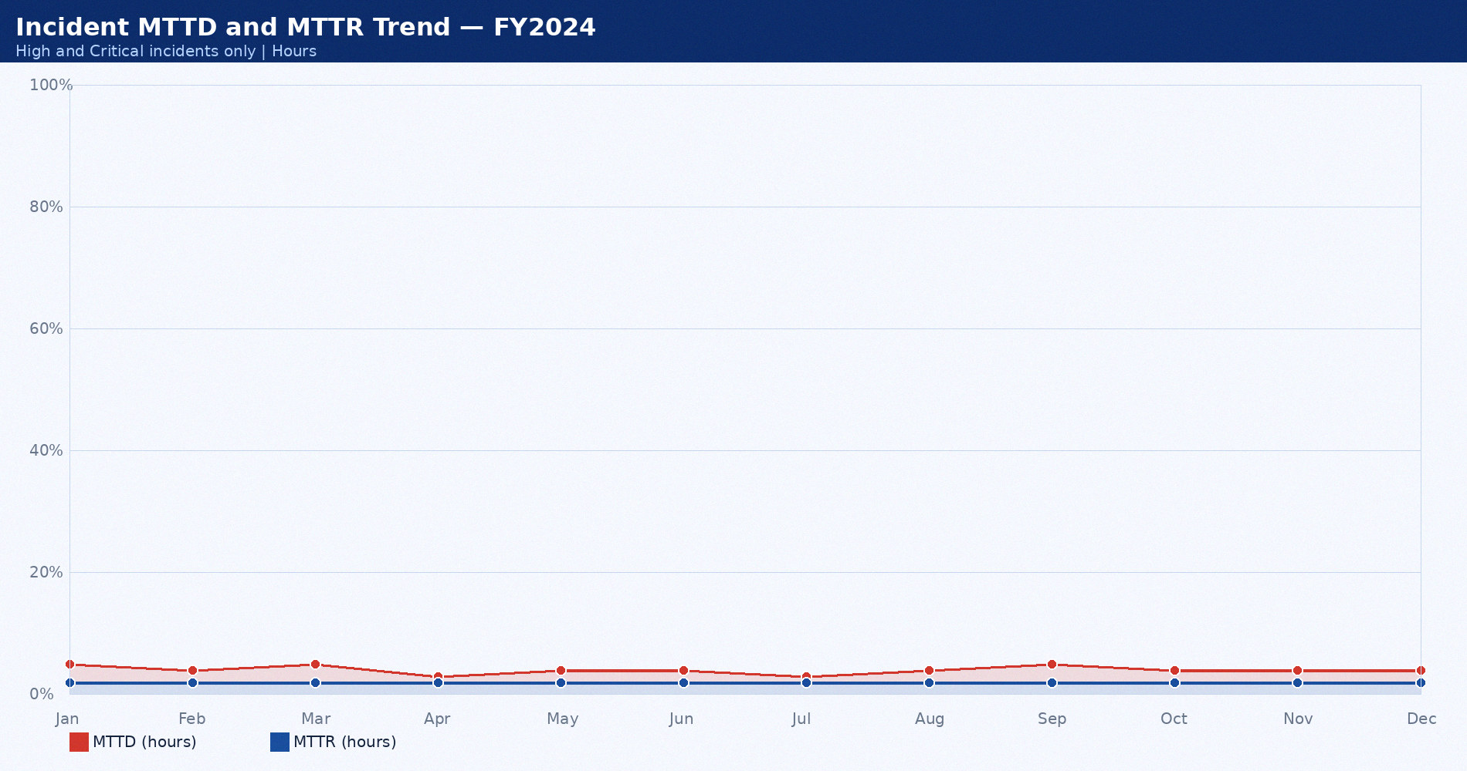
Incident MTTD and MTTR Trend — FY2024
High and Critical incidents only | Hours

Slide 41

Security Incident Volume — FY2024
By severity | Source: CrowdStrike + ServiceNow

Slide 42

Security Patch Compliance Trend — FY2024
72-hour window | Policy: 95%

Slide 43

MFA Enrollment Rate by User Category
Target: 100% — April 30, 2025

