Slide 1
Media Gateway Controller - open architecture
M.Sc. Pauli Maki-Pollari
Pauli.Maki-Pollari@ericsson.com
IP Solutions, Ericsson Finland

Slide 2
Main topics
Why telecom and datacom converge
From monolithic to a decomposed architecture
SS7 stack, what is signalling
Bearer and call control separation
Gateway concept
Standardisation: IETF, MSF
What is the Media Gateway Controller we develop
Implementation strategy in our current project
What is the competence that we need?

Slide 3
Why telecom and datacom converge
Price erosion
Explosive need of new capacity in the network
Need of better connectivity between the different networks
New features are needed
Datacom vendors like Cisco want to enter to classical telecom market with new solutions
Telecom Ericsson, Nortel, Lucent want to be players also in datacom or at least in the area where they meet
New technology is being introduced to telecom that was first introduced in the datacom side
  Anything (network signalling and media) on IP
  Decomposed architecture (compare with mainframes/PC industry)
  New faster movíng standardisation foras originating from the IP side

Slide 4
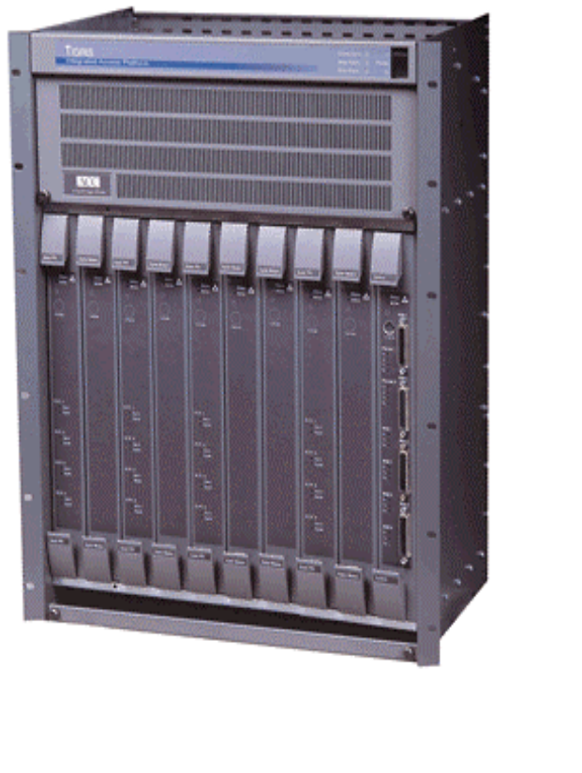
Evolution of Access Equipment
Tomorrow
Today
Signaling Gateway
SS7
Signaling
Termination
Signaling
Termination
IETF/Sigtran
ISDN/CAS
Media Gateway
controller
Call Control
Call Control
Media
Termination
IP
IETF/Megaco
E1/T1/DS3
PSTN
Media
Termination
IP

Slide 5
Some of the key assets of telecom vendors in the converged telecom/datacom arena
Experience in build realtime, extremely fault tolerant and responsive systems
Call and session control for voice
Experience of telecom applications
Experience of signalling
  Signalling between a local exchange and a telephone when there is an incoming call (UNI signalling)
  Signalling between a transit exchange and an IN node for routing a 800 call (database lookups)
  Signalling between a mobile exhange and a Home Location Register when a mobile node moves from one area to another (database modification)
  Signalling between two exchanges for setting up a call route between them (NNI signalling)
No signalling = no real-time data transfer!

Slide 6
What is SS7?
Signalling System No. 7 - The standard way for transport of signalling information in today’s circuit switched networks
Division into User Parts (e.g. ISUP) for call-oriented information and Application Parts (e.g. MAP) for non-call-oriented information
National variants
ISUP
MAP,INAP
TCAP
SCCP
MTP

Slide 7
Network to Network signalling (NNI)
Call control is exchange of application level information, such as a setup message for routing a telephone call from one user’s terminal to another. Typical information for call control is the address of the receiver (e.g. telephone number)
Bearer control is the exchange of network level information, such as establishing a connection for transport of data between two nodes. Typical information for bearer control is properties (e.g. Quality of Service parameters) of the connection
Device control is the exchange of information between a controller node and traffic node. Typical information for device control is “please connect interface A to interface Z for a telephone call”

Slide 8





Standardization arena
AAA
VAS
IN
DEN Architecture
Radius, Diameter, ...
Signaling GateWay
Sigtran
TCAP, INAP, ...
IETF/….
Media GW Controller
Application 1
Media GW Controller
Application 1
ISUP based info flow; H323, SIP, ..
SS7
MGCP/H.248
PSTN/ISDN
/PLMN
UNI/PNNI
Media GateWay
ATM or IP
Bearer Network
Media GateWay
ABC
Media GateWay
ETSI/TIPHON, IETF/Sigtran
IETF/Megaco, ITU-T
MSF(Multiservice Switching Forum) ALL!

Slide 9
The new MGC/MG architecture
The architecture is standardised by the Multiservice Switch vendor Forum (MSF)
The aim is to create a generic, well-specified protocol for use between any MGC and any MG
Candidates are:
  MGCP (and Megacop) as standardised by IETF Megaco
  H.GCP as standardised by ITU-T SG.16
Current status:
  MGCP is becoming a de facto standard, with a lot of vendors already supporting it
  Megacop is perceived as very complex while it is designed to solve all problems of the world for many different networks...

Slide 10
CASE: ONG Architecture - Packet-based, Multi-Service Access Network
1. Phone Switch / SS7 Signaling
STP
SG
Nodes (STP)
STP
ISUP/MTP
SG
2. Signaling Gateway (SG)
–
MTP Termination
3. Media Gateway Controller
Sigtrans
(ISUP/IP
(MGC)
TCAP/IP)
–
Signaling (ISUP, PRI, CAS)
–
Call Control
SIP, H.323,
–
MGCP (device control)
MGC
RADIUS
SN
–
SIP (Inter MGC)
4. Media Gateway (MG)
Phone
–
Media Conversion
Switch
MGCP
–
IP Cross Connect
5. Service Nodes (SN)
MG
IP
–
SIP Server/Client
T1/E1 IMT
RTP
–
Policy Server
T1 RBS,
–
AAA Server
E1 R2
–
H.323 Gatekeeper
PRI ISDN
–
VPN Service Manager
–
CDR Collector/
Biling
–
VPSM
The two major features:
SS7 connectivity for the media gateway (TIGRIS)
PSTN Voice over IP gateway

Slide 11
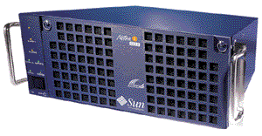
CASE: Media Gateway Controller (MGC)
Based on Open Platform
  Sun Microsystem’s platform
  Up to 4 Ultra-SPARC II 300 Mhz with 256M RAM (2GB max)
Fault Tolerant Architecture
  Hardware utilizes SUNft1800
Software
  ISUP Handling (International and National ISUP variants)
  Call Control
  Device Control
  Charging/Billing
  SIP and H.323 client
The Media Gateway Controller handles
call control and instructs Media Gateways
using MGCP or H.248 protocol.

Slide 12
Signalling protocols for Voice over IP
H.323
  A family of protocols (H.225, H.245, RAS, H.450.x used for signalling)
  Standardised by ITU-T SG.16 and ETSI Tiphon
  Philosophy: Redesign the telephony network on IP
SS7 over IP
  Philosophy: Connect incumbent network nodes with an IP bearer
  Standardised by ITU-T SG.11 and IETF Sigtran
SIP
  Native TCP/IP protocol, designed for any type of multimedia (e.g. VoIP) sessions
  Standardised by IETF Mmusic

Slide 13
CASE: What competence we expect in design
C++ (required)
Experience of some open source C++ component libraries, e.g. ace
Object oriented design
Experience of real time systems
Understanding of IETF
Knowledge of SIP, H323, ISUP, Radius
ASN.1, SNMPv3,
Knowledge of using parsers, lex, yacc..
English!

Slide 14
CASE: Some statements of my own
There are people working in, Madrid, Karstadt, Jorvas, Santa Barbara in this project
Only in English - Even between finns (the mails may get forwarded to our foreign friends
Interesting ways of working - 10 hours time difference between Jorvas and Santa-Barbara
If you want to travel, you definitely can, just pick up a suitable task
Very tempting work, great to be in setting the new solutions that will eventually replace PSTN

Slide 15
Referrences
IETF
  www.ietf.org
MSF
  www.msforum.org
The SIP home page
  www.cs.columbia.edu/~hgs/sip
The Future of IP Signalling,
presentation by Leif Björklund,
Ericsson Finland
Network gateway
presentation by Timo Äijälä
Ericsson Finland

