Slide 1
C++

Slide 2
OVERVIEW OF C++
History: C++ is a general-purpose programming language created by Bjarne Stroustrup as an extension of the C programming language, or "C with Classes".
C++ supports Procedural Programming Paradigm
C++ allows you to divide complex problems into smaller sets by using objects i.e., supports Object Oriented Programming
C++ is regarded as a middle-level language, as it comprises a combination of both high-level and low-level language features.
The Standard Template Library (STL) giving a rich set of methods manipulating data structures, algorithms, functions and iterators etc.

Slide 3
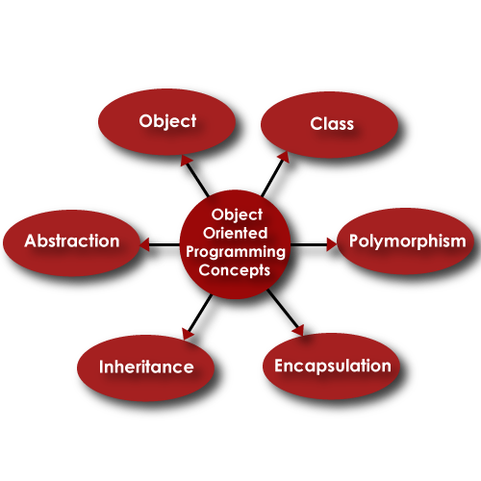
OOP CONCEPTS

Slide 4
Why C++ ?

Slide 5
My Learning of this week
Vectors
Strings

Slide 6
Vectors
Some commonly used Vector functions are:
vector.push_back();
vector.size();
vector.at(iterator);
vector.end() / vector.back();
vector.pop_back()
vector.begin() / vector.front();
vector.sort()
vector.distance(first iterator, second iterator)
vector.unique(first iterator, last iterator)
vector.resize(size)
vector.erase(position/range)
vector.clear()

Slide 7
Strings
getline(cin,str)
str.push_back(c)
str.pop_back()
str.copy(ch,length,start_index)
str1.Swap(str2)
toLower(str)
toUpper(str)
strcpy(dest,sor)

Slide 8
LeetCode Problems
Two Sum
Search Insert Position
Remove Duplicates From sorted Array
Remove Element
Length of Last word
Palindrome Number

Slide 9
Thank You

