Slide 1

Basic Details of the Team and Problem Statement
Ministry/Organization Name/Student Innovation:
PS Code:OS870
Problem Statement Title: How to use aadhaar number of students to identify fake enrolment,duplication and authentication of students
Team Name: scouts
Team Leader Name: md riyan ahmed
Institute Code (AISHE): C-19515
Institute Name: guru nanak institutions technical campus
Theme Name:

Slide 2
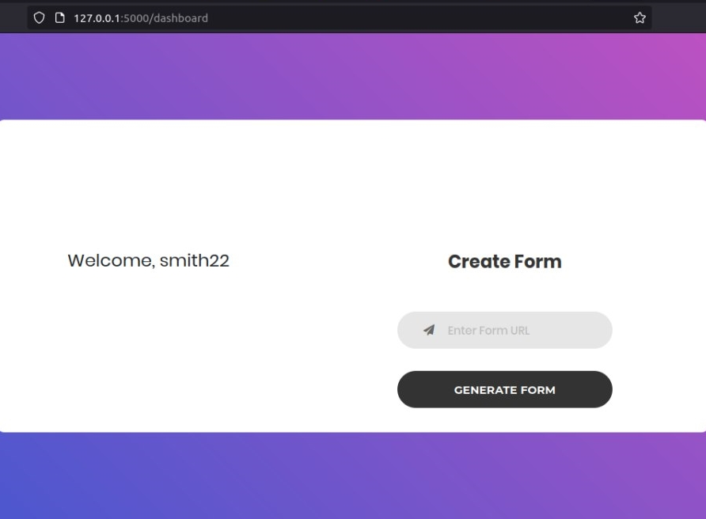
Idea/Approach Details
The faculty create a google form link and enter into our website
The website creates a new link of exam which will be given to the students
The students has to register in our website to take the test/exam
For registration, the student’s email and aadhaar number is taken and verified
The verified aadhaar number is bounded with the student’s email ID
The student with registered email are allowed to take the test/exam
Resulting in elimination of fake entries and duplications
The students have to login with the registered email ID to write the test
Technology stack:
Front End
HTML-jinja template
CSS –Designing
Javascript
Back End
SQlite – storing database
Flask framework (python module)

Slide 3
Idea/Approach Details
Describe your Use Cases here
Describe your Dependencies / Show stopper here
Online exam/tests
Authentication form filling
Web courses
A working operating system with windows/linux
A web browser i.e internet explorer, chrome, firefox
A web server to store user data and host the site

Slide 4
Team Member Details
Team Leader Name: Type Your Name Here
Branch (Btech/Mtech/PhD etc): Stream (ECE, CSE etc): Year (I,II,III,IV):
Team Member 1 Name: Type Your Name Here
Branch (Btech/Mtech/PhD etc): Stream (ECE, CSE etc): Year (I,II,III,IV):
Team Member 2 Name: Type Your Name Here
Branch (Btech/Mtech/PhD etc): Stream (ECE, CSE etc): Year (I,II,III,IV):
Team Member 3 Name: Type Your Name Here
Branch (Btech/Mtech/PhD etc): Stream (ECE, CSE etc): Year (I,II,III,IV):
Team Member 4 Name: Type Your Name Here
Branch (Btech/Mtech/PhD etc): Stream (ECE, CSE etc): Year (I,II,III,IV):
Team Member 5 Name: Type Your Name Here
Branch (Btech/Mtech/PhD etc): Stream (ECE, CSE etc): Year (I,II,III,IV):
Team Mentor 1 Name: Type Your Name Here
Category (Academic/Industry): Expertise (AI/ML/Blockchain etc): Domain Experience (in years):
Team Mentor 2 Name: Type Your Name Here
Category (Academic/Industry): Expertise (AI/ML/Blockchain etc): Domain Experience (in years):

Slide 5
Important Pointers
Please ensure below pointers are met while
Kindly keep the maximum slides limit to 4 pages
All the topics should be utilized for description of your idea
Try to avoid paragraphs and post your idea in points
Keep your explanation precisely and easy to understand
Idea should be unique and novel. If it has a business potential more weightage will be given.
Apart from this PPT abstract of your idea will be asked separately while submitting
You need to save the file in PDF and upload the same on portal. No PPT, Word Doc or any other format will be supported
You can delete this slide (Important Pointers) when you upload the details of your idea on SIH portal.

