Slide 1













Food Supply Chain Traceability & Recall Data Hub
Database Design Project
Team Members
Prerana
Harini
Riyanshi
Hardi

Slide 2






Project Overview
Food Supply Chain Traceability & Recall Data Hub
Project Summary
Purpose & Applications
A database design project aimed at creating a comprehensive traceability and recall management system for the food supply chain. The system will enable tracking of food products from farm to table and facilitate quick recalls when necessary.
Enable rapid traceability of food products throughout the supply chain
Facilitate targeted recalls instead of broad withdrawals
Improve supplier reliability tracking and management
Objectives
Provide data-driven insights for supply chain optimization
Enhance food safety monitoring and compliance
Develop a normalized database schema for food supply chain data
Real-World Impact
Implement efficient query mechanisms for traceability
Create visualization tools for supply chain insights
This system will help food companies reduce the time and cost associated with product recalls while improving consumer safety and trust. It addresses critical challenges in modern food supply chain management.
Design a user-friendly interface for data entry and retrieval
Team Members:
Prerana, Harini, Riyanshi, Hardi

Slide 3














Problem Statement & Motivation
Food Supply Chain Traceability & Recall Data Hub
Current Challenges
Motivation & Benefits
Key Pain Points Driving This Project:
Complex Supply Chains
Multi-layered food supply chains make tracking products from farm to table difficult, with numerous touchpoints and stakeholders.
Consumer safety concerns due to delayed recall responses
Financial losses from broad product withdrawals
Difficulty in identifying contaminated products
Manual tracking methods prone to human error
Slow Recall Processes
Regulatory compliance challenges
Traditional recall methods are time-consuming and often result in broad withdrawals rather than targeted recalls.
Expected Benefits:
Accelerated recall processes
Enhanced traceability
Data Fragmentation
Information silos across departments and systems prevent comprehensive view of supply chain operations.
Data-driven insights
Improved food safety
Team Members:
Prerana, Harini, Riyanshi, Hardi

Slide 4
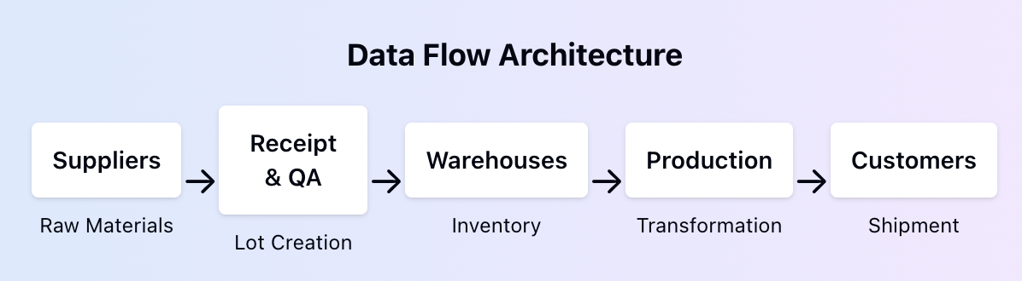
Design Approach & Architecture
Food Supply Chain Traceability & Recall Data Hub
Design Considerations
Key Features
• Normalization: 3NF for data integrity
• Scalability: Indexed for high-volume queries
• Traceability: Genealogy table for lot transformations
• Audit Trail: Comprehensive logging mechanism
• Data Quality: Constraint validation & monitoring
Lot-level tracking with genealogy
Multi-warehouse inventory management
Quality test integration
Recall management system
Order & shipment tracking
Encrypted sensitive data

Slide 5

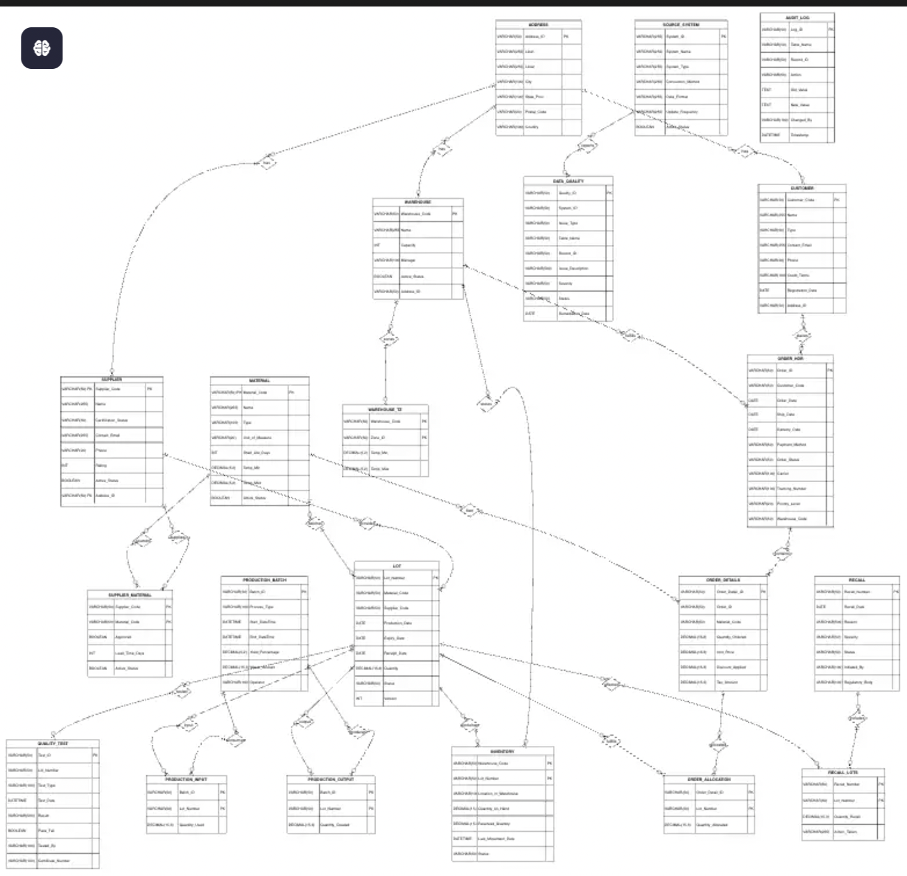
ERD & Schema Design
Food Supply Chain Traceability & Recall Data Hub
Core schema with normalized entities and relationships
Normalized to 3NF
Proper PK–FK mapping
Avoids redundancy
Ensures referential integrity

Slide 6



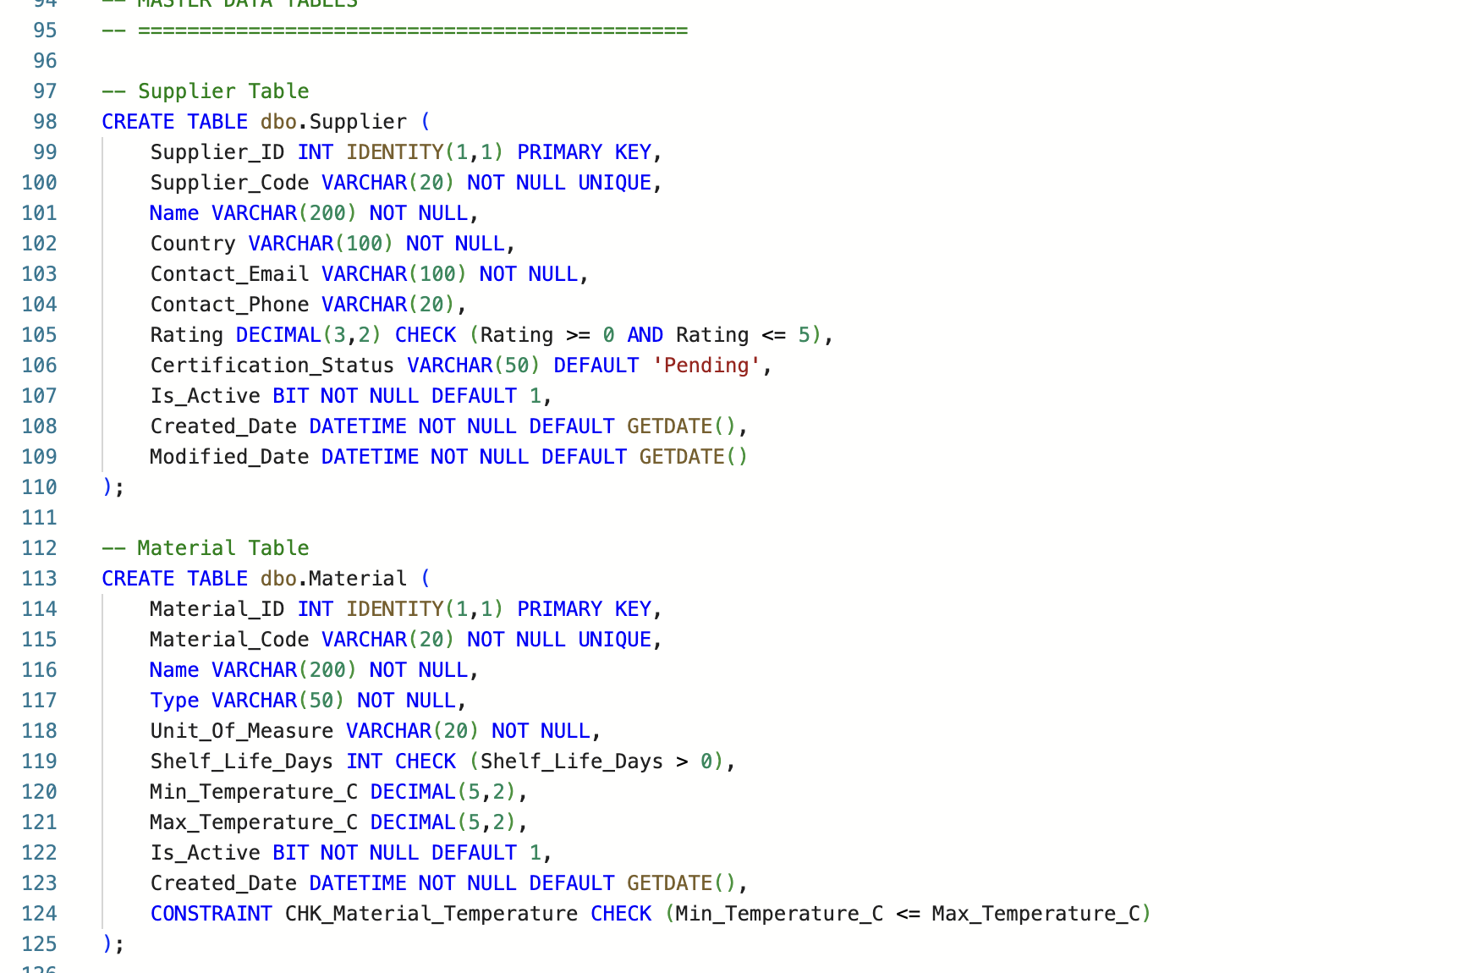
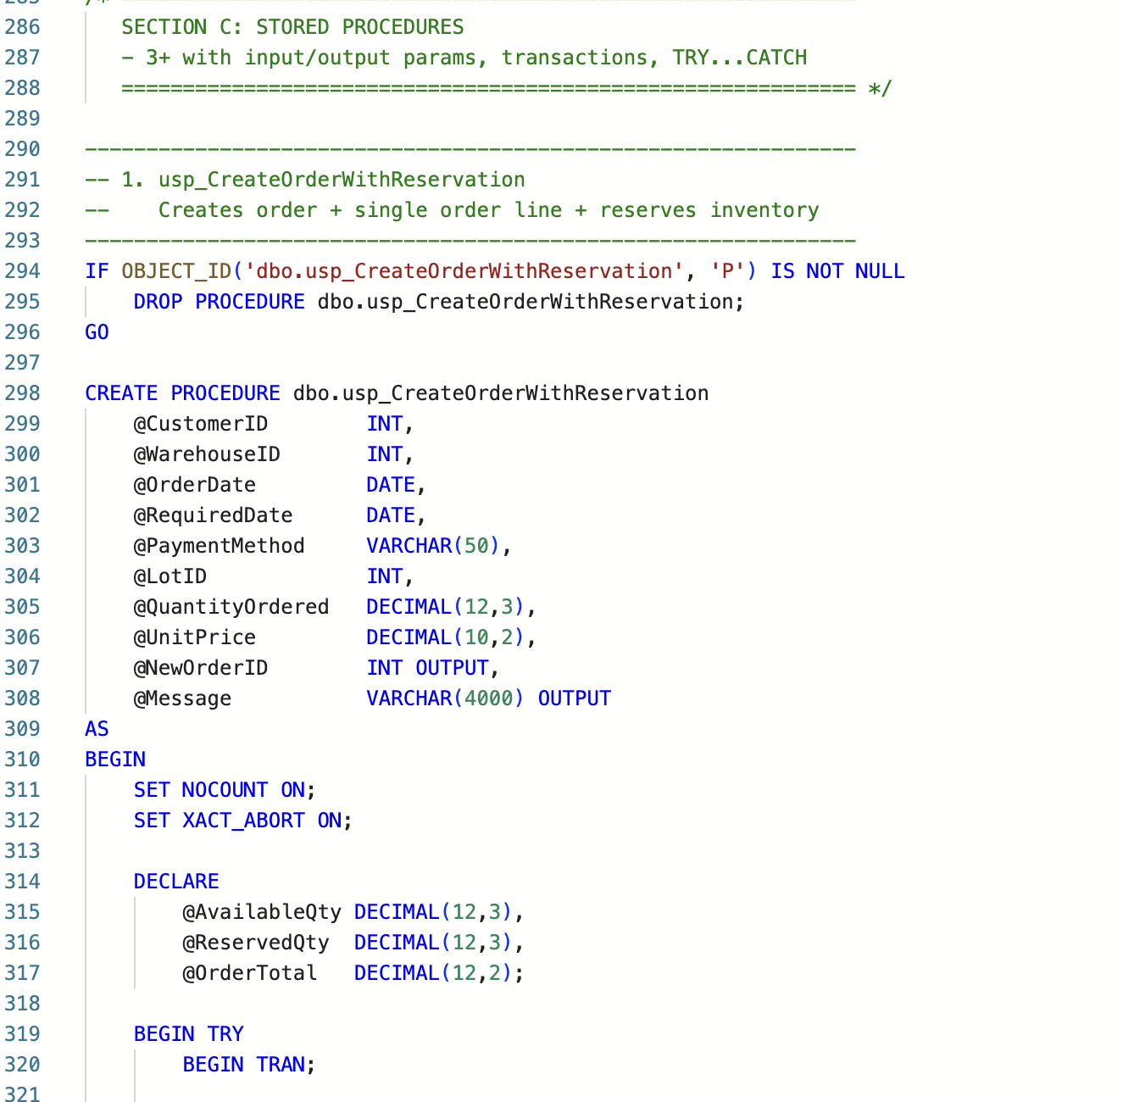
Table Structures & Implementation Highlights
Food Supply Chain Traceability & Recall Data Hub
DDL Implementation
Stored Procedures

Slide 7















Database Normalization & Integrity
Food Supply Chain Traceability & Recall Data Hub
Third Normal Form Implementation
Referential Integrity Measures
1NF
2NF
3NF
Primary & Foreign Key Mapping
Eliminated atomic columns
Removed partial dependencies
Removed transitive dependencies
Table
PK
FK
Products
product_id
supplier_id
Suppliers
supplier_id
location_id
Benefits of 3NF
Shipments
shipment_id
product_id, supplier_id
Reduced data redundancy
Improved data consistency
Enhanced update efficiency
Constraints
Triggers
NOT NULL, UNIQUE, CHECK
Automated integrity checks
Team Members:
Prerana, Harini, Riyanshi, Hardi

Slide 8
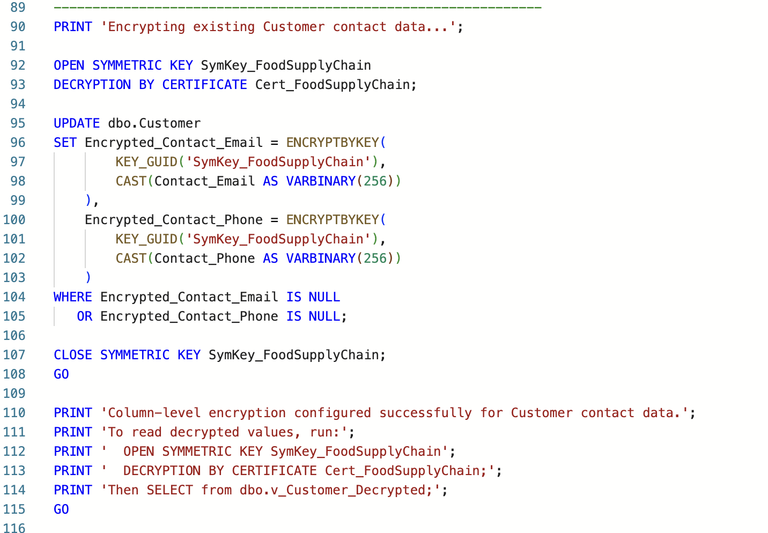
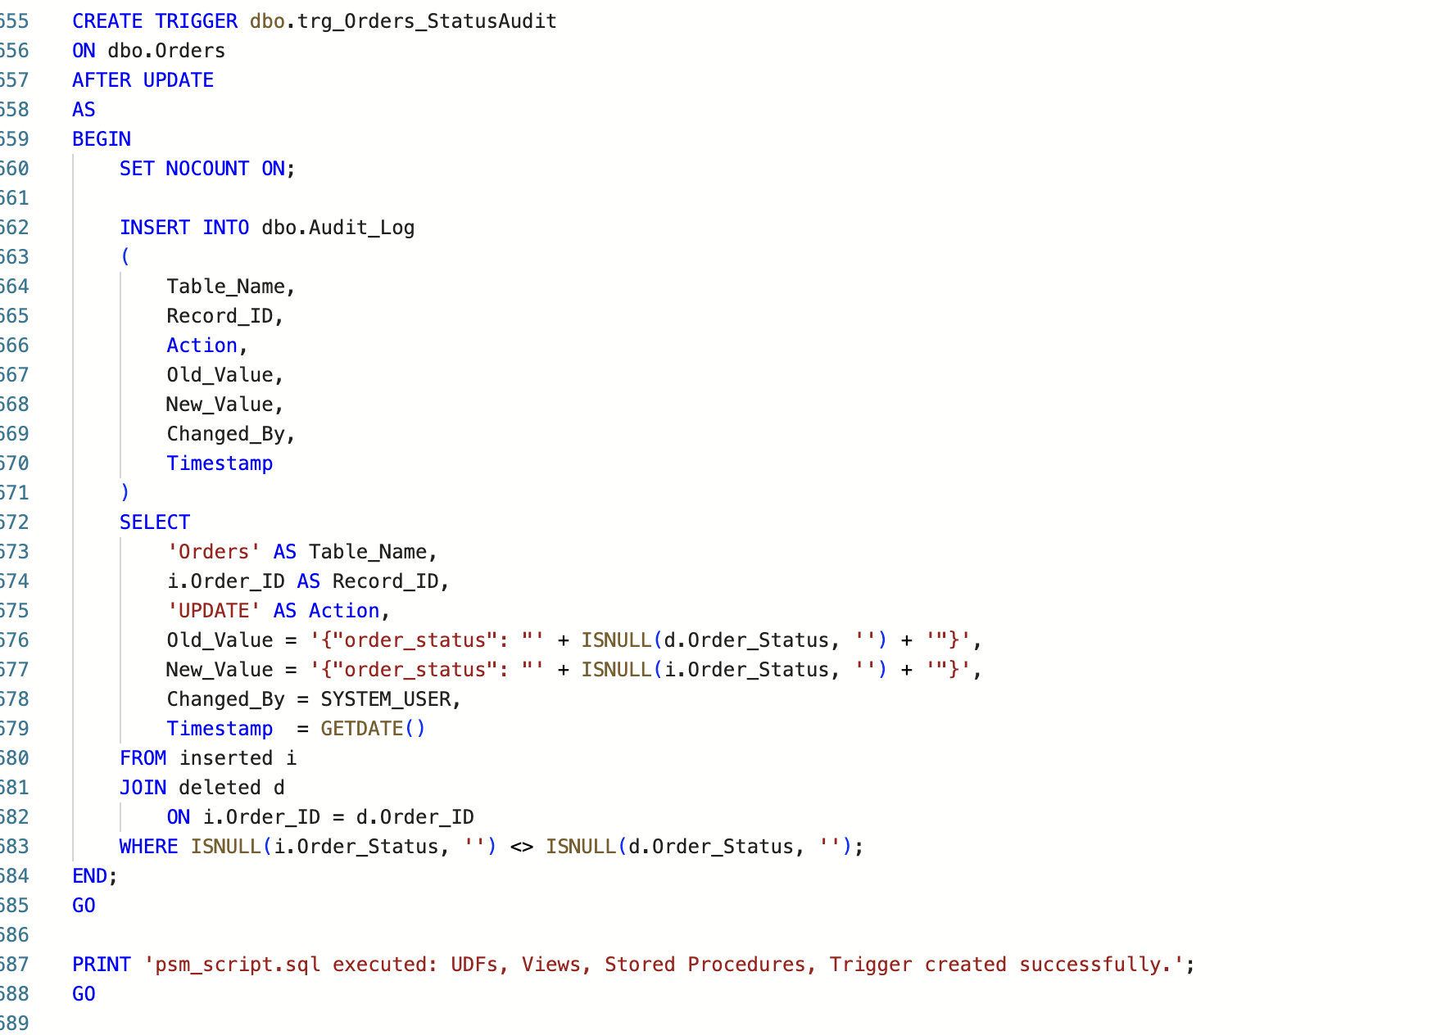
Triggers and Encryption
Food Supply Chain Traceability & Recall Data Hub

Slide 9
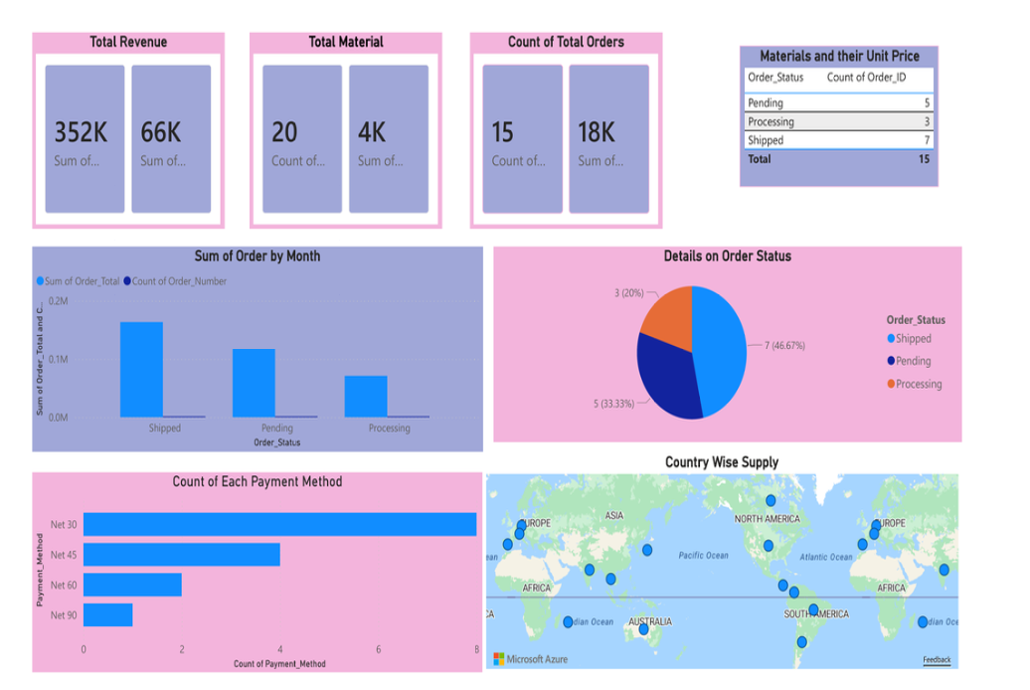
Data Insights & Visualization
Food Supply Chain Traceability & Recall Data Hub
Dashboard Key Features:
Monthly Trend Analysis: Order volume and revenue by month
Payment Terms Distribution: Net 30/45/60/90 breakdown
Geographic Supplier Map: Global supplier distribution visualization
Order Status Pipeline: Real-time processing status
Material Cost Analysis: Unit price tracking
Interactive Filtering: Drill-down capabilities
Key Business Insights:
33.33% pending orders need attention for workflow optimization
Global supplier diversification across continents reduces risk
Real-time live data integration from SQL database

Slide 10
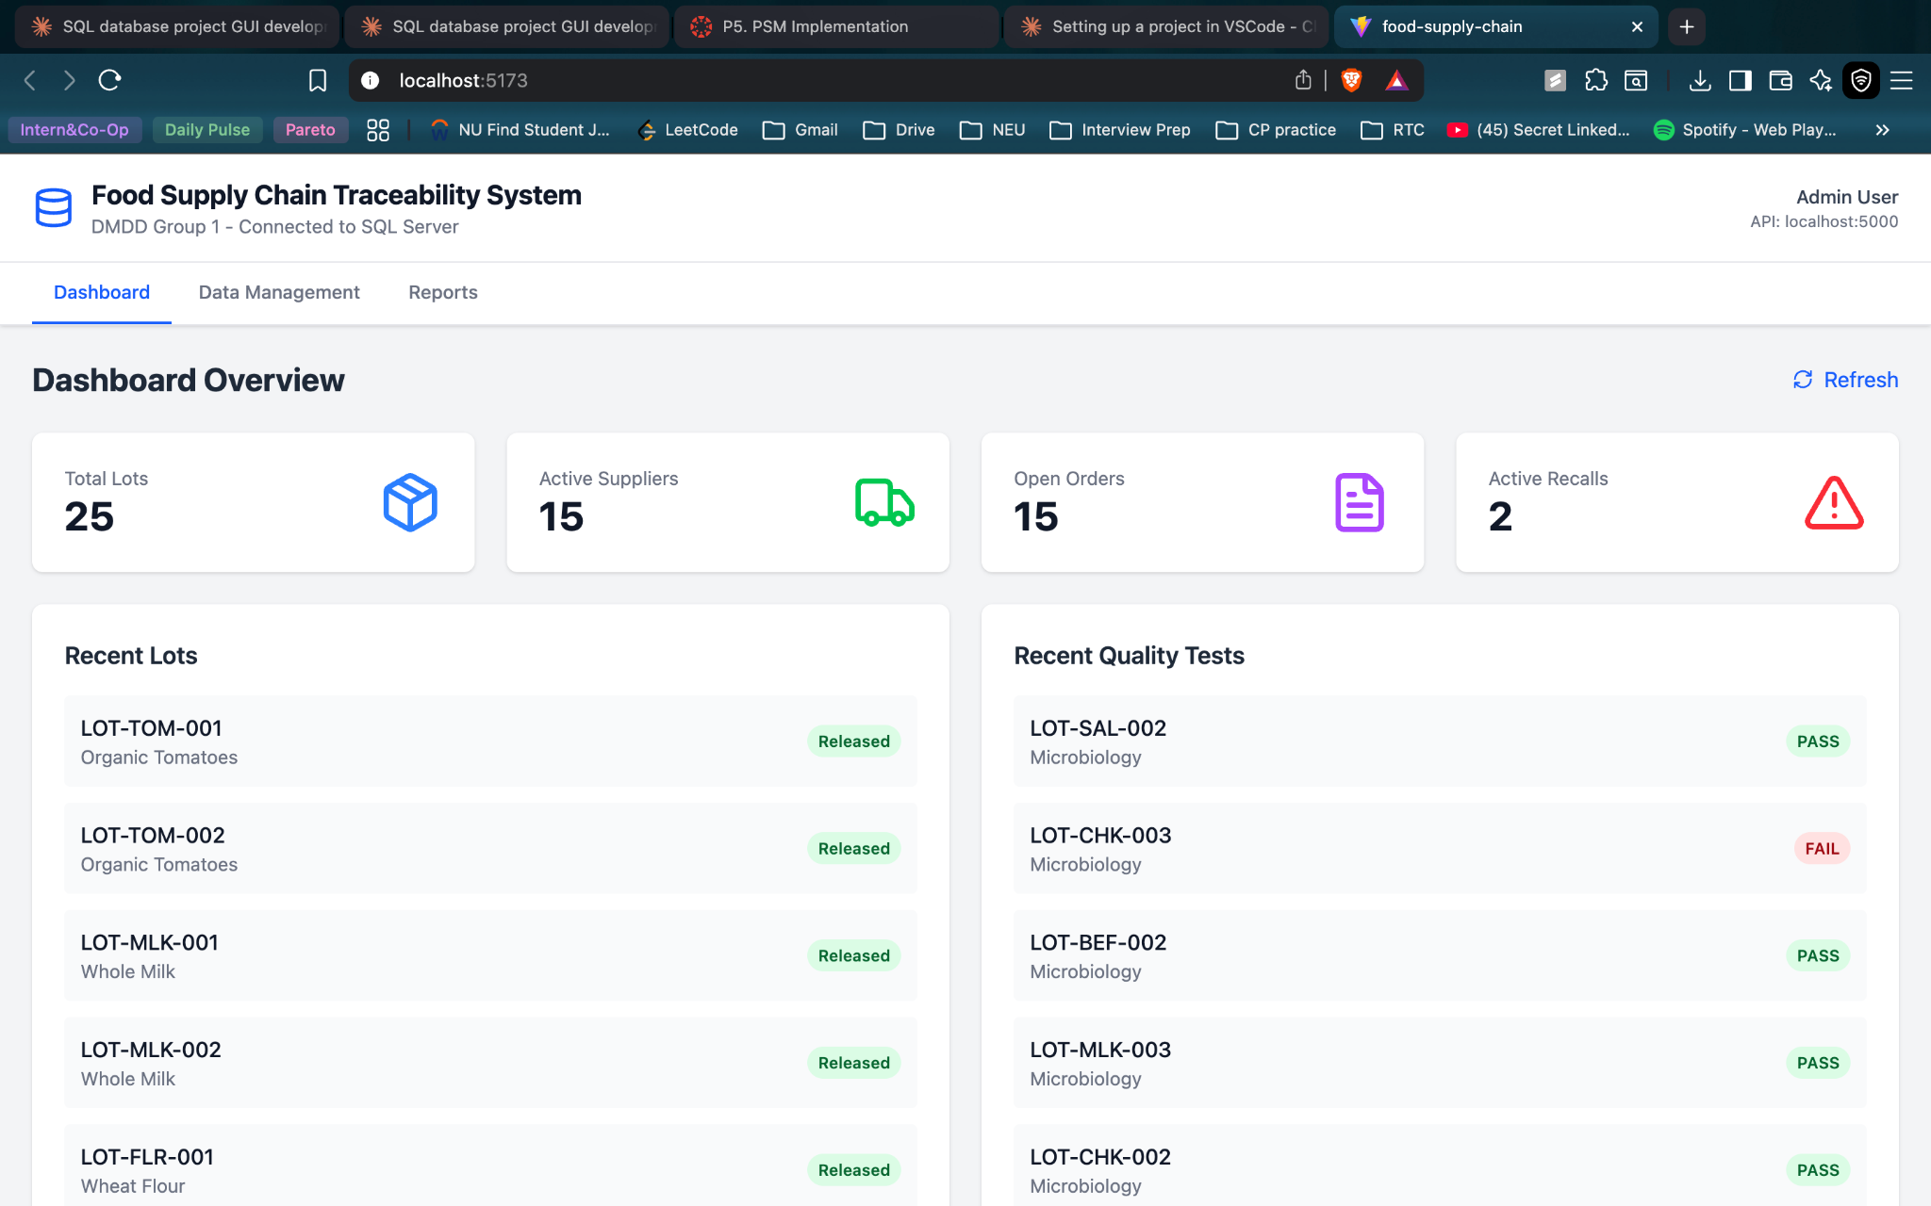
GUI
Food Supply Chain Traceability & Recall Data Hub

Slide 11













Demo Walkthrough
Food Supply Chain Traceability & Recall Data Hub
A three-step demonstration of the database system workflow:
1. Insert Data
2. Execute Query
3. Visualize
Insert Data
Execute Query
Visualize
Insert supplier information
Trace product journey
View supply chain map
Add product details
Identify suppliers
See product relationships
Log shipment data
Find related products
Analyze shipment patterns
Record transaction history
Generate reports
Identify bottlenecks
Team Members:
Prerana, Harini, Riyanshi, Hardi

Slide 12























References & Credits
Food Supply Chain Traceability & Recall Data Hub
Team Acknowledgments
Tools Utilized
Prerana
Database Design & Implementation
SQL Server
Power BI
Database Management
Data Visualization
Harini
Data Analysis & Visualization
Excel
Tableau
Riyanshi
Data Analysis
Visualization
Query Development & Testing
Hardi
Project Repository
Project Management & Documentation
GitHub Repository
Placeholder for code access
Documentation
Placeholder for project docs
Thank You
Team: Prerana, Harini, Riyanshi, Hardi

