Slide 1
Characterising Parser Errors
-Vinayak Athavale(201425077)
-Riya Pal(201425095)

Slide 2
Criteria Used
Length of Sentence
Part of speech
Dependency length
Dependency depth(distance from root)
Projective arcs

Slide 4
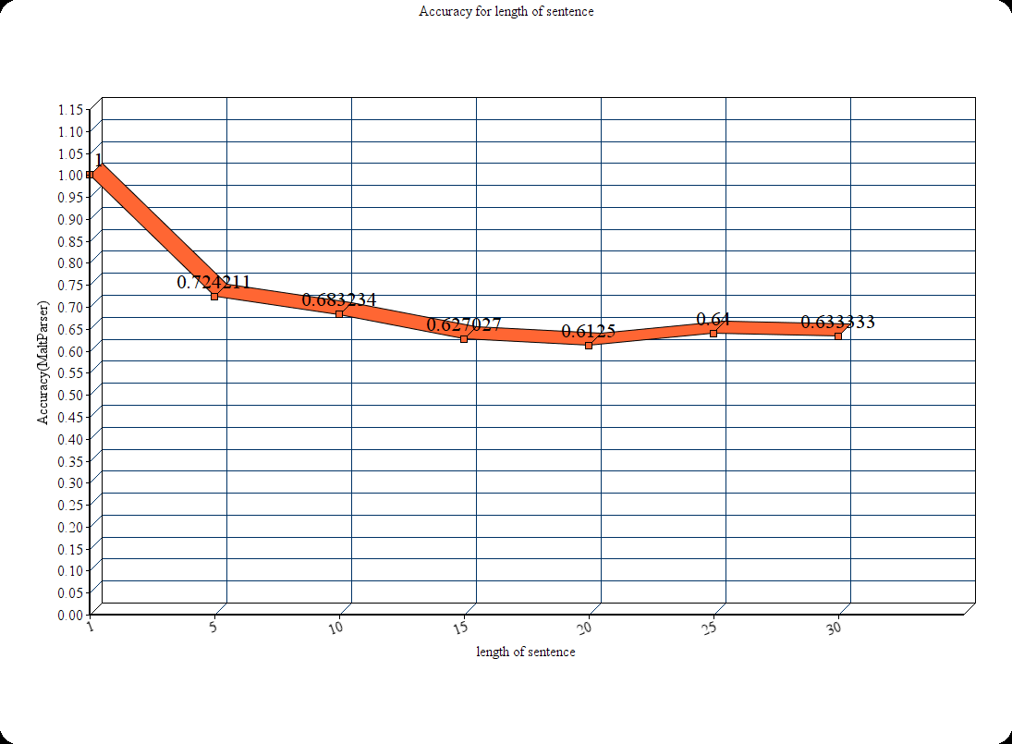

Slide 5
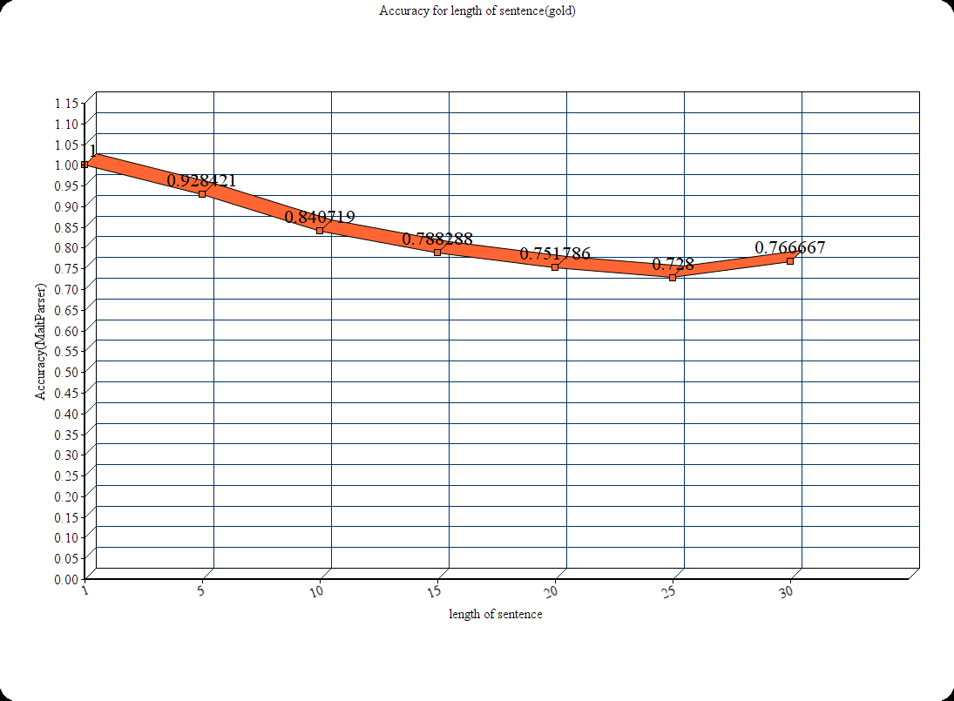

Slide 6
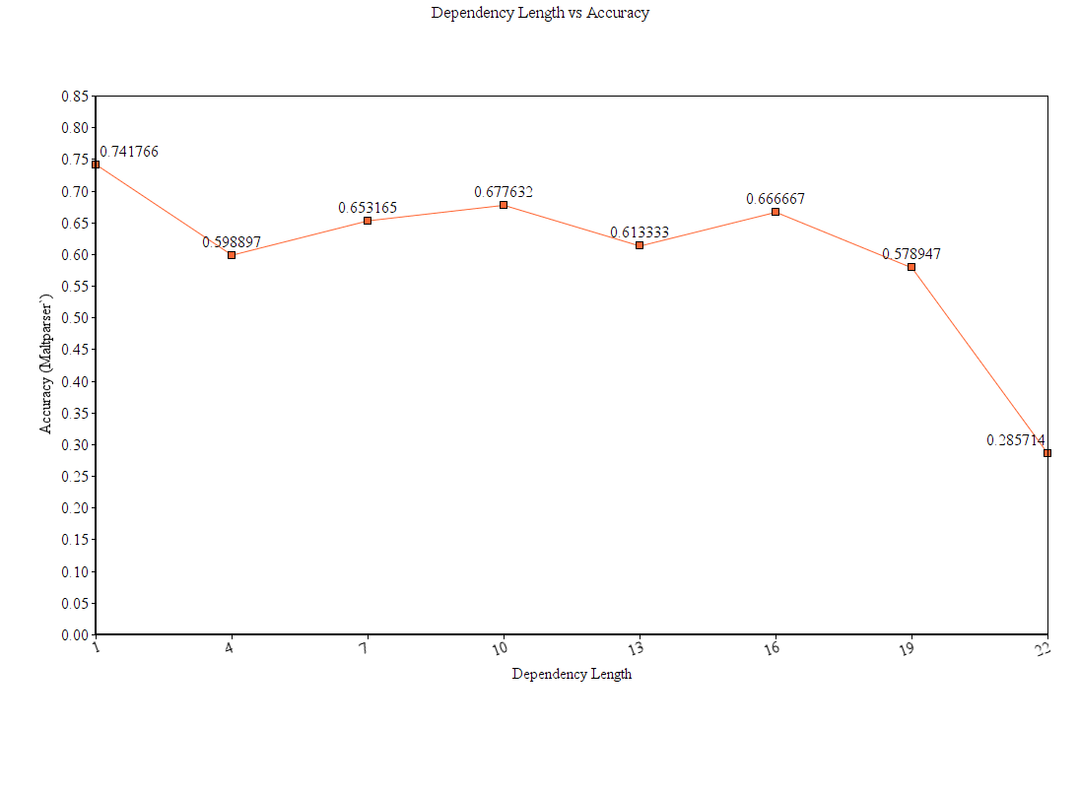

Slide 7
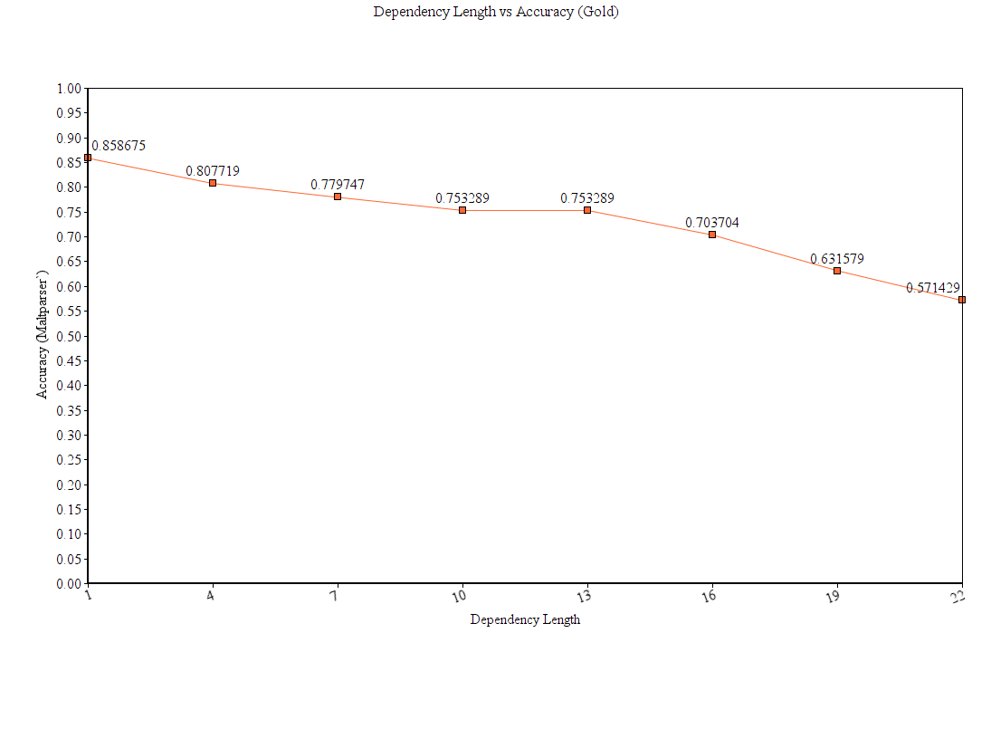

Slide 8
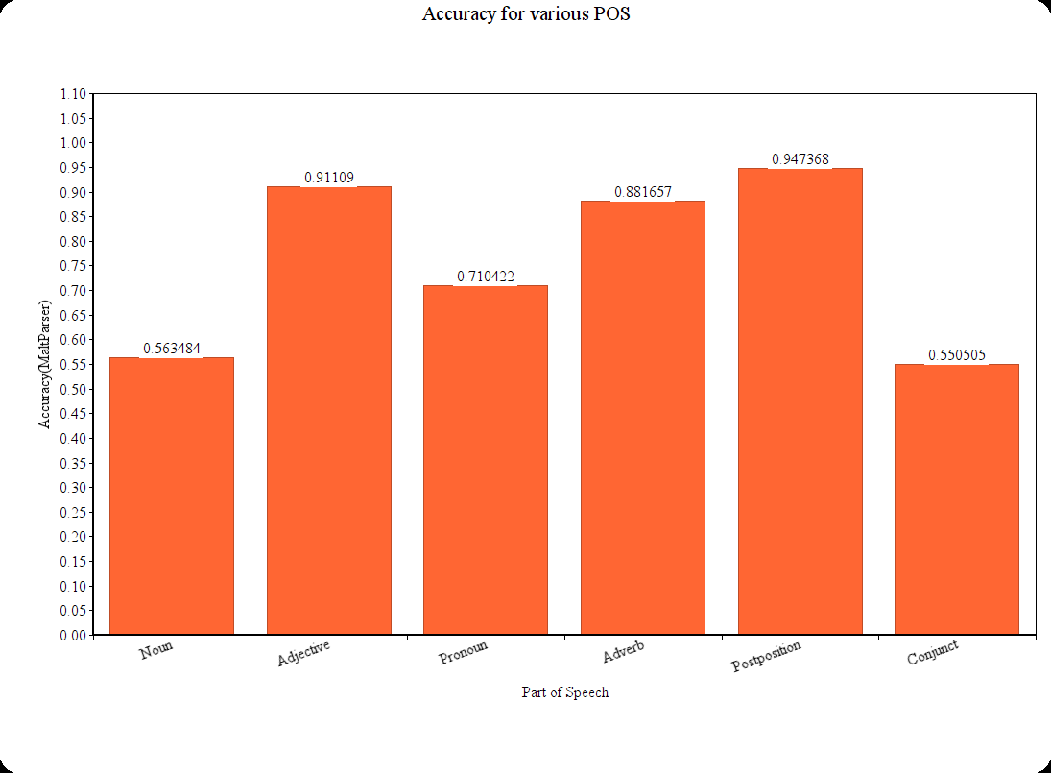

Slide 9
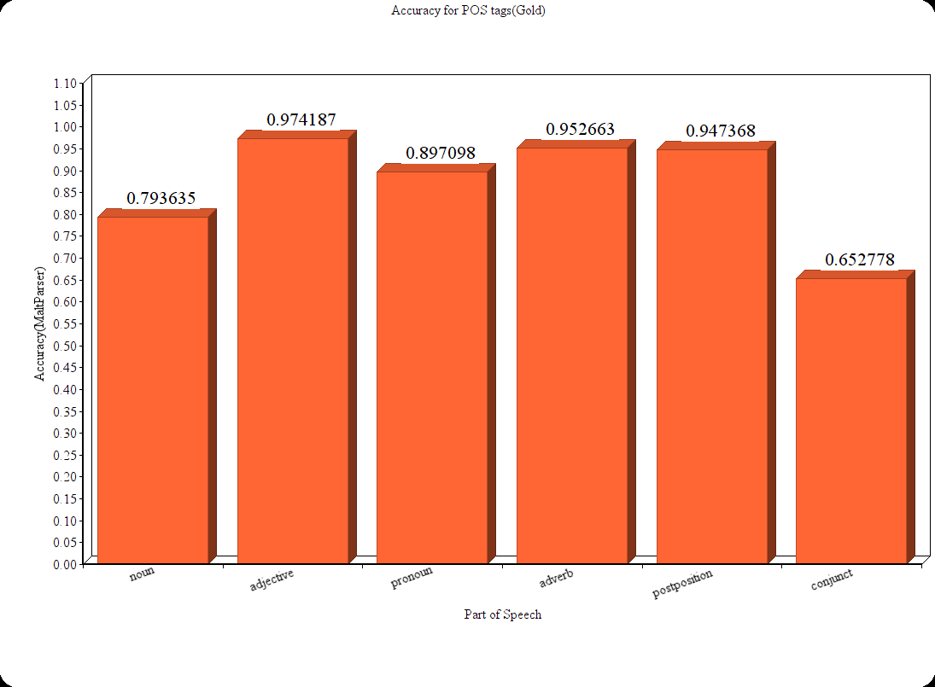

Slide 10
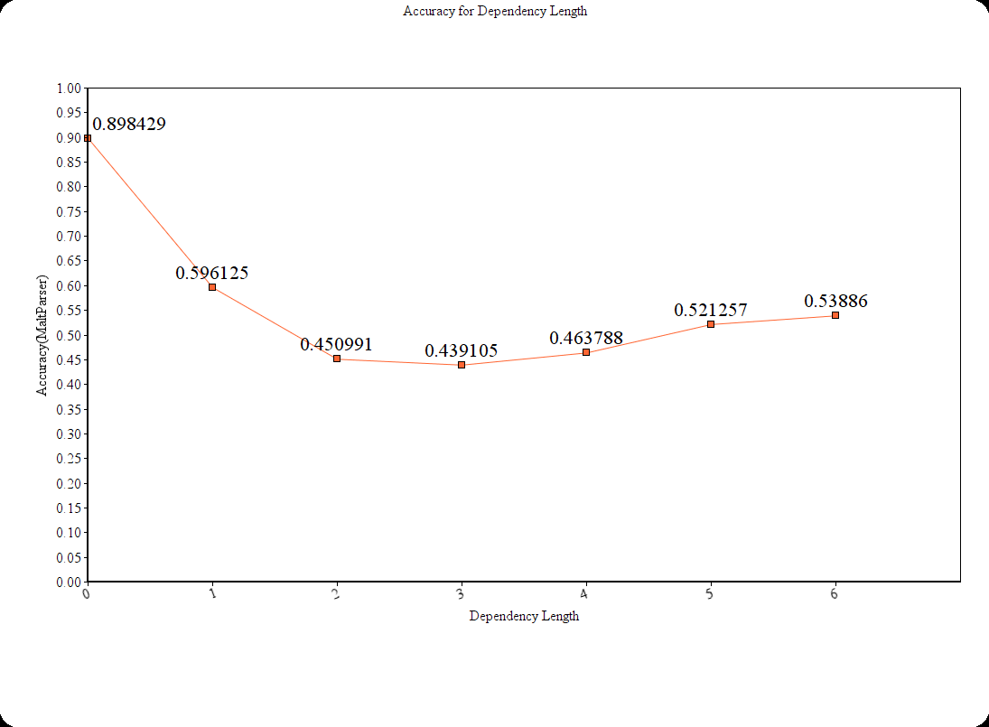
Depth of dependency
(distance from root)

Slide 11
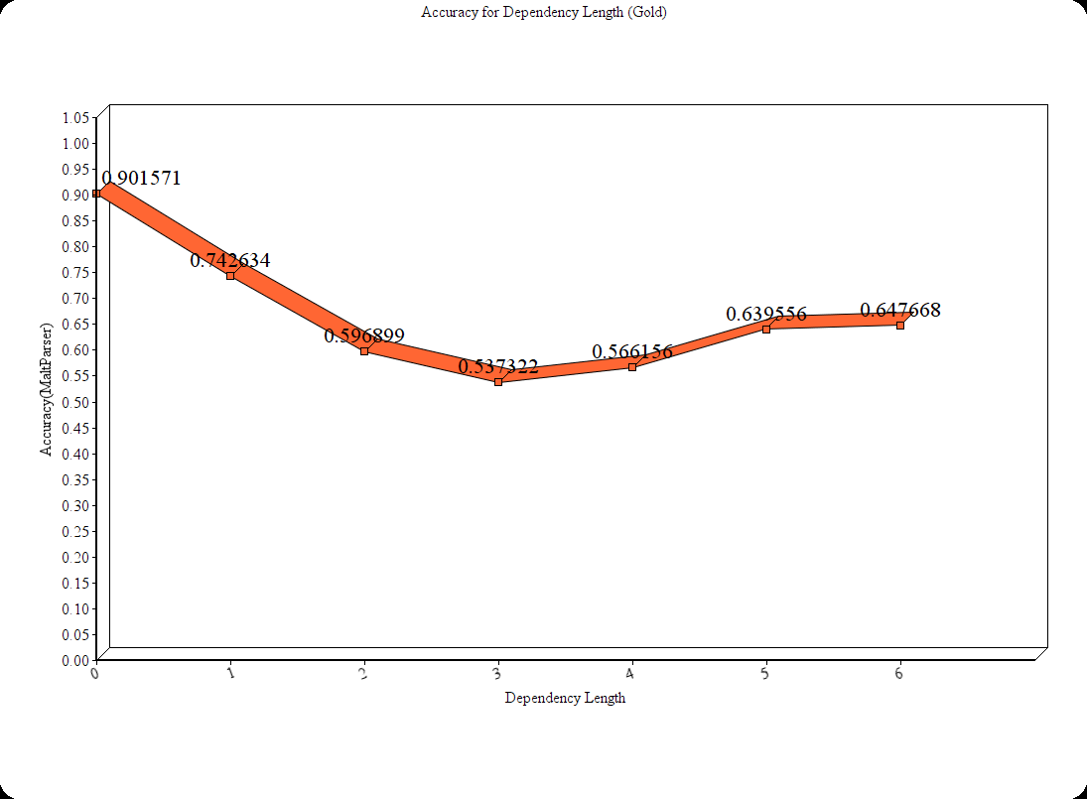
Depth of dependency
(distance from root) gold

Slide 12
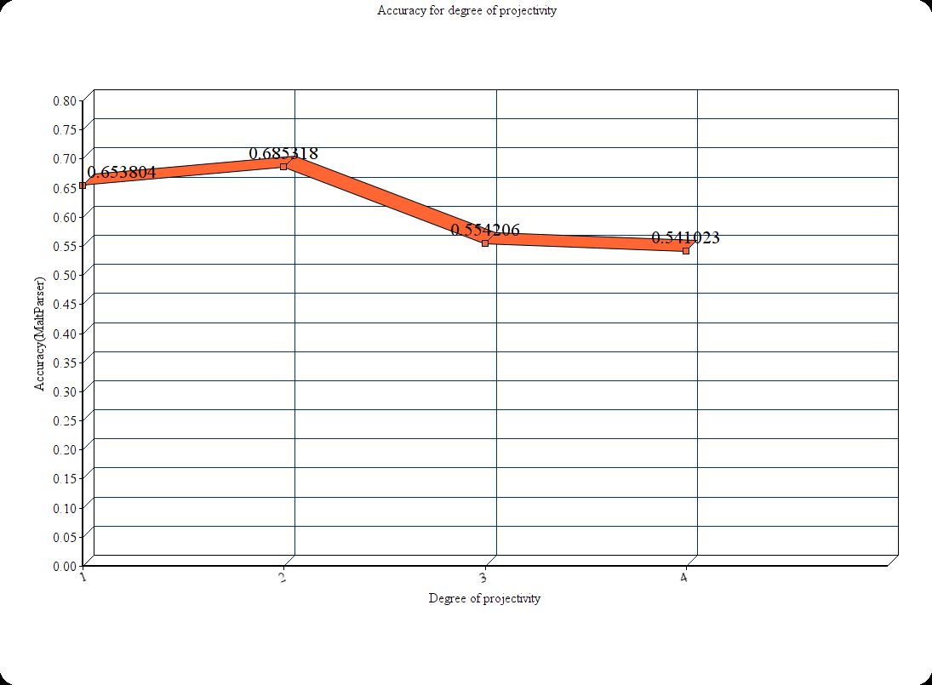

Slide 13
References
http://www.aclweb.org/anthology/D07-1013
http://www.maltparser.org/

Slide 14
Thank You

