Slide 1
GUI Calculator
A Simple Python GUI Calculator using Tkinter.
Presented by: Riya

Slide 2
Introduction
What is Tkinter?
- Tkinter is Python’s standard GUI library.
Purpose of the Project:
- Create a functional calculator using Tkinter with a clean layout and basic operations.

Slide 3
Features of the Calculator
- GUI-based interface using Tkinter
- Basic arithmetic operations: +, -, *, /
- 'C' for clearing input
- '=' for evaluating the expression
- Simple error handling

Slide 4
Code Overview – Part 1 (Imports and Setup)
import tkinter as tk
root = tk.Tk()
root.title("My Calculator")
root.geometry("400x430")
- Importing Tkinter
- Setting up the main application window

Slide 5
Code Overview – Part 2 (Display & Event Handler)
screen = tk.StringVar()
entry = tk.Entry(root, textvar=screen, font="Arial 20", bd=10, relief=tk.SUNKEN, justify="right")
entry.pack(...)
- Creating the display field
- Using StringVar to link the text

Slide 6
Code Overview – Part 3 (Event Handling Function)
def click(event):
text = event.widget.cget("text")
...
- Detects button clicks
- Handles logic for evaluation, clearing, or appending

Slide 7
Code Overview – Part 4 (Creating Buttons)
buttons = [
["7", "8", "9", "/"],
...
]
- Defining button layout
- Looping through layout to create buttons dynamically

Slide 8
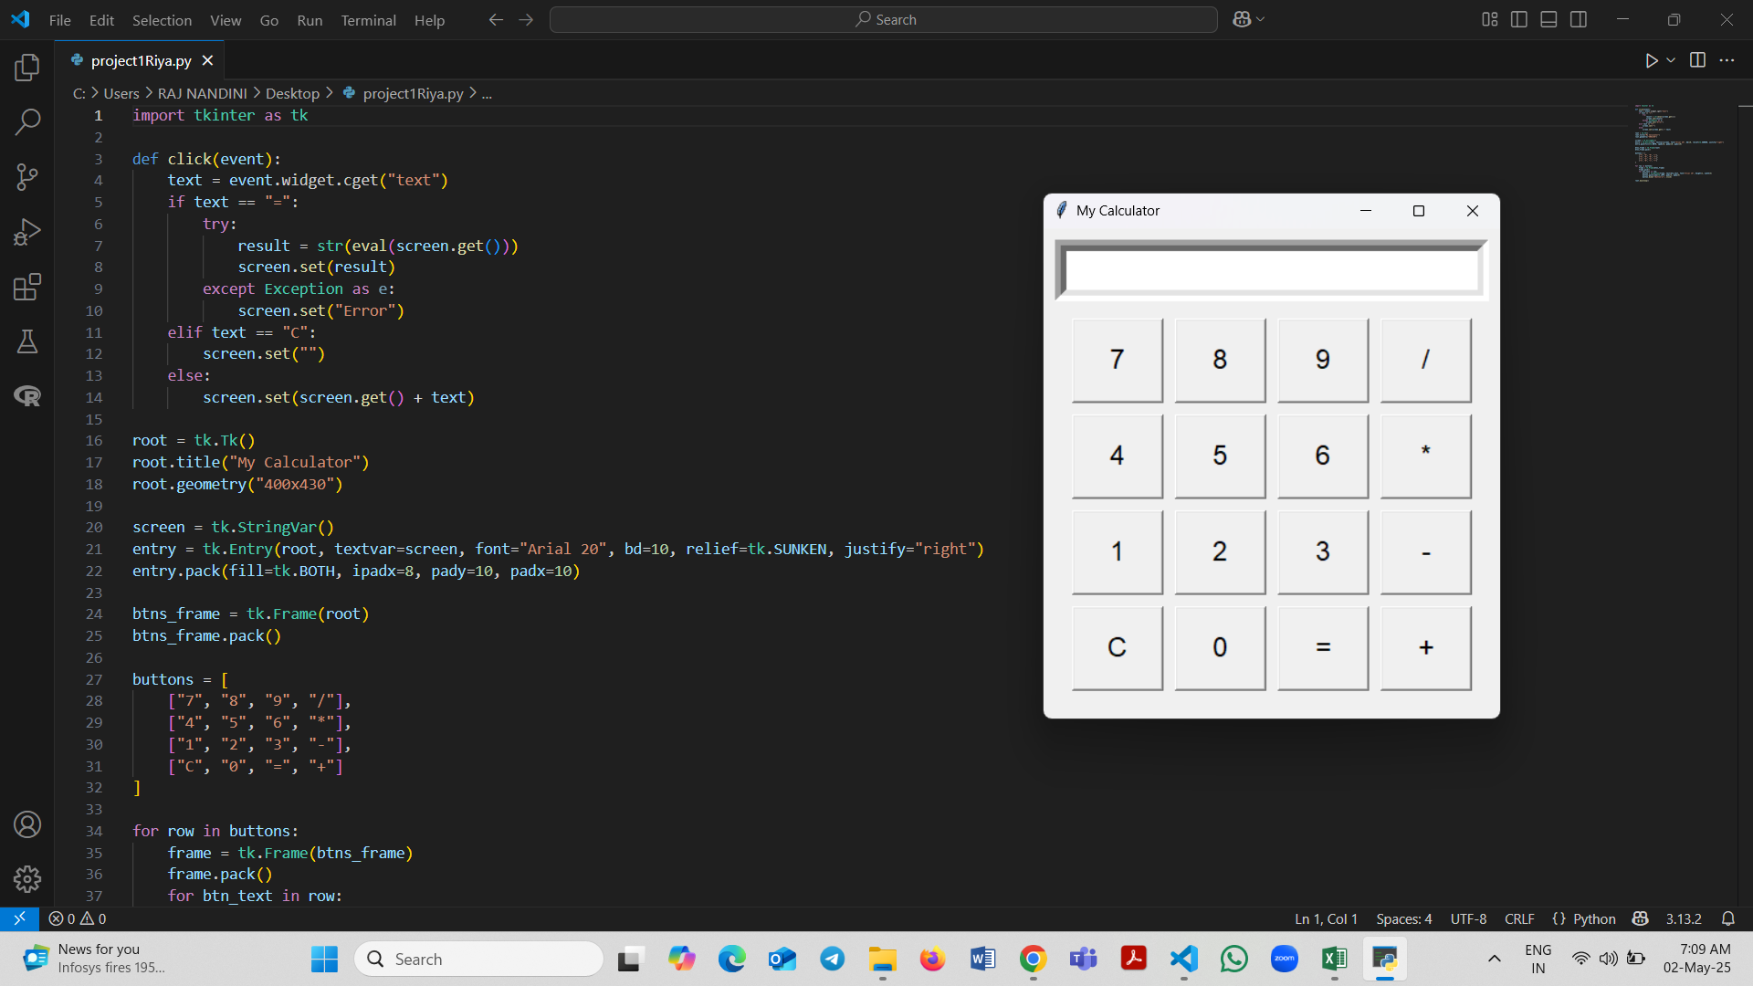
Output – Calculator GUI Screenshot

Slide 9
Potential Improvements
- Using grid() for better layout control
- Adding decimal support
- Supporting keyboard input
- Replacing eval() for better security

Slide 10
References
- Youtube, Chatgpt, Tutor

Slide 11
THANK YOU

