Slide 1
E-Diary
Amogh Parulekar - 21104001
Riya Patel -21104141
Kaushik Prabhu Nerurkar - 21104016
Ajit Pawar-21104054
Project Guide
Prof.Roshna Sangle

Slide 2
Contents
Introduction
Objectives
Scope
Features/Functionality
Project Outcomes
Technology Stack
Conclusion

Slide 3
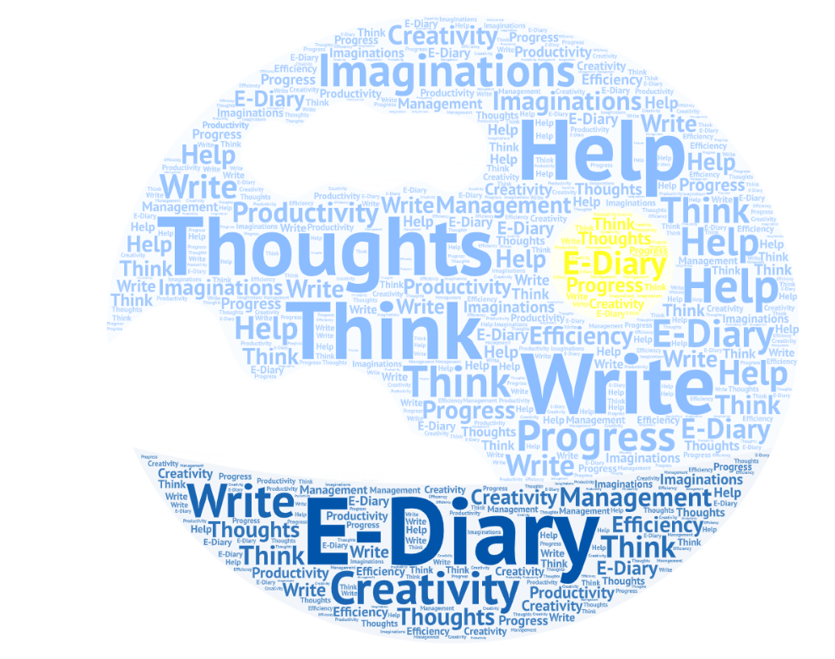
1.Introduction
E- Diary is a project that aims to provide a digital platform for users to manage their tasks. It is a comprehensive tool that allows users to track their progress, manage their day-to-day activities.
The project focuses on providing an easy-to-use interface for user to access their information
It helps them save time and effort by organizing their tasks and activities in one place. It also helps them track their progress and stay on top of their goals.

Slide 4
2.Objectives of the project
To be designed with the aim of providing a user-friendly, intuitive experience for all users, regardless of their level of technical knowledge.
To have a platform that will be optimized to ensure the best possible performance and user experience, while also providing a modern and aesthetically pleasing layout.
To have an attractive, user friendly and Secure Login page.
The primary goal of the E-Diary is to improve productivity and help them reach their goals.

Slide 5
3.Scope of our project
To provide a comprehensive and user-friendly interface for users to track their progress all in one place.
To have a secured usage for the user
To have a attractive interface for the user
To create a handy website for the user

Slide 6
4.Features/Functionality
E-Diary offers a range of features that make it a powerful tool for students.
The design of it will be modern with a focus on simplicity and ease of use. All features will be easy to find and use.
It helps the user to create a note to set goals or help track their progress
It offers a secure login to the user
The E-Diary can be accessed by multiple users
The user can create a category and add their tasks to it
The E-Diary has themes like dark, semi-dark, and light to comfort your eyes as per use.

Slide 7
5. Project outcomes
The platform will give users a powerful tool to track their progress.
The E-Student Diary project enables users to easily access and organize their data, achieve their goals
The project should have a secure login

Slide 8
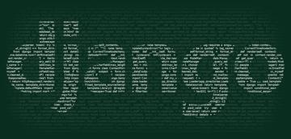
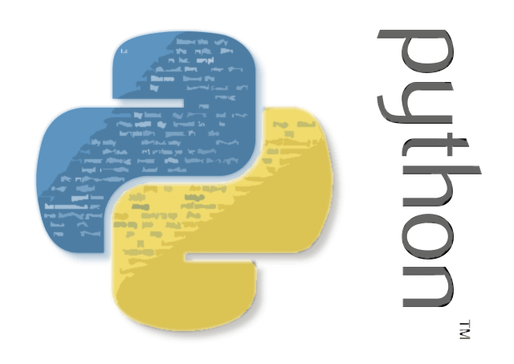



6. Technology Stack
This

Slide 9
7. Conclusion
E-Diary is a powerful tool that helps users to manage their academic and personal life. It provides a range of features to help users track their progress, plan their goals, and manage their day-to-day activities.
The project also takes security and privacy seriously and includes a range of safety and privacy features to ensure the security of data and information.

Slide 10
Thank you !!

