Slide 1
Online Quiz
Management
System
Rathod Krutarth(240160510040)

Slide 2
Overview
Introduction
Existing System
Problem in Existing System
New System
Need of New System
E-R Diagram
Use-case Description
Use-case Diagram
Activity Diagram
Data Dictionary

Slide 3
Introduction
The Online Quiz Management System is a web-based platform designed to create, manage, and conduct quizzes online.
It enables administrators to manage quizzes and user will take quizzes from any location.
It ensures automated evaluation and result generation, reducing manual effort and error.

Slide 4
Existing System
In the existing manual system:
Quizzes are conducted using paper.
Teachers manually grade student responses.
Data is not centralized or easily accessible.
Results may take time to be declared.
Students must be physically present.

Slide 5
Problem in Existing System
The existing manual quiz system:
It takes a lot of time to prepare question papers and check answers.
If there are many students, it becomes even harder to manage.
Mistakes can happen while checking or recording marks.
Also, students must come to school to take the quiz, which is not possible for everyone all the time.
There is no easy way to store or search old quiz records.

Slide 6
New System
The Online Quiz Management System lets admin create and manage quizzes on a computer.
User can take quizzes online and get instant results.
The system checks answers automatically and saves all data safely.
It is easy to use and works from anywhere.

Slide 7
Need of New System
The Online Quiz Management System saves time for teachers by checking answers automatically and giving instant results.
Students can take quizzes anytime from anywhere, which supports flexible learning.
All data is stored safely in one place, making it easy to track performance and access past records.
The system also reduces paper use, helping the environment and promoting digital education.

Slide 8
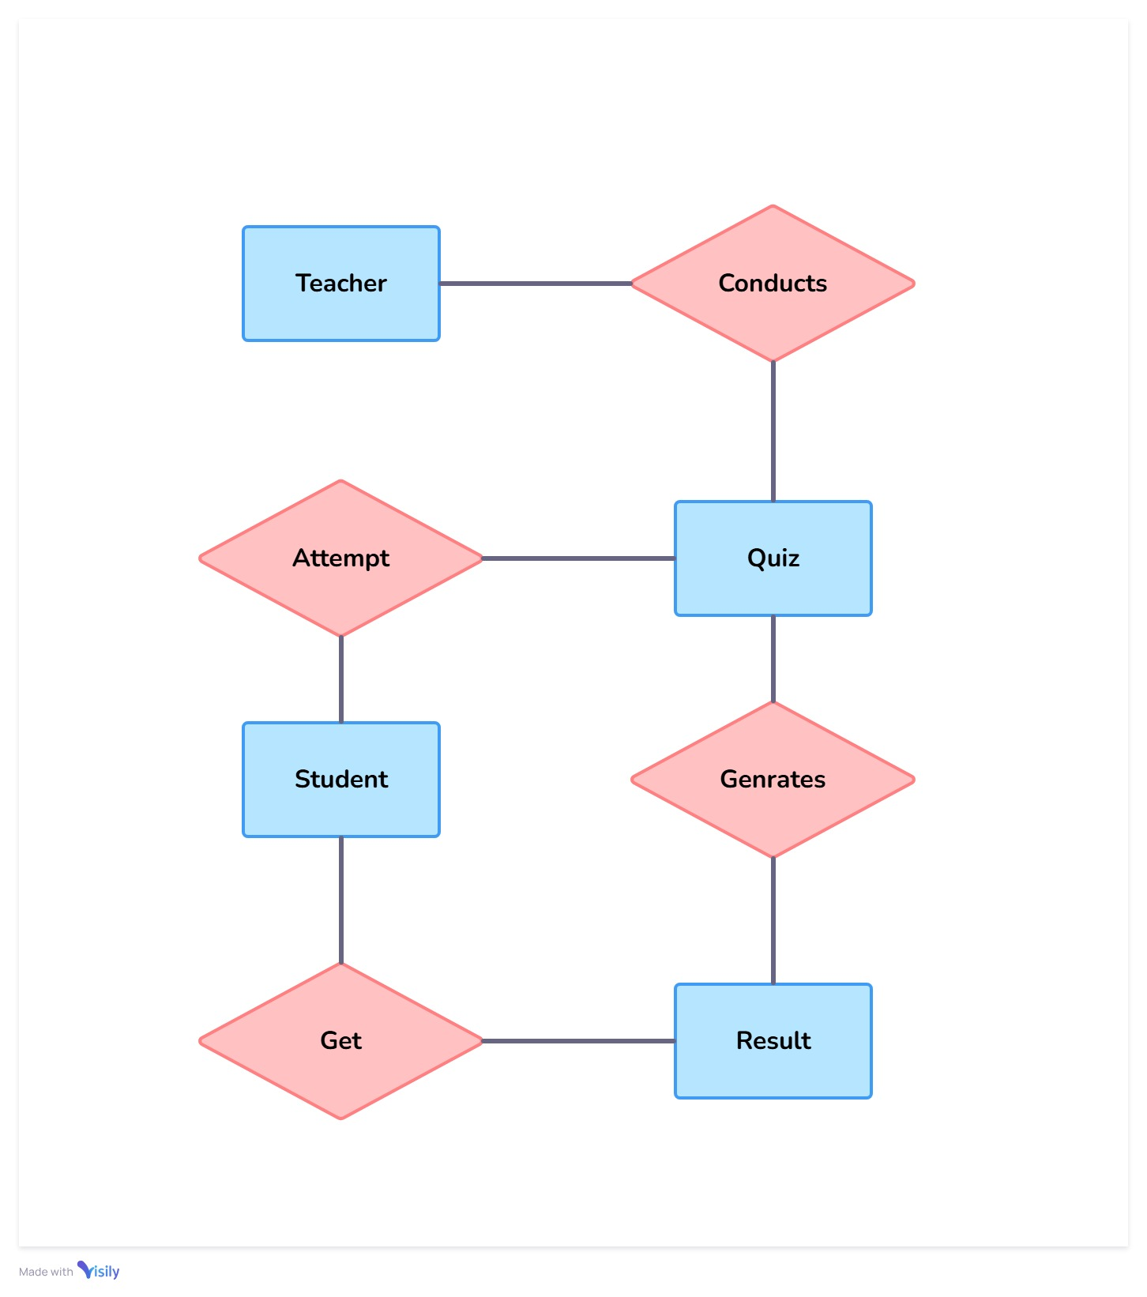
Entity Relationship
Diagram

Slide 9
Use case
Admin can login, create quiz, update quiz , delete quiz and manage users.
User can login , attempt quiz and get the result.

Slide 10
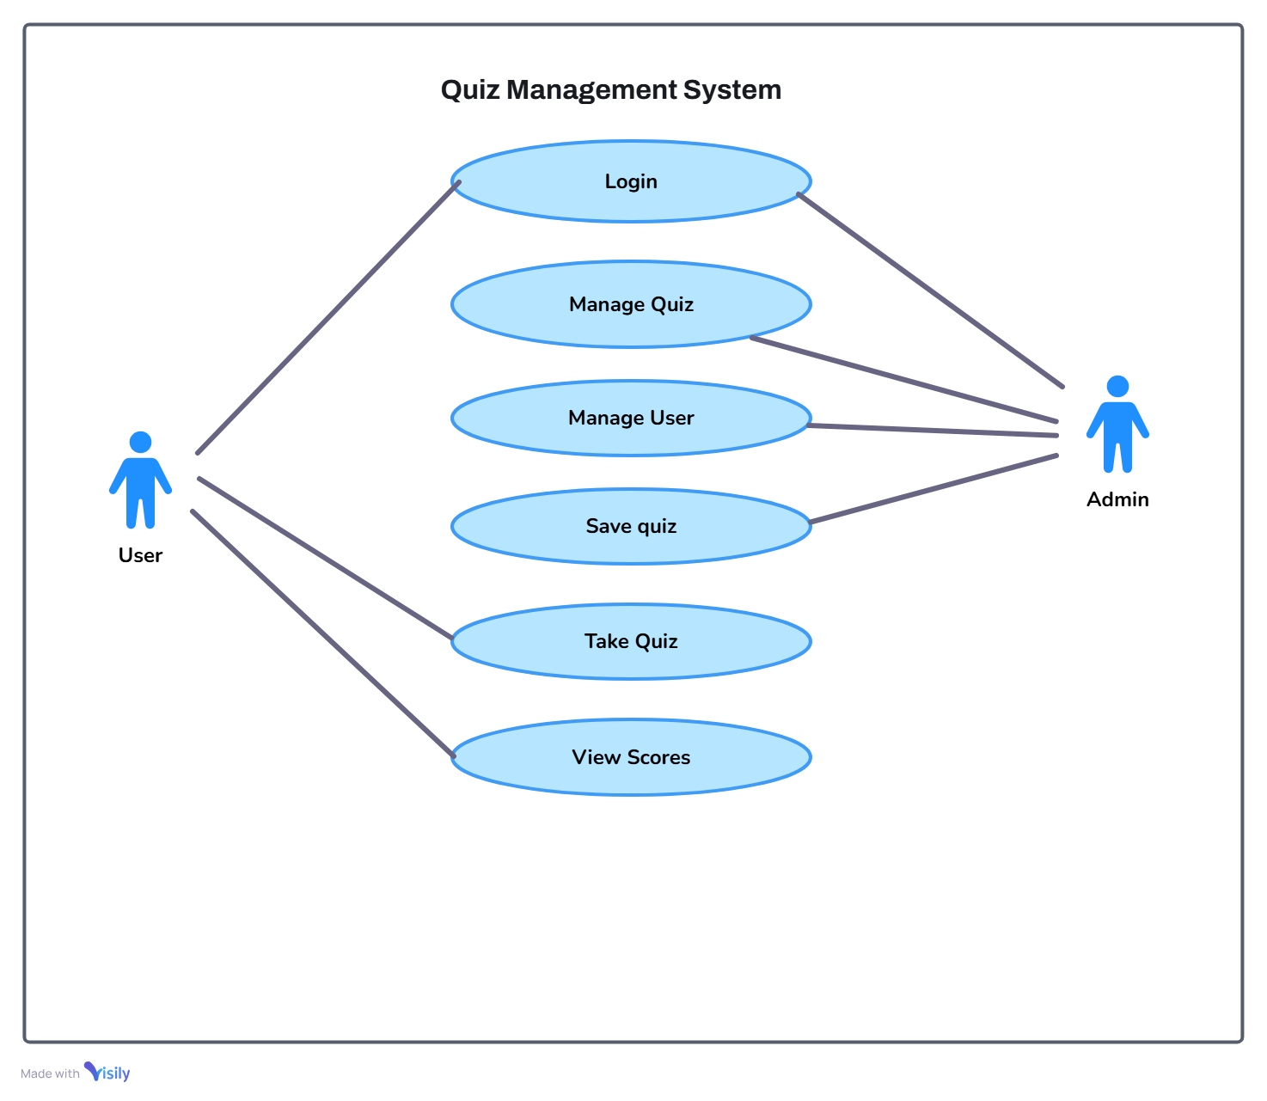

Slide 11
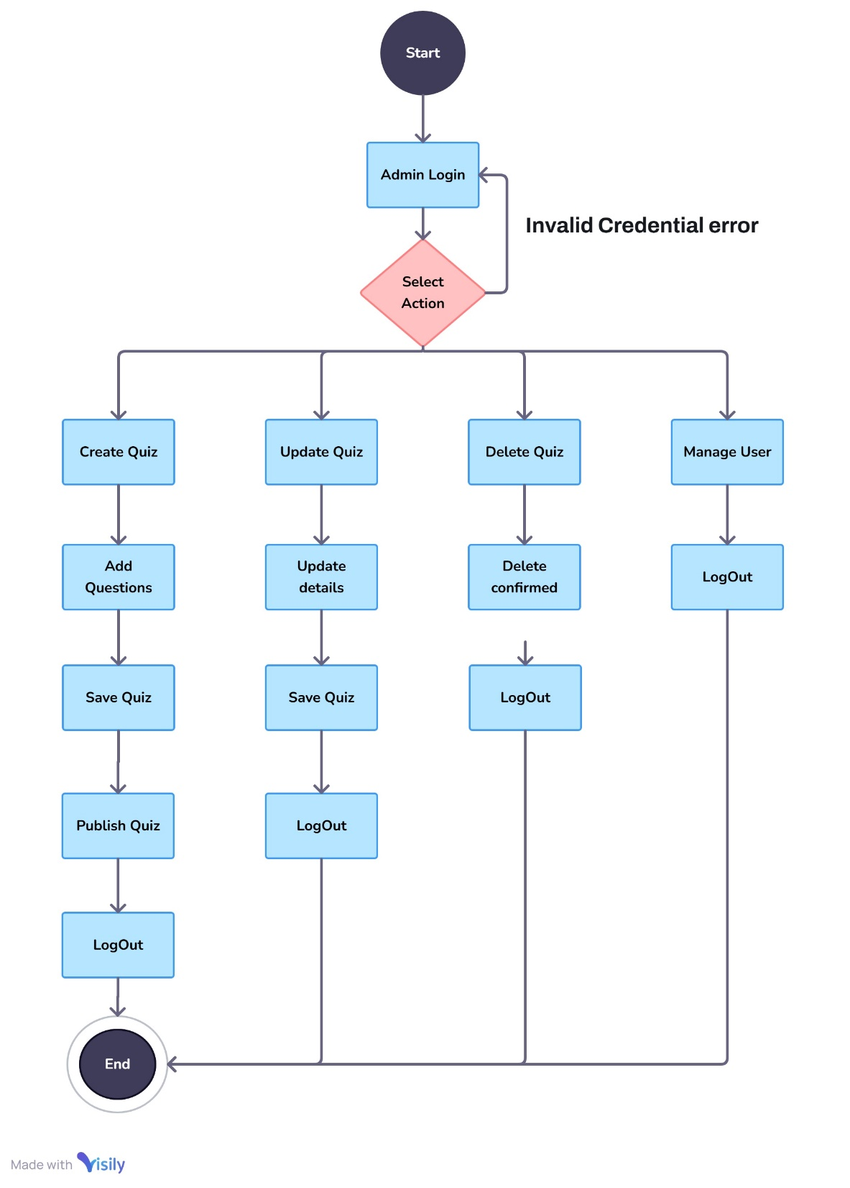
Activity Diagram :
Admin

Slide 12
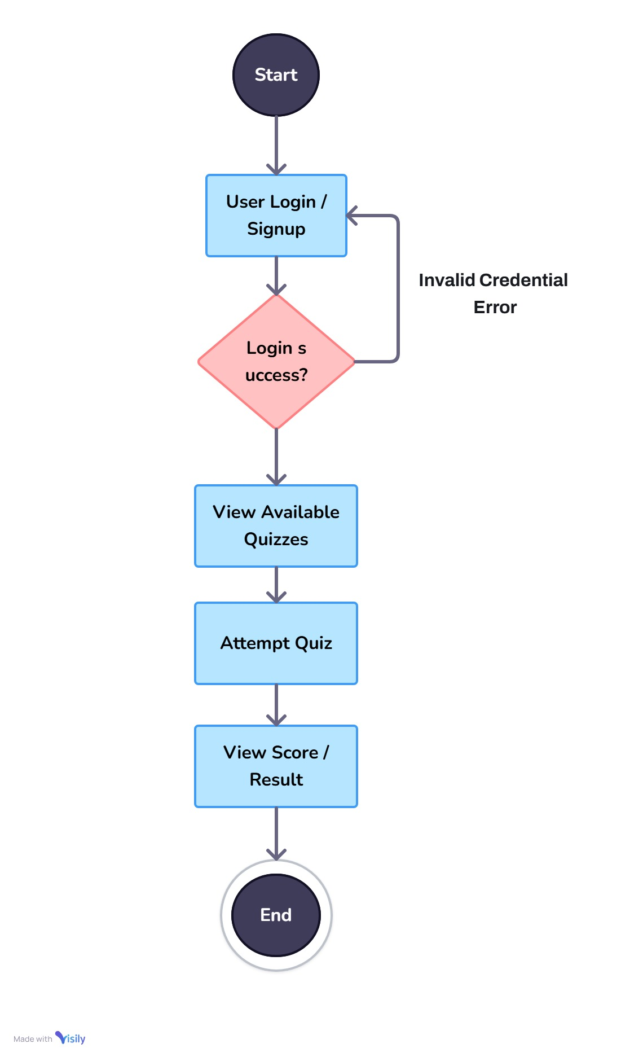
Activity Diagram :
User

Slide 13
Data Dictionary
Admin (admin_id, username, email, password)
User (user_id, name, email, gender, age ,Password)
Quiz (quiz_id, description, title, t_ques, ceration_date, createdBy)
Question (quiz_id, ques_id, ques_text, opt_a, opt_b, opt_c, opt_d, ans)
Result (res_id, quiz_id, user_id, score, total, percentage, data_taken)

