Slide 1
Grocery shop inventory management system
Submitted by : Parikshit Vaghela(212308020)
Guidance by : Dr.Ruchita shah

Slide 2
Overview
❖ Introduction
❖ Existing System
❖ Existing System Flowchart Diagram
❖ Existing System ER Diagram
❖ Existing Use-case Description
❖ New System
❖ Data Flow Diagram
❖ Use-case Description
❖ Use-case Diagram
❖ Activity Diagram
❖ Data Dictionary

Slide 3
Introduction
Inventory management system refer to the process of storing ordering and selling of goods and services . The discipline also involves the management of various supplies and processes.

Slide 4
Existing System
There is no computerized system present that’s why I want to make computerized application of grocery inventory management system.

Slide 5
Existing System Flowchart Diagram
Start
Visit shop
Purchase item
Payment
Get Bill
Mange stock
Stop

Slide 6
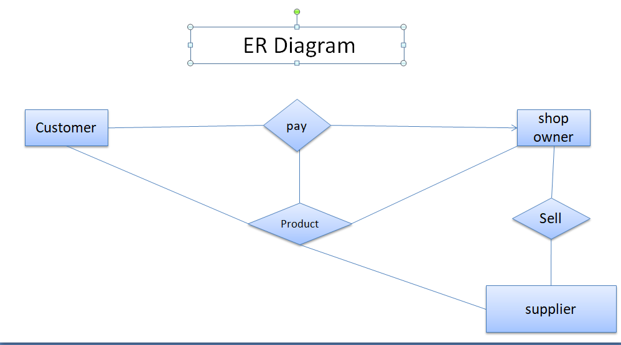
Existing System ER Diagram

Slide 7
Existing System Use Case Description
Owner:-
    Manage Customer , product , payment , bill
    Purchase product
    Sell product
    Give payment
    Get payment
Customer:-
    Purchase product
    Give payment
Supplier:-
    Sell product
    Get payment

Slide 8
Problem of Existing System
1.Time Consuming:: Paper work take extra time in all process. Find files, do entry, calculate manually all processes are need time.
2.Difficult to Manage Files:: Note all process in files and manage these all separate files is difficult. Update or delete the entry in file is make file non-attractive.
3.Data Security Problem:: There is risk to lost the files or anybody can access files and show the data inside files so data inside files are not secure.
4.Difficulty in data analysis:: The accountants usually found it difficult to analyze the customer’s data during generation of expenditure bills due to missing of some records.
5.Large Storage space:: We have to store all files like customer file, companies files , Items files etc which need space .

Slide 9
New System
Currently no computerized system exist so I will create a new system in the future , where owner can view , add , remove stock and create bill.

Slide 10
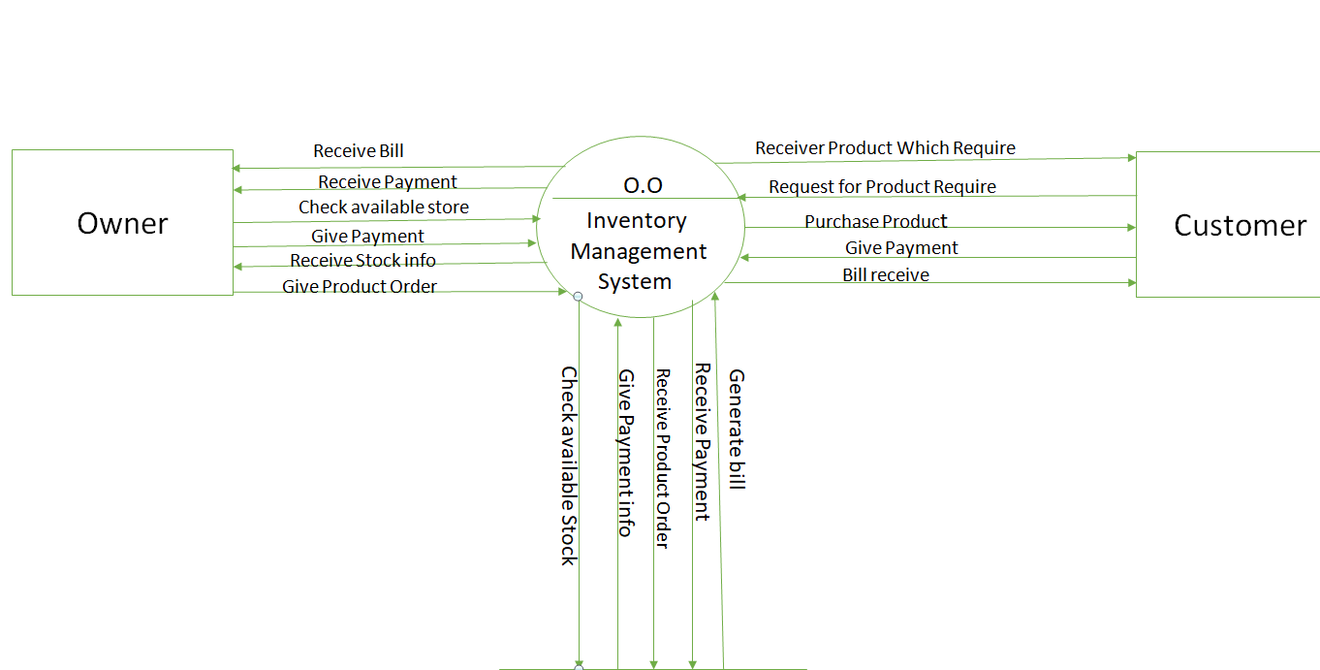
Data Flow Context level(0 level)Diagram
Supplier

Slide 11
Data Flow 1 level Diagram
Customer
Visit shop
Yes
Purchase product
No
Payment
Bill
Manage all things
Owner
Customer DFD level1 Diagram

Slide 12
Owner DFD level1 Diagram
Owner
Inquiry
Yes
Purchase product
No
Payment
Bill
Manage all things
Supplier

Slide 13
Use Case Diagram Description
Owner:-
    Login
    Manage Customer , product , payment , bill
    Purchase product
    Give payment
Customer:-
    Purchase product
    Give payment
Supplier:-
    Sell product
    Get payment

Slide 14


Use Case Diagram
Login
Uname
Password
Manage customer
Company
Supplier
Manage Product
Owner
Manage payment
Purchase product
Give Payment
Credit/debit
Only cash
Manage Bill
Customer

Slide 15
Activity Diagram
Owner
Login
View item
Select Category
Add to cart
Payment
Bill Generator

Slide 16
Data Dictionary
Login:-This table is represent detail of owner login detail.
Item:-This table is represent detail of item detail.
Customer:- This table is represent detail of Customer details.
Supplier:- This table is represent detail of Supplier details.
Stock:- This table is represent detail of all item’s Stock details.

Slide 17


