Slide 1
BookMart
Delivered By:
1.) Anqi Chen
2.) Riya Pawar
3.) Parth Patel
4.) Swet Patel
5.) Adnan Syed
6.) Dev Koshti

Slide 2
Contents
Introduction
Purpose
Project Scope
Product Function
User Classes
Assumptions
Product Function
Flowchart Interface
Analysis Model
Summary

Slide 3
Introduction
“BOOKMART” is the book management system tailored to meet the diverse needs of libraries, bookstores, and individual enthusiasts. In today's digital age, efficient organization and tracking of book collections are essential, and our team is committed to delivering a solution that addresses these challenges effectively.

Slide 4
Purpose
Efficiency
Accessibility
Organization
Tracking
Cataloging, search, borrowing/returning books
libraries, bookstores, and individuals
criteria such as title, author, genre, or ISBN
returning books, reports, track the status and history
Decision-Making
inventory status, borrowing trends

Slide 5
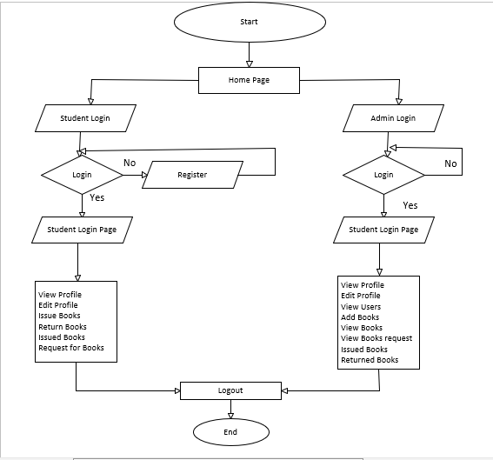
Flow Diagram

