Slide 1

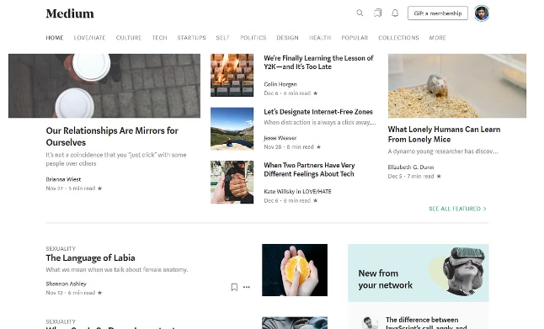
Blog Website: Medium
Welcome to this presentation on Medium, a popular online publishing platform. We'll explore its objective, backend flow, and future scope.
by Riya Raghuwanshi

Slide 2

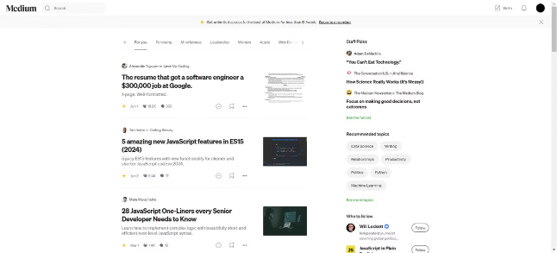
Objective of Medium
1
Empower Authors
2
Foster a Community
Provide a platform for individuals to share their ideas and stories with a global audience.
Encourage meaningful discussions and interactions among writers, readers, and editors.
3
Curate High-Quality Content
4
Enable Monetization
Allow creators to earn revenue from their writing through subscriptions, memberships, and partnerships.
Promote thoughtful, engaging, and well-written content through editorial review and recommendations.

Slide 3





Backend Flow of Medium
User Interaction
Users interact with the platform through web browsers or mobile apps, submitting content, reading articles, and engaging with the community.
Content Processing
Submitted content is processed through a content management system (CMS) to ensure quality, format, and compliance with platform policies.
Data Storage
User data, content, and metadata are stored in secure databases, ensuring accessibility and integrity.
Content Delivery
Processed content is delivered to users through a network of servers, optimized for speed and efficiency.
Analytics and Feedback
The platform collects data on user behavior and content performance, providing insights for improvement and optimization.

Slide 4
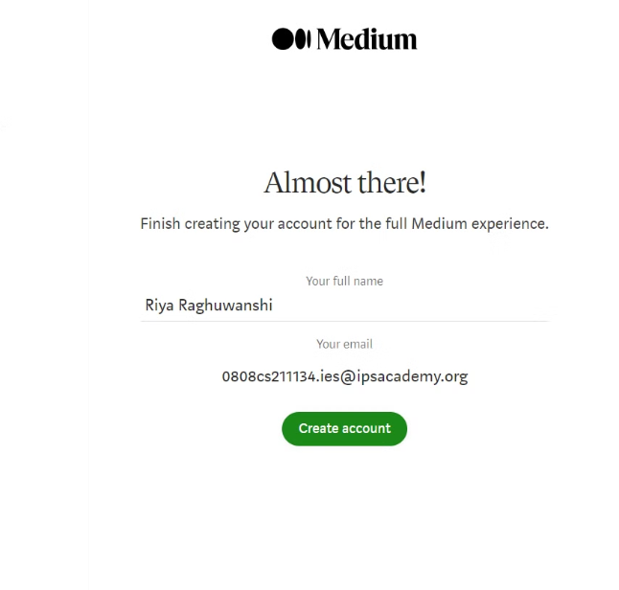
User Registration and Authentication
Registration
Authentication
User Profiles
Users can sign up for a Medium account using email addresses, social media accounts, or other methods.
The platform verifies user identity through password-based authentication or third-party providers.
Users can create profiles, customize their appearance, and connect with other members of the community.

Slide 5


Content Creation and Publishing
1
Drafting
Users can create new articles using Medium's built-in editor, which provides formatting tools, image upload, and other features.
2
Editing
Before publishing, users can edit and revise their content, ensuring clarity, accuracy, and quality.
3
Publishing
Once satisfied, users can publish their articles to the platform, making them visible to the public.
4
Distribution
Published content is distributed through the platform's network of readers, social media, and other channels.

Slide 6
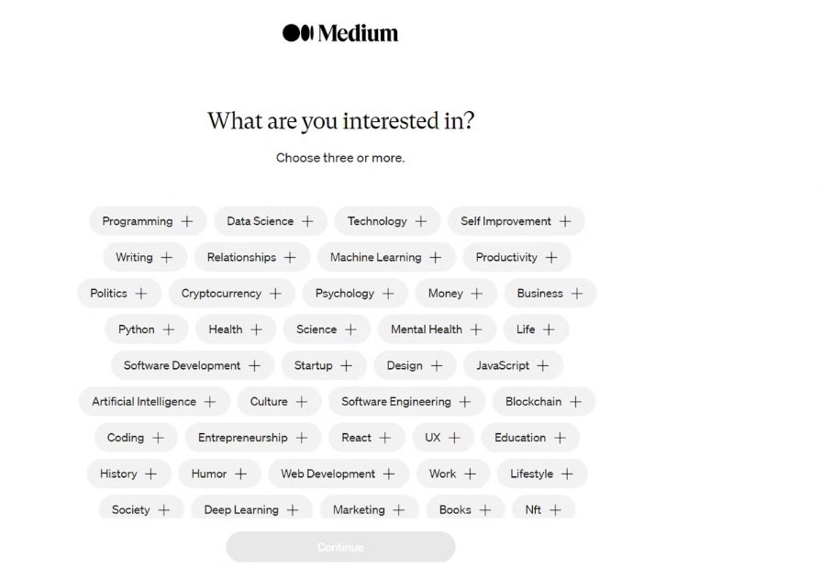
Content Curation and Recommendation
Editorial Review
Medium employs a team of editors to curate high-quality content, ensuring relevance, originality, and engaging writing.
Algorithmic Recommendations
The platform utilizes machine learning algorithms to personalize content recommendations, based on user interests and reading history.
Community Engagement
Users can follow writers, publications, and topics of interest, contributing to the platform's curation process through their engagement.

Slide 7
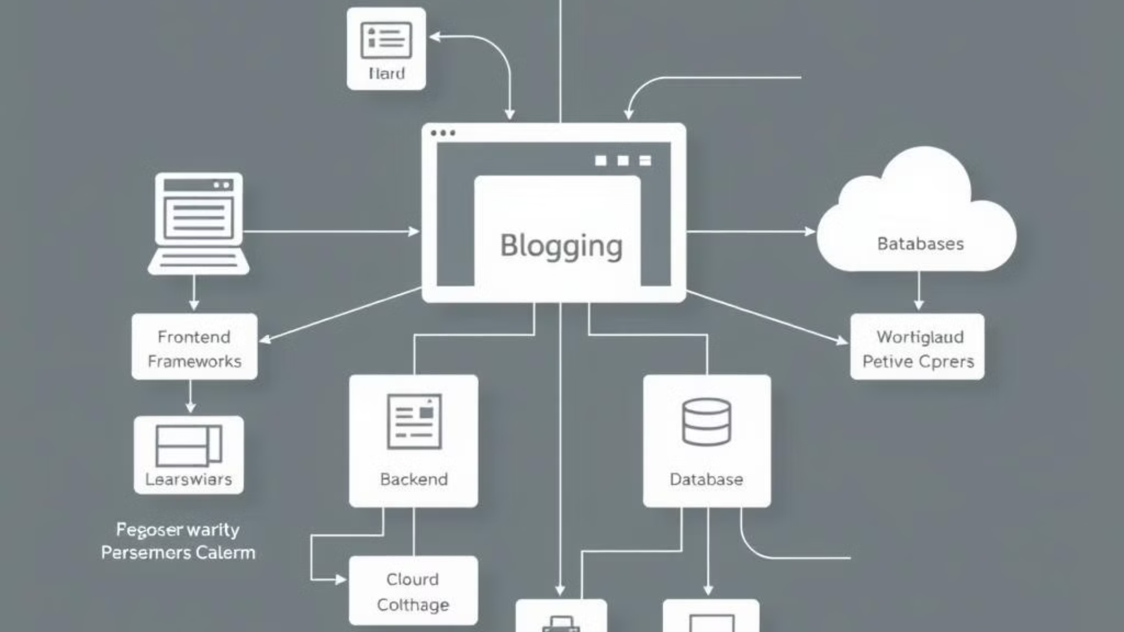
Technology Stack
Frontend:
Backend:
Database:
Additional Technologies:
JavaScript: The core language used for developing interactive elements on the web.
Node.js: It allows Medium to handle multiple requests efficiently and build scalable applications.
Amazon RDS (Relational Database Service): Used for managing relational databases in the cloud.
AWS (Amazon Web Services): Medium relies heavily on AWS for its cloud infrastructure.
React.js: A popular JavaScript library used by Medium for building user interfaces.
Express.js: It is used to build the server-side logic and handle routing, middleware, and request handling.
Amazon DynamoDB: A NoSQL database service, used for high-performance, scalable data storage.
Kafka: An event streaming platform used to handle real-time data feeds.
GraphQL: Used for efficient data fetching and real-time updates.
Nginx: It helps Medium manage high traffic and ensure fast content delivery.
Amazon S3 (Simple Storage Service): Used for storing and serving large amounts of static content.
ElasticSearch: Used for search functionality.
HTML/CSS: Standard web technologies used for structuring and styling the web pages.

Slide 8

Challenges faced by blogging website
Content Quality and Consistency: Maintaining high-quality content consistently is challenging. Bloggers need to keep their content relevant, engaging, and valuable to their audience.
Audience Engagement: Engaging readers through comments, shares, and interactions requires ongoing effort and creativity.
Monetization: Generating revenue from a blog can be challenging, especially in the early stages. Bloggers often rely on ads, sponsored content, affiliate marketing, or paid subscriptions, but these require a substantial and engaged audience.
SEO and Discoverability: Ensuring that blog content ranks well in search engines is crucial for attracting organic traffic. SEO requires knowledge of keywords, backlinks, and staying updated with search engine algorithms, which can be complex and time-consuming.
Competition: The blogging space is highly competitive, with numerous blogs covering similar topics. Standing out and maintaining a unique voice while competing with well-established blogs can be tough.

Slide 9






Future Scope and Roadmap
Community Growth
Technological Advancements
Continued expansion of the writer and reader community through targeted outreach and initiatives.
Integration of AI-powered features for content creation, recommendation, and user experience enhancement.
Monetization Options
Global Expansion
Exploration of new revenue streams for creators, including partnerships, advertising, and subscription models.
Expansion of the platform to new markets and languages, reaching a broader audience.

Slide 10
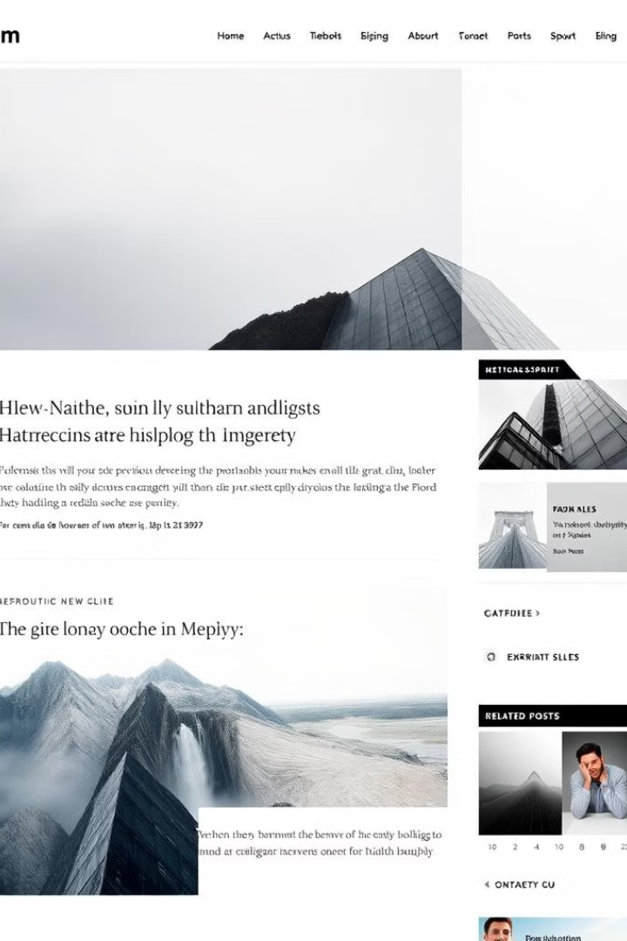
Thankyou Everyone

