Slide 1

Searching Algorithms
Welcome! Let's learn about Linear and Binary Search.
by Riya Raghuwanshi

Slide 2

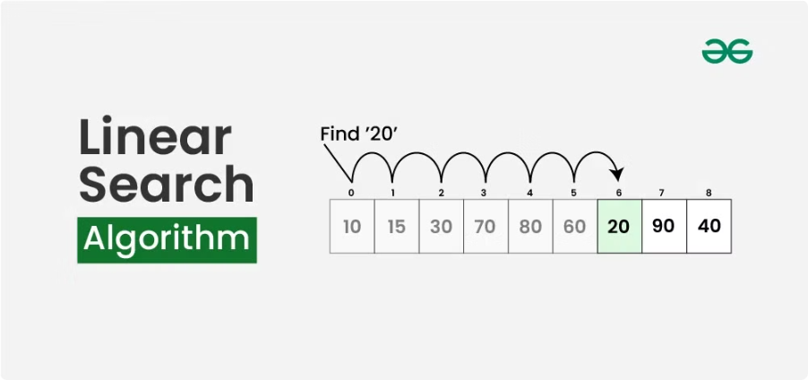
Linear Search
Check each element in the array sequentially.
Time Complexity: O(n)
1
1
Start at index 0
2
2
Compare current element to target
3
3
If equal, return index
4
4
If not, move to next element
5
5
Repeat until target is found or end of array

Slide 3



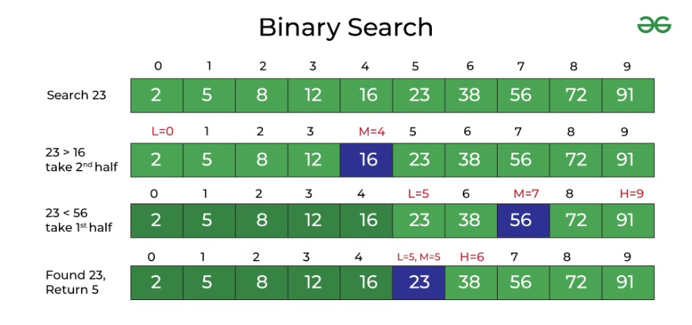




Binary Search
Efficient search for sorted arrays.
Time Complexity: O(log n)
1
Find middle element
2
Compare target to middle
3
If equal, return index
4
If greater, search right half
5
If less, search left half
6
Repeat steps 1-5 until found or array is empty

