Slide 1

MILESTONE 2:
GLOBAL ECONOMIC AND DEMOGRAPHIC
Power BI Desktop
ANALYSIS
RIYA RAJESH 14-07-2025
DA DS
MARCH BATCH

Slide 2
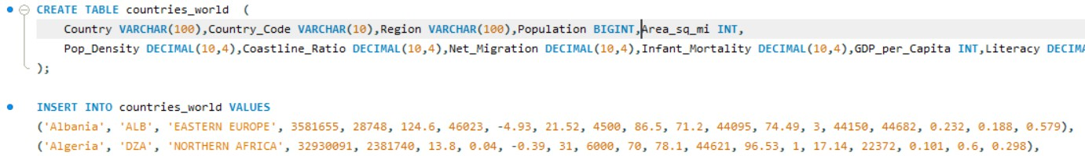
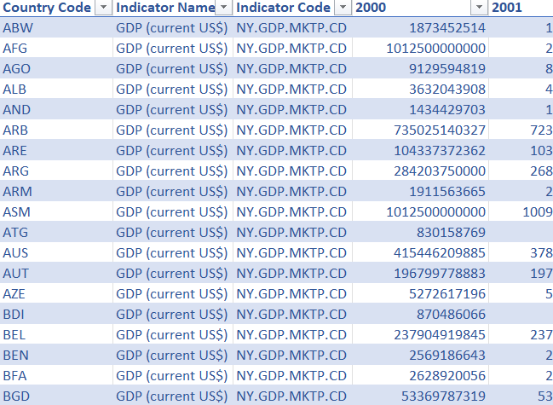
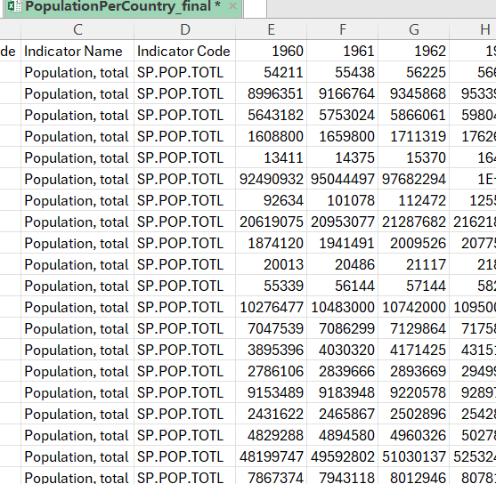
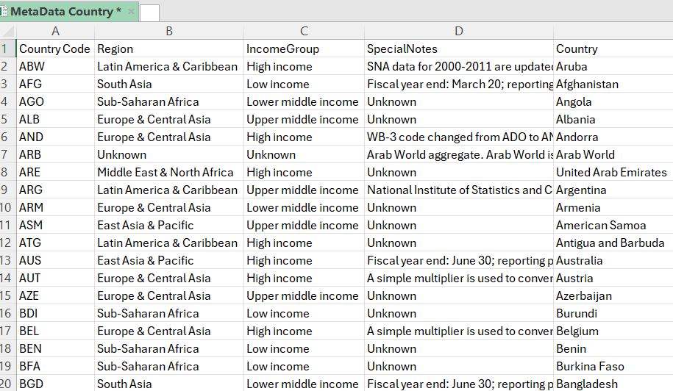
OBJECTIVE:
Power BI Desktop
The objective of this project is to analyze and derive insights from global data covering population, GDP, country characteristics, and health-related indicators from
multiple sources.
DATASET OVERVIEW:

Slide 3
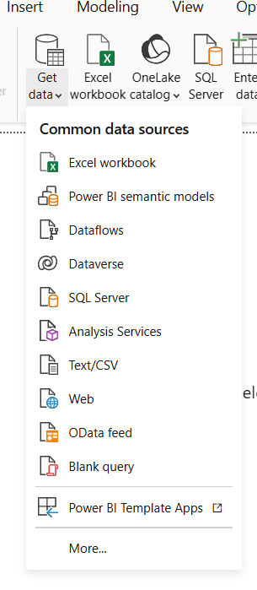
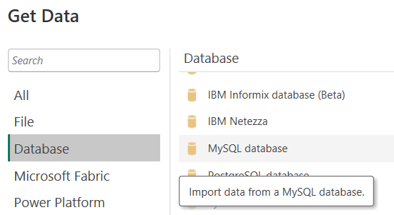
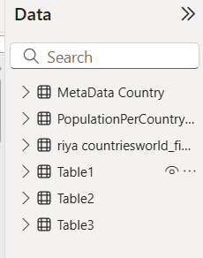
DATA CLEANING AND IMPORTING STEPS:
Power BI Desktop
Removed null values and filled blanks
Formatted columns
Imported SQL dataset: Using SQL connector and from 'Get Data' - MySQL Database - (Select file) - Connect
Imported CSV file: 'Get Data' - Text/CSV - Select file - Import
Imported Excel Worksheet: 'Get Data' - Excel Workbook - Select file and particular sheets needed - Import

Slide 4
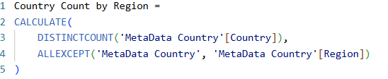
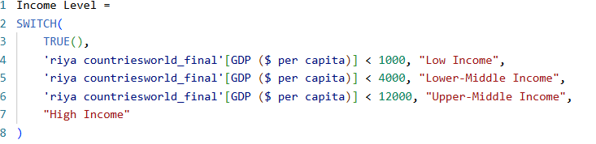
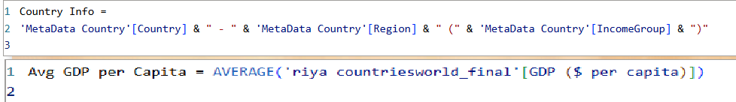
DAX FUNCTIONS USED:
Power BI Desktop

Slide 5




GLOBAL ECONOMIC AND DEMOGRAPHIC ANALYSIS
Power BI Desktop
TOTAL COUNTRIES
AVERAGE LITERACY RATE
AVERAGE GDP PER CAPITA
AVERAGE BIRTHRATE
AVERAGE DEATHRATE
573.80 9.72K
SUM of GDP by LITERACY AND COUNTRY
225
13.51K
29.15K
GDP SECTOR TOTALS
INCOME LEVEL
31.97
(15.19%)
Literacy (%) 1464
100%
Sum of GDP
Upper-Middle Inco…
72
Service Industry Agriculture
20K
Lower-Middle Inco…
68
High Income
66
59.464
(28.25%)
10K
Low Income
21
119.036
(56.56%)
Faroe Islands
Gibraltar
Greenland
Guernsey
Isle of Man
Jersey
Slovakia
Virgin Islands
Country
29.2%
AVERAGE OF LITERACY RATE
NET MIGRATION BY COUNTRY
POPULATION DIFFERENCE IN DECADES
50K
564.52T (37.78%)
19.87T (1.33%)
122.2T (8.18%)
35.7T (2.39%)
Net migration
Sum of 1960
Sum of 1970
Sum of 1980
Sum of 1990
Sum of 2000
Sum of 2010
573.80
1.00K
0K
French Guiana
Hong Kong
Belgium
Slovenia
Italy
Malta
Afghanistan
484.77T (32.44%)
0.00K
1.15K
267.3T (17.89%)
Country

Slide 6
KEY INSIGHTS:
Power BI Desktop
Global Population Dynamics
  Countries with highest populations include China, India, and the United States, showing consistent growth since 1960.
  Population growth rates are significantly higher in African and South Asian countries compared to Europe and North America.
  Low population density regions include large-area countries like Canada and Australia, despite their size.
Economic Strength – GDP Analysis
  Top GDP per capita countries include developed nations like Luxembourg, Switzerland, and Norway.
  Lowest GDP per capita is observed in Sub-Saharan Africa and conflict-affected countries.
  There is a clear positive correlation between GDP per capita and literacy rate
  High GDP volatility is seen in oil-dependent economies (e.g., Middle East).
Sector Contribution to GDP
  High-income countries have a greater share of GDP from services, while low-income countries rely more on agriculture.
  Industry-heavy countries (like China and Germany) balance GDP contributions across manufacturing and services.

Slide 7
KEY INSIGHTS:
Power BI Desktop
Literacy and Education
  Highest literacy rates are found in Northern and Western Europe, North America, and East Asia.
  Low literacy regions overlap with low-income economies, mostly in Sub-Saharan Africa and parts of South Asia.
  Countries investing more in services and education show better GDP and health indicators.
Infant Mortality & Health
  Infant mortality is drastically higher in low-GDP, low-literacy countries.
  Countries with higher GDP per capita tend to have lower infant mortality rates, confirming the importance of economic development in improving healthcare.
  Over time (from 1960–2016), most countries have reduced infant mortality, but the pace varies greatly by region.
Regional Insights
  South Asia and Africa exhibit rapid population growth but face developmental challenges like low GDP and literacy.
  Europe shows declining birthrates and stagnant population growth but maintains high GDP and strong health indicators.
  Middle Eastern countries show high GDP per capita but often low diversity in GDP sectors (oil-driven).

Slide 8
RECOMMENDATIONS:
Power BI Desktop
Strengthen Investment in Education
Improve Healthcare Infrastructure
Diversify Economies in Resource-Rich Countries
Control Population Growth in Rapidly Growing Regions
Encourage Urban Infrastructure in Densely Populated Countries
Leverage Digital Infrastructure
Enhance Data Monitoring and Policy Alignment

Slide 9
CONCLUSION:
Power BI Desktop
Global data reveals strong links between population, economy, education, and health.
High-income countries show high GDP per capita, strong literacy rates, and low infant mortality.
Low-income countries face challenges with rapid population growth and poor health outcomes.
Literacy and GDP have a positive correlation — education drives economic growth.
Infant mortality and GDP show a negative correlation — better economies support better healthcare.
Service-oriented economies tend to be more prosperous and stable than agriculture-dependent ones.

Slide 10
THANK YOU EVERYONE FOR YOUR PATIENCE
Power BI Desktop

