Slide 1
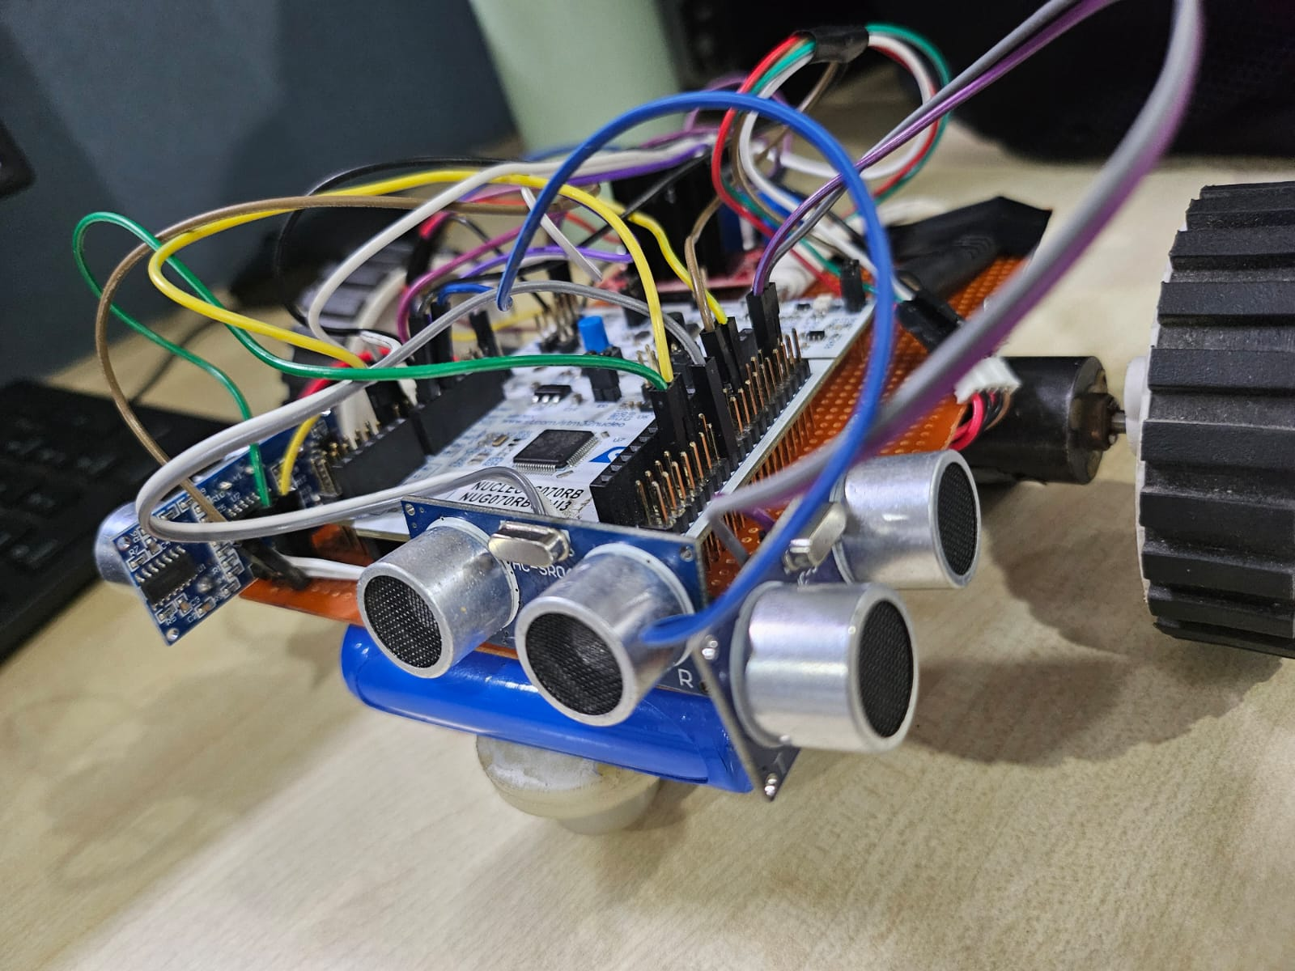
ECE211:
Maze Solver Robot
Annika Sinha, Surat Sathi Samanta, Riya Sachdeva

Slide 2
Problem Statement
To design an autonomous maze solver robot, which can navigate a walled maze without any human intervention.

Slide 3
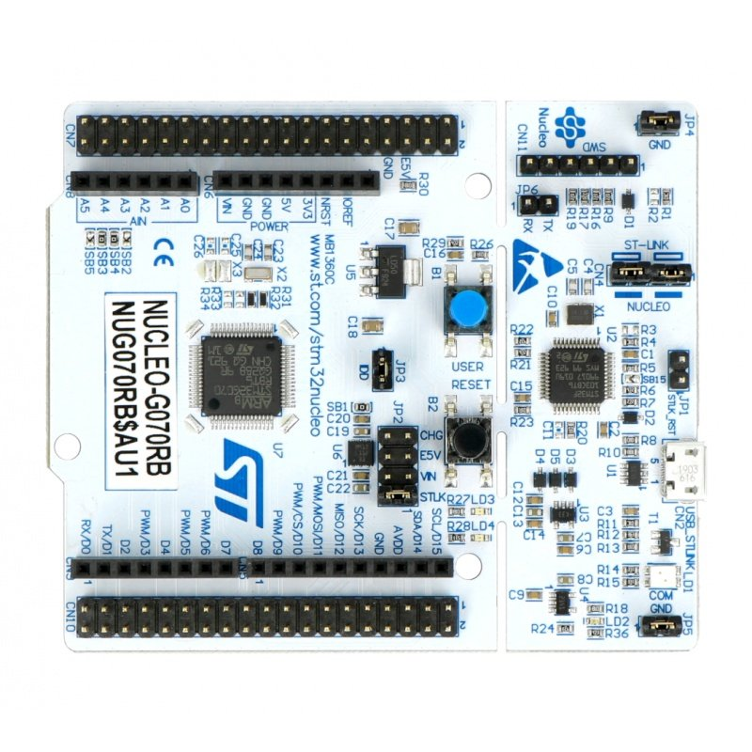
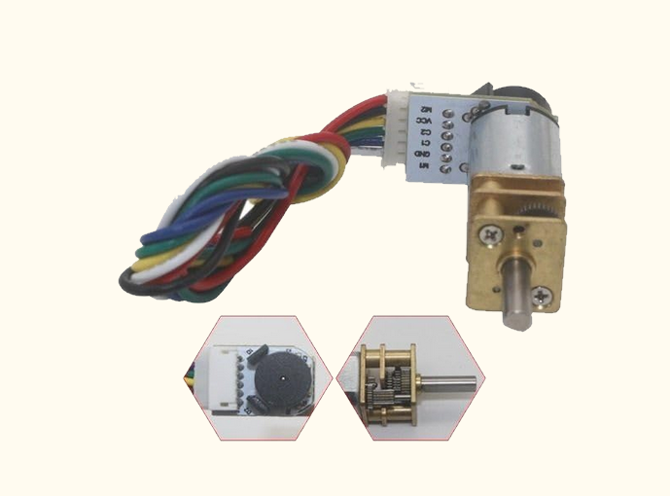
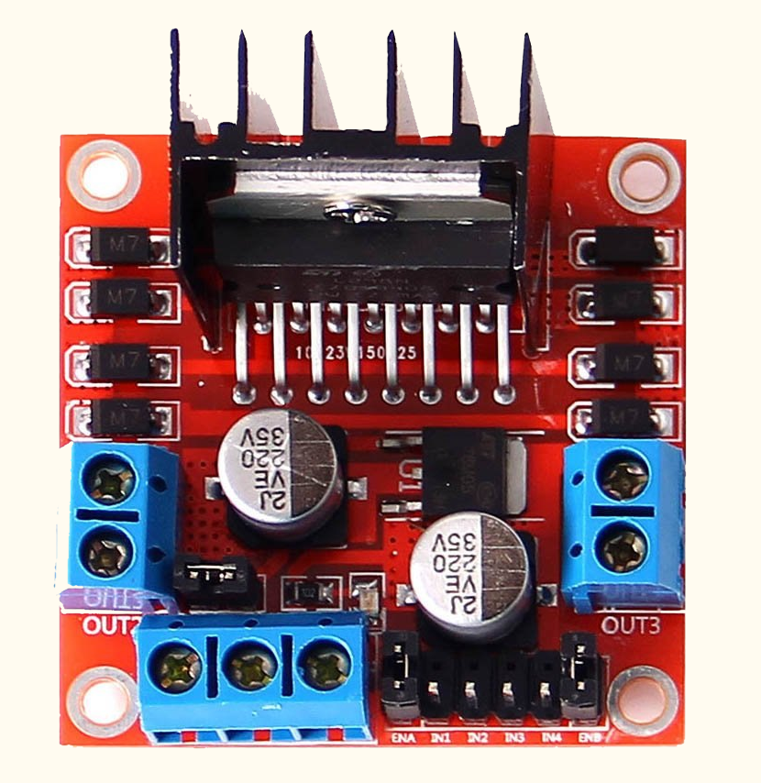
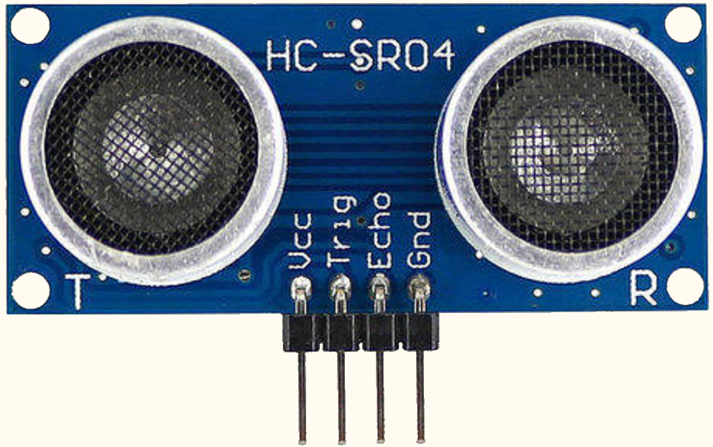
Equipment Used
Evaluation Board: STM32G070RB
Wall detection: Ultrasonic Sensor HC-SR04
Movement and Maze Mapping: 12V DC Single Output Encoder motors + L298N Motor driver

Slide 4
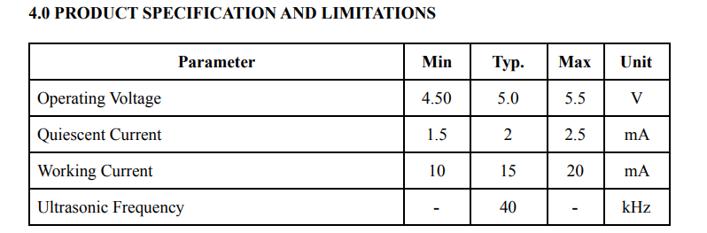
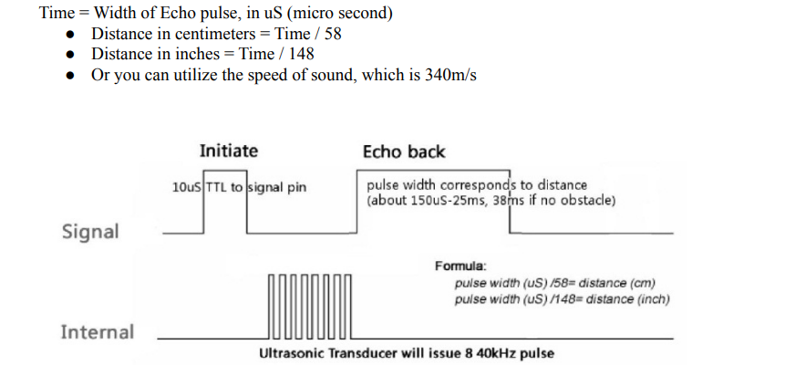
Ultrasonic Sensor: HC-SR04
The sensor sends Trigger pulses of 5V amplitude for 10 ms, and receives the reflected pulses on the Echo pin. The time difference is used to calculate the distance.

Slide 5
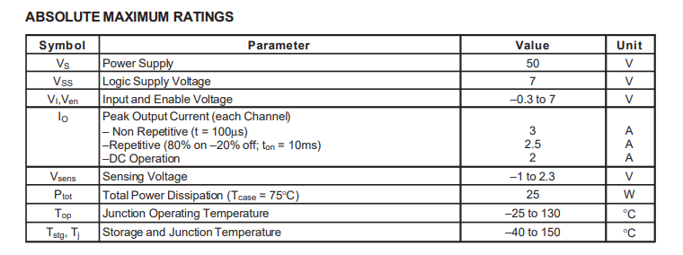
Motor Driver: L298N
The L298N is a dual H-Bridge motor driver which allows speed and direction control of two DC motors at the same time. The module can drive DC motors that have voltages between 5 and 35V, with a peak current up to 2A.

Slide 6
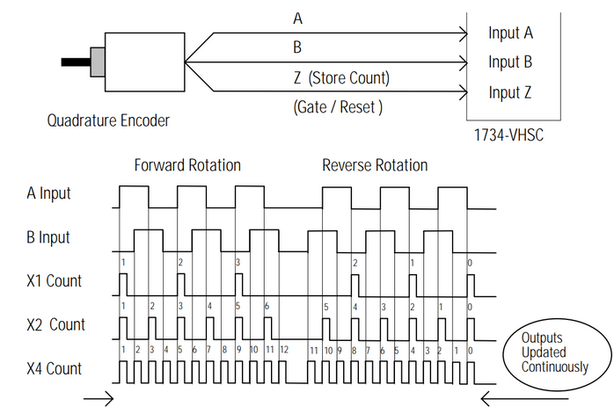
Encoder Motors: 12V DC Quadrature Encoder
Motor encoders are electromechanical devices that turn mechanical motion into an electrical signal. The output signal can either be a series of pulses, an analog signal, digital signal, or converted to a communication bus. Incremental encoders rely on the drive to interpret the position based on the output pulses that the encoder sends to the drive. The outputs for an incremental encoder are typically two square waves (A and B), which are then used to determine the direction of rotation.

Slide 7
Project Summary
The bot takes input data from 3 ultrasonic sensors, one for each direction: Left, Straight, Right
The data from the sensors is processed to determine the distance of wall from each sensor, and if it is less than the constant WALL_DISTANCE, the variable lsr in the code is updated to indicate that there is a wall in that particular direction.
lsr is a binary valued variable which takes values from 000 to 111.
lsr stands for left-straight-right. The digit 1 indicates that there is a wall in the corresponding direction, and 0 indicates that there is no wall.

Slide 8
Project Summary
The MCU implements a Wall-Follower Algorithm, which is described in later slides.
MCU writes movement instructions onto the L298N motor driver, which moves the 12V DC Encoder motors accordingly.
The encoder motors output nearly 200 pulses per rotation, and they send this data back to the MCU.
We can set the constants PULSES_STRAIGHT and PULSES_TURN to move the bot a desired distance. We have observed that 200 pulses in the clockwise direction for both motors correspond to roughly 9.24 inches movement forward and 120 pulses clockwise on one motor and 120 pulses anticlockwise on the other motor correspond to roughly 90 degree turns.

Slide 9
Project Summary
Once the desired pulse count is attained, the MCU gives the command to the motor driver to stop both the motors.
Then the code loops back to taking data from the ultrasonic sensors, and the process repeats till the end of the maze.
The maze is considered ended when no wall is detected, ie. lsr variable is 000.

Slide 10
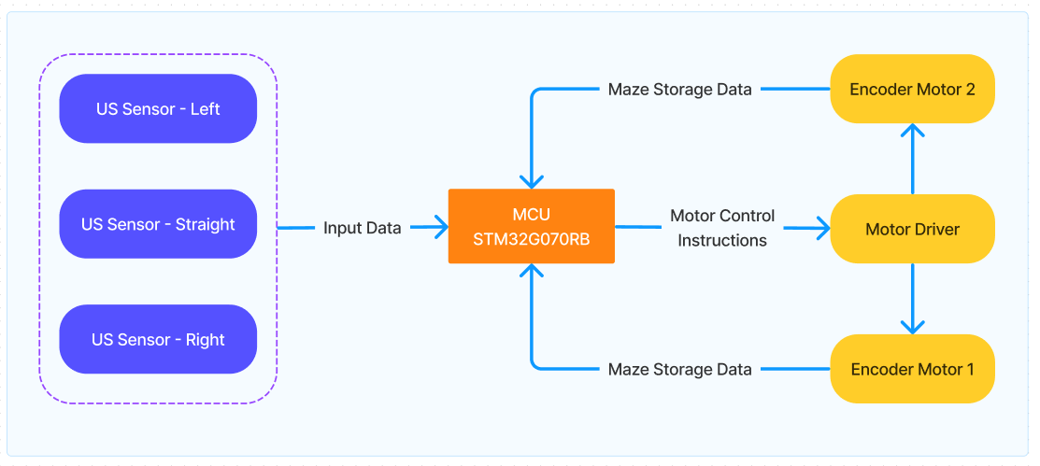
Block Diagram - Hardware

Slide 11
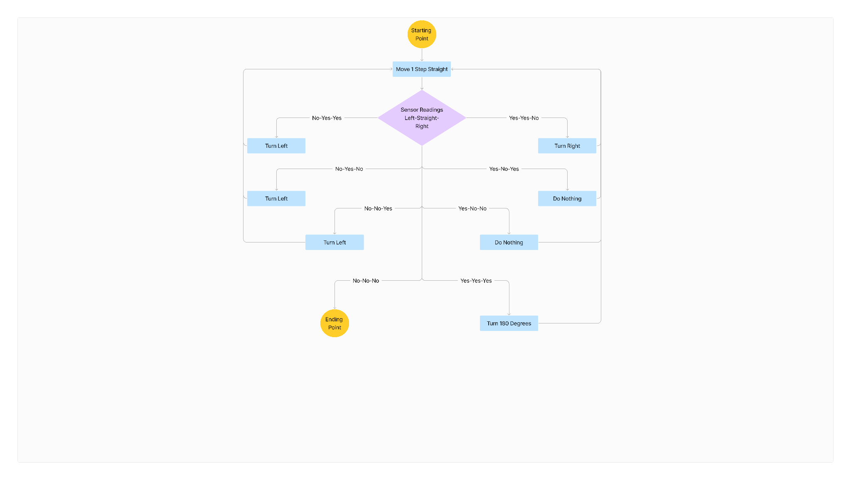
Algorithm: Wall Follower
It can solve any maze with square cells
Does not need prior information about the maze
Inefficient approach
Alternate: Flood Fill Algorithm

Slide 12
Algorithm: Flood Fill
Maze Representation: The maze is typically represented as a 2D matrix of cell coordinates, with information about blocked and open walls.
Marking the Exit: A unique value (often 0) is assigned to the exit cell.
Flooding the Maze: The algorithm starts from the exit cell and iteratively explores neighboring cells. If a neighboring cell is open (not a wall), it's assigned a value one higher than the current cell. This process continues, progressively "flooding" the maze with increasing values.
Micromouse Movement: The Micromouse starts at the starting position. In each step, it checks its neighboring cells. The cell with the lowest value (closest to the exit) that isn't a wall becomes the next move for the Micromouse.
Termination: The algorithm terminates when the Micromouse reaches a cell with a value of 0 (the exit).
Disadvantage: Needs prior information about the maze

Slide 13
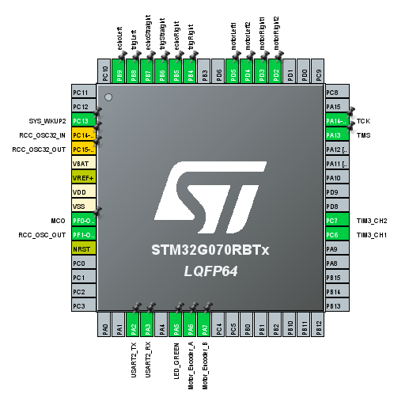
MCU Connections

Slide 14
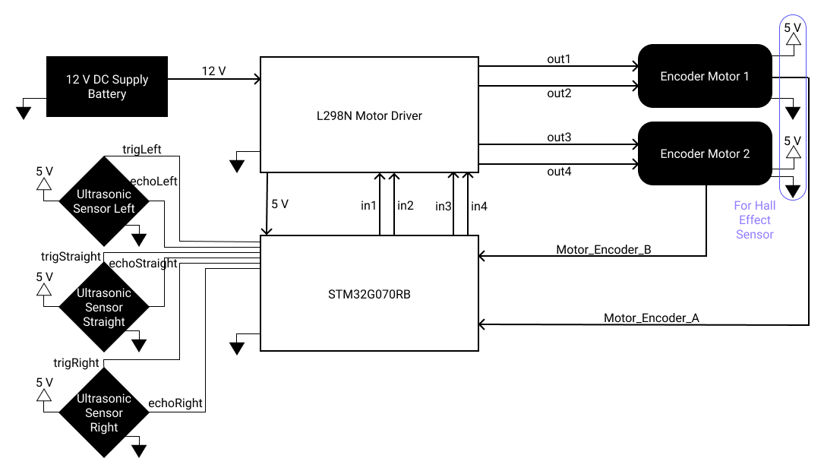
System Architecture

Slide 15
Implementation Details
The bot was first implemented on ESP32 using only 5V DC motors without the encoder. We were able to achieve basic LSR functionality.
We could not implement encoders on ESP32 because their output is 5V, and ESP32 pins are only 3V3 tolerant. So, we switched to STM32.
First we implemented ultrasonic sensors on STM32 using timers and learned the use of serial console.
We initially used 5V DC motors with 2-output encoders, but 5V motors were not able to drive the bot, so we switched to 12V DC motors with 1-output encoders.
There are 2 ways to implement encoder motors: Using encoder mode or using interrupts.
We use interrupts to increment the pulse count variables to control the movement of the motors.

Slide 16
Challenges Faced
We were able to smoothly design the first prototype on ESP32 using Arduino IDE.
Switching to STM32 was difficult to adapt to, as we were unfamiliar with industry grade evaluation boards and there is limited developer support available online for the STM32 ecosystem.
We tried to run STM32 using STM32Duino, but we were not able to get outputs of all 3 ultrasonic sensors simultaneously, so we switched to CubeIDE.
We had a lot of trouble with understanding timers to run ultrasonic sensors.
We had trouble with debugging and monitoring variable values as serial console is not readily available on STM32, but we later figured it out.
We were not able to understand encoder motor functionality for a very long time, and had to visit ST office twice to finally get them to work.
We also learned that E5V and 5V pins are not always internally connected.

Slide 17
Challenges Faced
During earlier stages of development, we purchased an encoder motor, whose data sheet was not available. We had to measure the pulses on the oscilloscope to figure out which wire served what purpose.
Apart from testing the integrated bot we also had to test the individual components multiple times. We tested the ultrasonic sensor using objects as barrier to see whether the distance was being measured accurately or not.
Testing the encoder motors was the most crucial as well as challenging part. We had to count the pulses for each rotation on the DSO so that we could program the bot’s controlled movement accordingly. The number of pulses for the forward movement as well as the straight movement were to be measured.

Slide 18
Testing and Evaluation
The bot exhibits controlled motion of 1 foot for 250 pulses and approximately 90 degree turns.
The bot implements the Wall Follower approach perfectly.
The test maze is made of a bulletin board with cardboard walls mounted using thumb pins.
Due to a weak chassis (perf board) and misaligned motors, the bot drifts left over long distances.
We tilted the walls of the maze to show bot functionality, but this remains an issue we need to solve.
Conclusion: The electronics and codebase are working perfectly, but there are mechanical issues in the bot.

Slide 19
Current Functionality/Existing Challenges
The bot can currently navigate a maze using the wall-following algorithm.
It can pass through loops and handle dead ends.
The algorithm works, but it is not efficient as it does not store the maze to figure out the shortest path.
We also need to use a proper metal or acrylic chassis; currently we are using a perfboard to hold the components together.
The DC motors are not same in terms of speed and torque, resulting in a slight left tilt. So we need to incorporate a PID tuning system to the encoder motors and to the ultrasonic sensors to ensure that the bot remains exactly straight.
We also plan to switch to 5V DC motors as they are lighter and faster.
One edge case we figured out where our algorithm would fail would be when all three roads are open, but they are all dead ends, and the dead end wall is further than the threshold distance of the bot.

Slide 20
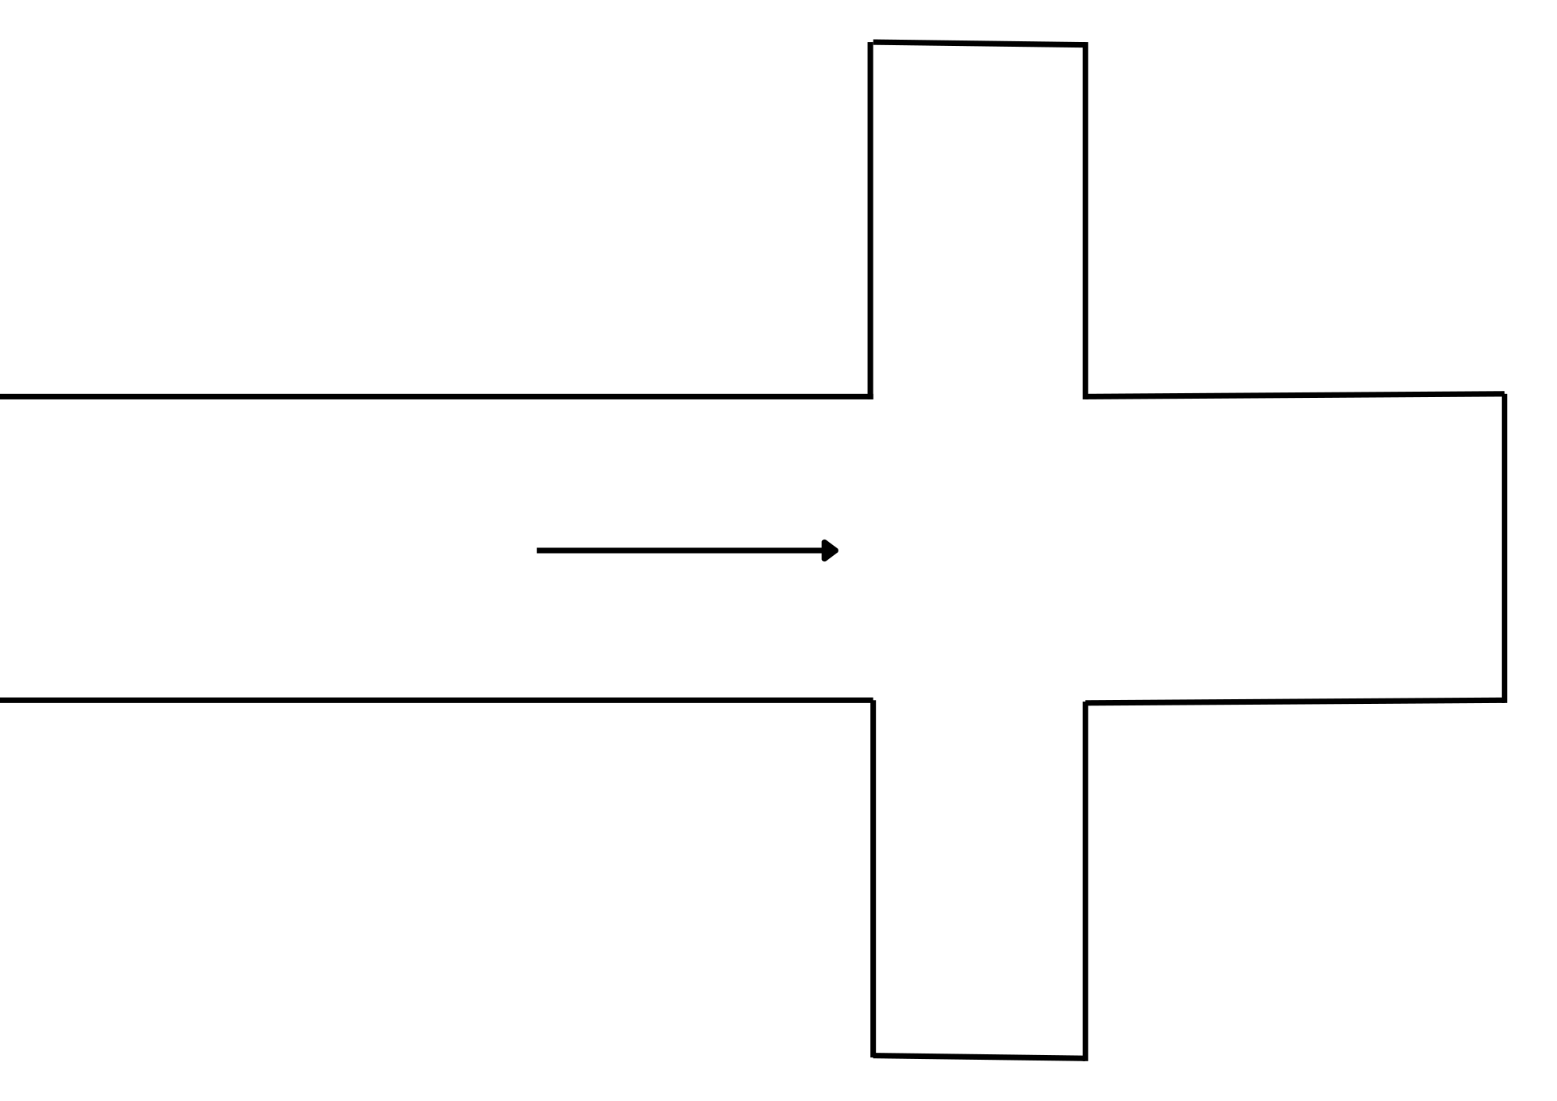
Current Functionality/Existing Challenges
In that case, the bot assumes it to be the end of the maze and stops. To fix this, we simply need to change the stop conditions. For example, we can add a black box to the floor at then end of the maze, and an IR sensor at the bottom of the bot to detect when the maze is actually finished. Upon this change to the stop code, the bot will now try to go through all three paths, thus mitigating the edge case. Here is a diagram of the case mentioned.

Slide 21
Applications and Future Scope
This bot will be developed further to run an optimized algorithm (Flood Fill Algorithm), which can solve the maze more efficiently. It can then be used in micro mouse competitions.
This bot can be modified for mapping cave systems and uncharted terrain which can be difficult for humans to navigate due to its autonomous ability.
It can be deployed in industrial warehouses with limited connectivity. We can set the coordinates of pick-up and drop locations in the warehouse and the bot will navigate from start to end on its own.
The bot can inspire the development of small, agile robots inspired by animals like mice or insects. These robots could be used for tasks like inspecting tight spaces or navigating through debris.

Slide 22
Applications and Future Scope
If this bot is equipped with cameras it could be used to inspect pipelines, ventilation ducts, or other narrow spaces for damage or blockages. This could be useful in industrial settings or building maintenance.
Integrating AI and machine learning algorithms into Micromice could enable them to adapt to unforeseen situations, learn from their experiences, and make real-time decisions while navigating complex environments.

Slide 23
Link to the codebase: GitHub
There are modules of the code we developed for each component, and the final code ‘stm32-lsr’.

