Slide 1
PROJECT TITLE
ONLINE BOOK STORE
RIYA SALESIA -211521205122
RESHMA -211521205119
RYYAN SHIFA -211521205126
PREETHI -211521205111

Slide 2
ABSTRACT
This presentation explores the design and functionality of an online book store, focusing on its key features, user experience, and business model. The online book store offers a wide range of books across various genres, providing users with easy access to literature through a seamless interface. Key components include advanced search options, personalized recommendations, user reviews, and secure payment methods. Additionally, the store integrates features like e-book downloads and audiobook options, catering to diverse reader preferences. This project highlights the importance of digital transformation in the publishing industry and aims to enhance customer engagement through an efficient and user-friendly platform.

Slide 3
INTRODUCTION
Our online book store aims to revolutionize the way the people discover
Purchase and enjoy books.
With an user friendly interface, vast collection and secure payment gateway we strived to provide an Unparallel book shopping experience

Slide 4
EXISTING SYSTEM
Traditional book store have limitations:
Geographical constrains
Limited inventory
Time-consuming browsing

Slide 5
PROPOSED SYSTEM
Provide a User friendly platform for customer to browse and purchase books in online
Ensure secure and efficient transaction
Enhance customer experience Through personalized recommendations
Improve search functionality for easy book discover

Slide 6
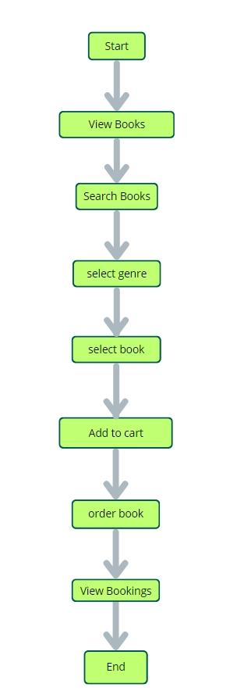
APPLICATION FLOW

Slide 7
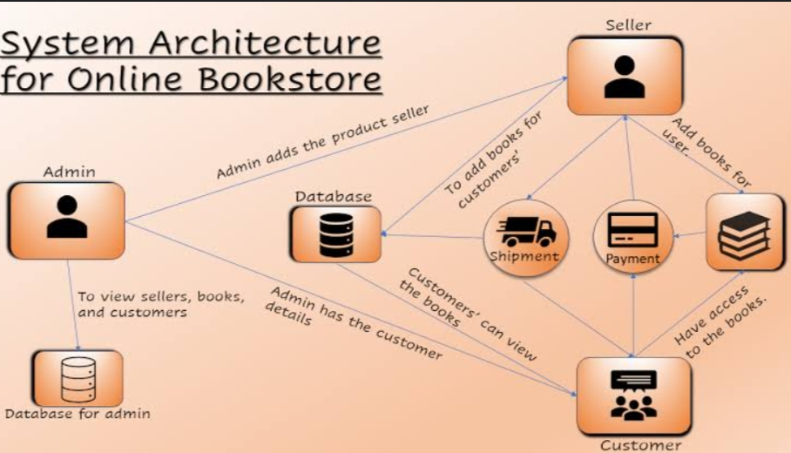
ROLE BASED ARCHITECTURE

Slide 8
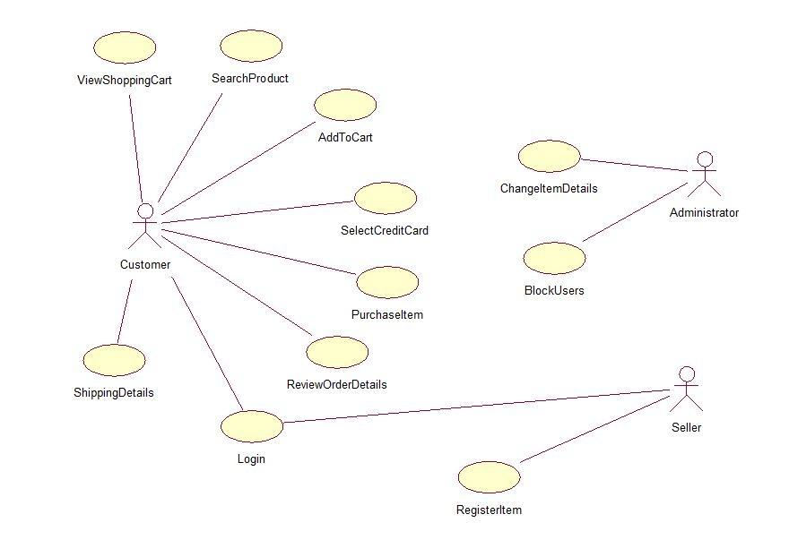
ER DIAGRAM

Slide 9
FRONT-END DEVELOPMENT
Focus on creating a User-centric interface for browsing ,purchasing and account management
Interactive elements:book filtering and search functionality
Technologies used: HTML5 ,CSS3, JavaScript and Bootstrap

Slide 10
BACK-END DEVELOPMENT
Technologies
Django Framework: Manages requests, user authentication, and processes orders.
PostgreSQL Database: Manages book inventory, customer data, and orders.
REST APIs: Facilitate data exchange between frontend and backend.

Slide 11
INTEGRATION
1. User authentication with payment gateway
2. Search functionality with book database
3. Shopping cart with order management
4. Payment processing with inventory management
5. Shipping integration with logistics provider

Slide 12
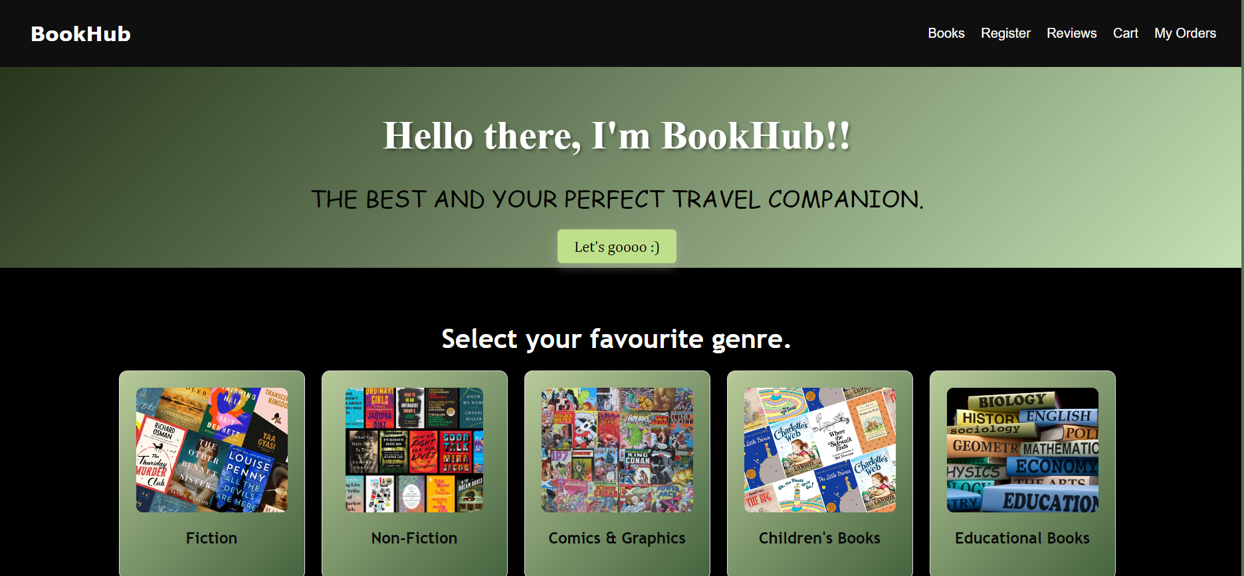
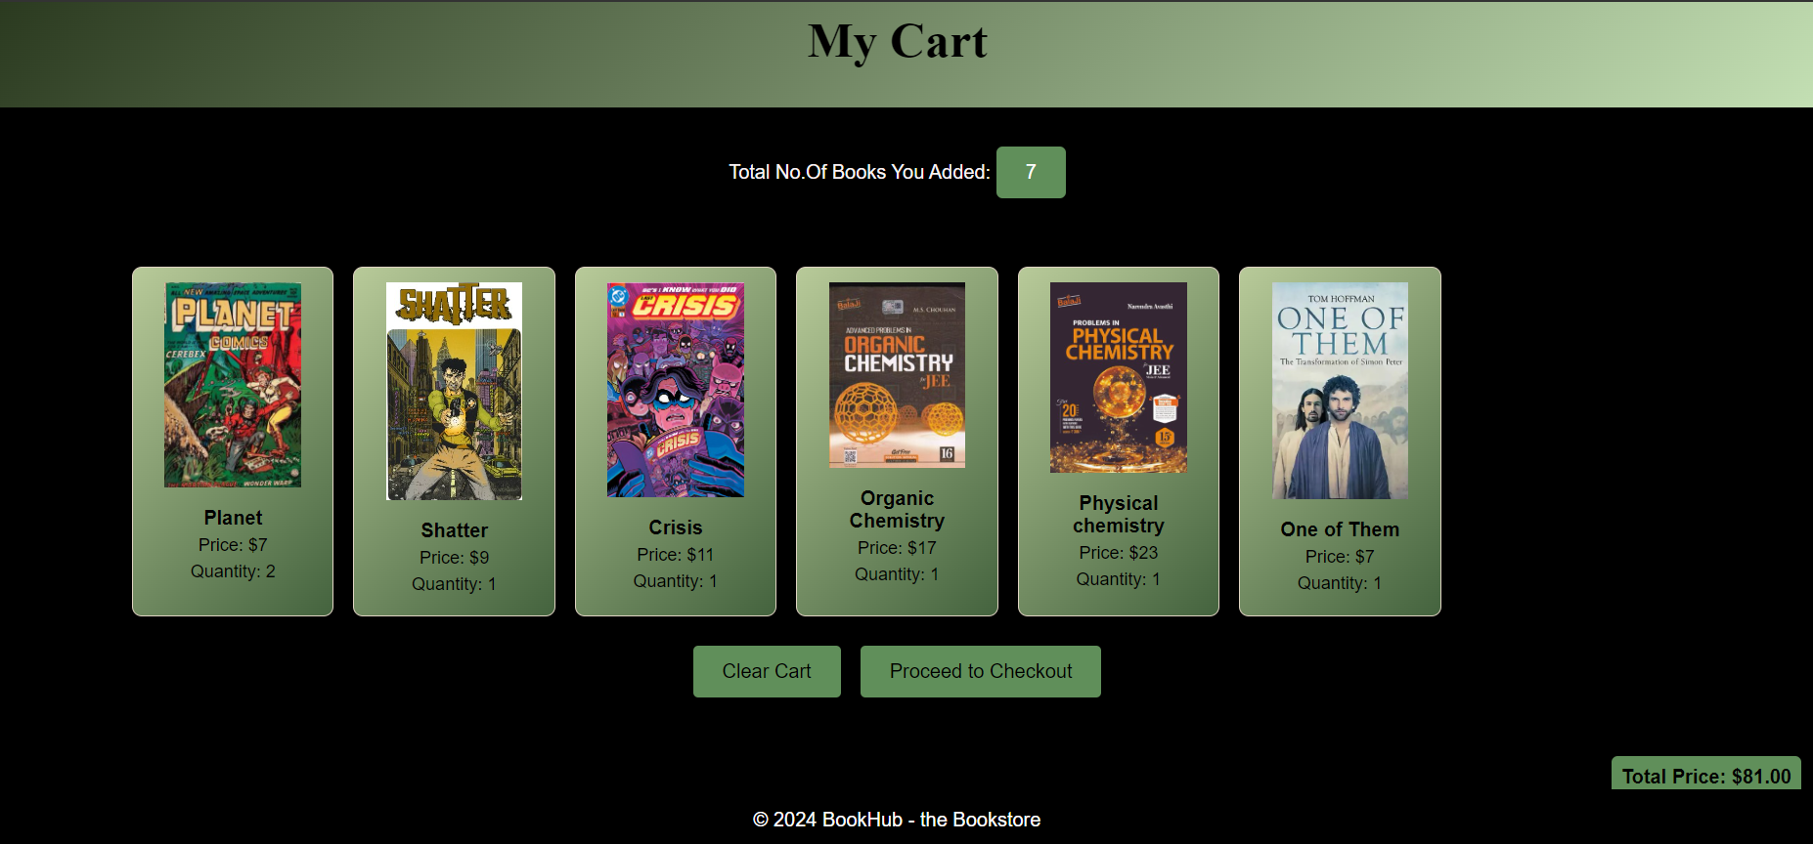
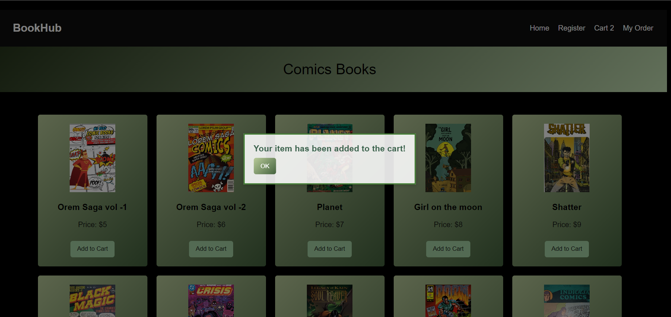
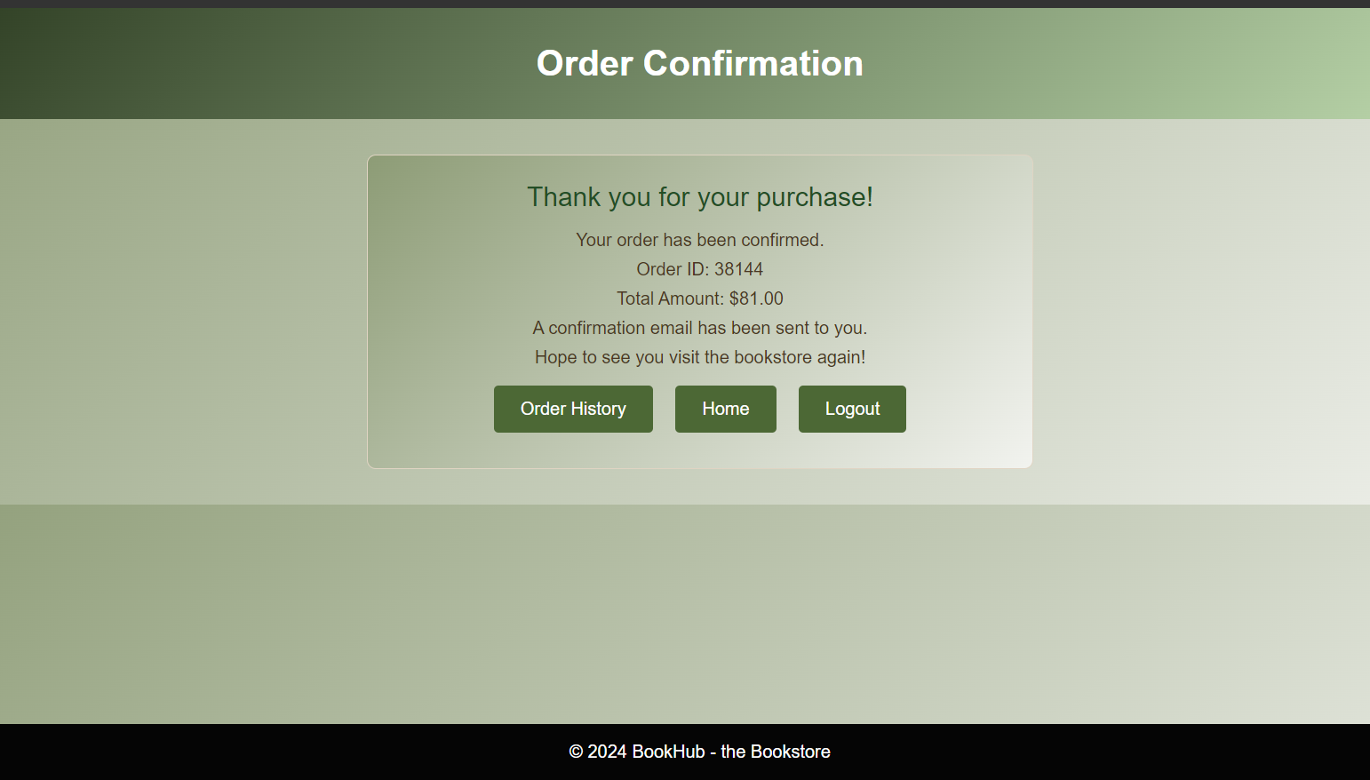
MODEL

Slide 13
CONCLUSION
We have created a platform
That provides vast collection of books
Supports scalable and performance – Optimized architecture
Enhances user engagement through social media integration

Slide 14
THANK YOU

