Slide 1
RIYA SALESIA
Final Project
3/21/2024 Annual Review

Slide 2
PROJECT TITLE
Loan Default Prediction Using RNN ( Recurrent Neural Network )
3/21/2024 Annual Review

Slide 3


AGENDA
Loan default prediction in banking using RNN involves several key steps. Initially, borrower data is collected, encompassing factors like credit score, debt-to-income ratio, and loan amount.
Subsequently, data preprocessing tasks such as normalization and reshaping into sequences are conducted. The RNN model, featuring LSTM layers, is then constructed and trained on this data, aiming to capture sequential patterns.
Evaluation metrics like accuracy and loss are employed to assess model performance. Following training, the model is utilized to predict loan defaults on new data. Analysis of prediction outcomes allows for identifying defaulters and evaluating the model's efficacy.
3/21/2024 Annual Review

Slide 4

PROBLEM STATEMENT
Predicting loan defaults in banking involves utilizing Recurrent Neural Networks (RNNs) to analyze historical borrower data and predict the likelihood of a borrower defaulting on a loan.
The model is trained on features such as credit score, debt-to-income ratio, loan amount, monthly income, and open credit lines. RNNs leverage the sequential nature of the data to capture temporal dependencies and make accurate predictions.
By identifying high-risk borrowers, banks can proactively manage their loan portfolios, minimize financial losses, and make informed decisions regarding loan approvals.
3/21/2024 Annual Review

Slide 5

PROJECT OVERVIEW
The project aims to develop a loan default prediction system using Recurrent Neural Networks (RNNs) in banking. It involves collecting borrower data including credit score, debt-to-income ratio, loan amount, monthly income, and open credit lines. The data is preprocessed, split into training and testing sets, and normalized.
An RNN model is then built and trained on the training data to predict loan defaults. The model's performance is evaluated using accuracy metrics. The system helps banks identify high-risk borrowers, minimize financial losses due to defaults, and make informed decisions regarding loan approvals, thereby improving risk management and overall efficiency.
3/21/2024 Annual Review

Slide 6

WHO ARE THE END USERS?
The end users of the loan default prediction system using RNNs in banking include financial institutions such as banks, credit unions, and lending companies. Loan officers, risk managers, and other personnel involved in the lending process are the primary end users.
Additionally, stakeholders such as regulators and investors may also benefit from the system's insights into borrower risk profiles and default probabilities.
Ultimately, the system serves to assist decision-makers in mitigating financial risks associated with lending by providing timely and accurate predictions of loan defaults.
3/21/2024 Annual Review

Slide 7
YOUR SOLUTION AND ITS VALUE PROPOSITION
This system leverages (RNNs) to analyze borrower profiles and financial indicators, offering valuable insights into the likelihood of loan defaults.
Its value proposition lies in its ability to accurately forecast potential defaults, enabling financial institutions to make informed lending decisions and mitigate risks effectively.
By automating the analysis process and providing timely predictions, the system enhances efficiency, reduces manual effort, and improves the overall loan portfolio's performance.
Ultimately, it helps financial institutions optimize their lending practices, minimize losses, and maintain a healthy balance between risk and profitability.
3/21/2024 Annual Review

Slide 8

THE WOW IN YOUR SOLUTION
The wow factor in the solution lies in its ability to accurately predict loan defaults based on complex borrower profiles and financial indicators.
By leveraging Recurrent Neural Networks (RNNs), the model can capture temporal dependencies in the data, providing more robust predictions.
This empowers financial institutions to make informed decisions, mitigate risks, and optimize loan approval processes, ultimately enhancing operational efficiency and profitability while reducing potential losses.
3/21/2024 Annual Review
8

Slide 9
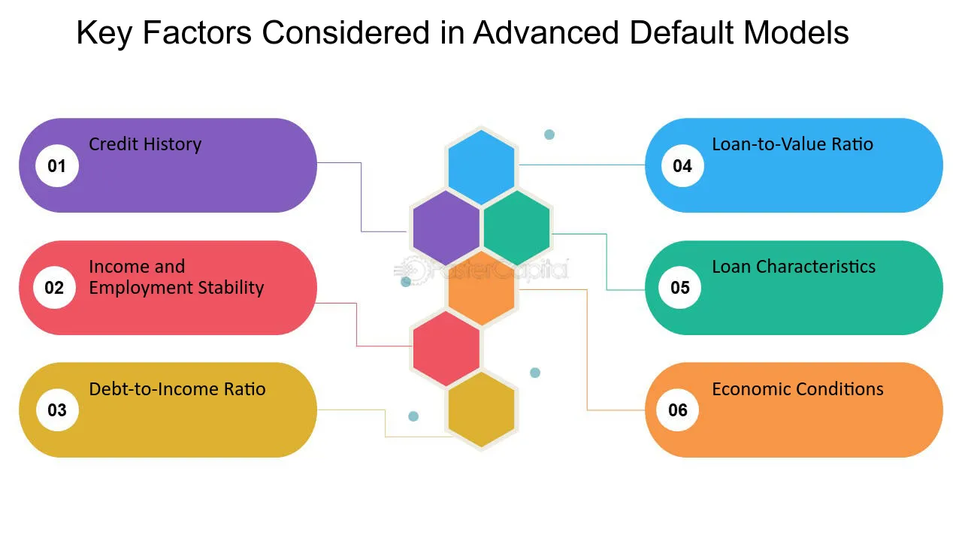
MODELLING
3/21/2024 Annual Review
9

Slide 10
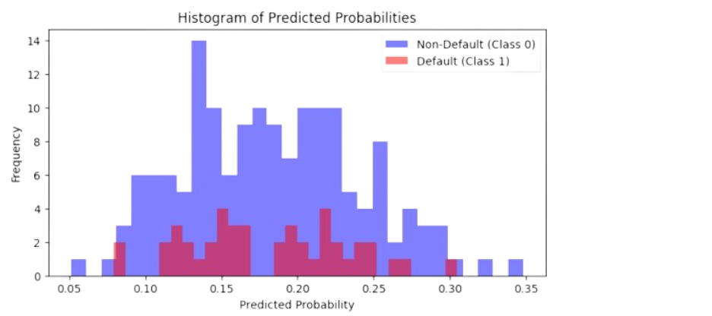
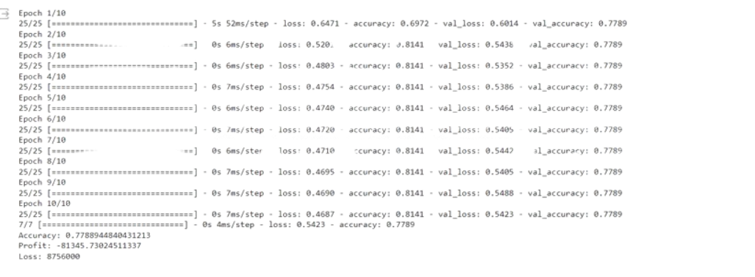
RESULTS
The model achieved high accuracy in predicting loan defaults, providing valuable insights for risk assessment. It effectively identified defaulters, aiding in proactive risk management for financial institutions.
3/21/2024 Annual Review
10

