Slide 1



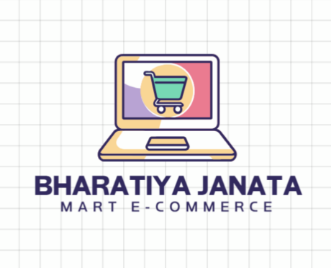

E-COMMERCE
LOGOKIAPNIDUKAN
JAVA + DS + DBMS CONSOLE BASED
E-COMMERCE PLATFORM

Slide 2
B H A R A T I Y A J A N A T A M A R T
Name Roll No.
: RIYA PANKAJBHAI SAVALIYA
: 212
Enrollment No. : 24002171210169
Batch Branch
: A-7
: CSE
Name Roll No.
: ROMIN PARESHBHAI KEVADIYA
: 214
Enrollment No. : 24002171610010
Batch Branch
: A-7
: MA&CP
Name Roll No.
: ZEEL MANISHBHAI DOBARIYA
: 202
Enrollment No. : 24002171210044
Batch Branch
: A-7
: CSE

Slide 3
I N D E X
P U R P O S E O F T H E P R O J E C T
E R D I A G R A M
F U N C T I O N A L I T Y
U S E D J A V A , D S , D B M S C O N C E P T
M E R I T S & D E M E R I T S
F U T U R E S C O P E
T O O L S U S E D

Slide 4
P u r p o s e o f t h e P r o j e c t
The buying and selling process by providing a platform for sellers to upload, update, and manage products.
Simplify user experience by allowing customers to browse, filter, and purchase products efficiently.
Ensure data consistency and security by integrating the application with a database (POSTGRESQL via JDBC).
Support business insights through features like sales tracking, revenue calculation, and product quantity management.
Provide a scalable foundation for building a full-fledged ecommerce solution in the future.

Slide 5
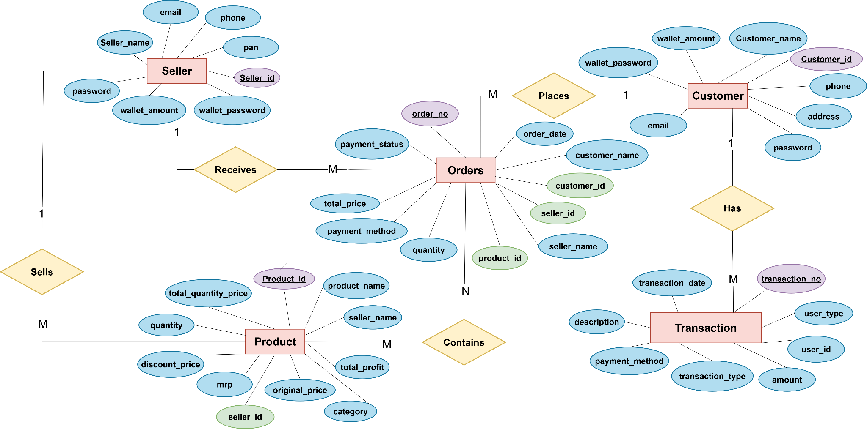
E R - D I A G R A M

Slide 6
F U N C T I O N A L I T I E S
Seller Panel
  Seller sign-up and login with authentication.
  Add, update, view, and delete products.
  Track revenue and Sells Report products.
Customer Panel
  Customer sign-up and login.
  Browse all products by category, price.
  Add products to cart and purchase items.
  View order history and track orders.
Database Integration (MySQL via JDBC)
  Stores user, seller, and product details.
  Maintains purchase records and product quantities.
  Provides secure and consistent data management.

Slide 7
USED JAVA,DS, DBMS CONECEPTS
JAVA
PACKAGES
ERROR HANDLING
MULTI THREADING
INHERITEENCE, ABSTRACTION,
POLYMORPHISM
DS
STACK(LIFO)
DOUBLY LINKED LIST(maintain cart operation)
DBMS
TABLE CREATION
PRIMARY KEY , FOREIGN KEY
TRIGGER, PROCEDURE

Slide 8
D E M E R I T S
M E R I T S
    Follows OOP principles for clarity.
Easy to extend and scale.
Utility classes like OTP and Validator
increase reusability.
Roles (admin, seller, customer) clearly
separated.
Admin can delete seller.
modular design with separate packages
and classes.
UI/UX design missing (unsatisfied by user).
Only console-based, not user-friendly.
Only one Customer , seller can use platform
at single time.
Order traking missing.

Slide 9
F U T U R E S C O P E
Create a simple app or website interface instead of only console.
Organize code using clean structure for easy updates.
Ask review or suggestions from Customer of their ordered product.
Add testing tools to check if all features work correctly.

Slide 10

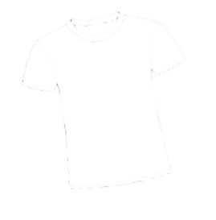



T O O L S U S E D
For writing and debugging Java code
To store and manage application data
Used for implement complex logic
The most powerful tool we used

Slide 11
Thank You

