Slide 1
Human resources slide 1
Training
Final Project
Presentation By: Riya Sharma

Slide 2
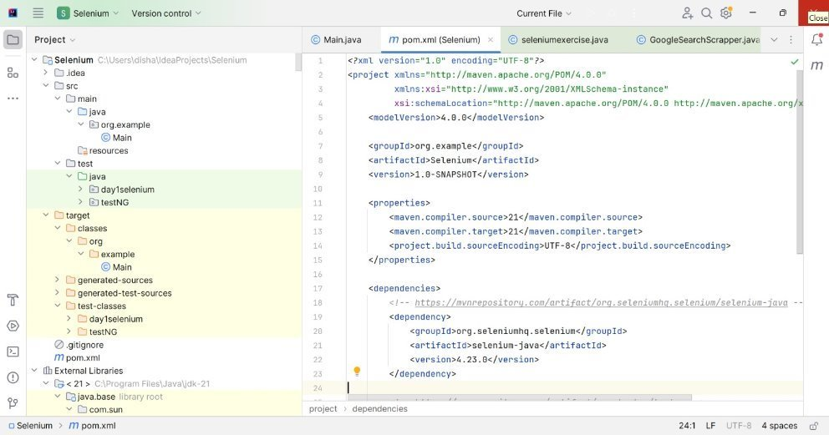
Human resources slide 2
PART - 1
SET UP IDE
Setting Up a Maven Project in IntelliJ IDEA
Start IntelliJ: Select "New Project."
Choose Maven: Pick "Maven" from the available project options.
Set SDK: Choose your Java SDK.
Project Name/Location: Provide a project name and select the desired save location.
Configure pom.xml: Add necessary dependencies and configure project settings in the generated pom.xml file.
Import Dependencies: IntelliJ will automatically download the dependencies listed in pom.xml.
Build/Run: Use IntelliJ's "Run" or "Build" options to compile and execute the project.

Slide 3
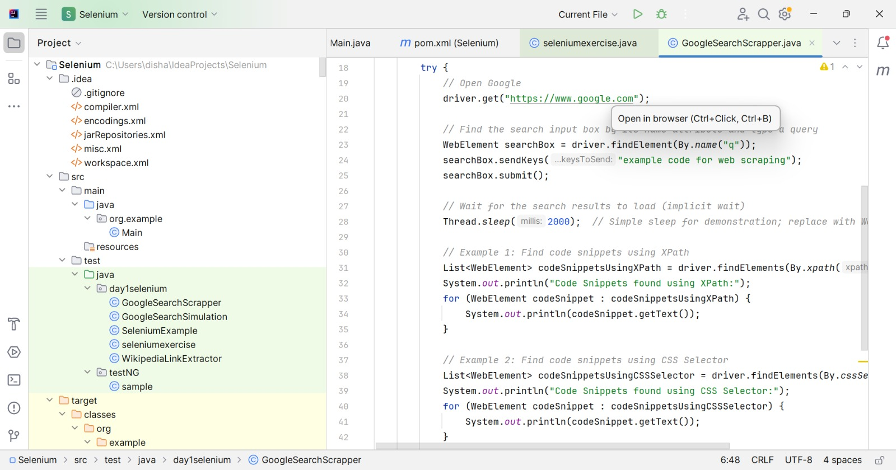
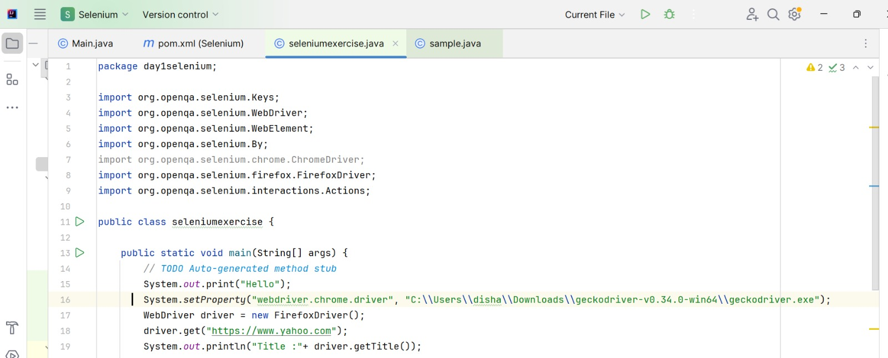
Human resources slide 2
PART - 1
UNDERSTANDING OBJECT IDENTIFICATION
Task: Studied and documented methods to identify web elements using XPath and CSS Selectors.
XPath is especially useful for locating elements without unique IDs or classes. It allows for complex queries, such as finding elements based on text content or relationships with other elements.
Example: //button[text()='Submit'] selects a button with the text "Submit."
CSS Selectors are typically faster and more readable for simpler queries. They are efficient when elements have identifiable attributes like IDs or classes.
Example: button.submit-btn selects a button element with the class "submit-btn."
CONFIGURING WEBDRIVER
Task: Downloaded and configured Java WebDriver for both Firefox and Chrome browsers.
Selenium WebDriver is a powerful tool for automating web browsers. By integrating it with Java in IntelliJ IDEA, it enables the creation of automated tests, allowing for seamless automation of browser interactions to test web applications.

Slide 4
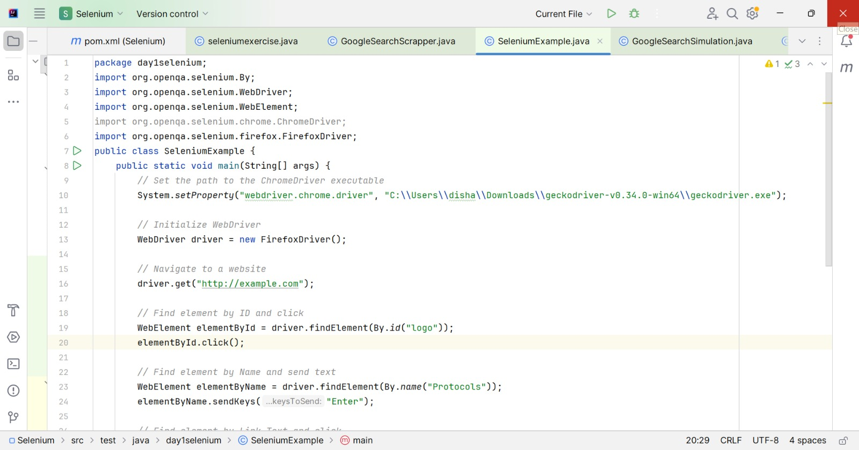
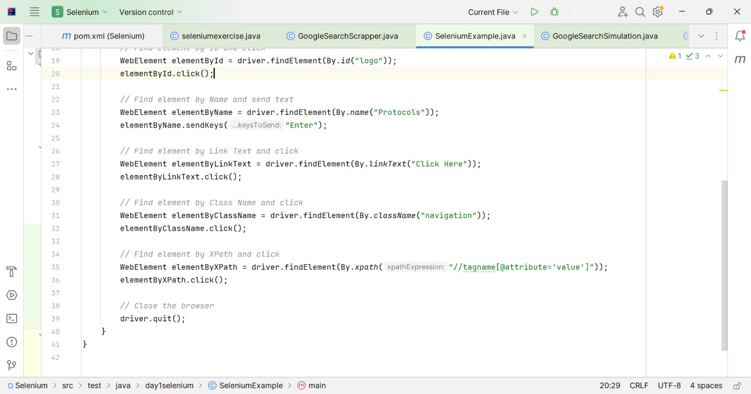
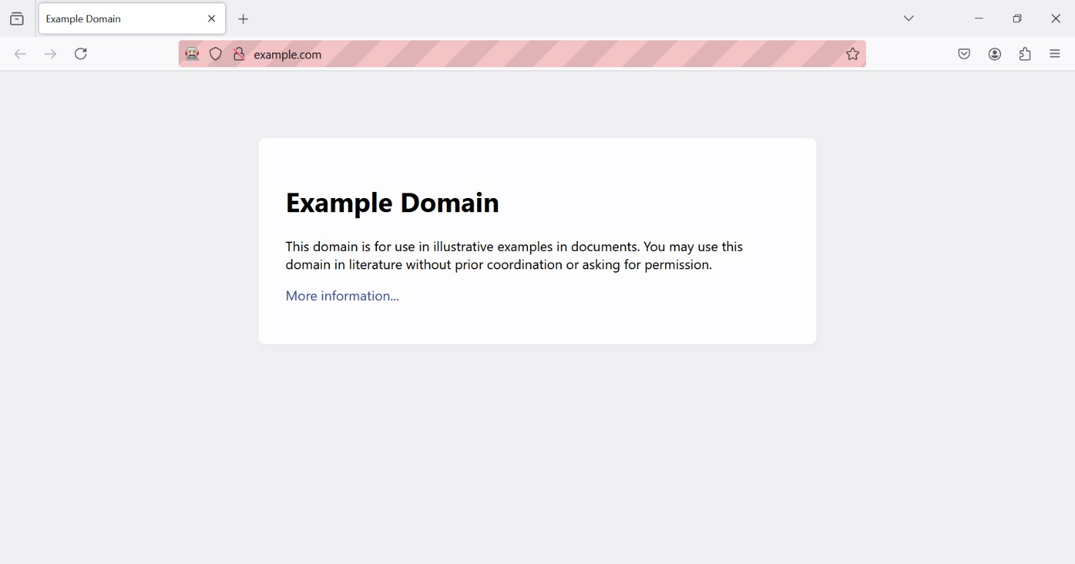
Human resources slide 2
PART - 1
HANDS-ON PRACTICE
Task: Developed a Selenium script to automate basic navigation and interaction with a sample website using different element locators such as id, name, linkText, className, and xpath.
1
2
3

Slide 5
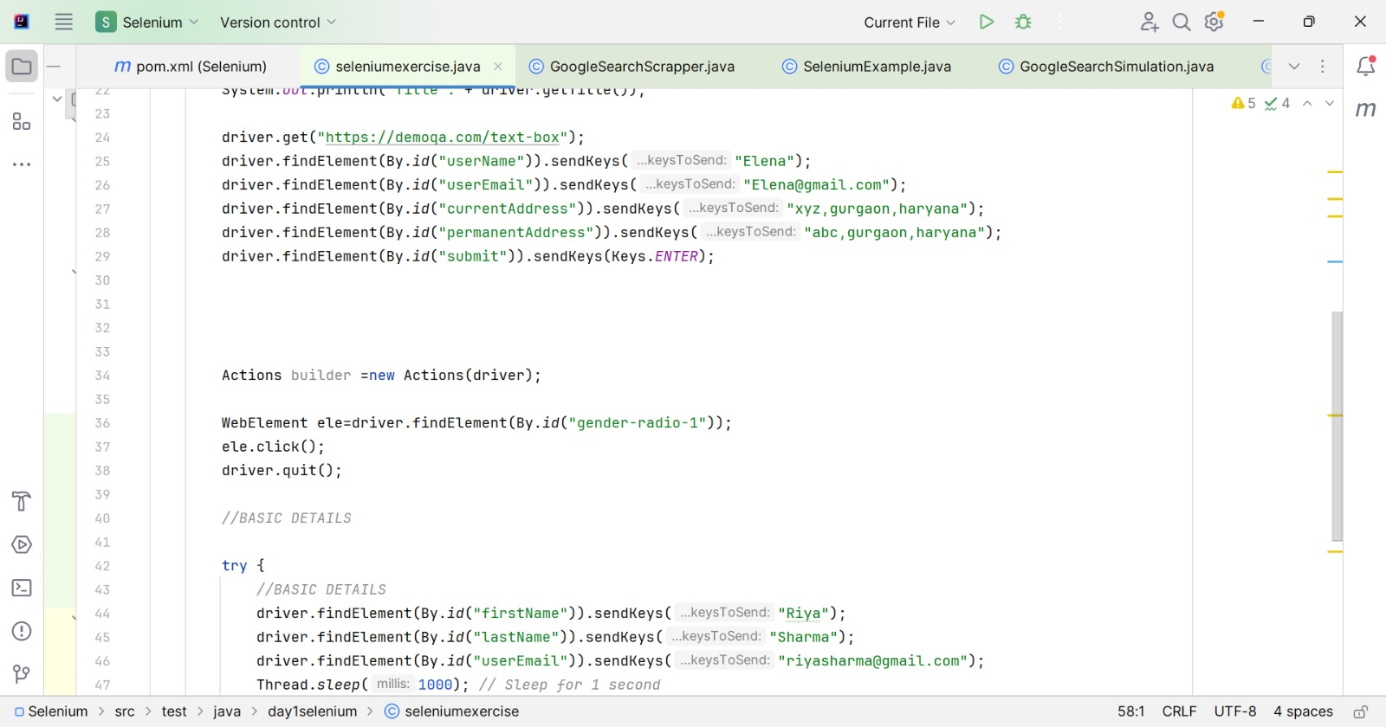
Human resources slide 8
PART 2: ADVANCED WEB ELEMENT HANDLING
MANAGING VARIOUS WEB ELEMENTS
Developed scripts to interact with multiple web elements on the DemoQA Forms page, including input fields, buttons, dropdowns, radio buttons, and checkboxes.
1

Slide 6
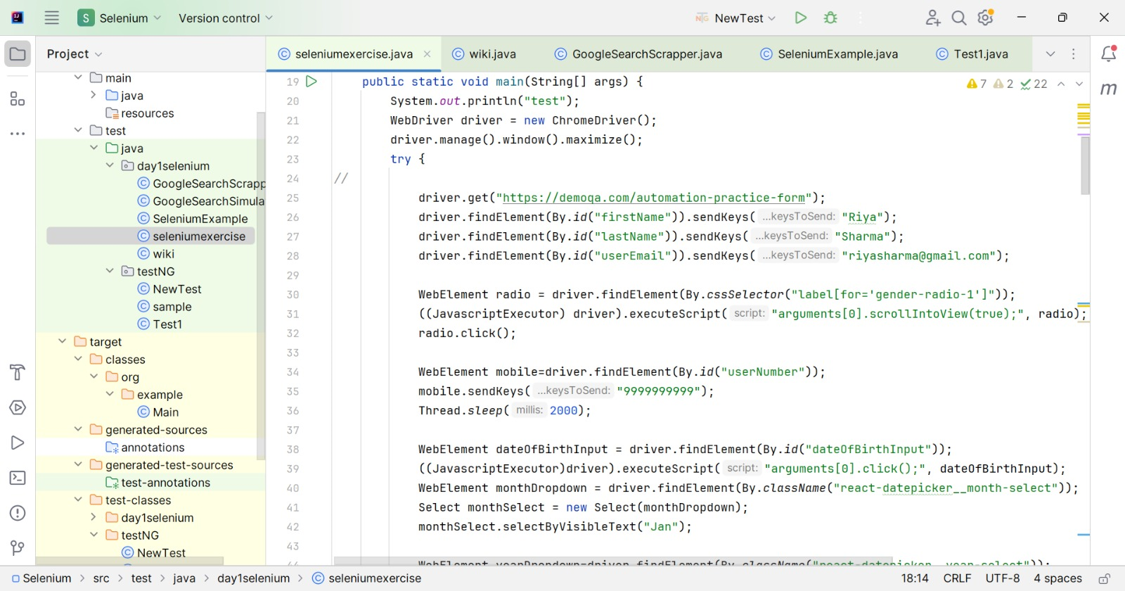
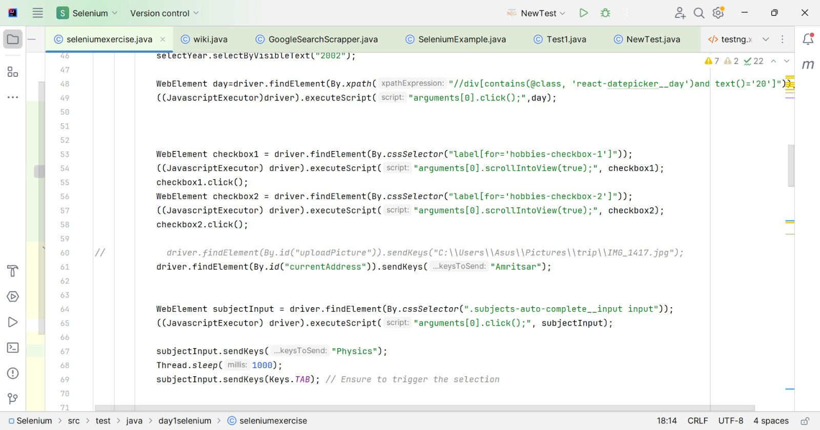
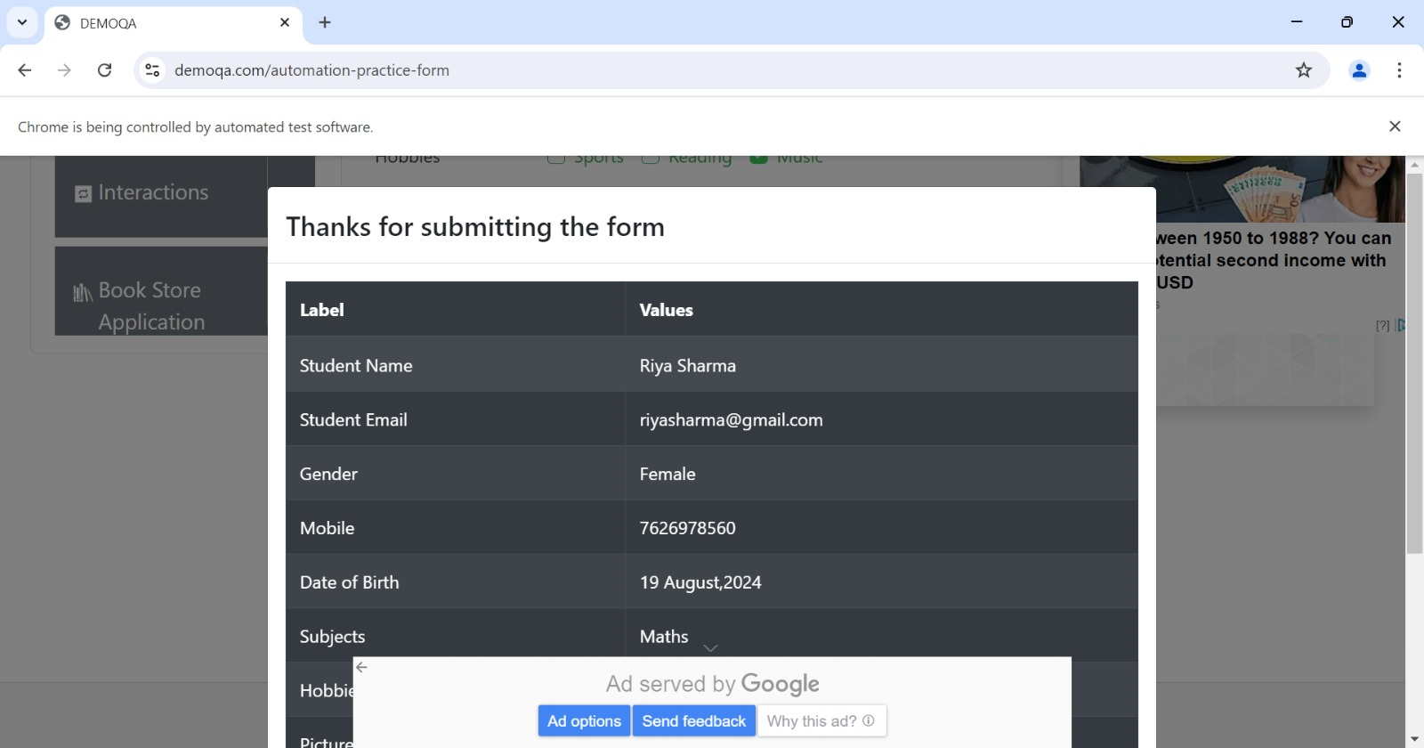
Human resources slide 8
2
3
4

Slide 7
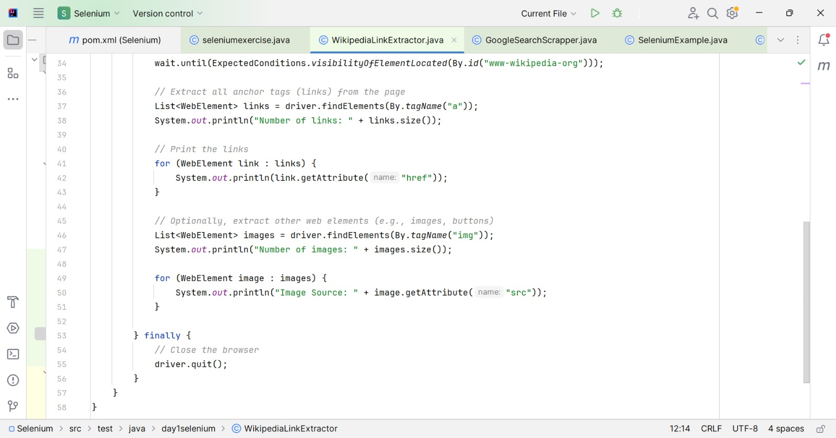
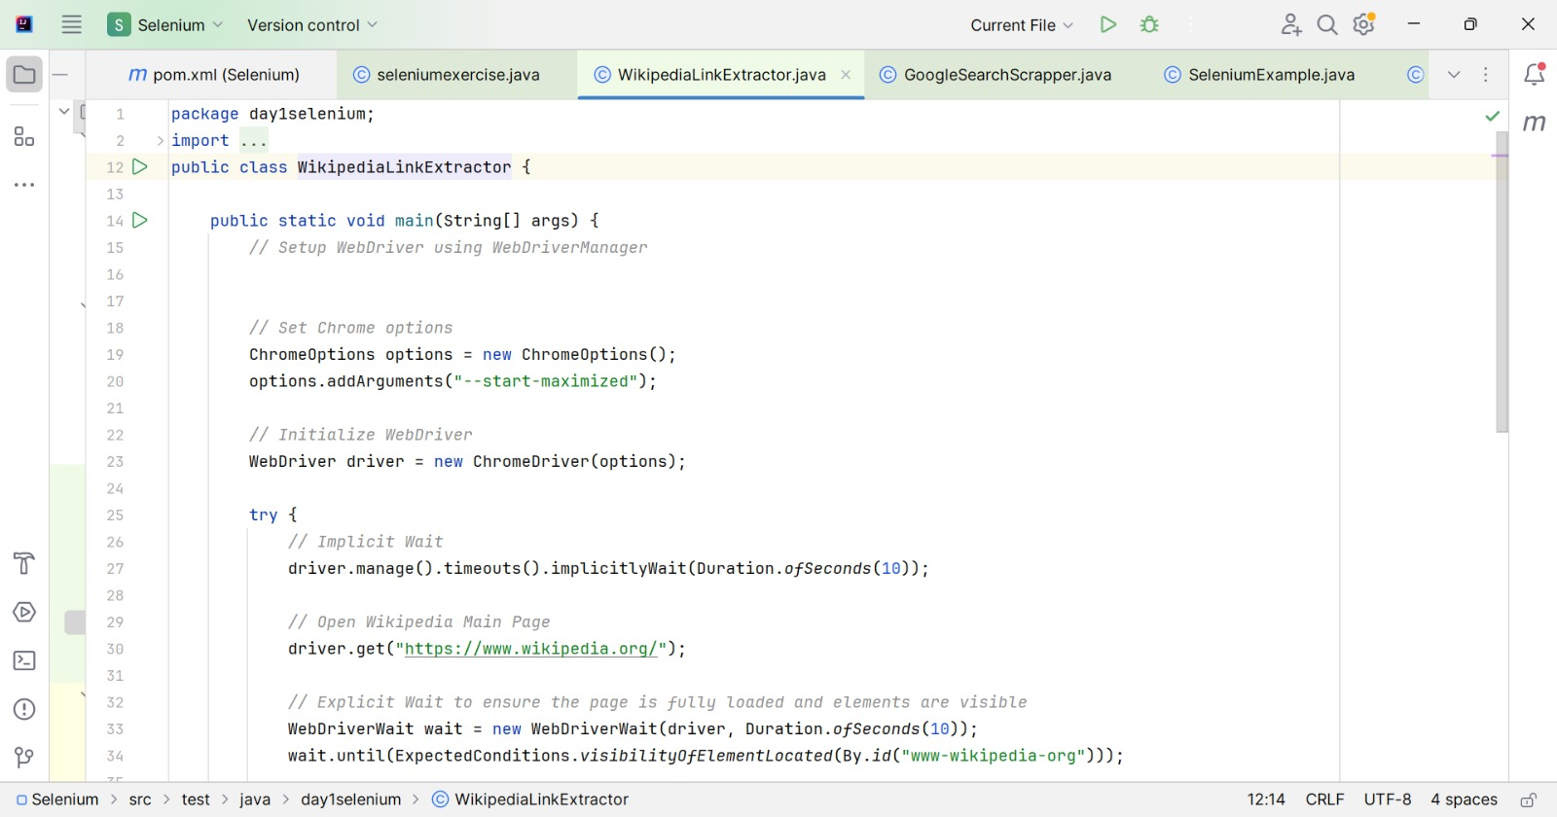
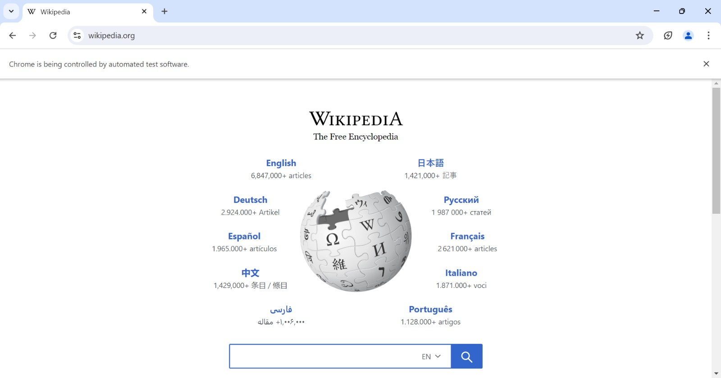
Human resources slide 8
PART 2: ADVANCED WEB ELEMENT HANDLING
EXTRACTING LINKS AND SYNCHRONIZATION
Extracted all links and other web elements from the Wikipedia Main Page. Implemented synchronization techniques using both implicit and explicit waits.
1
2
3

Slide 8
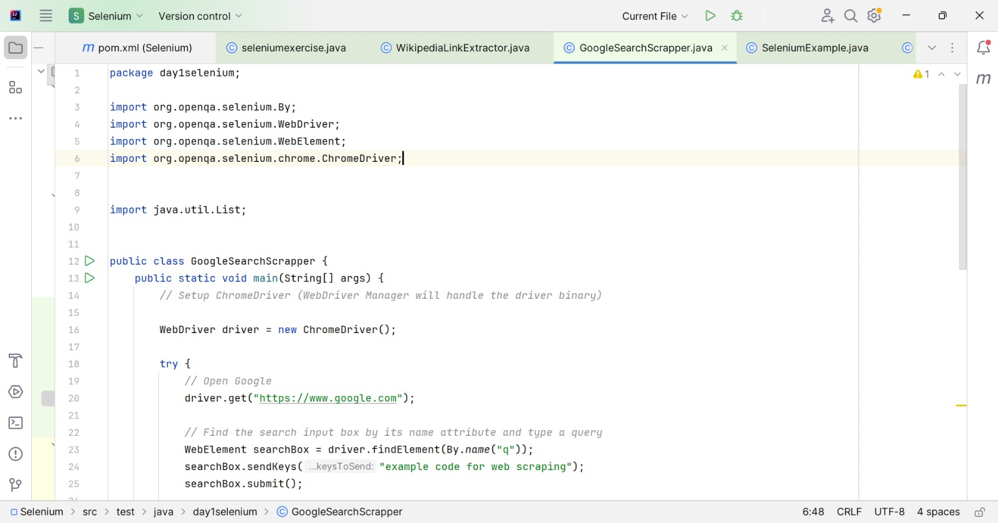
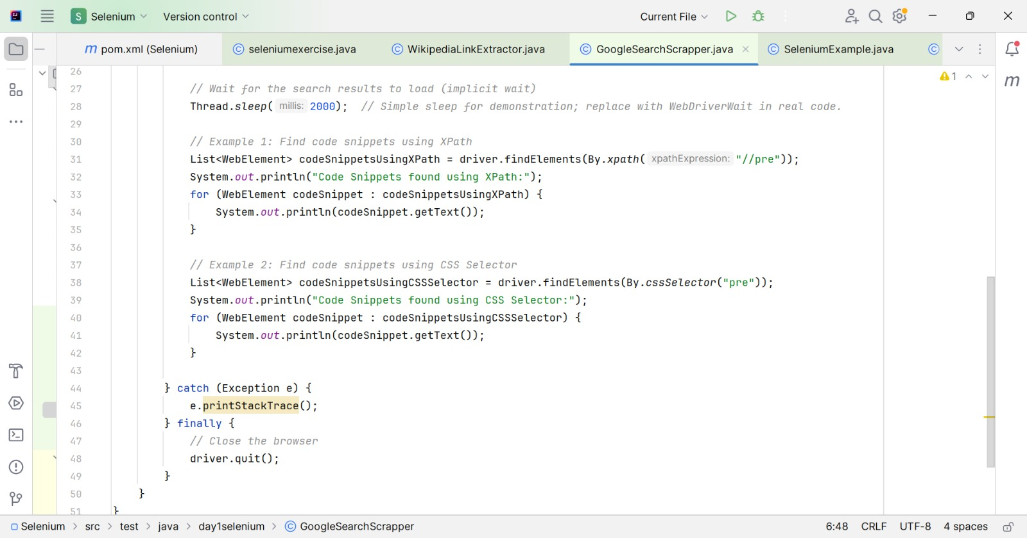
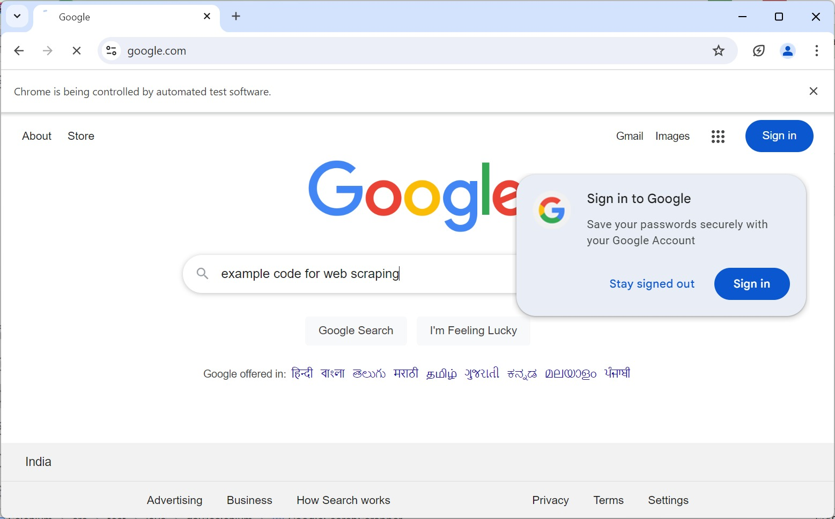
Human resources slide 8
PART 2: ADVANCED WEB ELEMENT HANDLING
SIMULATING KEYBOARD AND MOUSE ACTIONS
Simulated keyboard and mouse actions on the Google Search Page, including performing a search and managing search suggestions.
1
2
3

Slide 9
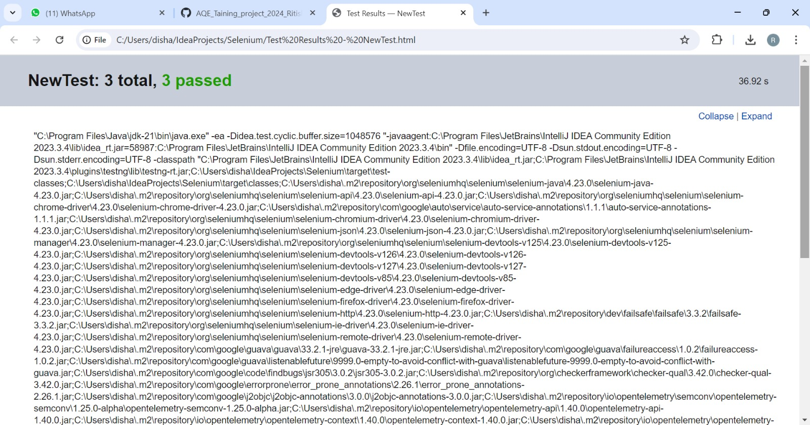
Human resources slide 8
PART 3: PAGE OBJECT MODEL (POM)
1

Slide 10
Human resources slide 10
Thank You

