Slide 1
Shortest route in a grid with obstacles

Slide 2

Shortest route in a grid
From a cell in the grid, we can move to any of its neighboring cell in one step.
Problem: From top left corner, find shortest route to each cell avoiding obstacles.
Input : a Boolean matrix $G$ representing the grid such that
$G[i,j]$ = 0 if ($i,j$) is an obstacle, and 1 otherwise.
obstacles

Slide 3
Step 1:
Realizing
the nontriviality of the problem

Slide 4
Shortest route in a grid nontriviality of the problem
Definition: Distance of a cell c from another cell c’
is the length (number of steps) of the shortest route between c and c’.
We shall design algorithm for computing distance of each cell from the start-cell.
As an exercise, you should extend it to a data structure for retrieving shortest route.
Don’t proceed to the next slide until you are convinced about the non-triviality and beauty of this problem ☺

Slide 5

Get inspiration from nature
The ripples travels along the shortest route ?

Slide 6
Shortest route in a grid nontriviality of the problem
How to find the shortest route to in the grid ?
Create a ripple at the start cell and trace the path it takes to

Slide 7
propagation of a ripple from the start cell

Slide 8
ripple reaches cells at distance 1 in step 1

Slide 9
ripple reaches cells at distance 2 in step 2

Slide 10
ripple reaches cells at distance 3 in step 3

Slide 11
ripple reaches cells at distance 8 in step 8

Slide 12
ripple reaches cells at distance 9 in step 9

Slide 13
ripple reaches cells at distance 10 in step 10

Slide 14
ripple reaches cells at distance 11 in step 11

Slide 15
ripple reaches cells at distance 12 in step 12

Slide 16
ripple reaches cells at distance 13 in step 13

Slide 17
ripple reaches cells at distance 14 in step 14

Slide 18
ripple reaches cells at distance 15 in step 15
Think for a few more minutes with a free mind ☺.
Did you get some insight into the problem from the animation ?
The route taken by ripple is indeed the shortest.

Slide 19
Step 2: Designing algorithm for distances in grid
(using an insight into propagation of ripple)

Slide 20

A snapshot of ripple after $i$ steps

Slide 21



A snapshot of ripple after $i$ steps
$L_{i}$
$L_{i}$ : the cells of the grid at distance $i$from the starting cell.

Slide 22



A snapshot of the ripple after $i+1$ steps
All the hardwork on the animation was done just to make you realize this important Observation. If you have got it, feel free to erase the animation from your mind ☺.
$L_{i}$
$L_{i+1}$
Observation: Each cell of $L_{i+1}$ is a neighbor of a cell in $L_{i}$.

Slide 23
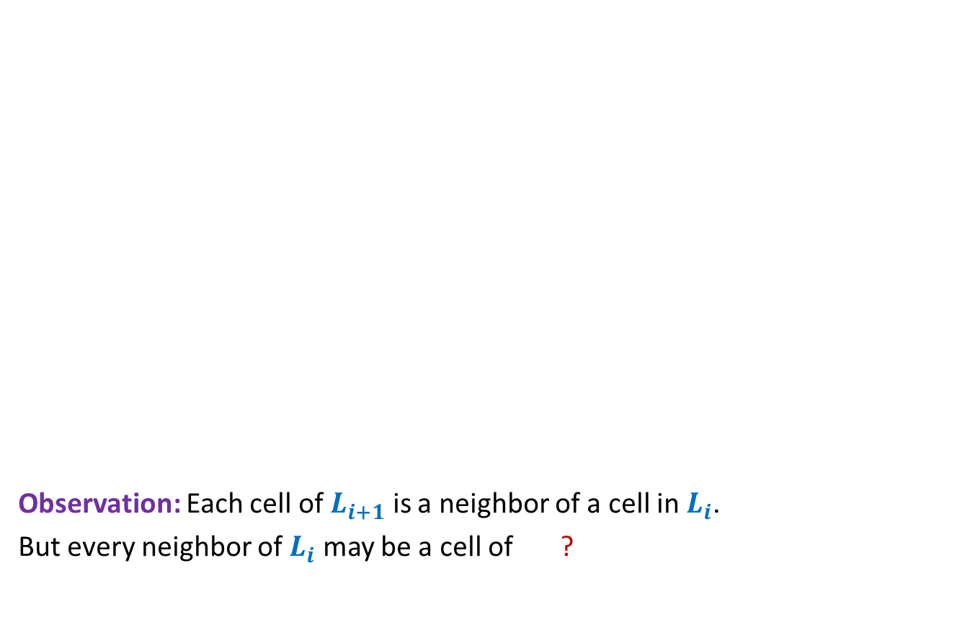


Distance from the start cell
It is worth spending some time on this matrix.
Does the matrix give some idea to answer the question ?
Observation: Each cell of $L_{i+1}$ is a neighbor of a cell in $L_{i}$.
But every neighbor of $L_{i}$ may be a cell of ?
$0$ 1 2 3 4 5 6 7 8 9 10 11 12 13 27 28 29 30
$1$ 2 3 4 5 7 8 9 10 11 12 13 14 26 27 28 29
2 3 4 5 15 10 11 12 25 26 27 28
3 4 5 6 14 13 12 11 12 13 24 25 26 27
4 5 6 13 14 23 24 25 26
5 6 7 14 15 22 23 24 25
6 7 8 15 16 17 18 19 20 21 22 23 24
7 8 9 16 17 18 20 21 22 23 24 25
8 9 10 17 18 26
How can we generate $L_{i+1}$ from $L_{i}$ ?
9 10 11 18 19 27
10 11 12 13 14 15 16 17 18 19 20 35 36 28
17 18 19 20 21 34 35 29
24 23 22 21 20 19 18 19 20 21 22 30 31 32 33 34 30
25 23 22 21 20 19 20 21 22 23 29 34 35 31
26 24 21 22 23 24 28 33 34 32
27 25 22 23 24 25 26 27 32 33 33
28 27 26 27 26 25 24 23 24 25 26 27 28 29 30 31 32 33 34
$L_{i−1}$ or $L_{i+1}$.

Slide 24

How can we generate $L_{i+1}$ from $L_{i}$ ?

Slide 25



How can we generate $L_{i+1}$ from $L_{i}$ ?
$$L_{i−1}$$
$$L_{i}$$
$$L_{i+1}$$

Slide 26

How can we generate $L_{i+1}$ from $L_{i}$ ?
Suppose all cells of $L_{i−1}$ get visited first.
$$L_{i−1}$$
$$L_{i}$$
$$L_{i+1}$$

Slide 27

How can we generate $L_{i+1}$ from $L_{i}$ ?
Suppose all cells of $L_{i−1}$ get visited first.
Then all cells of $L_{i}$ are visited, and
$$L_{i−1}$$
$$L_{i}$$
$$L_{i+1}$$

Slide 28


How can we generate $L_{i+1}$ from $L_{i}$ ?
Suppose all cells of $L_{i−1}$ get visited first.
Then all cells of $L_{i}$ are visited, and
then all cells of $L_{i+1}$ are visited.
So by the time all cells of $L_{i}$ are visited, if a cell neighboring to a cell of $L_{i}$ is unvisited, it must be a cell of $L_{i+1}$.
☺
$$L_{i−1}$$
$$L_{i}$$
$$L_{i+1}$$

Slide 29

How can we generate $L_{i+1}$ from $L_{i}$ ?
So the algorithm should be:
Initialize the distance of all cells except start cell as $∞$
First compute $L_{1}$.
Then using $L_{1}$ compute $L_{2}$
Then using $L_{2}$ compute $L_{3}$
…
$$L_{i−1}$$
$$L_{i}$$
$$L_{i+1}$$

Slide 30
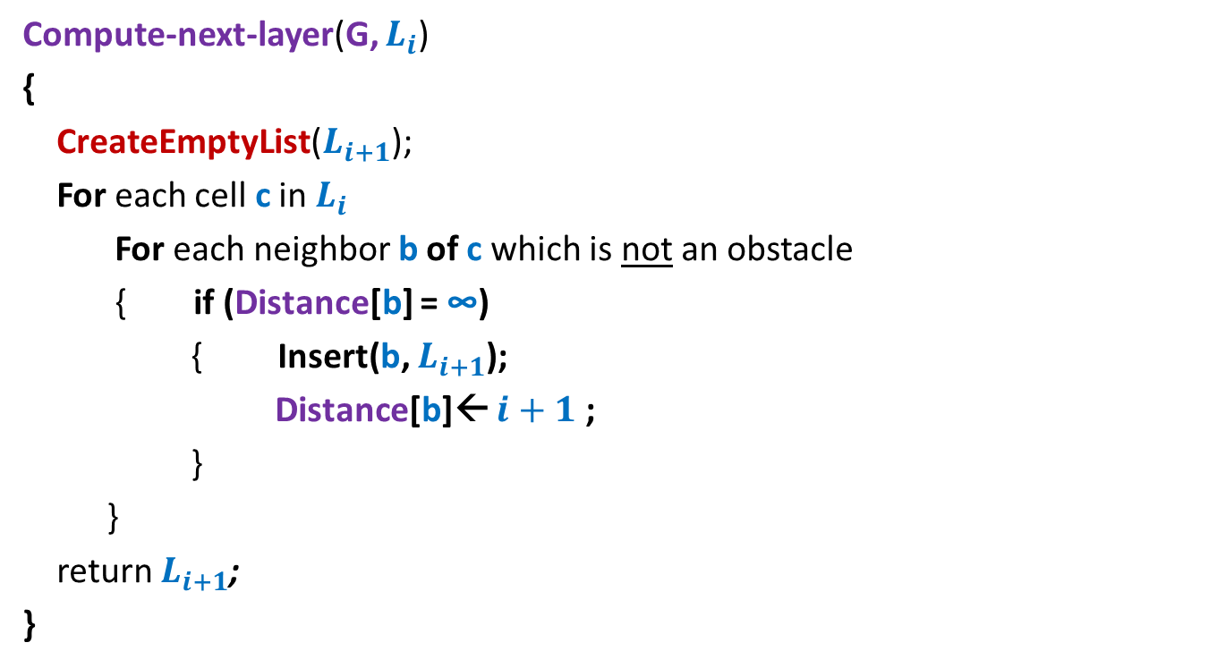

Algorithm to compute $L_{i+1}$ if we know $L_{i}$
Compute-next-layer(G, $L_{i}$)
{
CreateEmptyList($L_{i+1}$);
For each cell c in $L_{i}$
For each neighbor b of c which is not an obstacle
{ if (Distance[b] = ∞)
{ Insert(b, $L_{i+1}$);
Distance[b]← $i+1$ ;
}
}
return $L_{i+1}$;
}

Slide 31
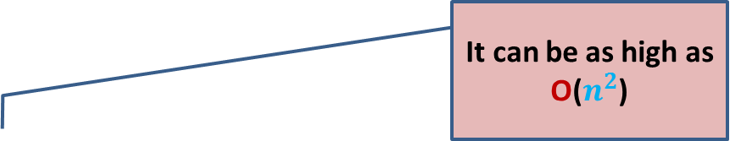

The first (not so elegant) algorithm (to compute distance to all cells in the grid)
Distance-to-all-cells(G, $c_{0}$)
{ $L_{0}$ ← {$c_{0}$};
For($i$= 0 to ?? )
$L_{i+1}$ ← Compute-next-layer(G, $L_{i}$);
}
The algorithm is not elegant because of
So many temporary lists that get created.
It can be as high as O($n^{2}$)

Slide 32


Towards an elegant algorithm …
Key points we observed:
We can compute cells at distance $i+1$ if …
Therefore, we need a mechanism
to enumerate the cells in
we know all cells up to distance $i$.
non-decreasing order of distances from the start cell.
How to design such a mechanism ?

Slide 33


Keep a queue Q
Spend some time to see how seamlessly the queue ensured
the requirement of visiting cells of the grid in non-decreasing order of distance.
$$L_{i}$$
Q
$$L_{i+1}$$

Slide 34
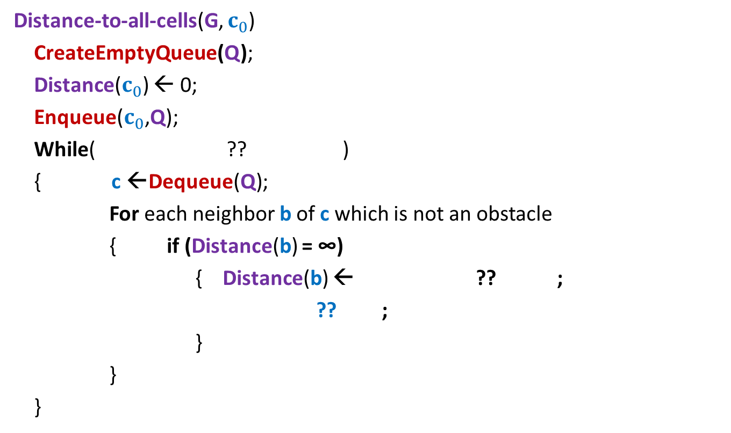
An elegant algorithm (to compute distance to all cells in the grid)
Distance-to-all-cells(G, $c_{0}$)
CreateEmptyQueue(Q);
Distance($c_{0}$) ← 0;
Enqueue($c_{0}$,Q);
While( ?? )
{ c ←Dequeue(Q);
For each neighbor b of c which is not an obstacle
{ if (Distance(b) = ∞)
{ Distance(b) ← ?? ;
?? ;
}
}
}
Not IsEmptyQueue(Q)
Distance(c) +1
Enqueue(b, Q);

Slide 35
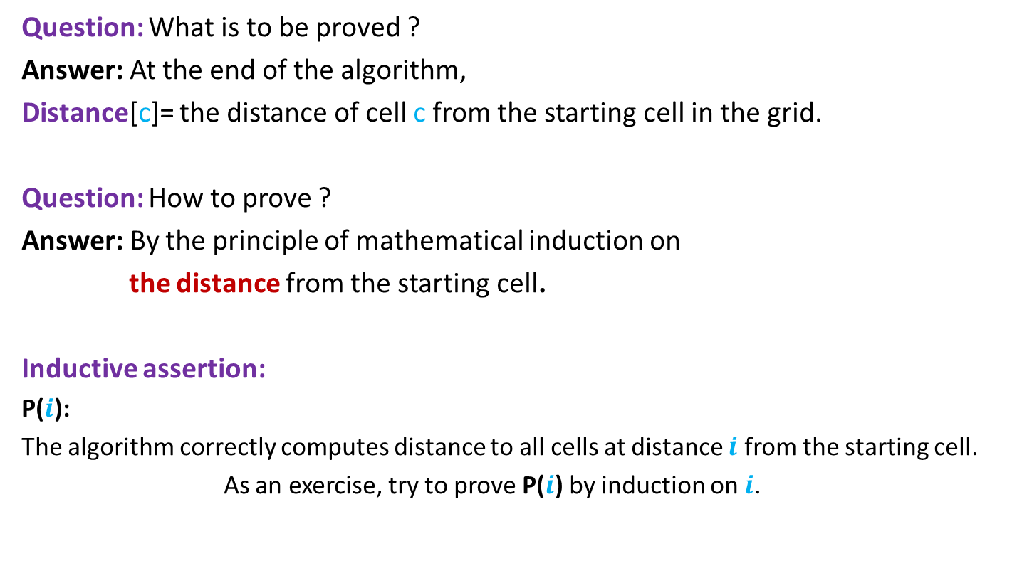
Proof of correctness of algorithm
Question: What is to be proved ?
Answer: At the end of the algorithm,
Distance[c]= the distance of cell c from the starting cell in the grid.
Question: How to prove ?
Answer: By the principle of mathematical induction on
the distance from the starting cell.
Inductive assertion:
P($i$):
The algorithm correctly computes distance to all cells at distance $i$ from the starting cell.
As an exercise, try to prove P($i$) by induction on $i$.

