Slide 1
MENTAL WELLNESS PREDICTION

Slide 2


GOAL
STATEMENT
The project focuses on using machine learning (ML) and Long short-Term Memory(LSTM) to identify and predict mental wellness issues in students. By examining factors like academic depression, mental thought patterns, and dietary habits. This proactive approach allows healthcare professionals to offer personalized support, ultimately improving students' overall well-being.
CONFIDENTIAL: The information in this document belongs to Boston Institute of Analytics LLC. Any unauthorized sharing of this material is prohibited and subject to legal action under breach of IP and confidentiality clauses.

Slide 3

WHY PROJECT IS IMPORTANT
Rising Importance of Mental Health
Mental health issues are increasingly prevalent, with millions affected worldwide.
Improved Quality of Life
Early prediction supports individuals in managing stress, emotions, and mental well-being effectively, improving their overall life satisfaction.
Workplace Productivity and Employee Well-being
Predictive tools help employers monitor and improve employee wellness, reducing absenteeism and enhancing workplace productivity.
Enhances Academic Performance
Predicting mental health issues helps identify signs of stress caused by academic pressure, deadlines, and exams.
Early prediction helps maintain a healthy balance between academic and personal life.

Slide 4

PROJECT OVERVIEW
Datasets
Depression Sentiment Dataset: 53,043 entries with text based statements and sentiment labels.
Student Depression Dataset: 27,901 entries, 18 columns including dietary habits, depression levels, academic pressure, sleep duration, and mental health-related factors.
Targets
The Depression Sentiment Dataset: targets status with categories like Normal – Depression – Suicidal – Anxiety – Bipolar – Stress and Personality disorder.
The Student Depression Dataset: focuses on Health Condition Unhealthy- Moderate – Healthy and a binary Depression column: Yes and No.
Model
Various machine learning techniques were applied to classify student depression data and Dietary Habit ,while Long Short-Term Memory (LSTM) was utilized for depression sentiment analysis.
Deployment
For deployment, I utilized Streamlet to predict mental health outcomes using the model. The user data submitted to the model is stored in both MongoDB and Excel for further analysis and record-keeping.

Slide 5
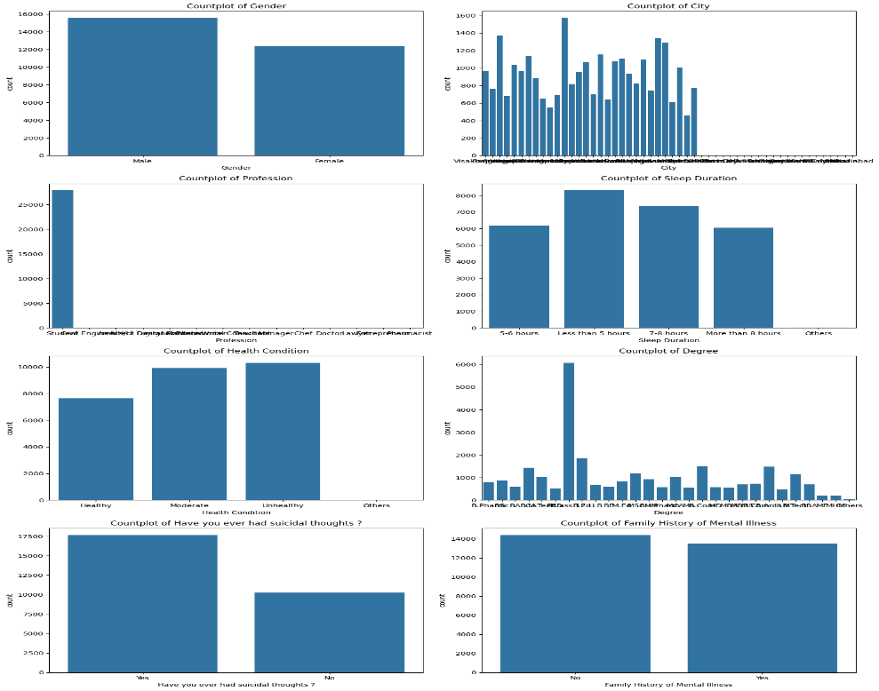
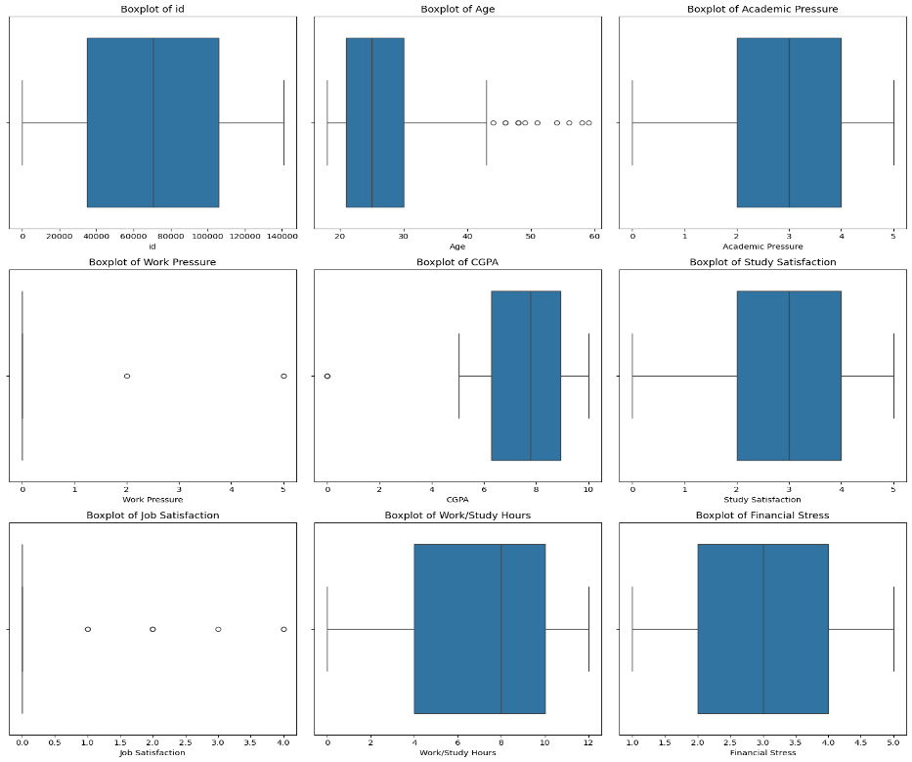
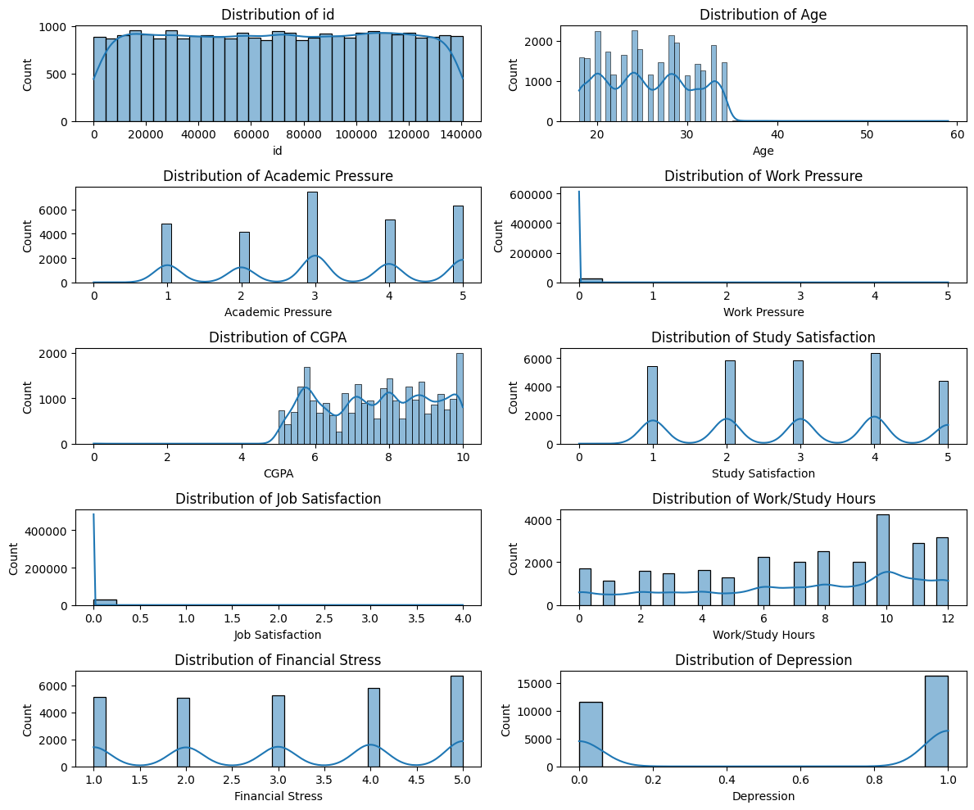
EXPLORATION DATA
Count Plot
Box Plot
Hist Plot
A nearly equal representation of males and females in the dataset
Students make up the largest group in the dataset.
Other professions like engineers, doctors, and teachers also have notable representation.
Nearly equal distribution between individuals reporting moderate and unhealthy conditions, with fewer individuals categorized as healthy.
Age and Work Pressure: Show significant outliers.
Right-skewed distribution, with most individuals aged between 20-30.
Right-skewed distribution, with most individuals studying/working around 4-6 hours
Highly skewed to the left, with most individuals scoring close to 0.
From this analysis job Satisfaction and Work pressure can be droped

Slide 6
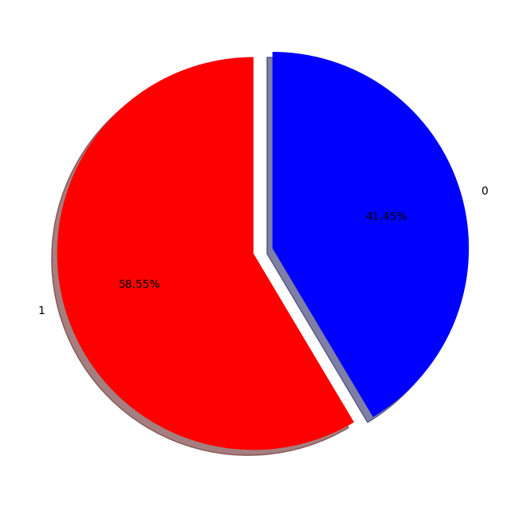
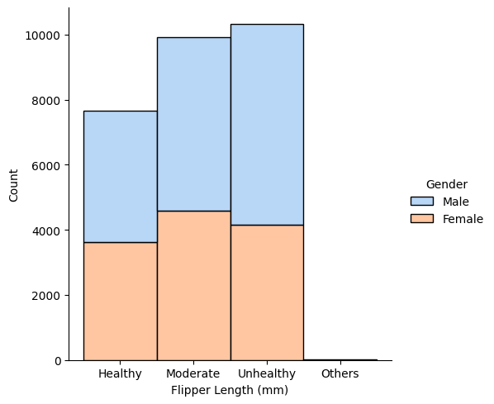
TARGET EXPLORATION
Depressed
Represents 58.55% of the data.
Categories: Health statuses ("Healthy," "Moderate," "Unhealthy," "Others") based on flipper length.
Counts: "Unhealthy" has the highest count, "Others" the least.
Gender: Males (blue) outnumber females (peach) in all groups.
Insight: "Unhealthy" dominates; males are more prevalent overall.
Not Depressed
Represents 41.45% of the data
Dietary Habit
Both data needs to be rebalanced using SMOTE (Synthetic Minority Oversampling Technique) to address class imbalance and enhance analysis accuracy

Slide 7
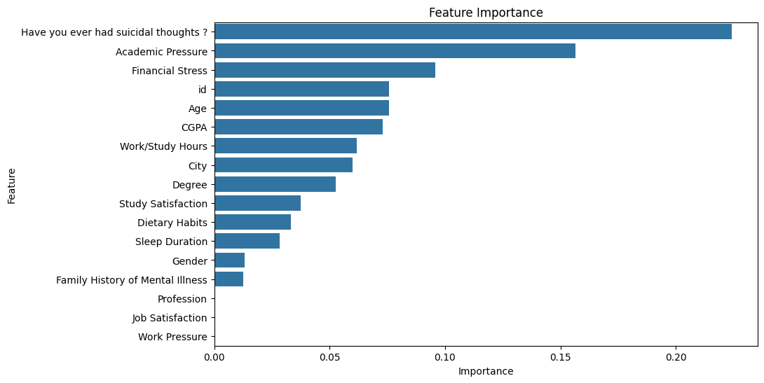
FEATURE SELECTION
The Student Depression Dataset consists of 27,901 entries with 18 columns.
The bar charts visualizes the feature importance. It ranks features based on their contribution to the model's predictive accuracy. Key observations include
Depression Feature Importance

Slide 8
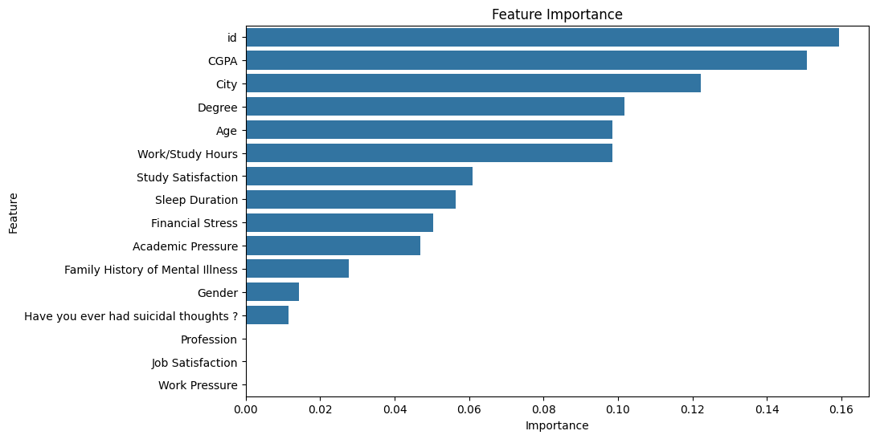
DATASET EXPLORATION
Dietary Habits Feature Importance
Features Selected = (Gender, Age, Have you ever had suicidal thoughts ?,Financial Stress, CGPA, Academic Pressure , Degree, Work/Study Hours, Sleep Duration)
Target = (Depression , Dietary Habit)
City: While city might seem relevant, it could be a noisy feature if the data isn't granular enough. If the target variable doesn't vary significantly across cities, or if there's a lack of data for certain cities, it might not be a useful predictor
ID: If the ID feature is somehow related to the target variable in a way that wouldn't be available in real-world scenarios, using it could lead to data leakage. This means your model would perform well on the training data but poorly on new, unseen data.

Slide 9
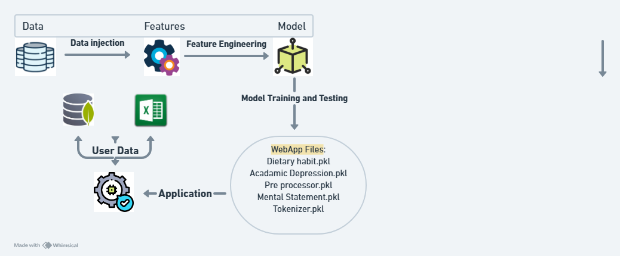
PROJECT FRAMEWORK

Slide 10
MODEL SELECTION
K-Neighbors Classifier:
Non-parametric method that captures complex patterns in data.
Does not assume a specific distribution, making it flexible.
Effective for smaller datasets and handles multi-class classification well.
Random Forest Classifier:
Ensemble method that combines multiple decision trees to enhance accuracy.
Controls overfitting, providing a more robust model.
Offers insights into feature importance, aiding in understanding factors influencing depression.
Gradient Boosting Classifier:
Builds models sequentially, correcting errors from previous models.
Often yields high predictive performance.
Robust to overfitting when properly tuned.
Decision Tree Classifier:
Easy to interpret and visualize, useful for understanding decision-making processes.
Captures non-linear relationships and interactions between features effectively.

Slide 11
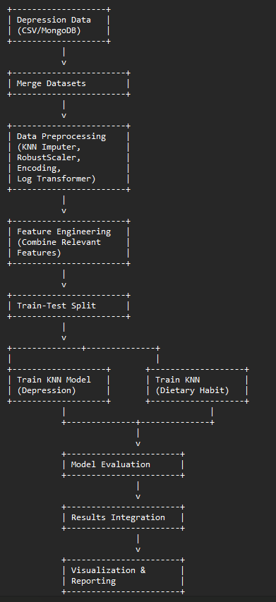
WORK ARCHITECTURE OF CLASSIFICATION MODEL

Slide 12
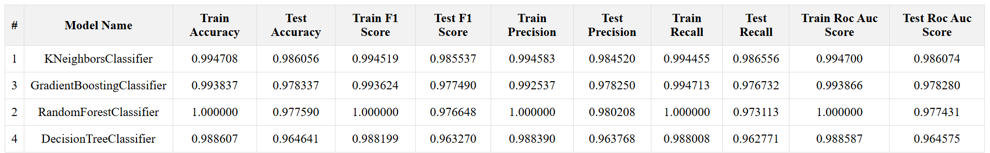
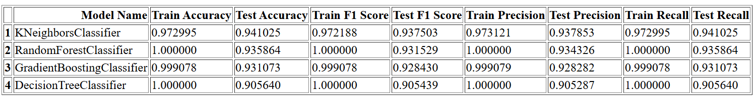
MODEL CLASSIFICATION REPORT
Depression Model Report
Dietary Habit Model Report

Slide 13
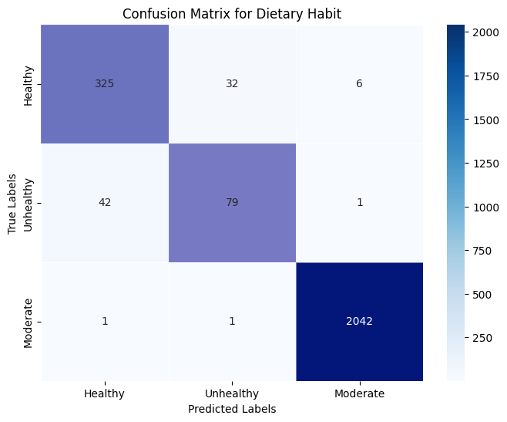
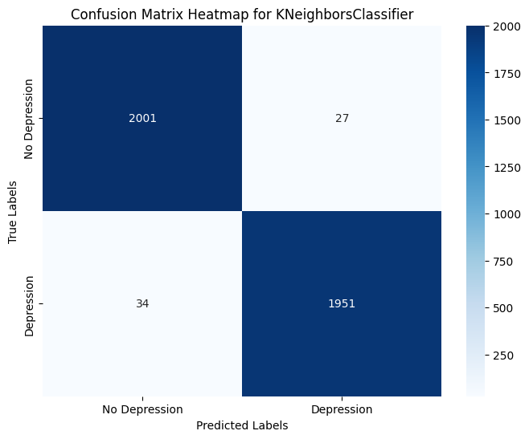
CONFUSION MATRIX ANALYSIS
Heat map Correctly predicted on Dietary Habit
Heat map Correctly predicted on Depression
High Accuracy:
The majority of predictions are correct:
2001 for "No Depression."
1951 for "Depression."
This indicates the model is performing well overall.
High Accuracy:
The model correctly predicted 325 instances as Healthy (True Positives).
The model correctly predicted 79 instances as Unhealthy.
The model correctly predicted 2042 instances as Moderate.

Slide 14
Why Use LSTM in This Context?
Sequential Nature of Text: LSTM is well-suited for capturing the dependencies and context in sequences like text data.
Handling Long-Term Dependencies: LSTMs are capable of learning patterns across long input sequences, making them effective for understanding complex relationships in text.
Classification Needs: In this project, the goal is to classify statements into specific psychological categories, which LSTM is robust at handling given its ability to preserve information from earlier in the sequence.

Slide 15
PROCESSES IN SENTIMENT MODEL
Load Data (Pandas)
Dataset loaded
Preprocess Data (Text Cleaning)
Text cleaning is performed to prepare the data for analysis. A function is defined to remove URLs, special characters, and convert text to lowercase
Encode Labels (Label Encoding)
The target labels (e.g., depression status) are encoded into numerical format using Label Encoder, which is necessary for training the model
Split Data (Train/Test):
The dataset is split into training and testing sets using train_test_split. This ensures that the model can be validated on unseen data
Tokenize Text (Keras Tokenizer)
The text data is tokenized using Keras's Tokenizer, which converts words into sequences of integers based on their frequency
Pad Sequences (Keras Padding)The sequences are padded to ensure that all input data has the same length, which is required for feeding into neural networks
Build Model (LSTM)
An LSTM model is constructed with an embedding layer followed by LSTM and dense layers for classification
Train Model (Fit Method)
The model is trained on the training dataset while monitoring validation performance through callbacks like early stopping and learning rate reduction
Evaluate Model (Test Results)
After training, the model's performance is evaluated on the test set to determine accuracy and loss

Slide 16
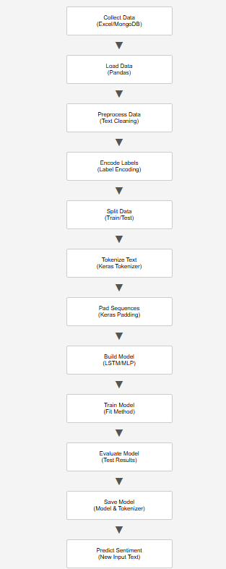
WORK ARCHITECTURE OF SENTIMENT MODEL

Slide 17
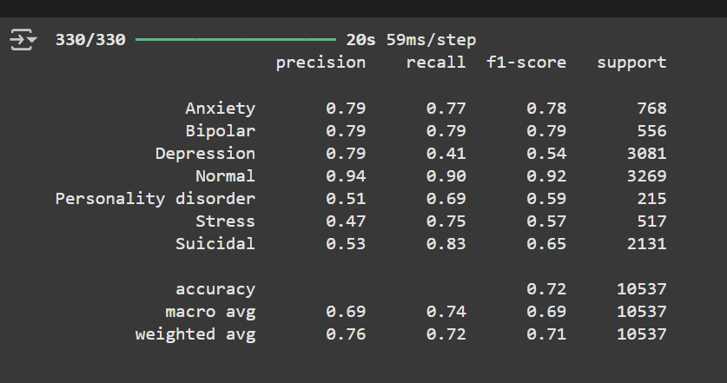
RESULTS
Classification Report Analysis:
Precision: Measures the accuracy of positive
Predictions.
Anxiety: Precision is 0.79, recall is 0.77, and F1-score is 0.78, indicating reasonably balanced performance.
Recall : Measures the model's ability to identify actual positives.
Normal: High precision (0.94) and recall (0.90), meaning the model performs well for this class.
F1-Score: Balances precision and recall.
Stress: Lower precision (0.47) but relatively high recall (0.75), suggesting the model struggles to avoid false positives for this class.
Overall Accuracy: Overall accuracy of the model across all classes, here 72%.

Slide 18
MODEL DEPLOYMENT
Deployment: The model has been successfully deployed using the Streamlit framework, providing a user-friendly interface for interaction.
Sentiment Analysis: The model is capable of predicting real-life sentiments with high accuracy, making it applicable to various practical scenarios.
Future Development: There is potential for the model to evolve into a fully functional application. This would enhance its usability and accessibility for a broader audience.
Data Management: When users interact with the model, their data will be securely stored and managed in a MongoDB database, ensuring scalability, reliability, and data integrity

Slide 20

Thank You!
CONFIDENTIAL: The information in this document belongs to Boston Institute of Analytics LLC. Any unauthorized sharing of this
material is prohibited and subject to legal action under breach of IP and confidentiality clauses.

