Slide 1


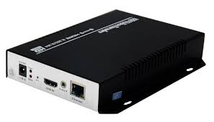


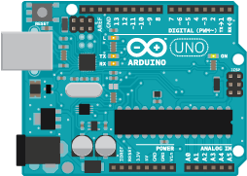
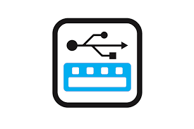
PC1 (networked)
PC2 (non networked offline PC)
VGA encoder captures VGA output
Of PC2 and sends to PC1 over network
Software in PC1 captures keyboard and mouse input and sends to Arduino over serial RX/TX pins.
If PC1 has no serial port, USB to serial converter can be used
Arduino presents itself as HID keyboard mouse to PC2 and sends keyboard mouse events received from PC1 to PC2

