Slide 1
MPT

Slide 2
MODULE PRACTICAL TEST

Slide 3
LAYERED ARCHITECTURE

Slide 4
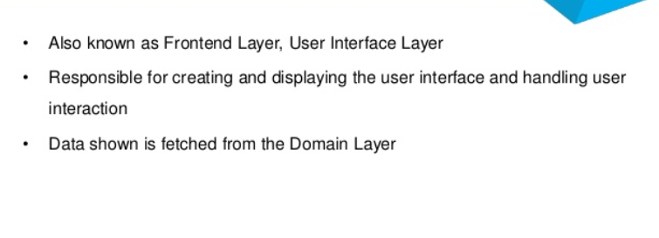

Slide 5
The presentation layer contains all of the classes responsible for presenting the UI to the end-user or sending the response back to the client (in case we’re operating deep in the back-end).

