Slide 1
Consumer
App
AI-Powered E-Waste
Collection & Recycling
Turning Electronic Waste into Sustainable Value
Logistics
Pickup
Core AI
Engine
Recycler
Center
Presented by: Team Eco-Loop
College of Business & Technology | Business Innovation Pitch
Notes:
Good morning judges and professors. Today we are pitching our innovative startup business model: an AI-Powered E-Waste Collection & Recycling Platform. In India, e-waste is growing exponentially, with our research showing India is now the world's 3rd largest e-waste generator. We are here to show how technology can turn a severe environmental hazard into massive economic value.

Slide 2
India's E-Waste Surges 100% to 3.8 MMT Outpacing Safe Disposal
Unconvenient household disposal channels drive environmental hazards and massive resource depletion.
TECH OBSOLESCENCE & ACCESS BARRIERS
• Rapid Upgrade Cycles: Shortened lifespans of phones, laptops, and chargers lead to massive tech piles in homes.
• Convenience Deficit: Households represent 70% of total e-waste generated, yet they completely lack organized and reliable doorstep collection methods.
Linear Material Degradation Flow
OLD ELECTRONICS
Discarded devices, chargers, and batteries pile up.
INFORMAL DISPOSAL
Informal sorting, unsafe open-burning, and dumping.
TOXIC POLLUTION & RESOURCE LOSS
• Severe Health Risks: Improper disposal leaks toxic heavy metals like lead, mercury, and cadmium into soil and water tables.
• Destroyed Wealth: Over $6 Billion (approx. ₹50,000 Crore) in precious earth materials—including gold, silver, copper, and lithium—are lost annually due to non-segregated dumping.
SEVERE VALUE LOSS
Toxic pollution, groundwater damage, and wasted minerals.
Notes:
This slide highlights the severe core problem we are tackling. India's massive urbanization has caused e-waste to rise 100% in a decade, hitting 3.8 MMT in 2024. Households generate 70% of this, but have no convenient disposal mechanisms. The current linear pathway is shown on the right: devices go to informal scrap dealers who burn cables, releasing lead/mercury into the groundwater, and losing ₹50,000 Crore worth of precious metals like gold and lithium.

Slide 3
AI Platform Achieves 96% Sorting Accuracy for Safe Recovery
A computer-vision-driven circular platform providing automated, convenient, and safe material recovery.
PLATFORM CORE CAPABILITIES
• Computer Vision Scanning
Our CNN model identifies electronic devices with 96% accuracy, instantly analyzing device details and quoting recycling value.
• Doorstep Pickup Network
Facilitated by localized logistics partners, users schedule quick e-waste pick-ups directly from households and offices.
• High-Efficiency Sorting
AI automatically segments items into three streams: Refurbishment (high margin resale), Reuse (component harvesting), or Recycling.
• Certified Compliance
Corporations receive digital recycling certificates and ESG carbon offset tracking to guarantee compliance with EPR laws.
Our Smart Circular Journey
1
1. USER SCAN — Uses smartphone app to scan device
2
2. AI IDENTIFY — CNN estimates value & sorting route
3
3. LOGISTICS PICKUP — Authorized doorstep pickup scheduled
4
4. BULK SORTING — AI routes to Reuse vs. Mineral Recycler
5
5. REPAIR & RECYCLE — Eco-friendly processing & recovery
6
6. VALUE RECOVERY — Gold/silver extracted; ESG certs issued
Notes:
Our solution replaces the broken linear path with a tech-driven circular ecosystem. The core innovation is our AI scanner, achieving 96% accuracy (backed by PMC peer-reviewed research), allowing users to scan their electronics instantly. On the right, you can see the end-to-end circular journey from user scan, logistics pickup, to smart bulk sorting and high-purity metal extraction. Crucially, we issue Digital Waste Passports to ensure transparency and trust.

Slide 4
Six Market Segments Align to Fuel Our Circular Value Chain
Aligning municipal and corporate ESG demands with consumer convenience to capture maximum supply.
HOUSEHOLDS
70% of e-waste generators. Demands extreme pickup convenience, transparent item valuation, and eco-rewards.
SCHOOLS & COLLEGES
Generate massive volumes of bulk upgrades. Needs eco-education workshops and organized bulk disposal routes.
OFFICES & CORPORATIONS
Highly regulated generators. Seek data-security compliance (secure wiping), ESG reports, and EPR certificates.
ELECTRONIC RETAILERS
Must support trade-in models. Need integration partners to offer trade-in discounts and offload return inventory.
AUTHORIZED RECYCLERS
Face chronic feedstock shortages. Demand large, pre-segregated bulk material feeds to run at capacity.
GOVERNMENT & MUNICIPAL
Seek smart-city waste solutions. Need technology-driven collection networks to clear hazardous regional landfills.
Notes:
E-waste requires a highly synchronized supply-and-demand market network. Rather than just targeting consumers, our platform connects 6 crucial segments. Households (70% supply) get convenience; schools and corporations get bulk logistics and secure data wiping; retailers get EPR support; and authorized recyclers get a steady, clean supply of pre-sorted materials which they desperately need to run their expensive metallurgy plants efficiently.

Slide 5
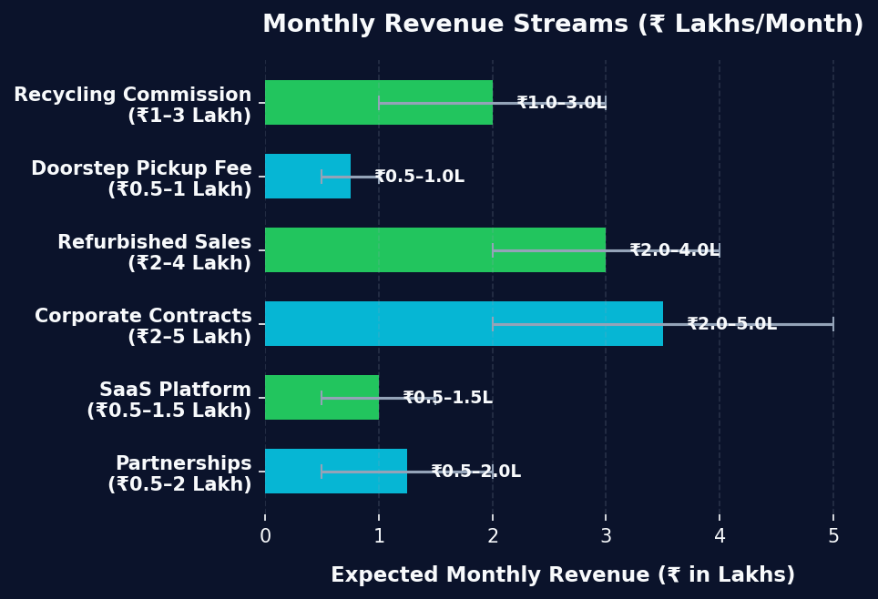
Six Revenue Streams Target ₹6.5L to ₹16.5L in Monthly Earnings
Diverse, robust income channels targeting a total expected revenue of ₹6.5 Lakh to ₹16.5 Lakh per month.
CORE REVENUE CHANNELS
• Recycling Commission ₹1.0 – ₹3.0 Lakh / Month
Cut on metal extraction commissions from authorized recyclers
• Doorstep Pickup Fee ₹0.5 – ₹1.0 Lakh / Month
Logistics convenience fee from households and schools
• Refurbished Device Sales ₹2.0 – ₹4.0 Lakh / Month
Direct sales of certified, repaired electronics via web-store
• Corporate ESG Contracts ₹2.0 – ₹5.0 Lakh / Month
B2B contracts for structured disposal & EPR cert compliance
• Recycler SaaS Platform ₹0.5 – ₹1.5 Lakh / Month
Subscriptions for our logistics routing & inventory CRM
• Eco-Partnerships ₹0.5 – ₹2.0 Lakh / Month
Sponsorships and brand placements for green awareness
TOTAL EXPECTED REVENUE: ₹6.5 – ₹16.5 LAKH / MONTH
Notes:
How do we make money? Unlike basic junk dealers, we have six diversified streams. The highest margin streams are Refurbished Device Sales (₹2-4 Lakh) and Corporate ESG Contracts (₹2-5 Lakh). As shown in the visual bar chart on the right, our total monthly revenue potential lies between ₹6.5 Lakh and ₹16.5 Lakh once we establish regional hubs, presenting a highly attractive return structure.

Slide 6
Lean Capital of ₹15L–27L Projects Rapid 4–6 Month Payback
Strategic capital allocation of ₹15 Lakh to ₹27 Lakh for startup setup and rapid market penetration.
STRATEGIC SEED CAPITAL ALLOCATION
• Platform Development (Web/App) ₹2.0 – ₹4.0 Lakh
• AI Scanner & ML Model Training ₹1.0 – ₹2.0 Lakh
• Logistics & Collection Vehicles ₹2.0 – ₹4.0 Lakh
• Regional Collection Hub Lease ₹3.0 – ₹5.0 Lakh
• Specialized Sorting Equipment ₹1.0 – ₹2.0 Lakh
• Human Capital & Employee Salaries ₹4.0 – ₹6.0 Lakh
• Target Customer Acquisition Marketing ₹1.0 – ₹2.0 Lakh
• Environmental Licenses & Misc. ₹1.0 – ₹2.0 Lakh
TOTAL INITIAL SEED CAPITAL
₹15.0 – ₹27.0 LAKH
Covers custom computer vision app, logistics fleet leasing, collection storage setup, and 12-month staff runway.
STEADY-STATE MONTHLY INCOME
₹6.5 – ₹16.5 LAKH / MO
Expected payback period is 4–6 months after pilot hub launch. Highly scalable, tech-heavy asset-light platform model.
Notes:
Let's look at the financing side. To bring this platform to market, we require a seed round of ₹15 to ₹27 Lakh. As detailed in the allocation table, this is tightly managed: only ₹3-5 Lakh on facilities leasing, keeping us asset-light. The majority is spent on App/AI modeling and initial marketing to drive household volume. With a monthly income potential of up to ₹16.5 Lakh, we project a rapid payback period of 4 to 6 months, making this model highly capital efficient.

Slide 7
Our Circular Model Diverts Toxic Waste While Scaling Profits
Delivering double-bottom-line results: measurable ecological preservation and robust commercial success.
ECOLOGICAL & ENVIRONMENTAL IMPACT
• Diverts Toxic Pollution: Prevents lead, mercury, and flame-retardant leaks from entering soil.
• Promotes Tech Refurbishment: Extends the useful lifespan of functional gadgets by 2–3 years.
• Supports Sustainable Recyclers: Standardizes certified feedstocks for authorized refineries.
• Critical Metal Extraction: Recover scarce heavy minerals (gold, copper, lithium) from waste stream.
BUSINESS & VENTURE IMPACT
• Recurring Corporate Revenue: Steady cash flow from corporate ESG contracts and EPR compliance.
• High-Margin Product Sales: Verified margins from directly selling refurbished devices online.
• Strong Volume Commissions: High-margin scrap material commissions from authorized recyclers.
• Scaleable Partner SaaS: Recurring monthly SaaS subscription fees from third-party waste aggregators.
“Turning Electronic Waste into Sustainable Value: From Discard to Economic Growth”
Collect
Classify
Reuse
Recycle
Recover
Create Value
Notes:
In conclusion, our platform delivers an incredibly powerful double bottom line: measurable ecological impact and massive business value. We recover critical minerals, supporting tech circularity in India. Business-wise, we establish high-margin recurring income. We are truly turning electronic waste into economic value. Thank you, and we are open for any questions.

