Slide 1

Doctor Management System
Member 1
Member 2
Member 3
Member 4
Member 5

Slide 2
Technologies Used
ReactJS
NodeJS
TypeScript
Remix v3 (Framework)
Shadcn/UI - UI Components
TailwindCSS

Slide 3
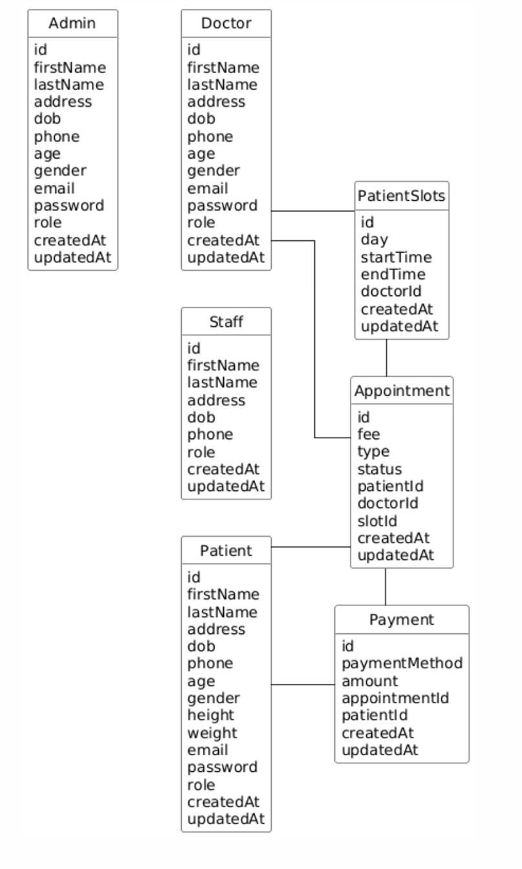
ER Diagram

Slide 4
Project Overview
The system allows administrators to efficiently manage doctors and staff by adding, editing, and overseeing their profiles. Admins also have access to a comprehensive view of all customers, enabling better customer relationship management and streamlined operations. This centralized control helps maintain up-to-date records and ensures smooth clinic management.
1
Patients benefit from the ability to browse all available doctors, view their open appointment slots, and book appointments with ease. They can also access their appointment history and review notes provided by doctors, which supports better continuity of care and personal health management. This user-friendly experience encourages patients to stay engaged with their healthcare.
2
For staff and doctors, the platform offers tools to manage daily workflows effectively. Staff can view all current and upcoming appointments, check in patients upon arrival, and keep the schedule running smoothly. Doctors have the flexibility to update their availability, see which patients have checked in, and record detailed notes for each appointment, ensuring high-quality and personalized care.
3

Slide 5
Admin Functionalities
Can manage staff and doctors.
Can view all the patients.

Slide 6

Doctor Functionalities
Can manage their patient slots.
Can view all the checked-in appointments.
Can write notes for the appointments.

Slide 7
Staff Functionalities
Can view all the today’s and future appointments.
Can check-in today’s appointments.

Slide 8

Patient Functionalities
Can view all the doctors and their available patient slots for all the days of the week.
Can book an appointment with the doctor on the available date.
Can view the notes for the appointments given by the doctor.
Can view all the past appointments.

Slide 9
Summary
This project is a comprehensive doctor management system designed to streamline operations for administrators, staff, doctors, and patients. Administrators can manage doctor and staff profiles and oversee customer information, while patients can easily book appointments, view available slots, and access their appointment history and notes. Staff and doctors benefit from efficient scheduling, patient check-ins, and the ability to update availability and appointment notes, resulting in improved workflow and enhanced patient care.

