Slide 1


DEPARTMENT OF COMPUTER SCIENCE AND ENGINEERING
20CS7503 & DESIGN PROJECT – III
END SEMESTER PRACTICAL EXAMINATION- NOV / DEC 2025
REVIEW PRESENTATION
Batch No.: 07
Date : 28-11-2025
Session : FN

Slide 2
AI-Driven Financial Document Analysis: A Privacy-Preserving Multi-Agent Framework Using Local Large Language Models
Team Members:
LOGESHWARAN P (811722104082)
RAKSHANA G (811722104119)
RIYAZ AHMED H (811722104124)
SURIYA ANAND R (811722104308)
Guide Name:
Ms. S. SHAHINA SHALU
Assistant Professor (CSE)

Slide 3
OBJECTIVE OF THE PROJECT
1. Automate financial document processing by extracting, categorizing, and analyzing data from invoices, statements, contracts, and reports.
2. Ensure privacy-preserving analysis by using locally deployed LLMs within a secure environment.
3. Enable multi-agent collaboration through specialized agents for tasks such as data extraction, compliance checking, and anomaly detection.
4. Improve accuracy and interpretability with context-aware analysis that supports auditors, analysts, and regulators.

Slide 4
INTRODUCTION
1. The financial sector produces massive volumes of complex documents such as invoices, statements, contracts, and compliance reports.
2. Manual processing is slow, error-prone, and increases risks of non-compliance, fraud, and incorrect decision-making.
3. Cloud-based LLMs offer automation but pose privacy and security issues for sensitive financial data.
4. Using locally deployed LLMs with a multi-agent framework ensures secure, intelligent, and compliant financial document analysis.

Slide 5
LITERATURE SURVEY
TITLE OF PAPER | AUTHOR(S) | PAPER GIST | TECHNOLOGY USED
Privacy-Preserving Large Language Models: Mechanisms, Applications, and Future Directions | Eric Song & Guoshenghu Zhao | Survey of privacy risks in LLMs and techniques like DP, FL, cryptography, and TEEs for secure deployment. | Differential Privacy (DP), Federated Learning (FL), Homomorphic Encryption, Trusted Execution Environments (TEE)
Multi-Agent Collaboration in AI: Enhancing Software Development with Autonomous LLMs | David Tunkel & Mubeen Wasif | Explores how autonomous LLM agents collaborate to divide tasks, cross-verify outputs, and improve workflow reliability | Multi-agent systems, LLMs, autonomous agents, message-passing coordination.
A Survey of Large Language Models for Financial Applications: Progress, Prospects and Challenges | Yuqi Nie, Vincent Poor, et al. | Reviews how LLMs are applied in finance including NLP, sentiment analysis, reasoning, and time-series modelling. | Transformer-based LLMs, financial NLP, sentiment models, agent-based modelling.
Beyond Pure Text: Summarizing Financial Reports Based on Both Textual and Tabular Data | Wang et al. | Proposes a joint model that combines text and table data for more accurate financial report summarization. | Hierarchical encoders, text–table fusion models, multimodal summarization.

Slide 6
TITLE OF PAPER | AUTHOR(S) | PAPER GIST | TECHNOLOGY USED
GPT-FinRE: In-Context Learning for Financial Relation Extraction Using Large Language Models | Rajpoot & Parikh | Uses in-context learning with LLMs to extract financial relationships with fewer labeled examples. | GPT models, In-Context Learning (ICL), retrieval augmentation, financial REFinD dataset.
Exploring the Effectiveness of Pretrained Language Models for Financial Data Extraction | Urvashi Khanna & Amin Beheshti | Evaluates transformer models for financial entity extraction, showing improved accuracy after fine-tuning. | Transformer NLP models, NER, domain-specific fine-tuning, contextual embeddings.
Hierarchical Model for Goal-Guided Summarization of Annual Financial Reports | Agarwal, et al. | Proposes a hierarchical summarization model that generates goal-specific summaries for financial reports. | Hierarchical encoders, goal-conditioned decoders, attention mechanisms, abstractive summarization models.
Financial Document Information Extraction Using Deep Learning | Zhang et al. | Introduces a deep learning framework using NER models to extract key entities from complex financial documents. | BiLSTM-CRF, transformer encoders, NLP-based NER, deep learning for document extraction.

Slide 7
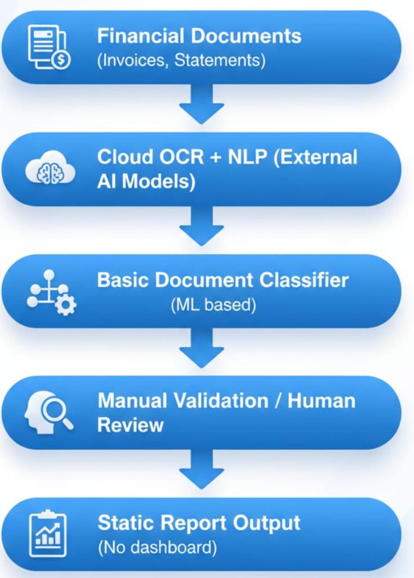
EXISTING SYSTEM ARCHITECTURE

Slide 8
PROBLEM IDENTIFICAITON
Highly inconsistent document formats make rule-based systems inaccurate across diverse financial layouts.
Manual processing leads to frequent errors such as misreading amounts or missing handwritten entries.
Traditional OCR lacks contextual understanding and struggles with low-quality scans, tables, and multilingual content.
No financial context awareness, making interpretation of totals, taxes, anomalies, and relationships challenging.
Labour-intensive workflows do not scale for large document volumes and cause operational delays.

Slide 9
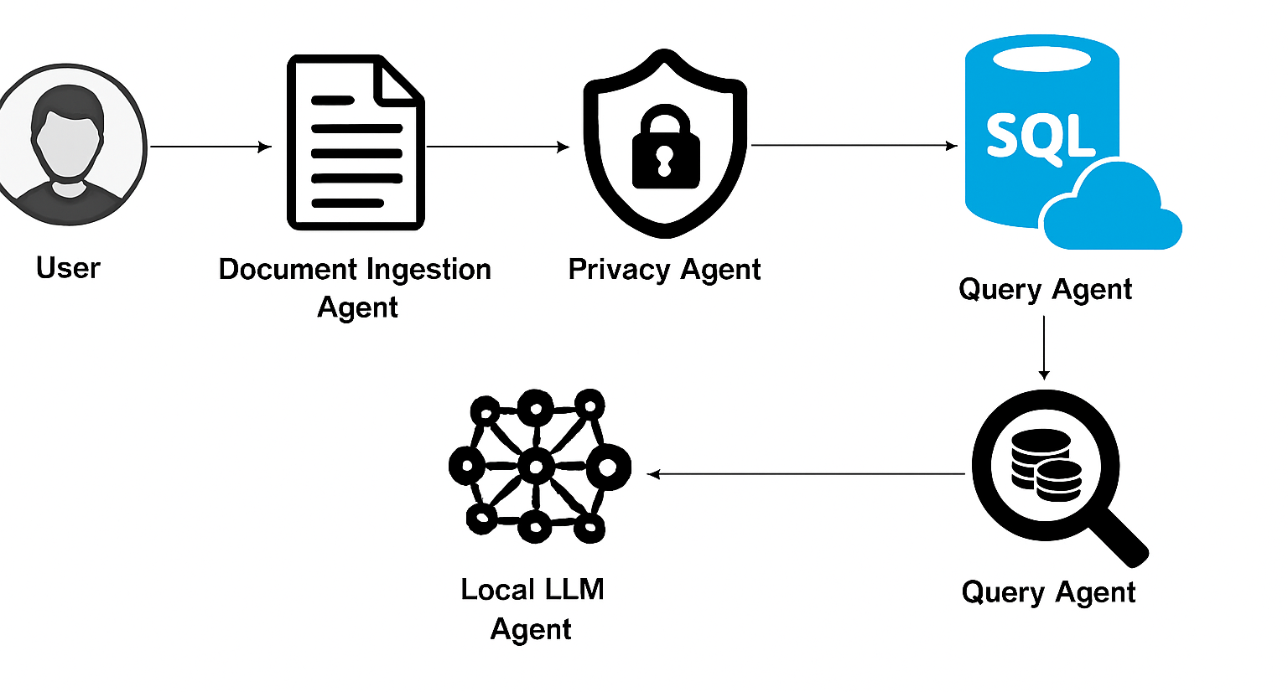
PROPOSED SYSTEM ARCHITECTURE

Slide 10
SOFTWARE AND HARDWARE REQUIREMENTS
HARDWARE
1. Processor: Intel i5 / AMD Ryzen
2. RAM: Minimum 16 GB
3. Storage: 512 GB SSD
4.GPU: NVIDIA RTX 3060 / 4060
5. System: 64-bit architecture
SOFTWARE
1. Operating System: Windows 10/11 (64-bit)
2. Programming Language: Python 9+
3. Frameworks & Libraries:
PyTorch/Tensorflow
Langchain
Scikit-learn
4. Database : PostgreSQL / MongoDB

Slide 11
MODULES
DOCUMENT INGESTION MODULE
DATA EXTRACTION AND COLLECTION MODULE
PRIVACY-PRESERVING ANALYSIS MODULE
MULTI-AGENT COLLABORATION MODULE
RISK AND COMPLIANCE CHECKING MODULE

Slide 12
DOCUMENT INGESTION MODULE
Collects and uploads financial documents in multiple formats (PDF, Word, Excel, Scanned Images).
Performs preprocessing such as Optical Character Recognition (OCR), text cleaning, and format normalization.
Acts as the entry point of the system, ensuring documents are ready for further analysis.

Slide 13
DATA EXTRACTION AND COLLECTION MODULE
Extracts key financial entities (names, dates, transaction IDs, amounts, account details).
Uses Natural Language Processing (NLP) and Local Large Language Models (LLMs) to understand document context.
Classifies documents into categories (e.g., invoice, contract, bank statement, tax report) for efficient analysis.

Slide 14
PRIVACY-PRESERVING ANALYSIS MODULE
Ensures all data is processed locally, avoiding risks of cloud-based LLMs.
Implements encryption, access control, and differential privacy techniques.
Provides a secure environment for sensitive financial information during AI-driven analysis.

Slide 15
MULTI-AGENT COLLABORATION MODULE
The system deploys multiple specialized agents, each implemented as an independent task-oriented component with its own processing logic.
The Extraction Agent parses the input document, identifies key entities, and converts unstructured text into structured financial data fields.
The Compliance Agent processes the extracted data and validates it against stored regulatory, tax, and industry-specific rule sets.
The Risk Agent performs anomaly detection by applying statistical checks and AI-based fraud detection models to flag suspicious patterns.
The Report Agent aggregates validated outputs from all agents and generates concise summaries, insights, and decision-ready reports.

Slide 16
RISK AND COMPLIANCE CHECKING MODULE
      This module cross-checks extracted financial fields against legal, tax, and regulatory rules stored in the system’s compliance library.
      Detects anomalies, inconsistencies, and potential fraud using rule-based checks and AI-driven models.
      Generates alerts, assigns risk scores, and logs issues to support auditors and analysts in making informed decisions.

Slide 17
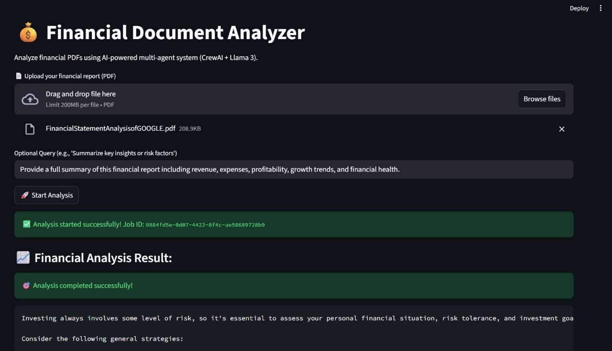
SAMPLE OUTPUT

Slide 18
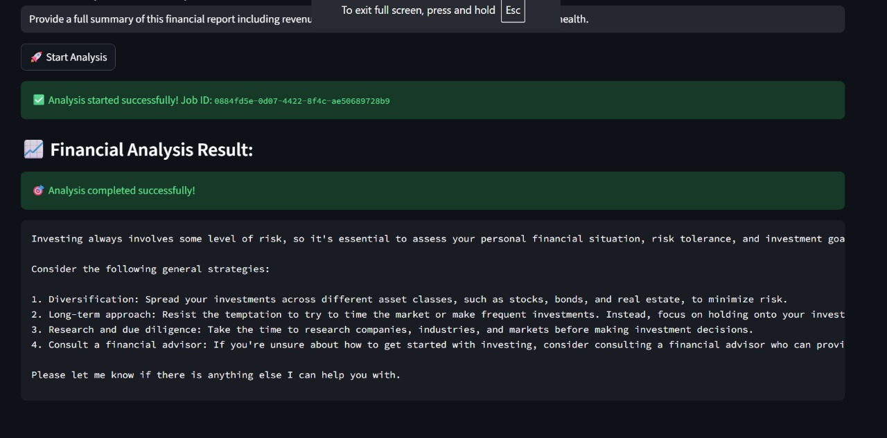

Slide 19
CONCLUSION
The proposed AI-Driven Financial Document Analysis Framework using local large language models and a multi-agent architecture provides a secure, scalable, and intelligent solution for financial institutions.
By automating document processing while preserving privacy, the system minimizes manual effort, reduces errors, ensures compliance with regulations, and detects potential risks or fraud in real time.
This framework not only enhances operational efficiency but also builds trust through data confidentiality, making it a future-ready approach for the financial sector.

Slide 20
FUTURE ENHANCEMENTS
Add AI-powered multi-document analysis for cross-referencing invoices, receipts, and statements.
Improve interoperability and data standardization across banks, vendors, and financial platforms.
Integrate advanced financial analytics and reporting tools like dashboards, forecasting, and anomaly detection.
Enhance system scalability and modular expansion for enterprise-level usage.
Mobile application expansion with features such as on-device document scanning, instant AI-based extraction, and offline secure processing.

