Slide 1





Analyzing eCommerce Business Performance with SQL
Created by:
Bagus Ariobimo
bagusariobimo7@gmail.com
https://www.linkedin.com/in/bagus-ariobimo
https://github.com/riyouuyt
“A data enthusiast who has completed a course in this field and is ready to start his career. Have a excellent understanding in statistics, programming, and data processing. Proficient in using tools such as Python, R, and SQL. Able to collect, clean and analyze data with the necessary techniques. Have skills in data visualization and simple statistical modeling. Creative problem solver and always thrive for learning. Ready to contribute to data-driven projects and collaborate in teams. Committed to further developing data science skills and achieving significant results in data analysis.”

Slide 2



Overview
Project Objective:
“In a company, measuring business performance is very important to track, combine and assess the success or failure of various business processes. "Therefore, this paper will analyze business performance for an eCommerce company, taking into account several business metrics, namely customer growth, product quality, and payment type."
Tools:
PostgreSQL (RDBMS) : Database Analysis
Excel : For Visualization
Google Drive : Query Documentation
Dataset Information:
This Datasets are from the rakamin itself comes with a zip file, if you want to know more about the dataset Click Here.
By systematically using these tools to analyze the datasets stored in PostgreSQL, this project will provide valuable insights into the eCommerce business's performance. These insights will guide strategic decisions to optimize customer growth, product quality, and payment processes, ultimately contributing to the company's overall success and competitiveness in the digital marketplace.

Slide 3
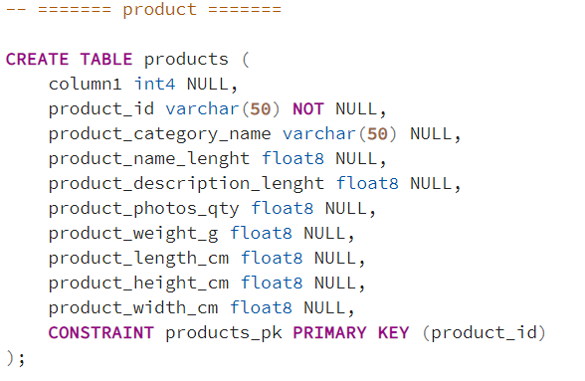
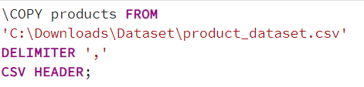
Data Preparation
For the data Preparation phase, we took two crucial steps:
Table Creation: We created the required tables using SQL queries to structure the data.
Data Import: We imported data into these tables using the COPY command within PostgreSQL's psql tool. We organized and assembled vital datasets, including Seller, Customer, Order Items, Order Payment, Geolocation, Product, Order Review, and Order datasets.
This meticulous data preparation lays the foundation for our comprehensive analysis of eCommerce business performance, enabling us to derive actionable insights from the collected information.
For more information about the query, Click Here

Slide 4
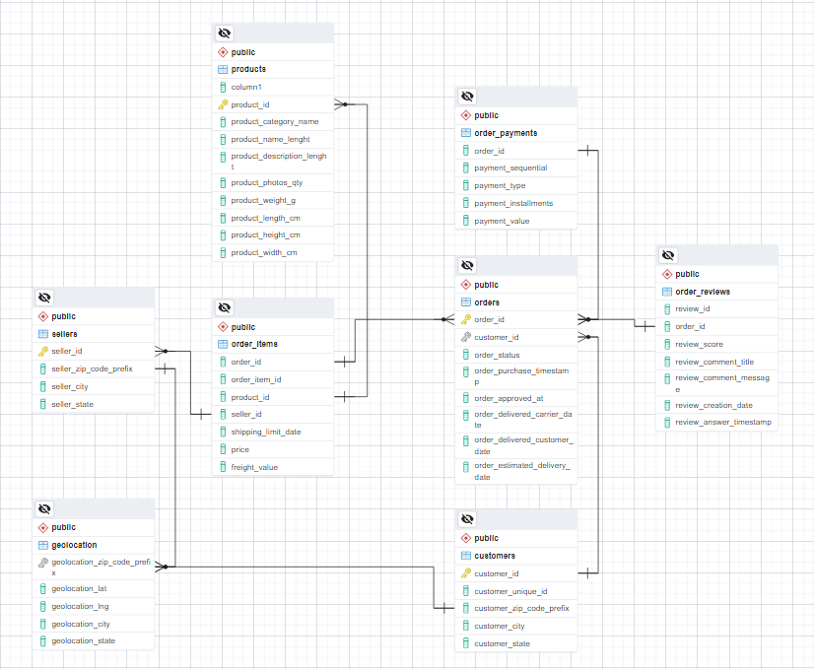
Data Preparation
With our data organized, we're now moving on to the next critical step:
creating an Entity-Relationship Diagram (ERD)
The ERD will serve as a visual representation of how the tables are interconnected, enabling us to gain a deeper understanding of the relationships between different aspects of our eCommerce business data. This step will facilitate comprehensive data analysis and decision-making in the subsequent stages of our project.
For the ERD, click Here

Slide 5
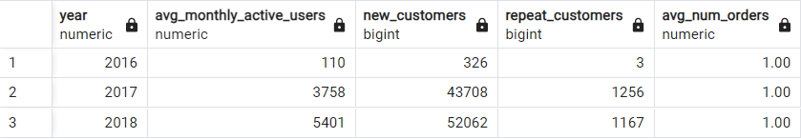
Annual Customer Activity Growth Analysis
Annual Report:
Over the three-year analysis of this eCommerce business, it is evident that the platform has achieved substantial growth and customer retention. In 2017, there was a remarkable surge in the number of monthly active users, averaging 3,758. This growth was mirrored in the influx of new customers, which reached an impressive 43,708. Equally noteworthy was the retention of 1,256 repeat customers.
The following year, 2018, continued to display positive trends. The average number of monthly active users remained robust at 5,401, indicating sustained user engagement. New customer acquisition remained strong with 52,062 new sign-ups, while 1,167 loyal customers continued to place repeat orders.
For Full Query Information, Click Here

Slide 6
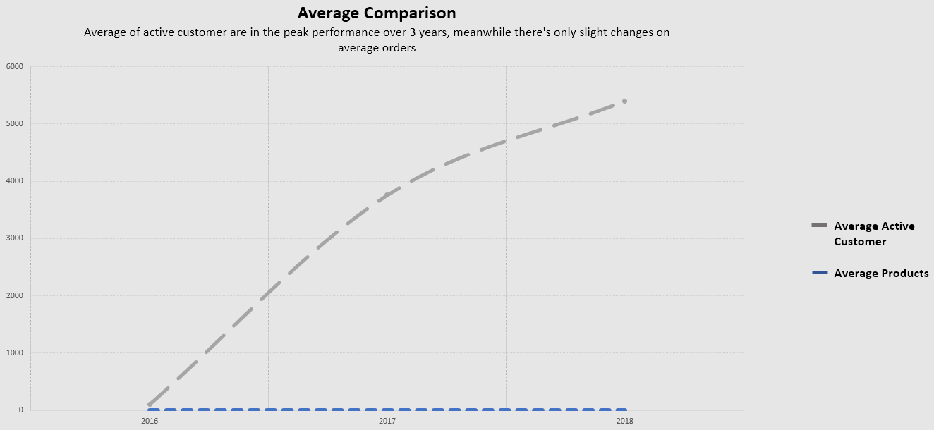
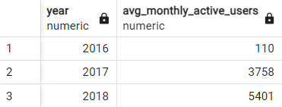
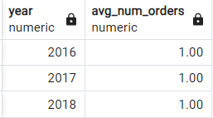
Annual Customer Activity Growth Analysis
Monthly Average Users (MAU) and Average Orders
MAU: The analysis reveals the following MAU trends:
In 2016, we had 110 average monthly active users.
This number saw a significant surge in 2017, reaching 3,758 MAU.
In 2018, the upward trend continued with 5,401 MAU.
Customer Order Behavior
On average, customers placed approximately 1 order each year throughout the analyzed period, reflecting the consistency in customer order behavior.
For Full Query Information, Click Here

Slide 7
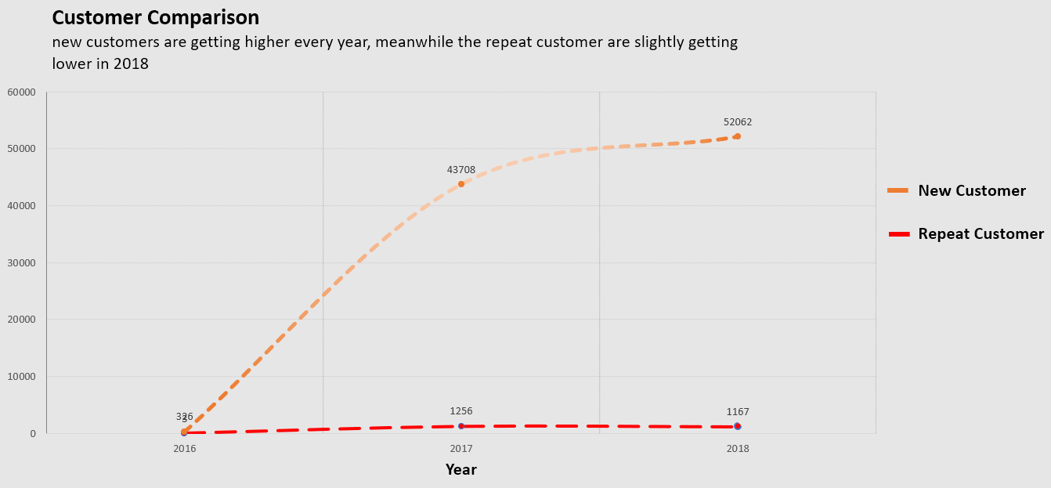
Annual Customer Activity Growth Analysis
New and Repeat Customer Comparison
The analysis highlights of trends in acquiring new customers:
Repeat Customer Retention:
New Customers result
In 2016, we successfully acquired 326 new customers.
The number of new customers saw an impressive growth in 2017, with 43,708 new customers.
In 2018, we added 52,062 new customers to our platform.
Repeat Customer Retention:
In 2016, we had 3 repeat customers.
By 2017, this number substantially increased to 1,256 repeat customers.
In 2018, we retained 1,167 repeat customers, showcasing our commitment to customer loyalty.
For Full Query Information, Click Here

Slide 8
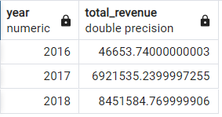
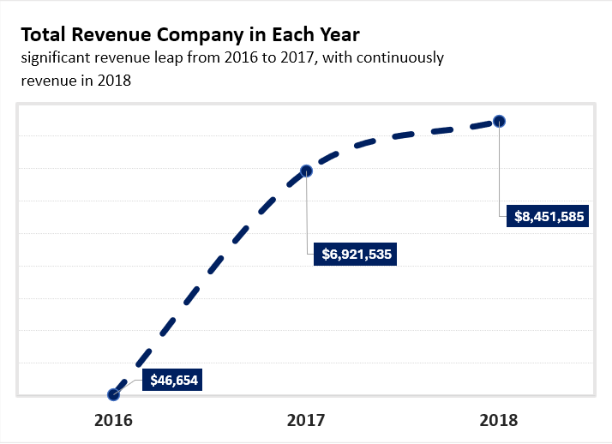
Annual Product Category Quality Analysis
Revenue Report
In our analysis of the e-commerce business performance from 2016 to 2018, several key observations have emerged regarding revenue. These observations shed light on our business's financial growth and trends:
Steady Revenue Growth: Over the three-year period, our total revenue demonstrated steady growth. We started in 2016 with $46,653.74 in total revenue, which increased significantly to $6,921,535.24 in 2017 and further to $8,451,584.77 in 2018. This upward trajectory indicates the increasing popularity of our platform and the potential for further growth.
Significant Revenue Leap: The year 2017 saw a remarkable leap in revenue, reaching $6,921,535.24. This spike indicates a substantial increase in customer engagement and purchases on our platform, reflecting the effectiveness of our marketing and sales efforts during that year.
Sustained Growth in 2018: It is noteworthy that our revenue continued to grow in 2018, reaching $8,451,584.77. This sustained growth reaffirms our platform's ability to maintain and build on the gains achieved in the previous year.
For more information about the query, Click Here

Slide 9
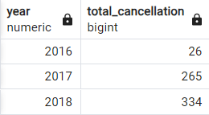
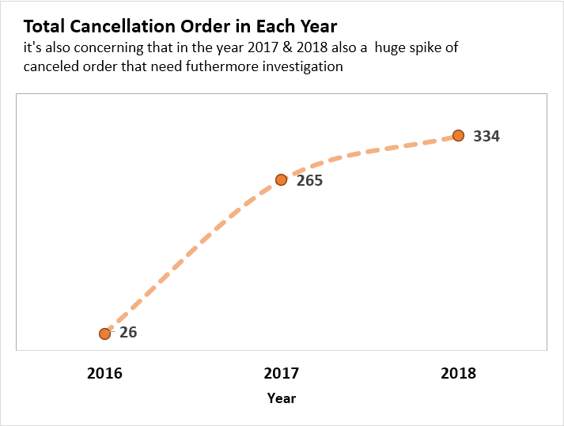
Annual Product Category Quality Analysis
Cancellation Report
Our analysis of order cancellations for the years 2016 to 2018 has unveiled important insights into customer behavior and order management. These observations shed light on the impact of cancellations on our business and provide an opportunity for improvement:
Consistent Growth in Cancellations: The data shows a consistent increase in the number of order cancellations across the three years analyzed. In 2016, there were 26 cancellations, which rose to 265 in 2017, and further increased to 334 in 2018. This upward trend indicates a need for a closer examination of our order fulfillment processes and customer experience.
Identification of Cancellation Trends: While the overall cancellations increased, there is also an opportunity to identify specific categories that may be more prone to cancellations. Understanding which product categories have the highest cancellation rates is crucial for addressing potential issues, improving customer satisfaction, and reducing revenue loss.
Need for Focused Efforts: The consistent growth in cancellations underlines the importance of developing strategies to minimize cancellations. These strategies may include improving product descriptions, enhancing the quality of products, and providing more accurate delivery estimates. By addressing these issues, we can create a more positive and seamless shopping experience for our customers.
Potential for Revenue Recovery: Minimizing cancellations not only improves the customer experience but also has the potential to positively impact revenue. By reducing cancellations, we can retain more orders, which in turn can lead to increased revenue and customer loyalty.
For more information about the query, Click Here

Slide 10
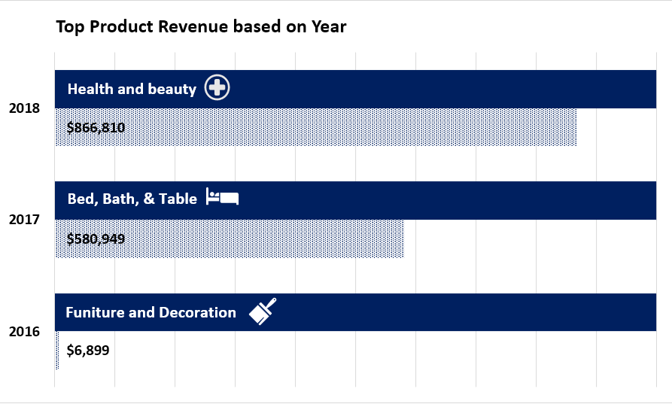
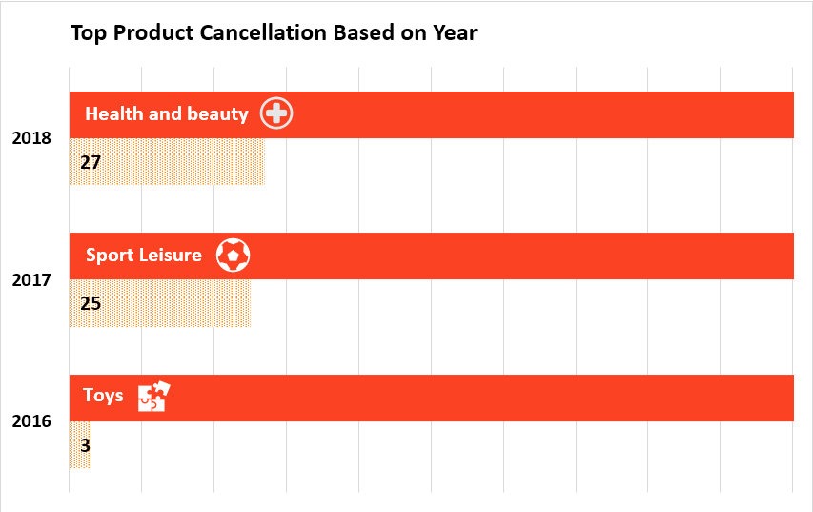
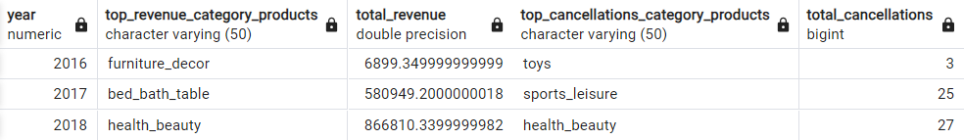
Annual Product Category Quality Analysis
Product Category Analysis report
In the years 2016 to 2018, our e-commerce platform displayed promising trends in both revenue and order cancellations:
Revenue Performance: We observed consistent growth in total revenue, starting at $46,653.74 in 2016 and reaching $8,451,584.77 in 2018. Notably, the Bed & Bath Table category excelled in revenue in 2017, while the Health & Beauty category took the lead in 2018.
Cancellation Trends: Order cancellations saw a steady increase over the years, emphasizing the importance of refining our order management processes. In 2016, Toys had the lowest cancellations, and in 2017, the Sports & Leisure category faced the most cancellations.
These insights guide us toward strengthening our high-performing categories and addressing specific concerns related to cancellations, ultimately fostering growth and enhancing the customer experience.
For more information about the query, Click Here

Slide 11
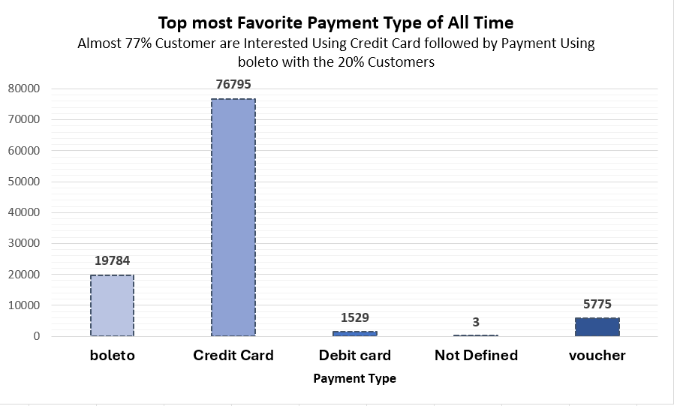
Analysis of Annual Payment Type Usage
Total Favorite Payment Types (All Time)
The data reveals the distribution of payment types used across all transactions. The most favored payment type is "credit card," with a substantial total of 76,795 uses. Following closely is "boleto" with 19,784 uses, "voucher" with 5,775 uses, "debit card" with 1,529 uses, and "not defined" with 3 uses. These insights provide valuable information about customer payment preferences.
For more information about the query, Click Here

Slide 12
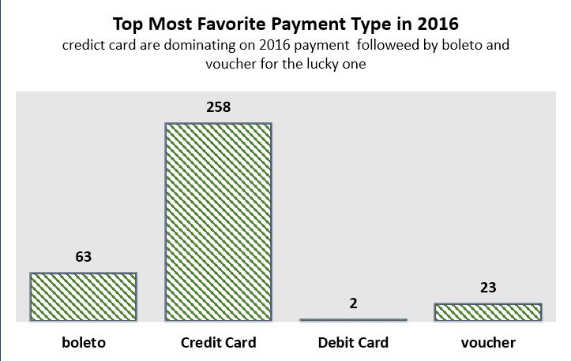
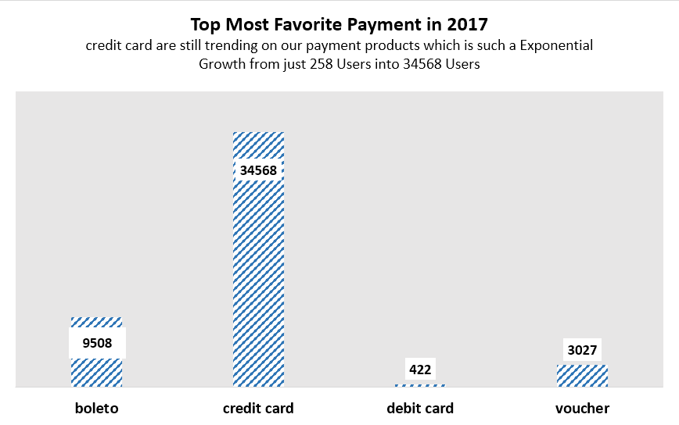
Analysis of Annual Payment Type Usage
Total Favorite Payment Types by Year
Analyzing payment preferences year by year provides a more detailed perspective:
In 2016, "credit card" was the most preferred payment type with 258 uses, followed by "boleto" with 63 uses, "voucher" with 23 uses, and "debit card" with 2 uses.
In 2017, "credit card" continued to lead with 34,568 uses, followed by "boleto" with 9,508 uses, "voucher" with 3,027 uses, and "debit card" with 422 uses.
For more information about the query, Click Here

Slide 13
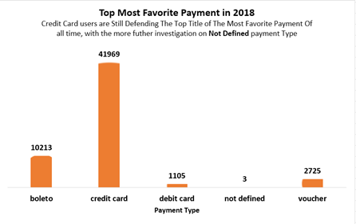
Analysis of Annual Payment Type Usage
In 2018, "credit card" remained dominant with 41,969 uses, followed by "boleto" with 10,213 uses, "voucher" with 2,725 uses, "debit card" with 1,105 uses, and "not defined" with 3 uses.
These insights highlight shifting payment preferences over the years, with "credit card" consistently favored as the primary payment method, closely followed by "boleto." Understanding these trends can help businesses tailor their payment options to meet customer needs and expectations.
For more information about the query, Click Here

Slide 14
Business Recommendation
1. Focus on High-Revenue Categories:
The consistent revenue contribution of the "health and beauty" category makes it crucial to prioritize. By expanding the range of products and strategically marketing within this category, the company can effectively capitalize on its popularity, driving further revenue growth.
2. Enhance Customer Engagement:
While the total revenue is growing, customer engagement remains a challenge due to low average order frequency. To address this, the company should develop targeted marketing campaigns and loyalty programs. These efforts will encourage repeat purchases, ultimately increasing the average number of orders per customer and boosting revenue.
3. Optimize Payment Methods:
Credit cards are the preferred payment method, indicating customer preference. To maintain customer trust, the company should ensure the security and reliability of credit card transactions. At the same time, it should continue to accept alternative payment methods like boleto and vouchers to cater to diverse customer preferences.
4. Proactive Cancellation Management:
With an increase in cancellations over the years, it's essential to mitigate this risk. To do so, the company should identify the top cancellation category products, address customer concerns or product issues in these categories, and implement feedback mechanisms to enhance product quality. This proactive approach will reduce cancellations and safeguard revenue.

