Slide 1

TITLE:
PATH2CAREER
NAME: MOHAMMED RIZWAN P S
GUIDE: DR. DEEPA MARY MATHEWS
MCA, BATCH-B
ROLL NO: 20

Slide 2
OBJECTIVE
Holistic Placement Preparation: Provide tools for aptitude tests, coding challenges, and AI-based mock interviews to help students prepare for both on-campus and off-campus placements.
Admin-Controlled Content Management : Allow admins to add and manage aptitude and coding questions weekly, track late submissions, and analyze student performance to identify monthly toppers.
AI-Driven Feedback and Insights :Use AI to generate mock interview questions, provide personalized feedback, and assign scores based on student performance to improve readines.
Interactive Communication and Job Management

Slide 3
EXISTING SYSTEM
Individual Aptitude and Coding Practice:
Students use various platforms to practice aptitude and coding independently.
Offline Mock Interview:
It is done with the help of admin.
Performance Tracking:
No measures to track performance.

Slide 4
PROPOSED SYSTEM
Centralized Platform for Placement Preparation:
Offers aptitude and coding practice tailored to college placements by admin.
AI-Based Mock Interviews with Feedback:
enables students to simulate real interviews with AI-generated questions and feedback.
Performance Tracking and Analysis:
Tracks student submissions, identifies late entries, and highlights toppers for each month.
Interactive Video Call Platform:
Facilitates real-time interaction between students and mentors or peers.

Slide 5
MODULES
Registration and Login Module
Student can only login when approved by admin
Job Registration Module
Both off campus and on campus.
Aptitude Test Module
Admin add question weekly and attended by student
Coding Test Module
Admin add Coding questions and attended by student
AI Mock Interview Module
Questions and feedback generated by ai AI
Meeting Module
Meeting link will be shared via email

Slide 6
TOOLS AND TECHNOLOGIES
FRONT-END
REACT
BACK-END
NODE JS
EXPRESS JS
DATABASE
MONGODB

Slide 7
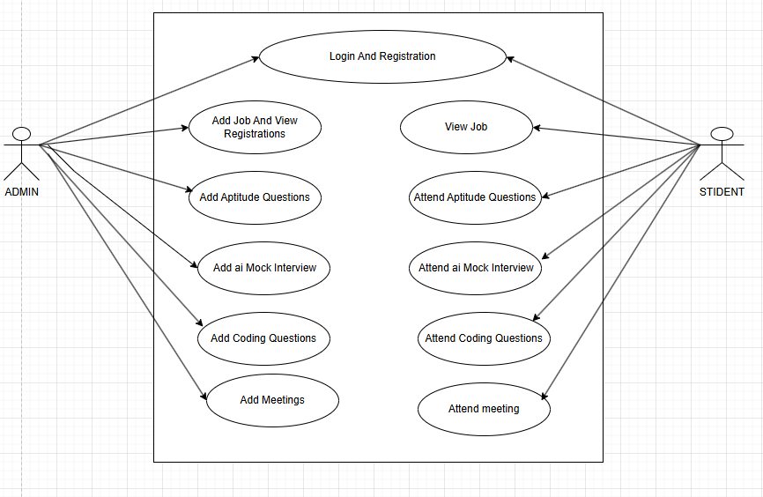
SYSTEM DESIGN

Slide 8
DATABASE
TABLES | DESCRIPTION
STUDENT DETAIL | TO STORE DETAILS OF THE STUDENT
APTITUDE QUESTIONS | TO STORE QUESTIONS AND ANSWERS
APTITUDE TESTRESULTS | TO STORE RESULT OF APTITUDE
CODING TEST | TO STORE QUESTIONS,TEST CASES
CODING TEST RESULT | TO STORE RESULT OF CODING TEST
MOCK INTERVIEW RESULT | TO STORE RESULT OF MOCK INTERVIEW
MEETING SCHEDULE | TO STORE DATE AND TIME

Slide 9
CONCLUSION
The proposed Path2Career platform provides a comprehensive solution for college students preparing for placements by integrating aptitude and coding practice, mock interviews, and real-time performance tracking .With user-friendly features, detailed analytics, and an interactive learning experience, the platform ensures a seamless and structured approach to placement preparation for students and administrators alike.

Slide 10
REFERENCES
Enhancing Student Placement Preparation Through Web Application P Shanmugam1 , Janhavi Lenka , M Yousuf Suhail.
An Integrated Web Application for Training and Placement, Harsh Akre

Slide 11


THANK YOU

