Slide 1

Work Hour Tracker
Team 5
IST 412
Fall 2018
Professor Jim Clarke
By:
Dennis Smith
Ricky Zhao
Sai Nithisha Guntamadugu
Jackson Penning
Bijal Patel
IST 412 The Engineering Complex Software Systems Team 5 ‹#›
Notes:
Team introduction

Slide 2
Agenda
Problem Statement - Nithisha
Solution Statement - Bijal
Team culture - Ricky
Technology used to implement the design - Dennis
Demo - Team
Retrospective - Jackson
Question and Answer - Team
IST 412 The Engineering Complex Software Systems Nithisha ‹#›
Notes:
Problem Statement - NOTE: Discuss Jim’s intial request - “time tracking app that is awesome”
Mission Statement - What are we setting out to achieve?
Solution Statement - ConOps … show the Architecture docs
Team Culture - bigger topic that will cover communication methods, sprint backlog technology, how we engaged client
Technology used to implement the design - .Net Core 2.1, Azure, MVC web application, maybe talk about programming techniques?
Demo - Everyone should have a page in the app to discuss.. Maybe? Or should Dennis and Ricky handle the demo? EVERYONE NEEDS TO BE FAMILIAR WITH THE APP!
Retro - Talk about DevOps … (honestly we didnt even learn much from Jim outside buzz words), our take aways, a good thing to mention is “We should have more readily engaged the client and set up recurring meetings..”
What tech

Slide 3

Problem Statement
What is the problem?
Create a time tracking application that is awesome!
Many companies may not be aware of the time employee’s are logging against various projects which can lead to under budgeting or over budgeting the project.
Mission Statement
Create a solution that will allow the client to more easily manage their employee hours on various projects which will give companies more information when budgeting projects.
Provide an interface for users to enter their time spent on projects.
Give users the ability to see what individuals worked on a particular project as well as a grand total of hours spent on a project.
IST 412 The Engineering Complex Software Systems Nithisha ‹#›
Notes:
The problem - Provide a solution that allows Project Managers / Manager the ability to better forecast project planning

Slide 4
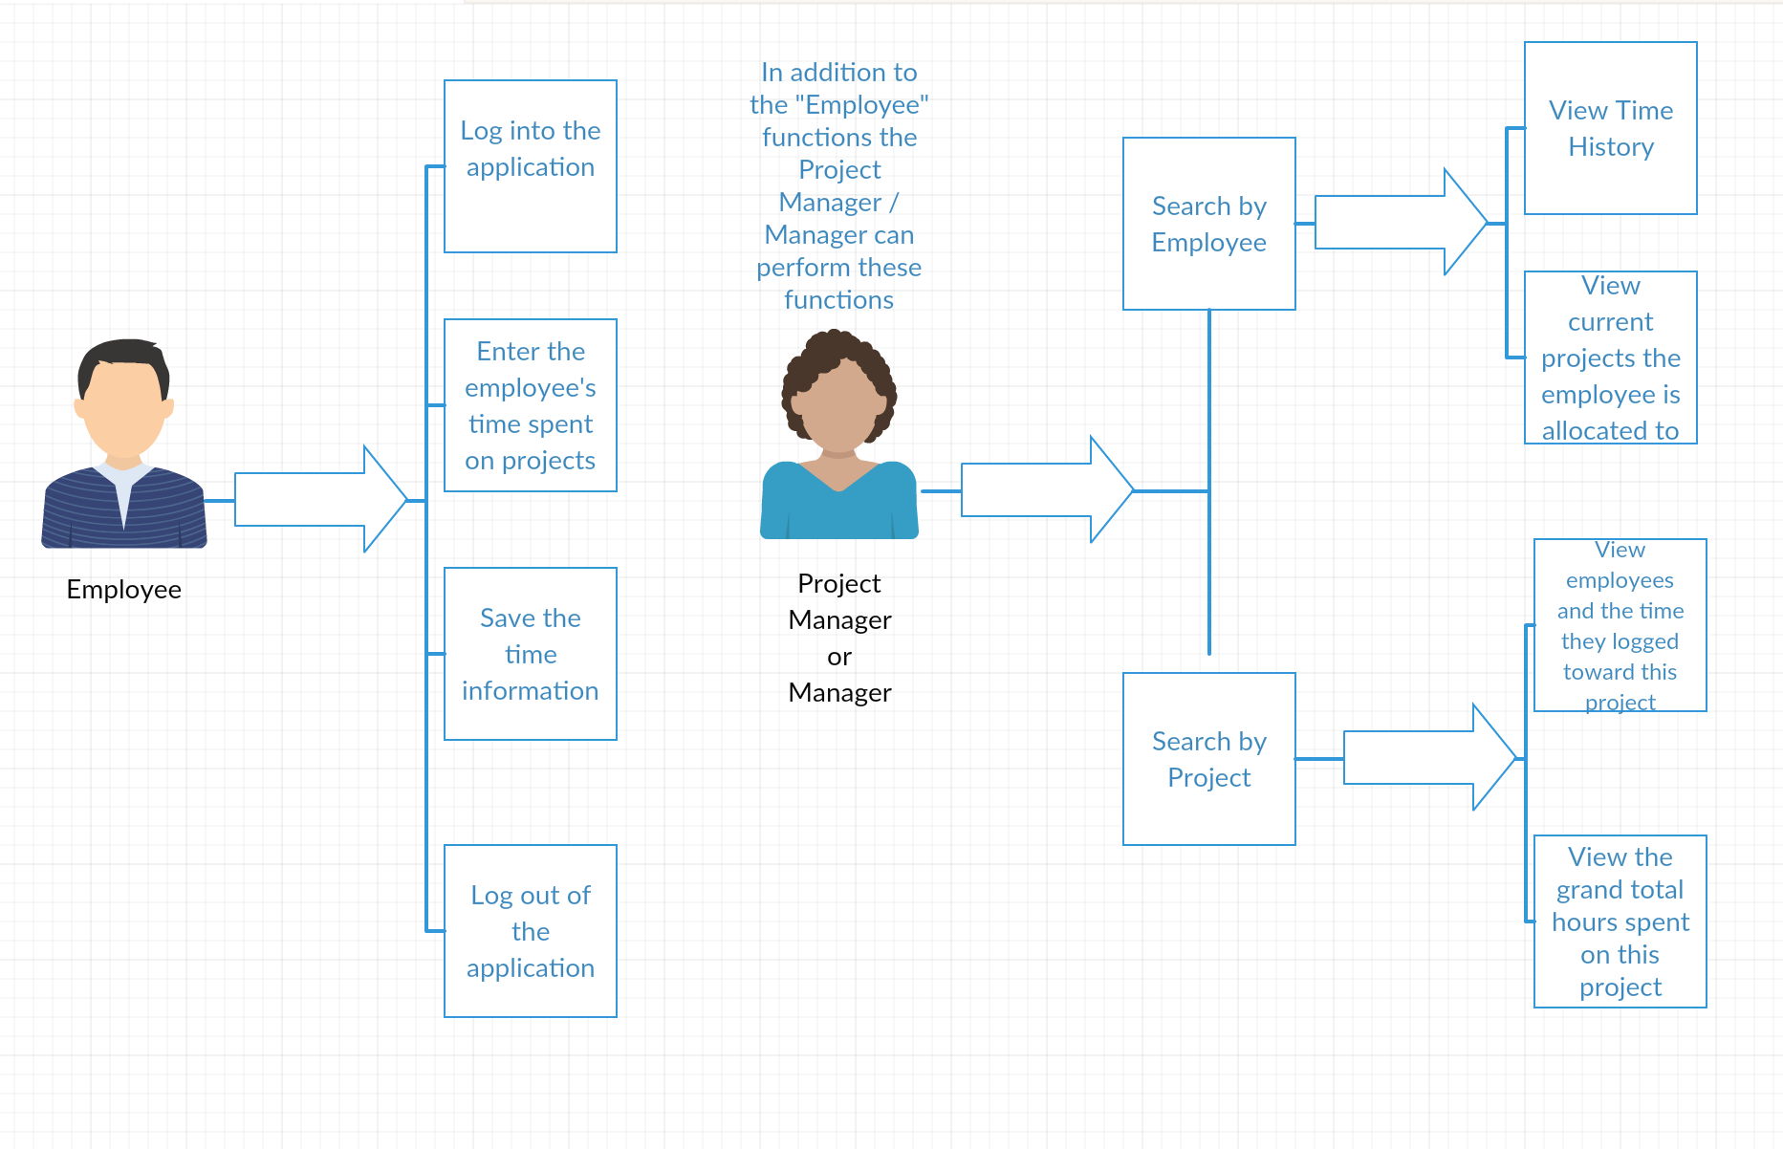
Solution Statement
How were we able to accomplish it?
Created user diagram, class diagram, and application workflow diagram
Formulated requirements and have them accepted by clients
Broke down requirements into user stories
Assigned user stories to different team members
Created application project framework
Set up azure database
Write code to access and persist data
Design Views(HTML Pages )
IST 412 The Engineering Complex Software Systems Bijal ‹#›

Slide 5
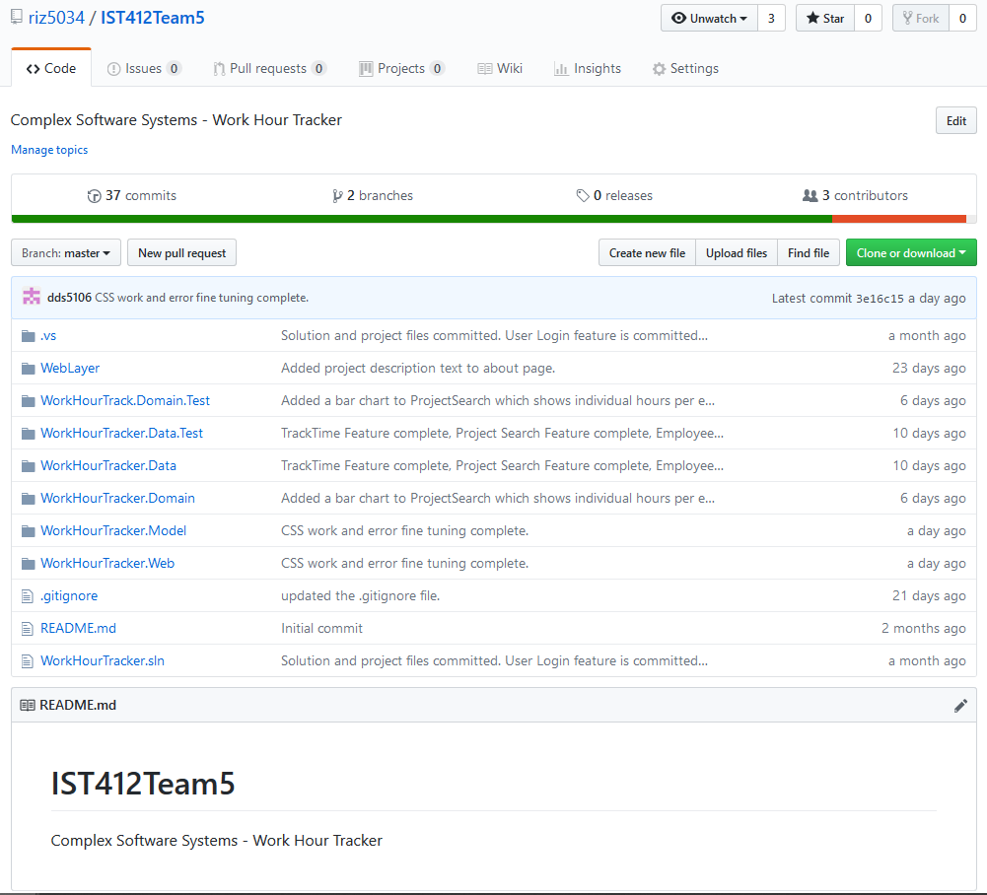
Team Culture
Team Communication
Slack was the primary text based communication channel
Zoom was used for online video communication
In-person meetings
Client Communication
Proposal review using Google Docs
In-person meetings
Project Planning
Azure DevOps was used for planning the development of features
GitHub was used for version control
IST 412 The Engineering Complex Software Systems Ricky ‹#›
Notes:
bigger topic that will cover communication methods, sprint backlog technology, how we engaged client

Slide 6
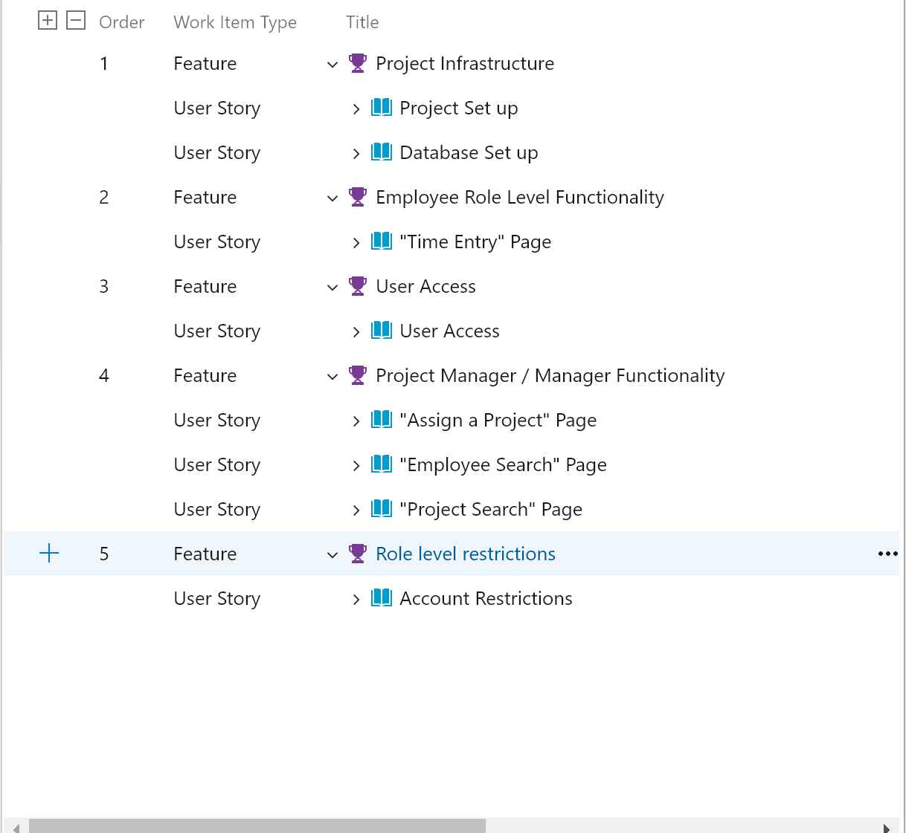
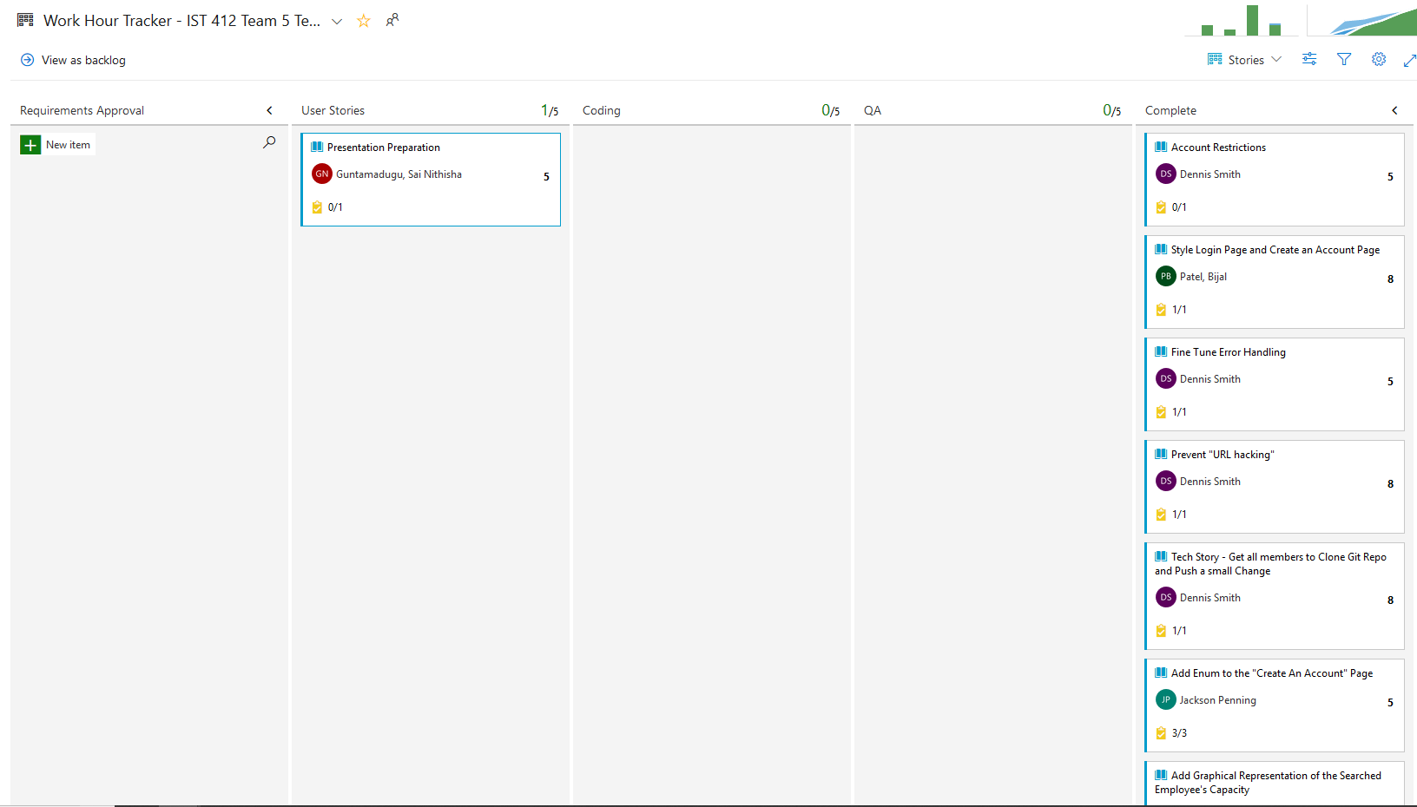
Team Culture (cont)
IST 412 The Engineering Complex Software Systems Ricky ‹#›

Slide 7
Technologies used to implement the Design
.Net Core 2.1
Azure SQL Database
ASP.NET Core MVC Web application
Dapper
IST 412 The Engineering Complex Software Systems Dennis ‹#›

Slide 8
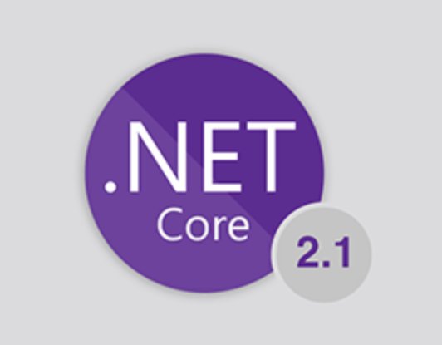
Technologies used to implement the Design (cont)
.Net Core 2.1
Lightweight
Cross Platform
IST 412 The Engineering Complex Software Systems Dennis ‹#›

Slide 9
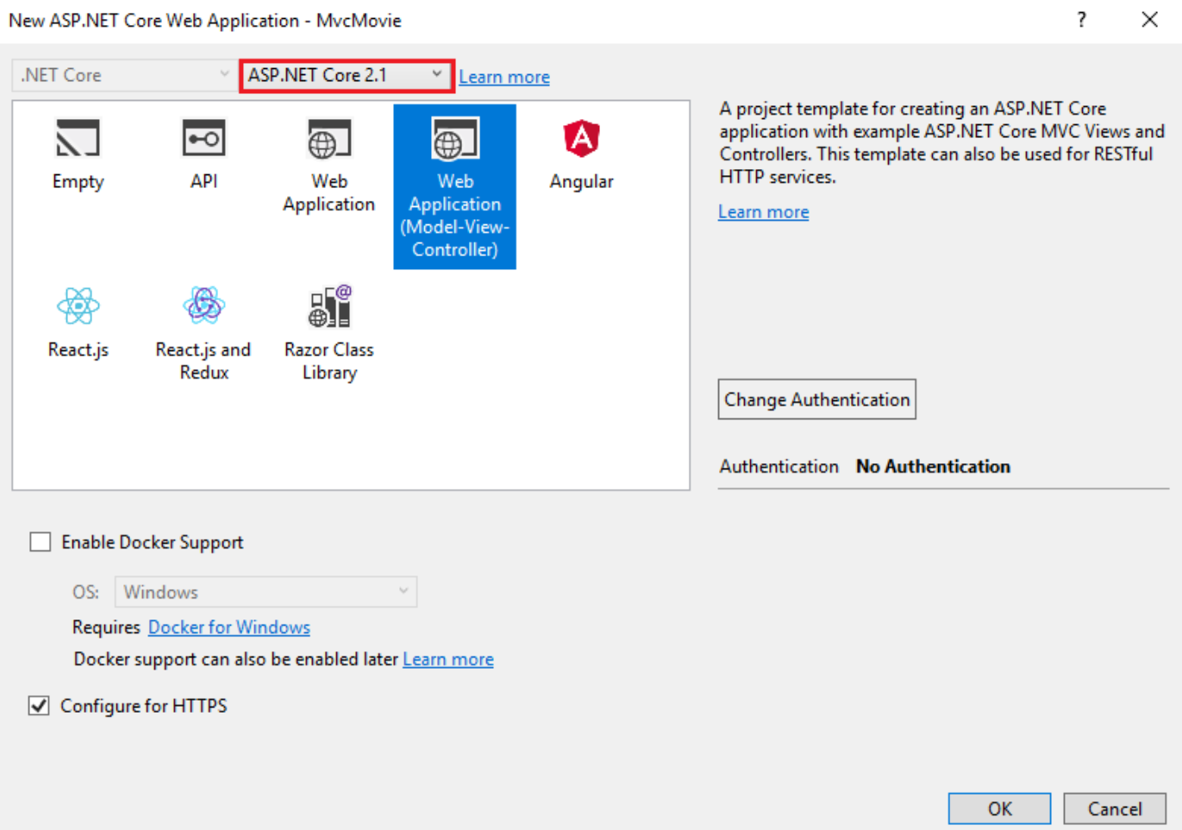
Technologies used to implement the Design (cont)
ASP.NET Core MVC Web application
Separation of concerns
asp- “tag helper attributes”
asp-controller
asp-action
4 Tier Architecture
IST 412 The Engineering Complex Software Systems Dennis ‹#›
Notes:
REST and MVC are a good fit. RESTful resource is exposed thru controller.
REST - Requests are made by the user to resource’s URI to elicit a response. Home/UserLogin to GET the ‘Login Page’

Slide 10
Technologies used to implement the Design (cont)
Azure SQL Database
No SSMS install required
Team could successfully talk to database
Quick set up (DevOps)
IST 412 The Engineering Complex Software Systems Dennis ‹#›

Slide 11
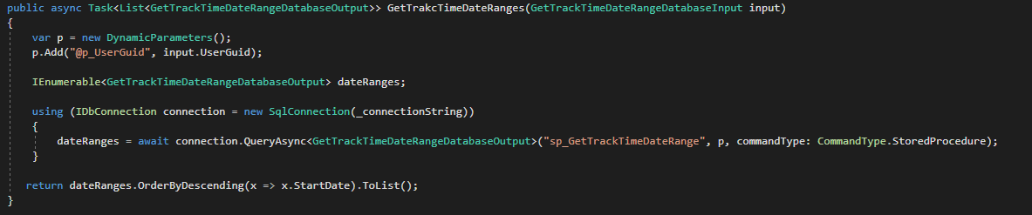
Technologies used to implement the Design (cont)
Dapper
ORM tool
Light weight, Fast
Notes:
LightWeight - no overhead associated with it unlike Entity Framework. Does not automatically generate you classes. Working with EF I was always frustrated trying to get the ORM to update the stored procedure if a parameter or output changed

Slide 12
Technologies used to implement the Design (cont)
TempData
Used to handle user login
TempData can be preserved across HTTP requests
Async Programming
Async and Await keywords
Increase Application Response when access web resources like Azure
Linq and lambda expressions
var XLabels = Newtonsoft.Json.JsonConvert.SerializeObject(Model.ChartData.Select(p => p.ProjectName).ToList());
dateRanges.OrderByDescending(x => x.StartDate).ToList();
Chart.js
Easy to create graphical representations of data
Unit Tests
XUnit
Ensure each module of the code continues to function as designed
IST 412 The Engineering Complex Software Systems Dennis ‹#›
Notes:
Discuss a bit about the programming techniques

Slide 13
Demo
Demo of the application
IST 412 The Engineering Complex Software Systems Team 5 ‹#›

Slide 14
Retrospective
Project takeaways
Became more familiar with version control systems and how to implement them either through the command line or through an IDE’s version control or Git options.
Learned to implement the ASP.NET MVC framework to develop an application with an underlying data layer.
Used industry standard cloud technology for project planning, and database services.
Maintained an open line of communication for project discussions amongst our group.
Integrated the stakeholder’s discussions and feedback into our design process.
IST 412 The Engineering Complex Software Systems Jackson ‹#›
Notes:
Here we will “tell them what we told them”
Give project take aways
Mention that we should have engaged the client more readily

Slide 15
Retrospective
Room for improvement
Although we engaged the client at regular intervals, we could have contacted the client more frequently.
Implementing even more of the stakeholder’s feedback into our design and overall development process could have further refined our end product to meet more of the client’s needs and specifications.
IST 412 The Engineering Complex Software Systems Jackson ‹#›

Slide 16
Question and Answer
Questions?
IST 412 The Engineering Complex Software Systems Team 5 ‹#›

