Slide 1
SIEM Threat Hunting
by Rizal

Slide 2
Case 1
list of unique IP addresses
bash script --> TH_task01-bash.sh
Task to list all unique of IP Addresses in log using bash script and print result on TH_task01.txt
Github result : here
cat CTF1.log | awk -F " " '{print $8 " " $9 " " $10 " " $11}' | grep -oE "[0-9]{1,3}\.[0-9]{1,3}\.[0-9]{1,3}\.[0-9]{1,3}" | sort | uniq >> TH_task01.txt

Slide 3
Case 2
list of unique IP addresses with country and number of hits
bash script --> TH_task02-bash.sh
python script --> TH_task02-python-GeoIP.py
cat CTF1.log | awk -F " " '{print $8 " " $9 " " $10 " " $11}' | grep -oE "[0-9]{1,3}\.[0-9]{1,3}\.[0-9]{1,3}\.[0-9]{1,3}" >> All_IP.txt
import urllib.request import json ipAddr = open("All_IP.txt","r") for ip in ipAddr: response = urllib.request.urlopen("http://extreme-ip-lookup.com/json/" + ip) geo = json.load(response) print(ip + geo["country"])

Slide 4
Case 2
after print result from bash script to All_IP.txt and using python script to generate Geolocation of IP Address list and count number of hits to apache using this script.
Bash script --> TH_task02-bash-GeoIP.sh
Github result : here
python3 geoIP.py | sort | uniq -c | sort -nr >> TH_task02.txt

Slide 5
Case 3
list of all activity per IP address to individual flat text files per IP
Not finish yet, I'm sorry :)
I has doing best scenario script to do enumration of the task but still doesn't work properly.

Slide 6
Case 4
detect SQLi with found entries
SQL Injection use sql statement to enumerate the queries from databases, i am searching for general statement like “select, from, delete, update, where and etc” until find best script regex for the log
bash script --> TH_task04-bash.sh
Github result : here
grep -aE "'\sand|'1|select |select\*|information_schema|\.sql|concat\(|rand\(" CTF1.log >> TH_task04.txt

Slide 7
Case 5
detect remote file inclusion with found entries
Firstly find similar regex word for RFI, i got sample words contains “variable=http://xxx.com” and after search log, got some variable of “file=http://bounce.trustkeeper.net/phpecho.txt” is possible to inject script in variable “auto_prepend_file=” port 80.
Bash script --> TH_task05-bash.sh
Github result : here
grep -aE "file=http" CTF1.log >> TH_task05.txt

Slide 8
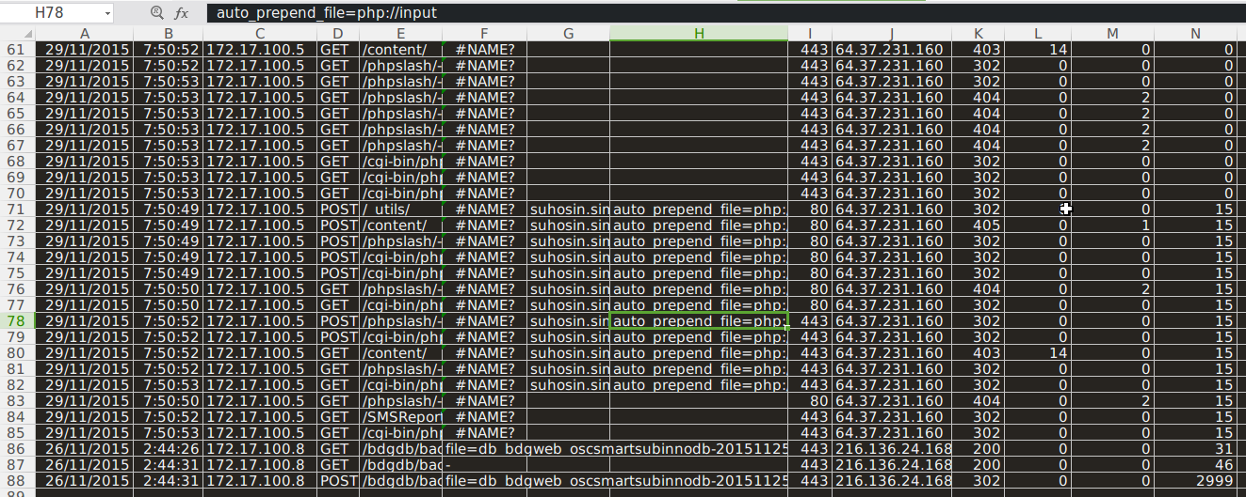

Slide 9
Case 6
detect web shells with found entries
After got information IP Address 64.37.231.160 is the person who do RFI, I analyze the packet using excel with filter of size and response. I got something interesting value of “c99.php” and “sniper.php” have bigger size different value and redirect status (302).
As information c99.php look like a shell has been upload to web server from RFI, here some detail :
http://www.topshellv.com/shell/c99-shell
Bash script --> TH_task06-bash.sh
Github result : here
grep -a "64.37.231.160" >> TH_task06.txt

Slide 10
