Slide 1
Facial Recognition System for Sound suggestion
By: Riz Amatya
Date: Dec 6, 2021

Slide 2
Introduction To Facial Recognition System
A facial recognition system is a computer application that can match a human face in a digital image or video frame using the facial features (face print) present in the image or video.
The process of detecting face, analyzing it, converting it into data and finding the similarity in the face structure is the main work of facial recognition system
Notes:
Tic tac toe is a paper-and-pencil game for two players, X and O, who take turns marking the spaces in a 3×3 grid. We have 9 spaces where each player turn by turn can mark either o or cross respectively. The player who succeeds in placing three of their marks in a diagonal, horizontal, or vertical row is the winner.

Slide 3
Objectives
In this project, facial recognition system will be trained to recognize facial features.
Will be using VGG16 (Very Deep Convolutional Networks for Large-Scale Image Recognition) which is Convolutional Network for Classification and Detection for training the dataset.
Agent will learn using CNN, in which the system remembers which action he performed in each state so that the next time he experiences the same state, he will recognize the features of the face.
Main objective of the project is to train the agent to learn the strategy to recognize facial features (surprise, happy, neutral, angry, disgust and fear images) and suggest songs accordingly.
Out of pictures given played, CNN model should be able to detect facial expression in most of the cases.

Slide 4
Approach
Tools :
Python 3.8
Tensorflow
Pandas
Matplotlib
Pydot
Graphviz
Numpy
Keras
Data : csv dataset is used to train our model
Fer2013

Slide 5
Techniques :
Creating the facial recognition model using Convolutional Neural Network (CNN).
The concept is that the convolutional layers extract basic, low-level properties that apply across images — such as edges, patterns, and gradients
Use strategies: (Model Creation ,Optimization using Adam(Method for Stochastic Optimization, Saving Model and implementing in the other photos for detection).
It will involve 4 steps : Model Creation, Adam Method, Saving Model, Using Model for detection and according to the result playing sound.
We will do 30 iterations to get better accuracy for the recognition.

Slide 6
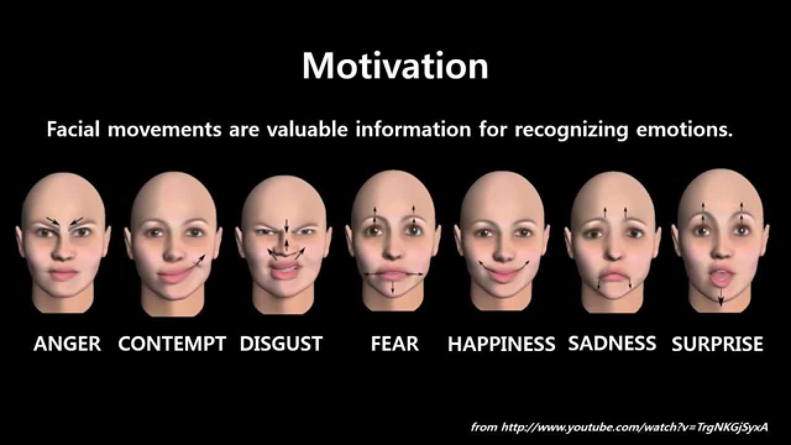
Approach Continue...
Define a CNN model approach from TensorFlow Keras for sequential data model.
The core of CNN is to create model for classification and detection followed by normalization, ReLu for activation function, pooling layers and add dropouts for learning purpose.

Slide 7
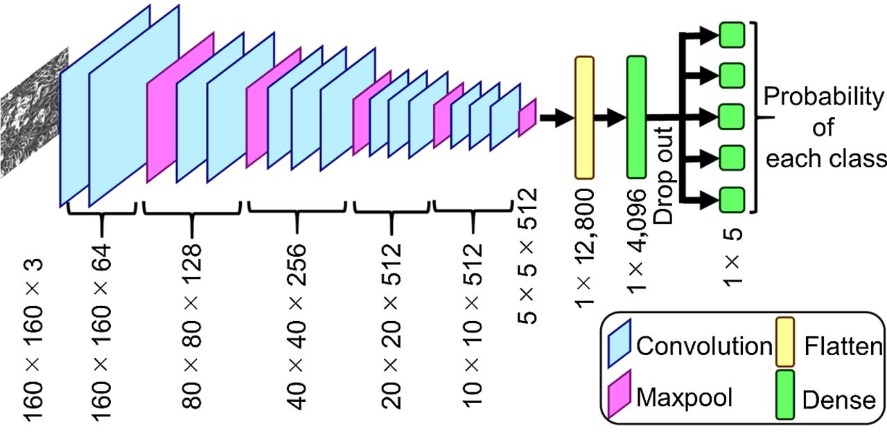
Working Of CNN Model

Slide 8
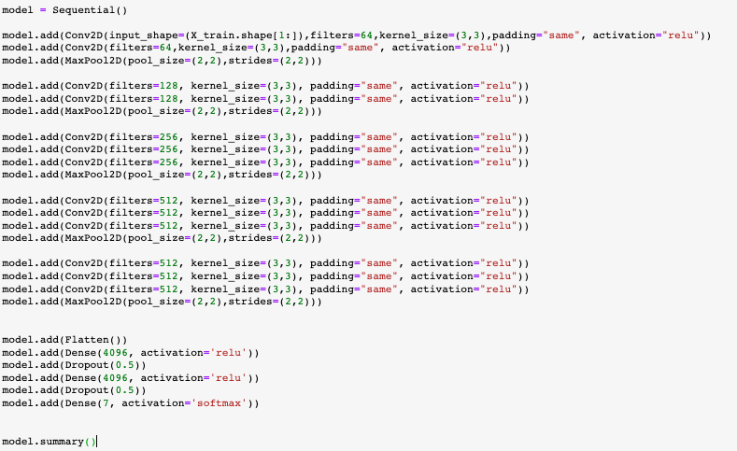
CNN Sequential Model

Slide 9
CNN Model and Adam- Implementation
Few parameters for CNN Model and Adam(activation function):
Learning rate(alpha): how fast the agent picks up new information vs. how long the agent remembers previous information
Loss factor/Decay rate: to assist our agent in deciding loss we use categorical cross-entropy.
Metrics: Metrics as accuracy to monitor the accuracy of the model.
We fit the data for validation and training purpose with batch size as 32 and iteration as 30.
This will allow our agent to remember which action is performed in each state, so that the next time he experiences the same state, it will perform the same action and try to improve the overall action.

Slide 10
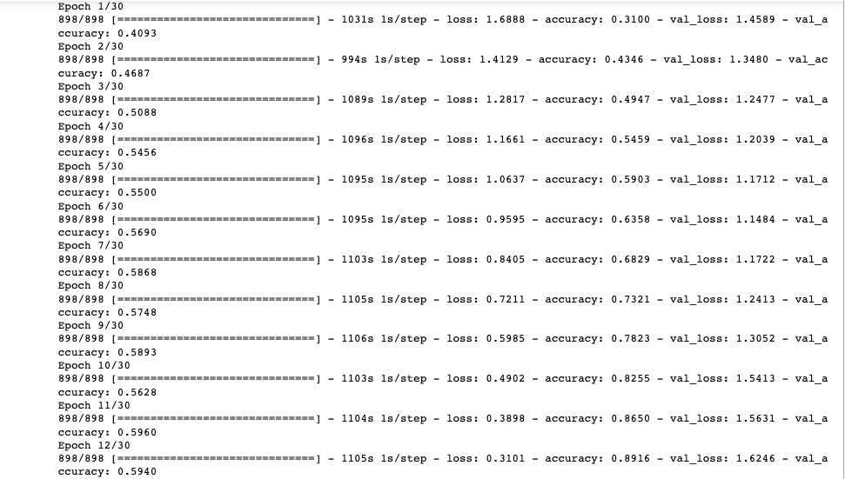
Implementation Iteration Images of Compile

Slide 11
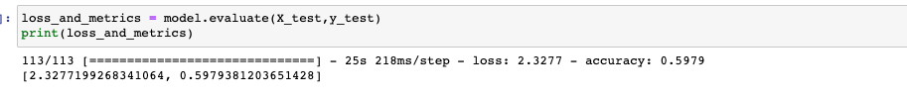
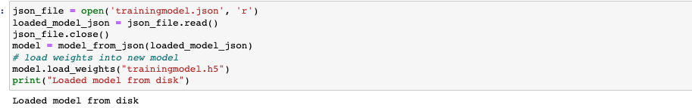
Implementation Continue...
We will be serialize the model to JSON and save the model's weights in a hd5 file.
This is the learning part of our model.
We also evaluate the loss and metric of the model.
Now we use the model for facial recognition such that the same model process doesn’t need to be repeated.

Slide 12
Evaluation And Result
We did 30 iteration to our dataset:
So after each iteration the accuracy improved and our model was create to analyze images
So after the model as save we just called the model and use it for prediction of the image given to it.

Slide 13
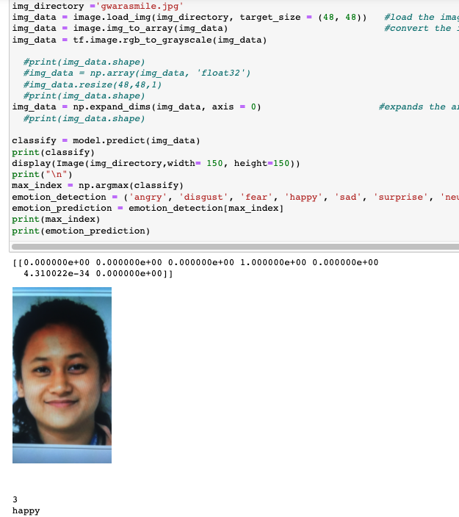
Result

Slide 14
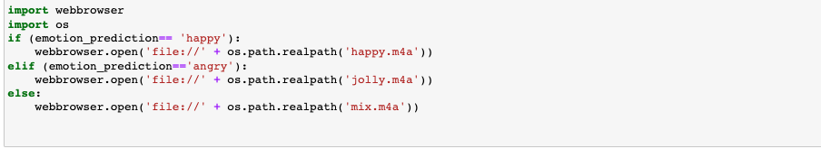
Result ..
Now we play song according to the facial recognition predicted

Slide 15
Conclusion
The system were initially not categorized properly as it was still learning.
However, after a while, the model began to iterate, and it began learning.
Learned how to build CNN model to predict song according to facial expression.

Slide 16
References
https://journals.plos.org/plosone/article?id=10.1371/journal.pone.0242269
https://towardsdatascience.com/face-recognition-for-beginners-a7a9bd5eb5c2
https://www.kaggle.com/msambare/fer2013

Slide 17
THANK YOU!!!

