Slide 1

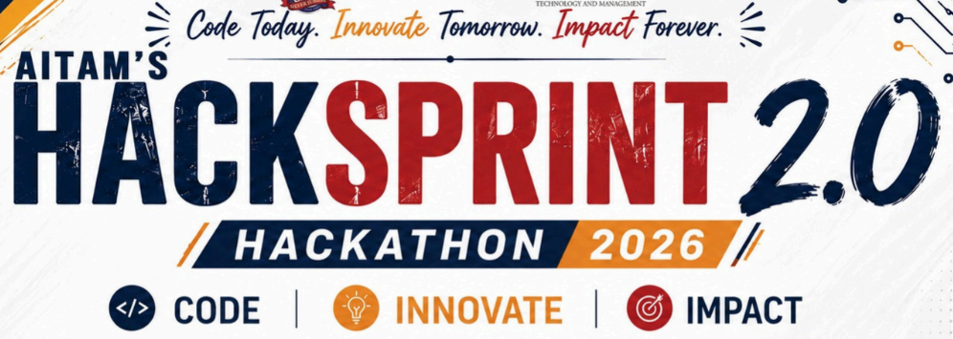
SETU
“A bridge between the seen and the unseen”
Offline AI Assistive Technology for Persons with Visual Impairment
Problem Statement #4
TEAM 31 • GRYFFINDOR
B. Dhanush
K. Siva Prasad
B. Dhanaraju
M. M. Ravi Teja Reddy
RGUKT Srikakulam
Rajiv Gandhi University of Knowledge Technologies

Slide 2
Introduction / Abstract
The Problem
India has 4.95 crore people with vision impairment — the largest such population in the world. Everyday tasks that sighted people never think about are daily obstacles: identifying a currency note, reading a signboard or medicine label, or knowing an obstacle is in the path ahead.
Existing assistive apps depend on the cloud. That makes them unusable exactly where they are needed most — rural areas, transit, low-connectivity environments — while sending a blind user's camera feed to a remote server.
100%
Offline — no cloud, no data leaves the device
5
Assistive modes in one voice-first interface
Our Solution
SETU (Sanskrit: “bridge”) is a voice-first assistive assistant that runs 100% on-device. Five capabilities — currency recognition, scene description, text reading, visual Q&A and proximity alerts — are invoked by a single spoken word and answered aloud, with no internet connection at any point.
0.3s
Currency scan, warm

Slide 3
Objectives
Six goals, each mapped to a measurable outcome in the working build.
01
Work fully offline
Every model runs on-device. No API keys, no network calls, no user data leaving the machine.
02
Make money identifiable
Detect Indian denominations and speak the total, so cash handling needs no second person.
03
Describe the world on request
Turn the live camera into a spoken description of the scene in front of the user.
04
Read printed text aloud
Extract text from signs, labels and documents, then summarise it in plain speech.
05
Warn before collision
Flag large hazards close in the walking path with graded voice and haptic alerts.
06
Be usable without sight
Voice-first control end to end — no menu, no button hunting, no screen dependency.

Slide 4
Proposed Solution
One wake word per capability. Speak it, point the camera, hear the answer.
“currency”
Currency Recognition
Custom YOLO detects each note and speaks the denominations and running total.
0.3 s
“describe”
Scene Description
Gemma 3 vision model narrates what is in front of the user in one short sentence.
1.5 s
“read”
Text & Signboard Reading
RapidOCR extracts the text, then Gemma summarises it in plain spoken language.
4.3 s
“question”
Visual Question Answering
Speech transcribed on-device by Whisper, answered against the live camera view.
~6 s
“detect”
Proximity / Obstacle Alert
YOLO flags large hazards close ahead and grades them as Careful or Stop.
0.03 s
Two-tier architecture
TIER 1 — fast & deterministic
Currency YOLO · YOLO11n · RapidOCR — milliseconds, confidence-gated
TIER 2 — open-ended reasoning
Gemma 3 4B · faster-whisper · Piper TTS — local Ollama, no network

Slide 5
Methodology
How a single spoken word becomes a spoken answer.
1
Listen
Browser speech recognition matches one of five command words continuously, with no cloud round-trip for the wake word.
2
Capture
The command mints an epoch token and grabs a frame — 1600 px for text and detail work, 640 px for fast object detection.
3
Route
The request goes to the matching Tier-1 model, or to Gemma when the task needs open-ended reasoning.
4
Verify
Confidence floors and a Gemma gate reject uncertain reads instead of guessing — abstaining is preferred to being wrong.
5
Speak
The answer is synthesised locally and played back; the epoch token discards any result the user has already superseded.

Slide 6
Implementation
A working system, not a prototype — every mode below runs today on a MacBook Air.
Engineering Highlights
Technology Stack
Custom-trained currency model
YOLO fine-tuned on 1,917 training and 472 validation images across 10 Indian denominations, old and new variants.
Gemma 3 4B
Vision + language · 3.3 GB · Ollama
Gemma-gated currency pipeline
The detector has no negative class, so Gemma first answers a yes/no “is currency present” before YOLO is trusted.
YOLO (custom)
Currency · 10 classes · 5.5 MB
YOLO11n
Objects · COCO · 5.6 MB
Resolution-aware capture
OCR receives 1600 px frames, object detection 640 px. Reading text at 640 px produced unusable output in testing.
RapidOCR
ONNX PaddleOCR · 15 MB
Race-free voice state machine
An epoch token cancels superseded work, so a second command can never be clobbered by a stale in-flight response.
faster-whisper
Speech-to-text · 141 MB
Honest failure paths
Low OCR confidence, silent audio and unreachable models each degrade to a spoken message — never a silent drop.
FastAPI + Vanilla JS
REST server · no build step
Privacy by architecture: 2,946 lines of code, 5 assistive modes, 0 cloud API calls — the camera feed never leaves the device.

Slide 7
Results and Analysis
Measured on a MacBook Air (Apple M4, 16 GB) — median of 3 runs, models warm. First call after idle adds ~4 s while Ollama reloads Gemma.
0.03 s
Proximity scan
0.30 s
Currency scan
0.96
OCR confidence
2,750
Multi-note total, correct
What testing changed
OCR engine swap
Tesseract read 37 garbage characters at 0.15 confidence on a 640 px frame; RapidOCR read 1,398 usable characters at 0.68. RapidOCR ships.
Vision model choice
Moondream answered in ~1 s but hallucinated. Qwen2.5-VL 7B took 51 s. Gemma 3 4B was the only one both accurate and fast.
False-positive guard
The currency model labelled a photo of people as “100 rupees” at 0.98 confidence — which is why Gemma now gates every currency read.
Problem Statement #4 — feature coverage
✓ Object detection
✓ Text / signboard
✓ Currency
✓ Text-to-speech
✓ Speech-to-text
✓ Obstacle detection
✓ Navigation assist
7 of 10 PS-4 features delivered and demonstrable — sound alerts, educational content and SOS are scoped, not started.

Slide 8
Conclusion and Future Scope
Conclusion
Future Scope
SETU shows that genuinely useful assistive AI does not require the cloud. Five capabilities that normally each need a separate app — and an internet connection — run together on one laptop, answered by voice in about a second.
The engineering that mattered was not model size but honesty: knowing when the system is unsure. Confidence floors, a Gemma verification gate and graded alerts mean SETU abstains rather than misleads — the right default when a user cannot check the answer themselves.
Android / iOS deployment
Port the pipeline to on-device mobile runtimes so SETU runs on the phone already in the user's pocket.
Indian language support
Whisper and Piper both support multilingual models — Telugu, Hindi and Tamil are the priority.
Environmental sound alerts
Audio event classification for horns, alarms and approaching vehicles, completing PS-4 coverage.
Why offline matters
4.95 crore Indians live with vision impairment, many in the low-connectivity areas where cloud assistive apps fail. An offline tool works on a village road, a hospital basement, a moving train — and never uploads a blind user's home, documents or money.
Offline emergency SOS
Location-tagged distress messaging that degrades to SMS when there is no data connection.
Monocular depth estimation
Replace the area-fraction heuristic with true depth for more accurate distance judgement.

Slide 9
References
1
Gemma 3 Technical Report
Google DeepMind, 2025. Vision-language model used for scene description, visual Q&A and currency verification.
2
YOLO11 / Ultralytics
Jocher, G. et al., 2024. Detection backbone for proximity alerts and the custom currency detector.
3
PP-OCR / RapidOCR
Du, Y. et al. PP-OCR: A Practical Ultra Lightweight OCR System, 2020. ONNX build used for text and signboard recognition.
4
Robust Speech Recognition via Large-Scale Weak Supervision
Radford, A. et al., OpenAI, 2022. Whisper architecture, deployed as faster-whisper for on-device speech-to-text.
5
Piper Text-to-Speech
Rhasspy Project, 2023. Local neural speech synthesis used for all spoken output.
6
National Blindness and Visual Impairment Survey
Ministry of Health and Family Welfare, Government of India. Source of the 4.95 crore prevalence figure.
7
Web Speech API Specification
W3C Community Group Report. Used for on-device wake-word matching in the browser client.

Slide 10
Thank You
Questions are welcome — we are happy to run a live demo.
SETU • Team 31 Gryffindor
RGUKT Srikakulam
B. Dhanush • K. Siva Prasad • B. Dhanaraju • M. M. Ravi Teja Reddy

