Slide 1
A Comparative Study of Binary Sentiment Analysis on IMDB and SST-2
NLP Course Project: From Classical Baselines to Transformer Architectures
Team Members (Gr. 341 & 331):
Cuclea Luca-Nicoale
Rizea Mihai-Marius
Dilmac Cemil-Andrei
Popa Petru

Slide 2
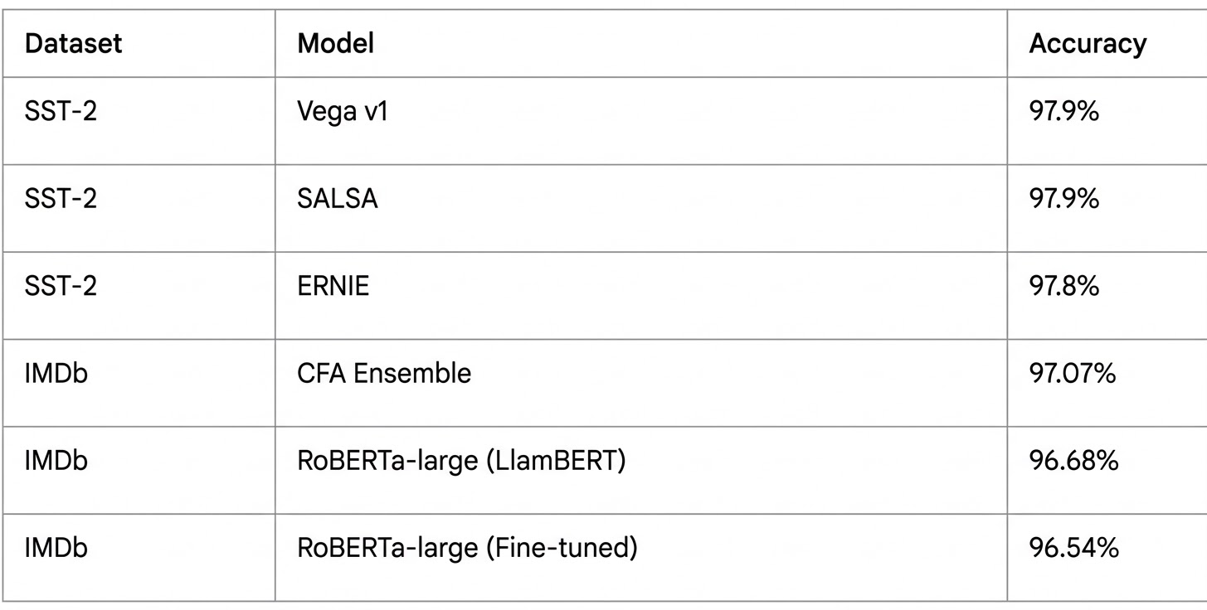
The SOTA Landscape
SST-2: large-scale Transformer encoders (Vega v1, Turing ULR v6)
IMDB: hybrid models (RoBERTa + SVM, XGBoost or LLMs)

Slide 3
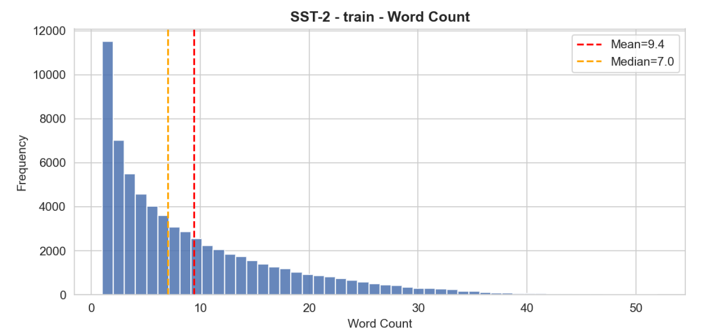
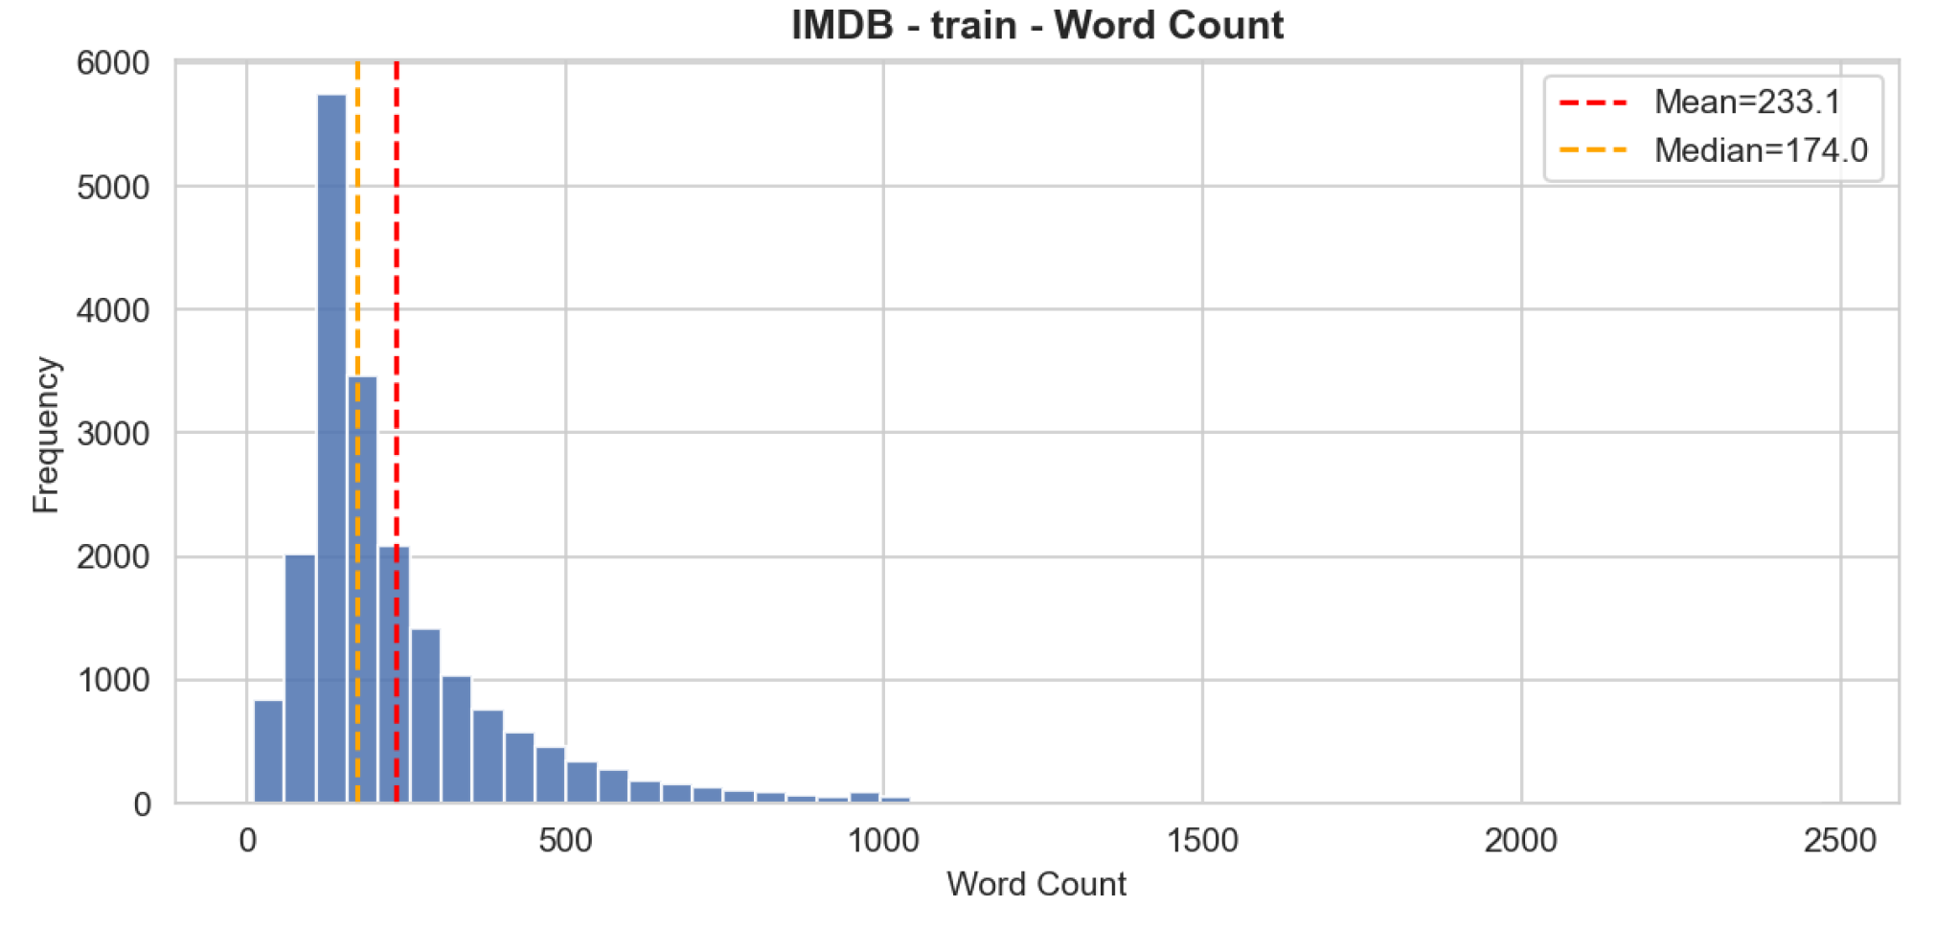
Datasets & Preprocessing
Scale Contrast:
short snippets (9.4 words avg) in SST-2
document-level reviews (233 words avg) in IMDB
Light Cleanup:
HTML removal
contraction expansion ("don't" -> "do not")

Slide 4
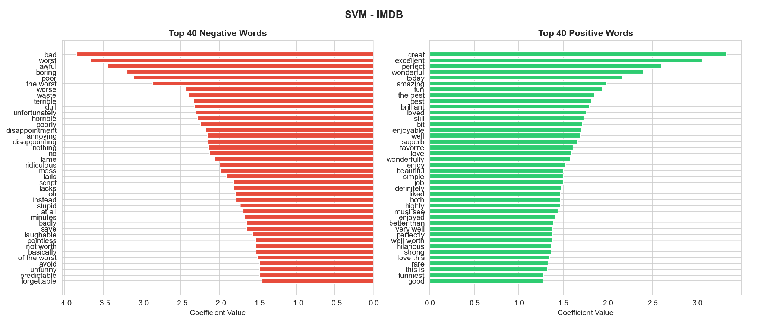
TF-IDF
Weighted Discrimination: prioritizes specific, informative words over raw frequency
Performance: 0.9148 acc and 0.970 AUC on IMDB validation
Capture of Phrases: Uses n-grams (1–3) to identify multi-word sentiment cues like "must see", "well worth", and "not worth"

Slide 5
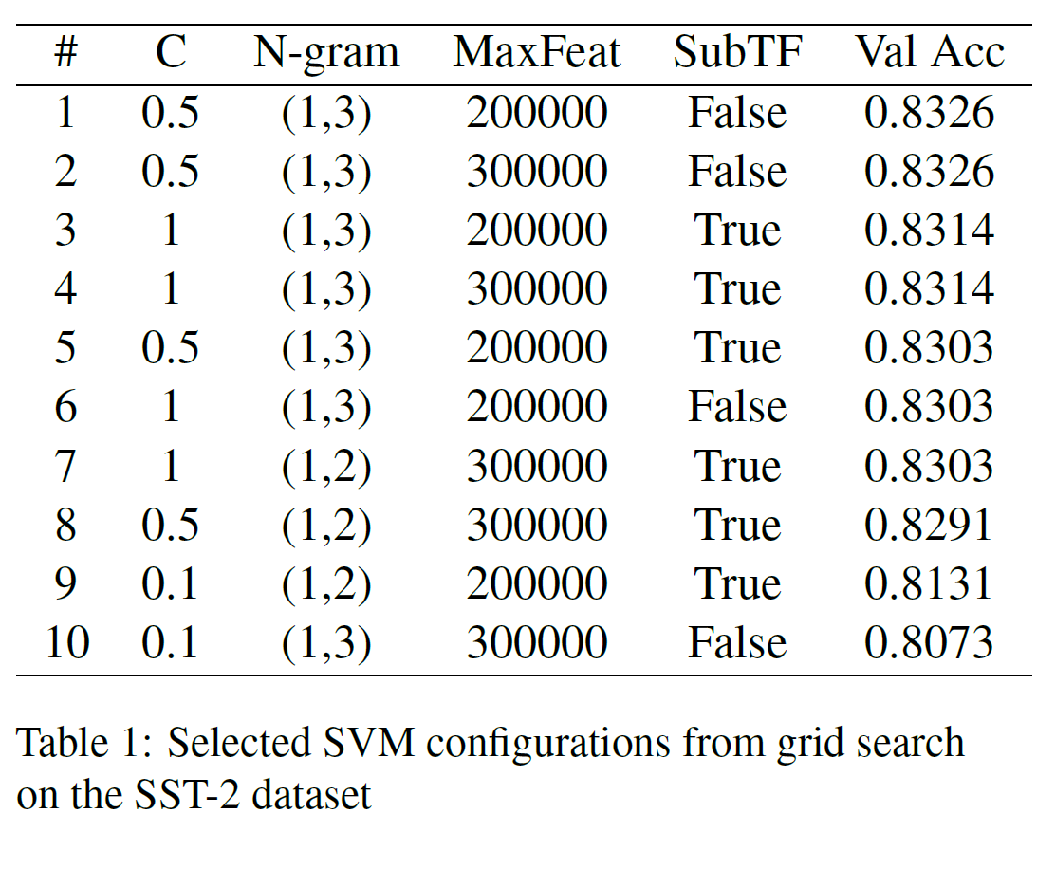
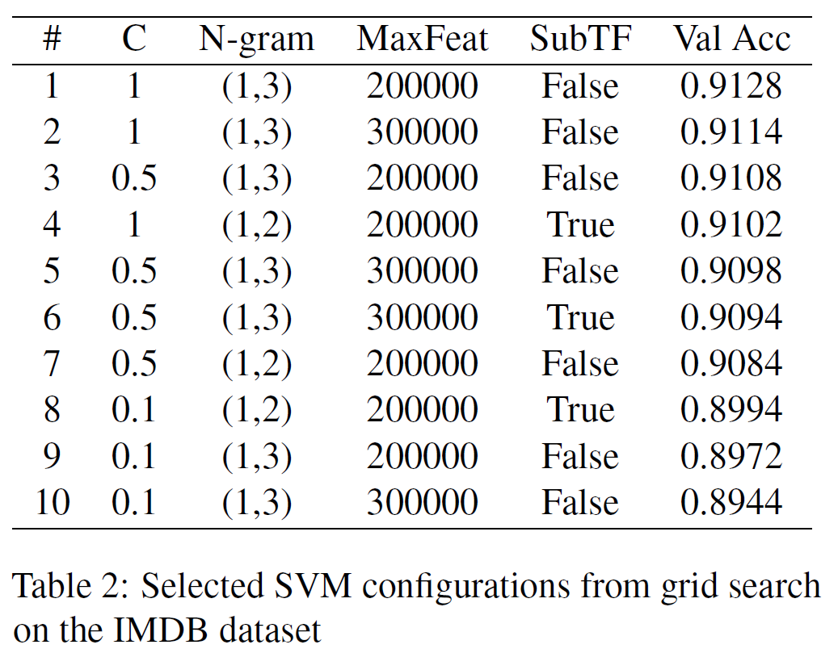
Classical Baselines
Linear SVM
Efficiency: fast and lightweight baselines, able to run on standard hardware without a GPU
High-Dimensional Scalability: handled TF-IDF matrices with up to 200,000 features through margin-maximizing approaches
Performance: 83.7% acc on SST-2 and 90.1% on the IMDB test set

Slide 6
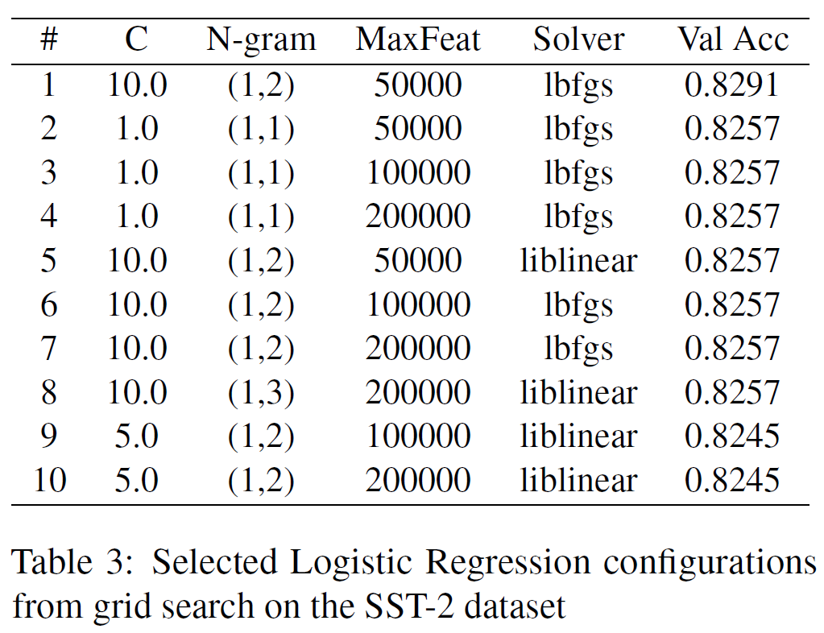
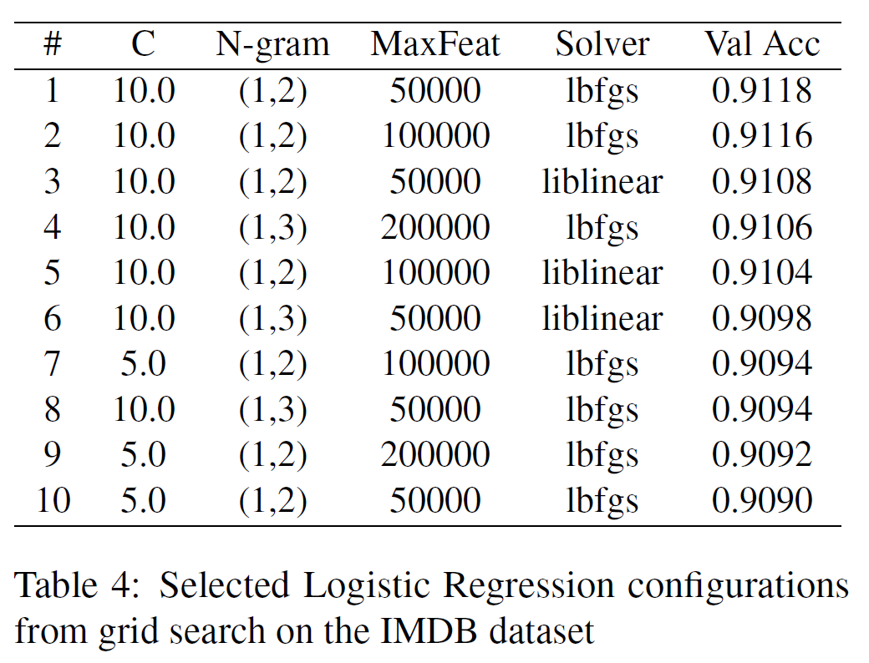
Classical Baselines
Logistic Regression
Efficiency: fast and lightweight baselines, able to run on standard hardware without a GPU
High-Dimensional Scalability: handled TF-IDF matrices with up to 200,000 features using L2-regularized logistic loss optimization
Performance: 83.4% acc on SST-2 and 90.9% on the IMDB test set

Slide 7
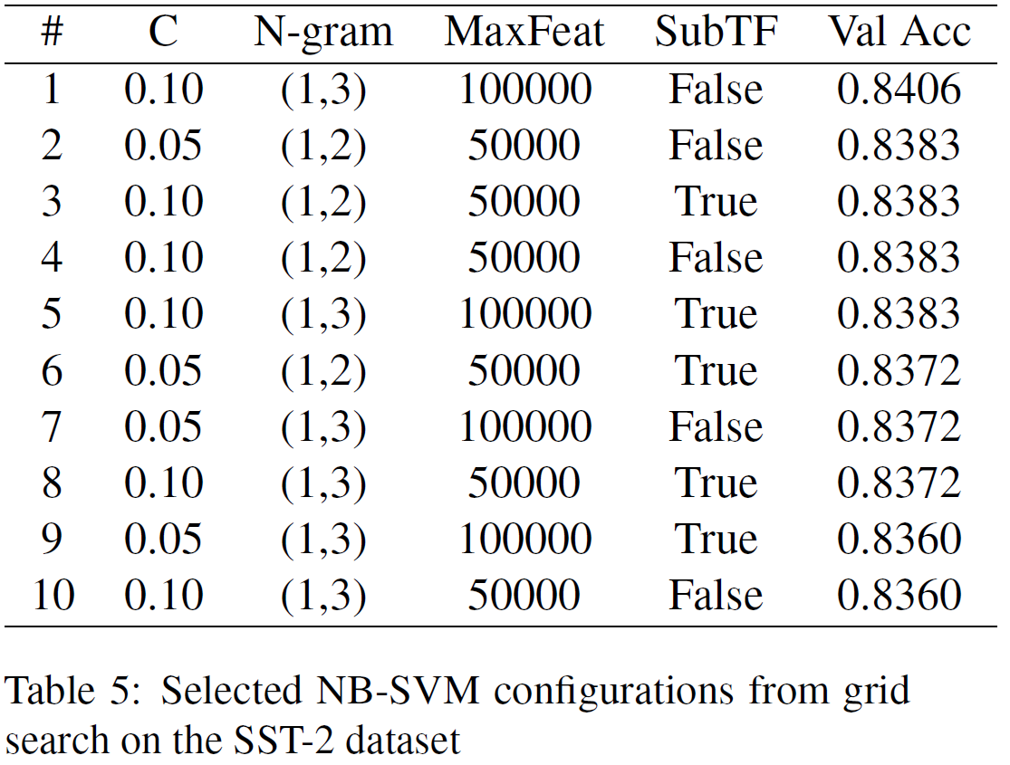
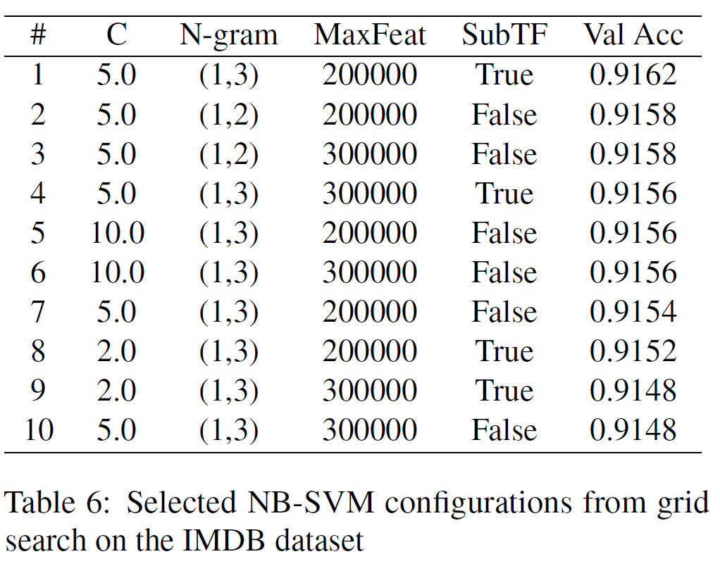
Hybrid Innovation
Naive Bayes + SVM
The Best of Both Worlds: generative power (Naive Bayes) + discriminative logic (SVM)
Log-Count Ratios: features are re-weighted based on how strongly they associate with a specific class, providing a cleaner signal for the SVM
Performance: 84% acc on SST-2 and 91.6% on IMDB (highest accuracy among all traditional methods on SST-2)

Slide 8
The Wall (Linguistic Messiness)
Contextual Blindness: Models fail when sentiment pivots mid-sentence through contrastive markers like "Instead" or "Unfortunately": “Comanche Moon had everything going for it. . . high-quality TV westerns. Unfortunately, the problems with ‘Moon’. . . ”
Poor aggregation of sentence-level sentiment: Model fails to aggregate general sentiment when encountering both positive and negative words in pretty equal amounts: “To summarize this movie: nice for TV but too small for the theatre. I enjoyed watching this movie at home but I wont watch it a second time. The concept is good, but ...”
Plot vs. Opinion: Descriptive words ("creepy teenager" or "bad things") are often misidentified as negative reviews of the movie’s quality rather than just plot summaries: “A depressed creepy teenager does many bad things. . .”
Irony and Mixed Signals: Phrases like "guilty pleasure" confuse word-counters because they focus on negative individual words ("bad", "tacky") while missing the positive overall framing: “That’s a bad, raunchy, pre- dictable, tacky, salacious soap opera. . . ‘The Best of Everything’ is just such a guilty pleasure for me”

Slide 9
The Sequential Shift LSTM
Order Matters: LSTMs use a hidden state and gating mechanisms to process text sequentially, allowing the model to "remember" earlier words and understand word order
Performance: 86% acc on SST-2 and 90% on IMDB
SST-2 Success: the sequences are short enough to capture local syntactic nuances without losing context
IMDB Struggle: Showed no improvement over classical models; the sentiment signal becomes diluted over hundreds of words, making keyword-driven SVMs just as effective

Slide 10
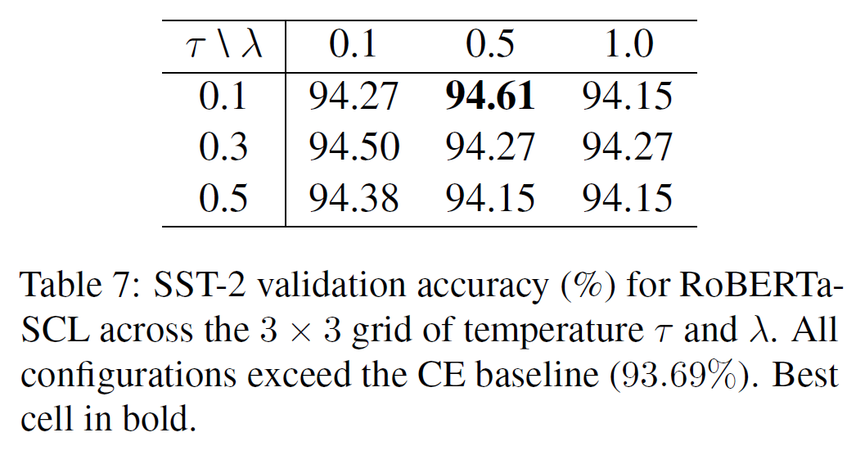
The Context Era (Transformers)
RoBERTa & RoBERTa + SCL
Deep Bidirectional Attention: Unlike LSTMs, RoBERTa doesn't just read left-to-right; it analyzes how each word is reinforced or contradicted by its entire surroundings
Context over Frequency: This architecture solves "The Wall" by understanding that a word like "bad" changes meaning when followed by "guilty pleasure"
SCL: pulls same-sentiment reviews into tight, distinct clusters in the vector space
Performance: 95.5% acc on SST-2 and 94.6% on IMDB

Slide 11
RoBERTa vs SVM improvements
Examples of texts SVM got wrong and SCL got right
Lexicon-poor — no polarity words, verdict implied by framing: "While the design and locations and photography are strong assets in this film […] The case is the use of the soundtrack music: a mix of Gustav Mahler and Andrew Lloyd-Webber that plays constantly and loudly [...]"
Double negation — surface words signal opposite of verdict: “Seeing that this movie was on the IMDB Bottom 20, I simply had to rent it. SUPRISE! SUPRISE! I have no regret of seeing this movie at all. In fact, I really enjoyed it... Rent it for a laugh that seems unintended but is actually meant to be funny. Wynorski is a genius.”
Contrast structure — positive start, negative verdict: "This one started excellently. The photography and audio are the best I've experienced in years... Now for the minuses. The screenplay was awful. Lopez's part turned out to be irrelevant or totally worthless to the plot..."
Cultural/rhetorical framing — no explicit sentiment, verdict implicit: "You cannot be seeing the same movie if you didn't grow up in France... You cannot translate its kind of fun — every name is a joke (how many people outside Paris would understand the pun in 'Couloirdebus'?).However Monica Bellucci is so beautiful, I almost forgot to breathe when I saw her."
Sarcasm / ironic praise: "The only negative I had is I felt like I wasted money on my Popcorn and Icee, there was no way I could eat or drink anything during this movie I was constantly laughing."

Slide 12
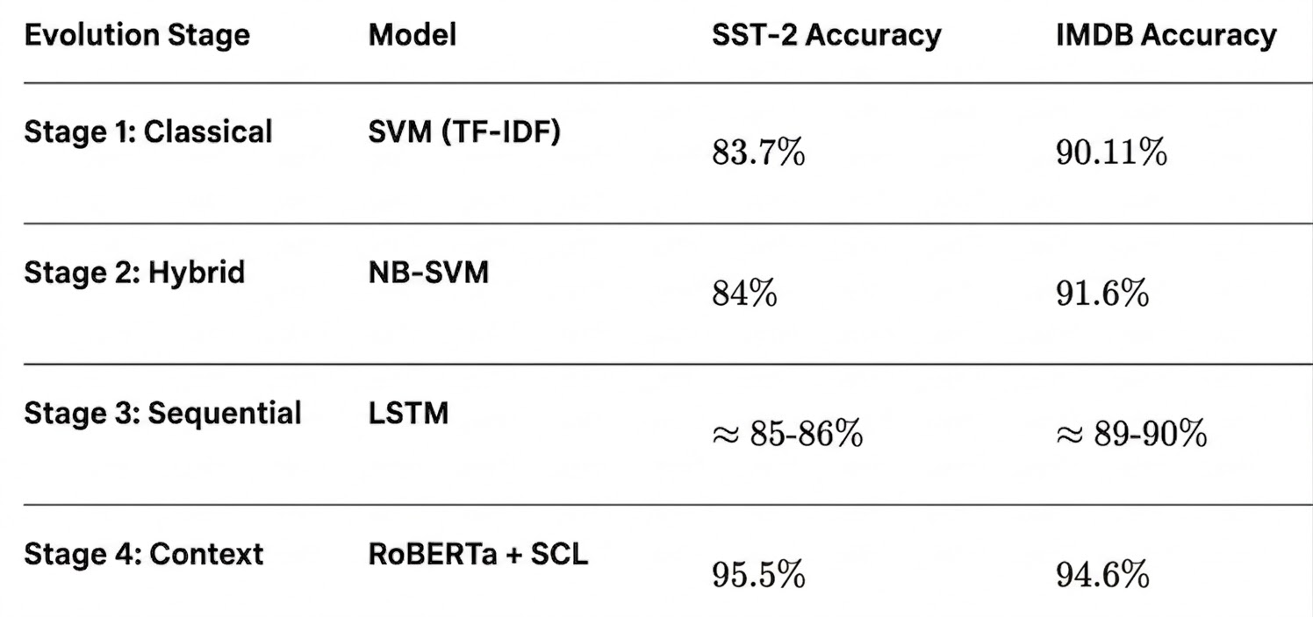
Quantitative Results
Breaking the Ceiling: RoBERTa+SCL successfully broke the 90% accuracy barrier on IMDB and pushed SST-2 past 94%
The Performance Gap: On IMDB, the transition from SVM to RoBERTa+SCL resulted in a +3.79% jump—meaning 949 fewer misclassifications on the test set
SCL Consistency: Every SCL configuration outperformed the standard cross-entropy baseline on SST-2

Slide 13
Limitations
Computational resources: classical and hybrid models were lightweight and could run on standard laptops, while Transformer-based models required stronger hardware, longer training times and a rented high-memory GPU.
Hardware dependency: for BERT and RoBERTa, we rented an NVIDIA RTX 5090 GPU with 32 GB of memory, especially because fine-tuning on larger datasets such as IMDB was more demanding.
Higher training complexity: RoBERTa with supervised contrastive learning was more expensive to train because it optimized both classification loss and contrastive loss.
Limited task scope: the study focused only on English binary sentiment analysis using IMDB and SST-2.
Generalization limits: results may not directly transfer to other languages, multilingual datasets or multi-class sentiment tasks.

Slide 14
Ethical Statement
Profiling risk: sentiment analysis can be used to build behavioral profiles based on online texts, even without explicit consent.
Surveillance concerns: if used by institutions, automatic classification could monitor citizens, detect criticism or label people as problematic.
Misclassification impact: sarcasm, jokes, anger or misunderstood opinions may be wrongly classified as dangerous, hostile or suspicious.
Decision-making limits: sentiment predictions should not be used as direct evidence or as the only basis for legal, administrative or security decisions.
Responsible use: in real-world applications, such systems should be transparent, limited in scope and supervised by humans. Outputs should be treated as uncertain predictions, not facts about a person.

Slide 15
Thank you for your time!

