Slide 1
CERCETARE CI / CD pipeline cu Jenkins Student: Coordonator științific: Eusebiu Rizescu S.I.dr.ing. Radu-Ioan Ciobanu

Slide 2
Context
Ce inseamna CI/CD?
CI – Continuous Integration
Fiecare commit declanseaza un build de aplicatie + teste
CD – Continuous Delivery
Schimbarile ajung in productie cu interventie manuala (apasare de buton)
CD – Continuous Deployment
Schimbarile ajung in productie complet automat

Slide 3
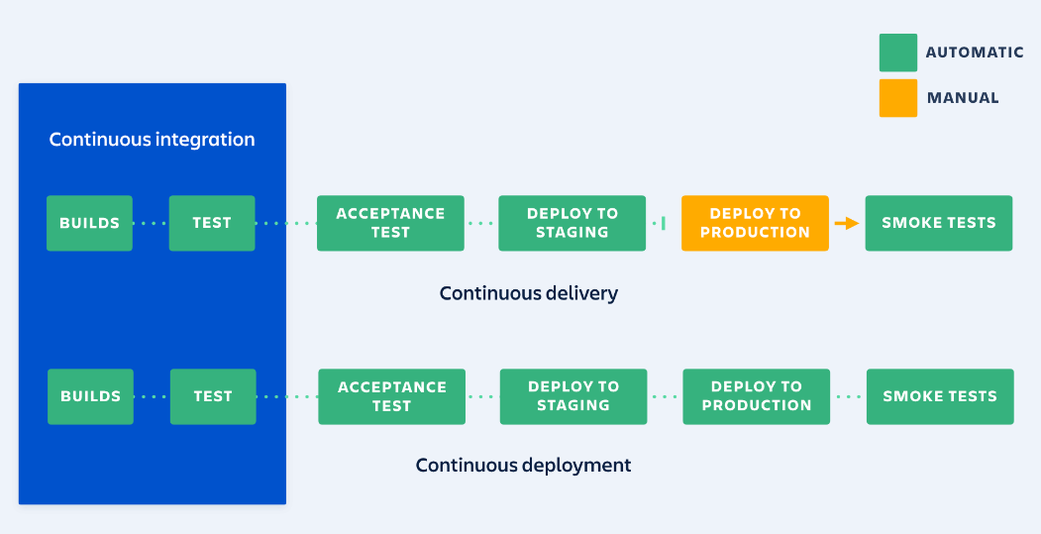
Diagrama

Slide 4
In ce va consta proiectul
Obligatorii:
Source Code Management:
GitLab, GitHub, Bitbucket
Build / Test / Deploy:
Jenkins, GitLab, Bamboo, Travis, CircleCI, TeamCity
Code Analysis:
Sonar, Checkmarx, Owasp
Extra:
Configuration Management:
Ansible, Puppet, Chef, Saltstack
Artifact Management:
Sonatype, Jfrog, Proget
User Management:
LDAP, AD
Issue Tracker:
Jira, GitLab, Taiga
Notifications:
Slack, Fleep, Ryver

