Slide 1
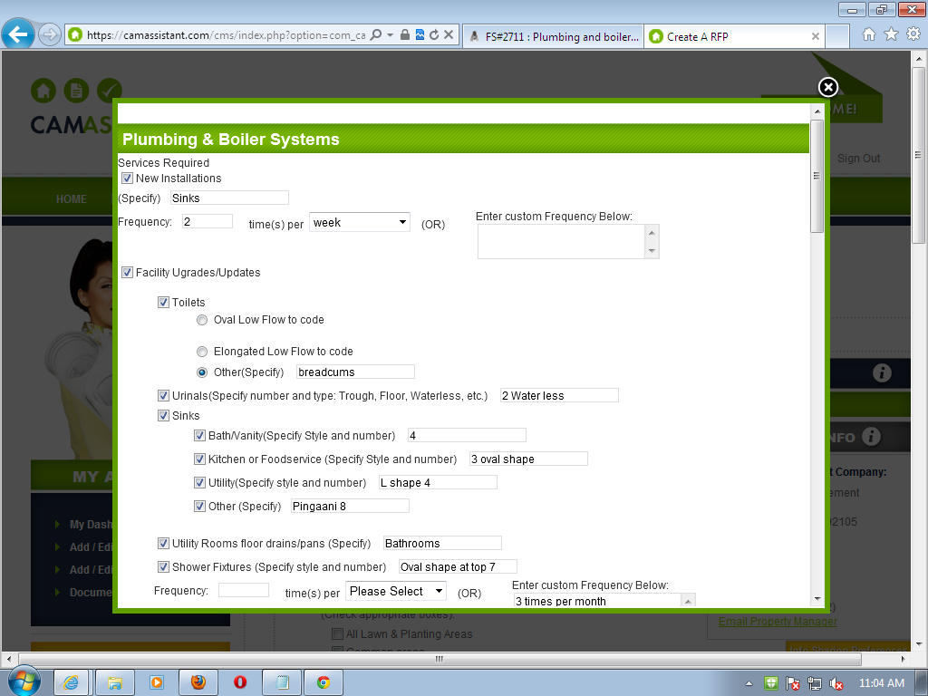

Slide 2
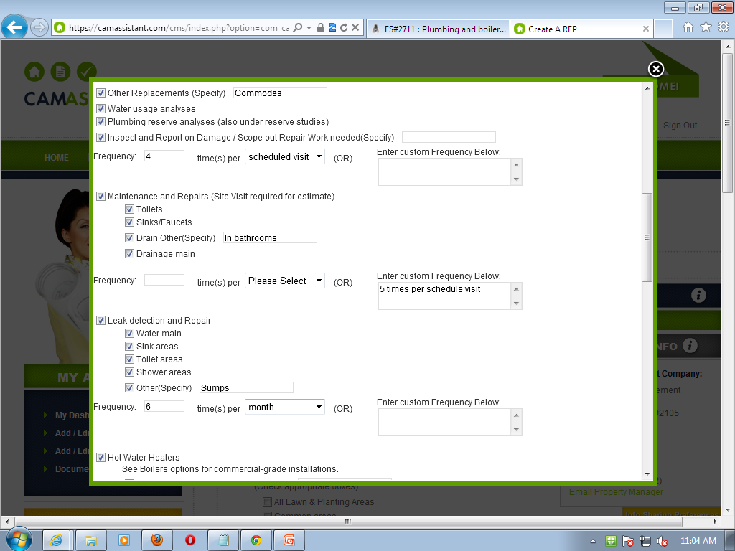
These options are not displayed
Entered data in box is not showing

Slide 3
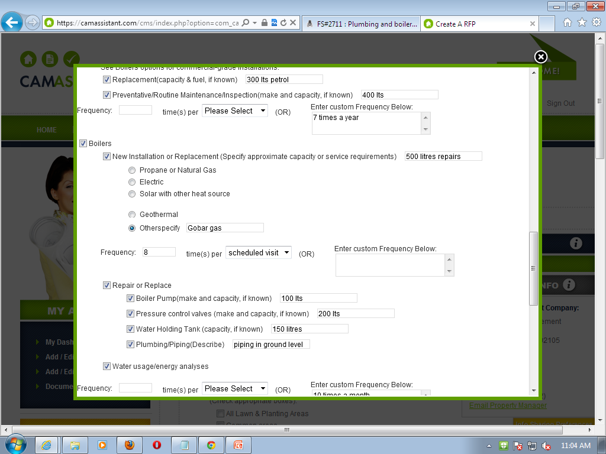
Displaying this option 2 times
Duplicate data

Slide 4
