Slide 1
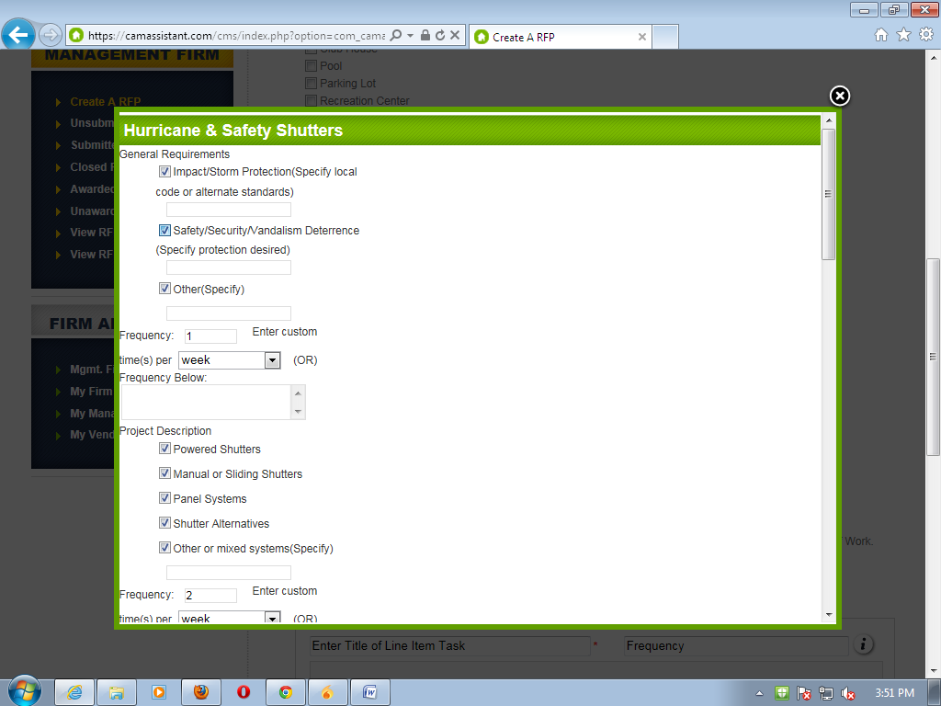
First line items are not displaying if data is not entered in boxes

Slide 2
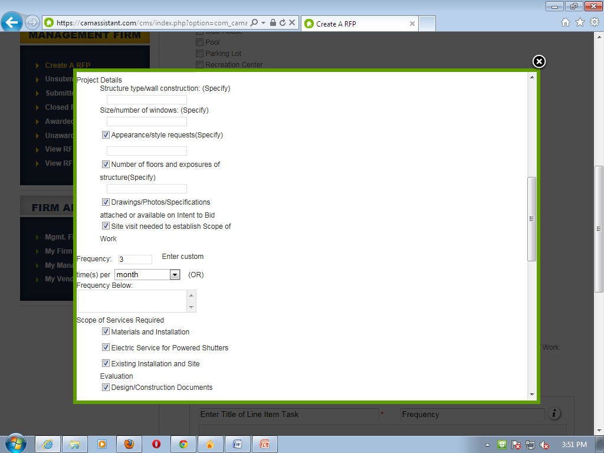
In project details the project description items are displayed

Slide 3
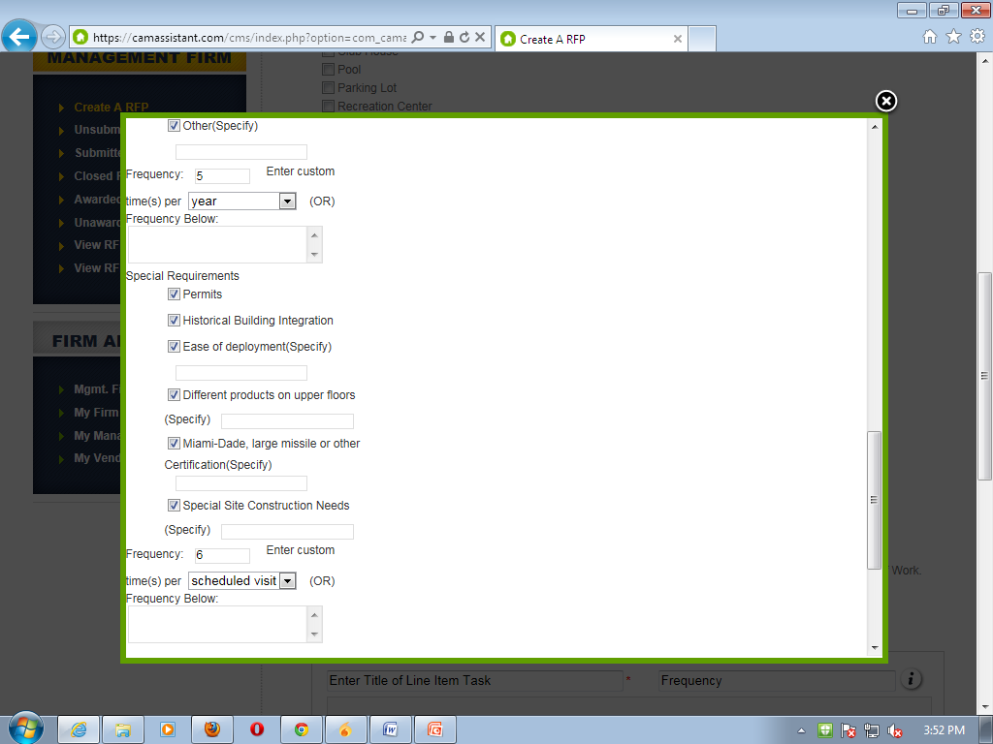
Full title not displaying

Slide 4
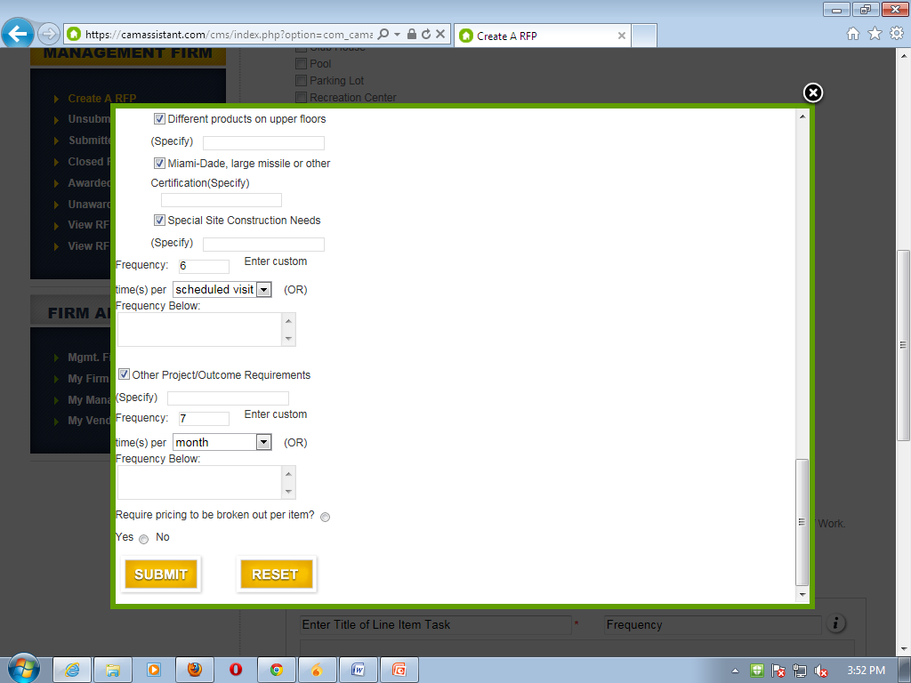

Slide 5
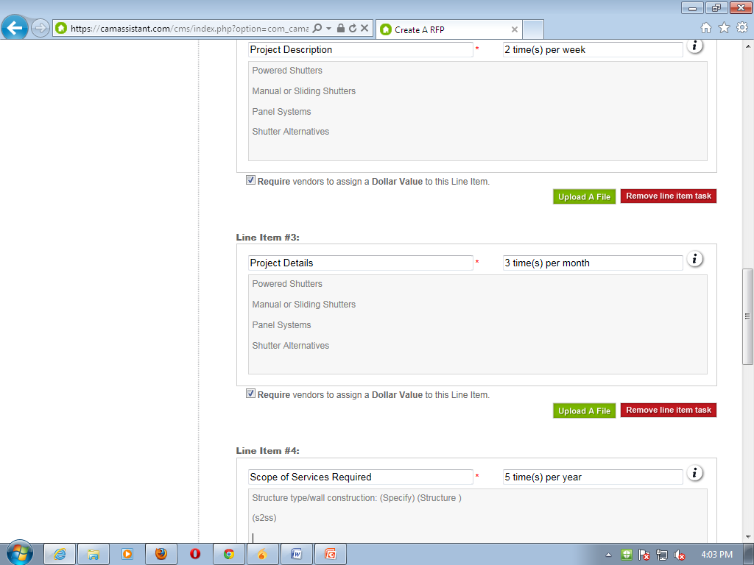
Having a same line items
Duplicate line items
No line items are displayed here

Slide 6
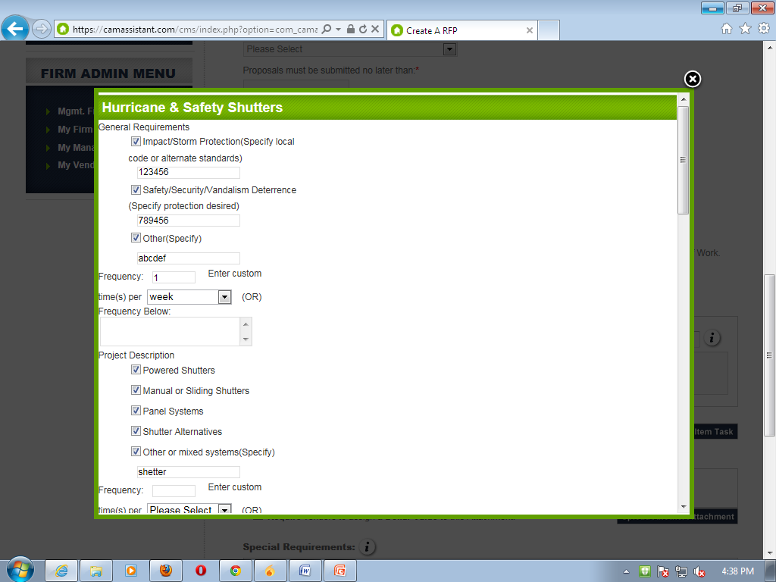
Design issues in IE

Slide 7
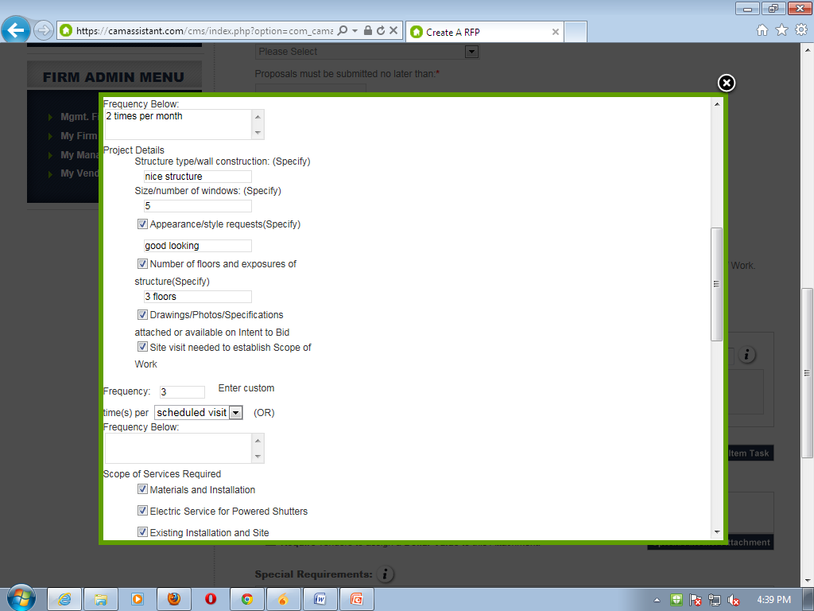
Entered data in box is not displaying
All line items are not displaying in scope of services required

Slide 8
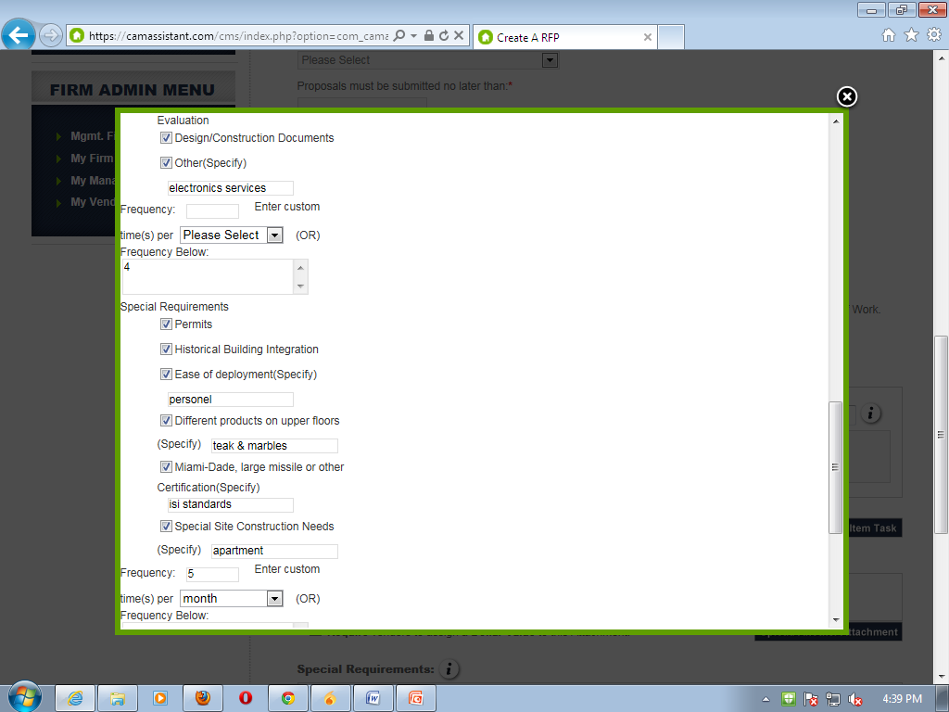

Slide 9
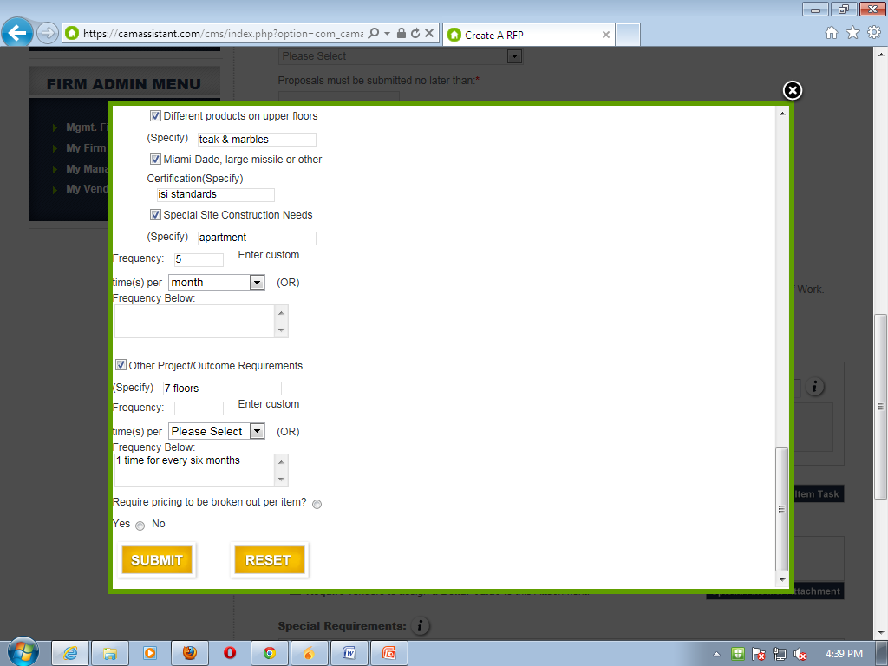

Slide 10
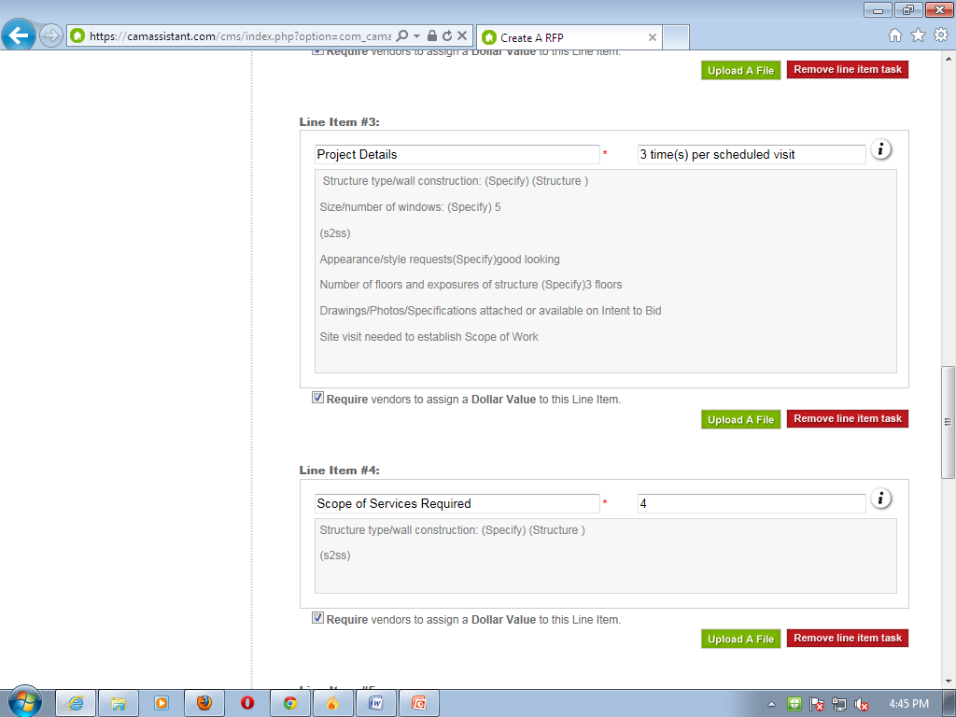
Entered data in box is not displaying
Remove junk data
Line items are displayed

