Slide 1
From channel charting to EMS configuration
AoA estimation and beam selection with few sweeps
M. Maleki, R. Aghazadeh Ayoubi, M. Mizmizi, U. Spagnolini | Politecnico di Milano | 24/10/26

Slide 2
From channel charting to EMS configuration
AoA estimation and beam selection with few sweeps
AoA estimation and beam selection with few sweeps
M. Maleki, R. Aghazadeh Ayoubi, M. Mizmizi, U. Spagnolini | Politecnico di Milano | 24/10/26

Slide 3
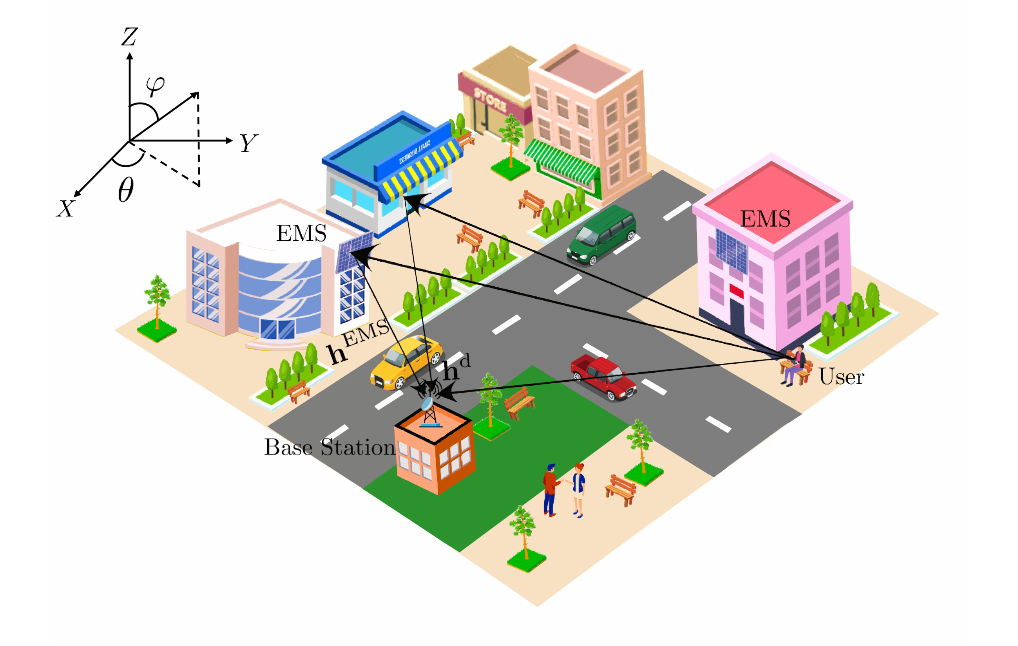
Smart radio environment: two EMSs help one base station
Our TWC paper: electromagnetic surfaces (EMSs) improve channel charting for localisation.
Scenario
30 GHz urban street, Sionna ray tracing; BS with 32 antennas.
Two passive EMSs (60x60 elements, lambda/2) on building walls; 3200 users on a grid.
A user reaches the BS directly (h^d) and through each EMS (h^EMS).
Channel charting
Each user: covariance of its uplink channel at the BS.
Log-Euclidean distance between covariances -> semi-supervised t-SNE (15% labelled anchors).
The chart places users so that similar channels are neighbours: with position labels it estimates where the user is.

Slide 4
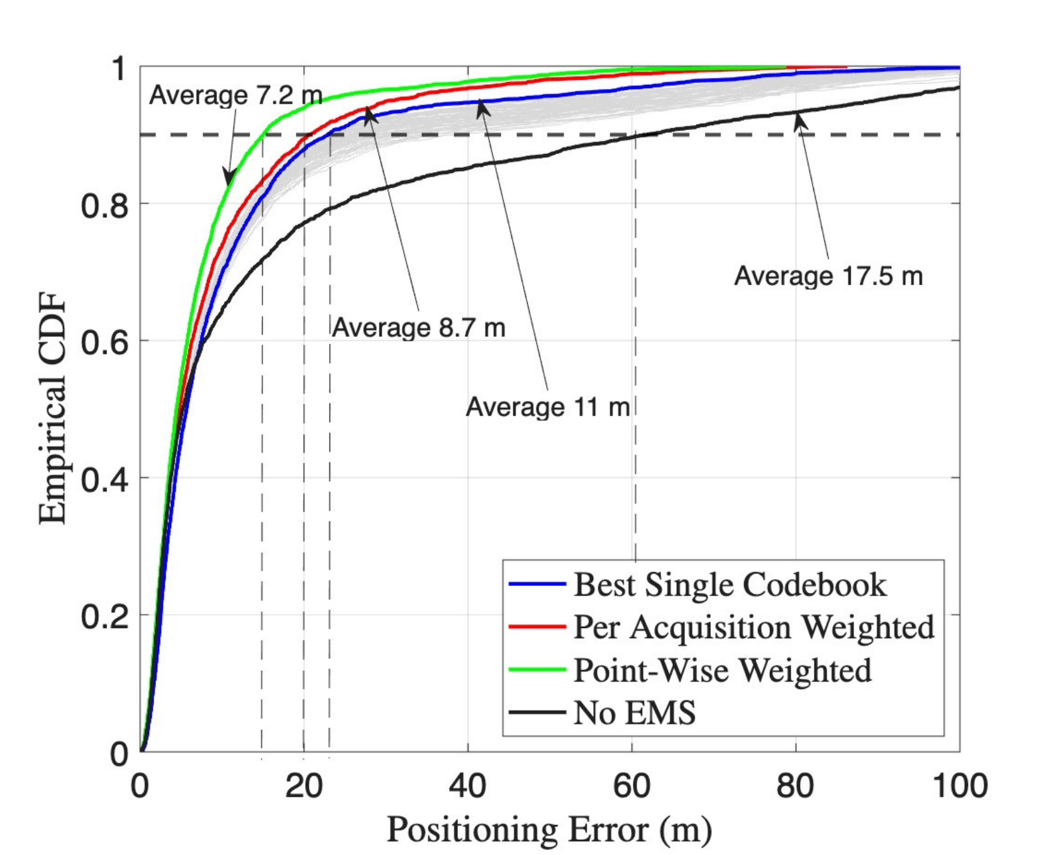
Paper result: EMS configurations make the chart more accurate
A few static EMS configurations (slots) give one chart each; fusing them per user halves the error.
Multi-slot acquisition
K static EMS phase profiles, one uplink acquisition each, no knowledge of the user needed.
One chart per configuration; per user, charts weighted by their quality (trustworthiness / continuity).
Positioning error (mean)
No EMS: 17.5 m -> best single configuration: 11 m
Per-acquisition weighting: 8.7 m -> point-wise weighting: 7.2 m
Message: the EMS shapes the radio map, and a few configurations are enough.

Slide 5
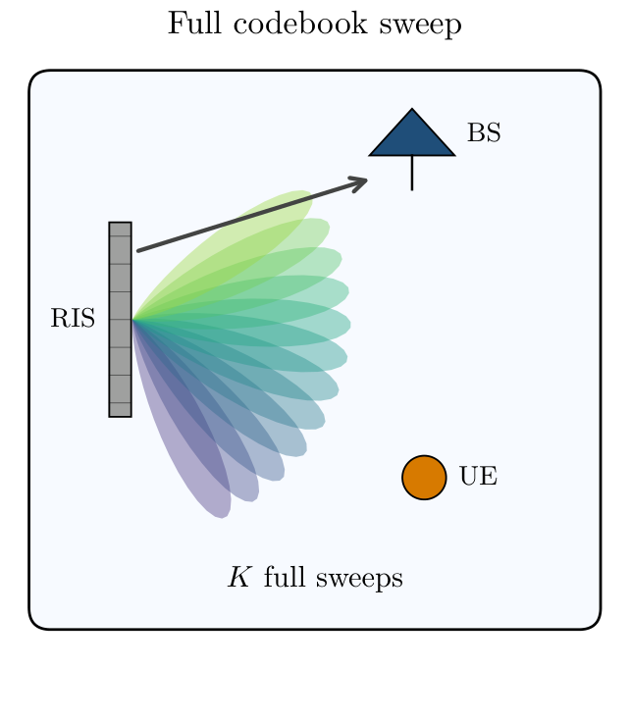
New goal: configure the EMS itself
To steer the EMS toward a user we need its direction; to learn the direction we must first illuminate it.
A reconfigurable surface needs a direction
The EMS (a RIS) reflects toward one direction per phase profile: a codebook of beams.
Best beam for a user = the one pointing at its angle of arrival (AoA) at the EMS, which is unknown.
The cost of finding it by search
Exhaustive sweep: try every beam, keep the strongest: 68 beams (60x60), 272 (240x240).
Guided searches (greedy, hierarchical) need fewer sweeps but still several per user.
Cyclic dilemma: steering needs the angle, measuring needs steering.

Slide 6
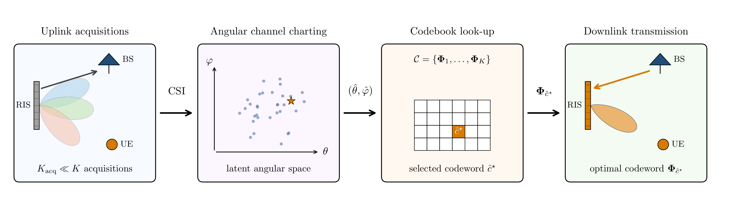
Proposed: channel charting of the angle, then a look-up table
The paper's static slots become training acquisitions; the chart learns the AoA instead of the position.
1 K training acquisitions
2 Angular chart
3 Look-up table
Static EMS configurations, as in the paper. Informed: chosen from the angular spread of the anchors.
Semi-supervised t-SNE labelled with the azimuth at the EMS; per user, the most trustworthy of the K charts.
Azimuth -> codeword through the steering law: the EMS serves the user without sweeping.

Slide 7
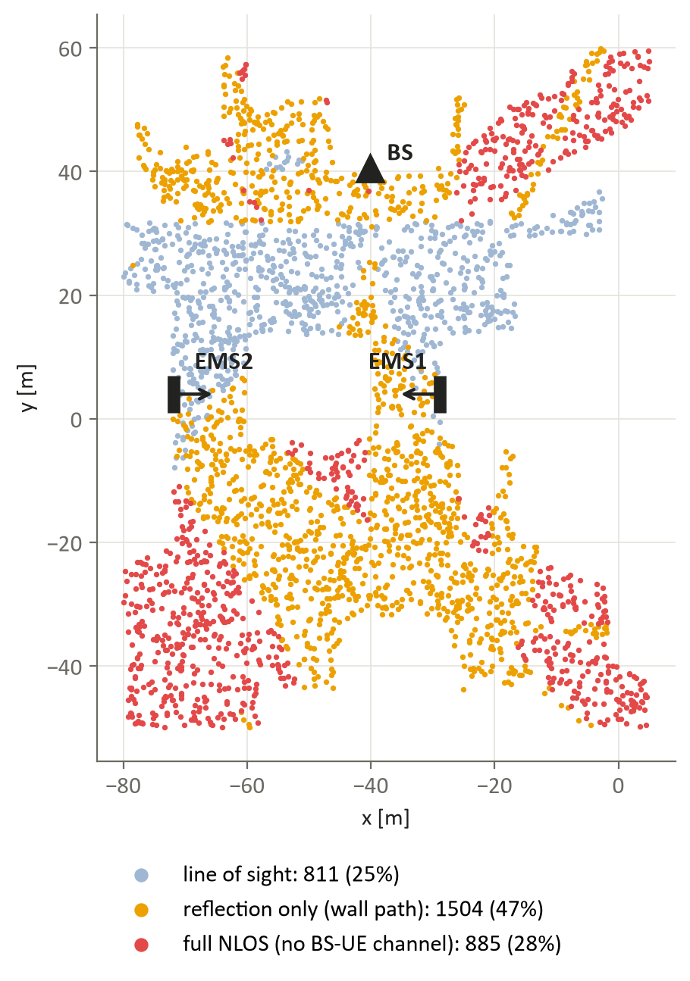
Who needs the EMS? The users in outage
Only users without a usable BS link gain from the EMS: in our scenario, 28% of the users.
Line of sight: 811 users (25%)
Strong direct link: the EMS is not needed.
Reflection only: 1504 users (47%)
A wall reflection reaches the BS, about 30 dB stronger than the best EMS path: the EMS adds less than 0.01 dB.
Full NLOS: 885 users (28%) -> our target
No BS-UE channel at all: the EMS is their only link. All results below are for these users.

Slide 8
Evaluation setup
Each EMS evaluated on its own: its chart, its beams, the users it reaches.
Surfaces and codebooks
Training (K acquisitions)
Real 60x60 EMS (ray-traced); synthetic 120x120 ... 240x240 (fitted spherical-wave model).
Codebook from the beamwidth: 68 beams (60x60) to 272 (240x240).
Estimated channels: 23 dBm, -92 dBm noise, 60 dB pilot gain.
Informed: training beams cover the angular groups of the anchors (prior).
Coarse-to-fine: one fixed ever-finer order (no prior).
Random: random codewords (no prior), 10 draws.
Baselines (same sweep budget)
Metrics
Greedy search and hierarchical search over the beams pointing at the user groups (same prior).
Exhaustive search (68 ... 272 sweeps) as the upper bound.
Pointing error of the chosen beam, in beamwidths (1 beamwidth = 1.7 deg at broadside, 60x60).
SNR gain of the chosen beam vs the unsteered EMS (zero phase), median over users.

Slide 9
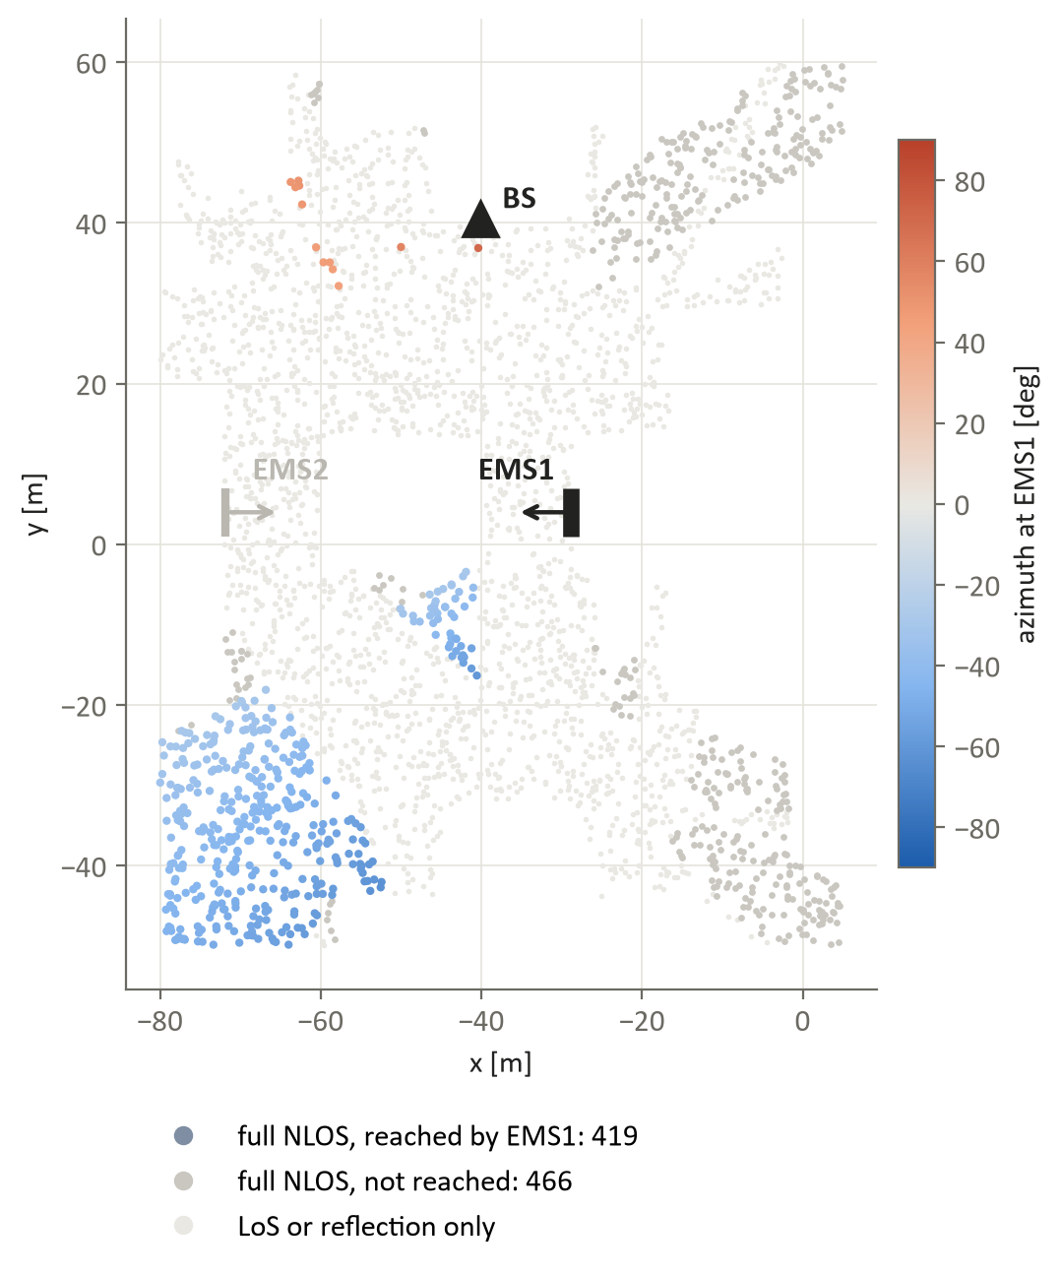
Case 1: EMS1 installed
Which users in outage can EMS1 serve, and how well does the chart locate them?
FIGURE TO DECIDE
Per-user error map of the t-SNE angle estimate, K = 3 (EMS1 trained alone).
Exists: serving_deployments/.../figures/per_user/1_informed_prior/map_M60_raytraced_K3
or: estimated vs true azimuth (truevsest_M60_raytraced).

Slide 10
Case 1: results
With 1-3 sweeps the chart beats a guided search; with more sweeps, search catches up.
FIGURE TO DECIDE
Median pointing error and median SNR gain vs number of sweeps (EMS1 trained alone):
t-SNE, t-SNE + neighbours, greedy and hierarchical search (clusters), exhaustive.
Exists as one column of figures_previous_style_newmetric/1_informed_prior; I can draw a 2-panel version.
Key numbers (real 60x60)
SNR gain at 1 sweep: t-SNE 16.3 dB, greedy 9.5 dB, hierarchical 8.7 dB.
Angle saturates after 3 acquisitions (median 2.1 deg).
From about 5 sweeps the guided search reaches t-SNE.

Slide 11
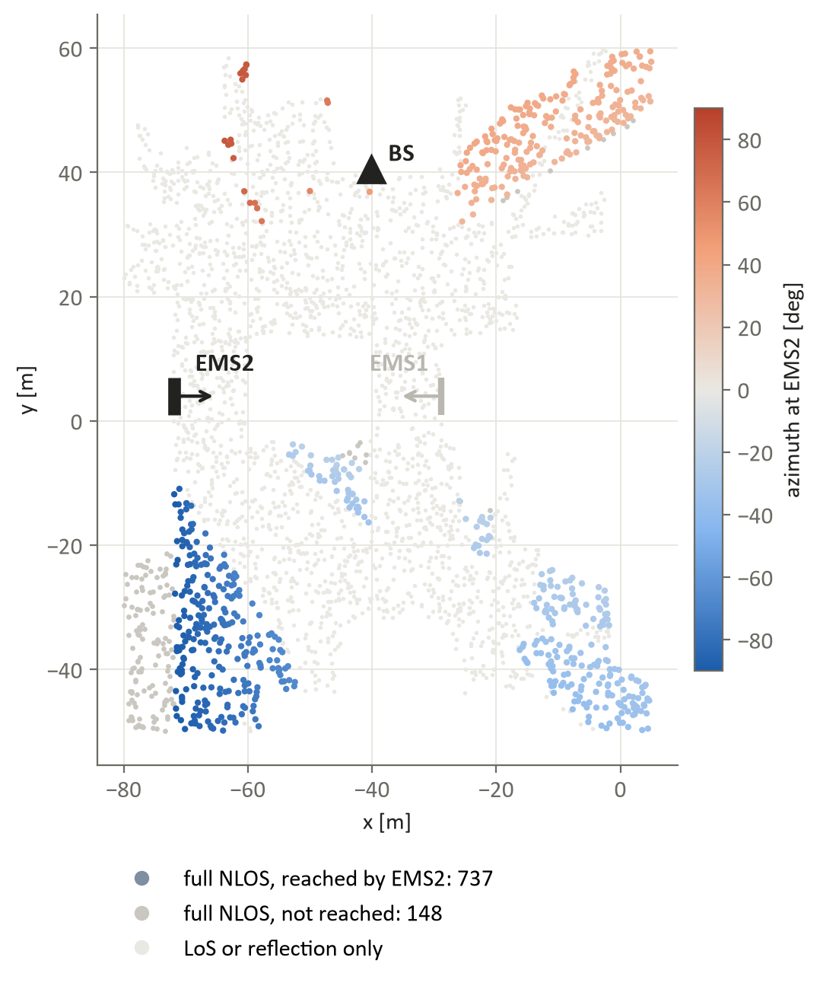
Case 2: EMS2 installed
EMS2 sees its users in three separate angular groups: one training beam lights only one.
FIGURE TO DECIDE
Estimated vs true azimuth for K = 1 and K = 3 (EMS2): with one acquisition, whole groups are misplaced; with three, they line up.
Exists: figures/per_user/1_informed_prior/truevsest_M60_raytraced

Slide 12
Case 2: results
Real 60x60: a guided search is as good early on; on larger surfaces the chart leads.
FIGURE TO DECIDE
Median SNR gain vs sweeps, EMS2 trained alone, real 60x60.
FIGURE TO DECIDE
Same for the 240x240 surface: t-SNE leads at 2-5 sweeps (25.6 vs 17.0 dB at 3 sweeps).

Slide 13
Training choice matters
Placing the training beams on the user groups (informed) beats random or fixed training.
FIGURE TO DECIDE
Median angle error vs K: informed vs coarse-to-fine vs random, EMS1 and EMS2 (trained alone).
Numbers exist (EMS2, real 60x60): K = 3: 3.7 deg informed vs 37 deg random; K = 10: 1.9 vs 14 deg.
Why
A chart places a user well only if a training beam lights it.
Informed training needs one beam per user group: about 3 for EMS2, instead of 6 (coarse-to-fine) or 10+ (random).

Slide 14
Takeaways
From localisation to configuration: the same static EMS slots, labelled with the AoA, let the BS choose the EMS beam without sweeping.
Target users: only full-NLOS users gain from the EMS (28% here); line-of-sight and wall-reflection users do not need it.
Few sweeps: with 1-3 acquisitions the chart serves users better than a guided search (EMS1; larger surfaces), and saturates at about 3.
Informed training (one beam per user group) is the key ingredient; a few users still get a wrong group (the tail).
Next: hybrid t-SNE + short search for the tail; joint use of both EMSs (backup).

Slide 15
Backup: both EMSs present
Joint channel, separate inference per EMS; or one joint chart for both angles.
FIGURE TO DECIDE
Joint channel, separate charts: EMS2 at K = 1 improves from 46 deg (alone) to 9 deg (joint).
Exists: serving_single_ems/.../figures_TEMP/fig_angle_joint_vs_separated
FIGURE TO DECIDE
One joint 2-D chart (both angles): clearly worse (6-15 deg vs 2-4 deg).
Exists: serving_joint_chart/.../figures/shell_order_bothReached

