Slide 1

Multi Agent Reinforcement Learning
Dr.Chandra Sekhar Vorugunti

Slide 2
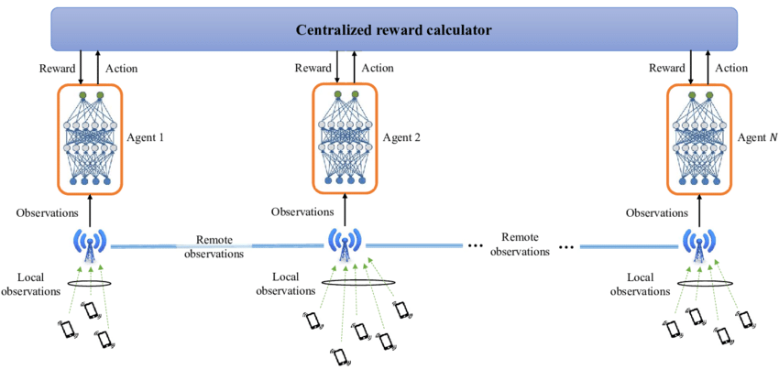
Multi Agent Reinforcement Learning (MARL)
What is Multi-Agent Reinforcement Learning?
Vanilla reinforcement learning is concerned with a single agent, in an environment, seeking to maximize the total reward in that environment.
It receives rewards for taking steps without falling over, and through trial and error, and maximizing these rewards, the robot eventually learns to walk.
In this context, we have a single agent seeking to accomplish a goal through maximizing total rewards.

Slide 3
Multi Agent Reinforcement Learning (MARL)
Multi-agent reinforcement learning studies how multiple agents interact in a common environment. That is, when these agents interact with the environment and one another, can we observe them collaborate, coordinate, compete, or collectively learn to accomplish a particular task. It can be further broken down into three broad categories:
Cooperative: All agents working towards a common goal
Competitive: Agents competing with one another to accomplish a goal
Some mix of the two: Think a 5v5 basketball game, where individuals on the same team are coordinating with one another, but the two teams are competing against one another.
A canonical example of MARL is a swarm of robots seeking to rescue an individual. Each robot has only partial observability of its environment (they can only see a small patch of land below them) therefore the robots need to coordinate with one another to rescue the individual.

Slide 4
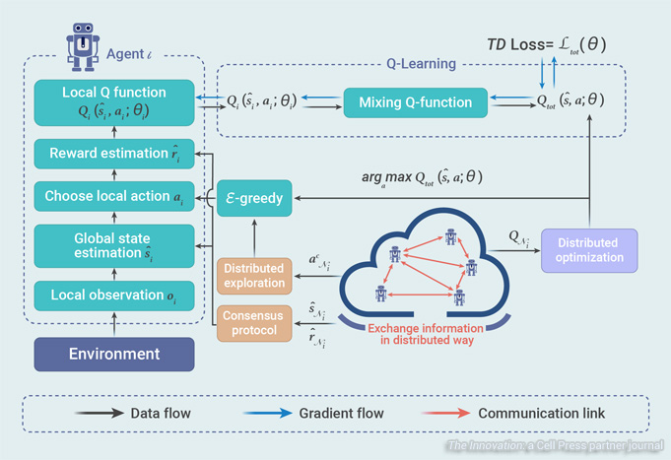
Multi Agent Reinforcement Learning (MARL)

Slide 5
Multi Agent Reinforcement Learning (MARL)
Local Observation o_{i}: Each agent i receives an observation from the environment, which may represent a partial view of the entire state space.
Global State Estimation s_{i} : The agent uses its observation to estimate the global state of the environment, which is necessary for making informed decisions. In some systems, the global state may be directly observable, or agents may need to communicate to estimate it.
Choose Local Action a_{i} : Based on its state estimation, the agent selects an action to take. This decision is often made using an
ϵ-greedy strategy, where the agent usually takes the best known action but occasionally explores by choosing a random action.
Reward Estimation : After taking an action, the agent receives a reward signal that estimates the immediate benefit of the action taken.

Slide 6
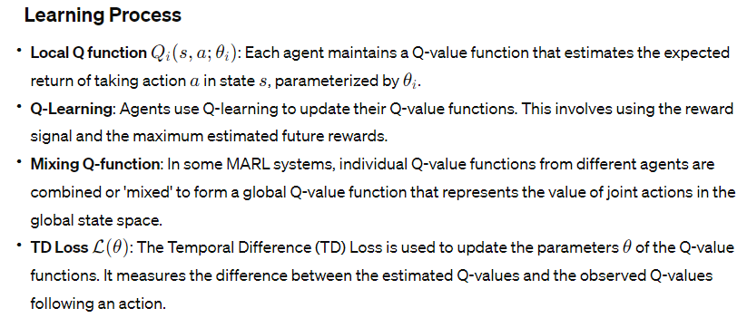
Multi Agent Reinforcement Learning (MARL)

Slide 7
Multi Agent Reinforcement Learning (MARL)
Data and Gradient Flow:
Solid blue lines indicate the data flow from the environment to the agents and among the agents themselves.
Dashed blue lines represent the gradient flow, which is the direction in which the parameters of the Q-value functions are updated.
Red dashed lines symbolize communication links between agents, which are used to exchange information necessary for learning and coordination.

Slide 8
Multi Agent Reinforcement Learning (MARL)
The overall system demonstrates how agents in a multi-agent reinforcement learning setting can independently gather information, learn from it, and collaborate to make decisions that are informed by both their own experiences and the shared knowledge from other agents.

Slide 9
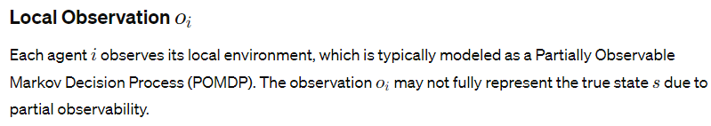
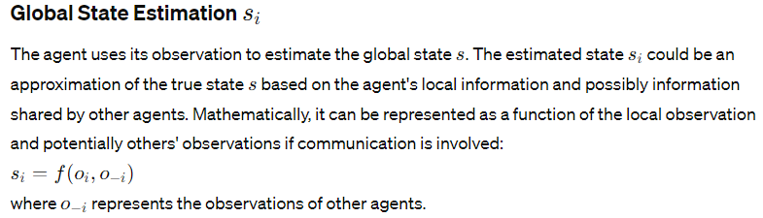
Multi Agent Reinforcement Learning (MARL)

Slide 10
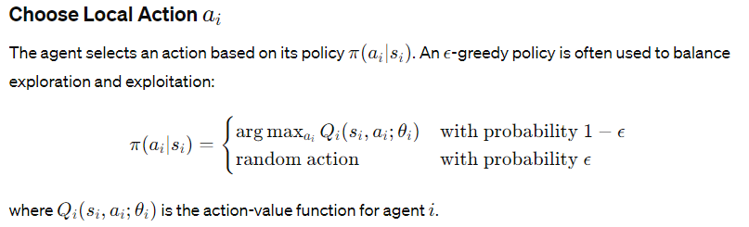
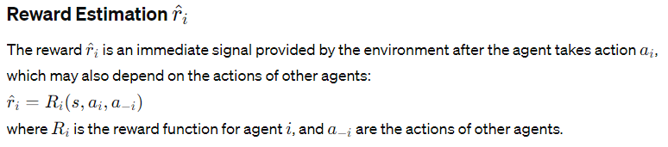
Multi Agent Reinforcement Learning (MARL)

Slide 11
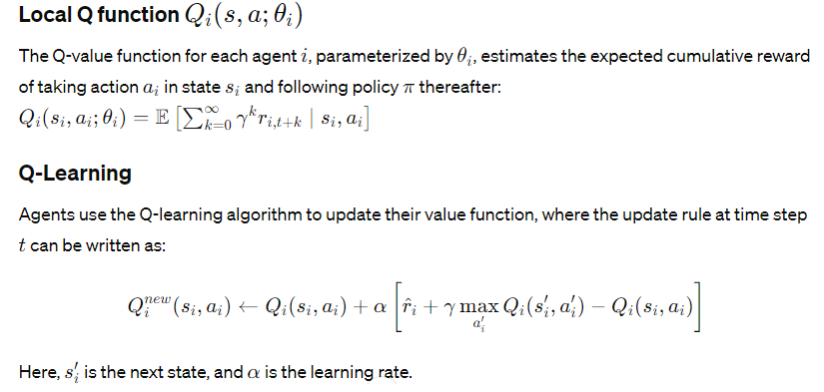
Multi Agent Reinforcement Learning (MARL)

Slide 12
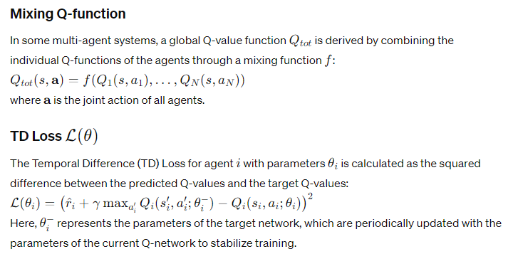
Multi Agent Reinforcement Learning (MARL)

Slide 13
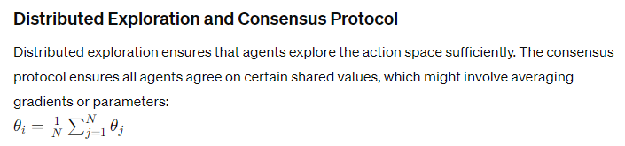
Multi Agent Reinforcement Learning (MARL)

Slide 14
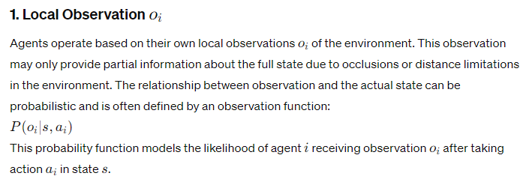
Multi Agent Reinforcement Learning (MARL)
Imagine a robot trying to locate a box in a warehouse. It might see the box with a high probability if it's close and there's good lighting (say, 90% chance, or = 0.9, P=0.9). If it's far away or behind obstacles, the chance it sees the box drops (say, 30% chance, or = 0.3 P=0.3). This probability changes based on the robot's action and location.

Slide 15
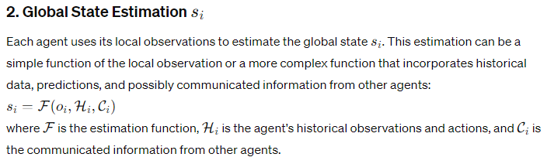
Multi Agent Reinforcement Learning (MARL)

Slide 16
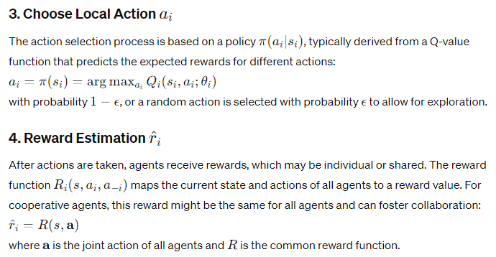

Multi Agent Reinforcement Learning (MARL)

Slide 17
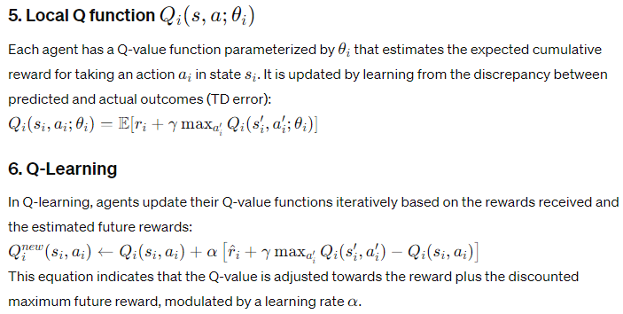
Multi Agent Reinforcement Learning (MARL)

Slide 18
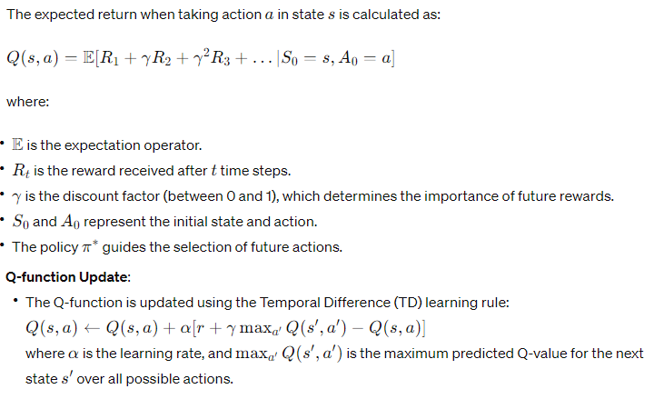
Multi Agent Reinforcement Learning (MARL)

Slide 19
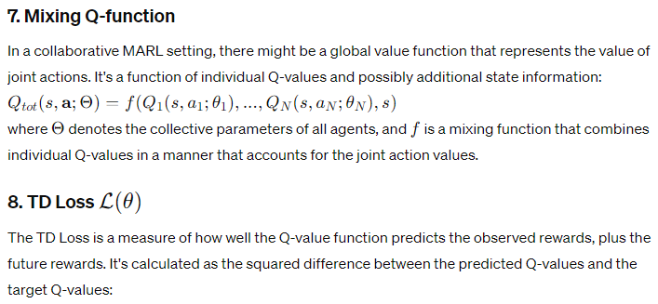
Multi Agent Reinforcement Learning (MARL)

