Slide 1


Introduction to Statistical Methods
BITS Pilani
Pilani|Dubai|Goa|Hyderabad
Team ISM
Slide 1 of 275 | Prof.Gangaboraiah PhD (Stats) Former Professor of Statistics | KIMS, B’lore

Slide 2
Webinar-4
Correlation Analysis
(Correlation, Regression and Maximum likelihood estimation)
(24th August 2023)

Slide 3
Contact session | List of topic | References
Webinar-4 | Correlation, Regression Analysis and Maximum likelihood estimation.

Slide 4
CORRELATION Analysis
1.1 Definition of Correlation
1.2Types of Correlation
1.3 Methods of studying Correlation

Slide 5
Definition of Correlation
Correlation is a statistical tool which is used to know the relationship between two or more than two variables.
In bivariate frequency distribution f(x,y) if a change in one variable x creates or effects any change in another variable y, then the two variables are set to be correlated.

Slide 6
Types of Correlation
Positive or Negative Correlation
Simple, Partial and Multiple correlation
Linear and non linear correlation

Slide 7
Positive or Negative Correlation
If a change in the variable X creates any change in the variable Y in the same direction then X and Y are said to be Positive correlated.
If one variable increases the second variable will also increases correspondingly.
Examples: 1. Income and expenditure
2. Distance travelled by train and train fare
3.Age and sickness
4. Advertising and sales
If a change in one variable creates change in other variable, but in opposite direction then two variables are said to be negatively correlated. i.e if one variable increases, then the other decreases or vice versa.
Examples: 1.Price and demand
2. Demand for sweaters and the day temperature.

Slide 8
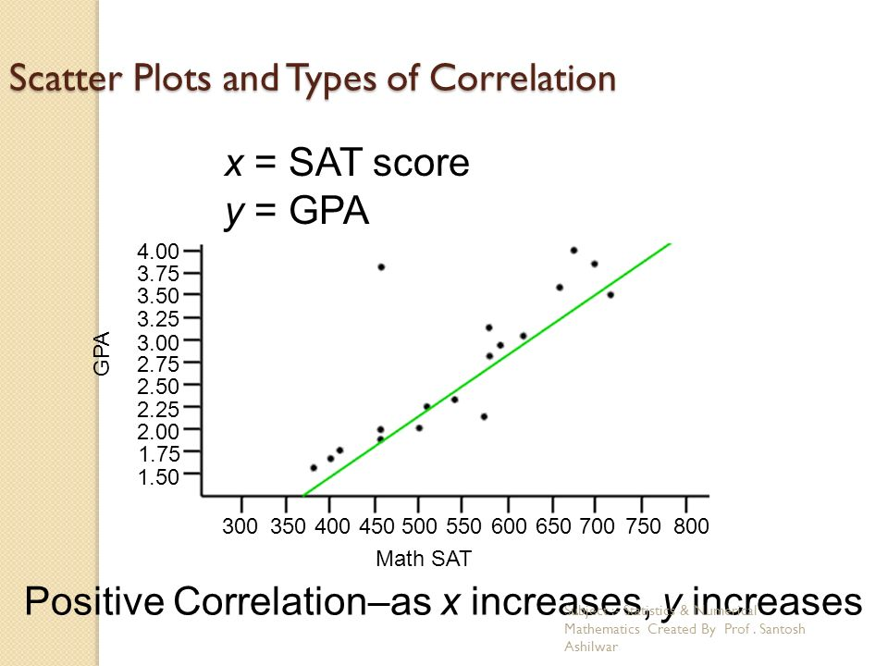
Cont…

Slide 9
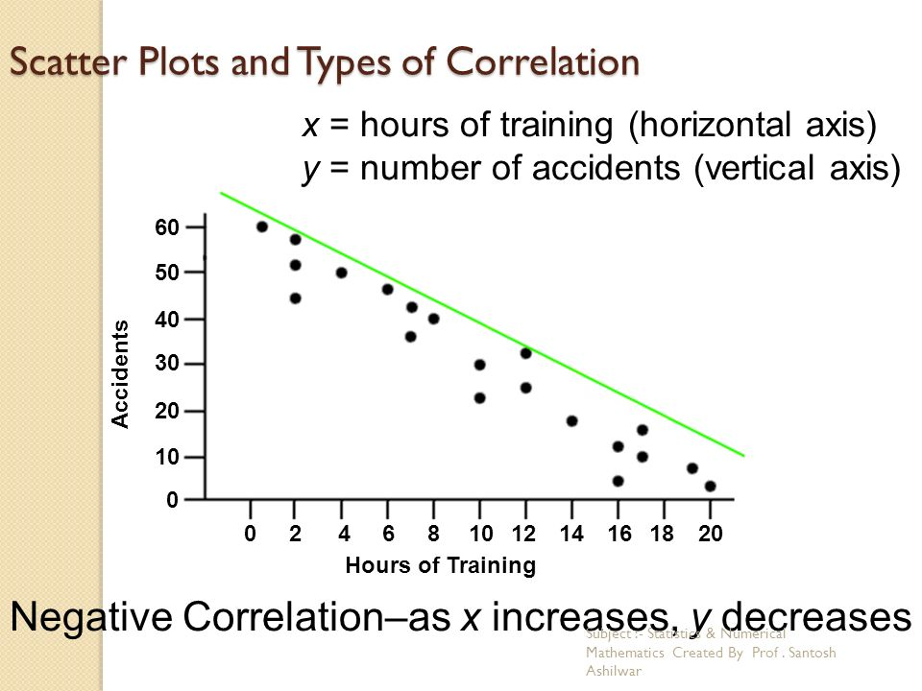
Cont…

Slide 10
Simple, partial and multiple correlation
The distinction between simple, partial and multiple correlation is based on the number of variables studied.
When only two variables are studied, it is a simple correlation
Example: Intelligent quotient and marks secured.
When 3 or more variables are studied then it is a multiple correlation.
Example: yield of rice per acre and both the amount of rainfall and the amount of fertilizers used.
In partial correlation we recognize more than two variables but consider only two variables are influencing each other and ignore other variables by keeping them as constant.
Example: Mileage of car and car type can only be studied by ignoring road conditions, driving skills etc..

Slide 11
Linear and Non-linear(curvi linear correlation)
If the change in one variable causes the change in other variable in constant ratio then it is called linear correlation.
If such variables are plotted on a graph paper, plotted points will fall on a straight line.
example: Amount of raw material required and number of finished goods.
When the amount of change in one variable is not in a constant ratio to the amount of change in other variable then it is called non-linear correlation.
Example: Amount of rainfall and yield of crop.

Slide 12
Methods of studying Correlation
There are various methods to know whether the two variables are correlated or not. They are
Scatter diagram
Karl Pearson's coefficient of correlation

Slide 13
Scatter Diagram
To know the correlation between any two variables , scatter diagrams are used.
Procedure: given n pair of values (x1,y1) (x2,y2)…(xn,yn) of two variables X and Y.
Take the independent variable on x axis and dependent variable on y axis. Then plot the n points on the graph.
The diagram of dots thus obtained is called scatter diagram.
If the points reveal any upward or downward trend the variables are said to be correlated , otherwise un-correlated.
If the points are very closed to each other, a good amount of correlation exists.
Upward trend indicates +ve correlation and downward trend indicates –ve correlation.
Limitation: By this method we cannot establish the exact degree of correlation between the variables.

Slide 14
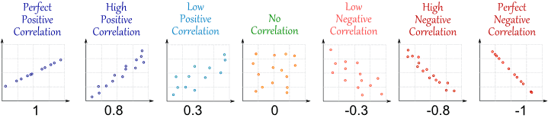
Scattered diagram- Some specific cases
$$−1≤Correlation\left(x,y\right)≤+1$$

Slide 15
Karl Pearson's coefficient of correlation
The extent relationship between the variables calculated with the help of statistical techniques known as correlation coefficient. It was developed by Karl Pearson. It is denoted by r(x,y) or
It always varies between +1 or -1
When r= +1 then it denotes perfect +ve correlation
r= 0 denotes no correlation
r= -1 perfect –ve correlation
Correlation coefficent between two random variables X and Y is as follows:

Slide 17
Properties of the coefficient of correlation
The coefficient of correlation lies between -1 and +1.
Correlation is independent of change of origin and scale.
The coefficient of correlation is the geometric mean of two regression coefficients
The degree of relationship between two variables is symmetric

Slide 18
Calculate karl pearson’s coefficient of correlation for the following data
X | 9 | 8 | 7 | 6 | 5 | 4 | 3 | 2 | 1
Y | 15 | 16 | 14 | 13 | 11 | 12 | 10 | 8 | 9
Sol: Correlation coefficient

Slide 19
X | Y | _{𝑋}2 | _{𝑌}2 | XY
9 | 15 | 81 | 225 | 135
8 | 16 | 64 | 256 | 128
7 | 14 | 49 | 196 | 98
6 | 13 | 36 | 169 | 78
5 | 11 | 25 | 121 | 55
4 | 12 | 16 | 144 | 48
3 | 10 | 9 | 100 | 30
2 | 8 | 4 | 64 | 16
1 | 9 | 1 | 81 | 9
∑ 𝑋 = 45 | ∑ 𝑌 = 108 | ∑ 𝑋² = 285 | ∑ 𝑌² = 1356 | ∑ 𝑋𝑌 = 597
Therefore, N=9,∑ 𝑋𝑌 = 597,∑ 𝑋 = 45, ∑ 𝑋² = 285, ∑ 𝑌 = 108, ∑ 𝑌² = 1356
There is a high degree of +ve correlation between variables X and Y.
i.e if x increases y also increases

Slide 20
Calculate karl pearson’s coefficient of correlation for the following data
x | 65 | 66 | 67 | 67 | 68 | 69 | 70 | 72
y | 67 | 68 | 65 | 68 | 72 | 72 | 69 | 71
X | Y |  |  |  |  | uv
65 | 67 | -3 | -2 | 9 | 4 | 6
66 | 68 | -2 | -1 | 4 | 1 | 2
67 | 65 | -1 | -4 | 1 | 16 | 4
67 | 68 | -1 | -1 | 1 | 1 | 1
68 | 72 | 0 | 3 | 0 | 9 | 0
69 | 72 | 1 | 3 | 1 | 9 | 3
70 | 69 | 2 | 0 | 4 | 0 | 0
72 | 71 | 4 | 2 | 16 | 4 | 8

Slide 22
sales | 15 | 18 | 25 | 27 | 30 | 35
Advertising expenditure | 50 | 65 | 82 | 95 | 110 | 120
Find the correlation coefficient for the above data

Slide 23
Regression Analysis
The term regression literally means stepping back towards the average
Definition: Regression analysis is a mathematical measure of the average relationship between 2 or more variables in terms of original units of the data.
In regression analysis there are 2 variables.
The variable whose values are influenced or can be predicted is called dependent variable and the variable which influences or used for prediction is called independent variable.
In regression analysis the dependent variable is known as regressed or explained variable, while the independent variable is known as regressor or predictor or explanator.

Slide 24
Lines of Regression
If we plot the points of a bivariate distribution in the scatter diagram the points will cluster round a curve called curve of regression.
If the curve is straight line it is called line of regression or linear regression otherwise the regression is said to be non linear regression.
Line of regression of y on x is the line which gives the best estimate for the value of y for any specified value of x.
Line of regression of x on y is the line which gives the best estimate for the value of x for any specified value of y.

Slide 25
Types of Regression
Simple Regression: the regression analysis confined to the study of only two variables at a time is called as simple regression
Multiple Regression: The regression analysis for studying more than two variables at a time is termed as Multiple Regression.
Utility of Regression Test: Regression lines are useful in prediction of values of one variable for a specified value of other variable.
Examples:
1.When price and demand are related, we can estimate the future demand for a specified price.
2. When crop yield depend on amount of rain fall then regression test can predict crop yield for a particular amount of rain fall.

Slide 26
Cont…
Let x and y are two variables for regression analysis then there will be two regression lines.
Regression line of x on y =
Regression line of y on x=
The intersection of two lines x on y and y on x gives the mean values of x series and y series. i.e., and

Slide 27
Properties of Regression coefficients
Correlation coefficient is the geometric mean of the regression coefficients.
If one regression coefficient is > unity then the other must be < unity.
The arithmetic mean of the two regression coefficient is > the correlation coefficient.

Slide 28
Problems
The folowing table gives the normal weight of kids during the first 8 years of life;
Obtain two lines of regression
Estimate the weight of kid at the age of 4 years
Age | 0 | 1 | 2 | 3 | 5 | 6 | 7 | 8
Weight | 5 | 7 | 8 | 10 | 15 | 17 | 20 | 22

Slide 29
solution : we know that regression line y on x is
Where
are means
is regression coefficient.
Line of regression x on y is
N=no of observations.

Slide 30
Age( x) | Weight( y)
0 | 5 | -4 | -8 | 16 | 64 | 32
1 | 7 | -3 | -6 | 9 | 36 | 18
2 | 8 | -2 | -5 | 4 | 25 | 10
3 | 10 | -1 | -3 | 1 | 9 | 3
5 | 15 | 1 | 2 | 1 | 4 | 2
6 | 17 | 2 | 4 | 4 | 16 | 8
7 | 20 | 3 | 7 | 9 | 49 | 21
8 | 22 | 4 | 9 | 16 | 81 | 36
Total=32 | 104 | 0 | 0 | 60 | 284 | 130
From the table

Slide 31
Line of regression y on x
Line of regression x on y

Slide 32
Weight of a kid at the age of 4 is estimating y when x=4
We use y on x regression line.
The weight of a kid at the age of 4is 14.336.

Slide 33
Problem: The following are the regression equations.
Find the regression line x on y and y on x and also find
And
The regression coefficients
Correlation Coefficients

Slide 34
Solution:
………………………..(1)
………………………..(2)
i. By solving two regression lines we get
And
= 13
And
=17
ii. Rewrite the equations of regression to get the form x on y and y on x
From eq-(1)

Slide 35
Equation (2)
Regression coefficient x on y =
Regression coefficient y on x =
iii)Correlation coefficient =
Since both regression coefficients are positive ,r must be positive there fore r=0.6

Slide 36
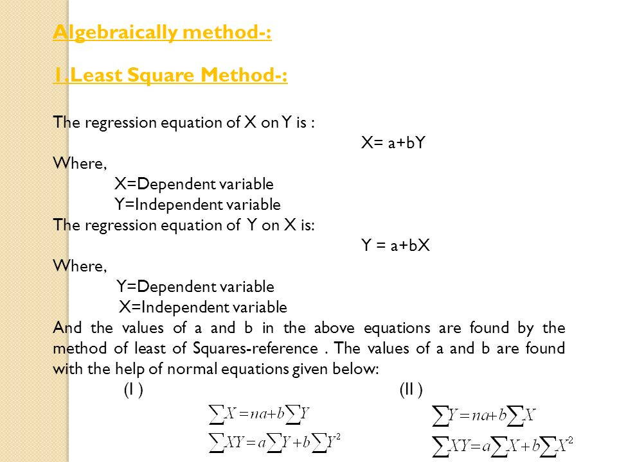
Least square Method

Slide 37
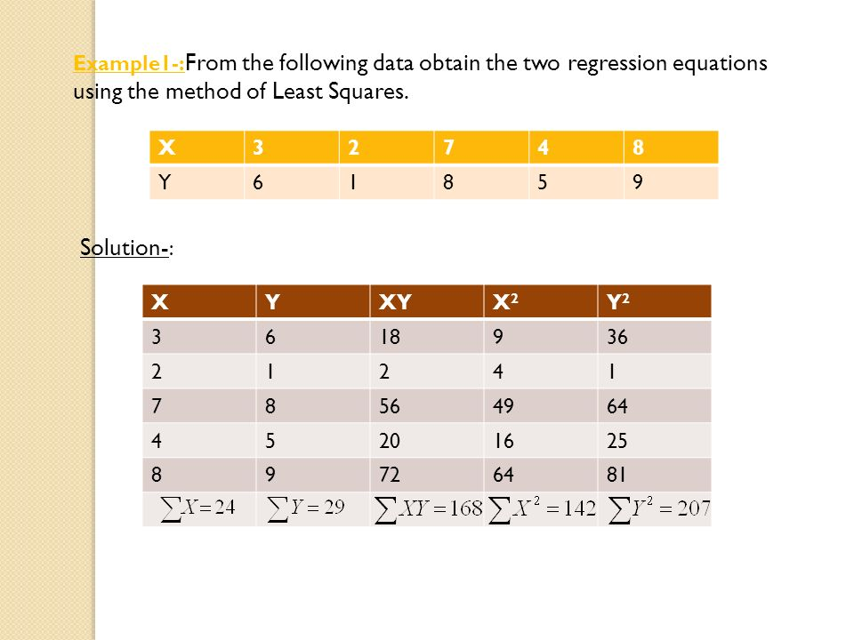
Cont…

Slide 38
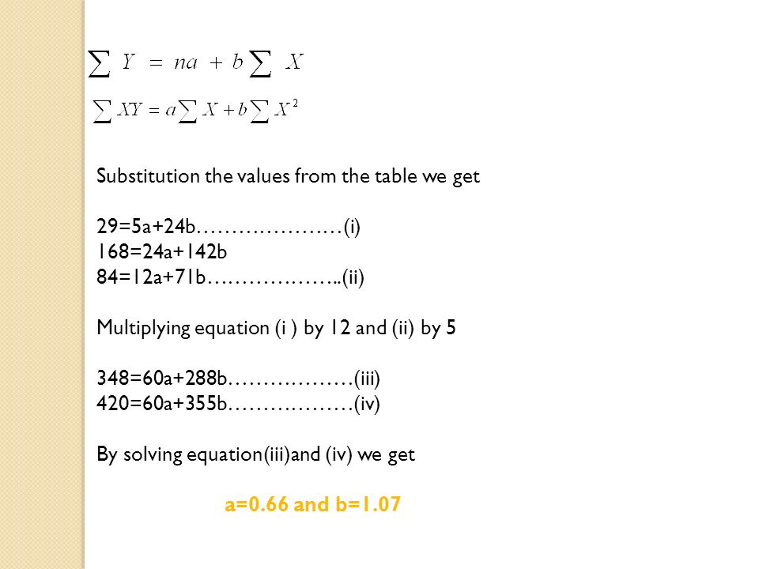
Cont…

Slide 39
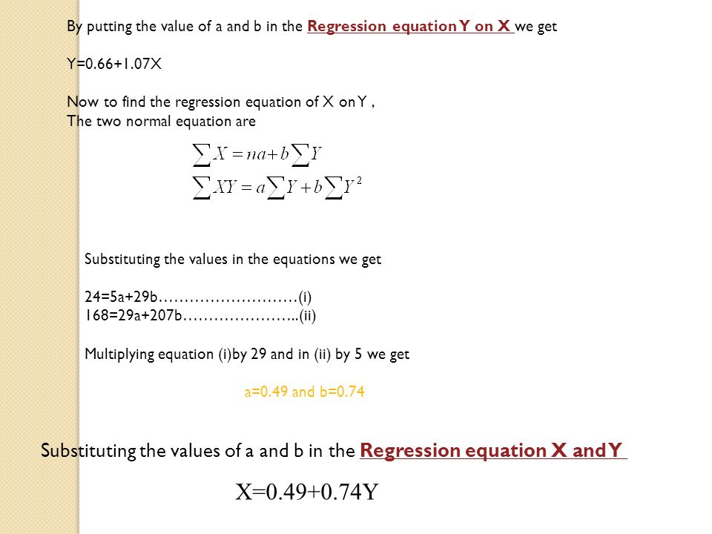
Cont…

Slide 40
Fit a straight line to the following data
Show that the line of fit 0f the following data is given by y=0.7x+11.28
x | 0 | 1 | 2 | 3 | 4
y | 1 | 1.8 | 3.3 | 4.5 | 6.5
x | 0 | 5 | 10 | 15 | 20 | 25
y | 12 | 15 | 17 | 22 | 24 | 30

Slide 41
Non linear least square approximation:
Parabola: let the equation of parabola to be fit be
The normal equations are
Solving these equations for a,b,c and substituting in (1) we get required parabola of best fit.
Problem
1)Fit the second degree parabola to the following data
x | 0 | 1 | 2 | 3 | 4
y | 1 | 5 | 10 | 22 | 38

Slide 42
sol: let the equation of the parabola be
The normal equations are

Slide 43
x | y | xy
0 | 1 | 0 | 0 | 0 | 0 | 0
1 | 5 | 5 | 1 | 5 | 1 | 1
2 | 10 | 20 | 4 | 40 | 8 | 16
3 | 22 | 66 | 9 | 198 | 27 | 81
4 | 38 | 152 | 16 | 608 | 64 | 256
Sub these values in the normal equations
Solving above a=1.42, b=0.26, c=2.221

Slide 44
Sub a, b, c in (1)
Is the required parabola of the best fit.
Power curve: The power curve is
Taking log on both sides
(2) Is a linear equation in X and Y
The normal equations are
Solving for A and b and substitute in (2).

Slide 45
Problem: Fit a curve
to the following data
x | 1 | 2 | 3 | 4 | 5 | 6
y | 2.98 | 4.26 | 5.21 | 6.10 | 6.80 | 7.50
Sol:
Taking log on both sides
This is a linear eq in X and Y
The normal eq s are
……………(3)

Slide 46
x | X=log x | y | Y=log y | XY
1 | 0 | 2.98 | 0.4742 | 0 | 0
2 | 0.3010 | 4.26 | 0.6294 | 0.1894 | 0.0906
3 | 0.4771 | 5.21 | 0.7168 | 0.3420 | 0.2276
4 | 0.6021 | 6.10 | 0.7853 | 0.4728 | 0.3625
5 | 0.6990 | 6.80 | 0.8325 | 0.5819 | 0.4886
6 | 0.7782 | 7.50 | 0.8751 | 0.6810 | 0.6056
TOTAL
Substituting the above values in (3)
4.3133 = 6A+2.8574 b
2.2671=2.8574 A +1.7749 b
Solving the equations for A and b
A = 0.4739 And b = 0.5143
a = = = 2.978
Substituting a and b in (1)

Slide 47
Exponential curve:
1)The exponential curve
Taking log on both sides
Equation (2) is linear equation in x and Y
So the normal equations are given by

Slide 48
Problem: Fit acurve of the form
to the following data
x | 0 | 5 | 8 | 12 | 20
y | 3.0 | 1.5 | 1.0 | 0.55 | 0.18
Sol: Let
Taking log on both sides

Slide 49
Equation (2) is linear equation in x and Y
So the normal equations are given by
x | y
0 | 3.0 | 0.4771 | 0 | 0
5 | 1.5 | 0.1761 | 25 | 0.8805
8 | 1.0 | 0 | 64 | 0
12 | 0.55 | -0.2596 | 144 | -3.1152
20 | 0.18 | -0.7447 | 400 | -14.894

Slide 50
Sub these values in (3) we get
Solving above for A and B
A=0.4815 and B=-0.0613
Sub a and b values in (1)

Slide 51
Maximum Likelihood Estimation (MLE)
Suppose we have a random sample x₁,x₂, ..,x_{n} whose assumed probability distribution depends on some unknown parameter θ.
Ex:
1) For Binomial unknown parameters are n, p.
2) For Poisson unknown parameter is λ.
Our goal is to find good estimator of θ(population parameter) using sample and which can be done with the help of MLE.

Slide 52
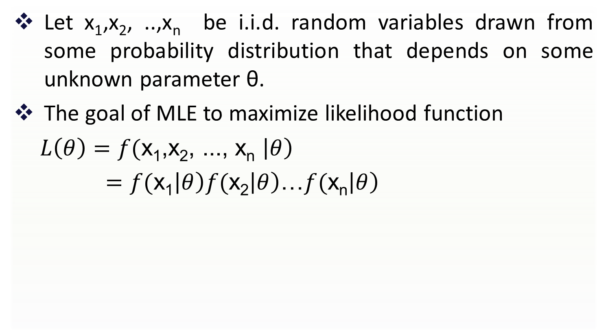
Maximum Likelihood function
Let x₁,x₂, ..,x_{n} be i.i.d. random variables drawn from some probability distribution that depends on some unknown parameter θ.
The goal of MLE to maximize likelihood function
$L\left(θ\right)=f($x₁,x₂, ..., x_{n} $\left|θ\right)$
$=f($x₁$\left|θ\right)f($x₂$\left|θ\right)$…$f($x_{n}$\left|θ\right)$

Slide 53

The maximum likelihood estimate (MLE) of θ is that value of θ that maximizes likelihood(θ).
It is defined as

Slide 54
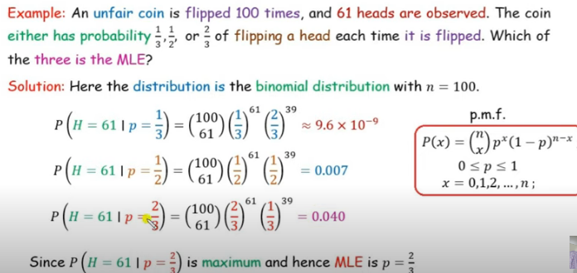

Slide 55
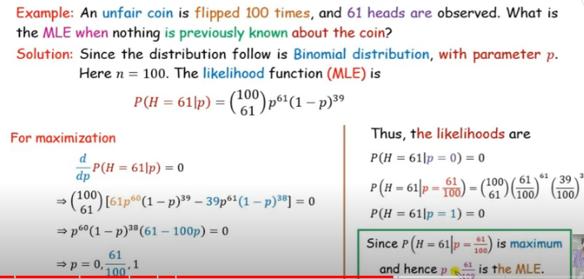

Slide 56
Maximum Likelihood for a Binomial distribution
Suppose we wish to find the maximum likelihood estimate (MLE) of θ for a Binomial distribution,

Slide 57
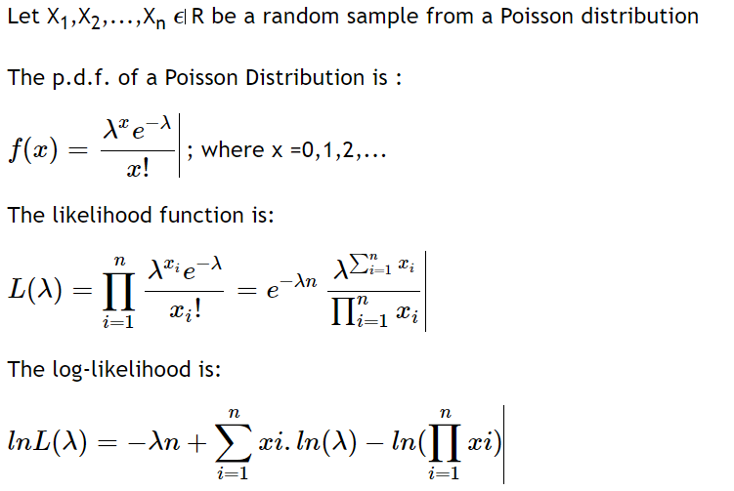

Slide 58
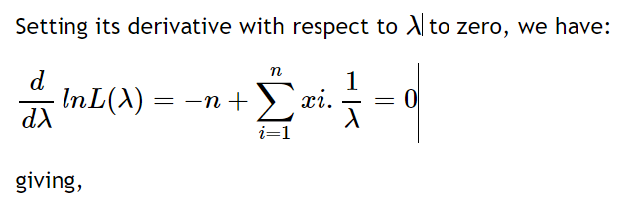
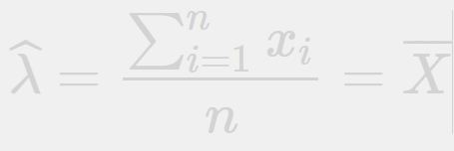


which is the maximum likelihood estimate

Slide 59
Thank you

