Slide 1
Mathematical Foundations for Machine Learning
MFML Team

Slide 2
S2 -22 AIMLCZC416, MFML
Webinar#3

Slide 3
Agenda
Gradient descent algorithm
Ada Grad method
RMS Prop method
Adam method
Comparison of Gradient descent , Ada Grad, RMS Prop and Adam method to find the Minima of 2D function.
Lagrange Multiplier – Example
PCA Steps – Example

Slide 4
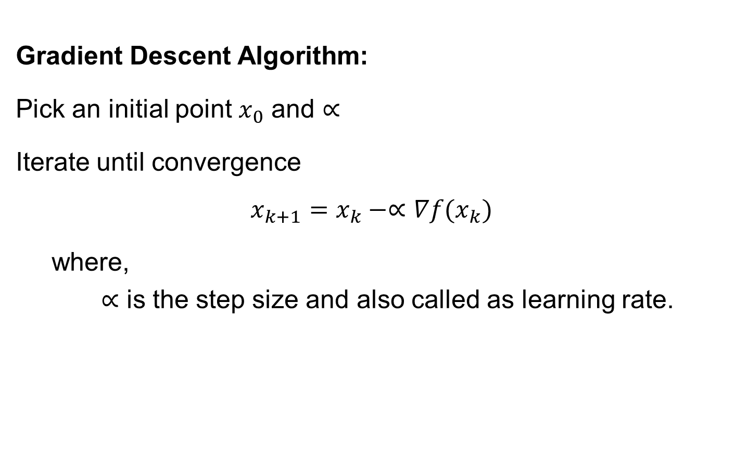
Gradient descent
Gradient Descent Algorithm:
Pick an initial point $x_{0}$ and $∝$
Iterate until convergence
$$x_{k+1}=x_{k}−∝∇f(x_{k})$$
where,
$∝$ is the step size and also called as learning rate.

Slide 5
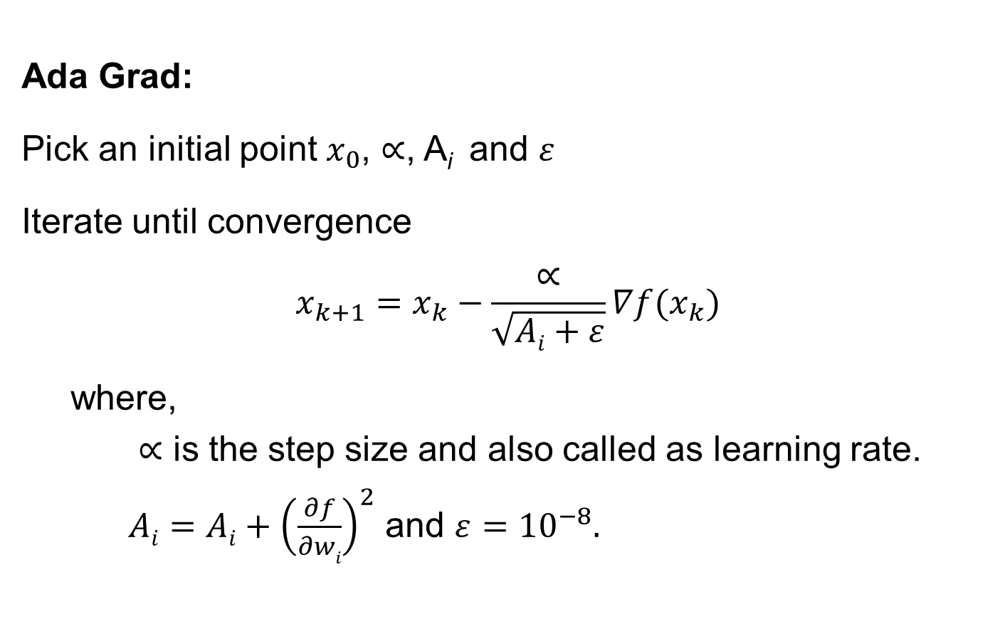
Ada Grad
Ada Grad:
Pick an initial point $x_{0}$, $∝$, A_{i} and $ε$
Iterate until convergence
$$x_{k+1}=x_{k}−\frac{∝}{\sqrt{Ai+ε}}∇f(x_{k})$$
where,
$∝$ is the step size and also called as learning rate.
$Ai=Ai+{\left(\frac{∂f}{∂wi}\right)}^{2}$ and $ε={10}^{−8}.$

Slide 6
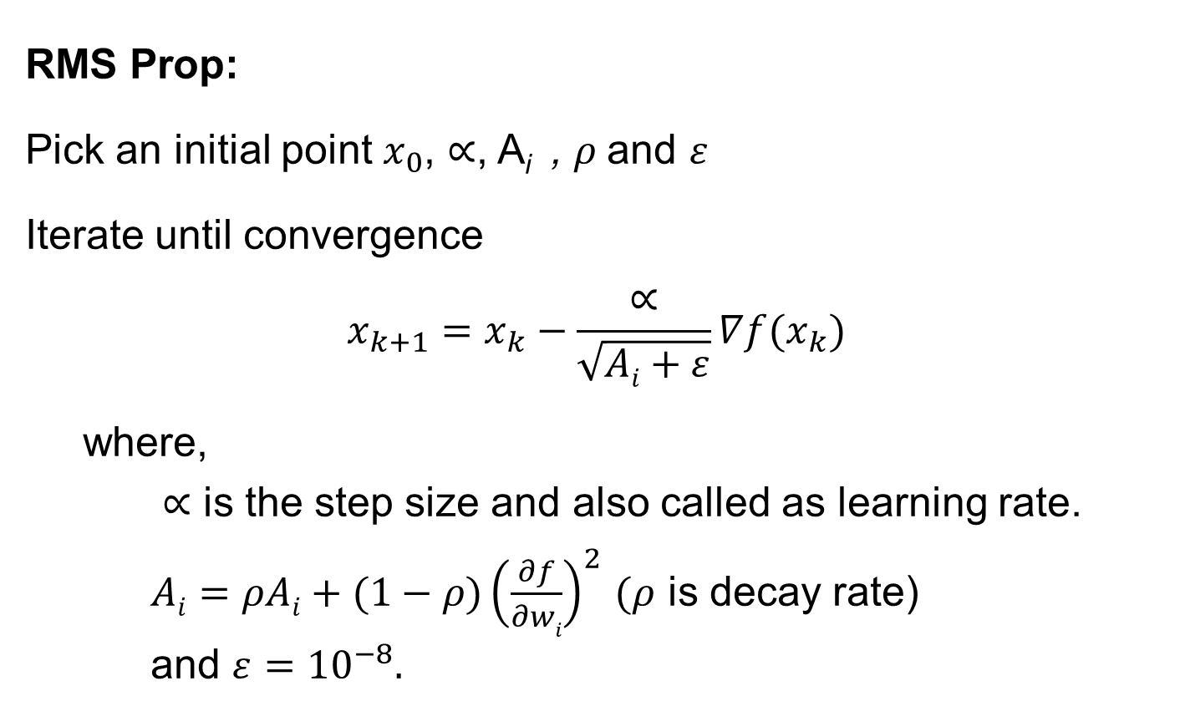
RMS Prop
RMS Prop:
Pick an initial point $x_{0}$, $∝$, A_{i} , $ρ$and $ε$
Iterate until convergence
$$x_{k+1}=x_{k}−\frac{∝}{\sqrt{Ai+ε}}∇f(x_{k})$$
where,
$∝$ is the step size and also called as learning rate.
$Ai=ρAi+(1−ρ){\left(\frac{∂f}{∂wi}\right)}^{2}$ $(ρ$ is decay rate)
and $ε={10}^{−8}.$

Slide 7
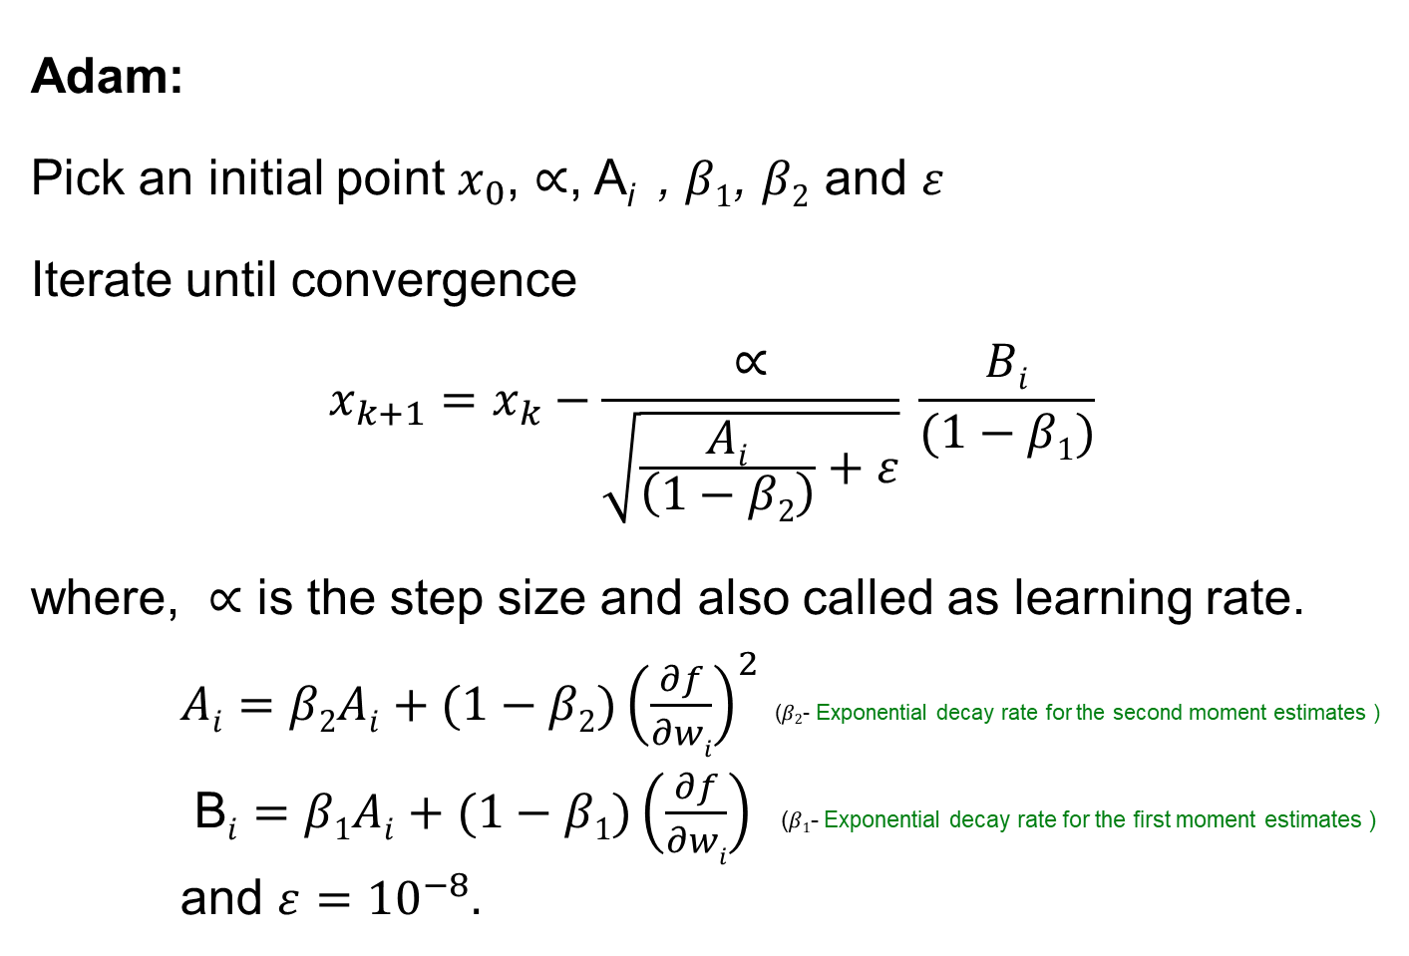
Adam method
Adam:
Pick an initial point $x_{0}$, $∝$, A_{i} , $β1$, $β2$ and $ε$
Iterate until convergence
$$x_{k+1}=x_{k}−\frac{∝}{\sqrt{\frac{Ai}{\left(1−β2\right)}+ε}} \frac{Bi}{(1−β1)}$$
where, $∝$ is the step size and also called as learning rate.
$Ai=β2Ai+(1−β2){\left(\frac{∂f}{∂wi}\right)}^{2}$ ($β2$- Exponential decay rate for the second moment estimates )
B$i=β1Ai+(1−β1)\left(\frac{∂f}{∂wi}\right)$ ($β1$- Exponential decay rate for the first moment estimates )
and $ε={10}^{−8}.$

Slide 8
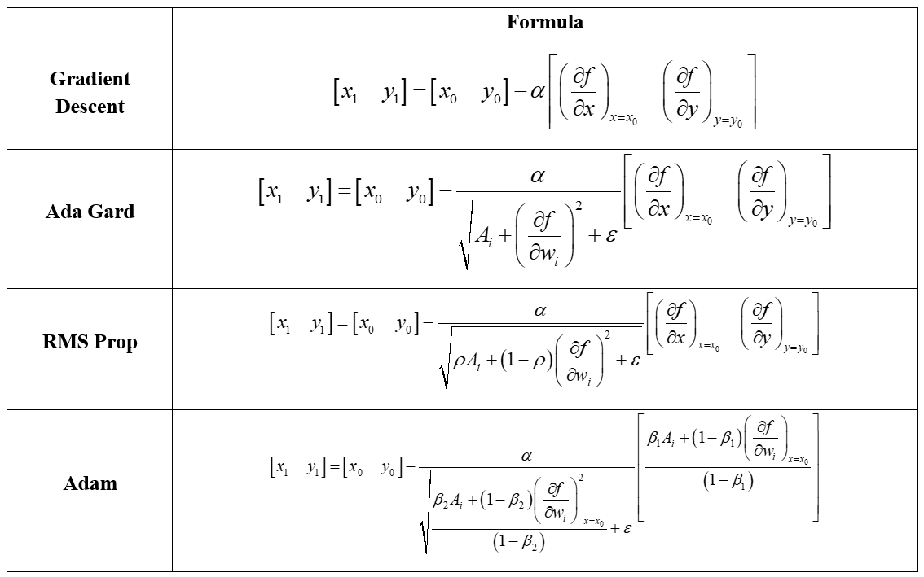
Comparison of Gradient descent , Ada Grad, RMS Prop and Adam Methods

Slide 9
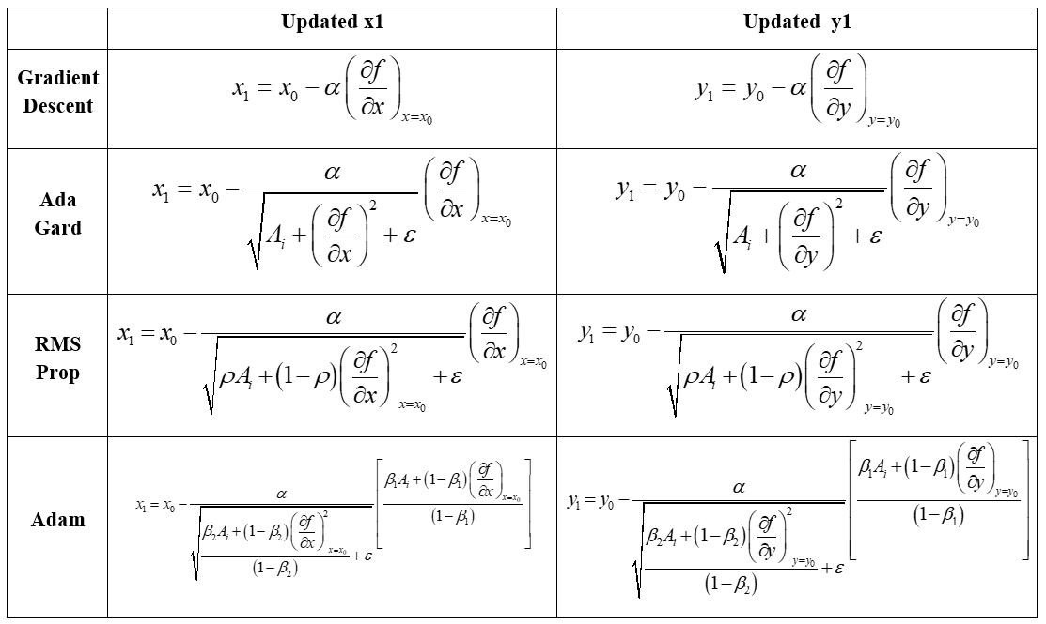

Slide 10
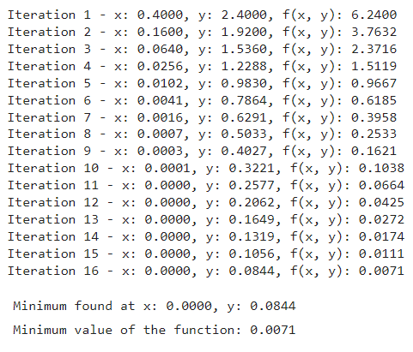
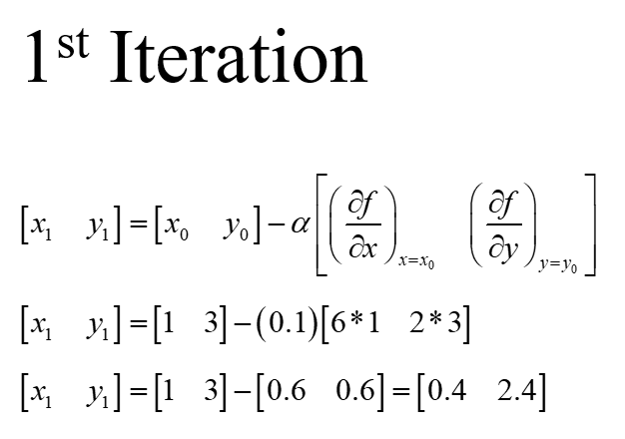
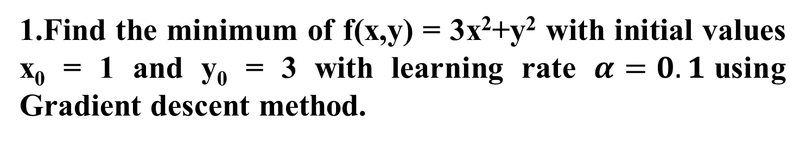
Problem on Gradient descent method
1.Find the minimum of f(x,y) = 3x²+y² with initial values x₀ = 1 and y₀ = 3 with learning rate $α=0.1$using Gradient descent method.
Solution:

Slide 11
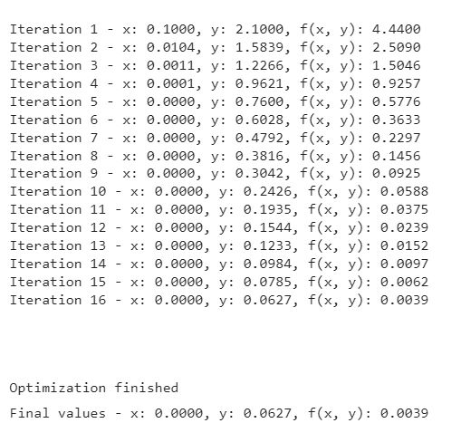
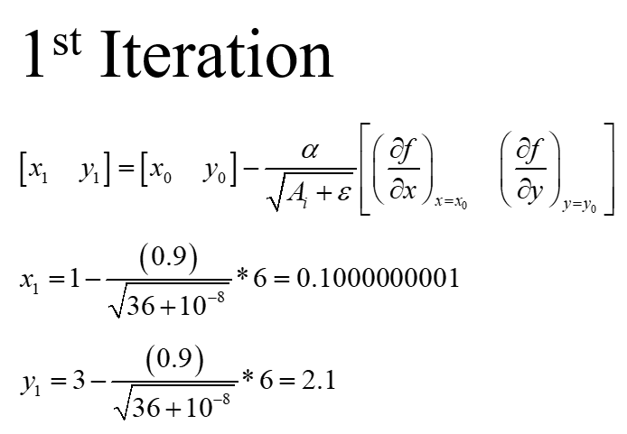
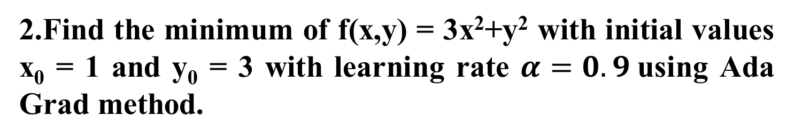
Problem on Ada Grad
2.Find the minimum of f(x,y) = 3x²+y² with initial values x₀ = 1 and y₀ = 3 with learning rate $α=0.9$using Ada Grad method.
Solution:

Slide 12
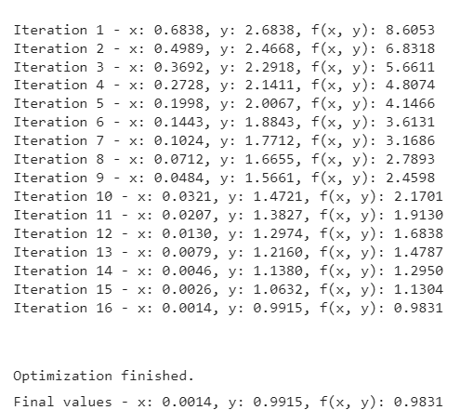
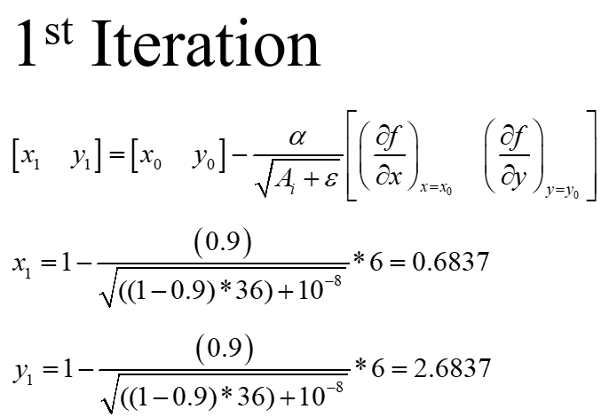
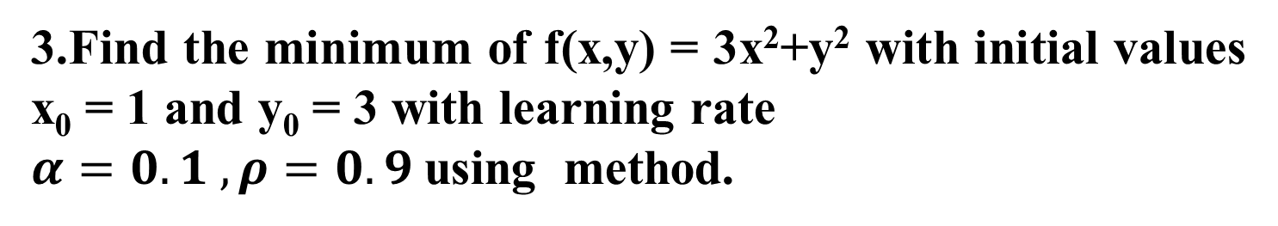
Problem on RMS Prop
3.Find the minimum of f(x,y) = 3x²+y² with initial values x₀ = 1 and y₀ = 3 with learning rate
$α=0.1 , ρ=0.9$using method.
Solution:

Slide 13
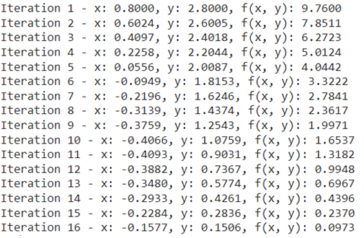
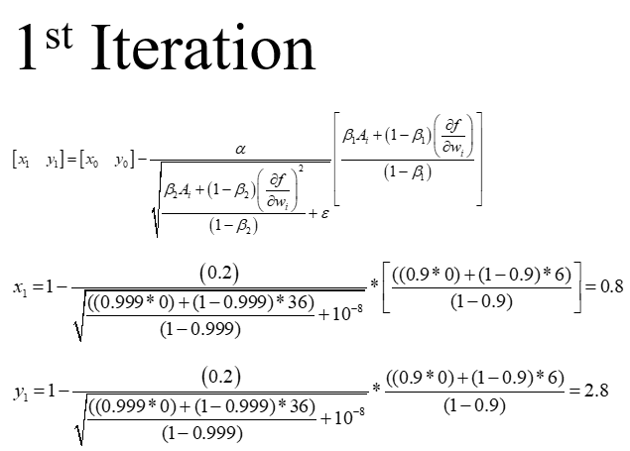
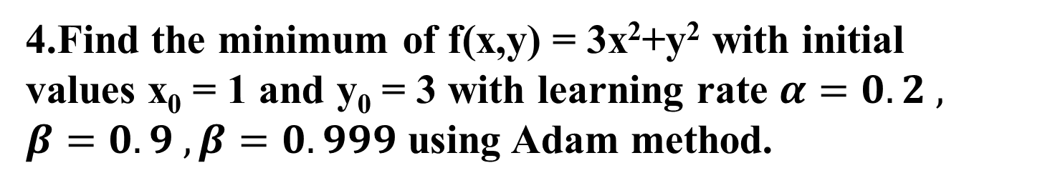
Problem on Adam
4.Find the minimum of f(x,y) = 3x²+y² with initial
values x₀ = 1 and y₀ = 3 with learning rate $α=0.2 ,$
$β=0.9 , β=0.999$ using Adam method.
Solution:

Slide 14
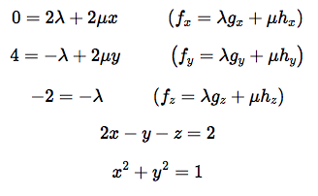
Lagragian Multiplier example
5. Find the maximum and minimum of f(x , y, z ) = 4y – z subject to the constraints 2x - y - z = 2 and x² + y² = 1.
Solution:
The system of equations to be solved are
1
2
3
4
5

Slide 15
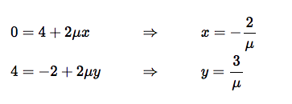

Lagragian Multiplier example
From equation 3 we get λ = 2. Plugging this into equation 1
and 2, solving for x and y respectively gives
Substituting these into equation 5

Slide 16




Lagragian Multiplier example
Case 1: When μ = √13
Substituting into equation 4 gives
Case 2: When μ = - √13
Substituting into equation 4 gives

Slide 17
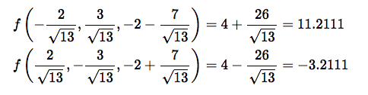
Lagragian Multiplier example
Check the two solutions computed above to find out the
maximum and minimum
MAXIMUM
MINIMUM

Slide 18
Principal Component Analysis
Steps Involved:
Compute the covariance matrix of the data set
Calculate the eigen vectors of the covariance matrix
The eigen vectors having the highest eigenvalue represents the direction in which there is the highest variance. So,this helps in identifying the first principal component.
The eigen vector having the next highest eigenvalue represents the direction in which data has the highest remaining variance and orthogonal to the first direction. This helps in identifying the second principal component.
Identify the top “k” eigenvectors having top “k” eigenvalues to get the “k” principal components.

Slide 19
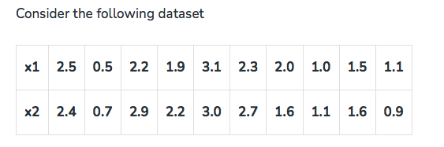
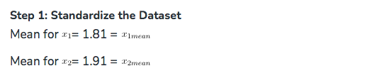
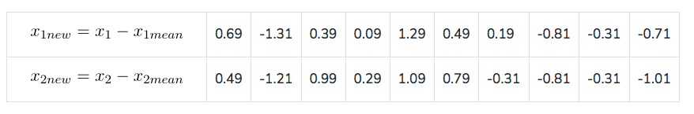
Problem on PCA
6.

Slide 20
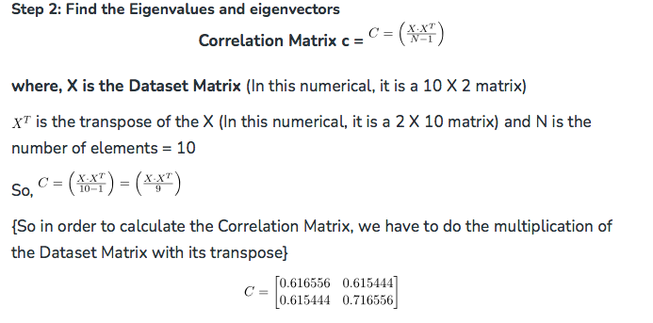
Principal Component Analysis

Slide 21
Principal Component Analysis
The two eigen values are λ₁ = 1.28403 and λ₂ = 0.0490834
Eigen vectors are computed
For λ₁
For λ₂
Step 3: Arrange the eigenvalues
The eigenvector with the highest eigenvalue is the principal component of the data set. So, in this case, eigenvectors of λ₁ are the principal components.

Slide 22
Thank You

